Slide 1
Macroeconomics
Lecture 4
29.04.24
Paolo Paesani
University of Rome Tor Vergata
Department of Economics and Finance

Slide 2
Labour contract design: problems and ER
How do employers design labour contracts when …
  Piece rate (W/P = MPL) is not applicable and wage per a given number of hours a week / month is the norm?
  Effort is not prefectly observable (asymmetric information)?
  Workers have alternatives to the job (new job, unemployment benefits)?
  Profit maximization remains the goal of the firm?
The answer to these questions begins by establishing the notion of Employment rent.
  ER = Net value of a worker’s job – Net value of the next best alternative
  ER = Cost of job loss

Slide 3
Employment rent and its determinants, 1
ER = Net value of a worker’s job to the worker herself – Net value of the next best alternative
Net value of a worker’s job to the worker herself = Job Benefits – Job Costs
Benefits: Wage income, Fringe benefits (e.g. company’s car, medical insurance), Job-specific assets (quality of workplace environment, proximity to home), Social status of being employed and of doing a particular job.
Costs: Disutility of work increases with effort (physical and mental fatigue, stress), Job-specific liabilities (unealthy workplace environment, commuting)

Slide 4
Employment rent and its determinants, 2
Net value of the next best alternative = Reservation wage
  Reservation wage (Varies inversely with unemployment)
  Wage obtained in alternative employment
  Unemployment benefit
  Family support
ER (per hour) = Benefits – Costs – Unemployment benefit
ER (total) = ER (per hour) × working hours as unemployed

Slide 5
Employment rent and its determinants, 3
The higher the ER, the more effort the worker puts into her work, in order to reduce the risk of loosing it .
ER as a motivating factor together with work ethics, peer pressure, self-esteem, chances of being promoted …
Employers can influence the ER and threaten workers with firing.
This is the main source of the power employers exert over employees and owners exert over managers.
  «Capitalism is the exploitation of man by man» (K. Marx).
  «Capitalism is the exploitation of man by man; Communism is the exact opposite» (attributed to J.K. Galbraith).

Slide 6
Work and wages: the labour discipline model
Strategic context (Game theory): One employer, one employee negotiate
  The employer, who wants ot maximize profits, «moves» first.
    Knowing how employees respond to wage incentives, on average, the employers offers a wage (including benefits) and the pledge that the employee will remain employed in subsequent periods at the same wage as long as she works hard enough.
  The employee «responds»
    The employee chooses the minimum effort level that corresponds to the wage offered by the employer (according to her best response function)
    Response is based on Total Employment Rent and knowledge that if effort is less that what the employer expects for a given wage, chances of loosing the job increase.
  The outcome of the game
    A wage – effort pair that is mutually satisfactory (Nash equilibrium)
  Sequential solution

Slide 7
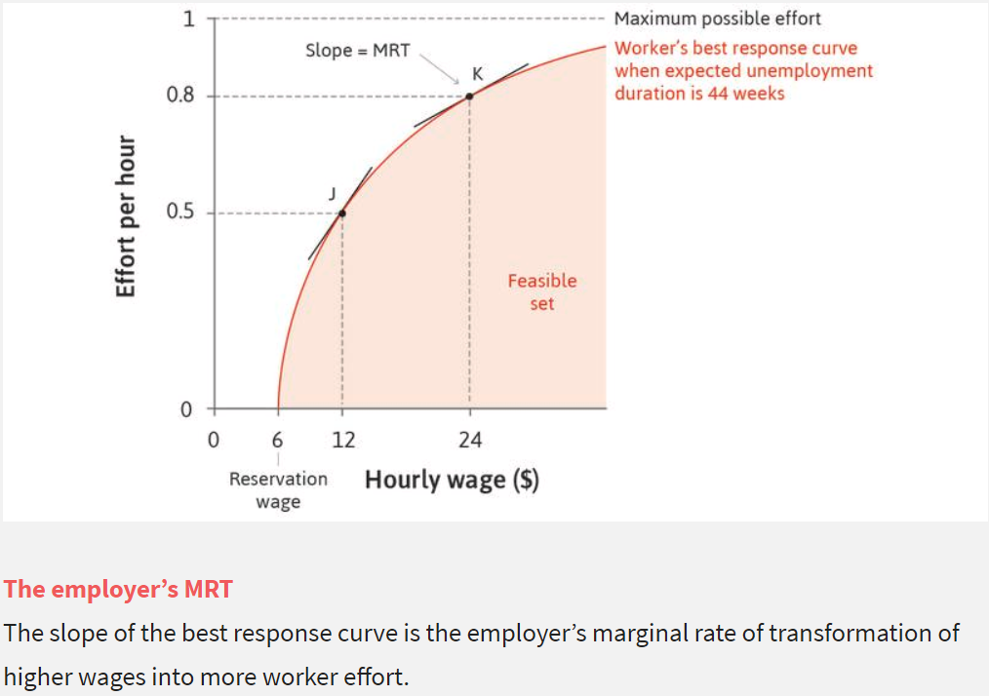
The employee’s best response function
A higher wage increases the employment rent and hence the benefit from effort, so it will lead her to choose a higher level of effort.
The effort the worker chooses will increase with the level of the wage chosen by the employer (concave best response curve)
The optimal amount of work that a worker chooses to perform for each wage that the employer may offer., or best response function worker’s best response function (to wage)

Slide 8
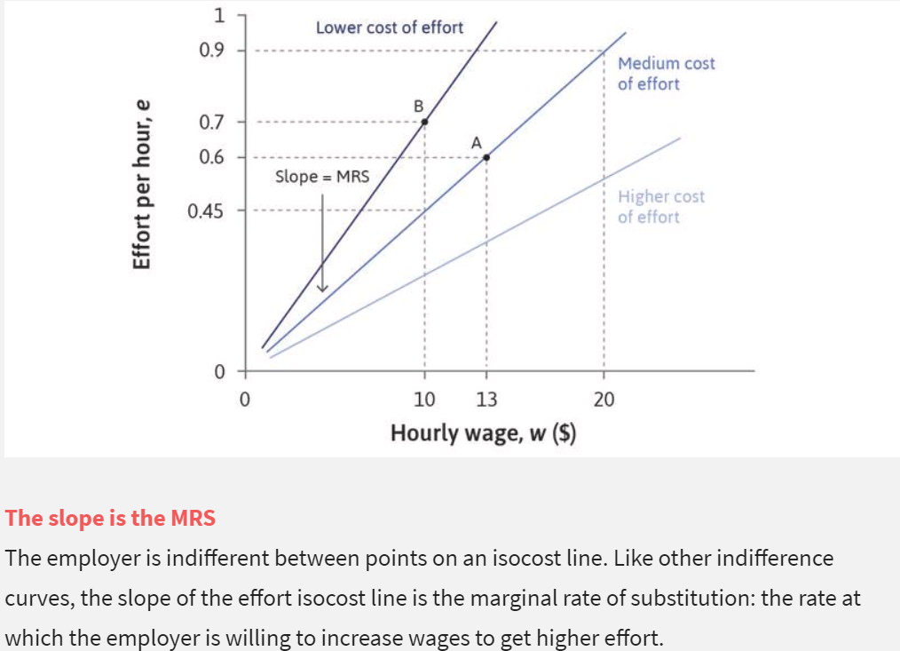
The employer’s indifference curves
Isocost Line
TC = w/e ; e = w(1/TC)
If TC is low (high), the line is steep (flat)
The wage, w, is the cost to the employer of an hour of a worker’s time. But what matters for production is not how many hours the employee provides, but how many units of effort: effort is the input to the production process. If the employee chooses to provide 0.5 units of effort per hour, and her hourly wage is w, the cost to the employer of a unit of effort is 2w. In general, if she provides e units of effort per hour, the cost of a unit of effort is w/e.
So, to maximize profits, the employer should find a feasible combination of effort and wage that minimizes the cost per unit of effort, w/e. Another way to say the same thing is that the employer should maximize the number of units of effort (sometimes called efficiency units) that he gets per dollar of wage cost, e/w.
The upward-sloping straight line in the figure joins together a set of points that have the same ratio of effort to wages, e/w.

Slide 9
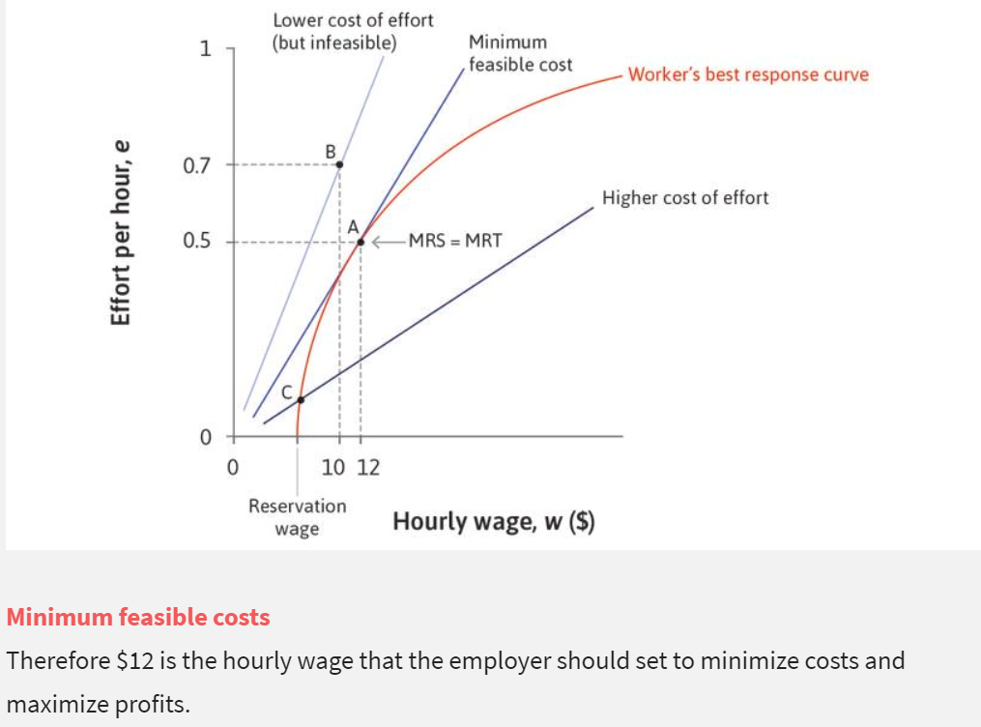
The solution
When wages are set by the employer in this manner, they are sometimes called efficiency wages because the employer is recognizing that what matters for profits is e/w, the efficiency units per dollar of wage costs, rather than how much an hour of work costs. What has the labour discipline model told us?
Equilibrium: In the owner-employee game, the employer offers a wage and the employee provides a level of effort in response.
Their strategies are a Nash equilibrium.
Rent: In this allocation the worker provides effort because she receives an employment rent that she might lose if she were to slack off on the job.
Power: Because the worker fears losing this economic rent, the employer is able to exercise power over her, getting her to act in ways that she would not do without this threat of job loss.
This contributes to the profits of the employer.

Slide 10
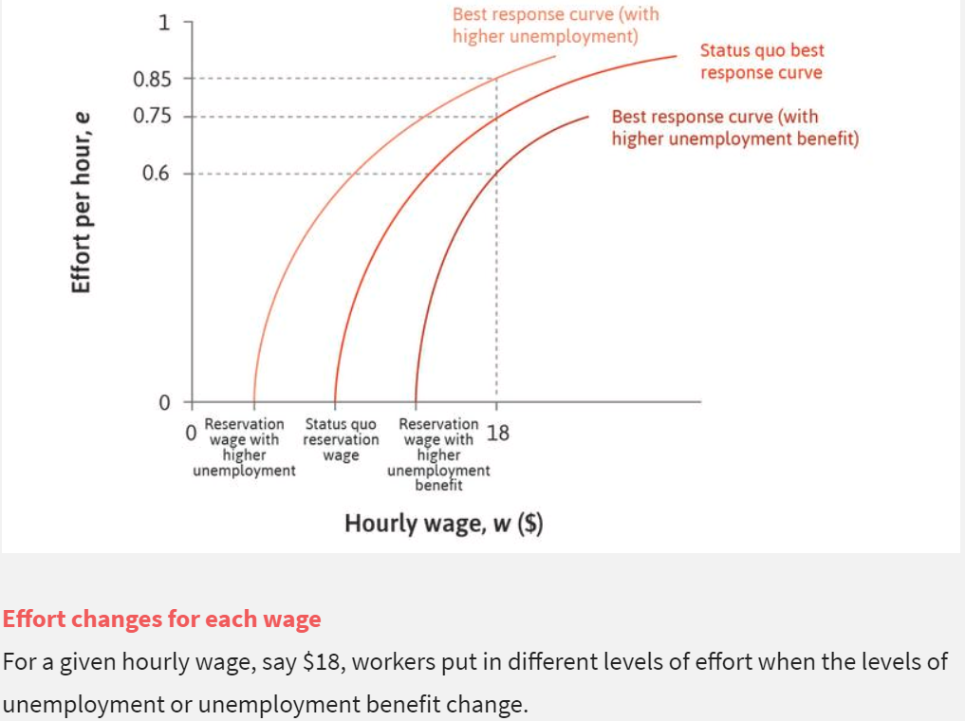
Unemployment as a disciplining mechanism

Slide 11
Introduction to the labour market
The firm’s perspective (division of labour again but in a different setting)
Stage 1: The human resources department determines the lowest nominal wage it can pay (W) so as not to undermine the workers’ motivation, given the prices and wages set by the other firms and the unemployment rate. It communicates this information to the marketing department (PD).
Stage 2: The marketing department sets the price (P), based on W, the shape and position of the demand curve facing the firm, and the goal of profit maximization. In this way, the firm sets the size of the markup over the cost of hiring labour and the amount of output the firm will sell. It communicates this information to the production department (PD).
Stage 3: The production department then calculates how many employees have to be hired to produce the output determined by the marketing department, based on the firm’s production function.

Slide 12
Introduction to the labour market, 2
The aggregate (macro) perspective: Once all firms in the economy have made their wage and price (markup) decisions, the output per worker in the economy is divided into the real wage that a worker receives, and the real profits that the owner receives. If all firms are charging the same price and setting the same nominal wage, then a higher real wage (W/P) means a lower markup (1 − (W/P)). To understand how the real wage and employment are jointly determined in the labour market, we need two basic concepts.
The wage-setting curve: The curve that gives the real wage necessary at each level of economy-wide employment to provide workers with incentives to work hard and well.
The price-setting curve: The curve that gives the real wage paid when firms choose their profit-maximizing price.

