Slide 1
Macroeconomics
Lecture 5
30.04.24
Paolo Paesani
University of Rome Tor Vergata
Department of Economics and Finance

Slide 2
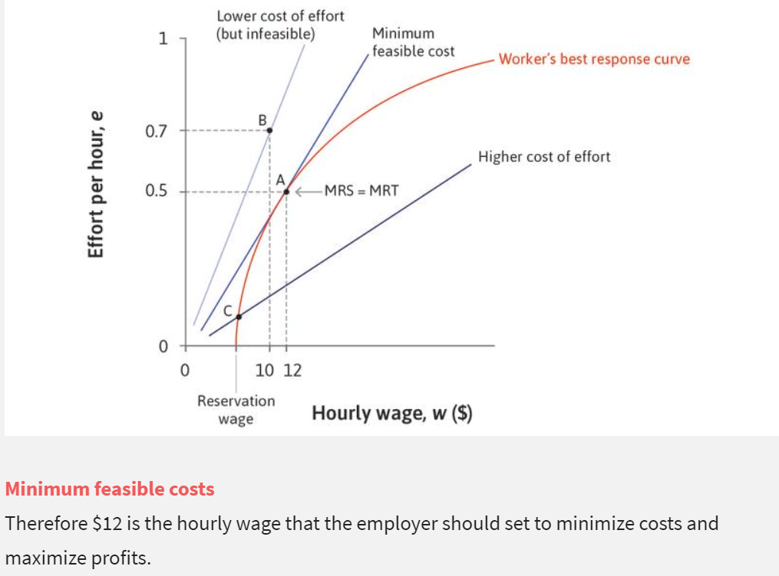
Hiring and the labour discipline model
When wages are set by the employer in this manner, they are sometimes called efficiency wages because the employer is recognizing that what matters for profits is e/w, the efficiency units per dollar of wage costs, rather than how much an hour of work costs. What has the labour discipline model told us?
Equilibrium: In the owner-employee game, the employer offers a wage and the employee provides a level of effort in response.
Their strategies are a Nash equilibrium.
Rent: In this allocation the worker provides effort because she receives an employment rent that she might lose if she were to slack off on the job.
Power: Because the worker fears losing this economic rent, the employer is able to exercise power over her, getting her to act in ways that she would not do without this threat of job loss.

Slide 3
Introduction to the labour market (step 1)
The firm’s perspective (division of labour again but in a different setting)
Stage 1: The human resources department determines the lowest nominal wage it can pay (W) so as not to undermine the workers’ motivation (effort e), given the prices and wages set by the other firms and the unemployment rate. It communicates this information to the marketing department (PD).
Stage 2: The marketing department sets the price (P), based on W, the shape and position of the demand curve facing the firm, and the goal of profit maximization. In this way, the firm sets the size of the markup over the cost of hiring labour and the amount of output the firm will sell. It communicates this information to the production department (PD).
Stage 3: The production department then calculates how many employees have to be hired to produce the output determined by the marketing department, based on the firm’s production function.

Slide 4
Introduction to the labour market (step 2)
The aggregate (macro) perspective: Once all firms in the economy have made their wage and price (markup) decisions, the output per worker in the economy is divided into the real wage that a worker receives, and the real profits that the owner receives. If all firms are charging the same price and setting the same nominal wage, then a higher real wage (W/P) means a lower markup (1 − (W/P)). To understand how the real wage and employment are jointly determined in the labour market, we need two basic concepts.
The wage-setting curve: The curve that gives the real wage necessary at each level of economy-wide employment to provide workers with incentives to work hard and well.
The price-setting curve: The curve that gives the real wage paid when firms choose their profit-maximizing price.

Slide 5
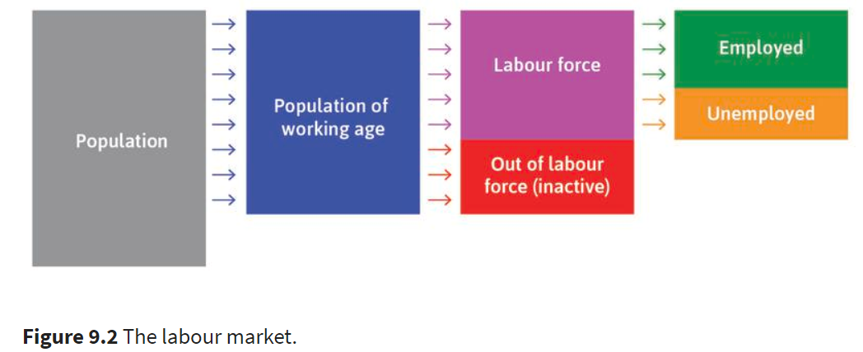
Employment and unemployment
Employed: paid employment or self-employment
Unemployed:
without work during a reference period (usually 4 weeks),
available for work
seeking work, which means they had taken specific steps in that period to seek paid employment or self-employment
16 < age < 64
(ILO)
Labour force (active)
Out of LF (inactive)

Slide 6




Measuring the economy: employment and unemployment (2)

Slide 7
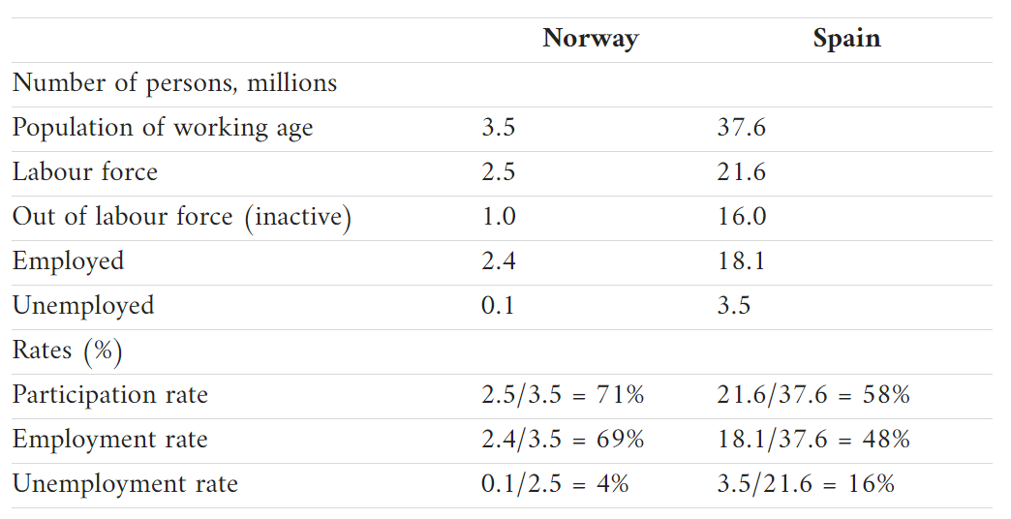
Measuring the economy: employment and unemployment (3)

Slide 8
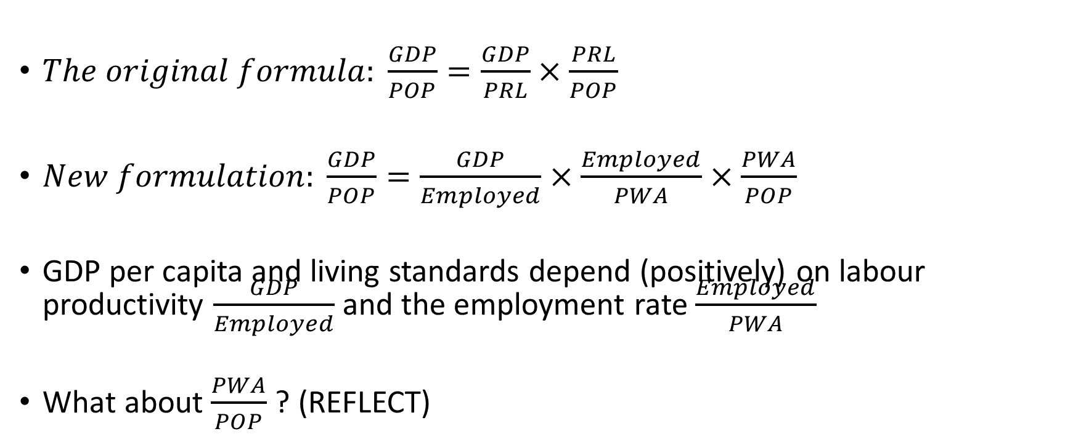
Adam Smith’s formula again
$The original formula: \frac{GDP}{POP}=\frac{GDP}{PRL}×\frac{PRL}{POP}$
$New formulation: \frac{GDP}{POP}=\frac{GDP}{Employed}×\frac{Employed}{PWA}×\frac{PWA}{POP}$
GDP per capita and living standards depend (positively) on labour productivity $\frac{GDP}{Employed}$ and the employment rate $\frac{Employed}{PWA}$
What about $\frac{PWA}{POP}$? (REFLECT)

Slide 9
The labour market: the wage-setting curve
The wage-setting curve: The curve that gives the real wage necessary at each level of economy-wide employment to provide workers with incentives to work hard and well.
Direct relationship between Employment and W/P
Underlying economic logic (coherent with labour discipline model)
↑Unemp. →↓Res.Wage → ↓W → ↑e/W → ↓ Employment, ↓W/P
↓Unemp. →↑Res.Wage → ↑W → ↓ e/W → ↑ Employment, ↑W/P

Slide 10
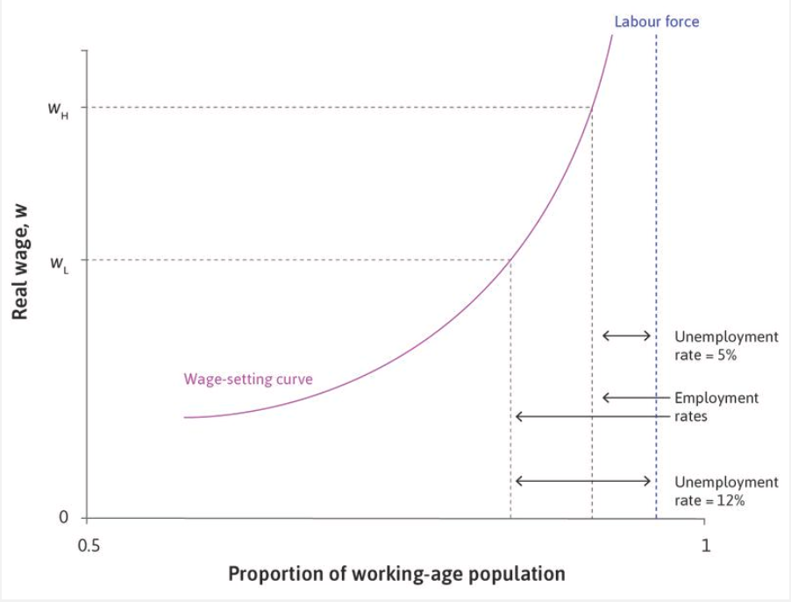
The wage-setting curve
The labour force is the vertical line furthest to the right: it has a value less than 1, depending on the participation rate.
Inactive workers are to the right of the labour force line.
The employment rate is the vertical line to the left of the labour force, indicating the share of the population who are actually working.
The unemployment rate is the proportion of those in the labour force who are not employed: that is, those workers in between the employment rate line and the labour force line.

Slide 11
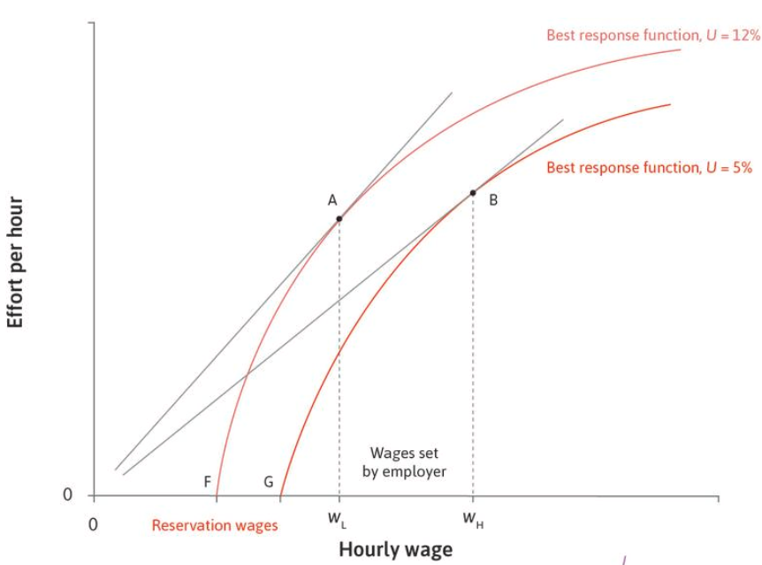
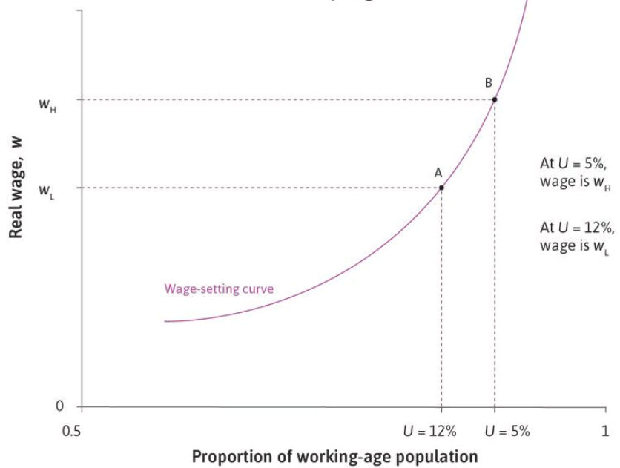
The wage-setting curve (2)

Slide 12
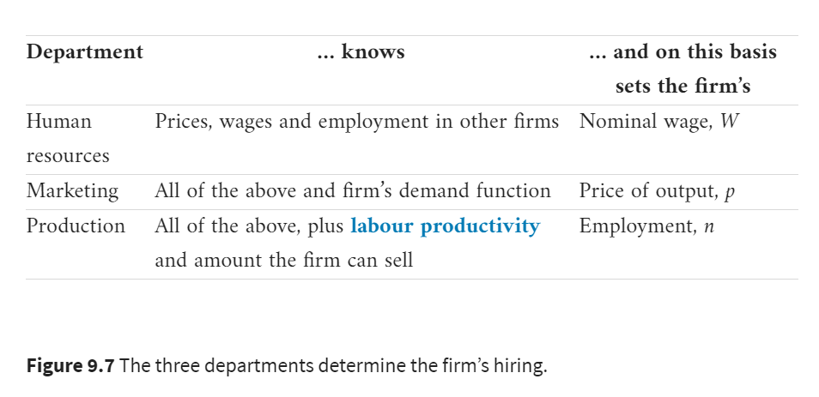
Intro to the price-setting curve

Slide 13
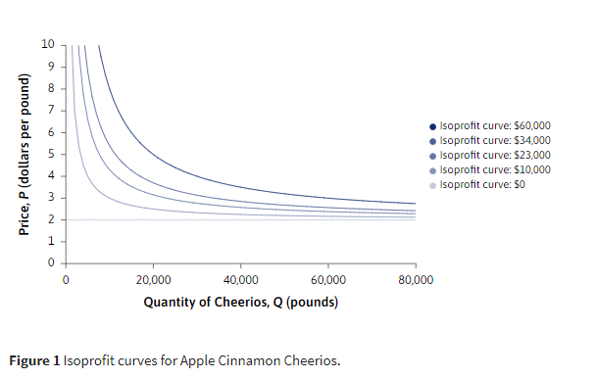
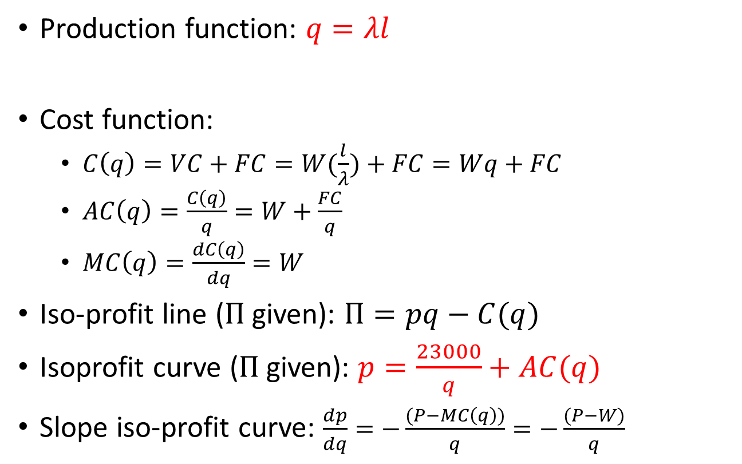
Intro to the PS curve: iso-profit curves
Production function: $q=λl$
Cost function:
  $C\left(q\right)=VC+FC=W(\frac{l}{λ})+FC=Wq+FC$
  $AC\left(q\right)=\frac{C\left(q\right)}{q}=W+\frac{FC}{q}$
  $MC\left(q\right)=\frac{dC\left(q\right)}{dq}=W$
Iso-profit line ($Π$given): $Π=pq−C(q)$
Isoprofit curve ($Π$given): $p=\frac{23000}{q}+AC(q)$
  Slope iso-profit curve: $\frac{dp}{dq}=−\frac{(P−MC\left(q\right))}{q}=−\frac{(P−W)}{q}$

Slide 14
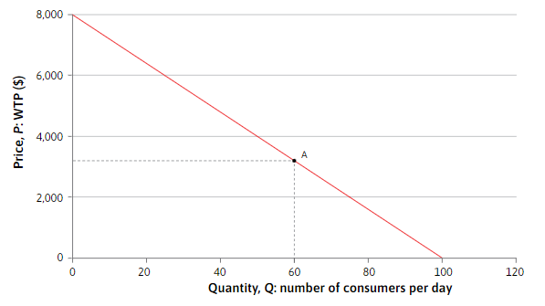
Intro to the PS curve: market demand
For any product that consumers might wish to buy, the product demand curve is a relationship that tells you the number of items (the quantity) they will buy at each possible price. For a simple model of the demand for Beautiful Cars, imagine that there are 100 potential consumers who would each buy one Beautiful Car today, if the price were low enough. Each consumer has a willingness to pay (WTP)willingness to pay close for a Beautiful Car, which depends on how much the customer personally values it (given the resources to buy it, of course). A consumer will buy a car if the price is less than or equal to his or her WTP. Suppose we line up the consumers in order of WTP, with the highest first, and plot a graph to show how the WTP varies along the line (Figure 7.9). Then if we choose any price, say P = $3,200, the graph shows the number of consumers whose WTP is greater than or equal to P. In this case, 60 consumers are willing to pay $3,200 or more, so the demand for cars at a price of $3,200 is 60.

Slide 15
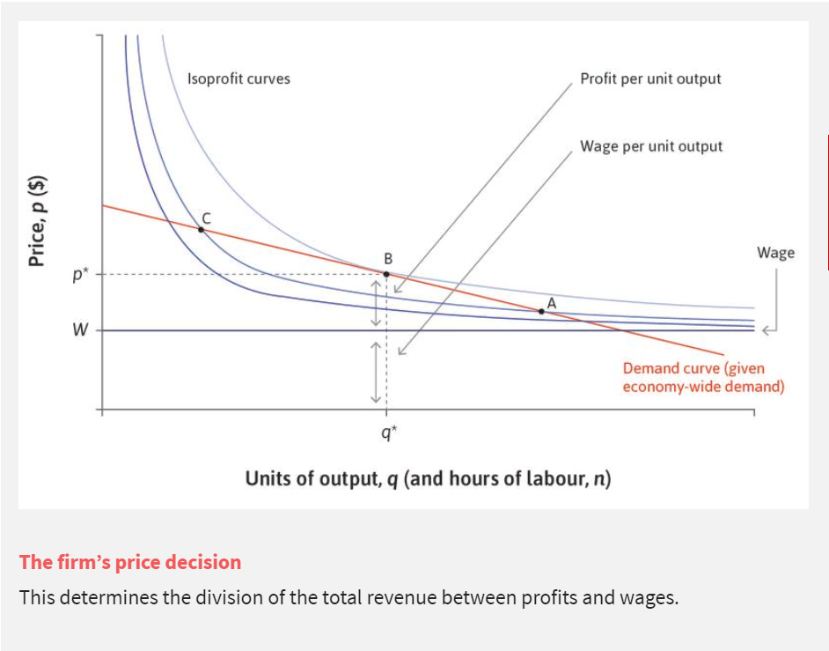
Intro to the PS curve: the firm’s price decision
    $$p=\frac{Π}{q}+AC(q)$$

Slide 16
Intro to the PS curve: the firm’s price decision, 2
By setting the price (for a given W), the firm determines the division of the total revenue between profits and wages.
NB: price setting firm (price-making) = firm has market power (different from perfect competition)!
This is based on the markup (p − W)/p (or 1 − (W/p)). This is greater when the demand curve is less elastic, indicating less intense competition.
If a firm found itself at a point like A, the marketing department would raise the price and inform the PD that it should produce less.
Similarly, if the firm were at point C, the marketing department would lower its price and the PD would get the message to produce more, to meet the higher sales at the lower price.

Slide 17
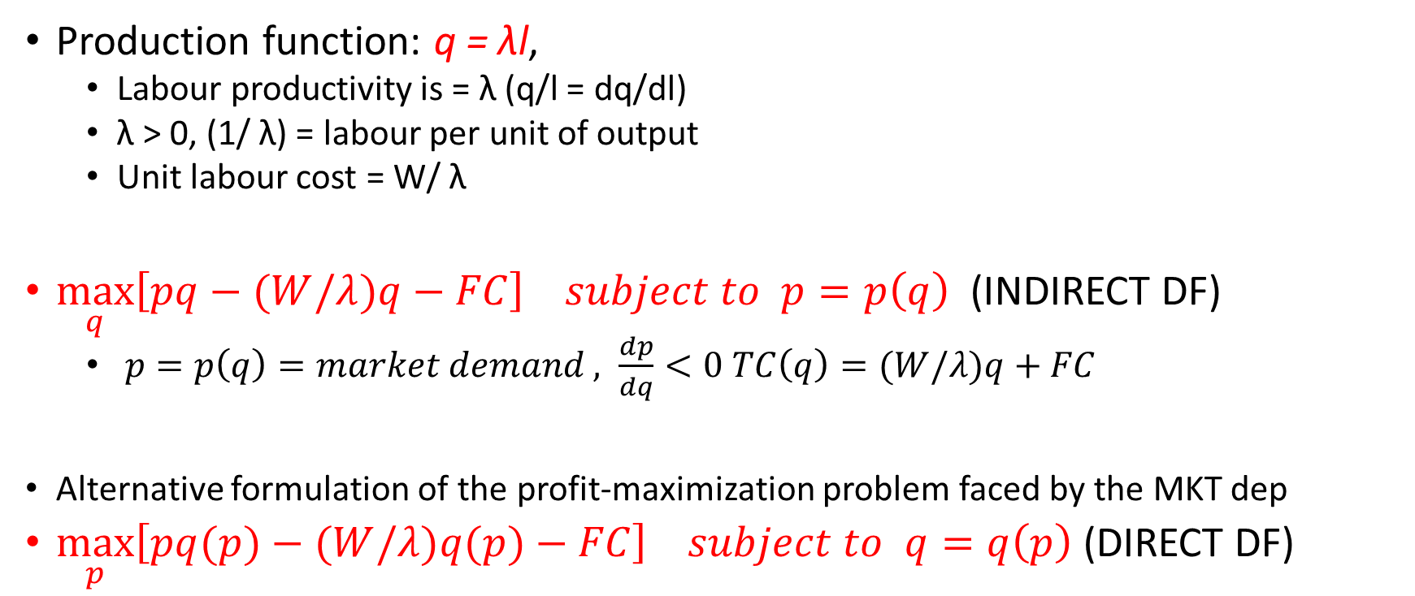
Intro to the PS curve: the firm’s hiring decision
Production function: q = λl,
  Labour productivity is = λ (q/l = dq/dl)
  λ > 0, (1/ λ) = labour per unit of output
  Unit labour cost = W/ λ
$\max_{q}\left[pq−(W/λ)q−FC\right] subject to p=p\left(q\right)$ (INDIRECT DF)
  $p=p\left(q\right)=market demand , \frac{dp}{dq}<0$ $TC\left(q\right)=(W/λ)q+FC$
Alternative formulation of the profit-maximization problem faced by the MKT dep
$\max_{p}\left[pq(p)−(W/λ)q(p)−FC\right] subject to q=q\left(p\right)$(DIRECT DF)

Slide 18
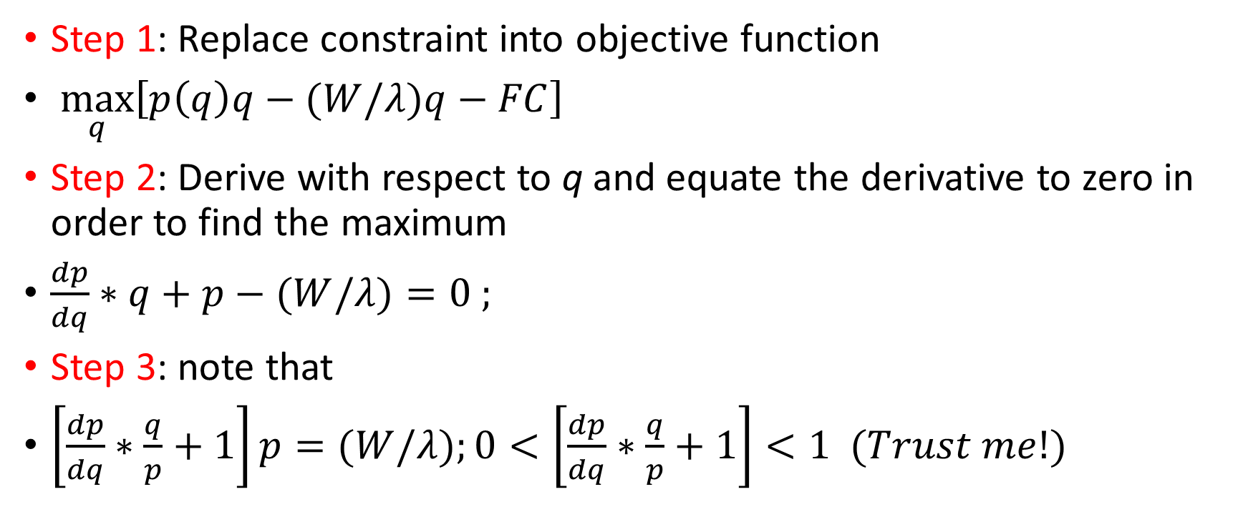
The firm’s hiring decision: mathematical solution
Step 1: Replace constraint into objective function
$\max_{q}\left[p\left(q\right)q−(W/λ)q−FC\right]$
Step 2: Derive with respect to q and equate the derivative to zero in order to find the maximum
$\frac{dp}{dq}∗q+p−(W/λ)=0 ;$
Step 3: note that
$\left[\frac{dp}{dq}∗\frac{q}{p}+1\right]p=(W/λ);0<\left[\frac{dp}{dq}∗\frac{q}{p}+1\right]<1 (Trust me!)$

Slide 19
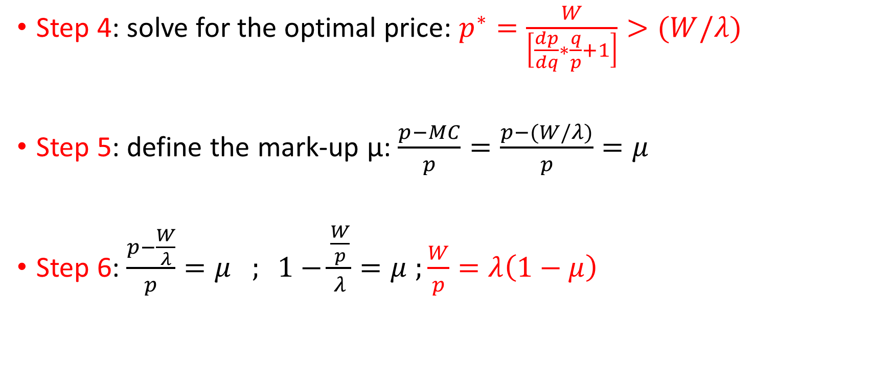
The firm’s hiring decision: mathematical solution (2)
Step 4: solve for the optimal price: $p^{∗}=\frac{W}{\left[\frac{dp}{dq}∗\frac{q}{p}+1\right]}>(W/λ)$
Step 5: define the mark-up μ: $\frac{p−MC}{p}=\frac{p−(W/λ)}{p}=μ$
  Step 6: $\frac{p−\frac{W}{λ}}{p}=μ ; 1−\frac{\frac{W}{p}}{λ}=μ$ $;\frac{W}{p}=λ\left(1−μ\right)$

Slide 20
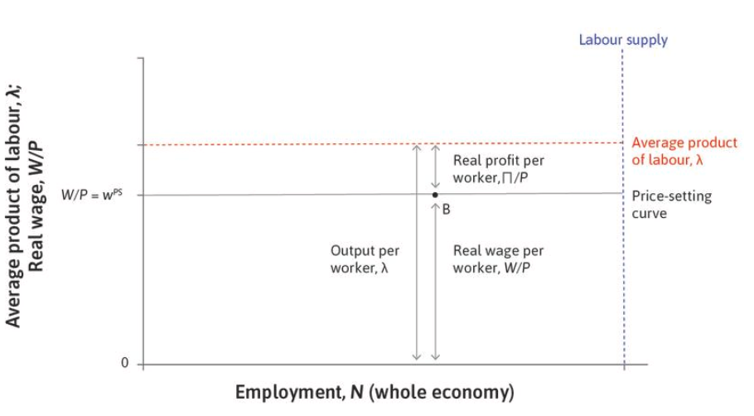
The price-setting curve

Slide 21
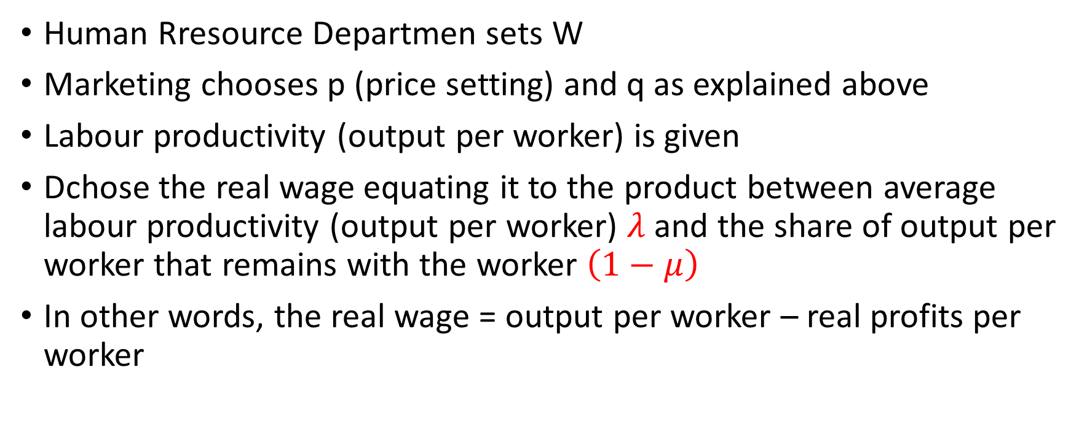
The price-setting curve: economic intuition
Human Rresource Departmen sets W
Marketing chooses p (price setting) and q as explained above
Labour productivity (output per worker) is given
Dchose the real wage equating it to the product between average labour productivity (output per worker) $λ$ and the share of output per worker that remains with the worker $\left(1−μ\right)$
In other words, the real wage = output per worker – real profits per worker

Slide 22
Homeworks
Sections 9.1 to 9.7
Exercises 9.1, 9.2, 9.3, 9.4, 9.5

