Slide 1
Macroeconomics
Lecture 8
07.05.24
Paolo Paesani
University of Rome Tor Vergata
Department of Economics and Finance

Slide 2
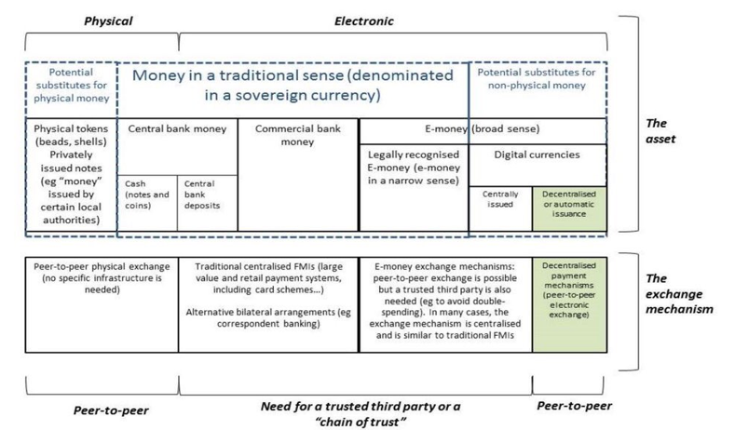
Types of money today
Bank for international settlements, 2015

Slide 3
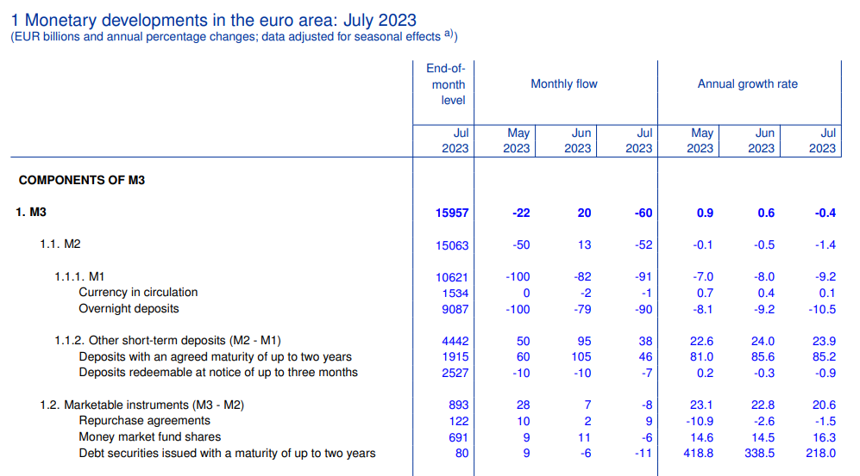
Monetary aggregates (ECB MDEA, July 2023)
https://www.ecb.europa.eu/pub/pdf/annex/ecb.md2307_annex.en.pdf

Slide 4
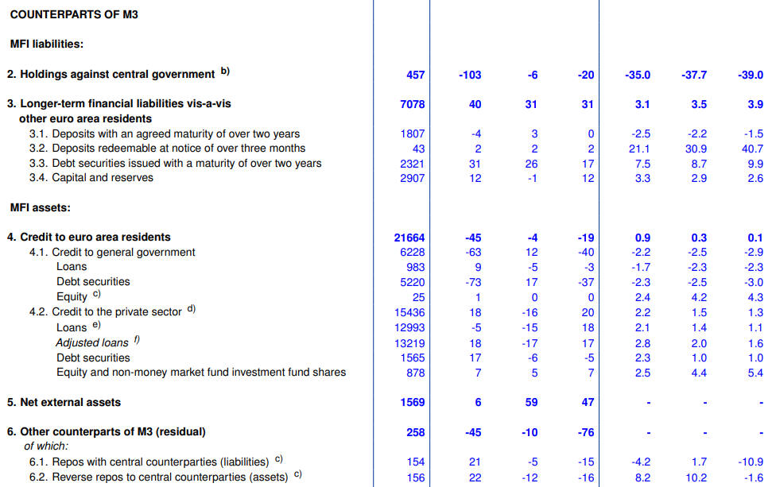
Monetary aggregates (ECB MDEA, July 2022)
https://www.ecb.europa.eu/pub/pdf/annex/ecb.md2307_annex.en.pdf

Slide 5
Credit
Credit enables firms to bridge the temporal gap between costs and revenues and to accumulate capital.
  Short/medium term credit and circulating capital
  Long-term credit and fixed capital
Credit enables households to reconcile their desired intertemporal spending path with their income path :
  Borrowing makes it possible to consume in excess of present income.
  Borrowing = Indebtedness = acquisition of net liabilities
  Saving makes it possible to consume in excess of future income.
  Saving = placement = acquisition of net assets = a.k.a «investment»

Slide 6
Credit, 2
Credit and Money
Most credit operations entail the transfer of sums of money over time.
  Debts are donominated in terms of money (unit of account).
  Debts are paid using money (legal tender).
Money is «created» via credit operations.
  Banks create bank money (deposits) by making loans to firms and households
  The central bank creates money (base money) by making loans to banks

Slide 7
The time element
Time 0 (the beginning): negotiation, contract drafting.
Time 1 (maturity or the end = fin = finance) the credit matures and paid (recall connection between credit and the means of payment function of money)
Finance (n.) c.1400, "an end, settlement, retribution," from Middle French finance "ending, settlement of a debt" (13c.), noun of action from finer "to end, settle a dispute or debt," from fin (see fine (n.)). Cf. Medieval Latin finis "a payment in settlement, fine or tax." The notion is of "ending" (by satisfying) something that is due (cf. Greek telos "end;" plural tele "services due, dues exacted by the state, financial means"). The French senses gradually were brought into English: "ransom" (mid-15c.), "taxation" (late 15c.); the sense of "management of money" first recorded in English 1770. (Source http://www.etymonline.com)

Slide 8
The time element, 2
Time 0 and Time 1 (maturity) can be very close to each other (overnight loans) or very far apart (e.g. 30 years mortgage loans):
  Short-term (maturity a year or less);
  Medium-term (maturity between one and five years);
  Long-term (maturity above five years)
  Infinite maturity (consols)
Examples
  Treasury bills vs. Government bonds
  Overnight interbank loans vs. 25 years mortgage backed loans
  Current account deposits vs. Saving deposits
The time dimension of credit is linked with the risk dimension (credit risk increases with time, see below) and the liquidity dimension (liquidity diminishes with time).

Slide 9
Lender and borrower
Lender (creditor) = L; Borrower (Debtor) = B
Lender owns something valuable (money, financial assets, goods) that he is willing to part with between Time 0 and Time 1.
Borrower needs what L owns and is willing to pay a premium (interest + guarantees) in order to have it.
Once L and B have reached an agreement, B receives the valuables from L and signs a debt contract whereby he assumes the obligation to pay back her/his debt in accordance with mutually agreed terms.
Peer-to peer Lending vs. financial intermediation

Slide 10
Lender and borrower, 2
The debt contract embodies B’s promise to pay back his debt. L will not enter into a credit transaction with B unless he trusts B (or unless rapid securitization is possible).
“An adequate level of trust in the implicit and explicit promises associated with outstanding debt contracts is an important prerequisite of a smoothly and efficiently operating financial system. Due to the intangible nature of trust, the danger of the financial crisis occurring whenever it is somehow weakened has always been inherent in a credit system. Institutional arrangements, such as lender of last resort (usually the central bank) or an insurance system (e.g. deposit insurance)” are important elements affecting the probability of such occurences.” (Baltensperger 1990)

Slide 11
Lender and borrower, 3
Trust alone, however, is rarely enough and credit markets come into existence and survive only if disciplining mechanisms exist, which prevent or restrict dishonest behavior (penalties enforced through legal provisions, bankruptcy laws, social stigma, exclusion from the credit market)
Lenders and borrowers can be individuals, non financial companies, banks, financial intermediaries, State and local authorities, supra-national institutions and he borrower’s identity is one of the main features defining the contract (see below)
The relationship between L and B as a power relation.
  Asymmetric and complex power relations
  Urgency, alternative sources of credit, market power exerted by L and B.

Slide 12
The debt contract
Obligation (n.) c.1300, from Old French obligacion "obligation, duty, responsibility" (early 13c.) and directly from Latin obligationem (nominative obligatio) "an engaging or pledging," literally "a binding" (but rarely used in this sense), noun of action from past participle stem of obligare (see oblige). The notion is of binding with promises or by law or duty. (Source http://www.etymonline.com

Slide 13
The debt contract, 2
Elements of the contract:
Identification of lender and borrower
Description of what is being transferred
Loan duration (maturity)
Payback conditions
  Periodic payments – normal case in case of long-term loans; no intermediate payment = zero coupon bond.
  Interest may be forbidden as is the Middle Ages or in the case of Islamic finance)
Additional clauses (e.g. marketability, guarantees)

Slide 14
The debt contract, 3
The debt contract can be marketable (e.g. government and corporate bonds) i.e. liquid or non-marketable (e.g. bank loan, consumer credit) i.e. illiquid.
Primary and secondary debt markets (financial markets)
Primary markets connect ultimate lenders and borrowers.
Secondary markets enhance liquidity

Slide 15
The debt contract, 5
Marketability (Liquidity) mitigates the importance of the personal element and the need for guarantees from B to L.
Marketability (Liquidity) requires standardization, low carrying costs, wide acceptance …
Marketability (Liquidity) as an antidote to credit risk (see below). If L looses confidence in B, he can always sell the contract to some one else (possibly at a discount) as long as the debt contract is liquid enough (if at all)
Liquidity premiums and the rate of interest.

Slide 16
Maturity and payback
As the loan reaches maturity, B pays back his debt (principal and interest) to L or to someone else if in the meantime L sold the contract to L’
Payback requires a unit of account to quantify the debt and a means of payment to be discharged of the obligation (Recall Keynes’s Treatise on Money)
Cases when payback does not take place as agreed:
  Renegotiation (extended maturity, interest reduction)
  Debt forgiveness / redemption
  Debt insolvency (Default partial or total)

Slide 17
Imperfect information and credit risk
The lender and the borrower share the credit risk (risk of default).
To the borrower, the credit risk is the risk of going bankrupt (with the costs / penalties / stigma this entails) and, more generally, the risk of earning a lower than expected return on the activity financed by borrowing.
To the lender, the credit risk is the risk of losing her/his money in case of default and, more generally, the risk of earning a lower than expected return on the loan.

Slide 18
Imperfect information and credit risk, 2
Credit risk is enhanced by information asymmetry between the provider and the receiver of funds, i.e. between lender and borrower (principal – agent relationship).
In general, borrowers know more about their financial conditions and their prospects than lenders, and may try to exploit this information to their advantage and the detriment of lenders. Lenders know this and act accordingly (credit rationing, incomplete markets)
Because of information asymmetries (market failure), credit markets cannot function as anonymous price-taking markets in the neoclassical sense. In general both the identity of the seller and the quantity sold are crucial determinants of its value (possibility of default increases with the level of indebtedness fro external and internal reasons).

Slide 19
Imperfect information and credit risk, 2
How can the lender be sure that the borrower will not simply run away with the funds or take on unsustainable risks? (Moral hazard, hidden action), How can the lender be sure the borrower is honest in the first place? (Adverse selection, hidden information)
  Screening (ex ante) / monitoring (ex post)
  Guarantees
  Shorten maturity
  Reduce exposure
  Long-term customer relation
  Credit rationing

Slide 20
Insolvency / default
Solvent (adj.) 1650s, "able to pay all one owes," from French solvent, from Latin solventem (nominative solvens), present participle of solvere "loosen, dissolve" (see solve). Noun meaning "substance able to dissolve other substances" first recorded 1670s. (Source http://www.etymonline.com)
Bankruptcy (n.): 1560s, from Italian banca rotta, literally "a broken bench," from banca "moneylender's shop," literally "bench" (see bank (n.1)) + rotta "broken, defeated, interrupted" from (and remodeled on) Latin rupta, fem. past participle of rumpere "to break" (see rupture (n.)). "[S]o called from the habit of breaking the bench of bankrupts" [Klein]. Earlier in English as a noun, "bankrupt person" (1530s) (Source http://www.etymonline.com)

Slide 21
Insolvency / default
Default occurs when repayment is not made on time
Default may be due to feasibility constraints, if the debtor has insufficient resources to meet the terms of the contract (even if enforcement is perfect), or incentive constraints, if the creditor cannot adequately enforce the contract (limited liability plus costly state verification)
Containment of default risk requires disciplining mechanisms
  Legal provisions (bankruptcy laws)
  Social stigma
  Exclusion from or discrimination in the future credit market

Slide 22
Interest
Interest: mid-15c., "legal claim or right; concern; benefit, advantage;" earlier interesse (late 14c.), from Anglo-French interesse "what one has a legal concern in," from Medieval Latin interesse "compensation for loss," noun use of Latin interresse "to concern, make a difference, be of importance," literally "to be between," from inter- "between" (see inter-) +esse "to be" (see essence). Compare German Interesse, from the same Medieval Latin source. Form in English influenced 15c. by French interest "damage," from Latin interest "it is of importance, it makes a difference," third person singular present of interresse. Financial sense of "money paid for the use of money lent" (1520s) earlier was distinguished from usury (illegal under Church law) by being in reference to "compensation due from a defaulting debtor." Meaning "curiosity" is first attested 1771. Interest group is attested from 1907; interest rate by 1868. (Source http://www.etymonline.com)

Slide 23
Interest, 2
Interest is the extra, B agrees to pay to L in return for the possibility of using L’s resources.
Interest is paid in many different ways
  One instalment at maturity,
  Several instalments between 0 and 1
  By borrowing at discount.
Interest can be zero! Interest can be negative !!!

Slide 24
Interest, 3
Lender lends X to Borrower at time 0
Borrower pays back X* to Lender at time 1, one year later
X* / X = (1+r) = gross nominal interest rate
( r ) = Net nominal interest rate
Ex. X = 100€, X* = 105€ = 100€ (principal) + 5€(interest)
(1+r) = 105/100 = 1,05
r = 0,05 = 5%

