Slide 1
Macroeconomics
Lecture 11
16.05.24
Paolo Paesani
University of Rome Tor Vergata
Department of Economics and Finance

Slide 2
Introducting the central bank
Central banks are public monetary and financial institutions (MFI) established to perform a series of functions related to the management of money and credit.
The relationship between central banks and governments has evolved over time, in many cases, from subordination to independence from government and parliament.
Independence is credited to enhance the effectiveness of central bank decisions (large literature, debateble issue)

Slide 3
Central bank functions
Banknote issuance
Monetary policy
Bank of the banks/ Lender of last resort
Supervision and regulation of the banking sector
Bank of the State / Public debt management
Management of the payment system
Management of official reserves, supervision of international capital flows, management of the exchange rate regime, management of gold reserves
Collection and elaboration of economic and financial statistics
Economic research
Liaison with international bodies (e.g. the Bank for International Settlements)

Slide 4
Banknotes, 1
Banknotes in the past (privately issued by «goldsmiths» and banks on a decentralised competitive basis) and banknotes today (publicly issued by a centralised monopolist authority)
Base money = Currency (banknotes and coins) + bank reserves
Banknotes = Fiat currency / Legal tender (Payment with banknotes guarantees finality)
Banknotes as «objects», manufactured (costs of production) and put into circulation by the central bank.
Seignorage is the income earned by the central bank when putting banknotes (and more generally monetary base) into circulation.

Slide 5
Source ECB Monthly Bullettin 2017/6

Slide 6
Banknotes
Source ECB Monthly Bulletin 2017/6

Slide 7
Banknotes, 2
Source ECB Monthly Bullettin 2017/6

Slide 8
Bank of the banks
The central bank collects liquid reserves from the banks (required reserves and excess reserves) and lends liquid reserves to the banks in the context of monetary policy operations.
In times of financial instability, the central bank performs the additional function of Lender of Last resort: a central bank's role as the entity that lends money to commercial banks and other financial institutions when they have no other means to raise funds. (Source: Financial Times)
Lender of last resort may lead to moral hazard problems, as there are concerns that some banks that know they will be bailed out may take on huge risks in the belief that they will be protected when things go wrong.

Slide 9
Bank of the banks, 2
Liquidity provision from the central bank to the banks (loans against the purchase of securities, seignorage)
B1
Central
Bank
B2
Deposit of liquid reserves with the CB
B3
B4
Interbank payments settled via transfer of bank reserves. Interbank payments give rise to bank interconnectedness

Slide 10
Bank of the banks and monetary policy
The regulation of bank reserves, is the fundamental instrument used by the central bank to influence the economy via monetary policy.
Monetary Policy: actions by the central bank aimed at achieving specific goals related to macroeconomico stabilization (e.g. price stability)
In order to achieve its goals, the central bank manouvers a series of monetary policy instruments, these include official interest rates (on loans of bank reserves), Required reserve regime, Open market operations and non conventional instruments.

Slide 11
Banking regulation and supervision
Most central banks are involved in the regulation and supervision of the national banking system.
This activity includes managing a wide range of issues such as: (1) entry into banking, (2) ownership, (3) capital, (4) activities, (5) external auditing requirements, (6) bank governance, (7) liquidity and diversification requirements, (8) depositor (savings) protection schemes, (9) asset classification, provisioning and write-offs, (10) accounting and information disclosure, (11) discipline/problem institutions/exit, (12) supervision, (13) banking sector characteristics, and (14) consumer protection.
The World Bank provides updated information on these issues http://econ.worldbank.org/

Slide 12
Bank of the State
Typically, central banks perform the State treasury service. This consists in the execution of all payment orders issued by central government bodies, drawn both against budget lines and against off-budget accounts, and in the collection of all the amounts due on whatever basis to the central government, both directly and indirectly. (Source Bank of Italy)
In connection with this function, central banks often assist national governments in the management of sovereign debt. Sovereign debt management is the process of establishing and executing a strategy for managing the government's debt in order to raise the required amount of funding, achieve its risk and cost objectives, and to meet any other sovereign debt management goals the government may have set, such as developing and maintaining an efficient market for government securities (Source IMF) https://www.imf.org/external/np/mae/pdebt/2000/eng/Index.htm
Coordinating public debt and monetary management raises a series of interesting issues http://www.bis.org/publ/bppdf/bispap65l_rh.pdf

Slide 13
Bank of the State, 2
The Economy
Central Bank
The State
Financial system
Government Purchases and Transfers
Taxes
Public debt operations

Slide 14
Central bank independence
The fact that the central bank is the Bank of the State calls into question its relationship with political authorities (Parliament, Government). In recent decades central banks have gradually become more and more independent from political authorities.
It all began in during the 1970s and 1980s which were characterized by sustained periods of high inflation in major industrialized economies. Inflation was imputed to several causes including the perception that governments may instruct central banks to overstimulate the economy “to achieve short-term output and employment gains that exceed the economy’s underlying potential. Such gains may be popular at first, and thus helpful in an election campaign, but they are not sustainable and soon evaporate, leaving behind only inflationary pressures that worsen the economy’s longer-term prospects”.
Ben. S. Bernanke. ‘Central Bank Independence, Transparency, and Accountability’ (2010).

Slide 15
Central bank independence, 2
In a world populated by agents who act on the basis of expectations, the perception that the government has an incentive to overstimulate the economy by «printing money» generates an economic phenomenon called inflation bias.
Consumers, savers, workers and firms expecting inflation to be higher than it would otherwise be adjust their expectations accordingly, irrespective of any (non credible) promise by the government and the central bank not to resort to the printing press. Nominal interest rates and nominal wages are adjusted accordingly, leading production costs and prices to rise (self-fulfilling prophecy).
One solution to the problem of inflation biased (modelled by Barro and Gordon among others) is central bank independence from elected authorities.

Slide 16
Legal independence
A bank is viewed as more independent if the chief executive is appointed by the central bank board rather than by the prime minister or minister of finance, is not subject to dismissal, and has a long term of office..
Independence is higher the greater the extent to which policy decisions are made independently of government involvement.
A central bank is more independent if its charter states that price stability is the sole or primary goal of monetary policy.
Independence is greater if there are limitations on the government’s ability to borrow from the central bank.
(Cukierman, A., S. B. Webb, and B. Neyapti. 1992. ‘Measuring the Independence of Central Banks and its Effects on Policy Outcomes’, The World Bank Economic Review, 6, 353-398.)

Slide 17
Goal independence
“[in the extreme case of goal independence], the principal (the government) delegates to the agent (the central bank) full policymaking powers, including the power to decide the appropriate policy target”.
“The U.S. Federal Reserve, which has a broad mandate to target stable prices and full employment, is considered by most commentators to enjoy goal independence”.
(C. Crowe, 2006. ‘Goal-Independent Central Banks: Why Politicians Decide to Delegate’, IMF Working Paper).

Slide 18
Instrument and operational independence
Instrument independence: the central bank freedom of action over its policy instruments in pursuit of a policy target decided by the government.
(e.g. the Bank of England since 1997).
Operational independence: It can be loosely defined as the budgetary and institutional independence that underpins instrument independence.
(C. Crowe, 2006. ‘Goal-Independent Central Banks: Why Politicians Decide to Delegate’, IMF Working Paper).

Slide 19
The payment system
The payment system – which includes financial market infrastructure for payments, securities and derivatives – is a core component of the financial system, alongside markets and institutions.
If modern economies are to function smoothly, economic agents have to be able to conduct transactions safely and efficiently.
Payment, clearing and settlement arrangements are of fundamental importance for the functioning of the financial system and the conduct of transactions between economic agents in the wider economy.
Private individuals, merchants and firms need to have effective and convenient means of making and receiving payments.
Moreover, funds, securities and other financial instruments are traded in markets, providing a source of funding and allowing households, firms and other economic actors to invest surplus funds or savings in order to earn a return on their holdings.
Active markets facilitate price discovery, the efficient allocation of capital and the sharing of risk between economic actors.

Slide 20
The payments system, 2
payment instruments, which are a means of authorising and submitting a payment (i.e. the means by which the payer gives its bank authorisation for funds to be transferred or the means by which the payee gives its bank instructions for funds to be collected from the payer);
processing (including clearing), which involves the payment instruction being exchanged between the banks (and accounts) concerned;
a means of settlement for the relevant banks (i.e. the payer’s bank has to compensate the payee’s bank, either bilaterally or through accounts that the two banks hold with a third-party settlement agent)
Tipically central banks are at the centre of national payments systems.

Slide 21
The process of initiating and receiving payments
Source: de Haan, Oosterloo, Shoenmaker (2012, p. 199)

Slide 22
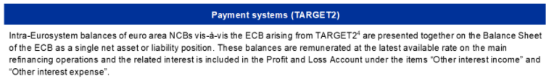


Slide 23
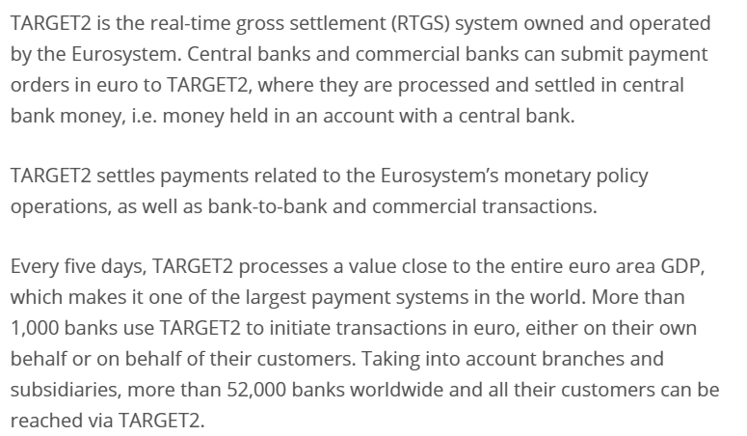
https://www.ecb.europa.eu/paym/target/target2/html/index.en.html

Slide 24
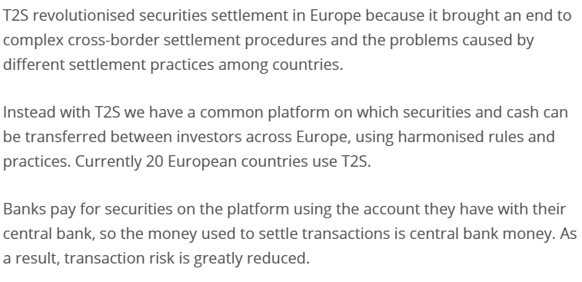
https://www.ecb.europa.eu/paym/target/t2s/html/index.en.html

Slide 25
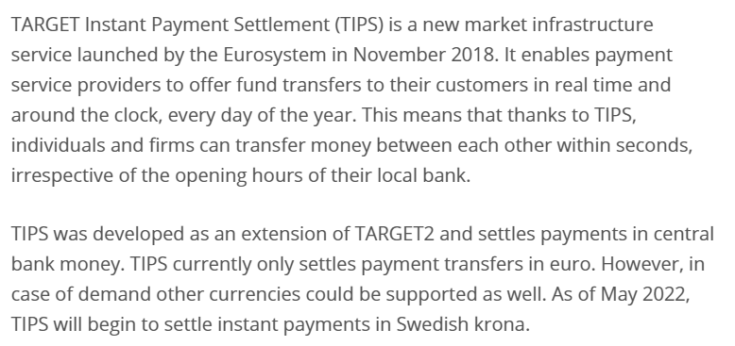
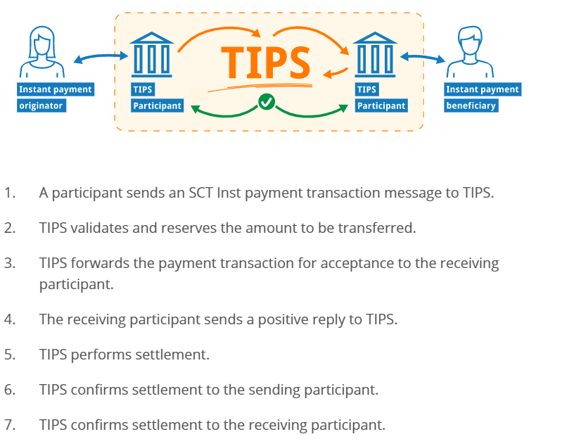
https://www.ecb.europa.eu/paym/target/tips/html/index.en.html

Slide 26
International payments and official reserves
As part of its management of the payment system, the central bank compiles the Balance of payments – a document which reports all economic and financial transactions between residents in a country and the rest of the world. As part of this activity the central bank monitors international capital flows and occasionally regulates them.
This activity if particularly important if the country operates under a fixed exchange rate regime (check definition). In this case, the central bank operates so as to maintain the currency close to the official parity (oscillation bands). This activity is closely related to the management of official reserves of foreign currency and gold.

Slide 27
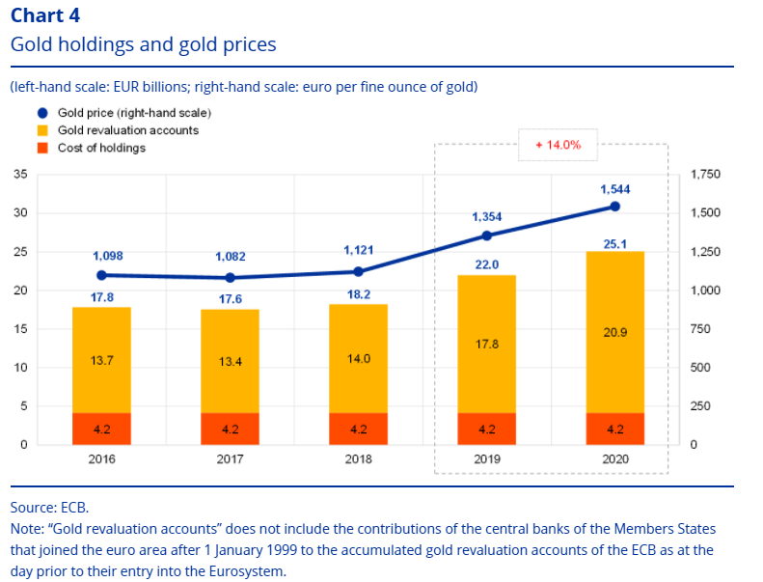
https://www.ecb.europa.eu/pub/annual/annual-accounts/html/ecb.annualaccounts2020~0508aea2f9.ga.html

Slide 28
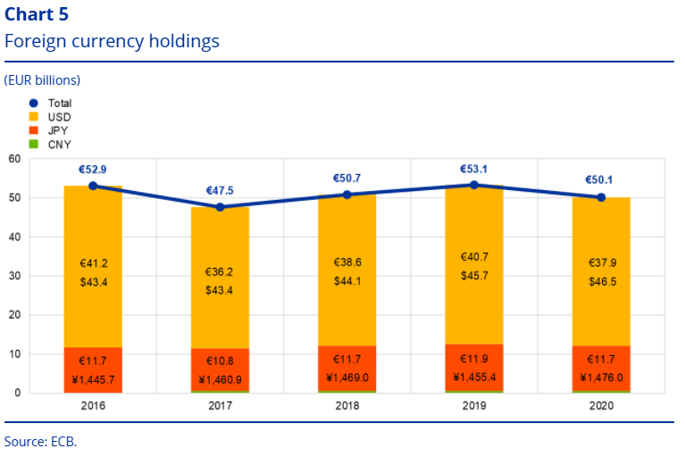
https://www.ecb.europa.eu/pub/annual/annual-accounts/html/ecb.annualaccounts2020~0508aea2f9.ga.html

Slide 29
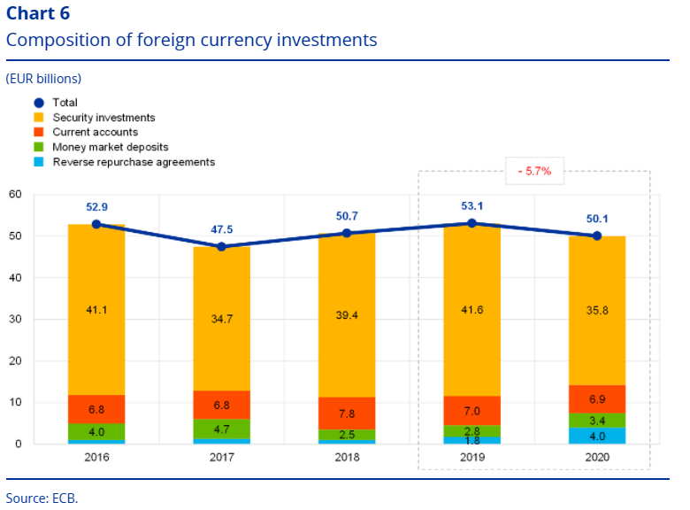
https://www.ecb.europa.eu/pub/annual/annual-accounts/html/ecb.annualaccounts2020~0508aea2f9.ga.html

Slide 30
Statistics and research (ECB)
The ECB, assisted by the NCBs, develops, collects, compiles and disseminates a wide range of statistics which are important to support the monetary policy of the euro area, the supervisory functions of the ECB, various other tasks of the ESCB and the tasks of the European Systemic Risk Board. These statistics are also used by public authorities, financial market participants, the media and the general public.
The production of high-quality scientific research helps provide solid and rigorous foundations for the ECB’s policy analysis and thereby makes an important contribution to the achievement of policy objectives. During 2016 economic research at the ECB provided new insights into many challenging and shifting analytical priorities. In addition, the activities of three research networks fostered intense collaboration among researchers throughout the ESCB.92

Slide 31
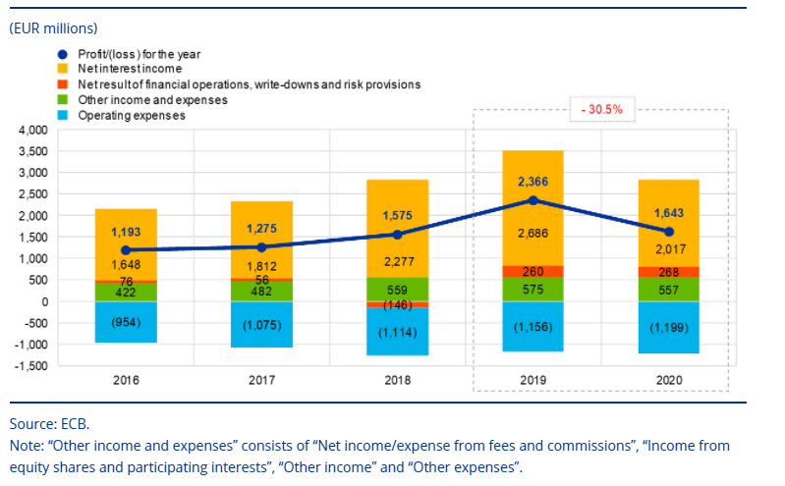
https://www.ecb.europa.eu/pub/annual/annual-accounts/html/ecb.annualaccounts2020~0508aea2f9.ga.html

Slide 32
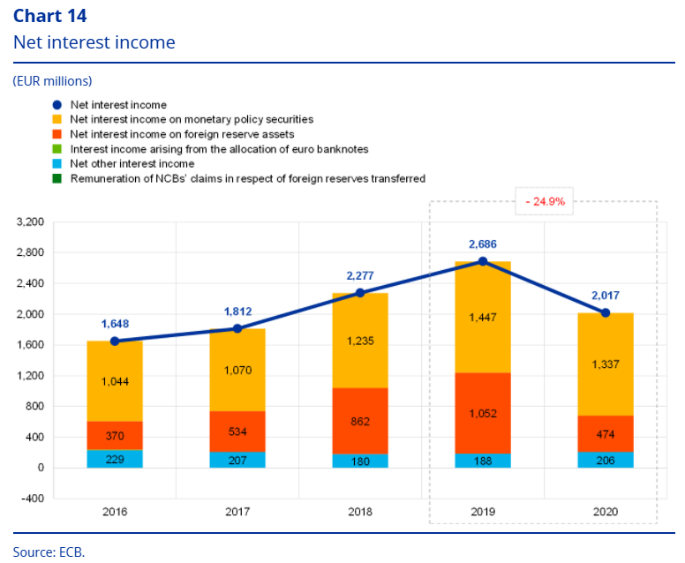
https://www.ecb.europa.eu/pub/annual/annual-accounts/html/ecb.annualaccounts2020~0508aea2f9.ga.html

Slide 33
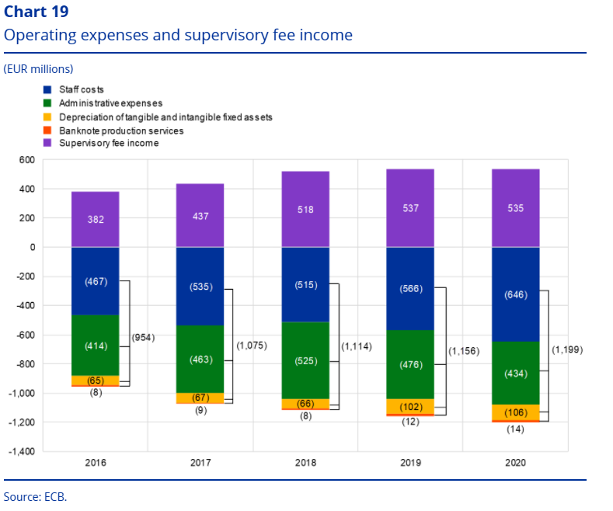
https://www.ecb.europa.eu/pub/annual/annual-accounts/html/ecb.annualaccounts2020~0508aea2f9.ga.html

Slide 34
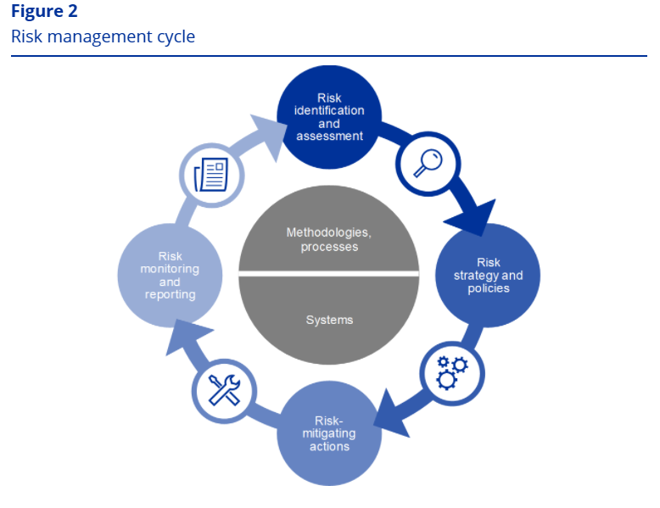
https://www.ecb.europa.eu/pub/annual/annual-accounts/html/ecb.annualaccounts2020~0508aea2f9.ga.html

Slide 35
Central Bank Risks (ECB)
The following sections focus on the risks, their sources and the applicable risk control frameworks.
1.4.1 Financial risks
The Executive Board proposes policies and procedures that ensure an appropriate level of protection against the financial risks to which the ECB is exposed. The Risk Management Committee (RMC), which comprises experts from Eurosystem central banks, contributes to the monitoring, measuring and reporting of financial risks related to the balance sheet of the Eurosystem, and it defines and reviews the associated methodologies and frameworks. In this way, the RMC helps the decision-making bodies to ensure an appropriate level of protection for the Eurosystem.
Financial risks arise from the ECB’s core activities and associated exposures. The risk control frameworks and limits that the ECB uses to manage its risk profile differ across types of operation, reflecting the policy or investment objectives of the different portfolios and the risk characteristics of the underlying assets.
https://www.ecb.europa.eu/pub/annual/annual-accounts/html/ecb.annualaccounts2020~0508aea2f9.ga.html

Slide 36
Central Bank Risks (ECB), 2
To monitor and assess the risks, the ECB relies on a number of risk estimation techniques developed by its experts. These techniques are based on a joint market and credit risk simulation framework. The core modelling concepts, techniques and assumptions underlying the risk measures draw on industry standards and available market data. The risks are typically quantified as the expected shortfall (ES),^{[18]} estimated at the 99% confidence level over a one-year horizon. Two approaches are used to calculate risks: (i) the accounting approach, under which the ECB’s revaluation accounts are considered as a buffer in the calculation of risk estimates in line with all applicable accounting rules; and (ii) the financial approach, under which the revaluation accounts are not considered as a buffer in the risk calculation. The ECB also calculates other risk measures at different confidence levels, performs sensitivity and stress scenario analyses, and assesses longer-term projections of exposures and income to maintain a comprehensive picture of the risks.
The total risks of the ECB increased during the year. At the end of 2020 the total financial risks for all the ECB’s portfolios combined, as measured by the ES at the 99% confidence level over a one-year horizon under the accounting approach, stood at €12.8 billion, which was €4.6 billion higher than the risks estimated as at the end of 2019 (Chart 20). The increase in estimated risks is mainly attributable to the net asset purchases under both the PEPP and the APP.
https://www.ecb.europa.eu/pub/annual/annual-accounts/html/ecb.annualaccounts2020~0508aea2f9.ga.html

Slide 37
Central Bank Risks (ECB), 3
Credit risk arises from the ECB’s monetary policy portfolios, its euro-denominated own funds portfolio and its foreign reserve holdings. While securities held for monetary policy purposes are valued at amortised cost subject to impairment and are therefore, in the absence of sales, not subject to price changes associated with credit migrations, they are still subject to credit default risk. Euro-denominated own funds and foreign reserves are valued at market prices and, as such, are subject to credit migration and default risk. Credit risk increased compared with the previous year owing to the expansion of the ECB’s Balance Sheet through purchases of securities under the APP and the PEPP.
Credit risk is mitigated mainly through the application of eligibility criteria, due diligence procedures and limits that differ across portfolios.
Currency and commodity risks arise from the ECB’s foreign currency and gold holdings. The currency risk increased compared to the previous year owing to lower currency revaluation accounts, which act as buffers against adverse exchange rate movements.
In view of the policy role of these assets, the ECB does not hedge the related currency and commodity risks. Instead, these risks are mitigated through the existence of revaluation accounts and the diversification of the holdings across different currencies and gold.
https://www.ecb.europa.eu/pub/annual/annual-accounts/html/ecb.annualaccounts2020~0508aea2f9.ga.html

Slide 38
Central Bank Risks (ECB), 4
The ECB’s foreign reserves and euro-denominated own funds are mainly invested in fixed income securities and are subject to mark-to-market interest rate risk, given that they are valued at market prices. The ECB’s foreign reserves are mainly invested in assets with relatively short maturities (see Chart 7 in Section 1.3.1 “Balance Sheet”), while the assets in the own funds portfolio generally have longer maturities (see Chart 9 in Section 1.3.1 “Balance Sheet”). This risk component, as measured under the accounting approach, increased slightly compared to 2019, reflecting developments in market conditions.
The mark-to-market interest rate risk of the ECB is mitigated through asset allocation policies and the revaluation accounts.
The ECB is also subject to interest rate risk arising from mismatches between the interest rate earned on its assets and the interest rate paid on its liabilities, which has an impact on its net interest income. This risk is not directly linked to any particular portfolio but rather to the structure of the ECB’s Balance Sheet as a whole and, in particular, the existence of maturity and yield mismatches between assets and liabilities. It is monitored by means of projections of the ECB’s profitability, which indicate that the ECB is expected to continue to earn net interest income in the coming years.
This type of risk is managed through asset allocation policies and is further mitigated by the existence of unremunerated liabilities on the ECB’s Balance Sheet.
https://www.ecb.europa.eu/pub/annual/annual-accounts/html/ecb.annualaccounts2020~0508aea2f9.ga.html

Slide 39
Central Bank Risks (ECB), 5
1.4.2 Operational risk
The Executive Board is responsible for and approves the ECB’s operational risk^{[20]} management (ORM) policy and framework. The Operational Risk Committee (ORC) supports the Executive Board in the performance of its role in overseeing the management of operational risks. ORM is an integral part of the ECB’s governance structure^{[21]} and management processes.
The main objective of the ECB’s ORM framework is to contribute to ensuring that the ECB achieves its mission and objectives, while protecting its reputation and assets against loss, misuse and damage. Under the ORM framework, each business area is responsible for identifying, assessing, responding to, reporting on and monitoring its operational risks, incidents and controls. In this context, the ECB’s risk tolerance policy provides guidance with regard to risk response strategies and risk acceptance procedures. It is linked to a five-by-five risk matrix based on impact and likelihood grading scales using quantitative and qualitative criteria.

Slide 40
International payments and official reserves
As part of its management of the payment system, the central bank compiles the Balance of payments – a document which reports all economic and financial transactions between residents in a country and the rest of the world. As part of this activity the central bank monitors international capital flows and occasionally regulates them.
This activity if particularly important if the country operates under a fixed exchange rate regime (check definition). In this case, the central bank operates so as to maintain the currency close to the official parity (oscillation bands).
This activity is closely related to the management of official reserves of foreign currency and gold.

Slide 41
Research and statistics
The CB develops, collects, compiles and disseminates a wide range of statistics (including forecasts) which are important to support the monetary policy, the supervisory / regulatory functions and its other tasks. These statistics are also used by public authorities, financial market participants, the media and the general public.
The production of high-quality scientific research helps provide solid and rigorousfoundations for the ECB’s policy analysis and thereby makes an important contribution to the achievement of policy objectives.

Slide 42
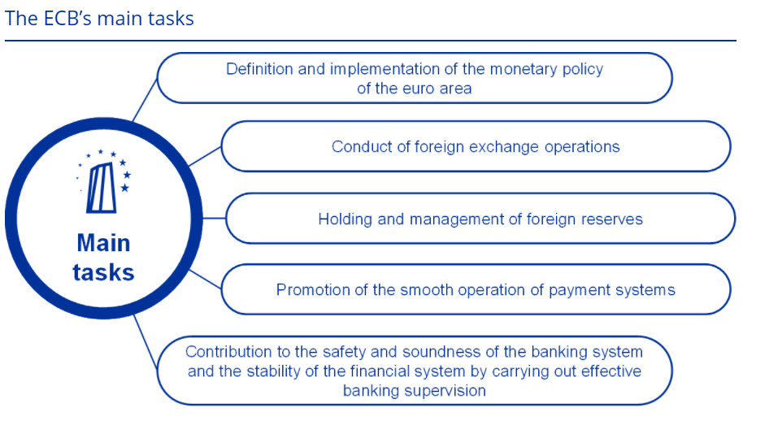
Central bank functions today, 2
https://www.ecb.europa.eu/pub/annual/annual-accounts/html/ecb.annualaccounts2020~0508aea2f9.ga.html

Slide 43
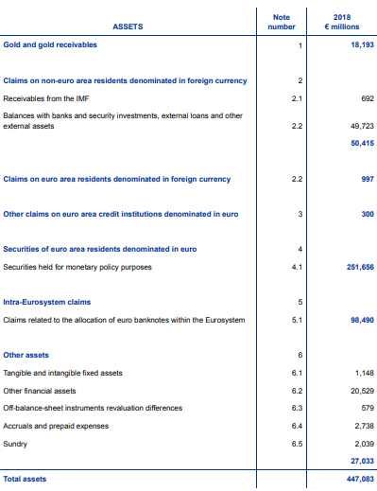
Source ECB AR 2018

Slide 44
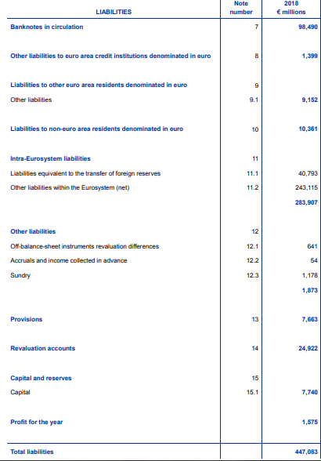
Source ECB AR 2018

Slide 45
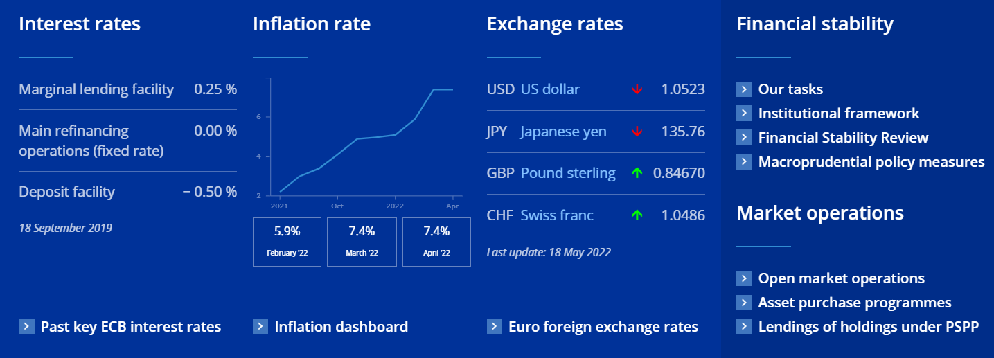

Slide 46
The money market
The money market consists of dealers in money or credit who trade in short-term financial assets. Money markets provide the infrastructure to reallocate liquidity from surplus units to deficit units. This is essential to ensure the smooth functioning of the payment system.
The core of the money market consists of the interbank market and of the foreign exchange market:
  Market for bank reserves
  Interbank market lending i.e. banks borrowing and lending to each other using interbank loans, commercial paper, repurchase agreements (interbank rates : EURIBOR, LIBOR, EONIA)
  Foreign exchange market: the market in which participants are able to buy, sell, exchange and speculate on currencies. (Nominal exchange rate determination).
  See de Haan et al. 2015 Section 5.2

Slide 47
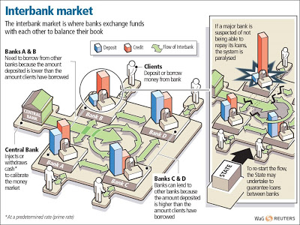
The money market

Slide 48
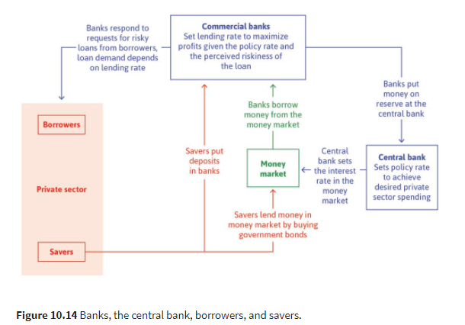
The central bank, banks, borrowers and savers

Slide 49
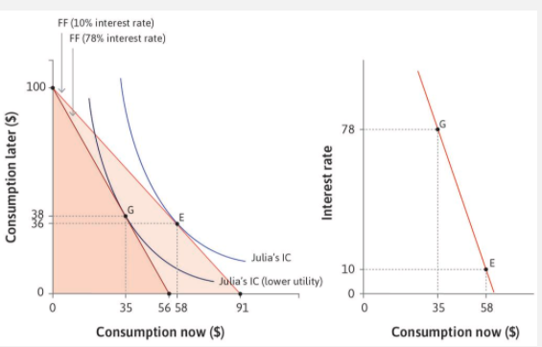
The central bank’s policy rate can affect spending

Slide 50
Homeworks
Section 10.9, 10.11
Exercises 10.3, 10.4
Read 10.12 and 10.13 focusing on principal agent
Take a look at https://www.ecb.europa.eu/home/html/index.en.html

