Slide 1
Macroeconomics
Lecture 12
15.05.24
Paolo Paesani
University of Rome Tor Vergata
Department of Economics and Finance

Slide 2
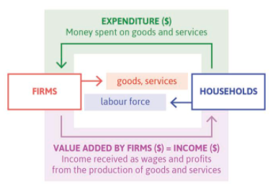
Back to square 1 …. Nominal GDP
GDP = Gross Domestic Product
GDP in nominal terms = total value of final goods and services produced within a country, in a given period of time, evaluated at market prices. Synonims for GDP = Aggregate income = Aggregate output
GDP can be defined according to any of these three perspectives. But we have to be careful in the definition because, while it is always the case that one person’s expenditure is another person’s income, globalization means that often the two people are in different countries. GDP is defined to include exports and exclude imports.
the government, and the public services the government provides, can be incorporated in a similar way. Households to government: Households pay taxes. Government to households: These taxes pay for the production of public services used by households.

Slide 3
Nominal GDP, GDP deflator, Real GDP
GDP = PY
P = GDP deflator
  Statistical index that measures the joint movement of prices over time.
  What prices? The prices of a «representative» bundle, comprising a sample of the final goods and services produced in the country GDP.
Y = Real GDP (a.k.a. GDP in real terms, GDP at constant prices)
  Statistical index the measures the volume (rather than the value) of aggregate production over time.
  Aggregate production? The total production of final goods and services.

Slide 4
GDP deflator
The GDP deflator is a price index like the CPI, but it tracks the change in prices of all domestically produced final goods and services. Instead of a basket of goods and services, the GDP deflator tracks the price changes of the components of domestic GDP, that is, of C + I + G + X – M (the GDP deflator includes exports, which are produced by the home economy, but excludes imports, which are produced abroad).
The GDP deflator can also be expressed as the ratio of nominal (or current price) GDP to real (or constant price) GDP. The GDP deflator series is most commonly used to transform a nominal GDP series into a real GDP series.
As we saw in Section 1.2 and Unit 1’s Einstein section, the real GDP series shows how the size of the home economy changes over time, taking into account changes in the price of domestically produced goods and services.

Slide 5
GDP, price level, inflation
Nominal prices, relative prices, price index (GPP)
Nominal GDP (2019)
(Q_{A,2019} * P_{A,2019}) + (Q_{B,2019} * P_{B,2019}) = 600€ (at 2019 prices) = P₂₀₁₉Y₂₀₁₉
Nominal GDP (2020)
(Q_{A,2020} * P_{A,2020}) + (Q_{B,2020} * P_{B,2020}) = 760€ (at 2020 prices) = P₂₀₂₀Y₂₀₂₀
How can we decompose GDP into product of P and Y? Various statistical methodologies: Laspeyeres. Paasche, Fisher, Chain index.
 | QA | PA | QB | PB
2019 | 100 | 2 | 100 | 4
2020 | 100 | 4 | 120 | 3

Slide 6
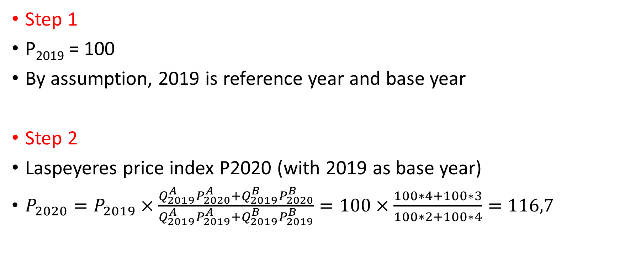
GDP, price level, inflation (2)
Step 1
P₂₀₁₉ = 100
By assumption, 2019 is reference year and base year
Step 2
Laspeyeres price index P2020 (with 2019 as base year)
$P_{2020}=P_{2019}×\frac{Q_{2019}^{A}P_{2020}^{A}+Q_{2019}^{B}P_{2020}^{B}}{Q_{2019}^{A}P_{2019}^{A}+Q_{2019}^{B}P_{2019}^{B}}=100×\frac{100∗4+100∗3}{100∗2+100∗4}=116,7$

Slide 7
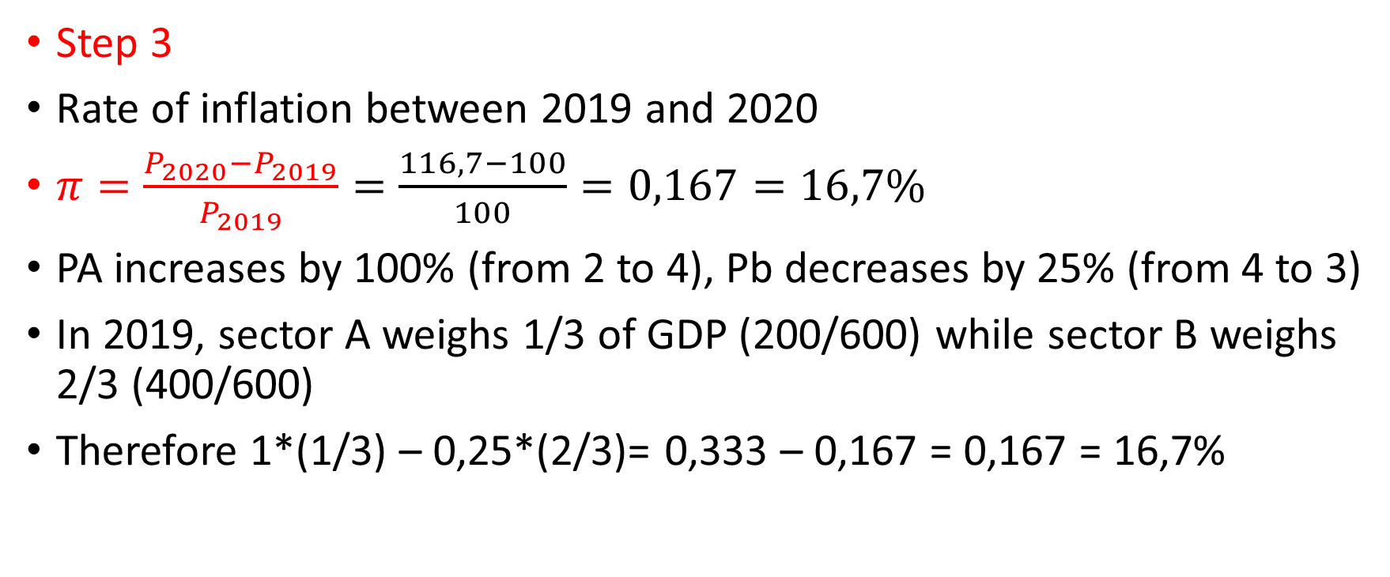
GDP, price level, inflation (2)
Step 3
Rate of inflation between 2019 and 2020
$π=\frac{P_{2020}−P_{2019}}{P_{2019}}=\frac{116,7−100}{100}=0,167=16,7\%$
PA increases by 100% (from 2 to 4), Pb decreases by 25% (from 4 to 3)
In 2019, sector A weighs 1/3 of GDP (200/600) while sector B weighs 2/3 (400/600)
Therefore 1*(1/3) – 0,25*(2/3)= 0,333 – 0,167 = 0,167 = 16,7%

Slide 8
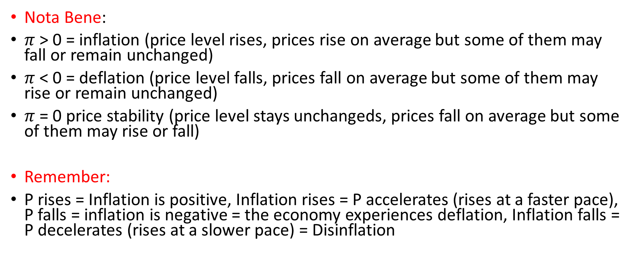
GDP, price level, inflation (3)
Nota Bene:
$π$ > 0 = inflation (price level rises, prices rise on average but some of them may fall or remain unchanged)
$π$ < 0 = deflation (price level falls, prices fall on average but some of them may rise or remain unchanged)
$π$ = 0 price stability (price level stays unchangeds, prices fall on average but some of them may rise or fall)
Remember:
P rises = Inflation is positive, Inflation rises = P accelerates (rises at a faster pace), P falls = inflation is negative = the economy experiences deflation, Inflation falls = P decelerates (rises at a slower pace) = Disinflation

Slide 9
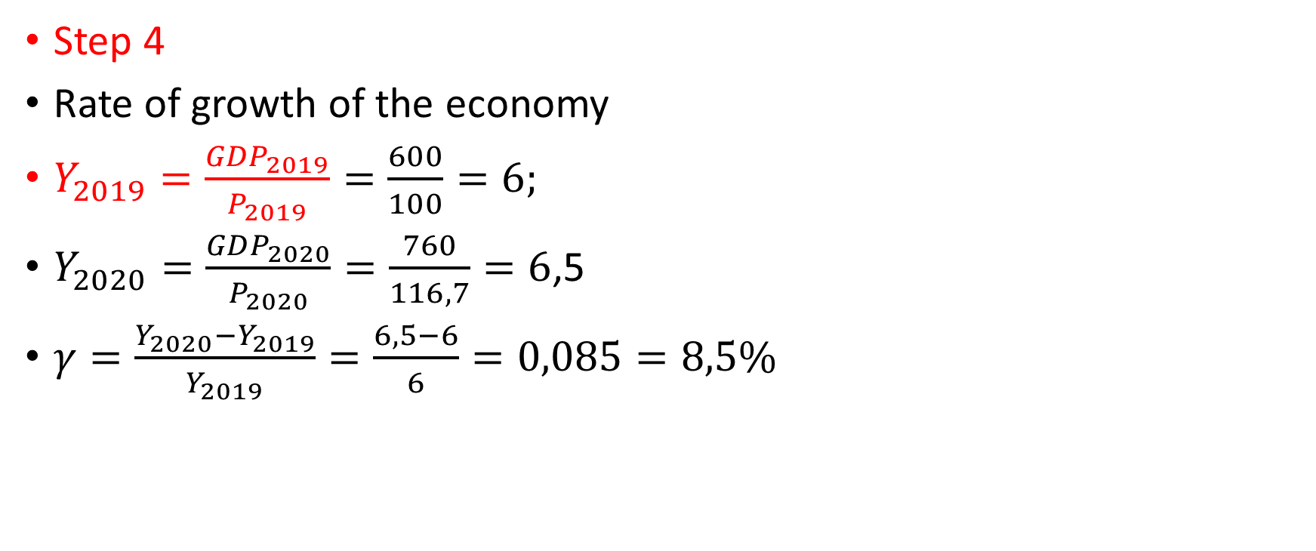
GDP, price level, inflation (4)
Step 4
Rate of growth of the economy
$Y_{2019}=\frac{{GDP}_{2019}}{P_{2019}}=\frac{600}{100}=6;$
$Y_{2020}=\frac{{GDP}_{2020}}{P_{2020}}=\frac{760}{116,7}=6$,5
$γ=\frac{Y_{2020}−Y_{2019}}{Y_{2019}}=\frac{6,5−6}{6}=0,085=8,5\%$

Slide 10
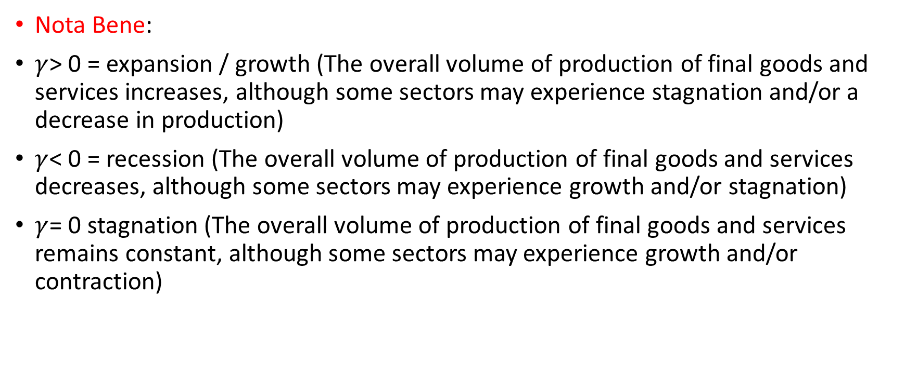
GDP, price level, inflation (5)
Nota Bene:
    $γ$> 0 = expansion / growth (The overall volume of production of final goods and services increases, although some sectors may experience stagnation and/or a decrease in production)
    $γ$< 0 = recession (The overall volume of production of final goods and services decreases, although some sectors may experience growth and/or stagnation)
    $γ$= 0 stagnation (The overall volume of production of final goods and services remains constant, although some sectors may experience growth and/or contraction)

Slide 11
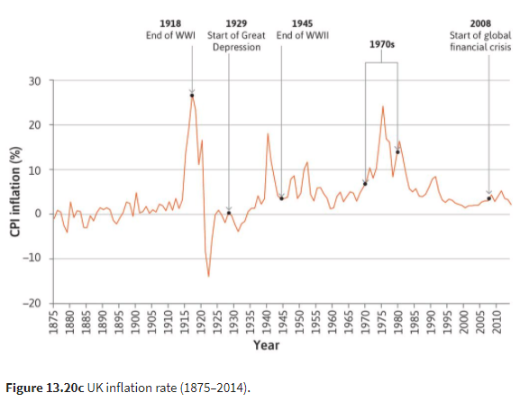
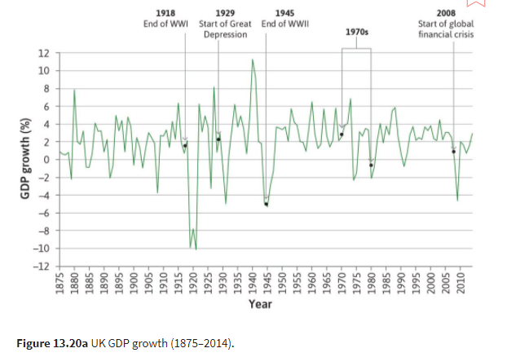
Growth and inflation

Slide 12
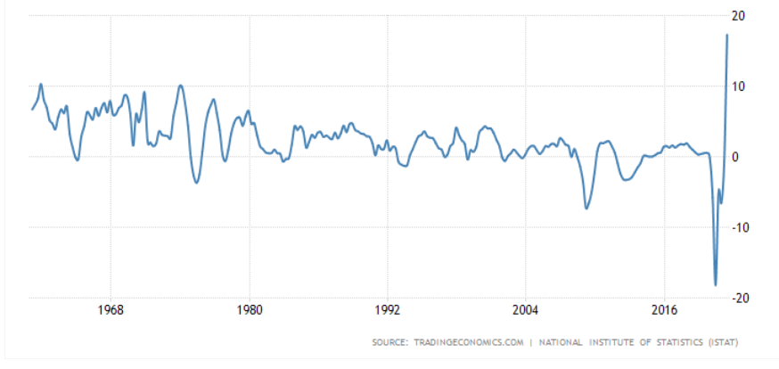
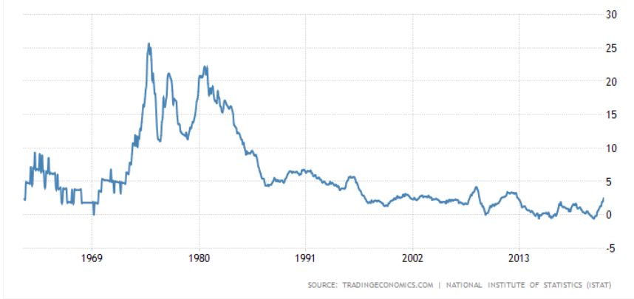
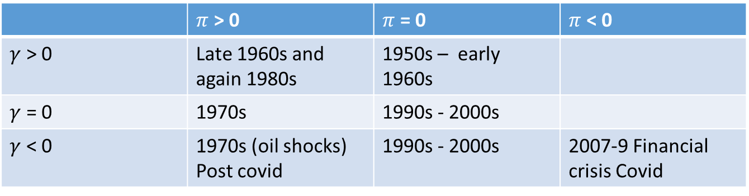
Growth and inflation: the case of Italy
 | $π$ > 0 | $π$ = 0 | $π$ < 0
$γ$ > 0 | Late 1960s and again 1980s | 1950s – early 1960s
$γ$ = 0 | 1970s | 1990s - 2000s
$γ$ < 0 | 1970s (oil shocks) Post covid | 1990s - 2000s | 2007-9 Financial crisis Covid
https://tradingeconomics.com/italy/gdp-growth-annual
https://tradingeconomics.com/italy/inflation-cpi

Slide 13
The CPI
The Consumer Price Index (CPI) measures the general level of prices that consumers have to pay for goods and services, including consumption taxes. The basket of goods and services is chosen to reflect the spending of a typical household in the economy. For this reason, the change in the CPI, or CPI inflation, is often considered to measure changes in the ‘cost of living’.
The CPI is based on what consumers actually buy. It includes the prices of food and drink, housing, clothing, transportation, recreation, education, communications, medical care, and other goods and services. The goods and services in the basket are weighted according to the fraction of household spending they account for. The CPI excludes exports, which are consumed by foreign residents, but includes imports, which are consumed by households in the home economy. The change in the CPI over the past year is commonly used as a measure of inflation.

Slide 14
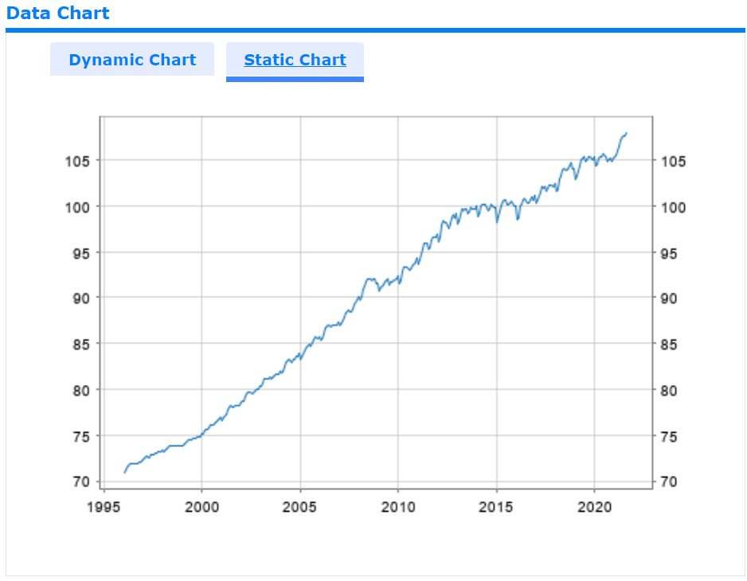
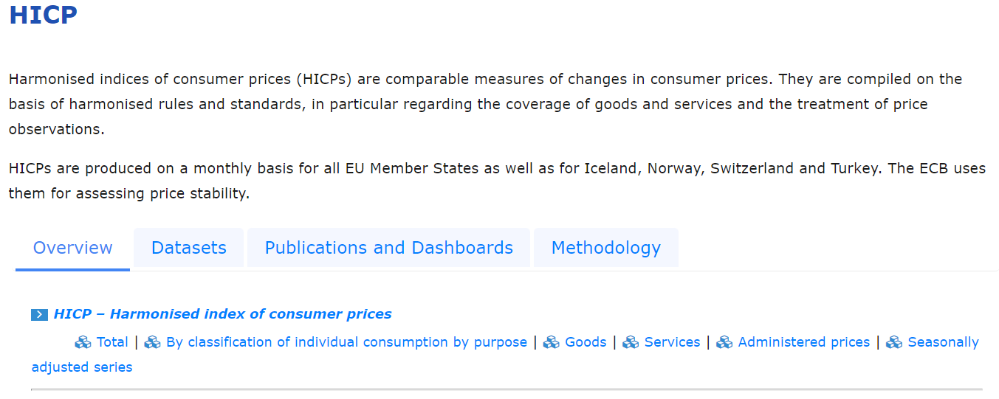
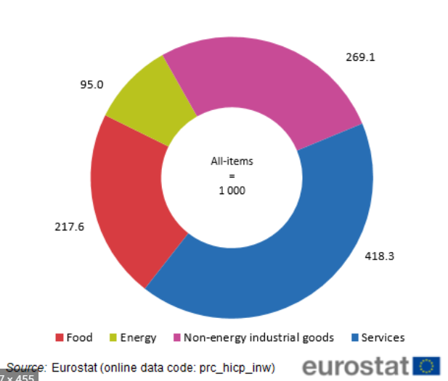
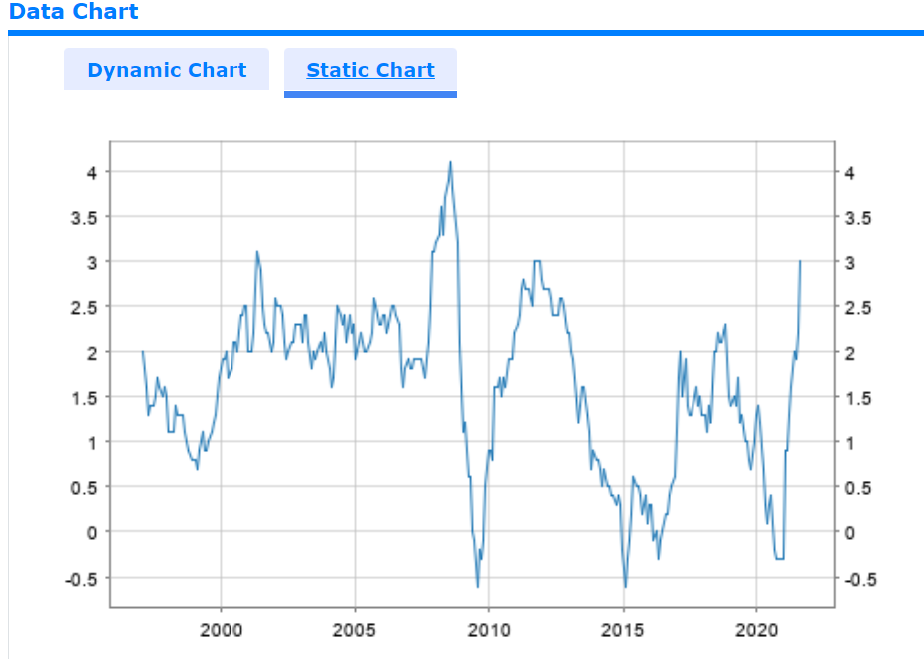
https://sdw.ecb.europa.eu/quickview.do?SERIES_KEY=122.ICP.M.U2.N.000000.4.INX
https://sdw.ecb.europa.eu/quickview.do?SERIES_KEY=122.ICP.M.U2.N.000000.4.ANR

Slide 15
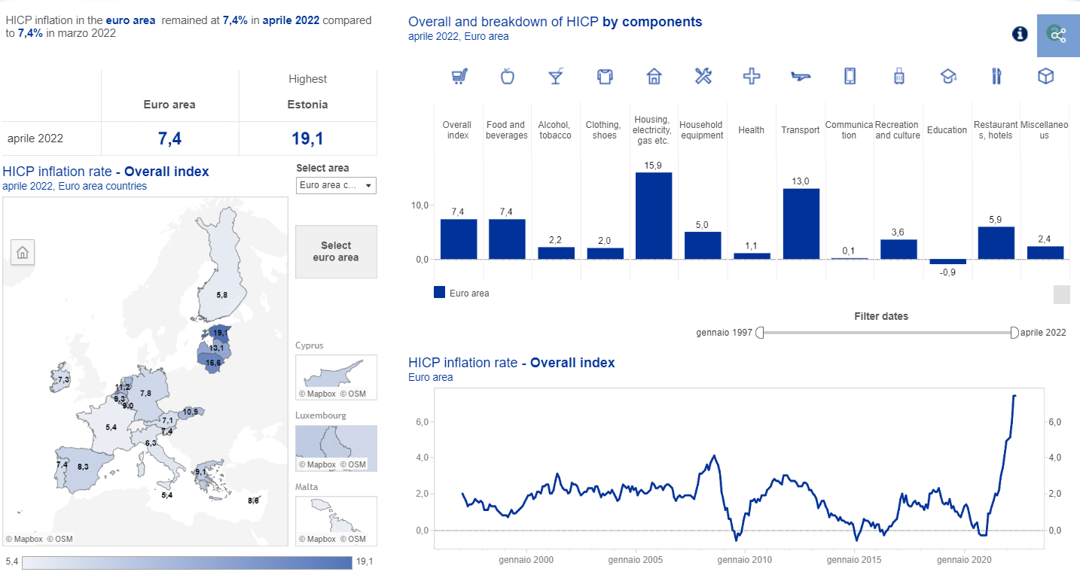
https://www.ecb.europa.eu/stats/macroeconomic_and_sectoral/hicp/html/index.en.html

Slide 16
Flash question
Based on the following data
Compute the value of the bundle in 2019 and 2020 at current prices
Use the Laspeyres formula to compute the price level for 2020, taking 2019 as base and reference year
Compute the rate of inflation between 2019 and 2020
How does this rate affect the general purchasing power of money and why?
 | QA | PA | QB | PB
2019 | 100 | 5 | 100 | 4
2020 | 100 | 5,5 | 100 | 2

Slide 17
Homeworks
Sections 13.3, 13.8

