Slide 1
Macroeconomics
Lecture 13
17.05.24
Paolo Paesani
University of Rome Tor Vergata
Department of Economics and Finance

Slide 2
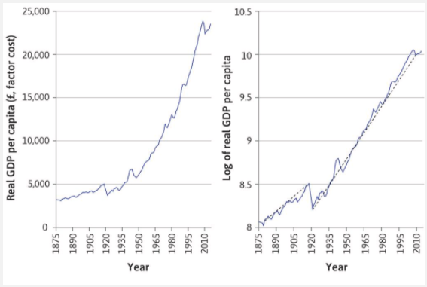
Growth and fluctuations
For the period after the First World War, a straight line from 1921 to 2014 fits the data well.
For a graph in which the vertical axis represents the log of GDP per capita, the slope of the line (the dashed black line) represents the average annual growth rate of the series (See Einstein box).
Immediately we notice that growth was steady from 1921 to 2014 (with a little uptick during the Second World War).
A line drawn through the log series from 1875 to 1914 is flatter than the line from 1921, indicating that the growth rate was lower.

Slide 3
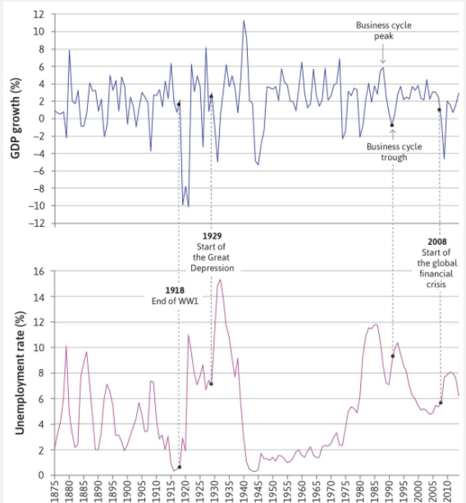
Growth and fluctuations (2)
Fluctuations are the deviations from the dotted black line showing the long-run growth rate in Figure 13.2. The top panel of Figure 13.3 plots the annual growth rate of UK GDPgross domestic product (GDP) close between 1875 and 2014.
Since we want to focus on the size of the economy and how it changes from year to year, we will examine total GDP rather than GDP per capita.
It is clear from the ups and downs of the series in Figure 13.3 that economic growth is not a smooth process. We often hear about economies going through a boom or a recession as growth swings from positive to negative, but there is no standard definition of these words.

Slide 4
Business cycle: definition
The movement from boom, to recession, and back to boom is known as the business cycle.
In Figure 13.3 you will notice that in addition to the yearly change in GDP, in which recessions measured by negative growth seem to happen about twice every 10 years, there are less frequent episodes of much larger fluctuations in output.
In the twentieth century, the big downward spikes coincided with the end of the First and Second World Wars, and with the economic crisis of the Great Depression. In the twenty-first century, the global financial crisis followed a period in which fluctuations were limited.
And now COVID – 19 ….

Slide 5
Recession: definition
NBER definition: output is declining. A recession is over once the economy begins to grow again.
Alternative definition: the level of output is below its normal level, even if the economy is growing. A recession is not over until output has grown enough to get back to normal.
There is a practical problem with the second definition: it is a matter of judgement, and sometimes controversy, over what an economy’s normal output would be (we return to this issue in later units, where we will see that ‘normal output’ is often defined as that consistent with stable inflation).

Slide 6
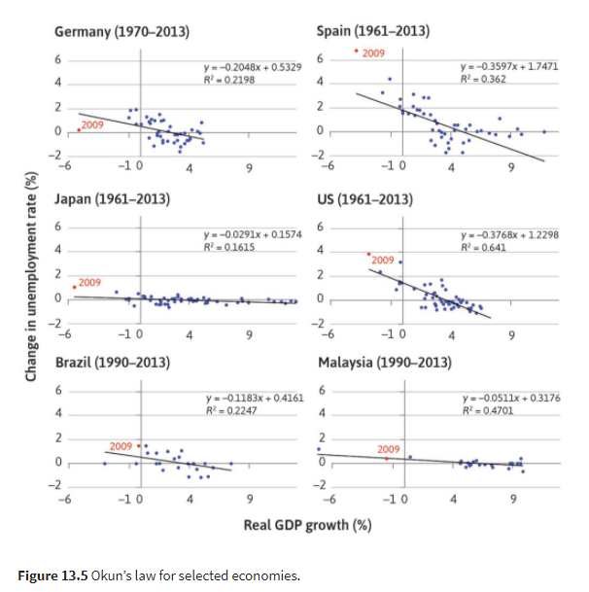
Output growth and changes in unemployment (2)
Okun’s law The empirical regularity that changes in the rate of growth of GDP are negatively correlated with the rate of unemployment.
Okun’s coefficient The change in the unemployment rate in percentage points predicted to be associated with a 1% change in the growth rate of GDP

Slide 7
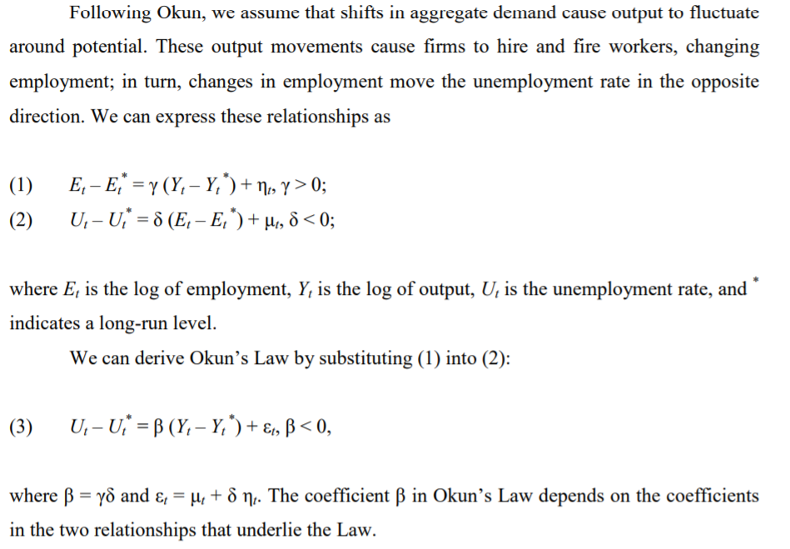
Source:https://www.econstor.eu/bitstream/10419/101356/1/733548652.pdf

Slide 8
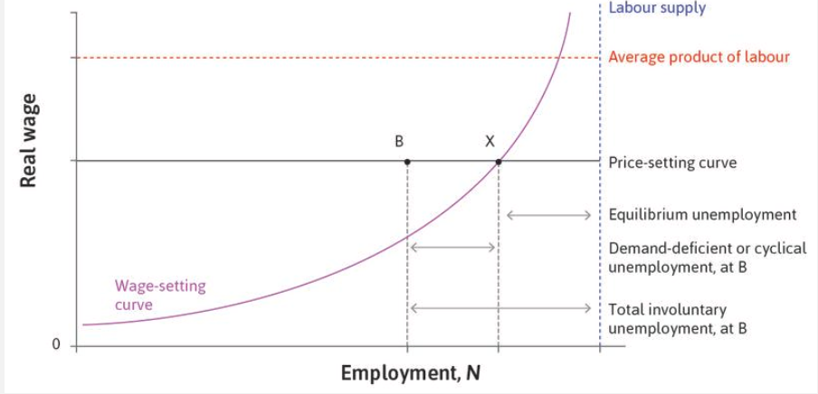
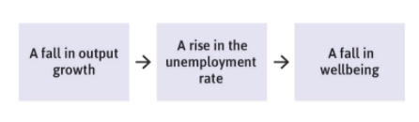
Output growth and changes in unemployment (3)
E
E*

Slide 9
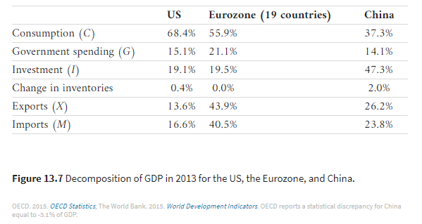
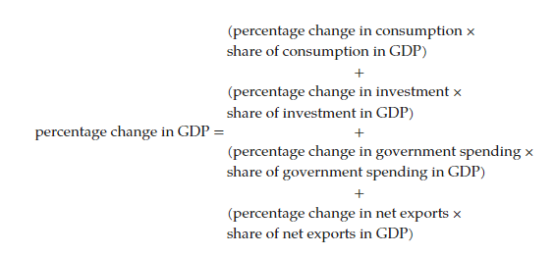
GDP and aggregate demand
GDP = Aggregate spending = Aggregate demand
GDP = C + I + G + X - M

Slide 10
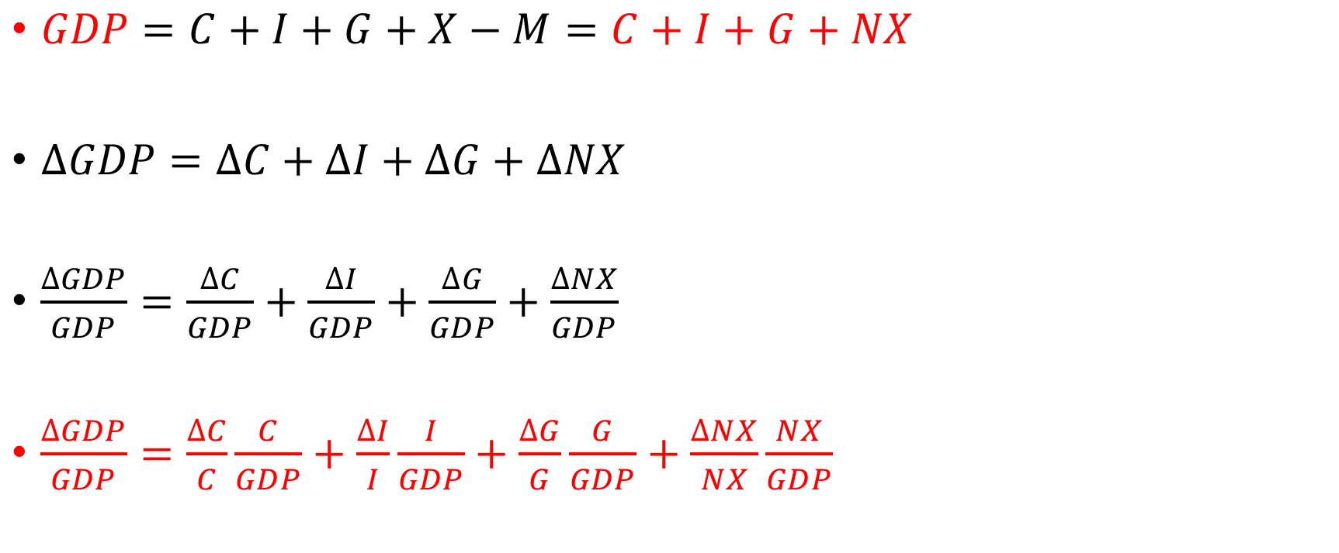
GDP and aggregate demand (2)
$GDP=C+I+G+X−M=C+I+G+NX$
$∆GDP=∆C+∆I+∆G+∆NX$
$\frac{∆GDP}{GDP}=\frac{∆C}{GDP}+\frac{∆I}{GDP}+\frac{∆G}{GDP}+\frac{∆NX}{GDP}$
$\frac{∆GDP}{GDP}=\frac{∆C}{C}\frac{C}{GDP}+\frac{∆I}{I}\frac{I}{GDP}+\frac{∆G}{G}\frac{G}{GDP}+\frac{∆NX}{NX}\frac{NX}{GDP}$

Slide 11
Consumption
Consumption includes the goods and services purchased by households. Goods are normally tangible things. Goods like cars, household appliances, and furniture that last for three years or more are called durable goods; those that last for shorter periods are non-durable goods. Services are things that households buy that are normally intangible, such as transportation, housing (payment of rent), gym membership, and medical treatment.
Household spending on durable goods like cars and household equipment is counted in consumption in the national accounts, although as we will see, in economic terms the decision to buy these long-lasting items is more like an investment decision.
Average propensity to consume C/GDP
Marginal propensity to consume dC/dGDP

Slide 12
Investment
This is the spending by firms on new equipment and new commercial buildings; and spending on residential structures (the construction of new housing).
Investment in the unsold output that firms produce is the other part of investment that is recorded as a separate item in the national accounts. It is called the change in inventories or stocks.
Including changes in stocks is essential to ensuring that when we measure GDP by the output method (what is produced), it is equal to GDP measured by the expenditure method (what is spent, including investment by firms in unsold inventories).

Slide 13
Government purchases
This represents the consumption and investment purchases by the government (consisting of central and local government, often called ‘general government’). Government consumption purchases are of goods (such as office equipment, software, and cars) and services (such as wages of civil servants, armed services, police, teachers, and scientists). Government investment spending is on the building of roads, schools, and defence equipment. Much of government spending on goods and services is for health and education.
Government transfers Spending by the government in the form of payments to households or individuals (benefits and pensions, such as Medicare in the US, or social security benefits in Europe, Unemployment benefits). Transfers are not included in government spending (G) in the national accounts because households receive them as income when they are spent, they are recorded in C or I. It would be double-counting to record this spending in G too.
Disposable income = GDP + GTR – TAX
G + GTR – TAX = Government budget deficit = ∆Public debt

Slide 14
Exports and imports
Exports (X)
Domestically produced goods and services that are purchased by households, firms, and governments in other countries.
Imports (M)
Goods and services purchased by households, firms, and governments in the home economy that are produced in other countries.
Net exports (X − M)
Also called the trade balance See also: trade deficit (X < M), trade surplus (X > M).

