Slide 1
Macroeconomics
Lecture 14
18.05.24
Paolo Paesani
University of Rome Tor Vergata
Department of Economics and Finance

Slide 2
Consumption
Consumption includes the goods and services purchased by households. Goods are normally tangible things. Goods like cars, household appliances, and furniture that last for three years or more are called durable goods; those that last for shorter periods are non-durable goods. Services are things that households buy that are normally intangible, such as transportation, housing (payment of rent), gym membership, and medical treatment.
Household spending on durable goods like cars and household equipment is counted in consumption in the national accounts, although as we will see, in economic terms the decision to buy these long-lasting items is more like an investment decision.
Average propensity to consume C/GDP
Marginal propensity to consume dC/dGDP

Slide 3
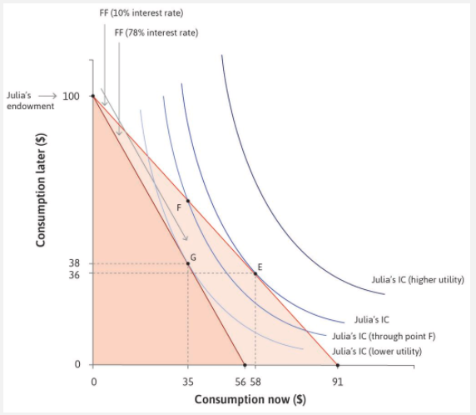
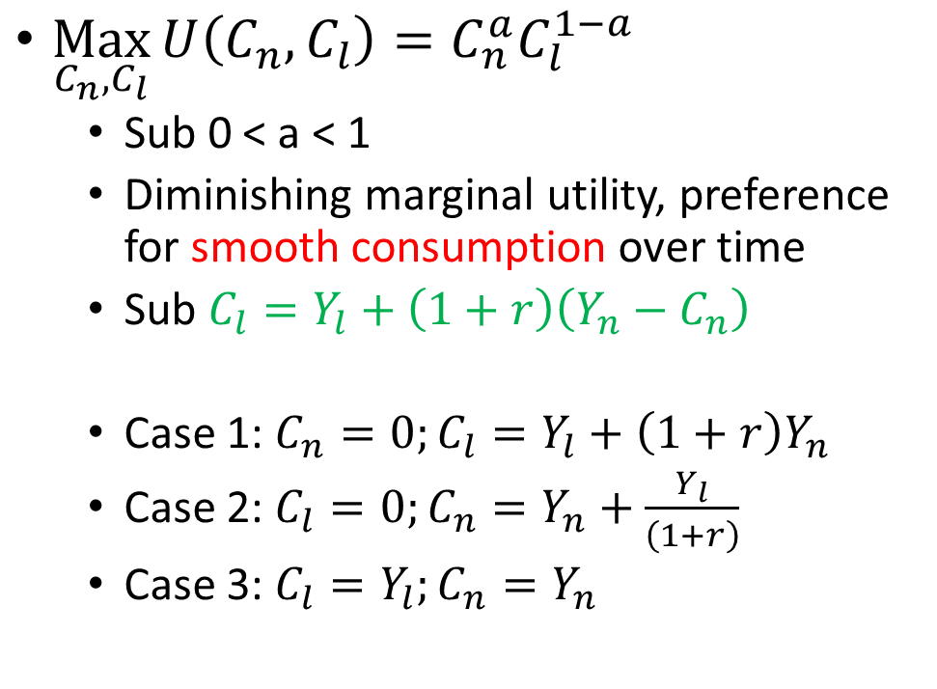
Household consumption: Julia and Marco
$\underset{C_{n},C_{l}}{Max}{U\left(C_{n},C_{l}\right)=C_{n}^{a}C_{l}^{1−a}}$
  Sub 0 < a < 1
  Diminishing marginal utility, preference for smooth consumption over time
  Sub $C_{l}=Y_{l}+\left(1+r\right)\left(Y_{n}−C_{n}\right)$
  Case 1: $C_{n}=0;C_{l}=Y_{l}+\left(1+r\right)Y_{n}$
  Case 2: $C_{l}=0;C_{n}=Y_{n}+\frac{Y_{l}}{\left(1+r\right)}$
  Case 3: $C_{l}=Y_{l};C_{n}=Y_{n}$

Slide 4
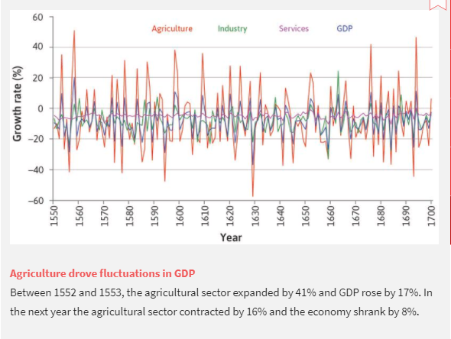
Household consumption: fluctuations in income

Slide 5
Household consumption: coping with fluctations
People use two strategies to deal with shocks that are specific to their household (shocks to Yn and Yl)
Self-insurance Households that encounter an unusually high income in some period will save, so that when their luck reverses, they can spend their savings. As we saw in Unit 10, they may also borrow in bad times if they can, depending on how credit-constrained they are. It is called self-insurance because other households are not involved.
Co-insurance: Households that have been fortunate during a particular period can help a household hit by bad luck. Sometimes this is done among members of extended families or among friends and neighbours. Since the mid-twentieth century, particularly in richer countries, co-insurance has taken the form of citizens paying taxes, which are then used to support individuals who are temporarily out of work, called unemployment benefits.

Slide 6
Household consumption: coping with fluctations, 2
Co-insurance is less effective if the bad shock hits everyone at the same time. When there is a drought, flood, or earthquake, it is more difficult for an agrarian economy to protect the wellbeing of the people who are affected. For example, it is not usually possible to store produce from a bumper harvest long enough to get through the next bad harvest, which may take several years to arrive.
But when these shocks hit, co-insurance may be even more necessary, as community survival requires that less badly hit households help the worst-hit households. In farming economies of the past that were based in volatile climates, people practised co-insurance based on trust, reciprocity, and altruism. These are norms, like the fairness norm we discussed in Unit 4, and they probably emerged and persisted because they helped people to survive in these regions that were often hit by bad weather shocks. Recent research suggests that they seem to have persisted even after climate had become largely unimportant for economic activity.

Slide 7
Household consumption: consumption smoothing
A basic source of stabilization in any economy comes from the desire of households to keep the level of their consumption of goods and services constant.
Keeping a steady level of consumption means households have to plan. They think about what might happen to their income in the future, and they save and borrow to smooth the bumps in income. This is the self-insurance we discussed above.
We have seen that this behaviour occurs in agrarian societies faced by weather and war shocks, but modern households also try to smooth their consumption. One way to visualize this behaviour is to focus on predictable events. A young person thinking about life can imagine getting a job, then enjoying a period of working life with income higher than the starting salary, followed by years in retirement when income is lower than during working life.

Slide 8
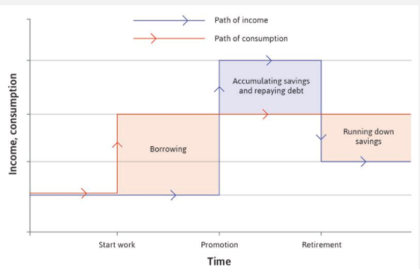
Household consumption: consumption smoothing (2)
The individual will make a judgement: This will be about whether the shock is temporary or permanent.
If the shock is permanent: We should adjust the red line in Figure 13.10 up or down to reflect the new long-run level of consumption that the individual adopts, consistent with the new pattern of forecast income.
If the shock is temporary: Little will change. A temporary fluctuation in income has almost no effect on the lifetime consumption plan, because it makes only a small change to lifetime income.

Slide 9
Household consumption: obstacles to consumption smoothing
There are three other things that constrain the ways in which households can smooth their consumption when faced with income shocks. The first two concern limits on self-insurance, the third is a limit on co-insurance:
Credit constraints or credit market exclusion: Introduced in Unit 10, this restricts a family’s ability to borrow in order to sustain consumption when income has fallen.
Weakness of will: A characteristic of human behaviour that leads people to be unable to carry out the plans—for example, saving in anticipation of a negative income shock—that they know would make them better off.
Limited co-insurance: So that those with a fall in income cannot expect much support in sustaining their incomes from others more fortunate than them.

Slide 10
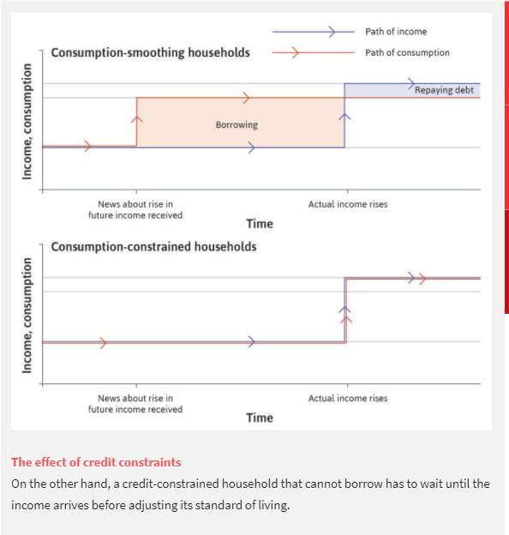
Household consumption: credit constraints

Slide 11
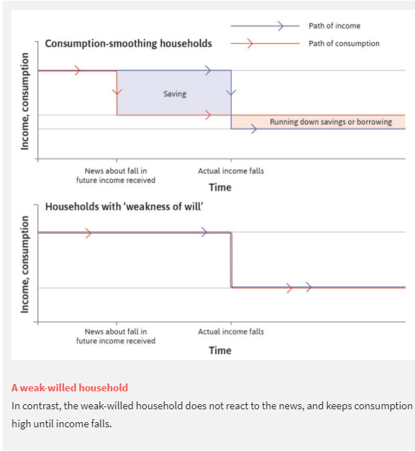
Household consumption: weak will

Slide 12
Homeworks
Section 13.5, 13.6

