Slide 1
Macroeconomics
Lecture 15
21.05.24
Paolo Paesani
University of Rome Tor Vergata
Department of Economics and Finance

Slide 2
Today’s key concepts
GDP = C + I + G + X - M
Investment
  Money spent by companies on new equipment, commercial buildings, new housing, inventories (raw materials semi-finished products, final goods)
  Gross investment (I) versus net investment (I – δK = ∆K, 0 < δ < 1 avergare depreication rate, depreciation = loss in the value of capital due to use)
  Volatility
Inflation

Slide 3
Introducing investment volatility
Households tend to smooth their consumption spending when they can, but there is no similar motivation for a firm to smooth investment spend­ing.
Firms increase their stock of machinery and equipment and build new prem­ises whenever they see an opportunity to make profits. But, unlike eating and most other consumption expenditures, investment expenditures can be postponed.
There are several reasons why this is likely to produce clusters of investment projects at some times, while few projects at other times.

Slide 4
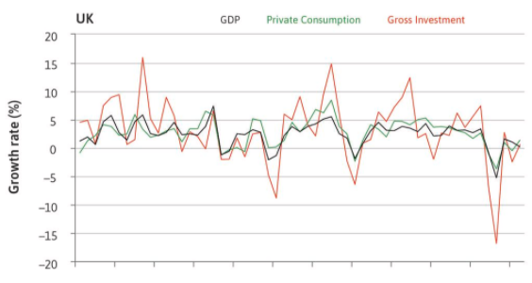
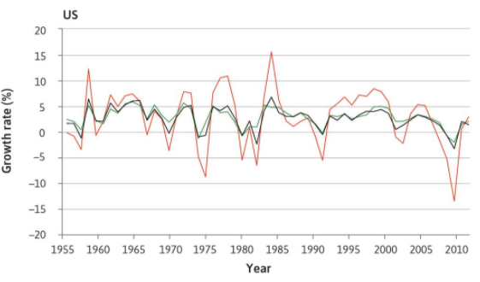
Introducing investment volatility (2)

Slide 5
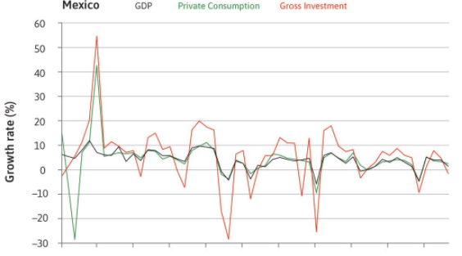
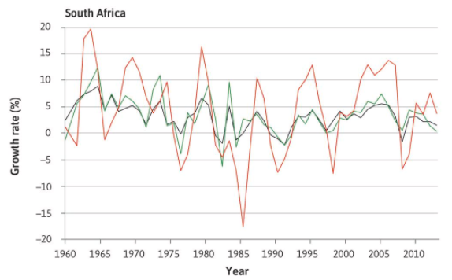
Introducing investment volatility (3)

Slide 6
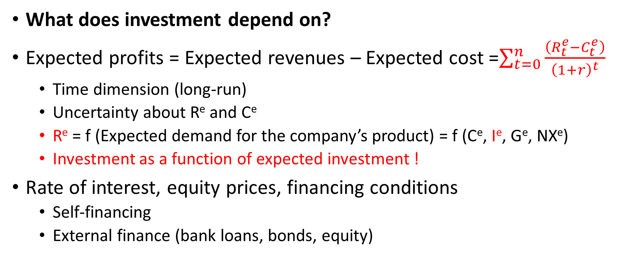
Understanding investment volatility
What does investment depend on?
Expected profits = Expected revenues – Expected cost =$\sum_{t=0}^{n}{\frac{\left(R_{t}^{e}−C_{t}^{e}\right)}{{\left(1+r\right)}^{t}}}$
  Time dimension (long-run)
  Uncertainty about R^{e} and Ce
  R^{e} = f (Expected demand for the company’s product) = f (Ce, Ie, G^{e}, NXe)
  Investment as a function of expected investment !
Rate of interest, equity prices, financing conditions
  Self-financing
  External finance (bank loans, bonds, equity)

Slide 7
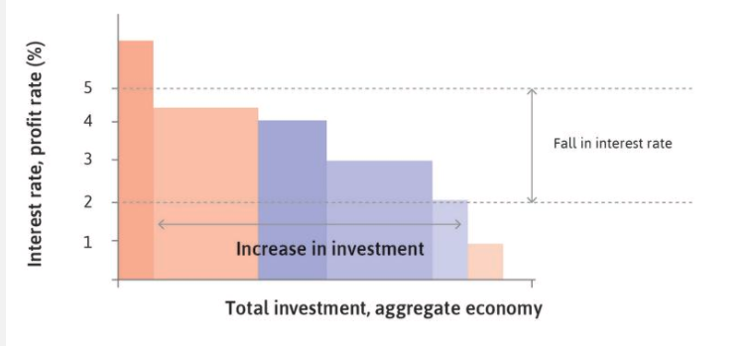
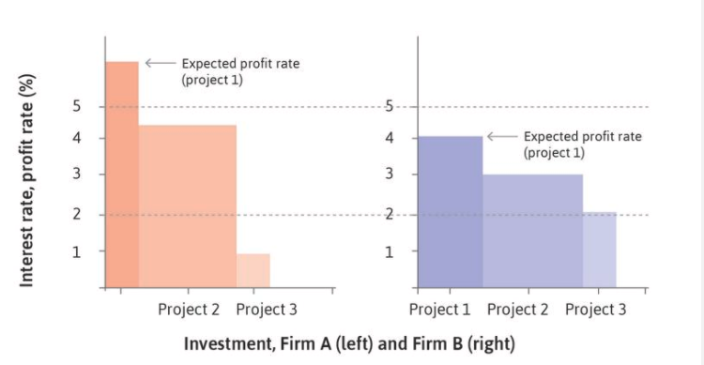
Understanding investment (2)

Slide 8
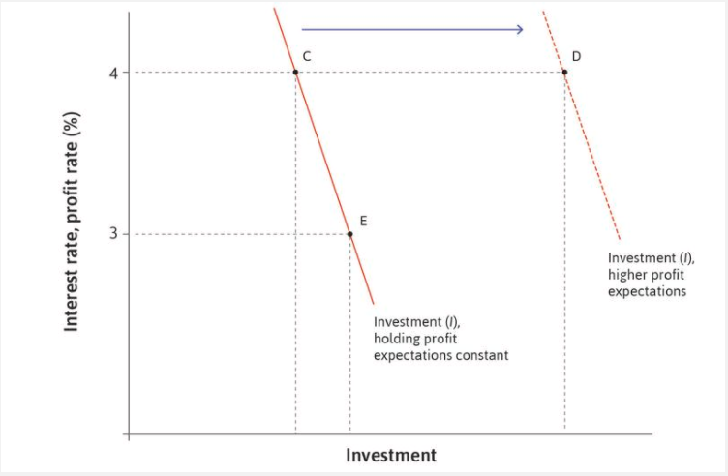
Understanding investment (3)

Slide 9
Understanding investment volatility
Capacity and capacity utilization (various sources)
  Installed productive capacity: the amount of productive resources (workforce, factories, etc.) present in a place that will enable an industry or industries to produce goods.
  Capacity utilisation is the extent to which a firm, an industry or a nation employs its installed productive capacity. It is the relationship between output that is produced with the installed equipment, and the potential output which could be produced with it, if capacity was fully used.
Obsolescence and technological progress
Competition (innovation and investment as competitive weapons)

Slide 10
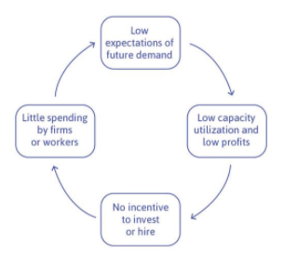
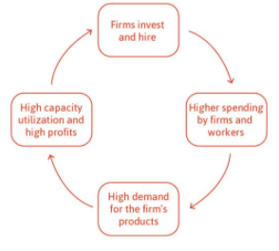
Expectations, capacity utilization, new investment

Slide 11
Expectations, capacity utilization, new investment (2)
These two circles highlight the role of expectations of future demand, which depend on the behaviour of other actors.
A game similar to those studied in Unit 4 can illustrate how to get out of the vicious circle and into the virtuous one. As in every game, we specify:
  The actors: The two firms.
  The actions that they can take: Invest, or do not invest.
  The information they have: They decide simultaneously, so they do not know what the other has done.
  The payoff: The profits resulting from each of the four pairs of actions that they could possibly take.

Slide 12
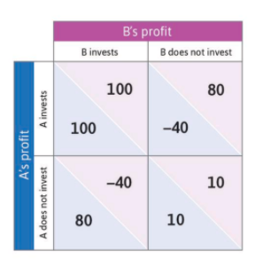
Expectations, capacity utilization, new investment (2)
From this figure you can see what happens when the virtuous (both invest) and vicious (neither invest) circles occur.
Note what happens if one of the firms invests but the other does not. If Firm A invests and B does not (the upper-right cell in the figure) then A pays to install new equipment and premises, but because the other firm did not invest there is no demand for the products that the new capacity could produce; so A makes a loss.
But had B known that A would invest, then B would have made higher profits by investing as well (getting 100 rather than only 80). On the other hand, had B known that A was not going to invest, then it would have done better to also not invest.
In this game, the two firms will do better if they do the same thing, and the best outcome is when both firms invest. This is another reason that investment tends to fluctuate a lot
Two Nash equilibria

Slide 13
How to break the vicious circle …
Joint ventures
Leader, follower
Publicly funded investment
Subsidies to invest
Tax incentives to invest
Monetary policy expansion
Foreign Direct Investment

Slide 14
Gross investment versus net investment
$K_{t}$= aggregate stock of capital at time t
$K_{t+1}$= aggregate stock of capital at time t+1
$I_{t}$= aggregate gross investment between of capital at time t
$δ$= Average capital depreciation rate 0 < $δ$ < 1
$δK_{t}$ = capital depreciation between t and t+ 1

Slide 15
Gross investment versus net investment
$K_{t+1}=\left(1−δ\right)K_{t}+I_{t}$
$K_{t+1}−K_{t}=I_{t}−δK_{t}$ Net investment
  K increases if $I_{t}>δK_{t}$
  $\text{K} \text{declines} \text{if} I_{t}<δK_{t}$
  $\text{K} \text{does} \text{not} \text{change} \text{if} I_{t}=δK_{t}$
NDP = GDP - $δK_{t}$

Slide 16
Homeworks
Section 13.7

