Slide 1
Macroeconomics
Lecture 16
21.05.24
Paolo Paesani
University of Rome Tor Vergata
Department of Economics and Finance

Slide 2
Economic shocks and their propagation
Closed economy, limited role for the government
AD = C + I (Aggregate spending)
GDP = AD = C + I
Causality: changes in AD → changes in GDP
Keynesian principle of effective demand: firms produce (and employ workers) on the basis of expected sales to households (consumption) or other companies (investment)
Sudden increases/falls in C and/or I (macroeconomic shocks) will affect GDP in the same direction

Slide 3
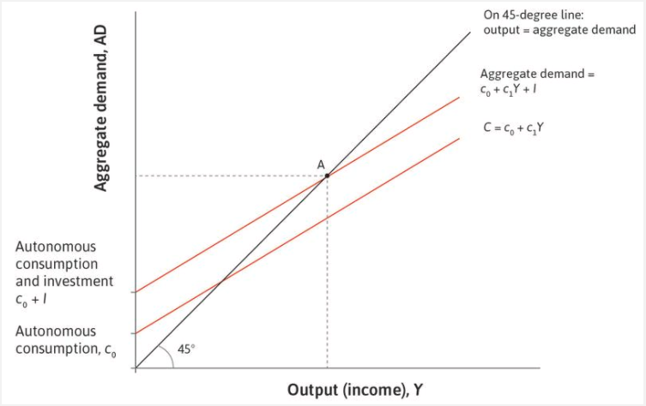
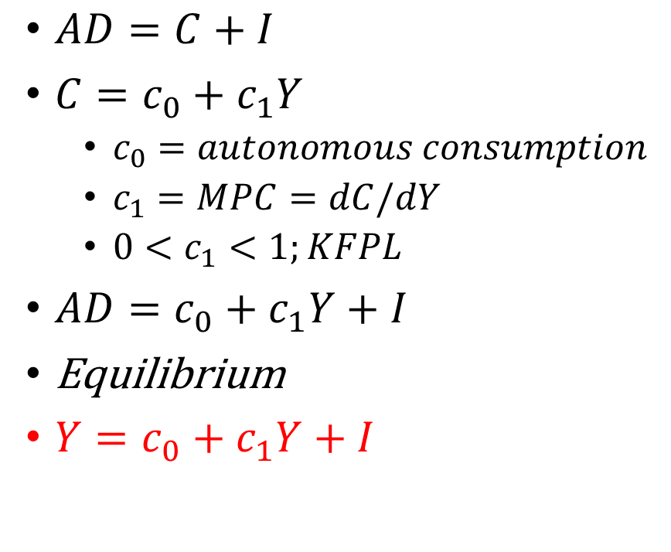
The multiplier model
$AD=C+I$
$C=c_{0}+c_{1}Y$
  $c_{0}=autonomous consumption$
  $c_{1}=MPC=dC/dY$
  $0<c_{1}<1;KFPL$
$AD=c_{0}+c_{1}Y+I$
Equilibrium
$Y=c_{0}+c_{1}Y+I$

Slide 4
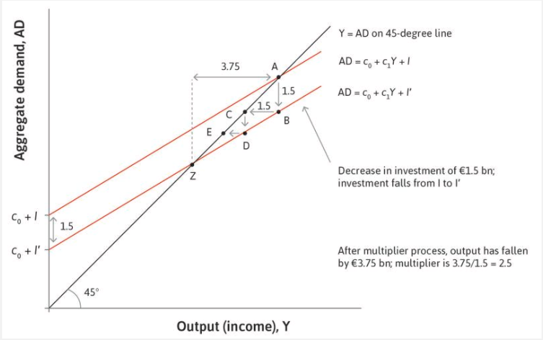
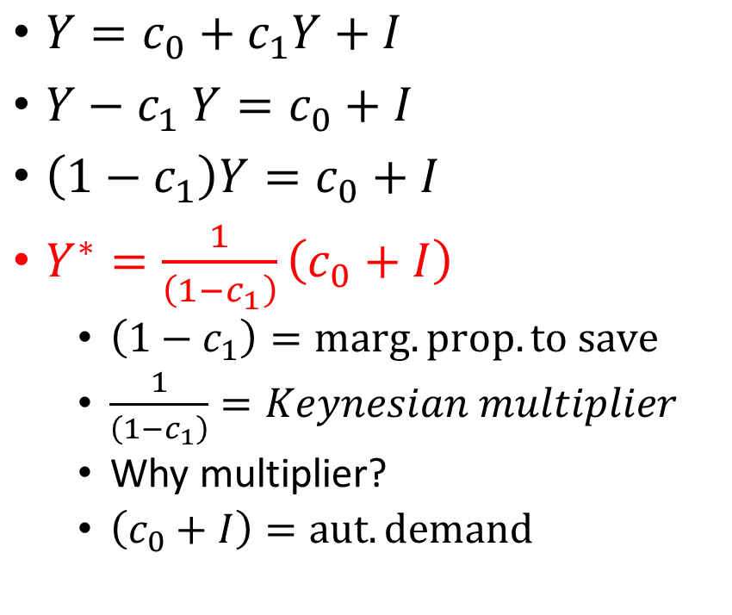
The multiplier model (2)
$Y=c_{0}+c_{1}Y+I$
$Y{− c}_{1}Y=c_{0}+I$
$\left(1−c_{1}\right)Y=c_{0}+I$
$Y^{∗}=\frac{1}{\left(1−c_{1}\right)}\left(c_{0}+I\right)$
  $\left(1−c_{1}\right)=marg. prop. to save$
  $\frac{1}{\left(1−c_{1}\right)}=Keynesian multiplier$
  Why multiplier?
  $\left(c_{0}+I\right)=aut. demand$

Slide 5
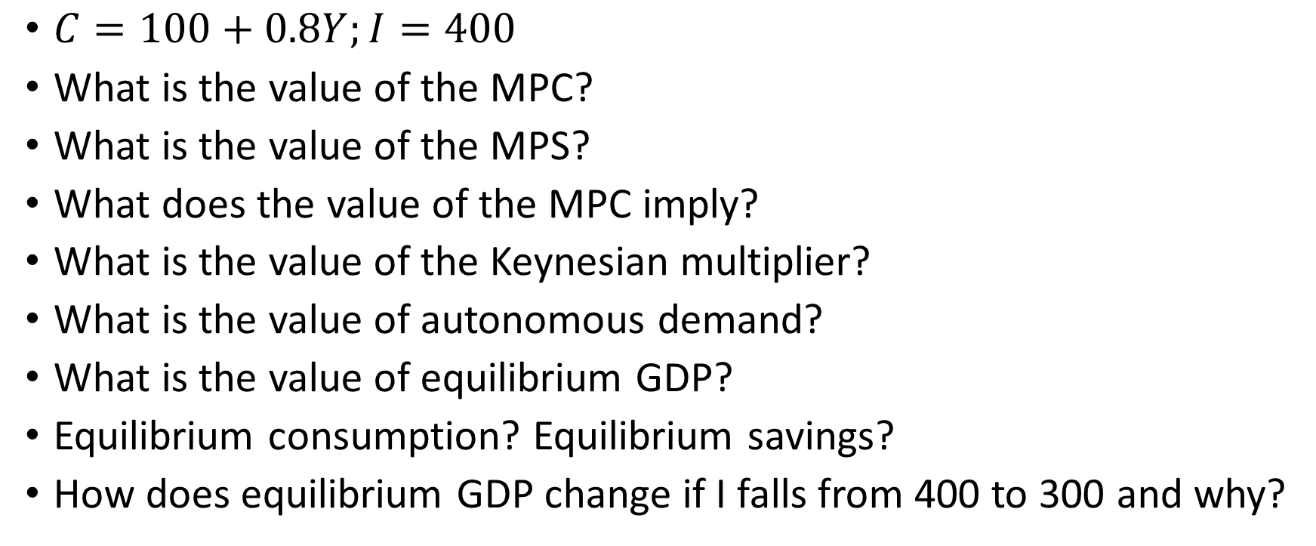
The multiplier model: flash exercise
$C=100+0.8Y;I=400$
What is the value of the MPC?
What is the value of the MPS?
What does the value of the MPC imply?
What is the value of the Keynesian multiplier?
What is the value of autonomous demand?
What is the value of equilibrium GDP?
Equilibrium consumption? Equilibrium savings?
How does equilibrium GDP change if I falls from 400 to 300 and why?

Slide 6
The multiplier model: solutions
What is the value of the MPC?
What is the value of the MPS?
What does the value of the MPC imply?
What is the value of the Keynesian multiplier?
What does the value of the multiplier imply?
What is the value of autonomous demand?
What is the value of equilibrium GDP?
Equilibrium consumption? Equilibrium savings?
How does equilibrium GDP change if I falls from 400 to 300 and why?

Slide 7
The multiplier model (3)
A fall in demand leads to a fall in production and an equivalent fall in income: This leads to a further (smaller) fall in demand, which leads to a further fall in production, and so on.
The multiplier is the sum of all these successive decreases in production: Eventually, output has fallen by a larger amount than the initial shift in demand. Output is a multiple of the initial shift.
Production adjusts to demand: Firms supply the amount of goods demanded at the prevailing price. When demand falls, firms adjust production down. The model assumes that they do not adjust their prices.

Slide 8
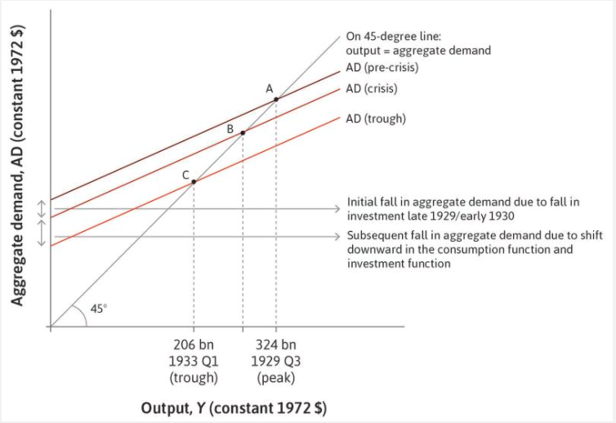
Impact of shocks on households:
↓I →↓Y→↓c_{o} →↓↓Y

Slide 9
Impact of shocks on households: ↓I →↓c_{o} →↓↓Y
Uncertainty: Uncertainty about the state of the economy provoked by the dramatic stock market crash of October 1929 made both firms and households more cautious, prompting them to postpone purchases of machinery and equipment and consumer durables.
Pessimism and the desire to save more: Households also became more pessimistic about their ability to maintain current levels of spending, as they feared unemployment and lower earnings in the future. Their assessment of their material wealth was also affected as the prices of houses and financial assets fell. The 1920s had seen a build-up of debt by households, as they were able to use instalment agreements for the first time to buy consumer durables.
The banking crisis and the collapse of credit: A third factor that shifted the aggregate demand line down to the level labelled ‘trough’ was the banking crisis of 1930 and 1931, which affected both consumption and investment. There was a wave of failures of small, weak, and largely unregulated banks across the US. The system of small banks was vulnerable to panic. Savers began to fear that they would not be able to get access to their deposits. As explained in Unit 10, as panic spread from bank to bank, bank runs affected the entire banking system. With the collapse of the banking system, households lost deposits and small firms lost their access to credit

Slide 10
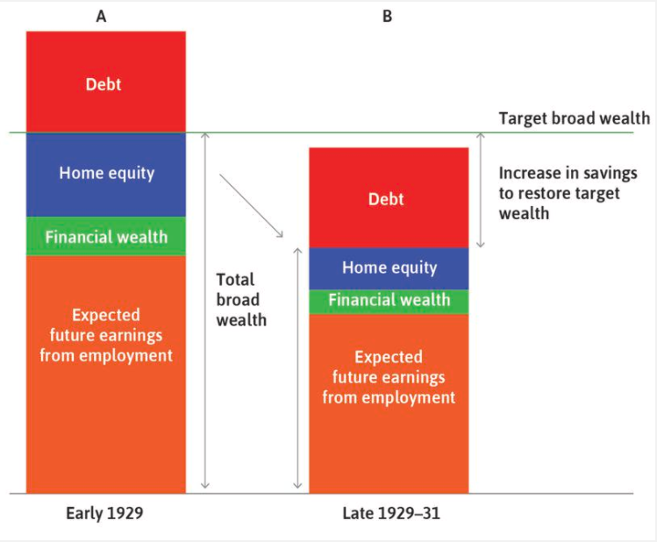
Impact of shocks on households: ↓I →↓c_{o} →↓↓Y

Slide 11
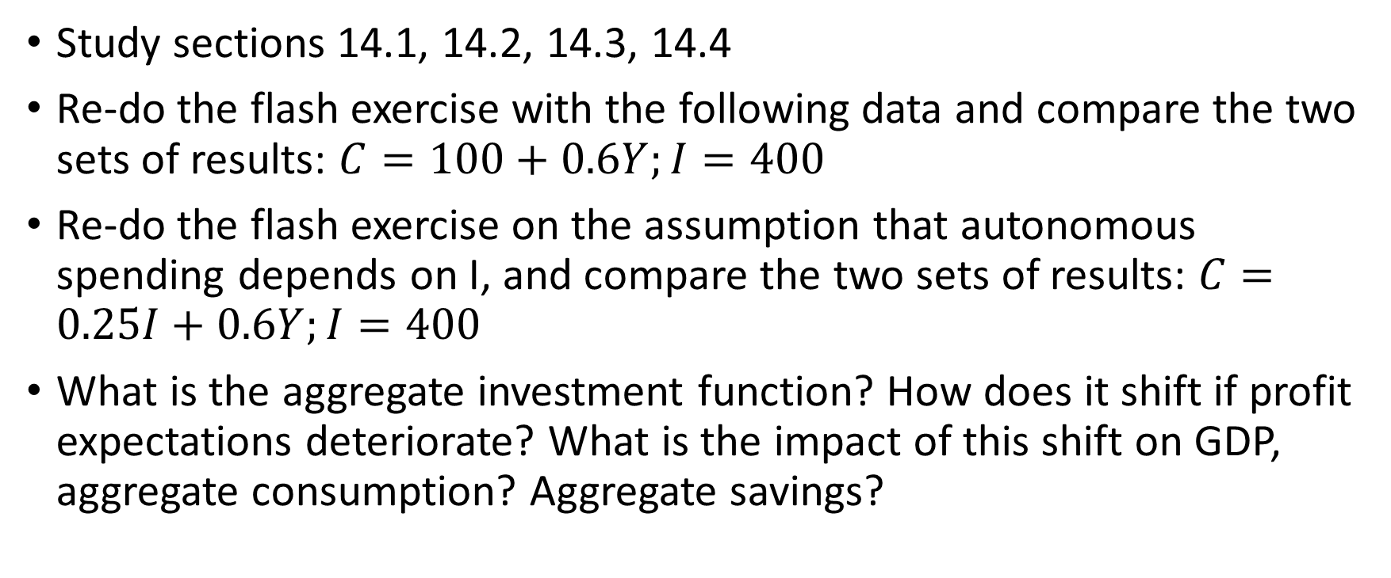
Homeworks
Study sections 14.1, 14.2, 14.3, 14.4
Re-do the flash exercise with the following data and compare the two sets of results: $C=100+0.6Y;I=400$
Re-do the flash exercise on the assumption that autonomous spending depends on I, and compare the two sets of results: $C=0.25I+0.6Y;I=400$
What is the aggregate investment function? How does it shift if profit expectations deteriorate? What is the impact of this shift on GDP, aggregate consumption? Aggregate savings?

Slide 12
The multiplier model including government and net exports
$Y=AD Equilibrium condition$
$AD=C+I+G+X−M Aggregate demand$
$C=c_{0}+c_{1}\left(1−t\right)Y Consumption function$
$I=I\left(r\right) Investment function$
$M=mY Import function$
$G and X exogenously given$

Slide 13
The consumption function
Household consumption spending depends on post-tax income. The government charges a tax t, which we assume is proportional to income. The income left after the payment of tax, (1 − t)Y, is called disposable income. The marginal propensity to consume, c₁, is the fraction of disposable income (not pre-tax income) consumed. This means that in the aggregate consumption function:
Spending on consumption is written as: C = c₀ + c₁(1 − t)Y.
All of the influences on consumption apart from current disposable income are included in autonomous consumption, c₀, and will therefore shift the consumption function in the multiplier diagram. These include wealth and target wealth, collateral effects, and changes in the interest rate.

Slide 14
The investment function
We have just seen that investment spending will be influenced by the interest rate and the expected post-tax rate of profit. In the aggregate investment function:
Spending on investment is a function of the interest rate and the expected post-tax rate of profit.
Ceteris paribus, a higher interest rate reduces investment spending, shifting down the aggregate demand curve.
A higher expected post-tax rate of profit raises investment spending, shifting up the aggregate demand curve.

Slide 15
Government budget balance
The government budget balance is the difference between government revenue less transfers, T, and government spending, G, that is, (T − G). As we have seen, if the economy is in recession, government transfers, like unemployment benefits, rise while tax revenues fall, so the government’s budget balance deteriorates and may become negative.
When the government’s budget balance is negative, this is called a government budget deficit government spending on goods and services, including investment spending, plus spending on transfers (such as pensions and unemployment benefits) is greater than government tax revenue. A government budget surplus is when tax revenue is greater than government spending. To summarize:
Budget in balance: G = T
Budget deficit: G > T
Budget surplus: G < T
The worsening of the government’s budgetary position in a recession is part of its stabilizing role. Conversely, when the government chooses to override the stabilizers to reduce its deficit, this may amplify fluctuations in the economy.

Slide 16
Net exports
The home economy sells goods and services abroad, which are its exports. The amount of foreign goods the home economy demands (its imports) will depend on domestic incomes. The fraction of each additional unit of income that is spent on imports is termed the marginal propensity to import (m), which must be between 0 and 1. So we have: net exports=𝑋−𝑀=𝑋−𝑚𝑌
If a country’s costs of production fall so that it can sell its goods at a lower price on world markets compared to the prices of other countries, the demand for its exports will increase, and domestic demand for imports will fall.

Slide 17
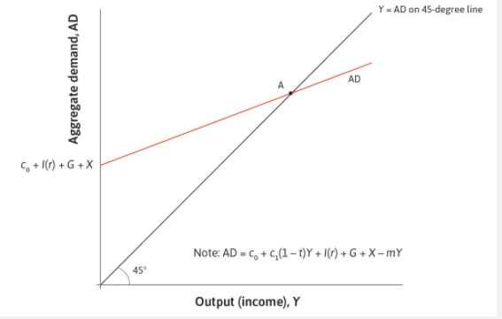
The multiplier model including government and net exports
$Y=C+I+G+X−M$
$C=c_{0}+c_{1}\left(1−t\right)Y$
$I=I\left(r\right)$
$M=mY$
Equilibrium
$Y=c_{0}+c_{1}\left(1−t\right)Y+I\left(r\right)+G+X −mY$
$Y−c_{1}\left(1−t\right)Y+mY=c_{0}+I\left(r\right)+G+X$
$Y[1−c_{1}\left(1−t\right)+m]=c_{0}+I\left(r\right)+G+X$
$Y^{∗}=\frac{1}{1−c_{1}\left(1−t\right)+m}\left[c_{0}+I\left(r\right)+G+X\right]$

Slide 18
Comparing multipliers
Closed economy, no taxation $multiplier=\frac{1}{1−c_{1}}$
Open economy, taxation$multiplier=\frac{1}{1−c_{1}\left(1−t\right)+m}<\frac{1}{1−c_{1}}$
A higher marginal propensity to import reduces the size of the multiplier: This makes the aggregate demand curve flatter.
An increase in the tax rate reduces the size of the multiplier: This makes the aggregate demand curve flatter.

Slide 19
The multiplier model: flash exercise
$C=100+0.8(1−0.25)Y;I=400;G=100;X=300;M=0.2Y$
What is the tax rate?
What is the value of the MPC? What is the value of the MPS?
What does the value of the MPC imply?
What is the value of the Keynesian multiplier?
What is the value of autonomous demand?
What is the value of equilibrium GDP?
Equilibrium consumption? Equilibrium savings? Equilibrium imports?
Government budget balance? Int.l trade balance?
How does equilibrium change if X falls from 300 to 250 and why?

Slide 20
The multiplier model: solutions
What is the tax rate?
What is the value of the MPC?
What is the value of the MPS?
What is the value of the Keynesian multiplier?

Slide 21
The multiplier model: solutions
What is the value of autonomous demand?
What is the value of equilibrium GDP?
Equilibrium consumption?
Equilibrium savings?
Equilibrium imports?
Equilibrium budget balance (G – T)?

Slide 22
The multiplier model: solutions
How does equilibrium change if X falls from 300 to 250 and why?
Impact on GDP will be?
New equilibrium GDP will be = 1.503 – 83.5=1.419,5
If GDP falls in response to the fall in Exports, this implies that
1) Private consumption = ???
2) Private savings = ???
3) Tax revenues = ???
4) The government budget balance = ???
5) Trade balance = ???

Slide 23
The stabilizing role of the government
The size of government: Unlike private investment, government spending on consumption and investment is usually stable. Spending on health and education, which are the two largest government budget items in most countries, does not fluctuate with capacity utilization or with business confidence. These kinds of government spending stabilize the economy. As we have also seen, a higher tax rate dampens fluctuations because it reduces the size of the multiplier.
The government provides unemployment benefits: Although households save to smooth fluctuations in income, few households save enough (that is, self-insure) to cope with an extended period of unemployment. So unem­ployment benefits help households to smooth consumption. Other pro­grams to redistribute income to the poor have the same smoothing effect.
The government can intervene: It can intervene deliberately to stabilize aggregate demand using fiscal policy.

