Slide 1
Macroeconomics
Lecture 17
22.05.24
Paolo Paesani
University of Rome Tor Vergata
Department of Economics and Finance

Slide 2
The stabilizing role of the government
The size of government: Unlike private investment, government spending on consumption and investment is usually stable. Spending on health and education, which are the two largest government budget items in most countries, does not fluctuate with capacity utilization or with business confidence. These kinds of government spending stabilize the economy. As we have also seen, a higher tax rate dampens fluctuations because it reduces the size of the multiplier.
The government provides unemployment benefits: Although households save to smooth fluctuations in income, few households save enough (that is, self-insure) to cope with an extended period of unemployment. So unem­ployment benefits help households to smooth consumption. Other pro­grams to redistribute income to the poor have the same smoothing effect.
The government can intervene: It can intervene deliberately to stabilize aggregate demand using fiscal policy.

Slide 3
Unemployment benefits: automatic stabilizers
↓I, ↓ X→↓Y→↑unempl→↑GTR→↑c₀ →↑Y
Could workers insure privately against job loss? There are also three reasons why the private market fails, and therefore governments provide unemployment insurance in the form of unemployment benefits:
Correlated risk: In a recession, job loss will be widespread. This means that there will be a surge in insurance claims across the economy and a private provider may be unable to pay out on the scale required.
Insurance companies cannot observe the reason for the job loss so they would have to insure the employee against a firm cutting back employment due to lack of demand, as well as the worker being fired for inadequate work. This creates a moral hazard, because a well-insured person is expected to make less of an effort on the job.
Suppose you learn that your firm is in difficulty, but the insurance company does not. This is another example of asymmetric information. You will therefore buy insurance when you learn of the likely closure of the firm, and it will be provided at good rates because the insurance company does not know that you are likely to make a claim on them. Workers who know their firm is performing well will not buy insurance.

Slide 4
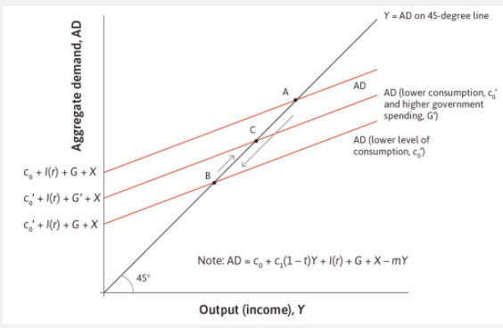

Slide 5
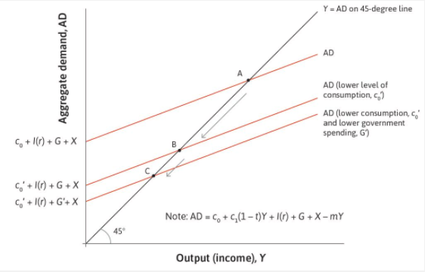
Destabilizing fiscal policy
↓I→↓Y →↓Tax=tY →↑(G-T) →↓G →↓↓Y

Slide 6
Observations about the multiplier
When we apply the model to the real world, it is important to realize that there is no single multiplier that applies at all times.
1/(1-c1); 1/[1-c1(1-t) +m]
Full capacity level? In the short run, K is given, land is given, to a certain extent Labour force is given but level of use varies in the short run
The multiplier will be a different size if the economy is operating at full capacity utilization and low unemployment than in a recession. With fully employed resources, a 1% increase in government spending would displace some private spending (crowding out) […] We would not normally expect a government to undertake a fiscal expansion when unemployment is very low.
The size of the multiplier will also depend on the expectations of firms and businesses. Households and firms react to policy changes, but they also anticipate them. For example, if firms anticipate that the government will stabilize the economy following a negative shock, this will support business confidence, and the policymaker will be able to use a smaller stimulus. Alternatively, if households think that higher government spending will be followed by higher taxes, those who have the ability to save may put aside more of their money to pay the extra taxes. If this happened, it would reduce the impact of the stimulus.

Slide 7
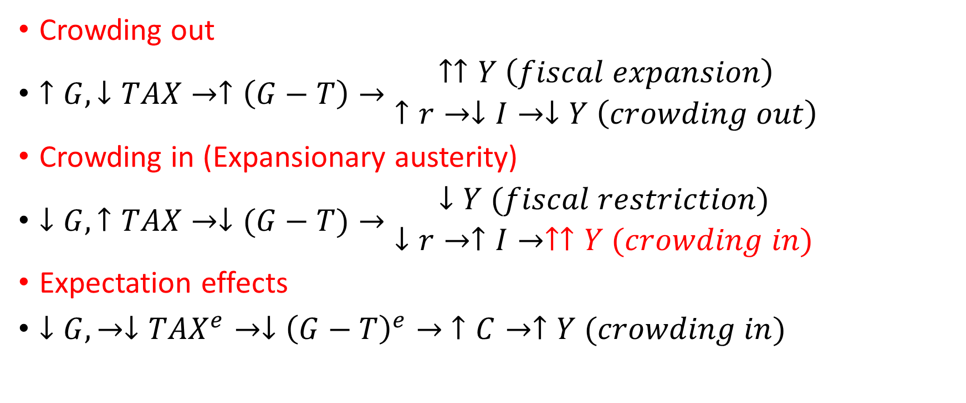
Observations about the multiplier
Crowding out
$↑G,↓TAX→↑\left(G−T\right)→\begin{matrix}↑↑Y \left(fiscal expansion\right) \\ ↑r→↓I→↓Y \left(crowding out\right)\end{matrix}$
Crowding in (Expansionary austerity)
$↓G,↑TAX→↓(G−T)→\begin{matrix}↓Y (fiscal restriction) \\ ↓r→↑I→↑↑Y (crowding in)\end{matrix}$
Expectation effects
$↓G,→↓{TAX}^{e}→↓{\left(G−T\right)}^{e}→$ $↑C→↑Y (crowding in)$

Slide 8
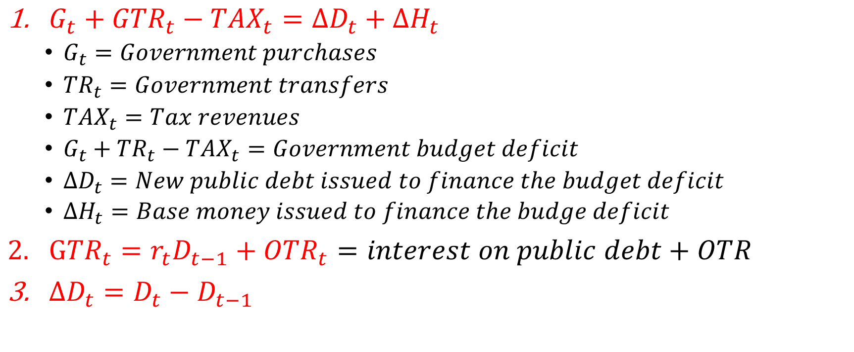
The government’s finance
$G_{t}+{GTR}_{t}−{TAX}_{t}=∆D_{t}+∆H_{t}$
  $G_{t}=Government purchases$
  ${TR}_{t}=Government transfers$
  ${TAX}_{t}=Tax revenues$
  $G_{t}+{TR}_{t}−{TAX}_{t}=Government budget deficit$
  $∆D_{t}=New public debt issued to finance the budget deficit$
  $∆H_{t}=Base money issued to finance the budge deficit$
$G{TR}_{t}=r_{t}D_{t−1}+{OTR}_{t}=interest on public debt+OTR$
$∆D_{t}=D_{t}−D_{t−1}$

Slide 9
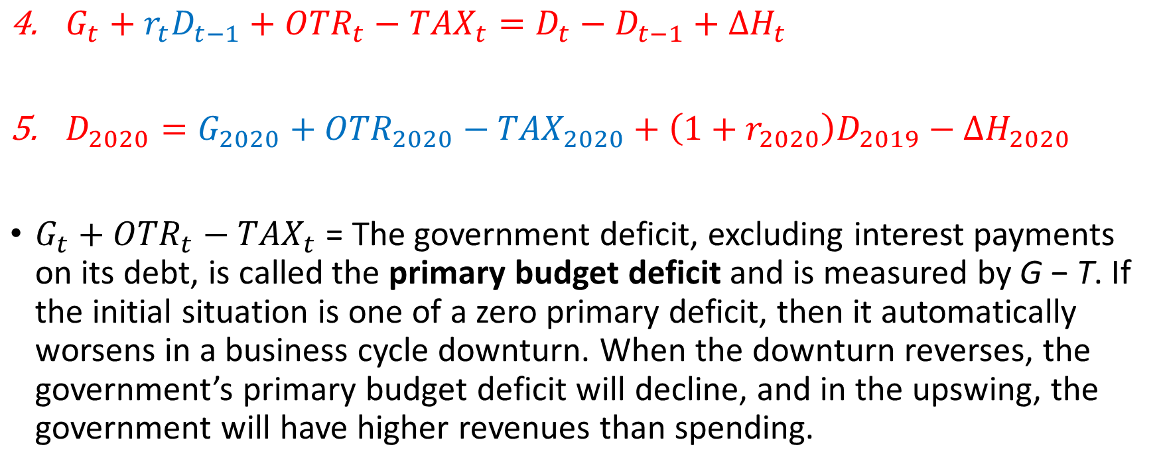
The government’s finance (2)
$G_{t}+r_{t}D_{t−1}+{OTR}_{t}−{TAX}_{t}=D_{t}−D_{t−1}+∆H_{t}$
$D_{2020}=G_{2020}+{OTR}_{2020}−{TAX}_{2020}+\left(1+r_{2020}\right)D_{2019}−∆H_{2020}$
$G_{t}+{OTR}_{t}−{TAX}_{t}$ = The government deficit, excluding interest payments on its debt, is called the primary budget deficit and is measured by G − T. If the initial situation is one of a zero primary deficit, then it automatically worsens in a business cycle downturn. When the downturn reverses, the government’s primary budget deficit will decline, and in the upswing, the government will have higher revenues than spending.

Slide 10
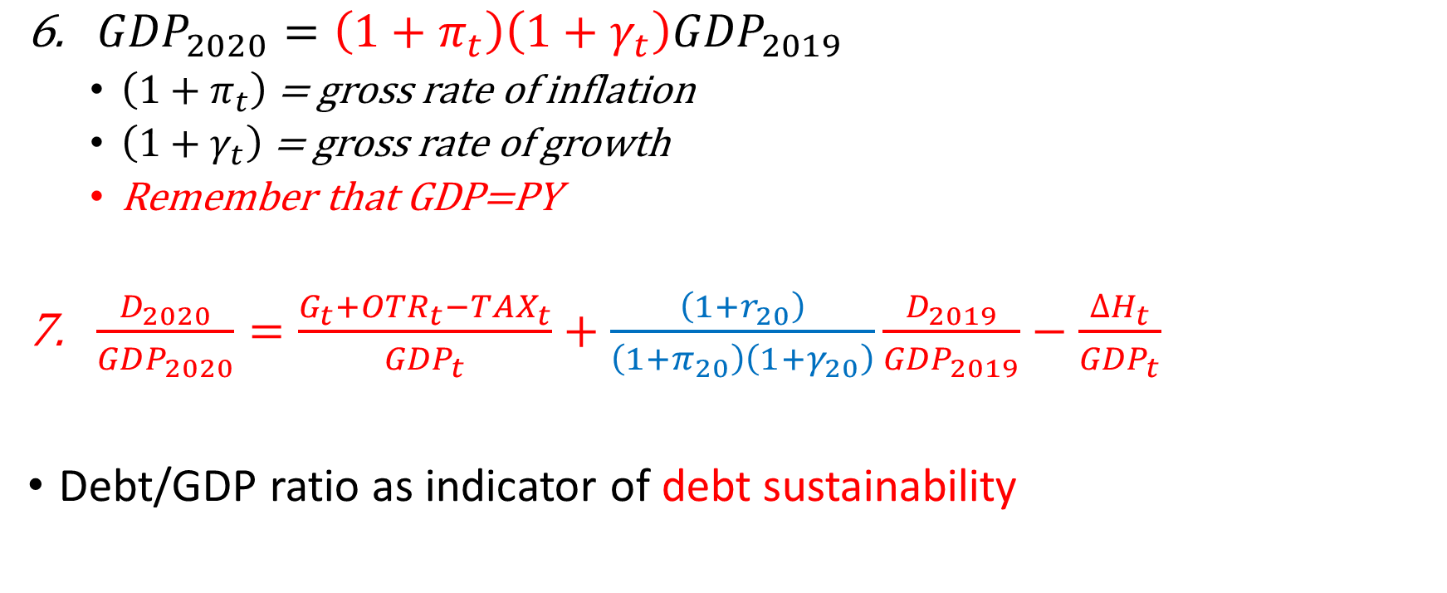
The government’s finance (3)
${GDP}_{2020}=\left(1+π_{t}\right)\left(1+γ_{t}\right){GDP}_{2019}$
  $\left(1+π_{t}\right)$ = gross rate of inflation
  $\left(1+γ_{t}\right)$ = gross rate of growth
  Remember that GDP=PY
$\frac{D_{2020}}{{GDP}_{2020}}=\frac{G_{t}+{OTR}_{t}−{TAX}_{t}}{{GDP}_{t}}+\frac{\left(1+r_{20}\right)}{\left(1+π_{20}\right)\left(1+γ_{20}\right)}\frac{D_{2019}}{{GDP}_{2019}}−\frac{∆H_{t}}{{GDP}_{t}}$
Debt/GDP ratio as indicator of debt sustainability

Slide 11
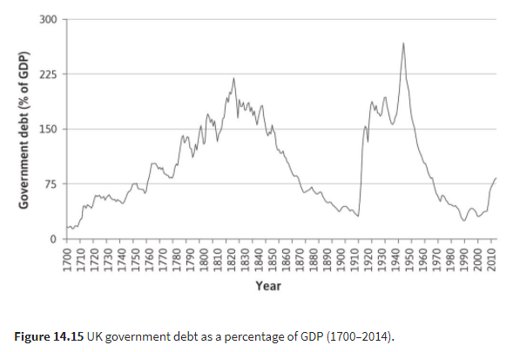

Slide 12
Policy to reduce the DEBT/GDP ratio
Primary surplus policy
  ↓G*, ↑TAX
  Benefits: full controllability, immediate effects, reduced risk premium
  Drawbacks: ↓GDP growth and employment
Unexpected inflation
  ↑ π
  Benefits: Fee from inflation, immediate and wide-ranging effects
  Drawbacks: Impoverishment of savers, allocative distortion, other negative effects of inflation (Ch. 6)

Slide 13
Policy to reduce the DEBT/GDP ratio, 2
Public debt management policy
  Advantages: Lasting effects, boosts investor confidence, promotes a reduction in the liquidity premium
  Drawbacks: Requires time and the 'assistance' of financial markets
Growth
  ↑ γ
  Advantages: Lasting effects, relieves debt burden and improves living standards
  Drawbacks: Time required, Difficulties
Financial repression (e.g. compulsory underwriting)

Slide 14
Public debt sustainability
Debt/GDP as an indicator of sustainability
Issues: Duration of debt? Level of tax burden? Stock / flow ratio?
Better to measure sustainability through Public Debt/Public assets? (but Public assets are not liquid and then the state is not an enterprise)?
Better to measure sustainability through Public Debt/Public assets? Public debt/Private Wealth (Private Wealth are not all liquid or easily measurable, wealth tax is complicated)
Better to measure sustainability in terms of INT/GDP ratio?
What about pension debt?
What about the intertemporal state budget constraint?

Slide 15
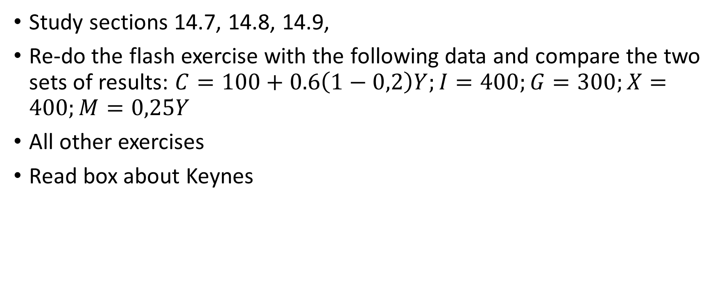
Homeworks
Study sections 14.7, 14.8, 14.9,
Re-do the flash exercise with the following data and compare the two sets of results: $C=100+0.6\left(1−0,2\right)Y;I=400;G=300;X=400;M=0,25Y$
All other exercises
Read box about Keynes

