Slide 1
Macroeconomics
Lecture 18
23.05.24
Paolo Paesani
University of Rome Tor Vergata
Department of Economics and Finance

Slide 2
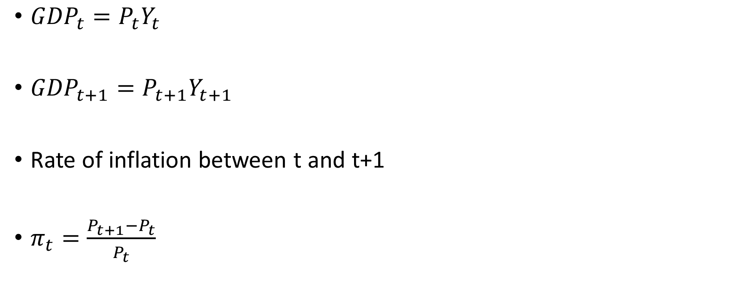
Defining inflation
${GDP}_{t}=P_{t}Y_{t}$
${GDP}_{t+1}=P_{t+1}Y_{t+1}$
Rate of inflation between t and t+1
$π_{t}=\frac{P_{t+1}−P_{t}}{P_{t}}$

Slide 3
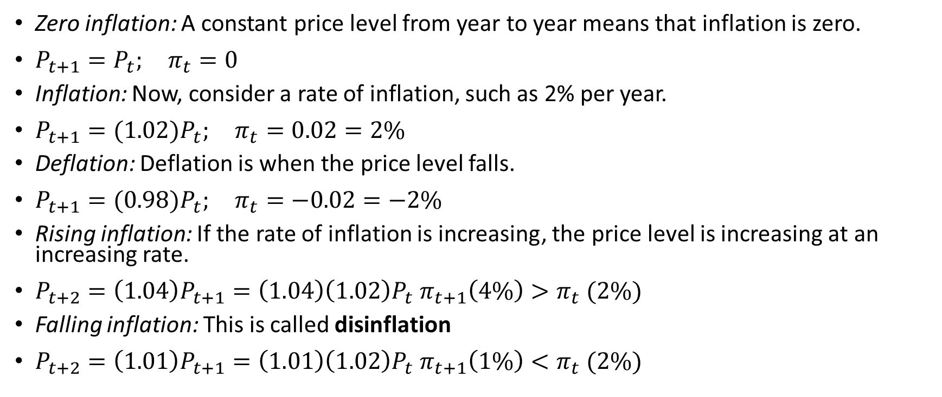
Defining inflation (2)
Zero inflation: A constant price level from year to year means that inflation is zero.
$P_{t+1}=P_{t}; π_{t}=0$
Inflation: Now, consider a rate of inflation, such as 2% per year.
$P_{t+1}={(1.02)P}_{t}; π_{t}=0.02=2\%$
Deflation: Deflation is when the price level falls.
$P_{t+1}={(0.98)P}_{t}; π_{t}=−0.02=−2\%$
Rising inflation: If the rate of inflation is increasing, the price level is increasing at an increasing rate.
${P_{t+2}={\left(1.04\right)P}_{t+1}={\left(1.04\right)\left(1.02\right)P}_{t} π}_{t+1}\left(4\%\right)>π_{t} (2\%)$
Falling inflation: This is called disinflation
${P_{t+2}={\left(1.01\right)P}_{t+1}={\left(1.01\right)\left(1.02\right)P}_{t} π}_{t+1}\left(1\%\right)<π_{t} (2\%)$

Slide 4
Costs and benefits of inflation
Who loses | Who gains
People living on fixed incomes in nominal terms (employees earning wages, pensioners earning pensions) | People living on incomes, which are not fixed in nominal terms and change with inflation (self-employed people, companies)
Lenders with nominal assets: Banks or others who have loaned money at fixed nominal interest rates will lose, because when the sum is repaid it will be worth less in terms of the goods or services it can buy. | Borrowers with nominal debt : Those with mortgages on fixed nominal interest rate loans, for example, will benefit from inflation, because the debt stays the same in nominal terms, and so becomes smaller in real terms.
Domestic exporters and Foreign importers | Domestic importers and fomestic exporters
Consumers, savers | Companies, the State (big borrower)
Observation:
Nominal wage = W, real wage = W/P, If W is given and P rises, W/P declines unless indexation
Nominal rate of interest = i, real rate = r = i - π, If P rises, r < i unless indexation
Moderate inflation vs. High inflation
Effects of deflation

Slide 5
Costs and benefits of inflation (2)
In an environment of high and volatile inflation, it is hard to separate the signal about the scarcity of resources (sent by relative prices) from the noise of erratically rising prices. Firms might find it harder to know which sector to invest in, or which crop would be better to plant (quinoa or barley, for example); individuals would find it harder to decide whether quinoa has become more expensive relative to other sources of protein. Moreover, in an inflationary environment, firms have to update their prices more frequently than they would prefer. This requires time and resources, referred to as menu costs.
Would households and firms be better off with falling prices? No. A sustained fall in the price level is undesirable for many of the same reasons that inflation is undesirable, and could have even more dramatic economic consequences. When prices are falling, households will postpone consumption (particularly of expensive items such as fridges, televisions, and cars) because they expect goods will be cheaper in the future. Similarly, deflation increases the debt burden of borrowers, for the same reason that inflation reduces it.

Slide 6
Costs and benefits of inflation (3)
Many economists think that a little bit of inflation is a good thing, as long as it remains stable. In the next unit we will see one reason why this is the case.
The process of innovation and change that characterizes a dynamic economy means that, in any given year, workers in some firms and sectors will be more in demand than in others. With rising prices, a fall in real income among the losers may be masked by the fact that nominal incomes are rising, or at least not falling.
For example, many people will not even notice a slight fall in their real wage due to modest inflation, but nobody would fail to notice a reduction in his or her nominal wage. With some low inflation, the adjustment of workers and resources between different firms and industries in response to changes in relative wages can take place without losers experiencing falling nominal wages. Inflation greases the wheels of the labour market.

Slide 7
Inflation and the distributive conflict
Economic environment
HR departments set wages in nominal terms ans s the price level is given, in real terms as well.
Marketing departments set individual prices based on nominal wages and mark-up
Firms are endowed with market power and are powerful enough to charge a higher markup, if the environment in which they operate makes it possible to do so.
Workers at the given unemployment rate have enough bargaining power to require the initial real wage in order to motivate them to work. If prices rise, workers will respond by requesting higher wages.

Slide 8
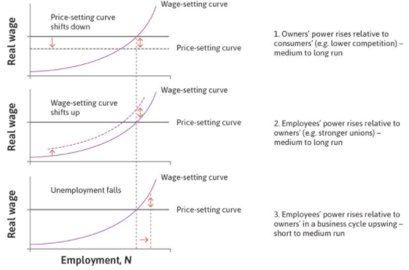
Causes of inflation
↑ bargaining power of employers
Cost-push
inflation
Demand-pull inflation

Slide 9
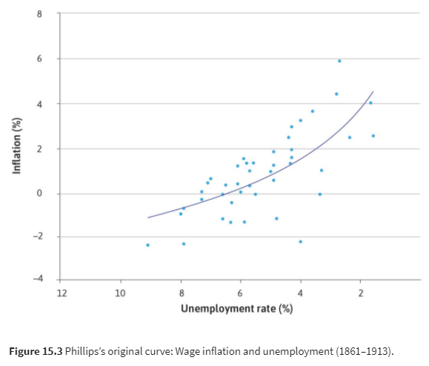
The Phillips curve

Slide 10
The Phillips curve (2)
When unemployment is low, the HR department needs to set higher wages: The cost of job loss is low and workers expect higher real wages if they are to work effectively.
Higher wages mean higher costs for firms: The marketing department will raise prices to cover the higher costs. As long as competitive conditions have not changed, the firm’s markup will be unchanged.
The price level will have gone up: Once all firms in the economy have set higher prices, the economy has experienced wage and price inflation. And real wages have not increased: the percentage increase in W equals the percentage increase in P, so W/P is unchanged.

Slide 11
The Phillips curve (3)
What happens next? We assume that aggregate demand remains high enough to keep unemployment below the labour market equilibrium.
At the next annual round of wage-setting, the HR department is in the same position as the previous year: with continuing low unemployment, workers are disappointed with their real wage.
It must raise nominal wages. When costs go up, the marketing department raises prices once more. This is called the wage-price spiral. It explains why, at low unemployment, the price level rises, not just in the year that unemployment fell, but year after year.
If there is a recession instead of a boom, the wage-price spiral operates in reverse, and the price level falls year after year.

Slide 12
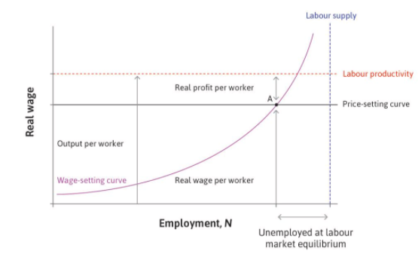
Equilibrium in the labour market a price stability
We will see that when the labour market is in equilibrium (the normal phase of the business cycle), there is no pressure for wages and prices to change. In Figure 15.4a, it is only at point (A), where the real wage on the wage-setting curve coincides with the real wage on the price-setting curve, that the labour market is at a Nash equilibrium. At this point both workers and firms are doing the best that they can, given the actions of the other.
At A, the claims of owners for profits and of workers for wages add up exactly to the size of the pie (the sum of the double-headed arrows showing the profits per worker and real wages is equal to output per worker, which is shown by the red dashed line). This means that the HR department will have no reason to raise wages, and with no increase in costs, the marketing department will keep prices unchanged. The real wage will remain constant and no one will be disappointed.

Slide 13
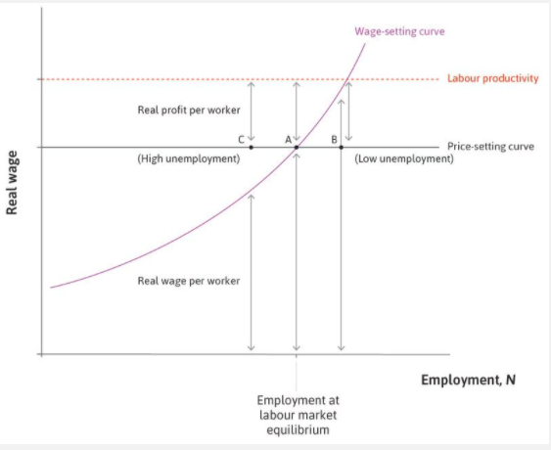
Disequilibrium in the labour market a price instability
If unemployment is lower than at the equilibrium: There is a positive bargaining gap and there is inflation.
If unemployment is higher than at the equilibrium: There is a negative bargaining gap and there is deflation.
If there is labour market equilibrium: The bargaining gap is zero and the price level is constant.

Slide 14
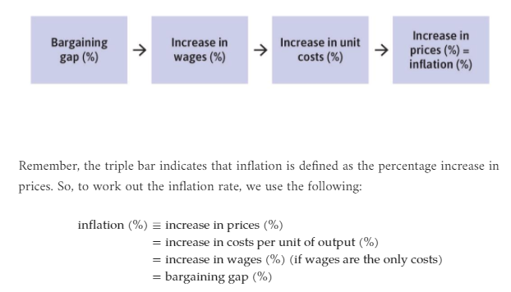
Disequilibrium in the labour market a price instability

Slide 15
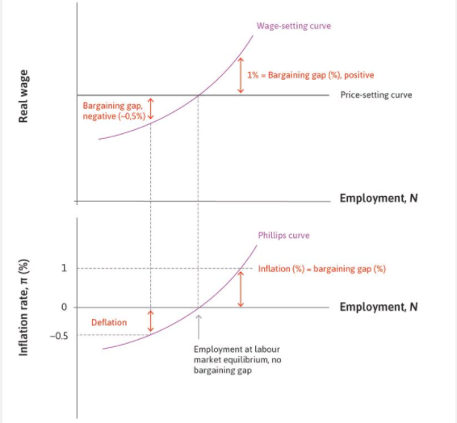
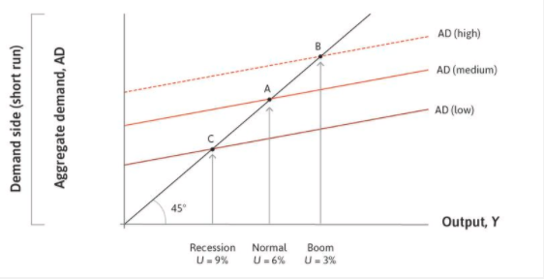
B
A
C
B
A
C

