Slide 1
Macroeconomics
Lecture 19
28.05.24
Paolo Paesani
University of Rome Tor Vergata
Department of Economics and Finance

Slide 2
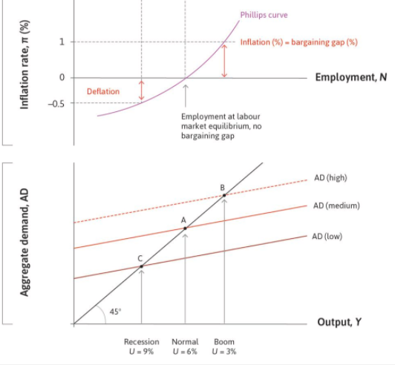
The Phillips curve as the policymaker’s feasible set
Phillips’ original curve suggests that there is a lasting trade-off between inflation and unemployment.
For example, if the government is happy to have inflation of 1% each year, then it can support a boom level of aggregate demand with an unemployment rate of 3% year after year.
If it prefers stable prices (zero inflation), then it needs to keep aggregate demand at the normal level, with unemployment of 6%.
This suggests that the Phillips curve is a feasible set from which the policymaker can select the desired combination of unemployment and inflation. The policymaker prefers low inflation and high employment, and those preferences can be represented in the usual way in the form of indifference curves.

Slide 3
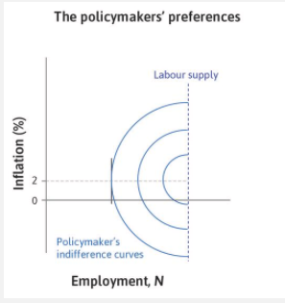
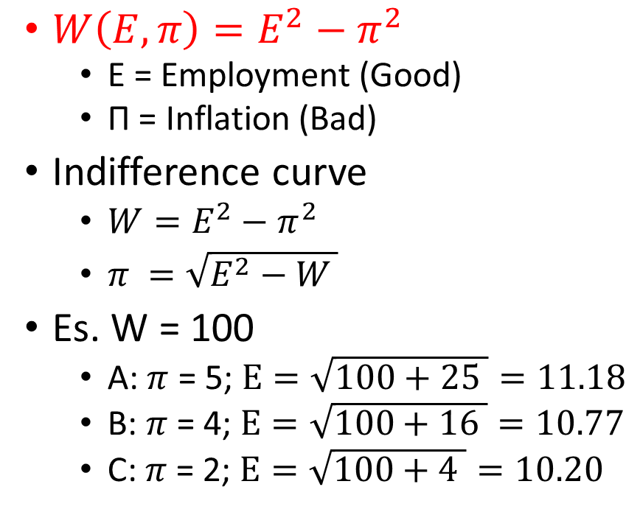
The policymaker’s preferences
$W\left(E,π\right)=E^{2}−π^{2}$
  E = Employment (Good)
  Π = Inflation (Bad)
Indifference curve
  $W=E^{2}−π^{2}$
  $π =\sqrt{E^{2}−W }$
Es. W = 100
  A: $π$ = 5; $E=\sqrt{100+25 }=11.18$
  B: $π$ = 4; $E=\sqrt{100+16 }=10.77$
  C: $π$ = 2; $E=\sqrt{100+4 }=10.20$
A
W = 100
B
W = 200
C
Bliss point

Slide 4
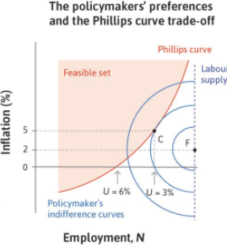
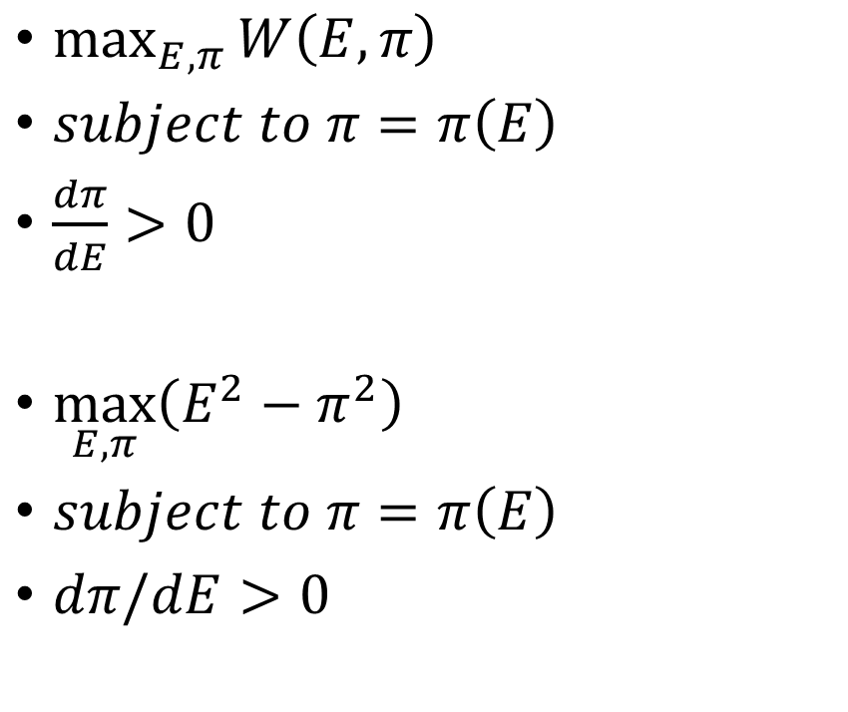
The policymaker’s problem
$\max_{E,π}{W\left(E,π\right)}$
$subject to π=π\left(E\right)$
$\frac{dπ}{dE}>0$
$\max_{E,π}\left(E^{2}−π^{2}\right)$
$subject to π=π\left(E\right)$
$dπ/dE>0$

Slide 5
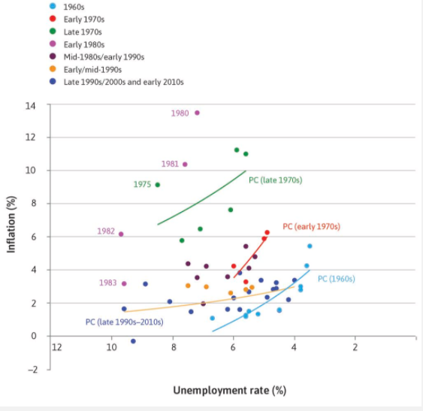
What happened to the Phillips curve?
In his presidential address to the American Economic Association in December 1967, Milton Friedman provided an explanation for why the Phillips curve is not stable.
He referred to the recent experience in the US. Since 1966 unemployment had been steady, averaging 3.7%, but inflation had increased from 3.0% to 4.2%. He said that the only way unemployment could be kept as low as 3% was by allowing inflation to keep increasing: ‘There is always a temporary trade-off between inflation and unemployment; there is no permanent trade-off,’ he claimed.
If there is no permanent trade-off, then the Phillips curve is not a feasible set in the same way as the feasible consumption frontier was: the feasible consumption frontier stays in place when a different point on it is chosen.
By contrast, Friedman, supported by evidence from many countries from the late 1960s, showed that if a government tries to keep unemployment ‘too low’ the result will be not just higher inflation, but rising inflation as well.

Slide 6
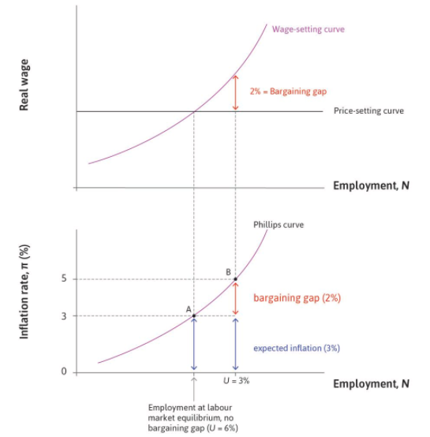
Introducing inflation expectations
We introduce the role of expected inflation by returning to the Phillips curve. Look at Figure 15.7.
You will notice that at the labour market equilibrium with an unemployment rate of 6%, the inflation rate is 3% and not zero as in Figure 15.4d.
If wage- and price-setters expect prices to rise by 3% per annum, and the level of aggregate demand is ‘normal’ and keeps unemployment at 6%, then the economy can remain at the labour market equilibrium with inflation remaining constant at 3% per annum.
Every year, wages and prices will rise by 3% and the real wage will remain at the intersection of the wage- and price-setting curves. This is point A.

Slide 7
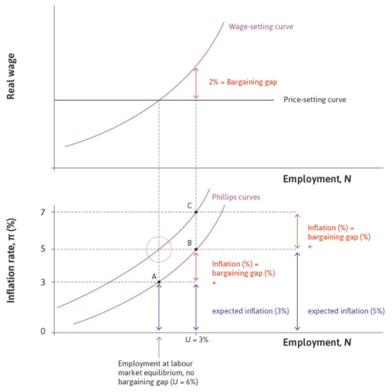
Introducing inflation expectations (2)
Now consider a boom, which takes the economy to lower unemployment at point B.
What will happen to inflation? Workers expect prices to rise by 3% and will require a nominal wage increase of 3% just to keep their real wage un­changed. But they require an additional 2% rise to give them an expected real wage rise on the wage-setting curve, so wages increase by 5%.
With their costs rising by 5%, firms will increase prices by 5%. In the boom, inflation will be 5%. This gives a Phillips curve like the one we have seen before. The only differ­ence is that inflation at labour market equilibrium is 3% rather than zero.

Slide 8
Supply and demand shocks
Friedman was correct in two ways:
Expected inflation shifts the Phillips curve.
Policymakers were wrong to think of the Phillips curve as a feasible set from which they could simply select the most electorally popular combination of inflation and unemployment.
But there are other causes of high and rising inflation.
The Phillips curve will shift up if the price-setting curve shifts down or the wage-setting curve shifts up. Recall Figure 15.2: if the power of owners of firms relative to consumers increases, the marketing department raises prices and kicks off a wage-price spiral. In that example, owners of firms in the home economy became more powerful because the government adopted policies that made it more difficult for foreign firms to enter the economy. Similarly, a wage-price spiral can begin if the power of employees increases relative to owners—as would be the case if trade unions become more powerful and exercise that power to achieve higher wage increases from the HR department.

Slide 9
Supply and demand shocks (2)
Shocks that move the Phillips curve by changing the labour market equilibrium are described as supply shocks, because the labour market represents production or supply in the economy.
They are different from demand shocks, like a change in investment or in consumption, which work via their effect on aggregate demand. While a negative demand shock will increase unemployment and reduce inflation, a negative supply shock can lead to increased unemployment and inflation at the same time.
Changes in the global economy can also cause supply shocks that trigger inflation. A particularly important change for understanding the shifts in Phillips curves, such as those for the US economy shown in Figure 15.6, is a change in the world oil price (we look at other possible causes in Units 16 and 17). The labour market model and the Phillips curve can explain why a one-off increase in the world oil price can lead to a combination of: a one-off increase in the price level (inflation) at the time of the shock, and rising inflation over time
Y(K,L, energy ) = C + I + G + X - M

Slide 10
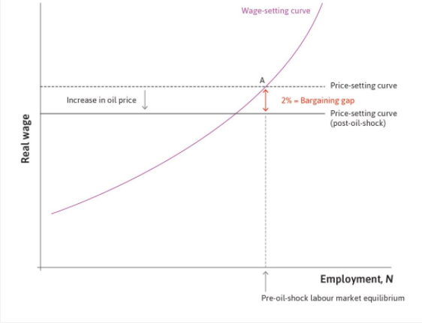
Oil shock
A rise in the oil price creates a bargaining gap and triggers a wage-price spiral through its effect on the price level. Firms raise their prices to protect their profit margins when the cost of imported oil rises. Firms across the economy will behave this way so the price level will rise.
This reduces the real wage of employees, so the price-setting curve shifts down (to see how firms set their prices following an oil price rise, see the Einstein at the end of this section).
At the initial employment level this opens up a bargaining gap between the real wage on the price-setting curve and the real wage on the wage-setting curve. That is, the rise in prices satisfies firms, but the corresponding fall in real wages does not satisfy workers.

Slide 11
Flash questions
How does the Phillips curve shift if oil prices decline?
What is the impact of Covid on the position of the Phillips curve?
What is the impact of a permanent rise in government expenditure on the position of the Phillips curve?
What is the impact of a permanent fall in taxation on the position of the Phillips curve?

Slide 12
Homeworks
Study 15.4, 15.5, 15.6
Exercise 15.3, 15.4, 15.5
Find out more about the oil shocks of the 1970s

