Slide 1
Macroeconomics
Lecture 20
28.05.24
Paolo Paesani
University of Rome Tor Vergata
Department of Economics and Finance

Slide 2
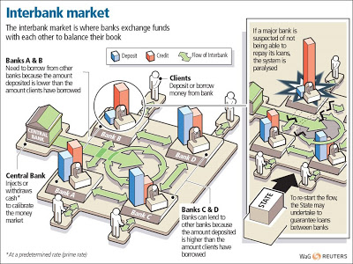
The money market

Slide 3
Conventional monetary policy operations
Time 0:
  The central bank lends ∆H bank reserves to the banks that need them.
  The central bank sets the rate of interest on this loan (official rate of interest)
  The banks that receive the loan transfer an equivalent amout of securities to the central bank as a guarantee (collateral).
Time 1:
  The banks payback ∆H(1+ i_{off}) to the central bank
  When they do so, the central bank transfers back to the banks the securities that they had given up as collateral.

Slide 4
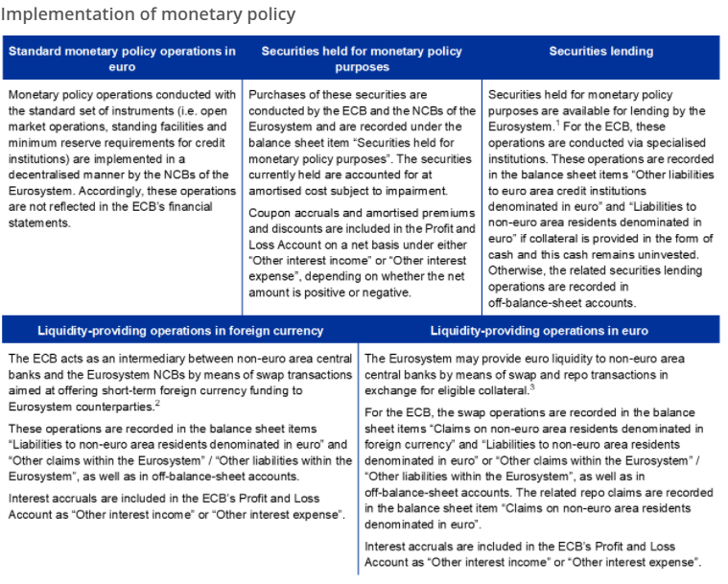
https://www.ecb.europa.eu/pub/annual/annual-accounts/html/ecb.annualaccounts2020~0508aea2f9.ga.html

Slide 5
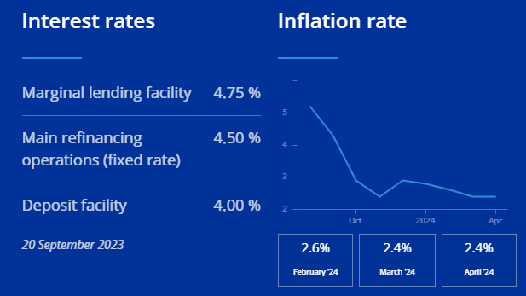
Conventional monetary policy operations
Refinacing operations often take place in the form of an auction
Monetary policy expansion means ∆H↑ and (1+ i_{off}) ↓
Monetary policy restriction means ∆H↓ and (1+ i_{off}) ↑
Allotment can be fixed or variable
Rate of interest can be fixed or variable

Slide 6
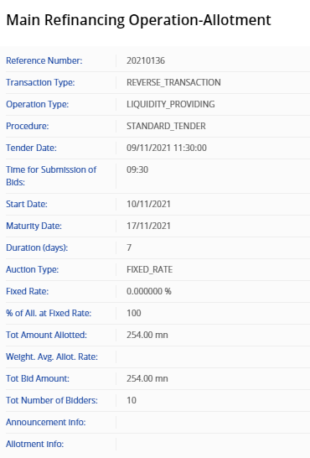
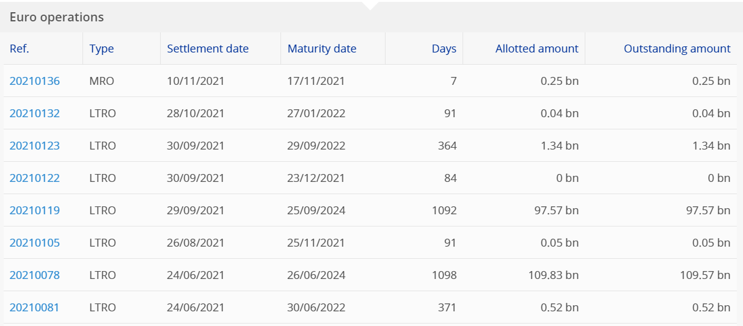
Conventional monetary policy operations

Slide 7
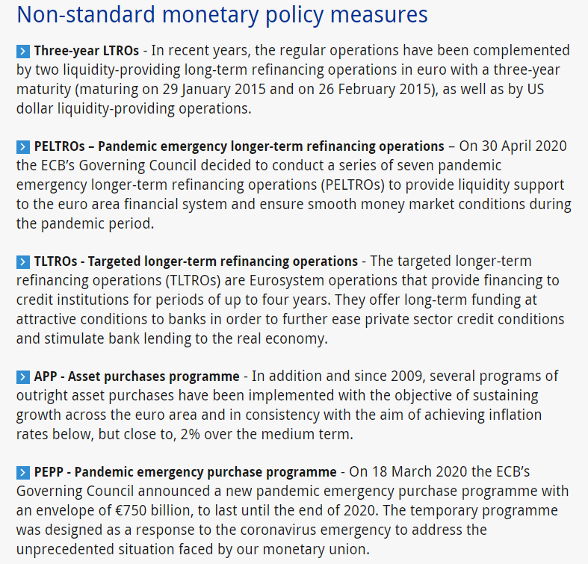
Non conventional monetary policy

Slide 8
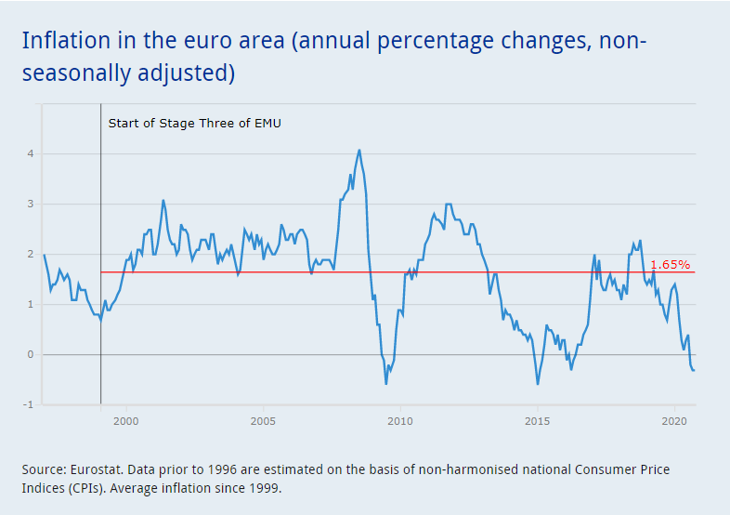
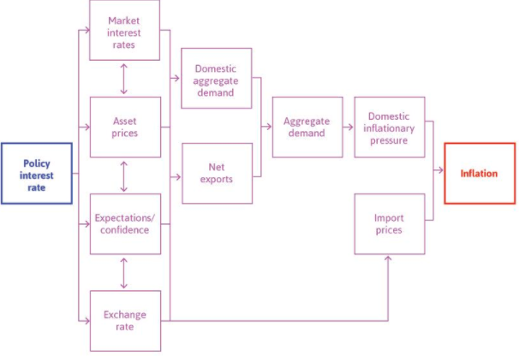
Monetary policy transmission

Slide 9

Interest rates transmission channel
An restrictive monetary policy leads interest rates (on bank loans and on bonds) to increase in nominal and real terms (as long as inflation expectations are assumed to remain constant or to increase less than proportionally with respect to the decline of nominal rates in absolute value). As real interest rates increase, the cost of capital rises, causing a fall in investment spending, thereby leading to a fall in aggregate demand (aggregate investment but also aggregate consumptuion) and a fall in output and inflation. In case of monetary policy expansion the effects are reversed at least until official interest rates in nominal terms are reduced to zero.
Expansionary monetary policy (the opposite)
With nominal MP rates at a floor of zero, a monetary policy expansion can raise the expected price level and hence expected inflation, thereby lowering the real interest rate, even when the nominal interest rate is fixed at zero. This is one of the aims of unconventional monetary policy. (See below)
↓ →
π↓

Slide 10


Exchange rate transmission channel
The schematic for the monetary transmission mechanism operating though the exchange rate is as follows. A Monetary restriction, rises nominal money market rates. As Funds a drawn into the coutry, the demand for domestic currency rises, and the supply of foreign currency rise, leading to the appreciation of the nominal exchange rate, to the decline of Net Exports, AD, GDP and inflation
This channel works with flexible exchange rates and is all the more relevant the more open the economy is to international trade and international capital flows. It also involves interest rate effects, because when domestic interest rates rise (or when FOREX market participants expect them to rise), deposits and other financial assets denominated in the domestic currency become more attractive relative to deposits and assets denominated in a foreign currency. The appreciation of the nominal exchange rate also causes the price of imported goods to fall. In case of monetary policy expansions all effects are reversed

Slide 11

Equity price transmission channel
Tobin's q Theory provides a mechanism by means of which monetary policy affects the economy through its effects on the valuation of equities.Tobin defines q as the market value of firms divided by the replacement cost of capital. If q is high, the market price of firms is high relative to the replacement cost of capital, and new plant and equipment capital is cheap relative to the market value of business firms.
Companies can then issue equity and get a high price for it relative to the cost of the plant and equipment they are buying. Thus investment spending will rise because firms can buy a lot of new investment goods with only a small issue of equity.
In case of a monetary polic restriction, portfolio reallocation, lower discount rates, worsenining profit expectations (regall the one period evaluation model) and less credit to finance equity purchases lead share prices to rise. Combining these views with the fact that lower equity prices will reduce q , investment, aggregate demand and inflationary pressure.

Slide 12

Wealth effect transmission channel
An alternative channel for monetary transmission through equity prices occurs through wealth effects on consumption. In countries where common stocks are a major component of household financial wealth (either directly or through investment and pension funds),when stock prices fall the value of financial wealth falls, thus reducing the lifetime resources of consumers, and consumption should fall
The Tobin's q framework applies straightforwardly to the the housing market, where housing is equity. An increase in house prices, which raises their prices relative to replacement cost, leads to a rise in Tobin's q for housing, thereby stimulating its production. Similarly, housing and land prices are an extremely important component of wealth and so rises in these prices increase wealth, thereby raising consumption.
Monetary restriction, which lowers land and housing prices through the mechanisms described above, thus leads to a fall in aggregate demand. Therefore, the monetary transmission mechanism also operates through the land and housing price channels but also trhough the market value of bonds (recall the lectures on the bond market and on bond price determination).

Slide 13
The bank lending transmission channel
The bank lending channel is based on the view that banks play a special role in the financial system because they are especially well suited to solve asymmetric information problems in credit markets [households, small and medium-size firms]. This is the idea on which the CC-LM model is based.
As long as there is no perfect substitutability between bank loans and other sources of funds, the bank lending channel of monetary transmission operates as follows.
Given banks' special role as lenders to classes of bank borrowers, expansionary monetary policy causes an increase in reserves, deposits and loans. This in turn will cause investment (and possible consumption) spending, and nominal GDP to rise.

Slide 14
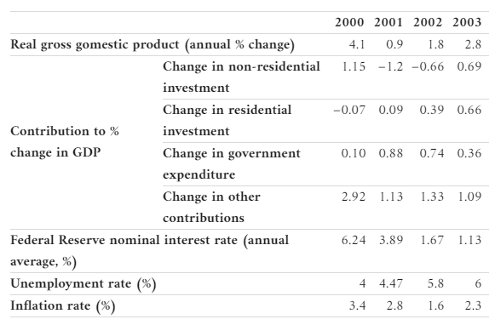
Combining monetary and fiscal policy to stabilize the economy (15.10)

Slide 15
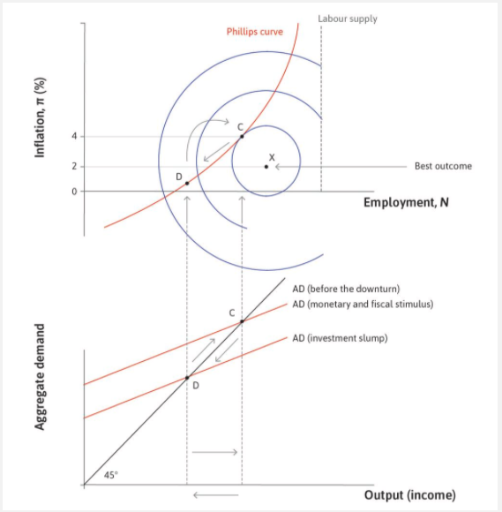

Slide 16
Homeworks
Study 15.7, 15.8, 15.9, 15.10, 15.11, 15.12
Exercise 15.3, 15.4, 15.5
Find out more about the oil shocks of the 1970s

