Slide 1
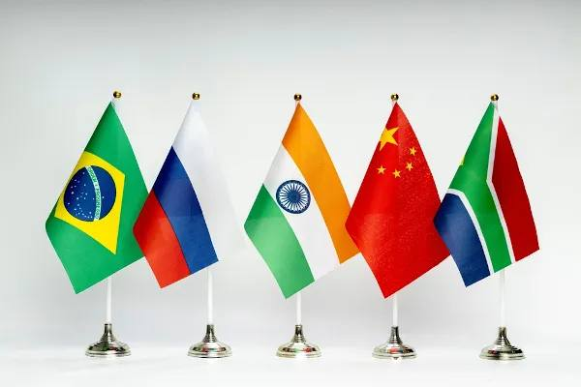
INTERNATIONAL ECONOMICS
PART III – Developing countries

Slide 2
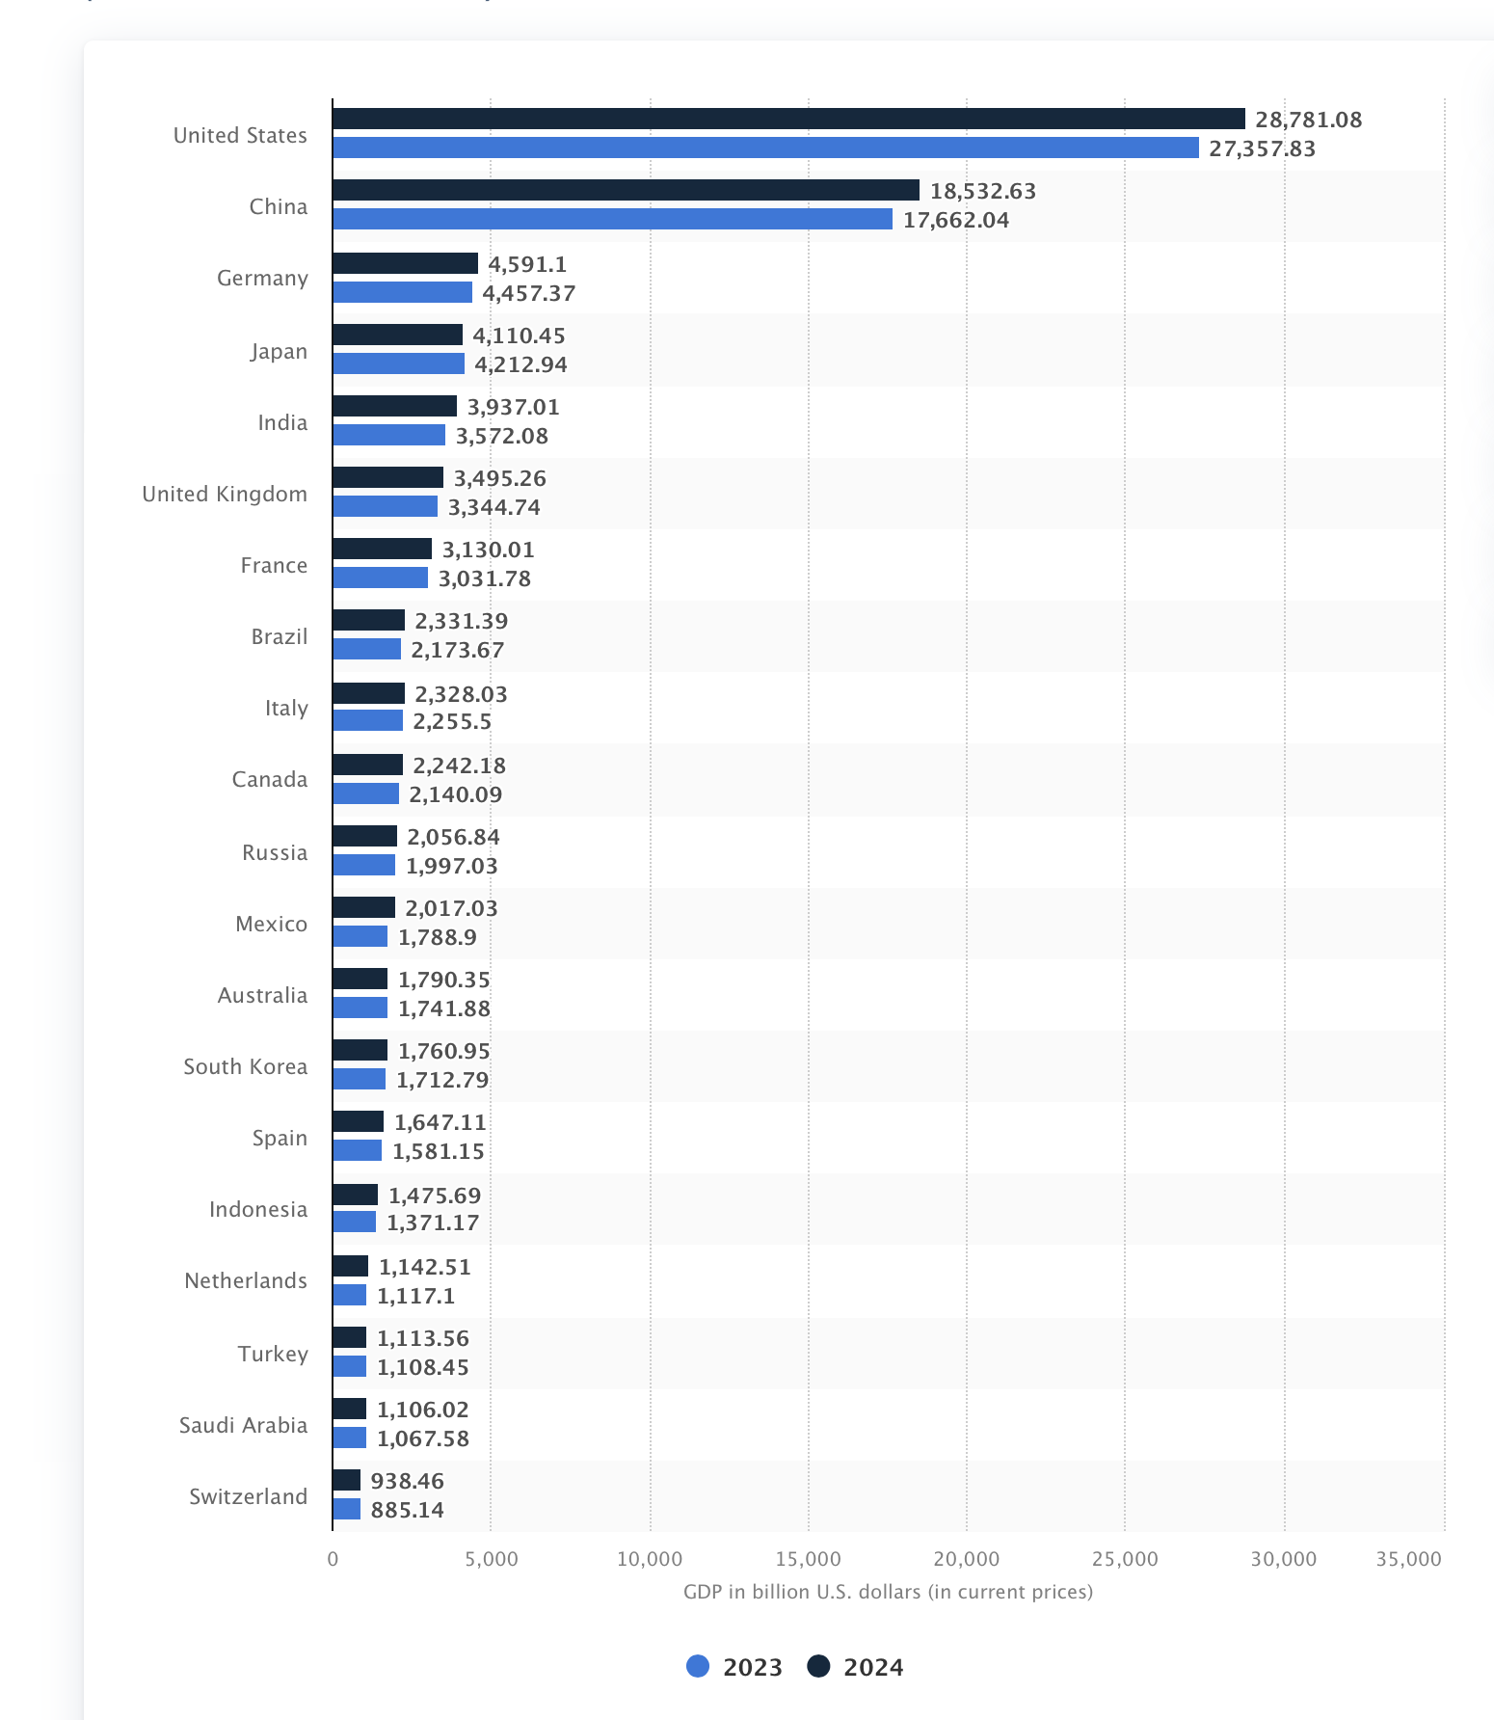
The 20 countries with the largest domestic product (GDP) in 2024
As of 2022 the global GDP is over 100 trillion US dollars

Slide 3
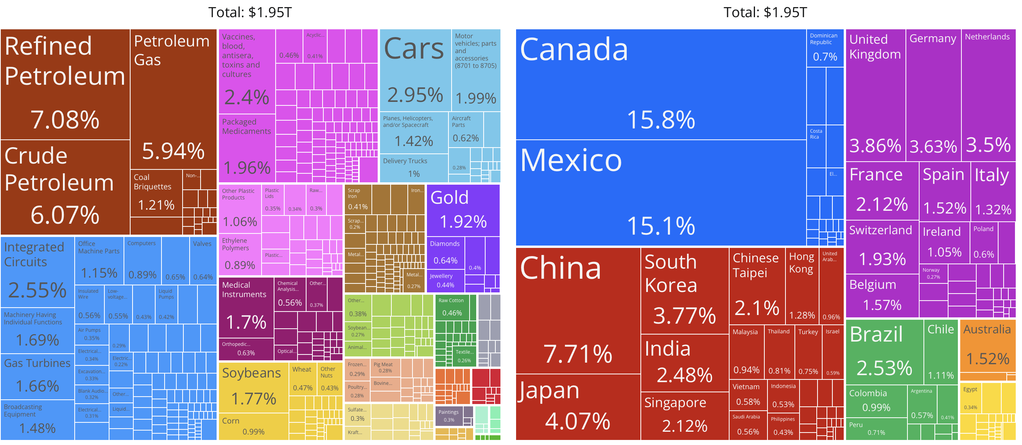
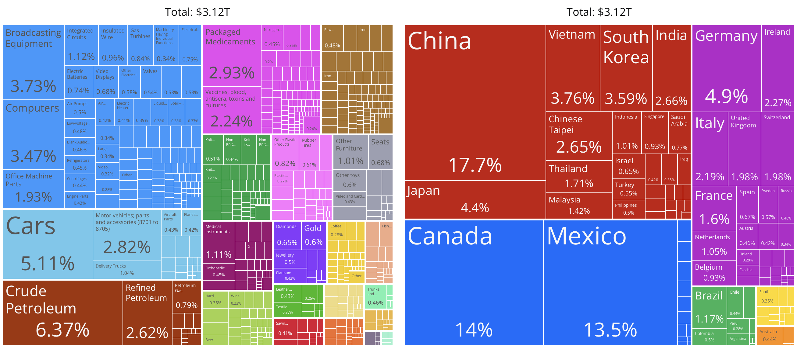
EXPORT & IMPORTS US (2022)

Slide 4
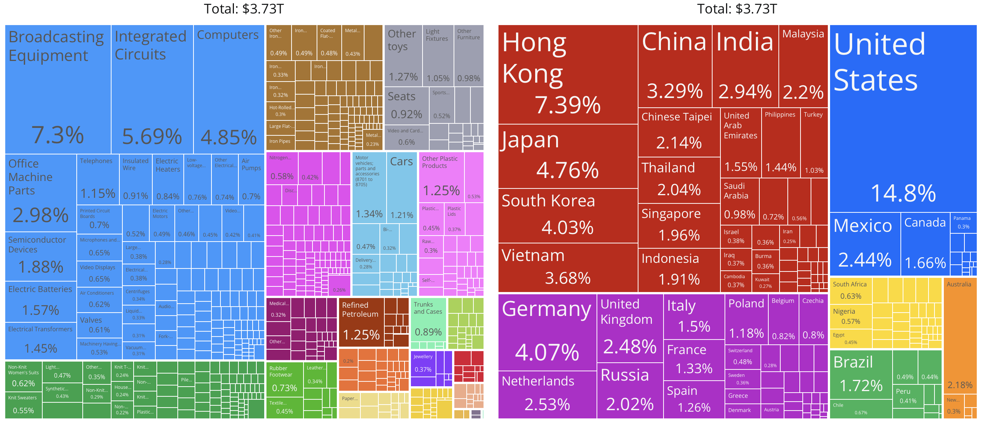
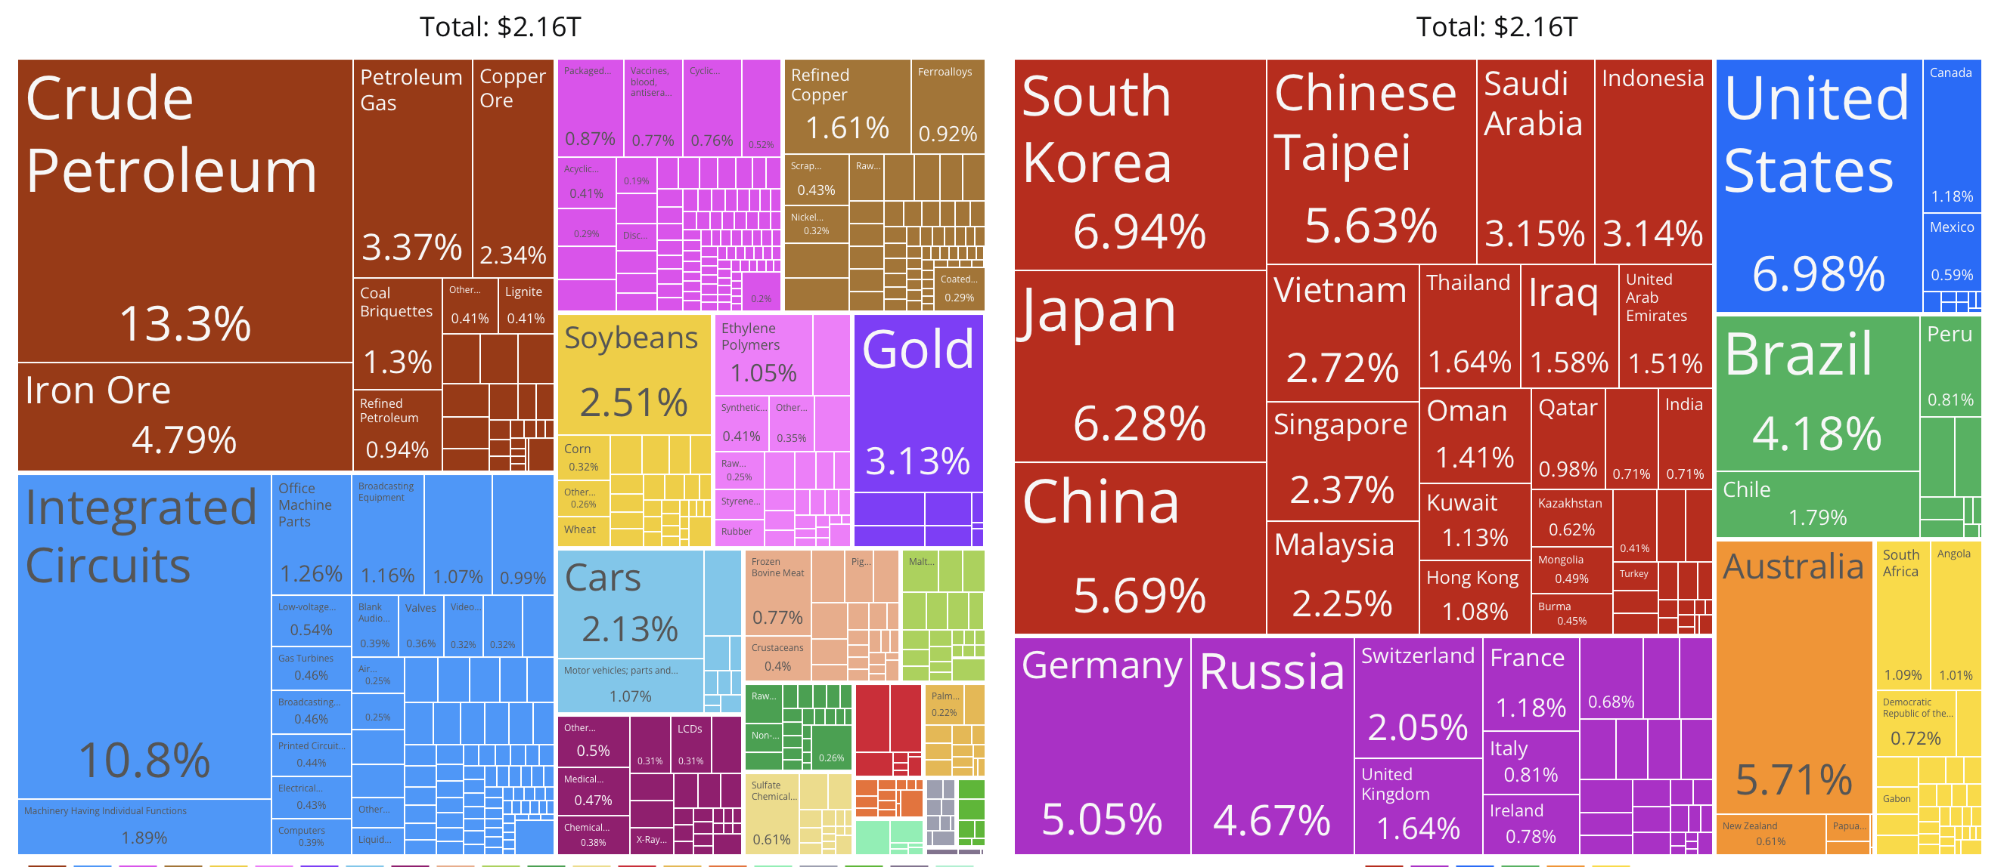
EXPORTS & IMPORTS - CHINA (2022)

Slide 5
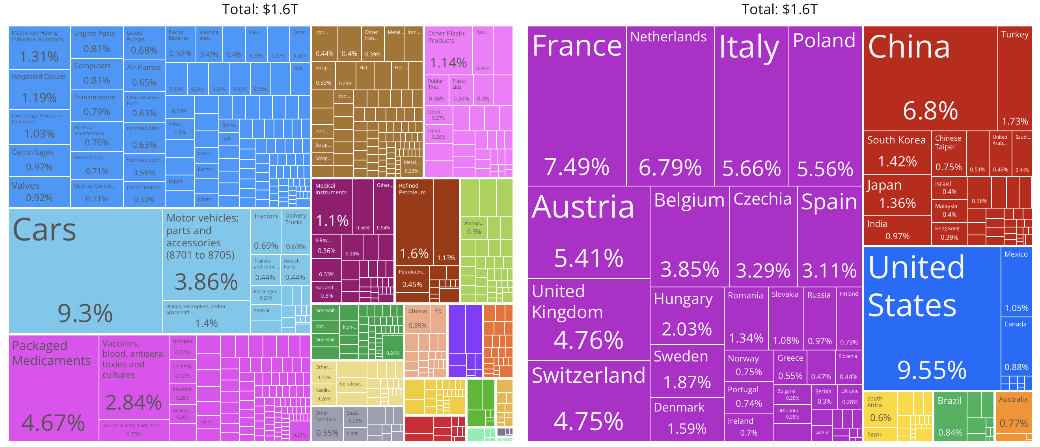
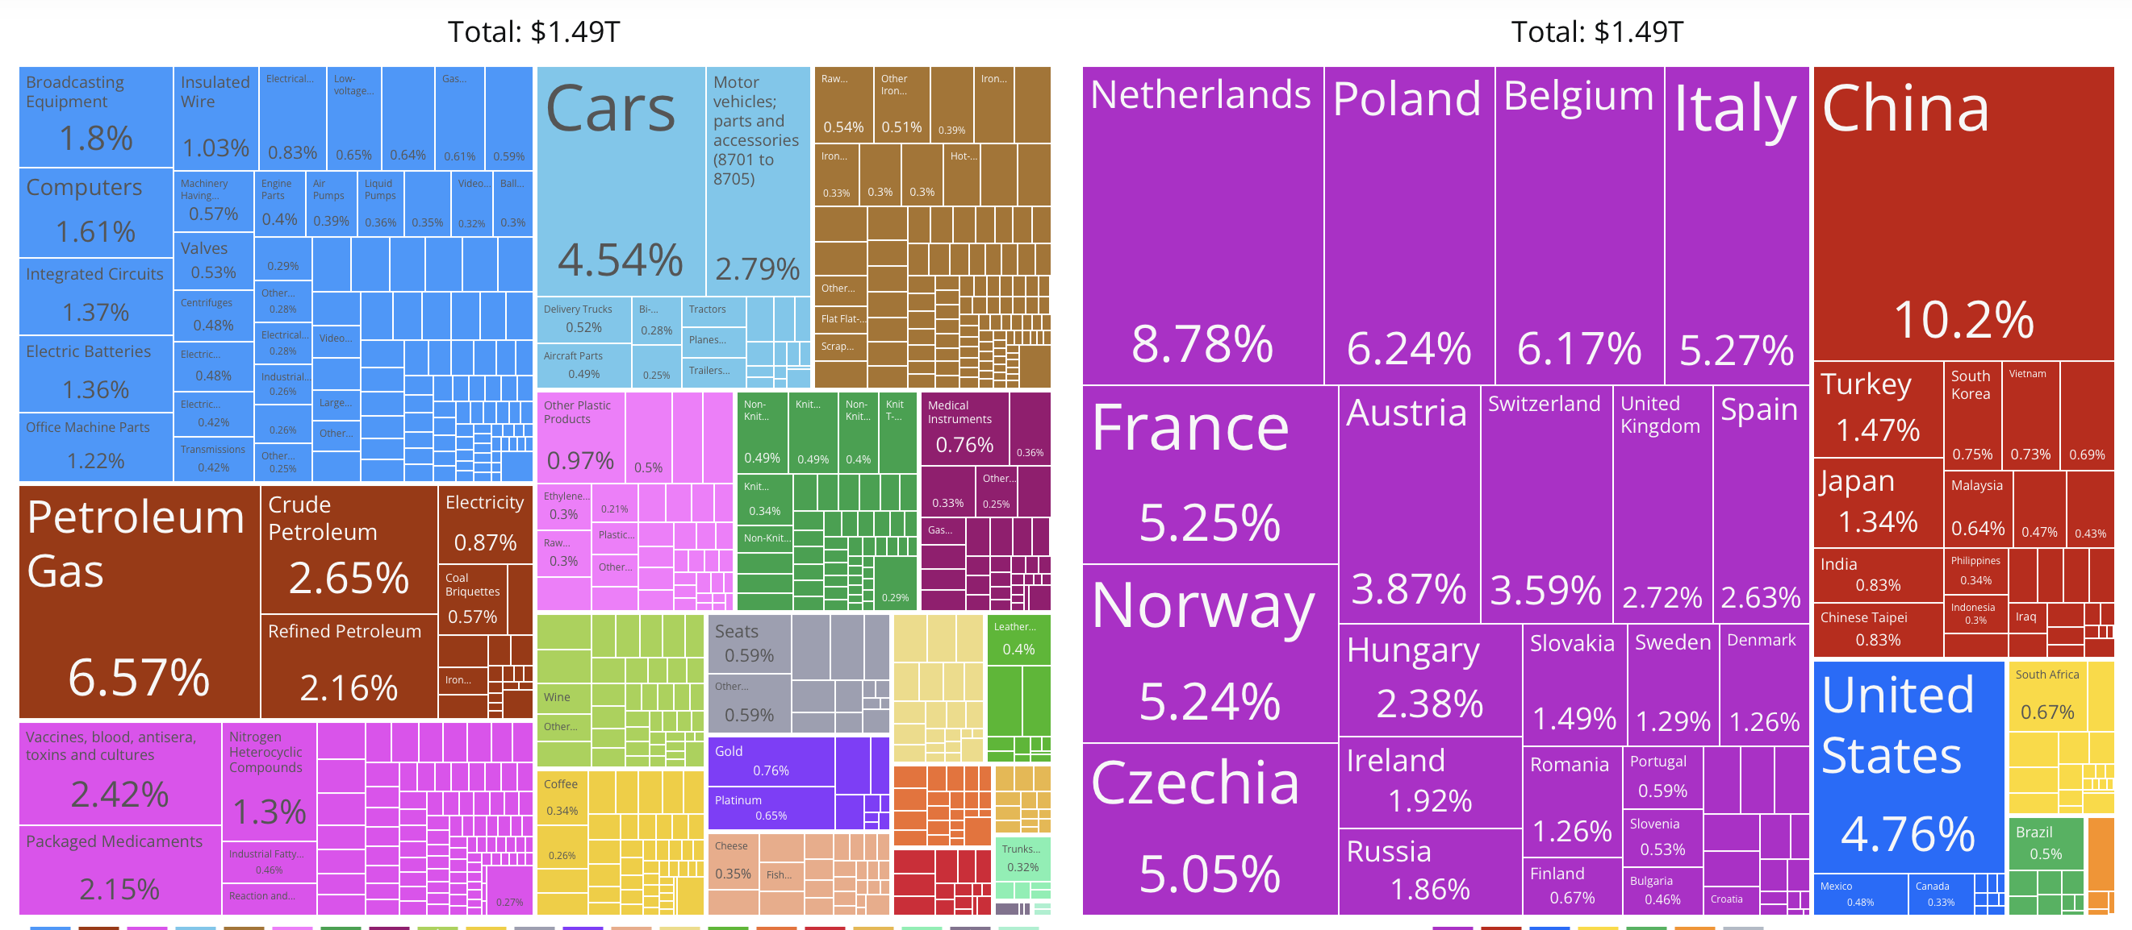
EXPORTS & IMPORTS - GERMANY(2022)

Slide 6
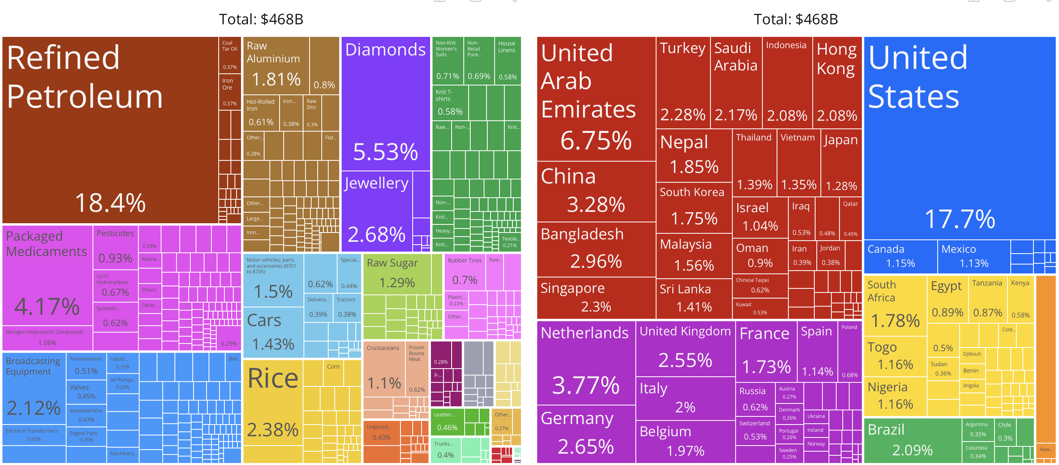
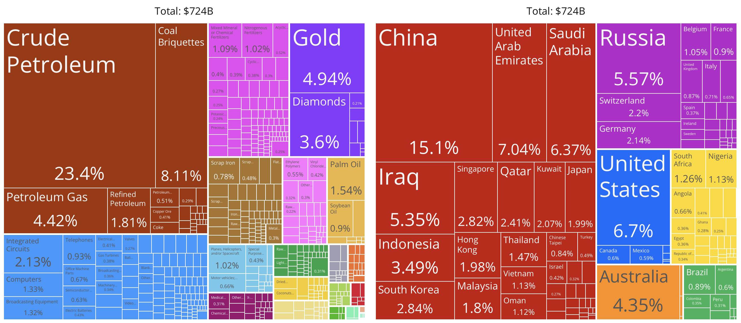
EXPORTS & IMPORTS INDIA(2022)

Slide 7
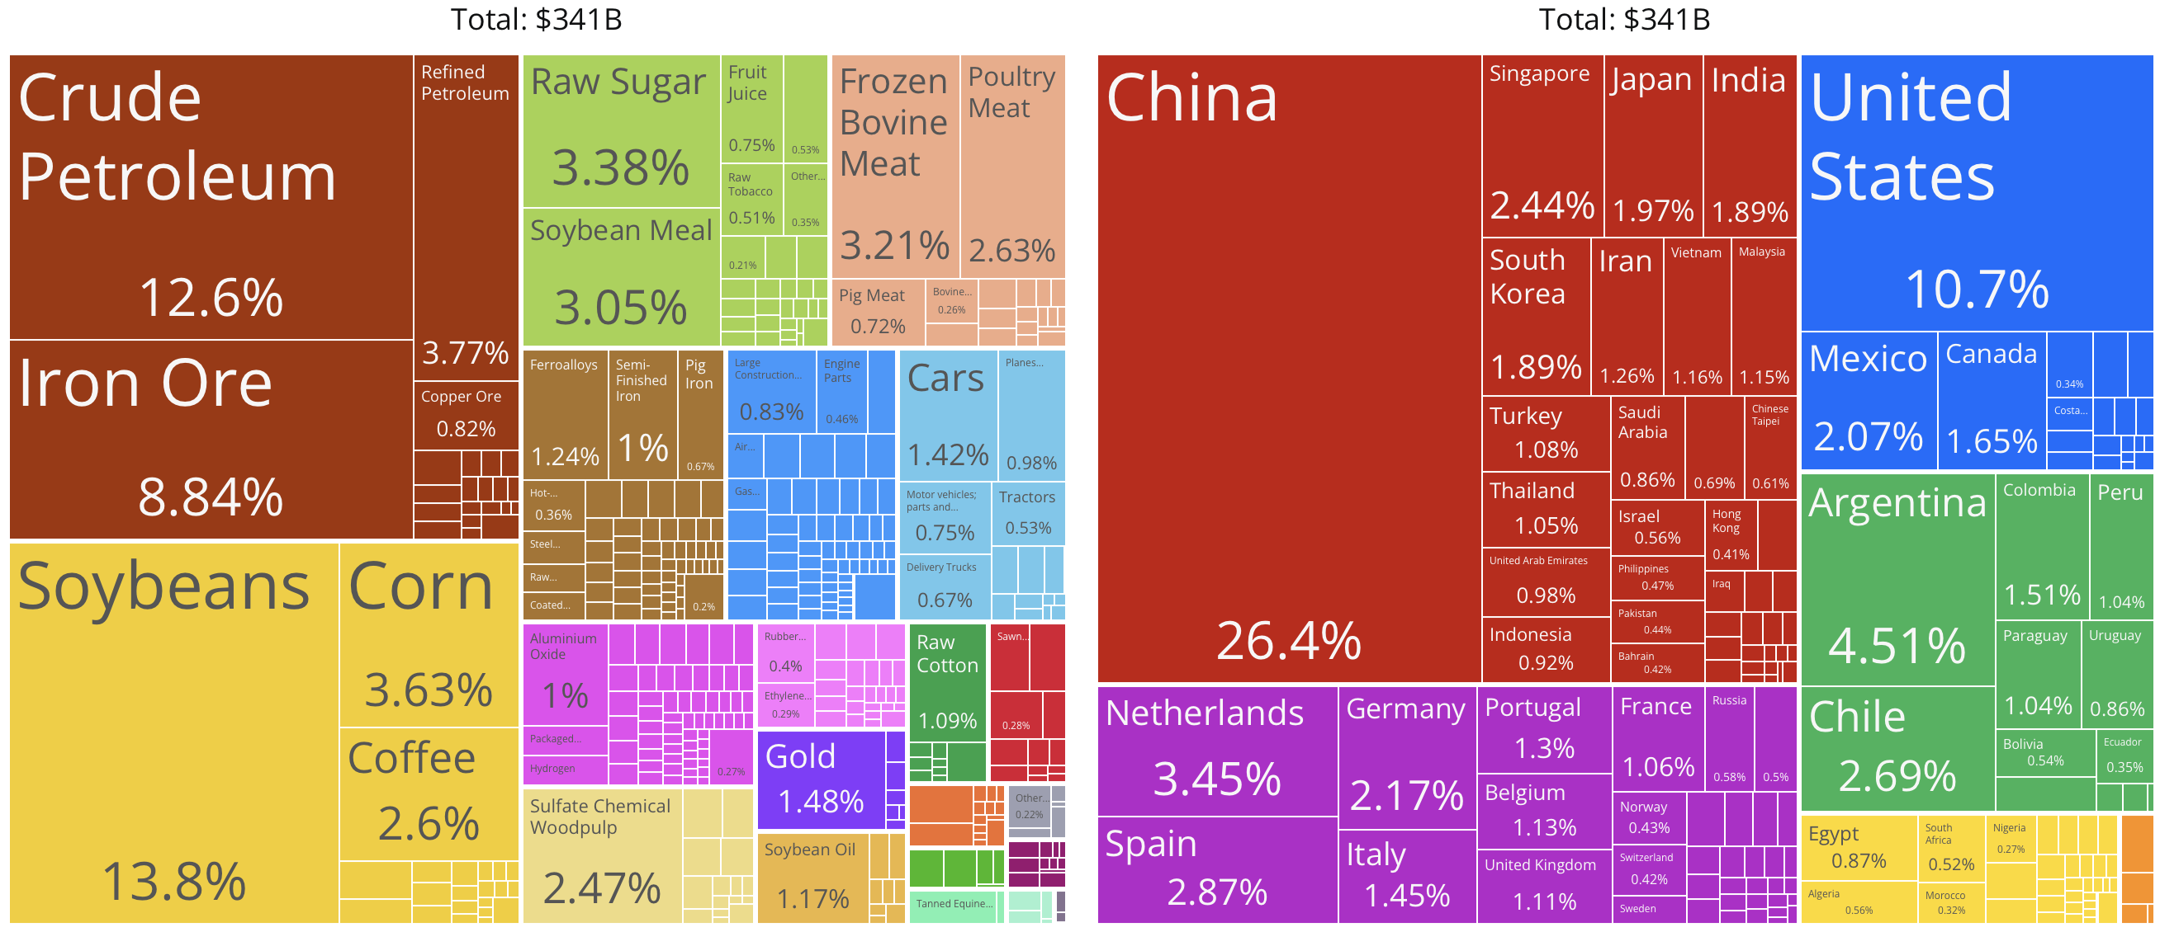
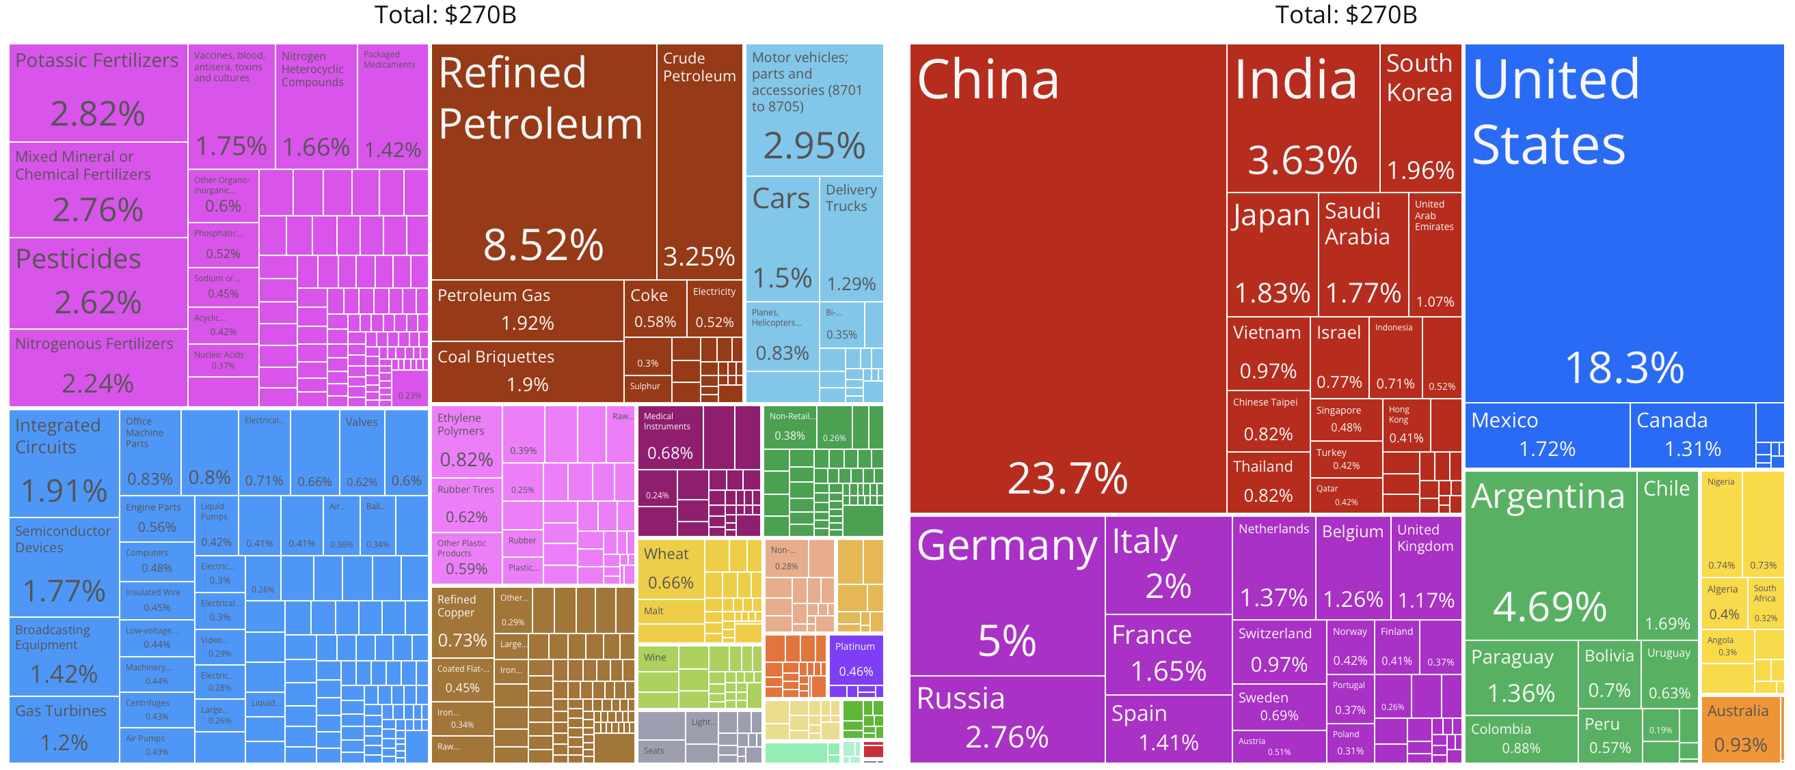
EXPORTS & IMPORTS BRASIL(2022)

Slide 8
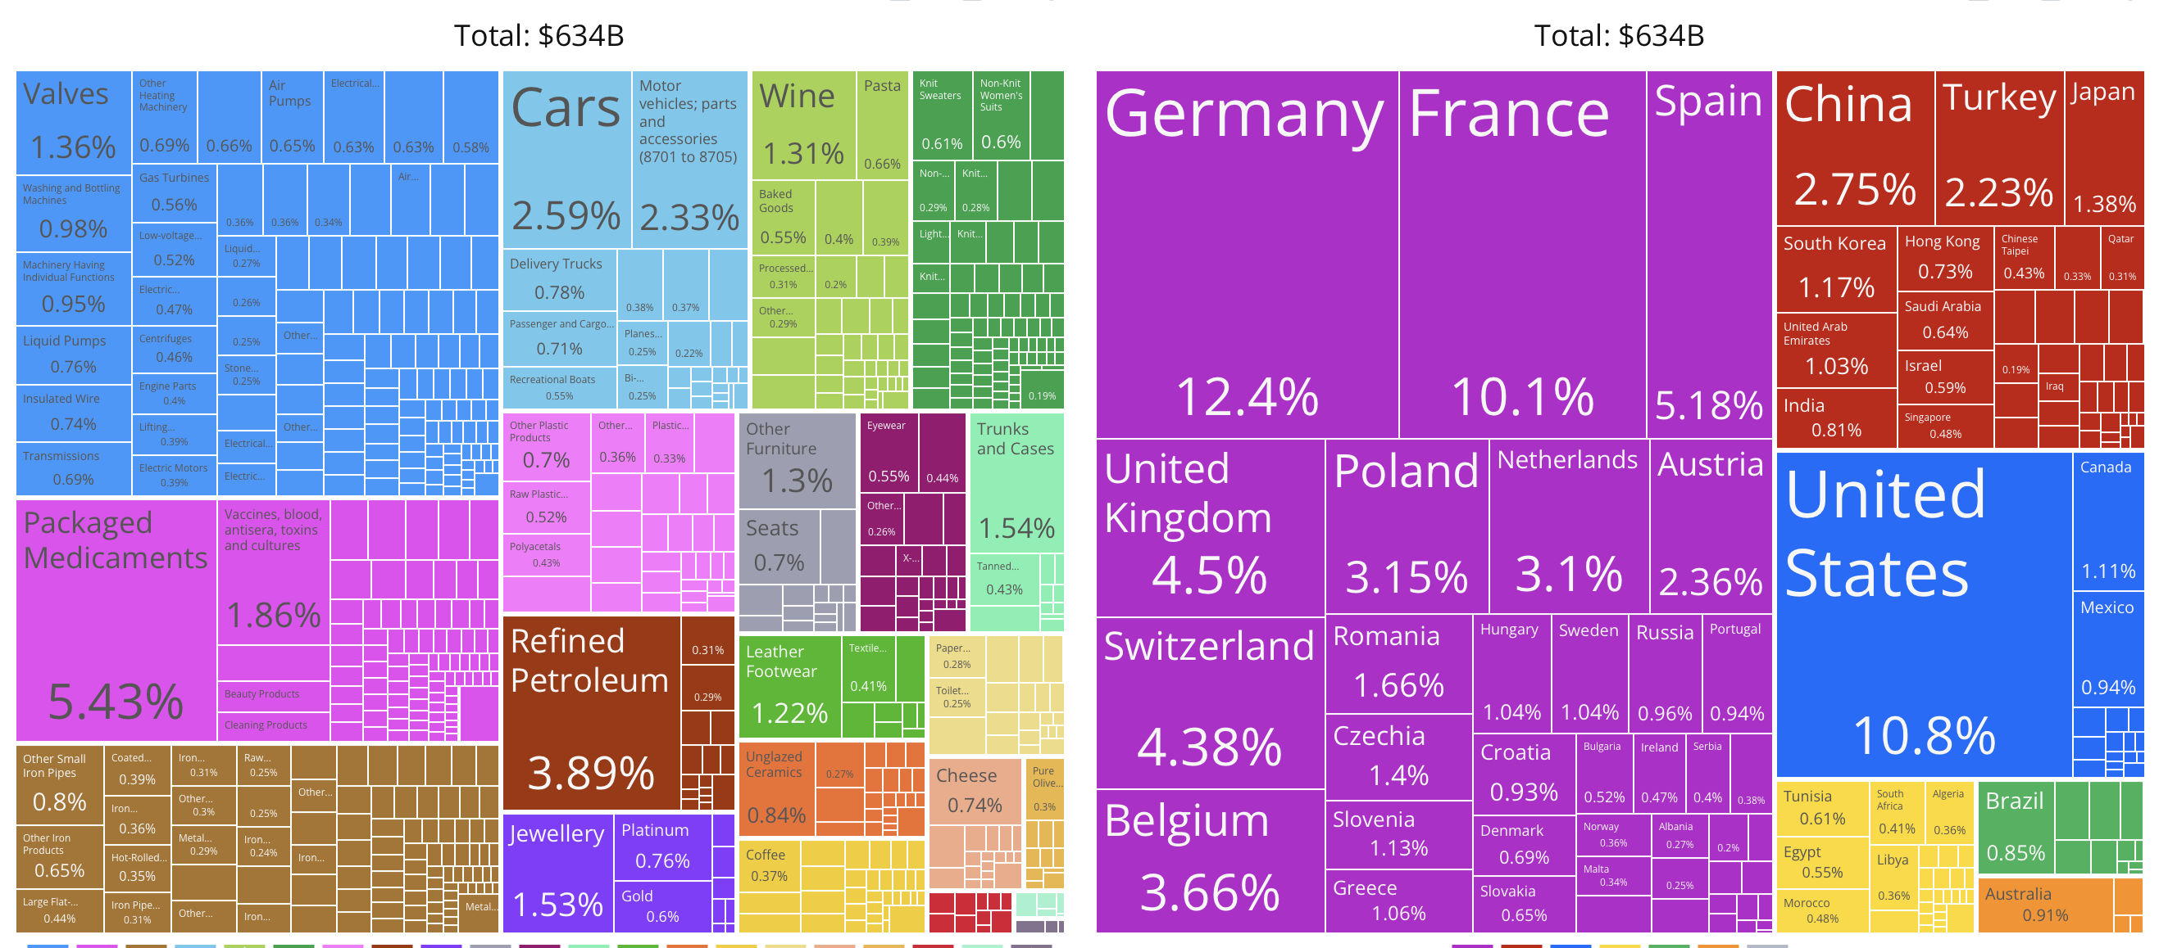
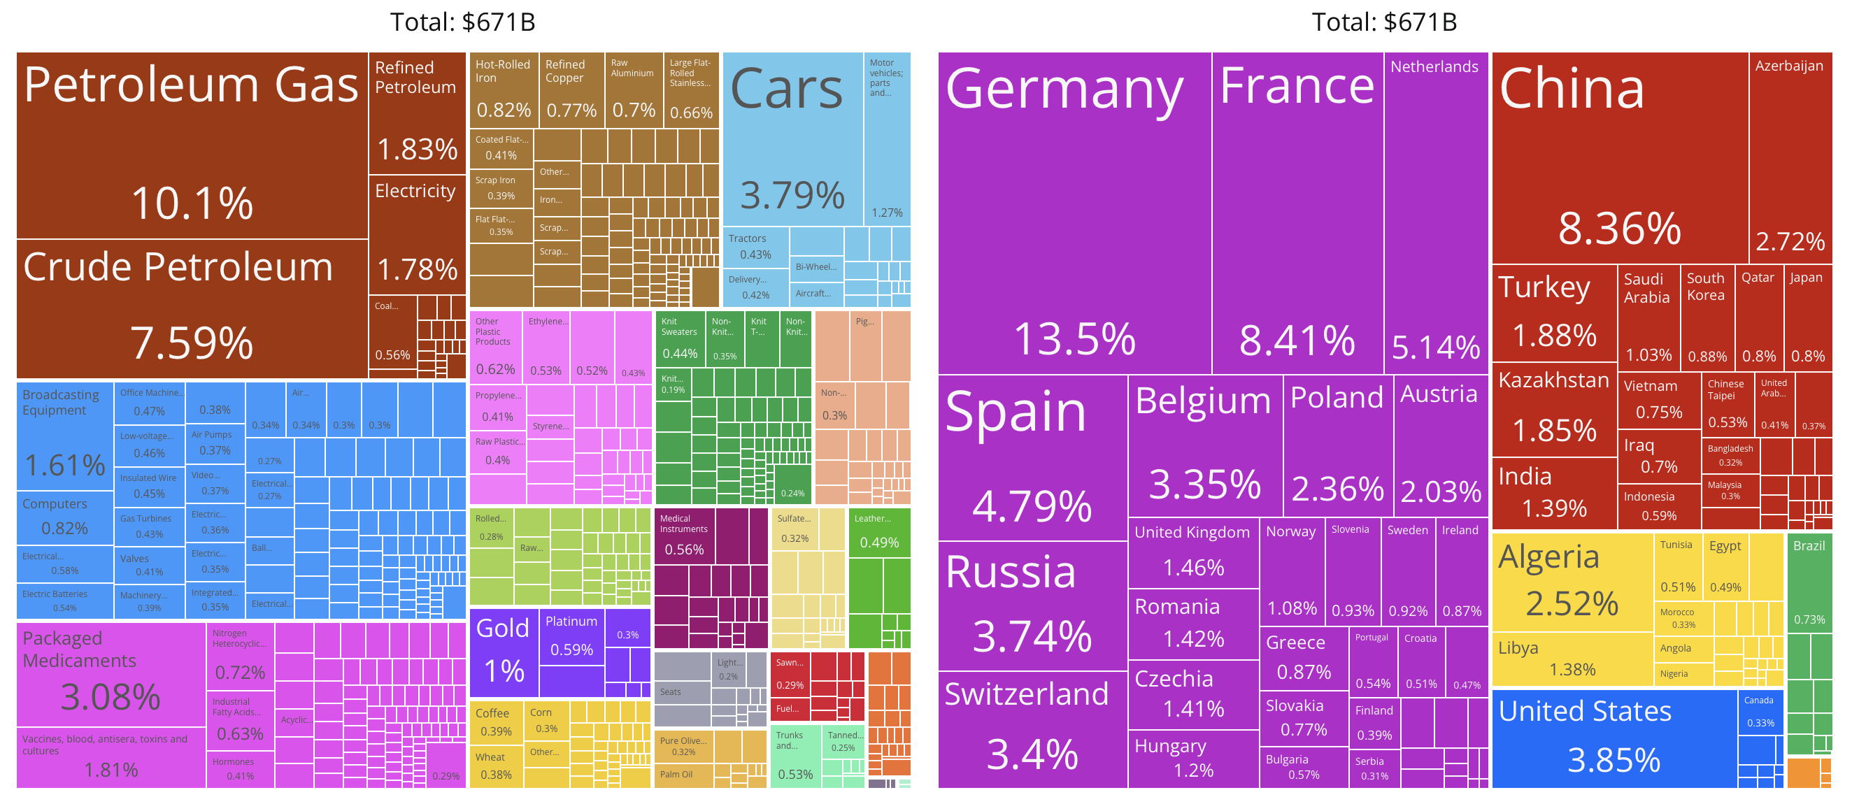
EXPORTS & IMPORTS ITALY(2022)

Slide 9
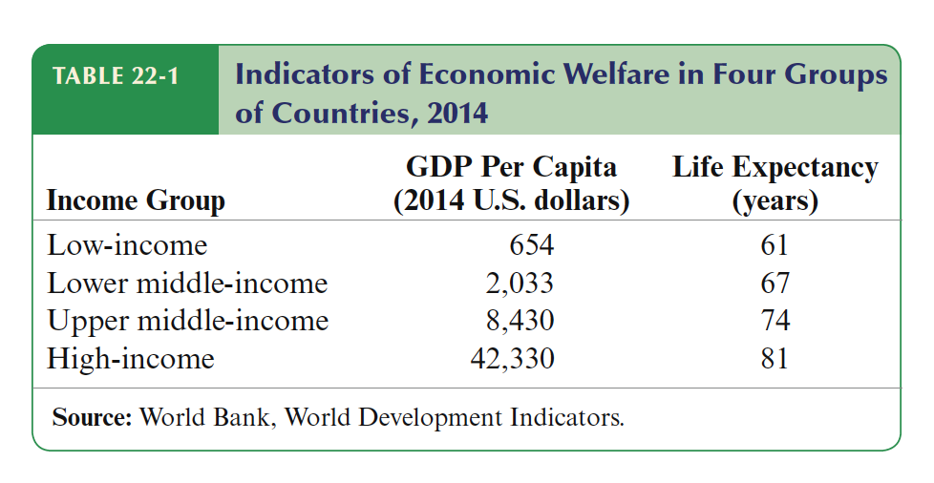
Developing Countries: growth and crisis
What have we learnt from the EZ crisis?
Developing countries: Growth, Crisis, and Reform
Developing countries: Growth, Crisis, and Reform
Income, Wealth and growth in the World Economy
lozzZ
After World War II trade between developed and developing countries has expanded. The two areas have become more ad more depend to each other. Since the 1960s some countries that once were poor have increased their standard of living while other have fallen behind.
The world’s economies can be classified in four main categories:
Low Income (Afghanistan, Cambodia, Haiti, Sub saharian countries & oth.), Lower middle-income (China, India, Pakistan, Philippines,
many Latin American and Caribbean, most African countries & oth.), Upper middle Income ( remaining Latin Americans, few Africans,
Turkey, Malaisya, Polnd, Russia $ oth.), High-Income ( rich industrial economyies Israel, South Korea, Singapore, Kuwait, Saudi Arabia,
Czech, Slovak Rep. & oth.)

Slide 10
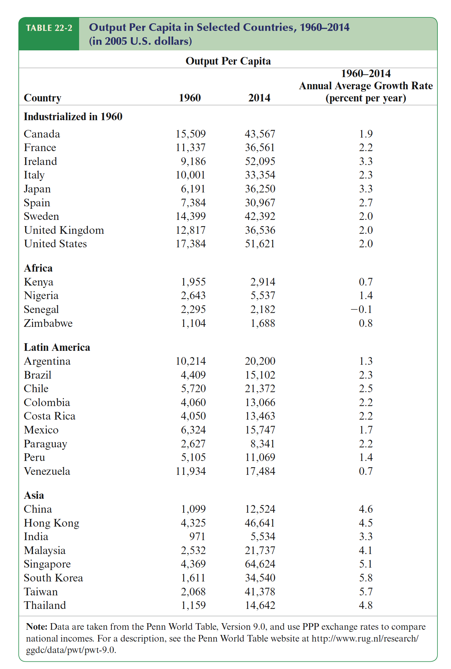
Developing countries: Growth, Crisis, and Reform
Developing countries: Growth, Crisis, and Reform
Income, Wealth and growth in the World Economy
The data show that after more than 50 years we do not observe a clear catch up. That is in contrast with Convergence theory. This theory suggests that in a world of free capital movement, capital should move to countries offering the highest return and if knowledge itself move across borders, then there is not reason why international income gap should persist.
African countries have grown at rates far below those of the industrialized countries, growth has been slow in Latin American (with the exception of Brazil and Chile that grow more than US). However, in the 2000s the economic growth in Africa was 5.2%. more than twice its pace in 1980s. And in 2024 9 of the 20 fastest-growing economies in the world will be in Africa (Niger, Senegal, Lybia, Rwanda, Cote d’Ivoire, Ethiopia, etc).
In contrast, East Asian countries have tended to grow at rates far above those of the industrialized countries. South Korea, with an income below Senegal in the 1960, has grown 6% per year. Some of the East countries that lived under Soviet rule now are in the upper income brackets. Notice that a country that grows a 3% double the standard of living each generation.
What explain the sharply divergent long-run growth patterns in table? The answer lies in the economic and political features of these countries (creating credible institutions, fighting corruption) and the ways these are changed over time in response to events and international pressures.

Slide 11
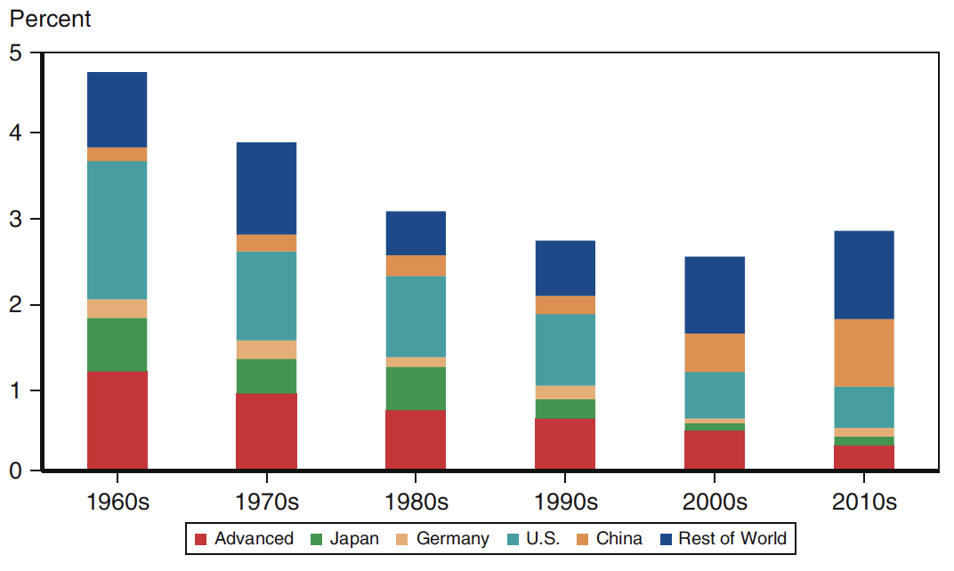
Developing countries: Growth, Crisis, and Reform
Developing countries: Growth, Crisis, and Reform
The importance of Developing Countries for Global Growth
A big change in the past decades is that poorer economies now account for a much bigger share of global income and global growth. As many developing economies have grown more quickly and come to account for. larger shares of world output, their GDP growth rates have become more important indetermining overall world growth. At the same time, growth in the richer economies hastended to slow over time.
Two main facts explain this change. First, emerging and developing economies, despite considerable heterogeneity in performance,overall tended to grow faster than the advanced countries; so as their global GDP shares increased, they became more important contributors to world growth. In this process, giants like China and India have played a notable role. Second, growth slowed in the advanced economies.
To understand global economic growth, we must look to the world’ poorer economies. What happens to those economies will have a large impact for richer countries.
Global Growth

Slide 12
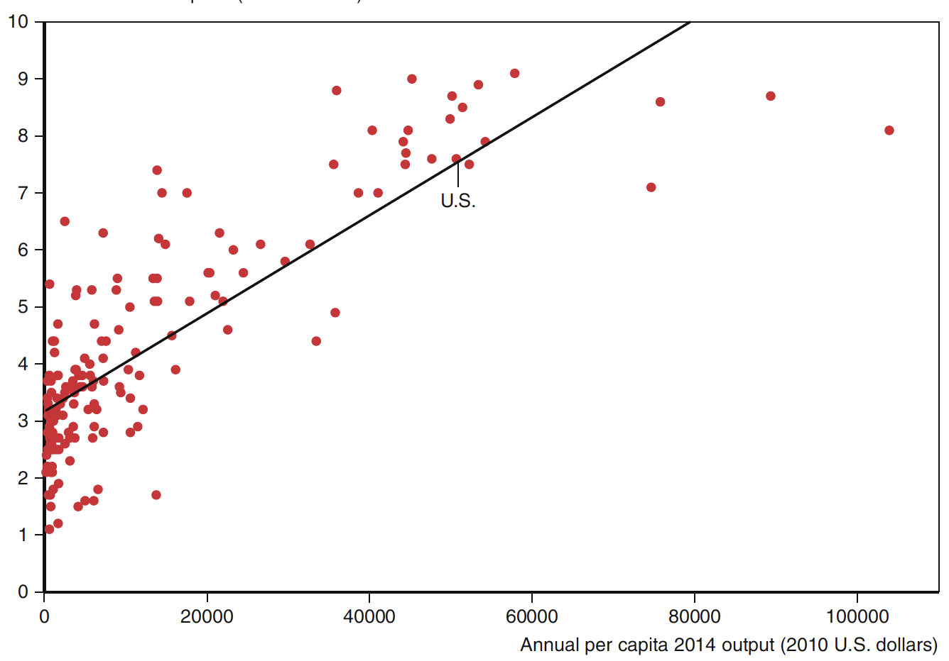
Developing countries: Growth, Crisis, and Reform
Developing countries: Growth, Crisis, and Reform
Structural Features of Developing Countries
Developing countries differ a lot among themselves. In the 1960s were much similar. Then things began to change. East Asian abandoned import-substituting industrialization, embracing an export-oriented development. This strategy was very successful. Latin American also reduced trade barriers while simultaneously to limit the role of government in the economy, reduce chronically inflation, open capital accounts to private transactions. Results were mixed.
Here some common features of developing countries:
Extensive direct government control of the economy including restriction on international trade, state ownership of industrial firm, control of financial transactions.
History of high inflation. Governments have difficulty to arise taxes. High tax evasion and black economy. Governments rely on seigniorage (printing money) to finance tits expenditures. The result is inflation or hyperinflation.
Weak credit institutions. Banks lend money they have borrow to finance poor or weak projects. Weak corporate governance Very difficult for stockholders to control firm managers.
Exchange rate are heavily controlled by governments. This because government want to control inflation. They also control capital movements by limiting foreign exchange transactions.
Natural Resources or agricultural commodities make up an important share of exports. For example, Russian petroleum, South African gold, Columbian coffee. Their economy are highly vulnerable to change in commodities prices.
Attempts to circumvents to government controls, taxes and regulations have helped to make corrupt practices a way of life of most developing countries.
Inverse index of Corruption
(cleanest = 10)

Slide 13
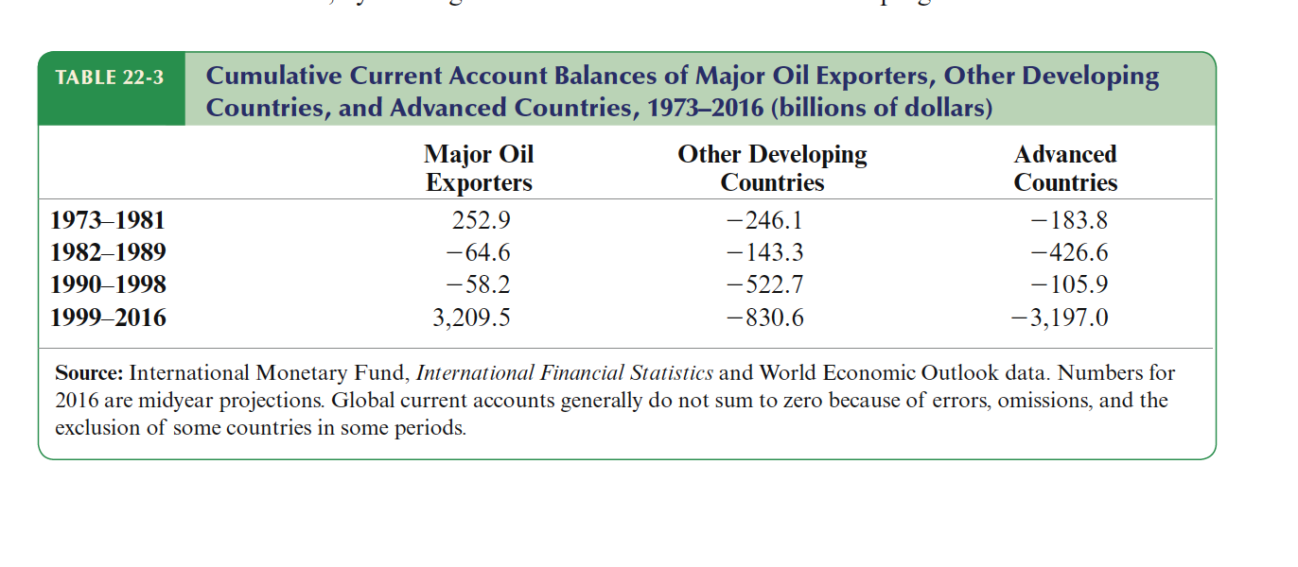
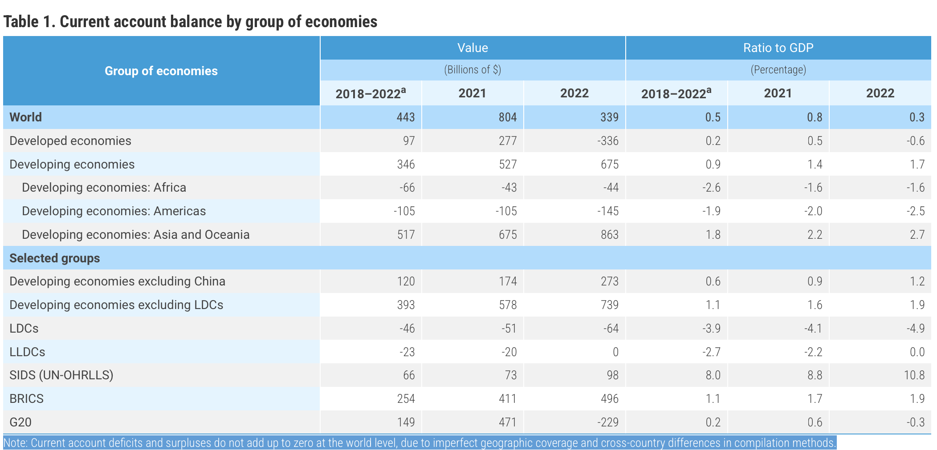
Developing countries: Growth, Crisis, and Reform
Developing countries: Growth, Crisis, and Reform
The Economics of Financial Inflows and Debt
Many developed countries have received extensive financial inflows from abroad and now carry substantial debt to foreigners (see tab 23.3).
Recall that CA = S – I. Since poor country have generally low level of S, in order to substain high level of I to promote economic growth they need to borrow abroad. That explains why developing countries have the tendency to cumulate foreign debt.
However, a surprising development starting around 2000 was that some developing countries (including many that were not oil exporters) ran surpluses, a counterpart of wealthier countries’ deficits (mainly that of the United States). Contrary to what simple economic theory would predict, capital was flowing uphill, from poorer to richer countries. One reason for these surpluses was developing countries’ strong desire to accumulate international reserves (See next slide).
Further, these countries may focus on export-oriented growth strategies, driven by cheaper labor and production costs. Their lower levels of domestic consumption and higher reliance on exports contribute to current account surpluses. Developed countries often act as destinations for global capital, as investors seek the safety and stability of developed financial markets. This capital inflow finances CA deficits. Developing countries, on the other hand, may lend surplus savings to the rest of the world by purchasing foreign assets, such as U.S. Treasury bonds, which reinforces their current account surpluses.

Slide 14
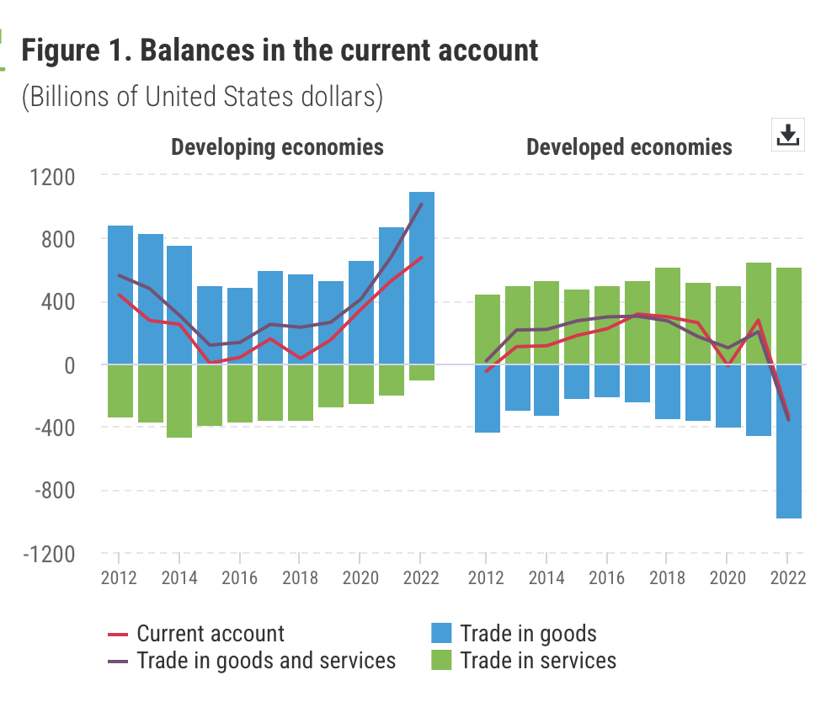
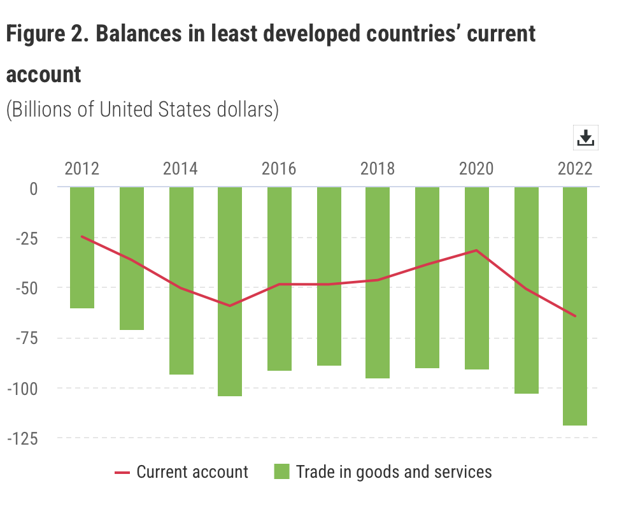
Developing countries: Growth, Crisis, and Reform
Developing countries: Growth, Crisis, and Reform
The Economics of Financial Inflows and Debt
In 2022, for many economies in the Americas, in Africa, and in South and South-East Asia, payments made for transactions with other economies exceeded their receipts earned, leading to negative current account balances. By contrast, most economies in Western, Central and Eastern Asia recorded current account surpluses.
Since 2019, developing economies have recorded a growing surplus in trade in goods vis-à-vis the developed economies, and their deficit in trade in services has decreased.
In 2022, Guyana recorded the highest current account surplus relative to GDP (40 per cent). Norway, Kuwait, Azerbaijan, and Papua New Guinea enjoyed surpluses of over 30 per cent of their respective GDP.
In absolute terms, the United States of America ($944 billion), the United Kingdom ($121 billion), and India ($80 billion) ran the world's largest current account deficits. China ($402 billion) recorded the largest absolute surplus, followed by the Russian Federation ($233 billion) and Norway ($175 billion). Many developed countries have received extensive financial inflows from

Slide 15
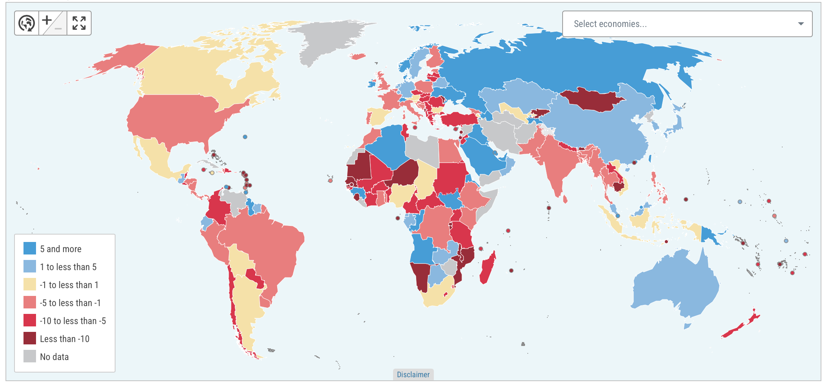
Current Account balance as a ratio to GDP (2022)

Slide 16
Developing countries: Growth, Crisis, and Reform
Developing countries: Growth, Crisis, and Reform
The Problem of Default
A loan is said to be in default when the borrower, without the agreement of the lender, fails to repay on schedule according to the loan contract. Both social and political instability in developing countries, as well as the frequent weaknesses in their public finances and financia institutions, make it much more risky to lend to developing than to industrial countries. And indeed, the history of financial flows to developing countries is strewn with the wreckage of financial crises and defaulted loan contracts:
  In early 19° century a number of American states defaulted on european loans.
  In the 19 th century Latin America crisis ran into repayments issues (Baring crisis)
  In1917 the russian communist government reputed foreign debt
  During the Great depression of the1930s nearly every developing countries defaulted in their external debt. Several European countries defaulted in their World War debt to the US.
  Many developing countrues have defaulted in recent decades.
  In 2020 Greece underwent a significant techical default when it negotiated the largest debt restructuring in history. Private creditors took a haircut of about 50-60% on the face value of their bonds to help reduce Greece's unsustainable debt load.

Slide 17
Developing countries: Growth, Crisis, and Reform
Developing countries: Growth, Crisis, and Reform
The Problem of Default (2)
How a default begins
What happen when a country suddenly loses access to all foreign sources of funds?
A sharp contractions in a country’s output and employment invariably occur. At a very basic level, the necessity for such contractions can be seen from the current account identity, S - I = CA. Imagine that a country is running a current account deficit that is 5 percent of its initial GNP, when suddenly foreig lenders become fearful of default and cut off all new loans. Since this action forces the current account balance to be at least zero (CA ≥ 0), the identity S - I = CA tells us that through some combination of a fall in investment or a rise in saving, S - I must immediately rise by at least 5 percent. The required sharp fall in aggregate demand necessarily depresses the country’s output dramatically. Even if the country were not on the verge of default initially—imagine that foreign lenders were originally seized by a sudden irrational panic—the harsh contraction in output that the country would suffer would make default a real possibility.
Foreign lenders will not only withhold new loans if they fear default, they will naturally also try to get as much money out of the country as possible by demanding the full repayment on any loans for which principal can be demanded on short notice (for example, liquid short-term bank deposits). When the developing country repays the principal on debt, it is increasing its net foreign wealth. To generate the corresponding positive current account item the country must somehow raise its net exports. Thus, in a sudden stop crisis, the country will not only have to run a current account of zero, it will also actually be called upon to run a surplus (CA > 0). The bigger the country’s short-term foreign debt—debt whose principal can be demanded by creditors—the larger the rise in saving or compression of investment that will be needed to avoid a default. You already may have noticed that developing-country sudden stops and default crises can be driven by a self-fulfilling mechanism analogous to the onesbehind self-fulfilling balance of payments crises

Slide 18
Developing countries: Growth, Crisis, and Reform
Developing countries: Growth, Crisis, and Reform
The Problem of Default (3)
Furthermore, default crises in developing countries are likely to be accompanied by balance of payments crises (when the exchange rate is pegged) and bank runs. A balance of payments crisis results because the country’s official foreign exchange reserves may be the only ready means it has to pay off foreign short-term debts. Through running down its official reserves, the government can cushion aggregate demand by reducing the size of the current account surplus needed to meet creditors’ demands for repayment. But the loss of its reserves leaves the government unable to peg the exchange rate any longer. At the same time, the banks get into trouble as domestic and foreign depositors, fearing currency depreciation and the consequences of default, withdraw funds and purchase foreign reserves in the hope of repaying foreign-currency debts or sending wealth safely abroad. Since the banks are often weak to begin with, the large scale withdrawals quickly push them to the brink of failure. Finally, a negative impact on the public finances may complete the doom loop. If the government needs to issue more debt as a result of bailing out the banks, then its own credit standing is weakened, which causes higher borrowing costs and a greater chance of a sovereign default.
Because each of these crisis “triplets” reinforces the others, a developing country’sfinancial crisis is likely to be severe, to have widespread negative effects on the economy,and to snowball very quickly. The immediate origin of such a pervasive economic collapse can be trough a sudden stop of financing, in the foreigh exchange or in the banking system.

Slide 19
Developing countries: Growth, Crisis, and Reform
Developing countries: Growth, Crisis, and Reform
The Problem of ”Original Sin”
Developing countries’ debt to foreigners are often denominated in foreign currency. This is not a matter of choice. Foreign investors - fearing devaluations and inflation - are willing to underwrite these debt if they are denominated in strong currency.
If these debt were denominated in local currencies, developing countries would never default since they could always meet their obligation printing money.
Western countries on the contrary borrow issuing assets in their local currencies. A devaluation or an inflation will increase the value of their assets since are denominated in foreign currency while the value their liabilities remain constant or rises a little if they have a small proportion denominated in foreign currency. Because poorer countries tend to be net debtors in the major foreign currencies, a depreciation of domestic currency causes a transfer of
wealth to foreigners by raising the domestic currency value of the net foreign debt
A country that can borrow abroad in its own currency can reduce the real resources it owes to foreigners, without triggering a default, simply by depreciating its currency. On the contrary, a developing country forced to borrow in foreign currency lacks this option and can reduce what it owes to foreigners only through some form of outright default.
Economists Barry Eichengreen of the University of California–Berkeley and Ricardo Hausmann of Harvard University coined the phrase original sin to describe developing countries’ inability to borrow in their own currencies. In these economists’view, that inability of poor countries is a structural problem caused primarily by features of the global capital market—such as the limited additional diversification potential that a small country’s currency provides to creditors from rich countries, who already hold all the major currencies in their portfolios. Other economists believe that the “sin” of developing countries is not particularly “original” but instead derives from their own histories of ill-advised economic policies.

Slide 20
Developing countries: Growth, Crisis, and Reform
Developing countries: Growth, Crisis, and Reform
The Debt Crisis of the 1980s
In 1981-83, the world economy suffered a steep recession. That made it hard for the Developing countries to make payments in their foreign loans.
In 1979 the Fed adopted a tight monetary policy to stop the two-digit inflation. The raise in interest rates (18%) and the strong appreciation of the dollar caused a huge increase in the debt burden of the developing countries which had adjustable-rate dollar denominated debts.
The crisis began in August 1982 when Mexico announced that its central bank had run out of foreign reserves and that it could no longer meet payments on its foreign debt. Seeing potential similarities between Mexico and other large Latin American debtors such as Argentina, Brazil, and Chile, banks in the industrial countries—the largest private lenders to Latin America at the time—scrambled to reduce their risks by cutting off new credits and demanding repayment on earlier loans. The results were a widespread inability of developing countries to meet prior debt obligations and a rapid move to the edge of a generalized default.
Most countries in East Asia were able to maintain economic growth and avoid rescheduling their debt (that is, stretching out repayments by promising to pay additional interest in the future). Nonetheless, by the end of 1986 more than 40 countries had encountered severe external financing problems. Growth had slowed sharply (or gone into reverse) in much of the developing world, and developing-country borrowing fell dramatically. Initially, industrial countries, with heavy involvement by the International Monetary Fund, attempted to persuade the large banks to continue lending, arguing that a coordinated lending response was the best assurance that earlier debts would be repaid. Policy makers in the industrialized countries feared that banking giants like Citicorp and Bank of America, which had significant loans in Latin America, would fail in the event of a generalized default, dragging down the world financial system with them.
But the crisis didn’t end until 1989 when the United States, fearing political instability to its south, insisted that American banks give some form of debt relief to indebted developing countries.

Slide 21
Developing countries: Growth, Crisis, and Reform
Developing countries: Growth, Crisis, and Reform
Reforms, Capital Inflows, and Return of Crisis
The early 1990s saw private capital flows into developing countries again. Low interest rates in the US provided an incentive to these flows.
The developing countries on the other hand had stabilized the inflation, limited the role of government in the economy, raised taxes, deregulated markets, privatized companies, improved the efficiency of the financial markets. Many young policy makers who took responsibilities in the government were well-trained economists in the American universities who believed that misguided policies were the reasons of past errors. The success of the East Asian economies was also a new stimulus to reform the societies.
Argentina. Argentina turned to radical institutional reforms in the early 1990s. Tariff were slashed, government expenditures were cut, Companies were privatized, and tax reforms helped the government to raise taxes. But the most daring reform was the new Convertibility Law that made the peso convertible in 1 dollar. This law also required that the monetary base be backed by gold or foreign currency. In this awy, the government could not anymore finance the public deficit printing money.
This was an extreme form of a currency board, i.e., of using fixed exchange rate to fight inflation, having the monetary base backed by foreign currency and the Central Bank that cannot hold domestic assets. Inflation dropped to 5% in 1995 from 800% in 1990. The real appreciation of the pesos led to unemployment and a growing current account deficit.
In 1995 the real appreciation ended but unemployment remained high. At the end of 1990s, the economic growth turned negative again and the government deficit was again out of control. As the world economy entered in a recession the country defaulted in its foreign debt in December 2001. The peso/dollar peg was abandoned. Devaluation and inflation soared again. In April of 2016 Argentina negotiated a settlement with holdout foreign creditors that finally allowed it to re-enter international capital markets as a borrower.

Slide 22
Developing countries: Growth, Crisis, and Reform
Developing countries: Growth, Crisis, and Reform
Reforms, Capital Inflows, and Return of Crisis
Brazil. Like Argentina Brazil suffered inflation in the 1980s as well as several attempts at stabilization accompanied by currency reforms. In 1994 the goverment introduced a new currency, the Real pegged to the dollar. Brazil defended the new exchanged rate with high interest rates. At the cost of widespread bank failures, Brazil defended the new exchange rate with high interest rates in 1995, then shifted to a fixed, upwardly crawling peg (*) in the face of substantial real appreciation. Inflation dropped from an annual rate of 2,669 % (in 1994) to under 10 % in 1997.
However, the economic growth remained sluggish despite several reforms were implemented such as reduction in import barriers, privatizations, and fiscal retranchment. A good part of the problem was the very high interest rate the government had to pay on its debt, a rate that reflected skepticism in markets that the limited upward crawl of the real against the dollar could be maintained.
In 1999, Brazil devalued the Real and then allowed to float. The currency lost 40% of its value against the dollar.
Recession followed as government incresed interest rate to prevent the Real from going free fall. Recession was short-lived, financial collapse was avoided. Brazil elected Ignazio Lula. The market-friendly policies he adopted preserved Brazil’s access to credit markes. The economy recovered. Brazil became a power in emerging markets. A key factor of its success was its commodity export to China.
Chile. Chile underwent significant economic reforms during the 1980s, driven largely by policies influenced by a group of economists known as the "Chicago Boys," who were trained at the University of Chicago. These reforms were implemented under the military dictatorship of Augusto Pinochet and aimed to transition the country from a state-led to a market-driven economy. (reduction of tariffs, privatizations, more flebility in the labor market, pension reform). Chile introduced a crawling peg exchange rate regime to bring down inflation .
(*) A crawling peg exchange rate regime is a system in which a country's currency is allowed to fluctuate within a defined range around a central value or "peg," which is periodically adjusted.

Slide 23
Developing countries: Growth, Crisis, and Reform
Developing countries: Growth, Crisis, and Reform
Reforms, Capital Inflows, and Return of Crisis
The Chilean central bank became independent of the fiscal authorities in 1990 (the same year a democratic government replaced the military regime of General Pinochet). That action further solidified the commitment not to finance government deficits by ordering the central bank to print money.
Another new policy was the encaje system, also known as the reserve requirement policy for capital inflows. This mechanism was implemented in the early 1990s as part of Chile's efforts to manage capital flows and mitigate the risks of excessive short-term, speculative investments. Foreign investors were required to place a percentage of their capital inflows (initially set at 20%, later raised to 30%) in a non-interest-bearing account at the central bank. This reserve had to be maintained for a minimum of one year, regardless of the duration of the actual investment.
The encaje applied to most forms of capital inflows, including portfolio investments, foreign loans, and other speculative investments (with the exemption of foreign direct investment). The purpose was to discourage short-term, speculative capital inflows that could destabilize the economy to prevent excessive appreciation of the Chilean peso, which could harm export competitiveness, and to allow the central bank to maintain more control over domestic monetary policy by reducing the pressure of volatile capital flows.
Chile’s policies have paid off handsomely. Between 1991 and 1997, the country enjoyed GDP growth rates averaging better than 8 percent per year. At the same time, inflation dropped from 26 percent per year in 1990 to only 6 percent by 1997. Chile has been rated not only as being the least corrupt country in Latin America, but also as being less corrupt than several European Union members and the United States. Commodity exports such as copper are important for Chile, and its economy therefore slowed as commodity prices fell during the 2010s.

Slide 24
Developing countries: Growth, Crisis, and Reform
Developing countries: Growth, Crisis, and Reform
Reforms, Capital Inflows, and Return of Crisis
Mexico. Mexico introduced a broad stabilization and reform program in 1987, combining an aggressive reduction in public-sector deficits and debt with exchange rate targeting and wage-price guidelines negotiated with representatives of industry and labor union. Mexico initially used a fixed exchange rate system, where the peso was pegged to the U.S. dollar. This system aimed to provide exchange rate stability and control inflation.
Crawling Peg (1991–1994): Mexico adopted a crawling peg or exchange rate band system to gradually depreciate the peso and maintain competitiveness. The system allowed the peso to fluctuate within a narrow, pre-announced range. The band was widened over time to provide more flexibility. This policy aimed to balance inflation control and export competitiveness while managing the pressures of increasing capital inflows.
During 1994, the country’s foreign exchange reserves fell to very low levels. Civil strife, a looming presidential transition, and devaluation fears contributed to this fall.
Another important factor behind the foreign reserve leakage, however, was a continuing extension of government credits to banks experiencing loan losses. Mexico had rapidly privatized its banks without adequate regulatory safeguards, and it had also opened its capital account, thus giving the banks free access to foreign funds. Because banks were confident they would be bailed out by the government if they met trouble, moral hazard was rampant.
Hoping to spur growth and reduce a current account deficit that by then was nearly 8 percent of GNP, the new Mexican government that took over in December 1994 devalued the peso 15 percent beyond the depreciation limit promised a year before. The devalued currency peg was immediately attacked by speculators, and the government retreated to a float (Tequila Crisis).

Slide 25
Developing countries: Growth, Crisis, and Reform
Developing countries: Growth, Crisis, and Reform
Reforms, Capital Inflows, and Return of Crisis
After the collapse, Mexico shifted to a floating exchange rate regime, allowing the peso to be determined by market forces. Inflation, which had dropped from 159 percent in 1987 to only 7 percent in 1994, soared as the peso depreciated. Mexico’s national output shrank by more than 6 percent
In 1995 unemployment more than doubled amid sharp fiscal cutbacks, sky-high interest rates, and a generalized banking crisis. But the contraction lasted only a year.
By 1996, inflation was falling and the economy was recovering as the peso continued to float. Mexico regained access to private capital markets and repaid the U.S. Treasury ahead of schedule.
The government implemented structural reforms and tightened monetary and fiscal policies to restore economic stability. Mexico regained access to private capital markets. A major achievement of Mexico has been expanding its democratic institutions and moving away from the virtual one-party rule that had characteriz much of the country’s 20th-century history.

Slide 26
Developing countries: Growth, Crisis, and Reform
East Asia: Success and Crisis
East Asia Economic Miracle
South Korea was a desperately poor nation in the 1960s, with little industry and apparently few economic prospects. In 1963, however, the country launched a series of sweeping economic reforms, shifting from an inward-looking, import-substitution development strategy to one that emphasized exports. And the country began a remarkable economic ascent. Over the next 50 years, South Korea increased its real per capita GDP by a factor of about 16—more than the increase that the United States has achieved over the past century.
Even more remarkable was that South Korea was not alone. Its economic rise was paralleled by that of a number of other East Asian economies. In the first wave were Hong Kong, Taiwan, and Singapore, all of which began growing rapidly in the 1960s. In the course of the 1970s and 1980s, the club of rapidly growing Asian economies expanded to include Malaysia, Thailand, Indonesia, and China. For the first time since the rise of Japan as an industrial power in the late 19th century, a substantial part of the world appeared to be making the transition from third world to first.
Perhaps surprisingly, before 1990 most rapidly growing Asian economies financed the bulk of their high investment rates out of domestic savings. In the 1990s, however, the growing popularity of emerging markets among investors in the advanced world led to substantial lending to developing Asia; several of the Asian countries began running, as a counterpart to these loans, large current account deficits as a share of GDP. A few economists worried that these deficits might pose the risk of a crisis similar to the one that had hit Mexico in late 1994, but most observers regarded large capital flows to such rapidly growing and macroeconomically stable economies as justified by the expected profitability of investment opportunities

Slide 27
Developing countries: Growth, Crisis, and Reform
East Asia: Success and Crisis
East Asia Economic Miracle (2)
This remarkable transformation was driven by a combination of policy decisions, cultural factors, and external conditions. Here are the main causes:
1. Export-Oriented Industrialization
Trade Liberalization: Many Asian countries shifted toward an export-led growth model, focusing on manufacturing goods for international markets.
Competitive Advantage: Governments targeted industries where they could compete globally, such as electronics, textiles, and automobiles.
Open Markets: Integration into the global economy facilitated technology transfer, access to foreign capital, and expanded export markets.
2. Government-Led Development Policies
State-Led Planning: Governments played an active role in economic planning, often implementing industrial policies that targeted strategic sectors (e.g., electronics in South Korea and semiconductors in Taiwan).
Incentives for Investment: Policies encouraged both domestic and foreign investment, including tax breaks, subsidies, and infrastructure development.
Infrastructure Investment: Massive investments in transportation, energy, and communication systems supported industrialization and urbanization.
3. Human Capital Development
Education Systems: Significant investments in education improved literacy rates and created a skilled labor force, which supported technological advancement and industrial growth.
Health Improvements: Better healthcare and sanitation contributed to a more productive workforce.
Vocational Training: Focus on technical and vocational training aligned skills development with industry needs.
4. High Savings and Investment Rates
Cultural Norms: High savings rates, often attributed to cultural factors and limited social welfare systems, provided a domestic source of capital for investment.
Reinvestment in Growth: High levels of public and private investment fueled infrastructure projects, industrial growth, and technological advancement.
5. Strong Institutional Frameworks
Political Stability: Many countries experienced stable governance, which provided a conducive environment for economic growth.
Effective Bureaucracy: Efficient public administration ensured the implementation of development policies.
Rule of Law: Protection of property rights and contract enforcement encouraged private-sector investment.

Slide 28
Developing countries: Growth, Crisis, and Reform
East Asia: Success and Crisis
East Asia Economic Miracle
6. Technological Adoption and Innovation
Technology Transfer: Access to foreign technologies through partnerships, licensing, and foreign direct investment enabled rapid industrialization.
Research and Development: Over time, countries such as Japan and South Korea moved from copying foreign technologies to becoming leaders in innovation.
7. Integration into the Global Economy
Foreign Direct Investment (FDI): Multinational corporations established operations in Asia, bringing capital, expertise, and market access.
Trade Agreements: Many countries actively pursued bilateral and multilateral trade agreements to promote exports.
8. Demographic Dividend
Young and Growing Workforce: A demographic shift provided a large, productive labor force with relatively low dependency ratios.
Urbanization: Migration from rural areas to cities increased productivity and supported industrialization.
9. Cultural and Social Factors
Work Ethic and Discipline: A strong cultural emphasis on education, hard work, and community cooperation supported rapid economic transformation.
Social Cohesion: Relatively low levels of inequality in the early stages of growth helped avoid social unrest and maintained political stability.
10. Role of International Factors
U.S. Support: During the Cold War, the U.S. provided financial aid and market access to allies in Asia to counter the spread of communism.
Global Demand: Rising global demand for manufactured goods, especially from developed economies, created a favorable environment for export-led growth.
Key Examples of Success
Japan: Became a global leader in manufacturing and technology.
South Korea: Transformed into an advanced economy through heavy industries and high-tech sectors.
Taiwan: Focused on small and medium-sized enterprises and technology-driven industries.
Singapore: Leveraged its strategic location and openness to trade and FDI.
Hong Kong: Thrived as a financial and trading hub.
The Asian Miracle was not without challenges, but its success is a testament to the effective combination of policies, institutional strength, and global integration. This model became an inspiration for other developing economies.

Slide 29
Developing countries: Growth, Crisis, and Reform
East Asia: Success and Crisis
East Asia Economic Crisis (1997 – 1997)
As it turned out, in 1997 Asian economies did indeed experience a severe financial crisis. And with the benefit of hindsight, several weaknesses in their economic structures— some shared by Latin American countries that had gone through crises—became apparent.
.
The 1997 Asian Financial Crisis was triggered by a combination of economic, financial, and structural factors. Below is an in-depth look at the primary causes:
1. Overreliance on Short-Term Foreign Borrowing
Many Southeast Asian countries borrowed heavily from international markets, often in short-term loans denominated in U.S. dollars.
This created a currency mismatch: revenues were in local currencies, while debt repayment obligations were in U.S. dollars.
When confidence waned and local currencies depreciated, debt servicing costs soared, leading to defaults.
2. Fixed Exchange Rate Policies
Several countries (e.g., Thailand, Indonesia, Malaysia) pegged their currencies to the U.S. dollar to promote stability and attract foreign investment.
As the U.S. dollar strengthened in the mid-1990s, these pegged currencies became overvalued, hurting export competitiveness.
Speculative attacks on these currencies further pressured central banks to defend their pegs, depleting foreign reserves.
3. Speculative Bubbles in Asset Markets
The region experienced rapid economic growth during the early 1990s, leading to excessive investment in real estate and stock markets.
These sectors became overheated, with prices rising beyond sustainable levels.
When the bubbles burst, asset values plummeted, undermining investor confidence.
4. Weaknesses in Financial Systems
Banks and financial institutions engaged in reckless lending, often to politically connected entities or risky ventures.
Regulatory frameworks were weak, and there was a lack of oversight and prudential measures to manage risks.
Non-performing loans surged as the economic downturn deepened, exacerbating banking crises.

Slide 30
Developing countries: Growth, Crisis, and Reform
East Asia: Success and Crisis
East Asia Economic Crisis
.
5. External Economic Shocks
In 1995, the Mexican Peso Crisis triggered concerns about financial vulnerabilities in emerging markets, prompting investors to scrutinize Southeast Asia.
The U.S. Federal Reserve's tightening of monetary policy in the mid-1990s strengthened the dollar, putting pressure on Asian currencies.
6. Loss of Investor Confidence
As concerns about economic fundamentals grew, foreign investors began withdrawing capital from the region, triggering massive capital flight.
This outflow of funds led to liquidity shortages, currency collapses, and stock market crashes.
7. Contagion Effect
The crisis in Thailand spread quickly to other countries due to interconnected trade and financial markets.
Investors, fearing a domino effect, began withdrawing funds from other Asian economies, amplifying the crisis.
8. Inadequate Policy Responses
Governments initially attempted to defend their currencies by using foreign exchange reserves and raising interest rates, but these measures often worsened the situation.
Delayed or inconsistent responses to structural problems (e.g., banking reform) further undermined confidence.
These factors collectively created a perfect storm, leading to one of the most severe economic crises in modern history. It highlighted the importance of sound economic policies, robust financial regulation, and the dangers of excessive reliance on short-term external debt.

Slide 31
Developing countries: Growth, Crisis, and Reform
East Asia: Success and Crisis
East Asia Economic Crisis (1097 – 1988)
.
Timeline of Events
Trigger (July 1997):
  The crisis began when Thailand’s currency, the baht, collapsed after the government was forced to float it due to speculative attacks and dwindling foreign reserves.
  This marked the start of a financial contagion.
Spreading Crisis:
  The crisis spread to neighboring countries, including Indonesia, Malaysia, South Korea, and the Philippines.
  Currency values plummeted, stock markets collapsed, and debt burdens soared as local currencies depreciated against the U.S. dollar.
Economic and Social Impact:
  Economies entered deep recessions, with GDP contracting significantly in countries like Indonesia and Thailand.
  Millions of people fell into poverty due to job losses, business closures, and rising living costs.
  Social unrest broke out in some countries, particularly in Indonesia, where it contributed to the fall of President Suharto’s regime.
.

Slide 32
Developing countries: Growth, Crisis, and Reform
East Asia: Success and Crisis
East Asia Economic Crisis
Key Responses
IMF Bailouts:
  The International Monetary Fund (IMF) provided financial assistance packages to affected countries, including Indonesia, Thailand, and South Korea.
  However, the bailouts came with strict conditions, including austerity measures, structural reforms, and banking sector overhauls.
Reforms:
  Countries implemented structural reforms to improve transparency, reduce corruption, and strengthen financial systems.
  Floating exchange rates replaced fixed systems in many cases, allowing currencies to adjust more freely. frameworks.
Consequences
Economic Recovery:
  While the crisis caused severe short-term pain, most countries recovered within a few years, supported by export-led growth and global economic recovery.
  Some, like South Korea, emerged stronger with reformed financial systems.
Long-Term Lessons:
  The crisis highlighted the risks of excessive short-term borrowing and the need for sound financial regulation.
  It also underscored the dangers of pegged exchange rate systems in the face of speculative attacks.
The Asian Financial Crisis is often cited as a cautionary tale about the volatility of globalized financial markets and the importance of maintaining economic fundamentals and robust regulatory frameworks.
.

Slide 33
Developing countries: Growth, Crisis, and Reform
East Asia: Success and Crisis
East Asia Economic Crisis
.
Countries Severely Hit
Thailand:
  The epicenter of the crisis.
  The baht lost over half its value.
  The economy contracted sharply, and the banking sector collapsed.
Indonesia:
  Experienced the most severe impact.
  The rupiah depreciated dramatically, losing up to 80% of its value.
  The economy shrank by over 13% in 1998.
  Social unrest and political turmoil culminated in the resignation of President Suharto.
South Korea:
  Major corporate bankruptcies occurred.
  The won depreciated significantly.
  The International Monetary Fund (IMF) provided a record bailout of $57 billion.
  Economic reforms were initiated as part of IMF conditions.
Malaysia:
  The ringgit depreciated sharply.
  The Kuala Lumpur Stock Exchange lost about half its value.

Slide 34
Developing countries: Growth, Crisis, and Reform
East Asia: Success and Crisis
East Asia Economic Crisis
.
Philippines:
  The peso depreciated.
  Economic growth slowed, and the banking sector faced distress.
Hong Kong:
  Faced speculative attacks on its currency but managed to maintain its peg to the U.S. dollar through massive intervention.
  The stock market experienced a sharp downturn.
Wider Effects
The crisis affected other emerging economies, including Russia and Brazil, and led to a reassessment of global financial systems.
It highlighted vulnerabilities in emerging markets, leading to calls for improved financial regulation and crisis management frameworks.
Recovery
Recovery began by the late 1990s as countries implemented structural reforms, recapitalized banking systems, and adopted more flexible exchange rate regimes. The crisis significantly reshaped economic policies in Asia, emphasizing financial stability and foreign exchange reserve accumulation.

Slide 35
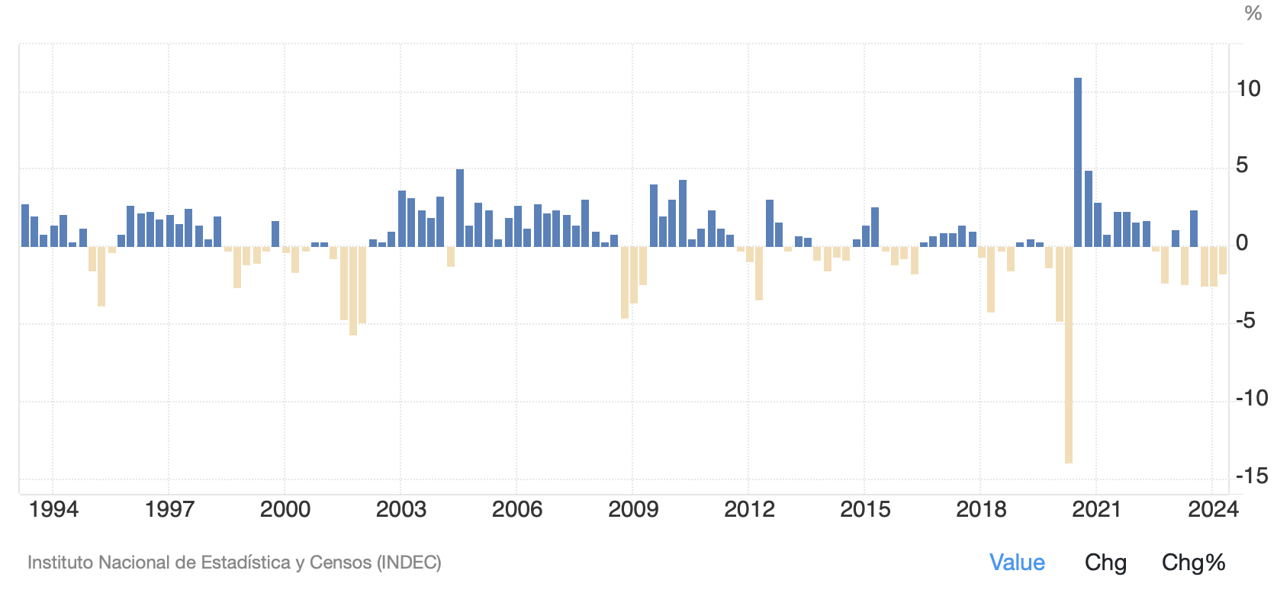
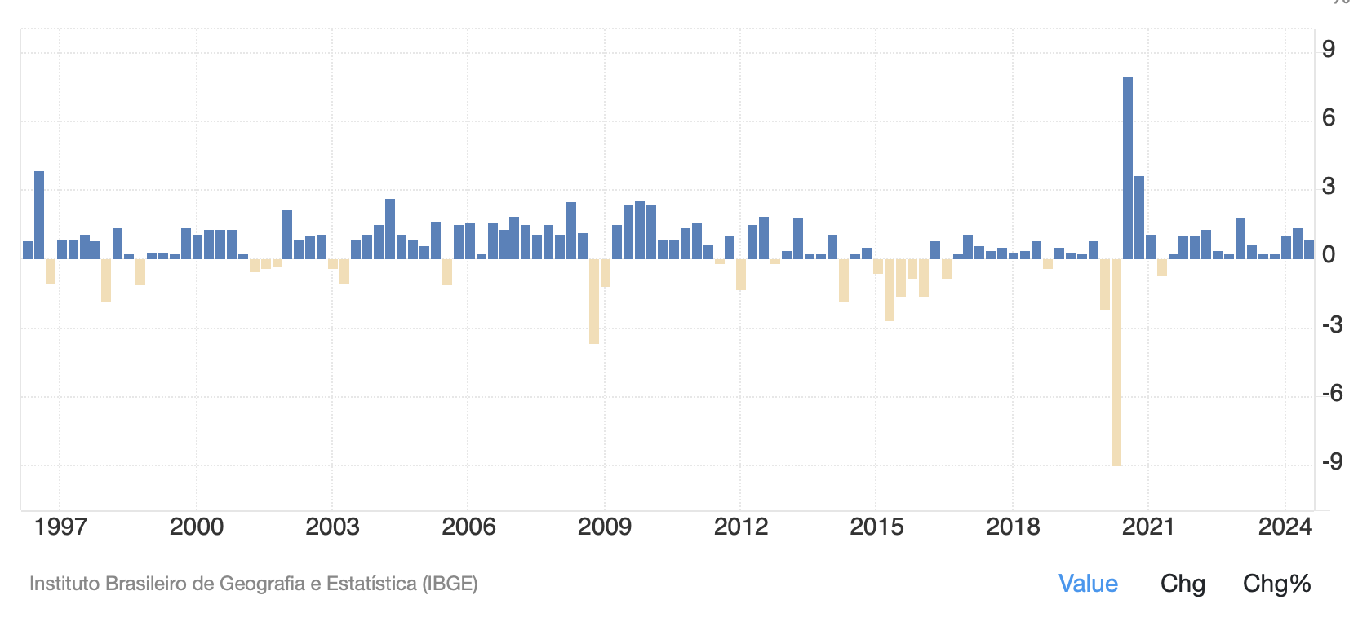
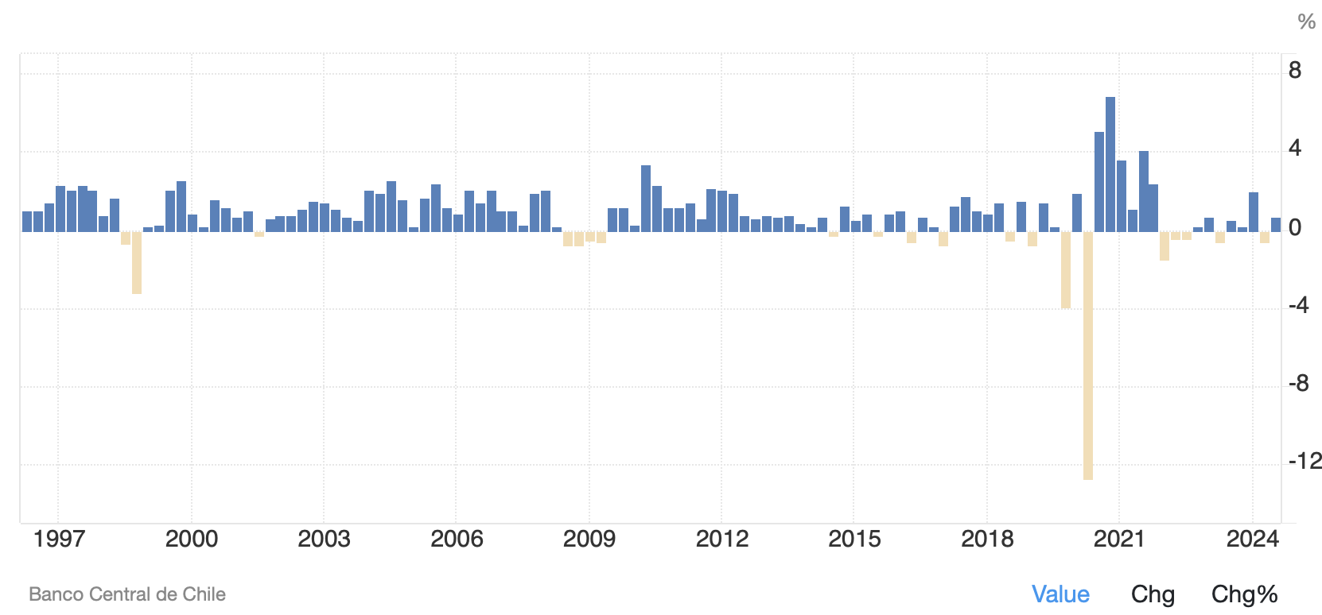
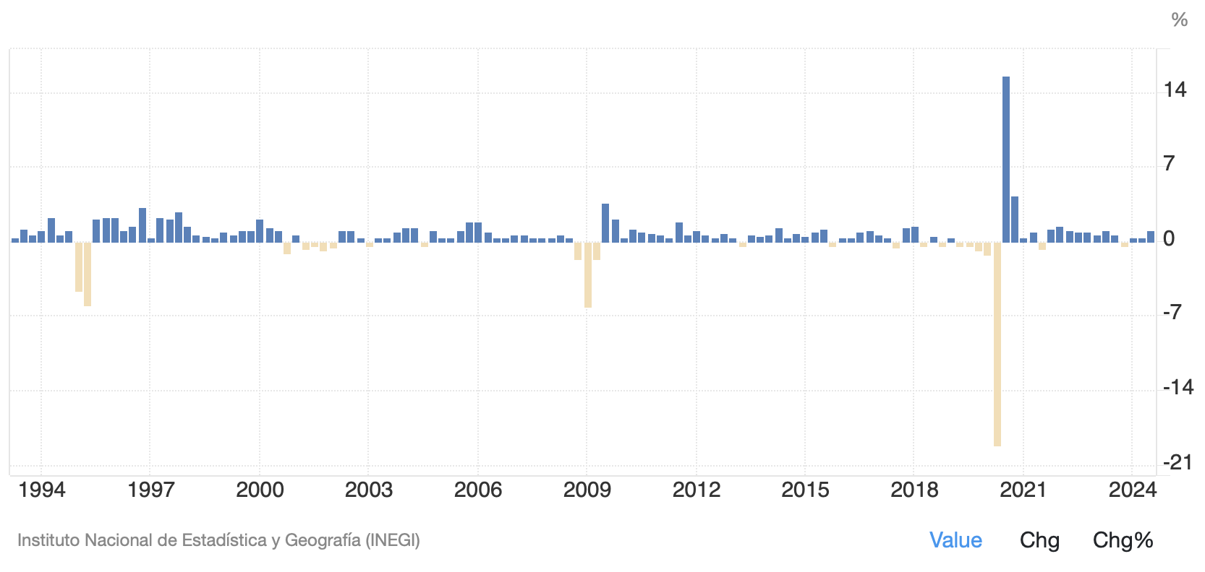
Argentina – GDP Growth
Brazil – GDP Growth
Chile – GDP Growth
Mexico – GDP Growth

Slide 36
Home
L = 1000 h
a_{LW} = 4
a_{LC} = 2
cheese
Foreign
L = 1000 h
a*_{LW} = 2
a*_{LC} = 4
wine
P_{c}/P_{w}
A: 2
P_{c}/P_{w} = 1
A: a*_{LC} / a*_{LW} = 4/2 = 2
B: a_{LC} / a_{LW} = 2/4 = 0.5
C: (L/a_{LC} ) / (L/a*_{LW}) = Q_{C} / Q*_{W} = 1000/2 / 1000/2 =1
B: 0.5
C:1
(Q_{C}+Q_{C}*)//(Q_{L} + Q*_{W})
P_{c}/P_{w} = 4 – 3
(Q_{C}+Q_{C}*)//(Q_{L} + Q*_{W})
P_{c}/P_{w} = 1 equilibrium price
1 Pound of cheese = 10 $
wage _{home} = 5 $ per hour
wage _{foreign} = 5 $ per hour

Slide 37
(interest parity condition). The interest rate in 1Y dollar denominated deposit is 4%. The Interest rate in 1Y euro denominated deposit is 2%. 1Y a-head expected exchange rate is 1.02 (units of dollar per 1 euro). What is the spot rate between the dollar and euro?
  0.9
  1
  1.18
  1.19
(DD-AA model) In the context of the DD-AA model a rise in the foreign price makes foreign goods more expensive. What will be the effect on output and exchange rate?
  DD shifts to the left causing an increase in output and a depreciation of the exchange rate.
  DD shifts to right causing an increase in output and an appreciation of the exchange rate
  DD shifts to right causing an increase in output and depreciation of the exchange rate.
  DD shifts to the left causing a decrease in output and an appreciation of the exchange rate,
(The Standard Model) – Which one of the following statements is true in the context of the Standard Model:
  A decline in the terms of trade increase a country’s welfare.
  In an open economy a change in the terms of trade is always beneficial.
  Autarchy can sometimes be a good solution.
  Opening up the Trade will change a country’s terms of trade (price of export in terms of import). That will always improve its welfare level with respect to a situation without trade (autarchy) proving that trade is always potentially beneficial.

Slide 38
(Question): Which of the following sentences is false?
(A): Under a monetary regime of fixed exchange rate, a given increases of government spending is more expansionary in terms of output than in a regime of floating exchange rate.
(B): Under a regime of floating exchange rate, the Central Banks can use the monetary policy to curb the business cycle.
(C): Under a regime of fixed exchange rate, the Central Bank can affect the money supply at its discretion.
(D): Under the Gold Standard, each country fixes a conversion rate between its currency and a quantity of gold and, consequently, all the exchange rates are fixed.
(Question): In the US a representative basket of goods costs 1100 $, in Europe the same representative basket of goods costs 1000 €. What is the exchange rate (units of dollar per euro) if the Purchasing Power Parity theory holds? The Fed decides to double the money stock. What will be the price of the basket of goods in the US and the exchange rate in the long run according to the Monetary Approach to the exchange rate?
(A): 1.1; 1100; 1.1
(B): 1.1; 2200; 2.2
(C): 0.9; 1100;0.9
(D): 0.9; 2000; 1.1
(Question): Which of the following sentences is false?
(A): The Gold Standard ended because countries start printing money to finance WWI.
(B): The Gold Standard was more stable in terms of price variability than the Bretton Woods period.
(C): The Gold Standard survived in the United States until 1932.
(D): During the Gold Standard, the level price did not grow very much because discoveries of new gold mines were very limited.

Slide 39
(Question): Which of the following sentences is correct?
(A): China which is a low productivity country, and therefore, a low wage country has a comparative advantage in the production of goods that use extensively unskill-labor.
(B): China is very competitive in the international market because has a very high labor productivity.
(C): Since Trade exploits poor countries, China’s workers receive a very low wage.
(D): China is very competitive because uses dumping policies.
(Question): Effects of alternative trade policies. Which of the following sentences is wrong:
(A): Tariffs decrease consumers surplus of the importing country, increase government revenues and have an ambiguous effect on overall national welfare
(B): Export subsidies decrease consumer surplus, decrease government revenues, increase overall national welfare.
(C): Import quotas decrease consumer surplus, have no effect on government revenues, have an ambiguous effect on overall national welfare.
(D): Tariffs - for a large country - decrease consumer surplus, increase government revenues, increase overall national welfare.
(Question): (money market and interest rate) Which of the following sentences is correct?
(A): An increase in the money supply induces an increase in the interest rate and an appreciation of money.
(B): An increase in the money supply induces a decrease in the interest rate and an appreciation of the currency.
(C): A decrease in the money supply induces an increase in the interest rate and an appreciation of the currency.
(D): A decrease in the money supply induces an increase in the interest rate and a depreciation of the currency.
(Question): Which of the following sentences is false?
(A): Under a regime of floating exchange rate, the Central Banks can use the monetary policy to curb the business cycle.
(B): Under a regime of fixed exchange rate, the Central Bank can affect the money supply at its discretion.
(C): Under the Gold Standard, each country fixes a conversion rate between its currency and a quantity of gold and, consequently, all the exchange rates are fixed.
(D):Under a monetary regime of fixed exchange rate, a given increases of government spending is more expansionary in terms of output than in a regime of floating exchange rate.

