Slide 1


Social Innovation
DR. ADEDAPO ADEBAJO

Slide 2

LECTURE:
SOCIAL BUSINESS MODEL CANVAS

Slide 3
Defining Business Model
There is no generally accepted definition of the term business model. The diversity of the definitions poses challenges for delimiting the nature and components of a model and determining what constitutes a business model. It also leads to confusion in terminology, as business model, strategy, business concept, revenue model, and economic model are often used interchangeably.

Slide 4
Defining Business Model
A business model is an outline for how your company plans to make money and create value.
In general, a business model explains four things:
  What product or service a company will sell.
  How it intends to market that product or service.
  What kind of expenses the company will face.
  How the company expects to turn a profit.

Slide 5
Defining Business Model
Amit & Zott (2001) assert that “business model” depicts the content, structure and governance of transactions designed to create value through the exploitation of business opportunities.
Margretta (2002) defines business models as stories that explain how enterprises work.
Osterwalder, Pigneur & Tucci (2005) define business model as the rationale of how an organization creates, delivers, and captures value.
By using the term of organization, Osterwalder, Pigneur & Tucci does not exclude organizations that is not normally associated with business in business model, such as non-profit organizations, charities, public sector entities and for-profit social ventures.

Slide 6
Defining Business Model
Osterwalder & Pigneur (2010) argue that every organization has a business model, because it must generate enough revenue to cover its expenses to survive.
The only difference between traditional business enterprise and social enterprise concerns the focus of the organization.
Business enterprise focuses more on financial returns or shareholder value, while social enterprise focuses more on ecology, social causes, and public service mandates.
They use the term “beyond-profit business models” to characterize business models for organizations that are not traditional for-profit companies.
They further split these “beyond-profit business models” into two categories: third-party funded enterprise models and triple bottom line business models.

Slide 7
Business Model Canvas
Business Model Canvas allows business model to be simple, relevant and intuitively understandable, while not oversimplifying the complexities of how enterprises function (Osterwalder & Pigneur, 2010 p.15).
The Canvas becomes a shared language and a useful tool for stakeholders to talk about business model.

Slide 8
Business Model Canvas
For social enterprise, which Osterwalder & Pigneur consider as “beyond-profit business models”, they adjust the Canvas accordingly to fit the requirement of a social enterprise to define and further innovate its business model.
In third-party funded enterprise model, the product or service recipient is not the payer. The payer is a third party, which might be a donor. The third party pays the organization to fulfil a mission, which may be a social, ecological, or public service nature. Examples are philanthropy, charities and government

Slide 9
Business Model Canvas
For triple bottom line business models, the Canvas is extended at the bottom with two new building blocks: the social and environmental costs and the social and environmental benefits, consistent with its values: People, Profit and Planet
The triple bottom line model seeks to minimize negative social and environmental impacts and maximize the positive.

Slide 10
Social Business Model Canvas
Since 2008 hundreds of different version of Osterwalder’s original Canvas have spread out. But most importantly, practitioners noticed that the Business Model Canvas was a great tool for describing profit-oriented organizations, but not socially-oriented ones.
The Canvas failed to highlight key components of non-profit initiatives, particularly those related to their beneficiaries and impact missions.
Thus, the Social Business Model Canvas came to life. Created by Social Innovation Lab (2013), this Canvas builds on the previous one and is commonly used by social enterprises, as it considers all the necessary components needed to achieve both social and economic sustainability.

Slide 11
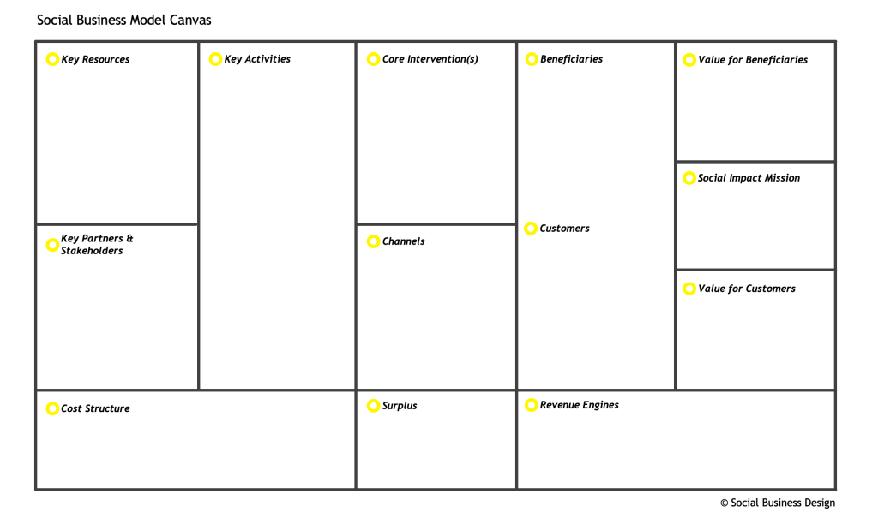

Slide 12
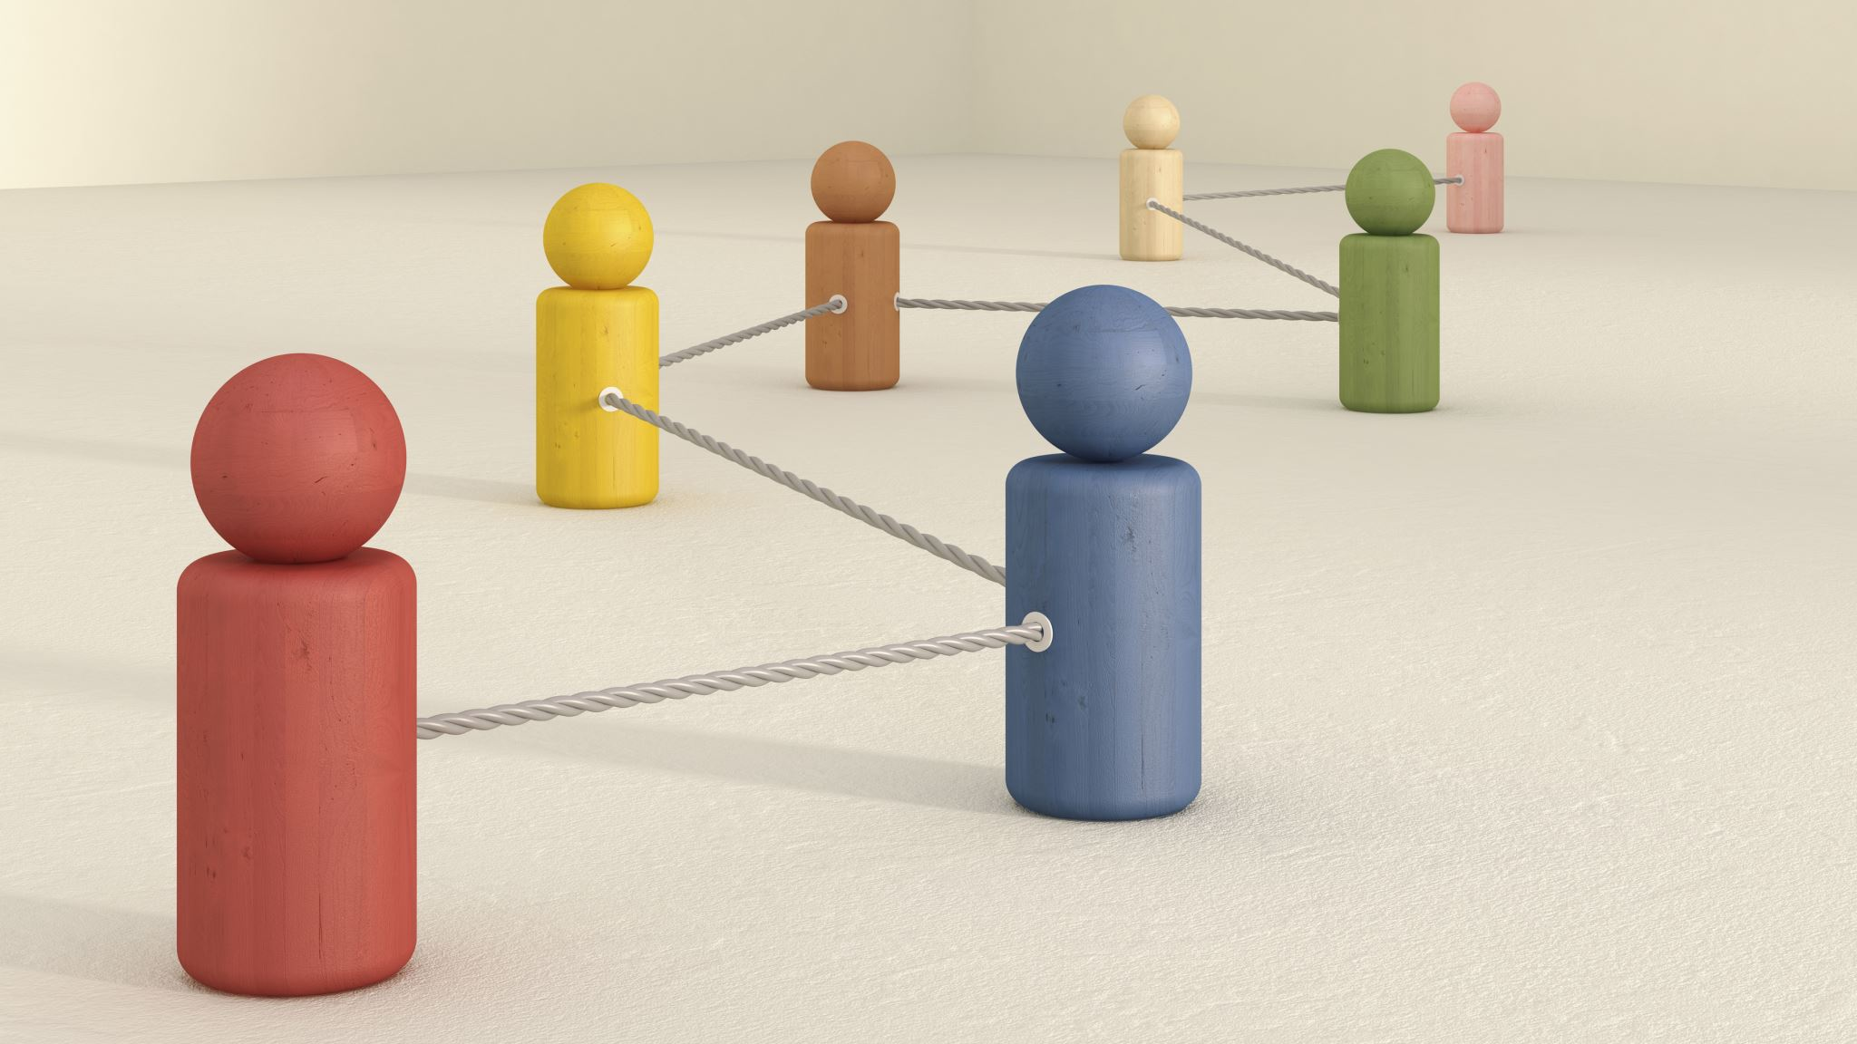
Social Impact Mission
Socially-oriented enterprises all aim to change society for the better. This block is meant to highlight the ultimate social change the organization aims to generate.

Slide 13

Beneficiaries
The term “beneficiaries” we usually refer to those targets mostly affected by the social problem tackled. In other words, people whose lives the organization wants to radically improve. In this block, it’s important to clearly identify target groups through segmentation criteria such as demographics, geographics, psychographics and behaviours.

Slide 14

Core intervention
In other words, the core product, service or solution offered. A company may have one or more core offerings, especially when beneficiaries and customers differ. So, it’s important to list them all in here.

Slide 15

Value for Beneficiaries
When we talk about “value”, we usually refer to the main benefits of using a certain product, service or solution. In this block, we therefore highlight all the pain relievers and gains provided to beneficiaries thanks to the core intervention.

Slide 16
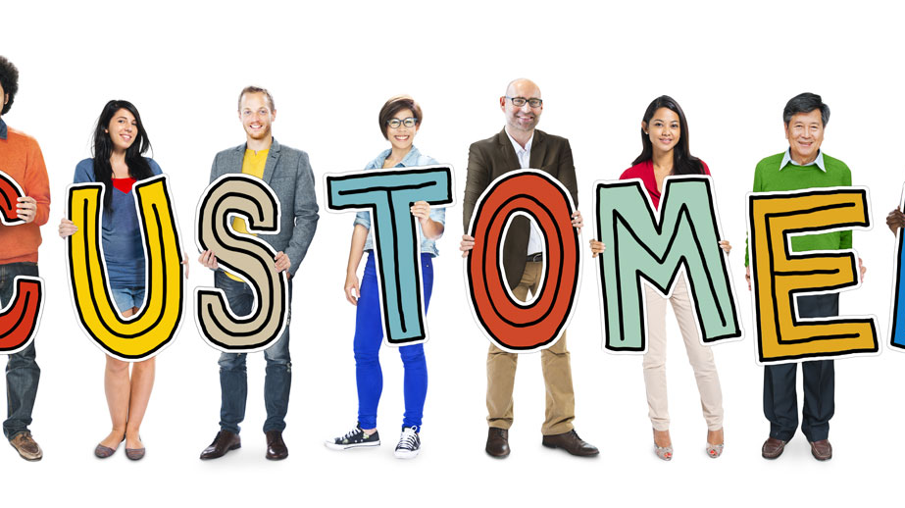
Customers
Sometimes, beneficiaries can pay for the product or service offered. When it happens, they are also the actual customers of the social enterprise. But most frequently, beneficiaries can’t afford doing that.
Thus, third (paying) parties are needed. They can be companies, individuals, foundations, public authorities, just to name a few. This block shows who the ultimate payers truly are.

Slide 17
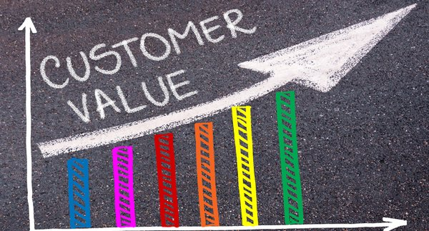
Value for Customers
This refers to how much a product or service is worth to a customer. It's a measure of all the costs and benefits associated with a product or service.

Slide 18
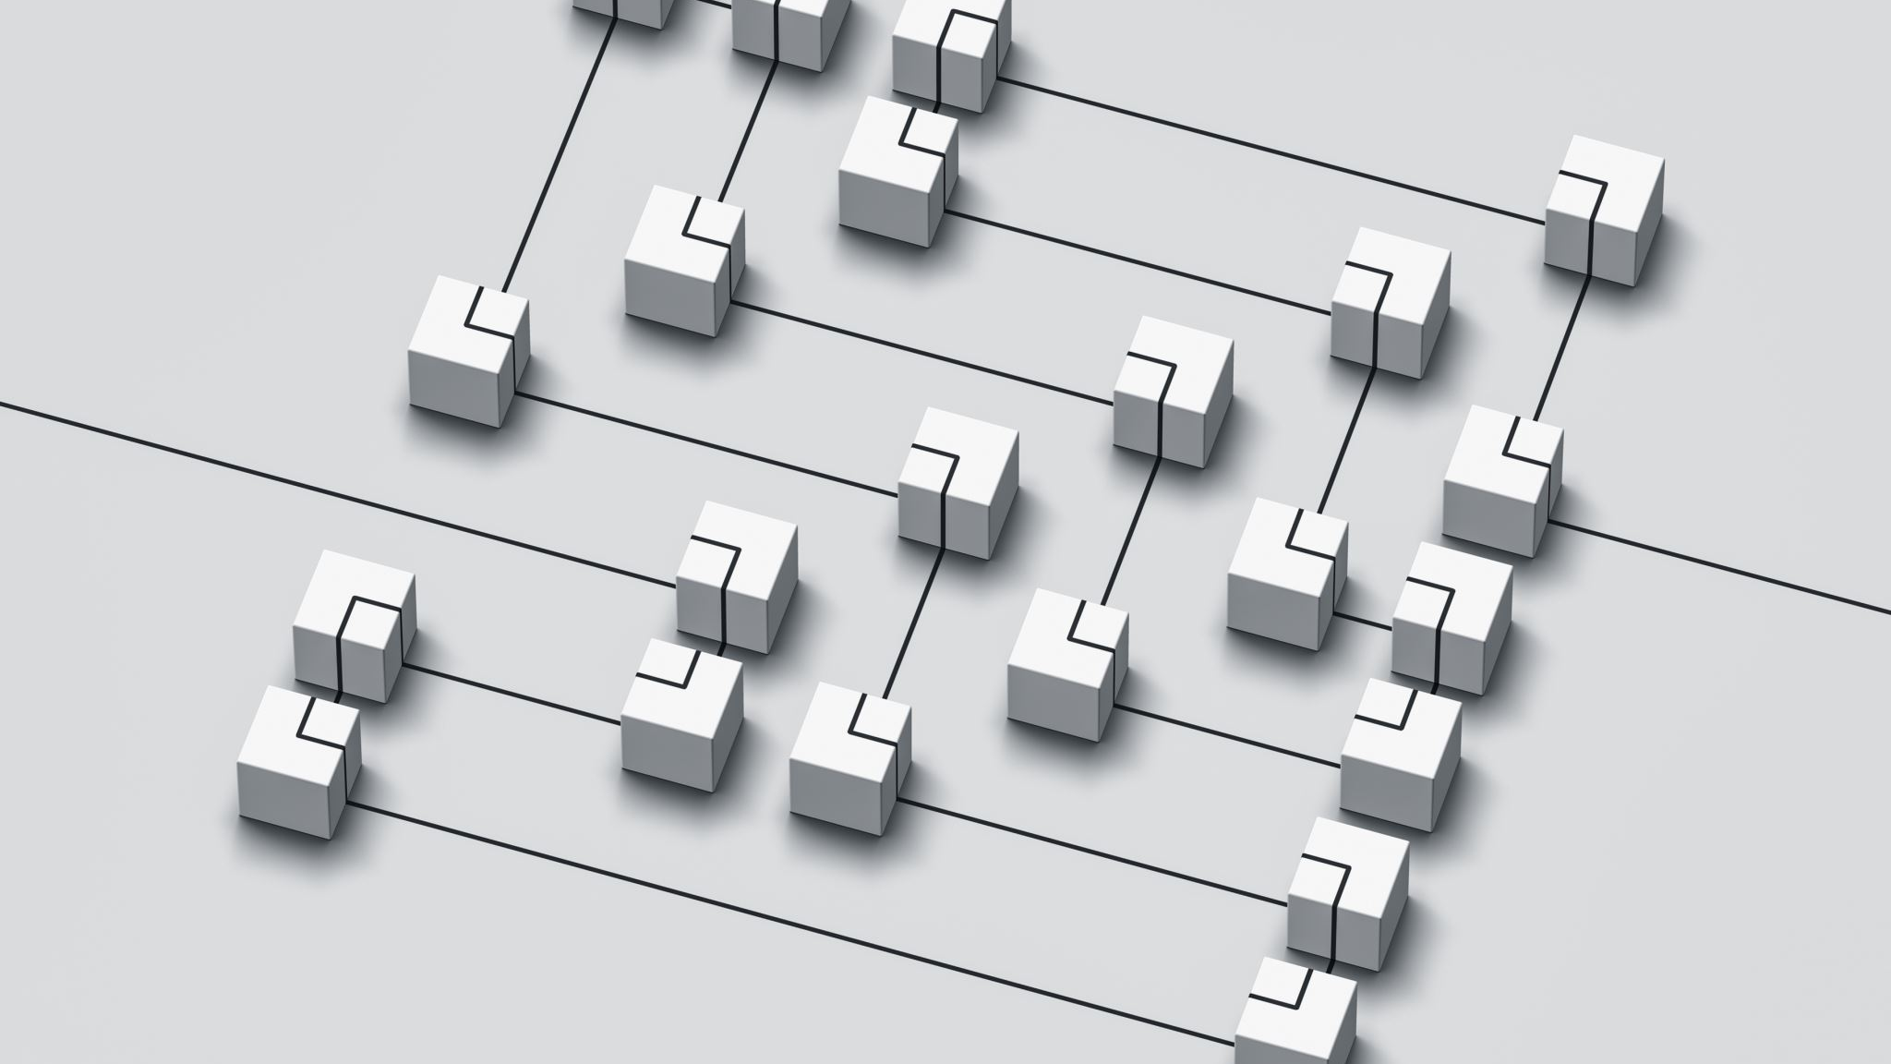
Channels
This block lists all the main channels used by the company to get in touch, communicate and engage with the public, as well as to sell and deliver its solution. They can be either physical or digital, owned or indirect.

Slide 19

Key Activities
Time to think about what’s needed to carry out all that has been included in the previous blocks. So, this section highlights all the mission-critical activities needed to keep the business up and running. Production, marketing, R&D, community engagement may be couple examples of that, but every enterprise has its own.

Slide 20

Key Resources
Fundamental resources can be physical, intellectual, human, technological or financial. Without them, it won’t be possible for the company to carry out any of the activities and operations mentioned above.

Slide 21

Key Partners
In this block, we include those players (public and private) that provide key external resources or support for the business model to work. However, partners and stakeholder should not be conflated as they are not the same.

Slide 22

Cost Structure
Creating and delivering a product or service results in costs and expenses. In this block, we consider the major elements of cost impacting the business. These may include staff, technology, infrastructure, advertisement, and so forth.

Slide 23

Revenue Engines
Social enterprises usually rely on a mix of different revenue streams to become (and remain) financially viable. This section lists all the different ways the organization generates such revenues – those otherwise known as “revenue engines”.
For instance, a company may sell its solutions either through one-time purchases or through recurring ones (i.e. subscription, rental). Again, other engines may include intermediary fees, sponsorships, or even donation-based streams.

Slide 24

Surplus
Finally, this block explains how the company intends to use the surplus, when generated. Examples of that may include reinvesting it to further increase the reach of impact or even donating it to related causes.

Slide 25
Benefits of SBMC
The Social Business Model Canvas (SBMC) builds on Alex Osterwalder’s previous work. Because of the way it is designed, there are several reasons why social entrepreneurs can benefit from using it:
Firstly, the Canvas helps bringing the team together around the table to discuss business models using a shared (visual) language.
Secondly, this tool fosters both creativity and analysis, as teams can use it for both sketching new business models or analysing existing ones.
Lastly, the Social Business Model Canvas can be also used with external stakeholders, since it helps describing key components of a business model in a concise, effective manner.

