Slide 1


Social Innovation
DR. ADEDAPO ADEBAJO

Slide 2

LECTURE:
SOCIAL JUSTICE AND SUSTAINABLE ENTERPRISE

Slide 3
Sustainability and Sustainable Development
Sustainable development is the overarching paradigm of the United Nations. The concept of sustainable development was described by the (1987) Brundtland Commission Report as “development that meets the needs of the present without compromising the ability of future generations to meet their own needs” (United Nations General Assembly 1987, 24).
There are four dimensions to sustainable development society, environment, culture, and economy which are intertwined, not separate.

Slide 4
Sustainable Development
Social
Economic
Biological

Slide 5

Social System
Social system goals, such as citizen participation and social justice, guide the inclusion of citizens in decision making regarding resource provision and management.

Slide 6
Economic System
The economic system goals of efficiency, equity in distribution, and social welfare improvements assure fairness in allocation of resources and reduction of waste in the provision and distribution of goods and services

Slide 7
Biological System
Biological system goals, including genetic diversity, resilience, and biological productivity, create balance between natural capital and human resource use
Notes:
These goals form the ground work for the sustainable development theoretical framework.

Slide 8
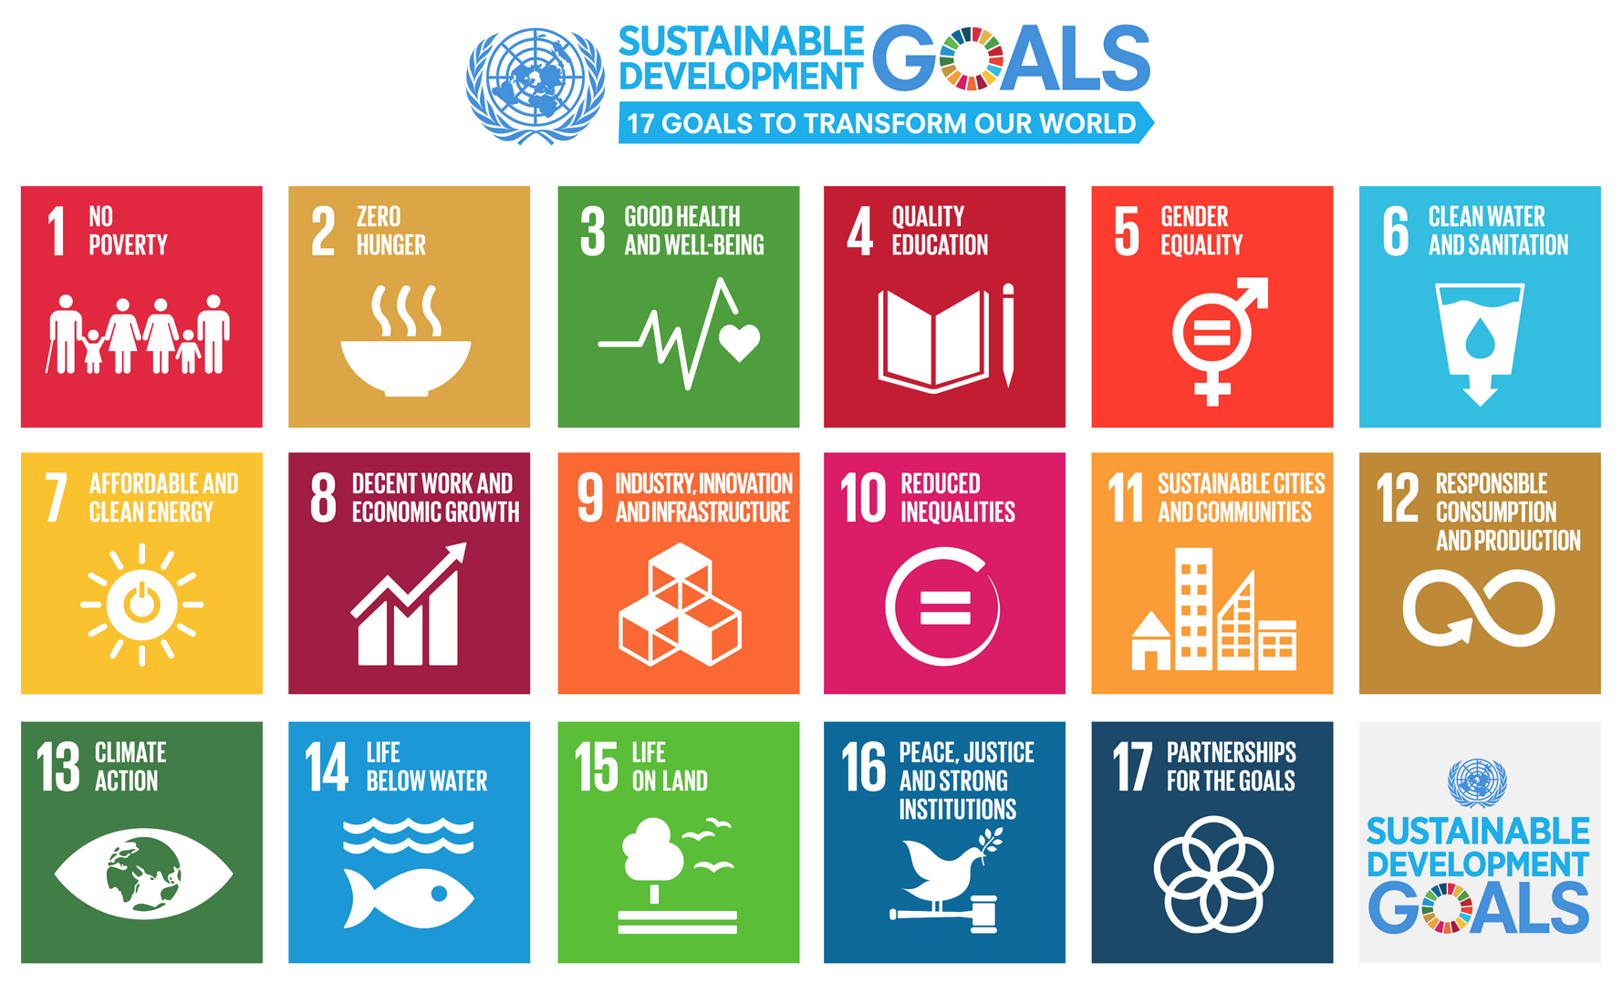
Business and Sustainability
To encourage sustainability across sectors, the United Nations created 17 Sustainable Development Goals (SDGs) to mend some of the world’s most pressing problems, giving every actor a role to play. From economic growth to clean energy, gender equality, clean water, education for all, sustainable cities, and responsible consumption, the goals have the potential to be met by 2030 if a combination of companies, individuals, and governments commit to their success.

Slide 9

Businesses and Sustainability
Business stakeholders increasingly recognize the need for greater coverage of sustainability issues, corporate social responsibility (CSR), and corporate citizenship.

Slide 10
Corporate Social Responsibility
CSR is understood as supporting activities with a strong focus on civil society. CSR also often includes the relations to local and national governments and the acceptance of governance responsibility (Schrader 2003).
CSR as the management of a company’s positive impact on society and the environment through its operations, products, or services and through its interaction with key stakeholders such as employees, customers, investors, and suppliers

Slide 11
CSR, CS and CR
Corporate Social Responsibility
Corporate Responsibility
Corporate Sustainability
From a business perspective, the areas of corporate sustainability, corporate responsibility, and corporate social responsibility (CSR) all seek to address these issues by transcending the core responsibilities of businesses (i.e., to make proﬁts) to noneconomic (or better pre-economic) aspects such as ecological and social responsibilities.

Slide 12
Sustainable Business
People
Profit
Planet
Sustainable businesses see each focus of their triple bottom line — people, planet, and profits — as a priority, and they use their influence and creativity as a business to create a positive impact on the communities around them.
A sustainable business considers the triple bottom line: people, planet, and profits. Each of these elements are equally important for the sustainable business to not only do no harm, but to actively lead initiatives and create products that bring benefits to all stakeholders, from local communities, people throughout the supply chain, and ultimately the customer.

Slide 13

Sustainable Enterprise
Sustainable enterprise is an organization that can anticipate and meet the needs of present and future generations of customers and stakeholders through creating and innovating new business strategies and activities that accelerate positive social change, protect and preserve environmental integrity, while enhancing business performance.

Slide 14

Sustainable Enterprise
Sustainable enterprise incorporates principles of sustainability into each of its business decisions, it supplies environmentally friendly products or services that replaces demand for nongreen products and/or services, it is greener than traditional competition, and has made an enduring commitment to environmental principles in its business operations

Slide 15
A company truly becomes a sustainable enterprise when its sustainability vision is aligned with its business goals.
Sustainability
Vision
Business Goals

Slide 16
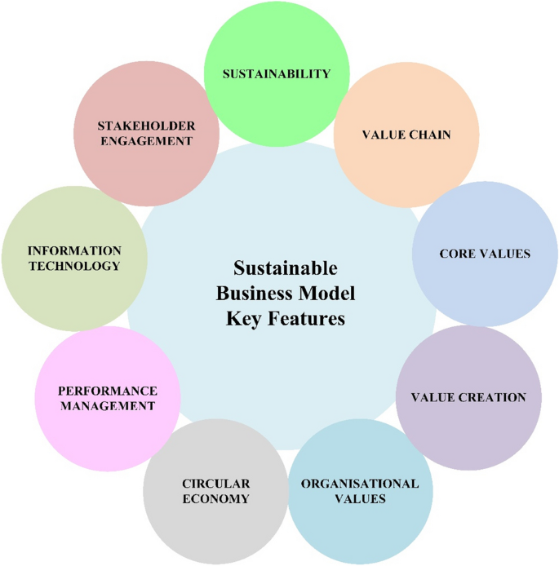
How Companies Become Sustainable Enterprises
Corporations integrate the social and environmental issues and challenges into their business strategy and operations.

Slide 17
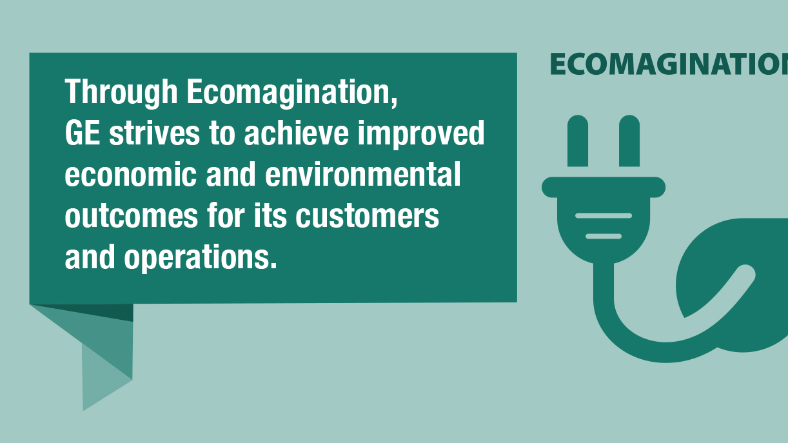
For example, General Electric CEO Jeff Immelt announces a new initiative, “ecomagination,” committing the mega-manufacturer to double its investment in environmental products – everything from energy-saving light bulbs to industrial-sized water puriﬁcation systems and more efﬁcient jet engines.
Backed by a multimillion-dollar ad campaign, Immelt positions GE as the cure for many of the world’s environmental ills.

Slide 18
Attributes of Sustainable Enterprises
Sustainability becomes part of the organization’s DNA in such a way that every decision is made within the context of whether or not it supports or detracts from the organization’s sustainability vision.
Sustainable enterprises innovate solutions to society’s greatest needs.
Their products are leading edge and globally sought after. They break into new markets and deﬁne them.
They see opportunities where others see insurmountable challenges.
Their practices are ahead of government legislation.

Slide 19
Linking Sustainable Enterprise and Social Justice
Social justice is a moral and political construction aimed at equal rights and collective solidarity, advocating for a more just society, assured by the redistribution of wealth, and realize its perpetual state of injustice.
Social justice is based on equal rights of any person and the possibility of all human beings, without any discrimination, to benefit from economic and social progress, irrespective of the political or social-economic doctrine

Slide 20



Corporate Social Justice

Slide 21
Corporate Social Justice
Despite many organizations making great strides when it comes to CSR, it’s often tacked on to the end of the campaign. It has no legal or social obligation for organizations to effect change.
Corporate social justice, on the other hand, requires organizations to deeply integrate how they’re behaving internally to how they behave externally. It’s built to create positive, societal change. It becomes, then, a necessity of how an organization operates, not just a marketing strategy.

Slide 22
Defining Corporate Social Justice
According to the Harvard Business Review, corporate social justice is a framework “regulated by the trust between a company and its employees, customers, shareholders, and the broader community it touches, with the goal of explicitly doing good by all of them.”
Companies are increasingly taking a stand on social justice issues, for reasons both moral and profit-making.

Slide 23
CSJ and CSR: The Difference
Corporate Social Justice is a reframing of CSR that centers the focus of any initiative or program on the measurable, lived experiences of groups harmed and disadvantaged by society.
Where CSR is often realized through a secondary or even vanity program tacked onto a company’s main business, Corporate Social Justice requires deep integration with every aspect of the way a company functions.
Corporate Social Justice is a new paradigm that imagines a healthier and mutually beneficial relationship between companies and the communities they interact with. It is driven by the growing desire of socially-aware consumers and employees for companies, especially socially-conscious and forward-thinking companies, to do better.

Slide 24
Social Innovation
Corporate Social Justice
Sustainable Development

Slide 25
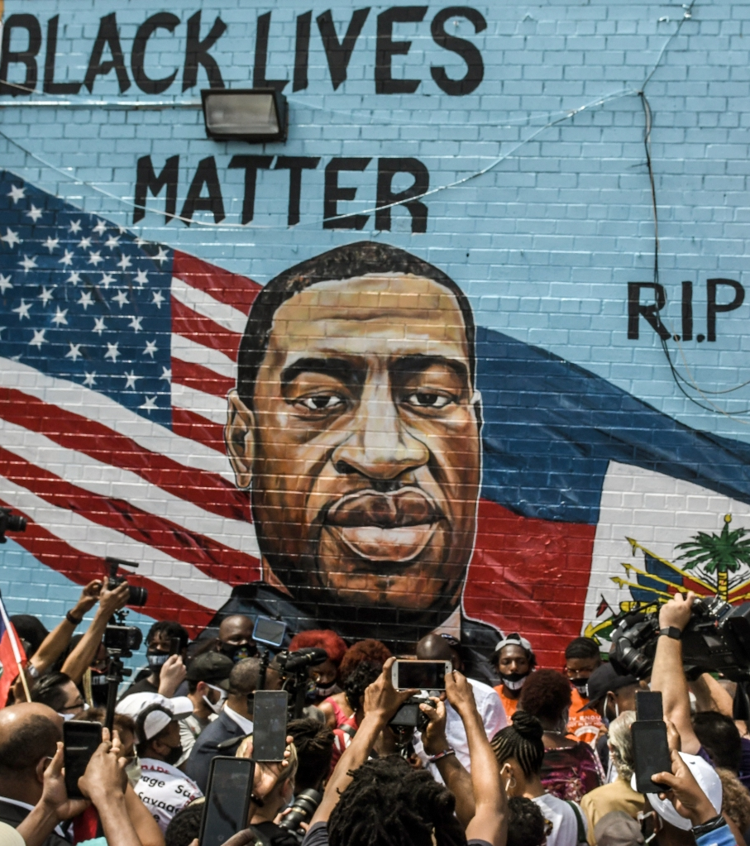
Example One
The May 2020 killing of George Floyd by a white police officer was a major catalyst. Some companies posted black squares on their social media pages for Black Out Tuesday, a social media event that sought to amplify Black voices. Some released statements of solidarity on their social media accounts. Some provided a platform for their Black employees to provide their experiences on being Black in America. And others revamped or adopted Diversity, Equity, and Inclusion departments, provided racial bias training, or implemented goals on hiring, retaining and promoting more Black employees.

Slide 26

Example Two
Recently, with the implementation of the Texas anti-abortion law, some companies immediately got involved in fighting against the law. Uber and Lyft created defense funds to protect their drivers from lawsuits arising from transporting women to abortion clinics

Slide 27

Example Three
In September 2021, more than 50 business signed an open letter criticizing the Texas abortion law indicating that not only did it go against reproductive rights, but it was also bad for business, making it difficult to recruit talent from out of state and to retain employees due to a lack of reproductive well-being.

Slide 28
https://www.youtube.com/watch?v=yetFk7QoSck
https://www.youtube.com/watch?v=DWsUrMfDaG4
https://www.youtube.com/watch?v=cvb49-Csq1o
https://www.youtube.com/watch?v=gt-ga9hdZ0w
https://www.youtube.com/watch?v=OSNxs1o-2DU

Slide 29

Social Entrepreneurship

Slide 30
Social Entrepreneurship
On the positive side, it connotes a special, innate ability to sense and act on opportunity, combining out-of-the-box thinking with a unique brand of determination to create or bring about something new to the world.
On the negative side, entrepreneurship is an ex-post term, because entrepreneurial activities require a passage of time before their true impact is evident.
Notes:
Any definition of the term “social entrepreneurship” must start with the word “entrepreneurship.” The word “social” simply modifies entrepreneurship.

Slide 31
Defining Entrepreneurship

Slide 32
Schumpeter’s Perspective
Schumpeter’s entrepreneurial spirit, who identifies a commercial opportunity – whether a material, product, service, or business – and organizes a venture to implement it.
Successful entrepreneurship, he argues, sets off a chain reaction, encouraging other entrepreneurs to iterate upon and ultimately propagate the innovation to the point of “creative destruction,” a state at which the new venture and all its related ventures effectively render existing products, services, and business models obsolete.

Slide 33
Drucker’s Perspective
Peter Drucker, on the other hand, does not see entrepreneurs as necessarily agents of change themselves, but rather as canny and committed exploiters of change. According to Drucker, “the entrepreneur always searches for change, responds to it, and exploits it as an opportunity,”3 a premise picked up by Israel Kirzner, who identifies “alertness” as the entrepreneur’s most critical ability.

Slide 34

Entrepreneurship
Regardless of whether they cast the entrepreneur as a breakthrough innovator or an early exploiter, theorists universally associate entrepreneurship with opportunity.
Entrepreneurs are believed to have an exceptional ability to see and seize upon new opportunities, the commitment and drive required to pursue them, and an unflinching willingness to bear the inherent risks

Slide 35

Entrepreneurship
Entrepreneurship describes the combination of a context in which an opportunity is situated, a set of personal characteristics required to identify and pursue this opportunity, and the creation of a particular outcome.
It is important to dispel the notion that the difference can be ascribed simply to motivation – with entrepreneurs spurred on by money and social entrepreneurs driven by altruism.
Notes:
The truth is that entrepreneurs are rarely motivated by the prospect of financial gain, because the odds of making lots of money are clearly stacked against them. Instead, both the entrepreneur and the social entrepreneur are strongly motivated by the opportunity they identify, pursuing that vision relentlessly, and deriving considerable psychic reward from the process of realizing their ideas
Regardless of whether they operate within a market or a not-for-profit context, most entrepreneurs are never fully compensated for the time, risk, effort, and capital that they pour into their venture

Slide 36
Entrepreneurship- Commercial vs Social
The critical distinction between entrepreneurship and social entrepreneurship lies in the value proposition itself.
For the entrepreneur, the value proposition anticipates and is organized to serve markets that can comfortably afford the new product or service, and is thus designed to create financial profit
The social entrepreneur, however, neither anticipates nor organizes to create substantial financial profit for his or her investors – philanthropic and government organizations for the most part – or for himself or herself. Instead, the social entrepreneur aims for value in the form of large-scale, transformational benefit that accrues either to a significant segment of society

Slide 37
Entrepreneurship- Commercial vs Social
Unlike the entrepreneurial value proposition that assumes a market that can pay for the innovation, and may even provide substantial upside for investors, the social entrepreneur’s value proposition targets an underserved, neglected, or highly disadvantaged population that lacks the financial means or political clout to achieve the transformative benefit on its own.
This does not mean that social entrepreneurs as a hard-and-fast rule shun profitmaking value propositions. Ventures created by social entrepreneurs can certainly generate income, and they can be organized as either not-for-profit or for-profit.

Slide 38
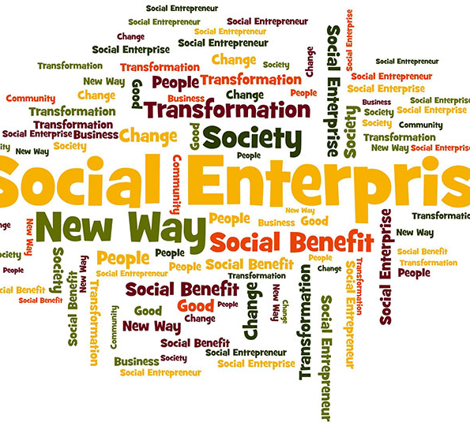
Social Entrepreneurship
What distinguishes social entrepreneurship is the primacy of social benefit, what Duke University professor Greg Dees in his seminal work on the field characterizes as the pursuit of “mission-related impact.

Slide 39
Components of Social Entrepreneurship
Social entrepreneurship as having the following three components:
Identifying a stable but inherently unjust equilibrium that causes the exclusion, marginalization, or suffering of a segment of humanity that lacks the financial means or political clout to achieve any transformative benefit on its own.
Identifying an opportunity in this unjust equilibrium, developing a social value proposition, and bringing to bear inspiration, creativity, direct action, courage, and fortitude, thereby challenging the stable state’s hegemony.
Forging a new, stable equilibrium that releases trapped potential or alleviates the suffering of the targeted group, and through imitation and the creation of a stable ecosystem around the new equilibrium ensuring a better future for the targeted group and even society at large.

Slide 40

Questions

