Slide 1


Social Innovation
DR. ADEDAPO ADEBAJO
SEMINAR THREE

Slide 2




SIX STAGES OF SOCIAL INNOVATION

Slide 3
Prompts, Inspirations and Diagnoses
Framing the question
Recognising the problem
Proposals and Ideas
Finding the right answer
Prototyping and Pilots
Prototypes, pilots & trials
Finance for emerging ideas
Sustaining
Scaling
Systemic Change
Creating a business
From symptom to cause
Imagining the solution
Thinking differently
Open innovation
Participation
Facilitating participation
Institutions
Ownership and organisational form
Governance
Organisational models
Operations
Venture finance
Public sector
Generative diffusion
Inspiration
Diffusing demand
Scaling and diffusion in the public sector
Commissioning and procurement
Transmitters
Suppliers of innovation
Organisation and scale

Slide 4


STAGE TWO

Slide 5

Proposals and Ideas

Slide 6
Finding the right answer
Asking the right question is the first step to finding the right answer. But once the right question has been framed, there are a series of methods for searching out and suggesting solutions.
The way an innovation is developed is just as important as the innovation itself. The two are linked: the process will have an impact on the kind of innovation developed.
In most cases the success of the innovation will rest on the participation and involvement of a wide variety of interests – the users and beneficiaries of the innovation as well as the producers and suppliers.

Slide 7
Imagining Solutions
There are a series of methods, especially within the field of design, which bring people together to develop solutions. Often this is called ‘co-design’.

Slide 8
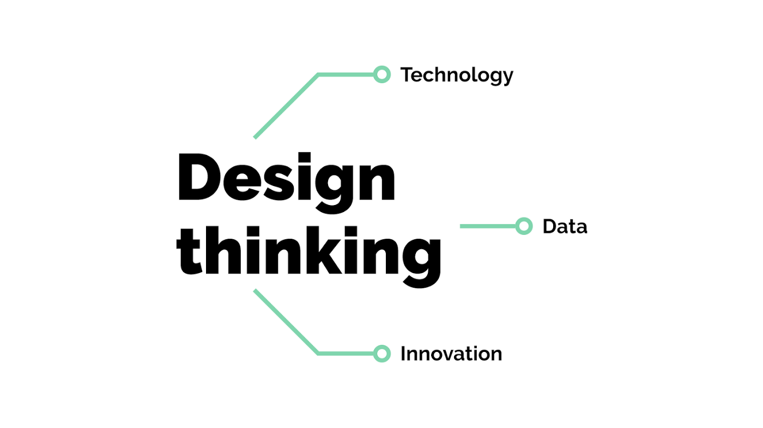
User-led Design/Design Thinking
Users are often best placed to identify their own needs and come up with ideas about how best to meet them. In practice much of what is called ‘user-led design’ would be better described as ‘user engagement in design’, with designers and professionals still playing key roles as orchestrators and facilitators.

Slide 9

Re-designing services
Notes:
One recent example is IDEO’s work with the SPARC centre at the Mayo Clinic (see-plan-act-refine-communicate), which involved turning an internal medicine wing into a laboratory designed to improve patient-provider experiences. The team turned an internal medicine wing into a ‘four-zone journey’ through which patients proceed: starting with the Service Home Base, moving to the Visitor-Facing Hub which leads to the Preparation Service Area before finally reaching Innovation Central. The wing is now a permanent section of the clinic where staff and doctors can develop and prototype new processes for improving service delivery.

Slide 10
c. Other types
Creative thinking methods
Continuous management system
Engaging citizens through the media

Slide 11
Thinking Differently
Start with the user
Review extremes
Visiting

Slide 12
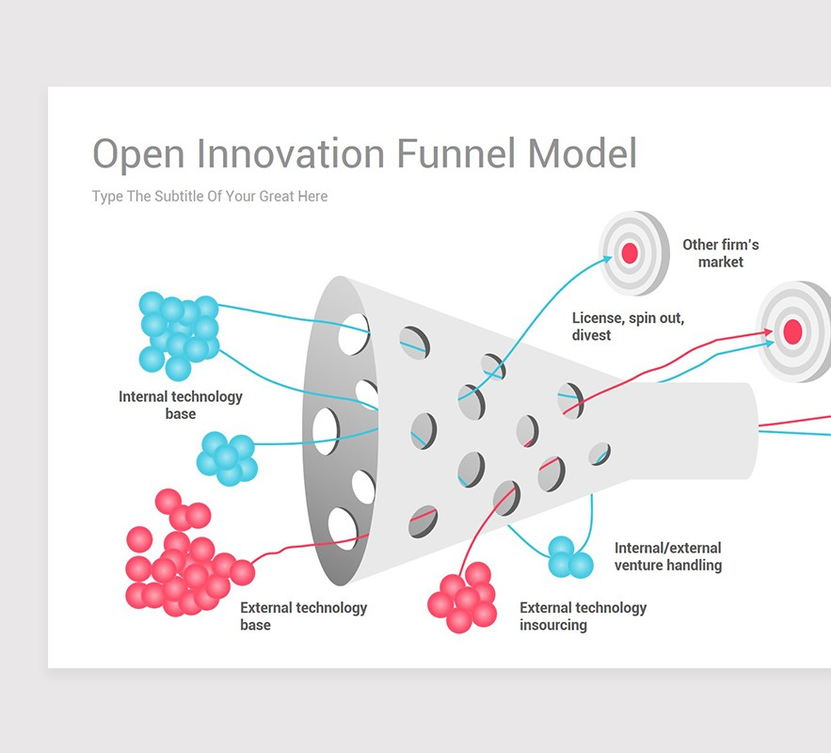
Open Innovation
Notes:
Open innovation describes the process of harnessing the distributed and collective intelligence of crowds. It is based on a number of principles, including: collaboration, sharing, self-organisation, decentralisation, transparency of process, and plurality of participants.

Slide 13

Citizen
Participation

Slide 14

Institutions

Slide 15

Think Tanks

Slide 16

Consulting Firms

Slide 17

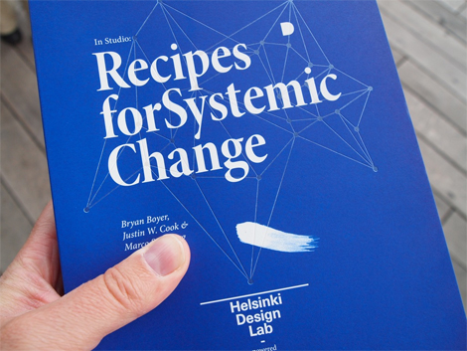
Design Labs
Notes:
In Finland, the national innovation agency SITRA has set up the Helsinki Design Lab, to see how design can be used as a strategic tool to tackle the complex and systemic challenges facing contemporary Finnish society.

