Slide 1
Introduction to
International economics
Lecture 7
Paolo Paesani
University of Rome Tor Vergata
ALEF Department
23/09/2025

Slide 2
Exchange rates and the FOREX market
Nominal exchange rates are determined within the foreign exchange market.
The foreign exchange market (also known as forex, FX, or the currency market) is an over-the-counter global marketplace that determines the exchange rate for currencies around the world. Participants are able to buy, sell, exchange, and speculate on currencies. Foreign exchange markets are made up of banks, foreign exchange dealers, commercial companies, central banks, investment management firms, hedge funds, retail forex dealers, and investors.
It is, by far, the largest financial market in the world and is comprised of a global network of financial centers that transact 24 hours a day, closing only on the weekends.
Currencies are always traded in pairs, so the "value" of one of the currencies in that pair is relative to the value of the other.
https://www.investopedia.com/terms/forex/f/foreign-exchange-markets.asp

Slide 3
Exchange rates and the FOREX market, 2
This determines how much of country A's currency country B can buy, and vice versa. Establishing this relationship (price) for the global markets is the main function of the foreign exchange market. This also greatly enhances liquidity in all other financial markets, which is key to overall stability.
The value of a country's currency depends on whether it is a "free float" or "fixed float". Free floating currencies are those whose relative value is determined by free market forces, such as supply / demand relationships. A fixed float is where a country's governing body sets its currency's relative value to other currencies, often by pegging it to some standard.
Free floating currencies include the U.S. Dollar, Japanese Yen and British Pound, while examples of fixed floating currencies include the Chinese Yuan and the Indian Rupee.
https://www.investopedia.com/terms/forex/f/foreign-exchange-markets.asp

Slide 4
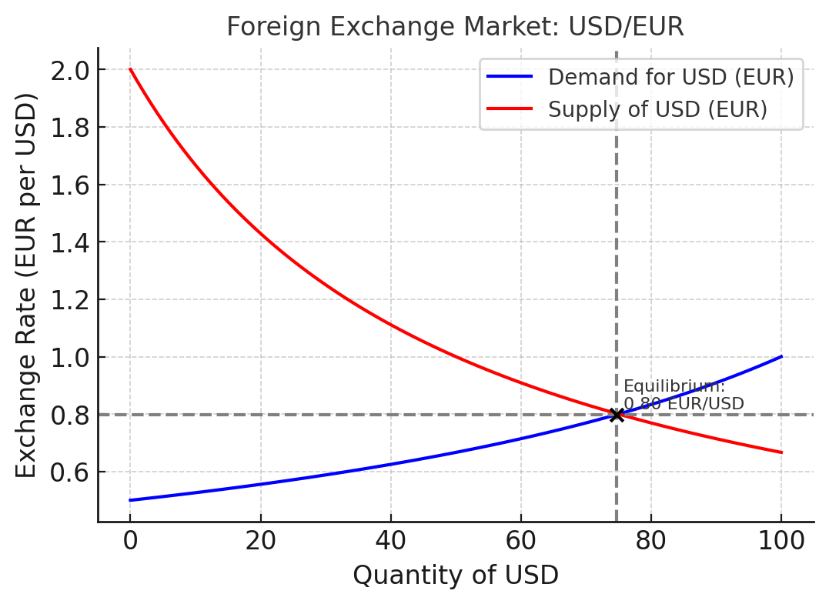
Foreign Exchange Market: USD/EUR (floating)
https://chatgpt.com/

Slide 5
Who Demands USD (in Exchange for EUR)?
European importers buying U.S. goods and services and invoicing in dollars.
European investors purchasing U.S. financial assets.
U.S. investors in Europe repatriating their funds.
European tourists travelling to the United States.
Speculators expecting USD to appreciate / EUR to depreciate.
European governments and central banks are acquiring US dollar reserves in order to prevent the euro from appreciating too much.
FED Reserve to prevent the dollar from depreciating too much.

Slide 6
Who Supplies USD (in Exchange for EUR)?
American importers buying European goods and services and invoicing in Euros.
European exporters to the US (invoicing in USD and then exchanging USD into EUR)
American investors purchasing European financial assets.
European investors in the US repatriating their funds
American tourists travelling to Europe.
Speculators expecting USD to depreciate / EUR to appreciate.
U.S. government or Federal Reserve reducing USD reserves.

Slide 7
Why Might Demand for USD Increase?
Higher European demand for U.S. exports.
Higher U.S. interest rates attracting European capital.
Expectations of USD appreciation.
Rise in European tourism to the United States.
Political or economic instability in Europe.

Slide 8
Why Might Supply of USD Increase?
Higher U.S. demand for European exports.
Higher European interest rates attracting U.S. capital.
Expectations of USD depreciation.
Rise in American tourism to Europe.
Political or economic instability in the United States.

Slide 9
Connections between E and BOP, 1
Demand for foreign currency = Supply of domestic currency = Outgoing payments (residents in the country paying money to foreign residents)
  Importers, Domestic tourists travelling abroad, Domestic entities employing foreign factors of production, outward transfers = Debit items CA
  Investors placing funds abroad, bears on domestic currency, bulls on foreign currency, central bank wishing to weaken the DC = Debit items FA
Supply of foreign currency = Demand for domestic currency = Incoming payments (foreign residents paying money to residents in the coutry of interest)
  Exporters, Foreign tourists travelling in the country, Foreign entities employing resident factors of production, inward transfers = Credit items CA
  Investors placing funds in the country, bears on foreign currency, bulls on domestic currency, central bank wishing to strenghten the DC = Credit items FA

Slide 10
Connections between E and BOP, 2
Payments by residents of a country to foreign residents (outgoing payments) result in the demand for foreign currency against the supply of domestic currency.
These payments (e.g. imports of goods and services, income payments to foreign residents by domestic entities, purchases of foreign assets) are recorded as debit items in the balance of payments.
Payments by foreign residents to residents of a country (incoming payments) result in the supply of foreign currency against the demand for domestic currency.
These payments (e.g. exports of goods and services, income payments to domestic residents by foreign entities borrowing abroad) are recorded as a credit items in the balance of payments.

Slide 11
Connections between E and BOP, 3
If incoming payments exceed outgoing payments, and the country adopts a floating exchange rate regime, the domestic currency tends to appreciate relative to foreign currencies other things equal (possibly self-correcting).
Net foreign lenders tend to have strong currencies (unless countervailing factors come into play). Such as?
If outgoing payments exceed incoming payments, the domestic currency tends to depreciate relative to foreign currencies other things equal (possibly self-correcting).
Net foreign lenders tend to have weak currencies (unless countervailing factors come into play). Such as?

Slide 12
Exchange rates and the balance of payments: with government or central bank intervention (dirty floating)
The government or central bank may be unwilling to let the country’s currency float freely.
Frequent shifts in the demand and supply curves would cause frequent changes in the exchange rate.
This, in turn, might cause uncertainty for businesses, which might curtail their trade and investment. The central bank may thus intervene in the foreign exchange market. But what can it do?
The answer to this depends on its objectives. It may simply want to reduce the day-to-day fluctuations in the exchange rate, or it may want to prevent longer-term, more fundamental shifts in the rate.

Slide 13
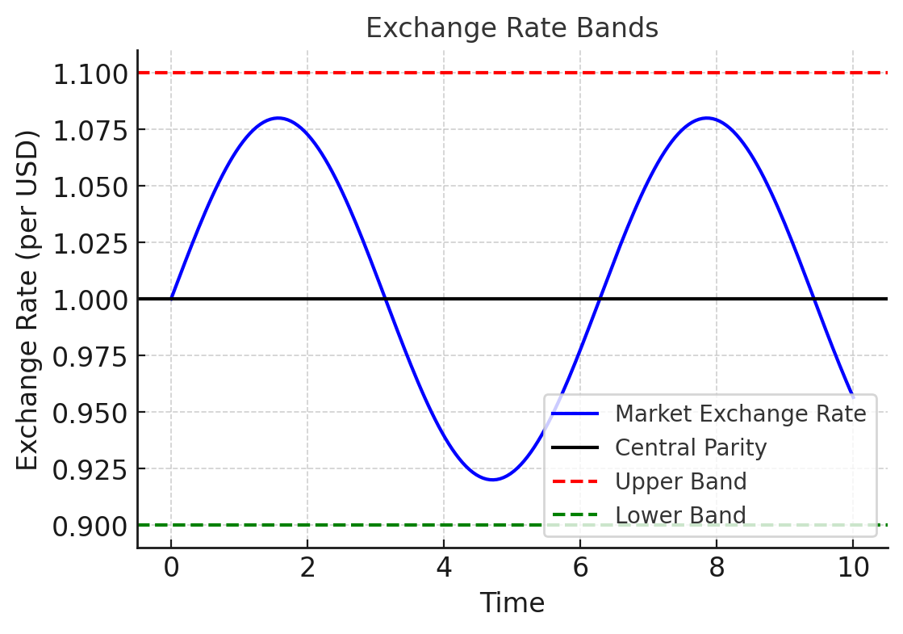
What is a Fixed Exchange Rate with Bands and how does it work?
Authorities set a central parity for the domestic currency.
An allowable fluctuation band is defined (e.g., ±2.25%).
The exchange rate moves within the band under market forces.
At the boundaries, the central bank intervenes to prevent breaches.
Exchange rate determined by supply and demand inside the band.
Market forces work freely until limits are tested.
https://chatgpt.com/

Slide 14
Central Bank Intervention
At the upper limit: central bank sells foreign currency and buys domestic currency.
At the lower limit: central bank buys foreign currency and sells domestic currency.
Intervention requires sufficient foreign exchange reserves.
Directly impacts the domestic money supply and monetary polic
  Intervention affects liquidity and credit conditions.
  Selling reserves reduces the money supply.
  Buying reserves increases the money supply.
  Independent monetary policy is constrained unless sterilised
https://chatgpt.com/

Slide 15
Risks and Credibility Issues
Persistent imbalances may erode reserves.
Speculative attacks can occur if markets doubt sustainability.
Requires credible commitment, fiscal discipline, and strong reserves.
Regime | Advantages | Disadvantages
Floating | • Automatic adjustment to shocks. • Independent monetary policy. • No need for large reserves. | • Higher volatility. • Risk of overshooting. • Uncertainty for trade and investment.
Fixed | • Exchange rate stability. • Predictability for trade and investment. • Discipline on inflation. | • Loss of monetary independence. • Vulnerability to speculative attacks. • Requires large foreign reserves.
https://chatgpt.com/

