Slide 1
INTEC Lecture 3
The current and capital accounts
Paolo Paesani
University of Rome Tor Vergata
ALEF Department
09/09/2026

Slide 2
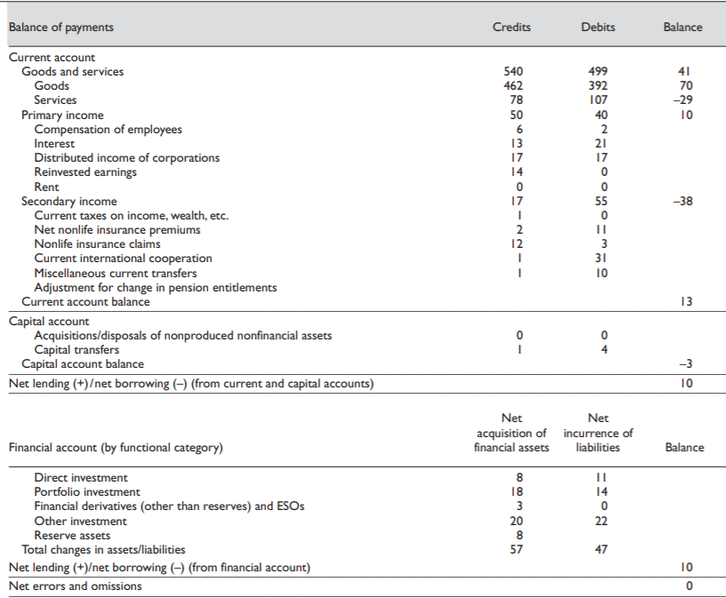

Slide 3
Current account
The current account balance shows the difference between the sum of exports and incomes receivable and the sum of imports and incomes payable (exports and imports refer to both goods and services, while income refers to both primary and secondary income).
The current account balance is the overall balance of all the above four subdivisions. A current account surplus is where credits exceed debits. A current account deficit is where debits exceed credits.

Slide 4
Current account: goods and services
CC = NXG + NXS + INC + NCT
  NXG = Exports of goods – Imports of goods. This records imports and exports of physical goods (previously known as ‘visibles’). Exports result in an inflow of money and are therefore a credit item. Imports result in an outflow of money and are therefore a debit item. The balance of these is called the balance on trade in goods or balance of visible trade or merchandise balance. A surplus is when exports exceed imports. A deficit is when imports exceed exports.
  NXS = Exports of services – Imports of services (tourism, transports, financial service, insurance ecc.). The balance of these is called the services balance.
The balance of both the goods and services accounts together is known as the balance on trade in goods and services or simply the balance of trade.
  Y = C + I + G + X – M
  X – M = NXG + NXS

Slide 5
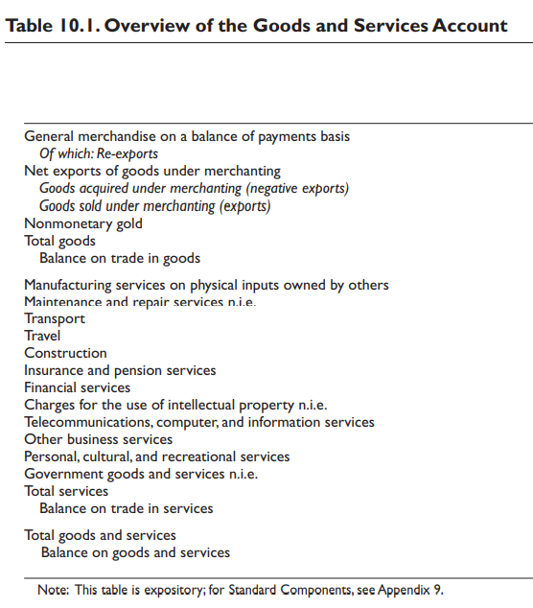
Current account: goods and services, 2
10.1 The goods and services account shows transactions in items that are outcomes of production activities.
10.2 The focus of this account is the point at which goods and services are exchanged between a resident and a nonresident.
10.3 Production is an activity in which an enterprise uses inputs (intermediate inputs, labor, produced and nonproduced assets) in order to transform them to an output that can be supplied to other units.
10.4 The corresponding entries to goods and services flows may be in the financial, current, or capital accounts
https://www.imf.org/external/pubs/ft/bop/2007/pdf/chap10.pdf

Slide 6
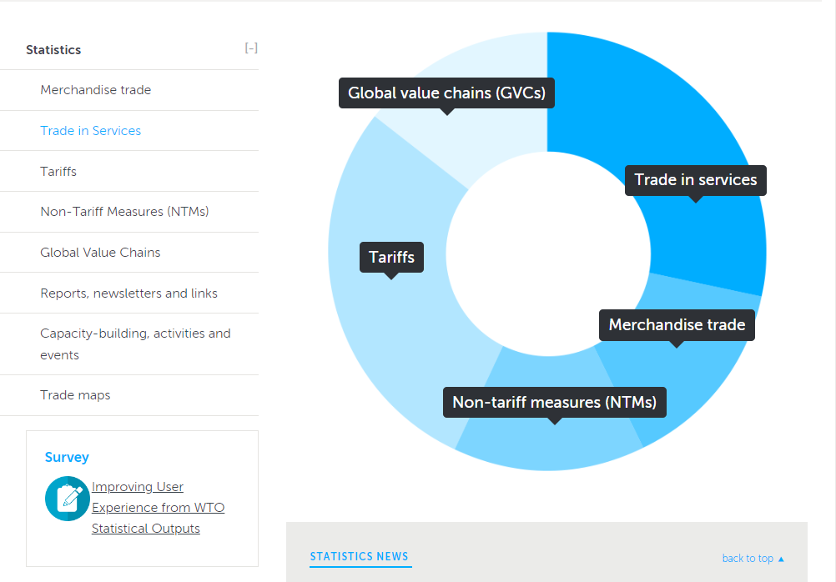
https://www.wto.org/english/res_e/statis_e/statis_e.htm

Slide 7
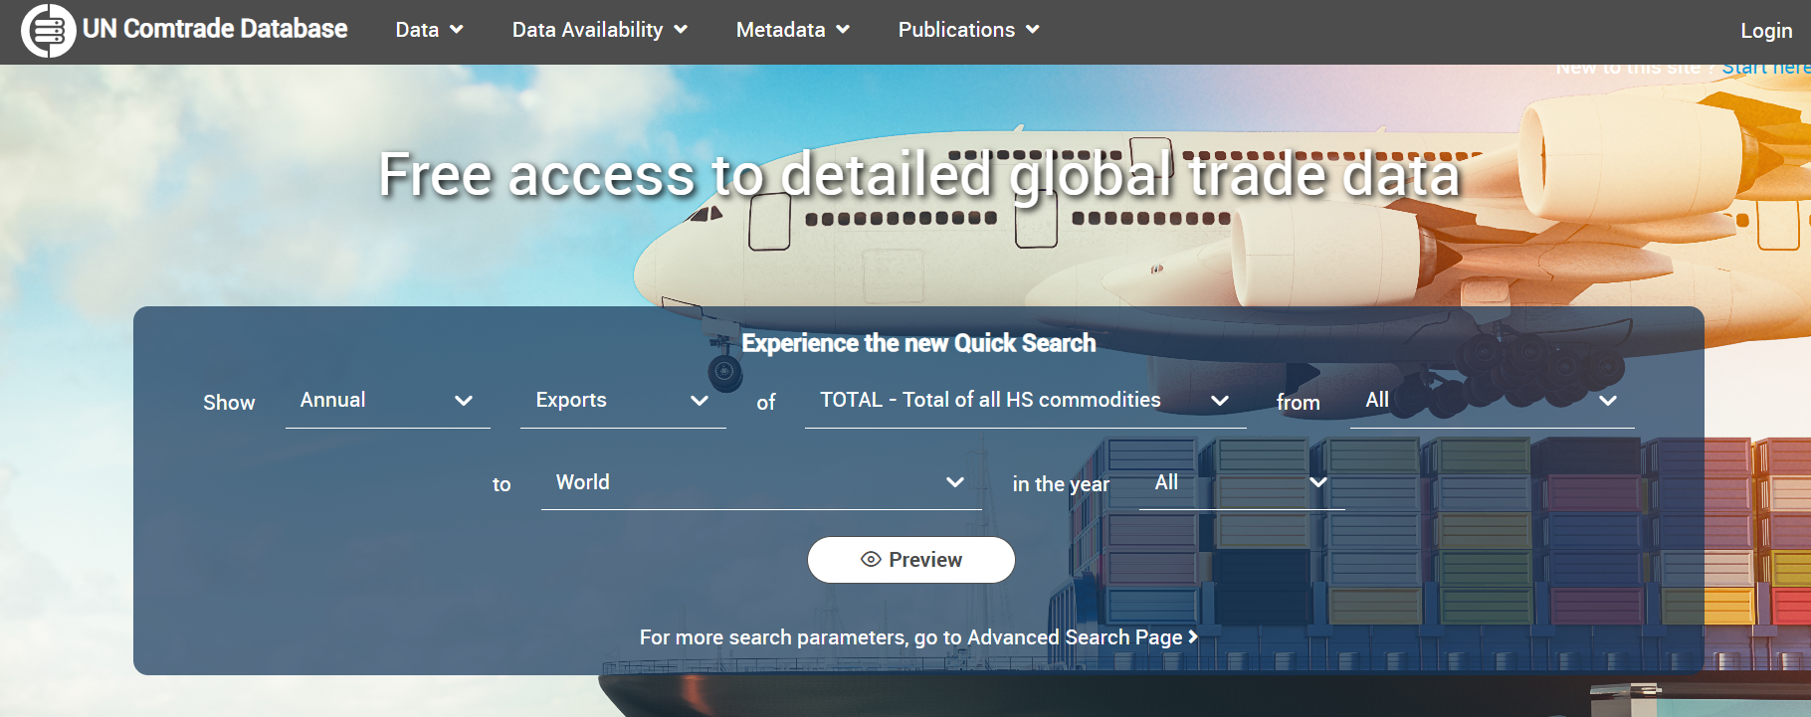
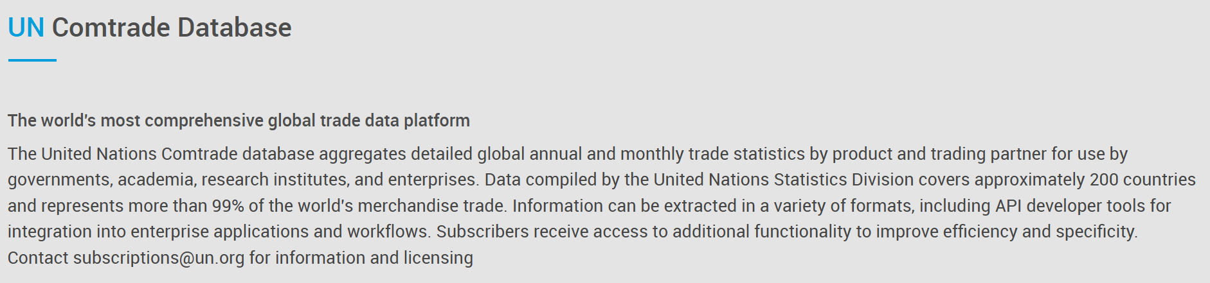
https://comtradeplus.un.org/

Slide 8
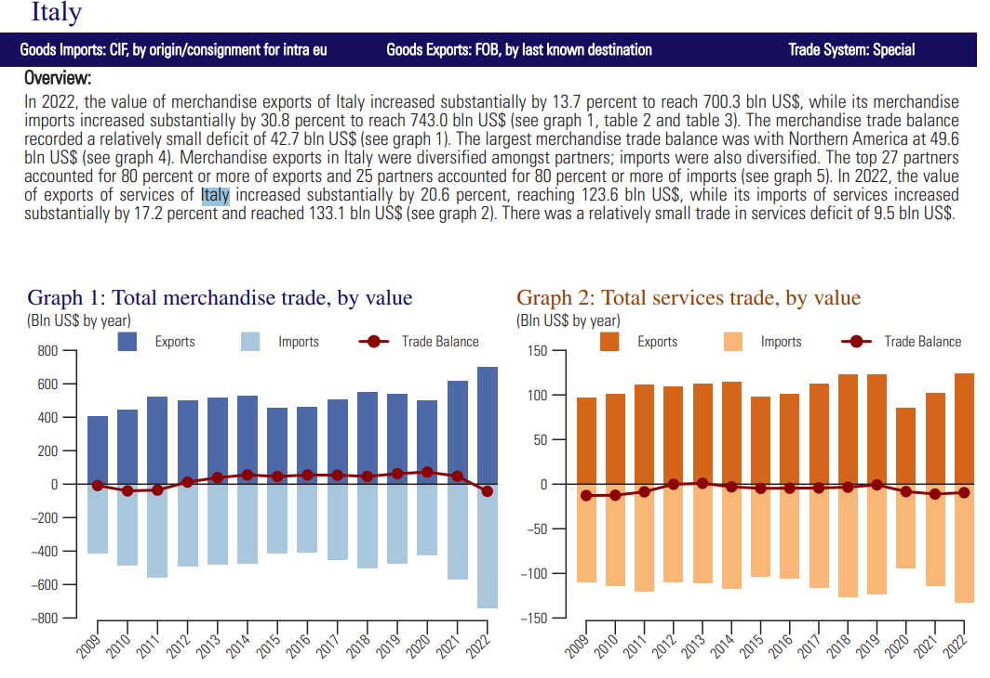
Focus on exports and imports (example, 2022 last available report), 1
https://comtradeapi.un.org/files/v1/app/publicationfiles/2022/VolI2022.pdf

Slide 9
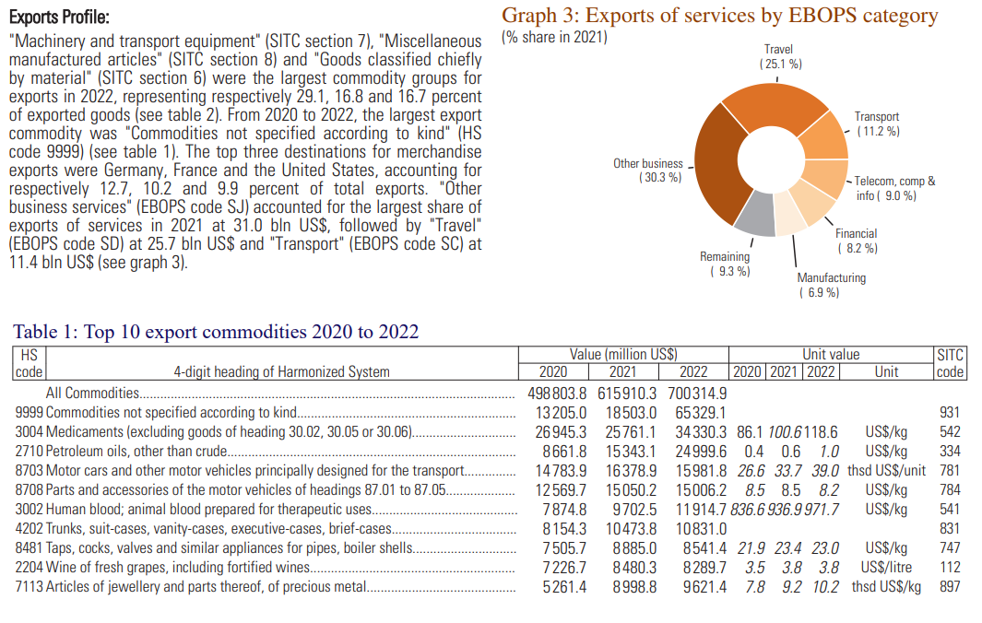
Focus on exports and imports (example), 2
https://comtradeapi.un.org/files/v1/app/publicationfiles/2022/VolI2022.pdf

Slide 10
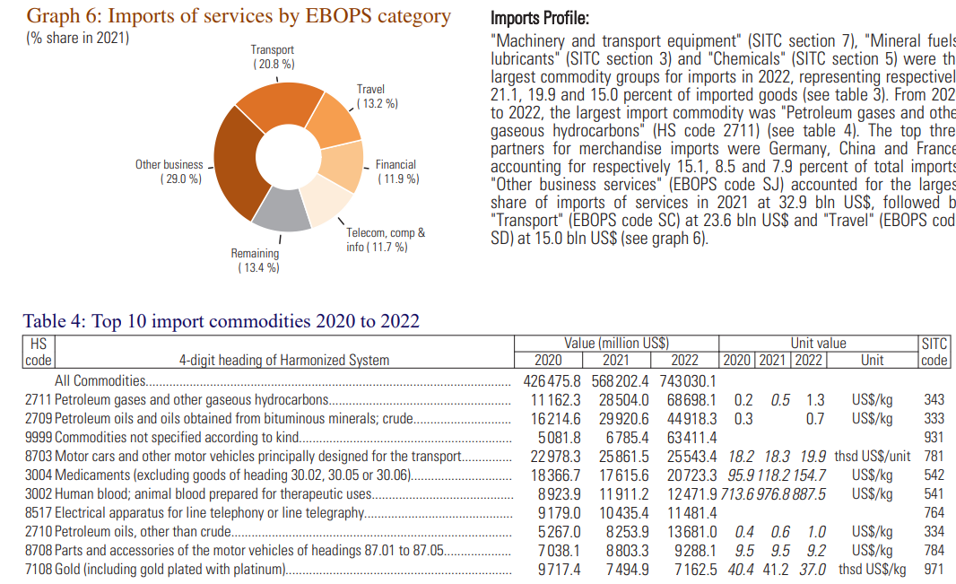
Focus on exports and imports (example), 3
https://comtrade.un.org/pb/downloads/2021/VolI2021.pdf

Slide 11
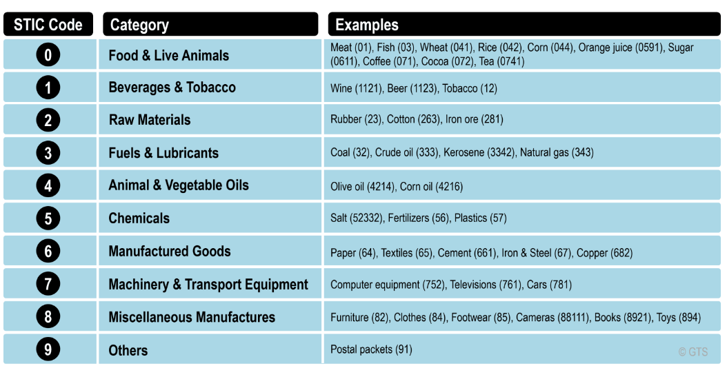
Exports and imports of goods: Classification
SITC = The Standard International Trade Classification (SITC) is a standardised way of classifying goods that is used in statistics on imports and exports. The codes are listed here for each commodity group.
FOB = Free on board or freight on board. The FOB (free on board) value of exports and imports of goods is the value of the goods at the exporter's customs frontier. Foreign transport and insurance services between the exporter's and importer's frontiers are not included in the value (but are recorded under services).
CIF = Cost, insurance and freight. The cost, insurance and freight (CIF) price is the price of a good delivered at the frontier of the importing country, or the price of a service delivered to a resident, before the payment of any import duties or other taxes on imports or trade and transport margins within the country.
https://transportgeography.org/contents/chapter7/globalization-international-trade/standard-international-trade-classification/

Slide 12
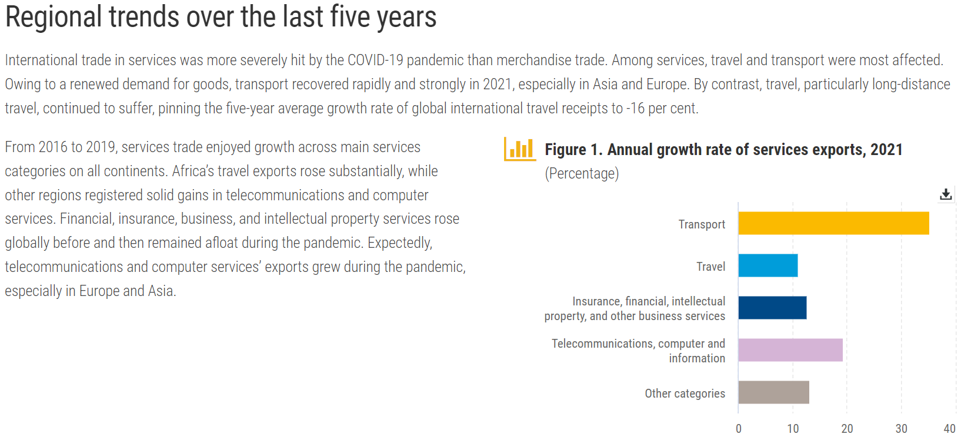
International trade in services
https://hbs.unctad.org/trade-in-services-by-category/

Slide 13
Determinants of Exports
Determinant | Mechanism | Example
Exchange Rates | A weaker domestic currency makes exports cheaper abroad. | Euro depreciation boosts EU exports.
Global Demand | Higher growth in trade partners increases import demand. | US recovery raises demand for Asian goods.
Production Capacity | Greater output ability supports higher export volumes. | China’s industrial capacity fuels exports.
Relative Prices/Inflation | High inflation erodes price competitiveness. | Stable inflation helps German exports.
Trade Policies | Lower tariffs and agreements promote exports. | NAFTA boosted Mexican exports to the US.
Input Costs | Cheaper inputs lower production costs and export prices. | Low wages support Bangladesh’s textile exports.
Foreign Direct Investment | FDI brings tech and access to global supply chains. | FDI in Vietnam boosts electronics exports.
Infrastructure/Logistics | Efficient transport lowers trade costs. | Singapore’s ports aid its re-export hub role.
Commodity Prices | Export revenues depend on world commodity prices. | Oil price hikes benefit Saudi exports.
Stability / Geopolitical conditions | Political/economic stability builds trade trust. | Switzerland’s stability supports financial exports.
https://chatgpt.com/

Slide 14
Determinants of Imports
Determinant | Mechanism | Example
Domestic Income/GDP Growth | Higher income raises demand for foreign goods. | US growth increases imports from China.
Exchange Rates | Stronger domestic currency makes imports cheaper. | Yen appreciation lowers Japan’s import costs.
Relative Prices/Inflation | If domestic prices rise faster than abroad, imports become more attractive. | High inflation in Argentina fuels imports.
Trade Policies | Tariffs/quotas restrict imports; liberalisation increases them. | EU tariffs reduce imports of steel.
Consumer Preferences | Demand shifts to foreign brands or products. | Italian consumers buy German cars.
Production Capacity & Structure | Weak domestic production raises reliance on imports. | Limited electronics production in Africa boosts imports.
Global Commodity Prices | Higher oil or food prices increase import bills. | India’s oil import bill rises when crude prices increase.
FDI and Global Value Chains | Integration in global supply chains raises intermediate imports. | Vietnam imports components for electronics assembly.
Infrastructure/Logistics | Efficient logistics can facilitate higher import flows. | Efficient ports in Netherlands boost imports.
Macroeconomic/Political Stability | Stable environments support higher import activity. | Stable Singapore imports large volumes of goods.
https://chatgpt.com/

Slide 15
Current account: primary and secondary income accounts
CC = NXG + NXS + INC + NCT
INC Income flows (a.k.a. primary incomes) These consist of wages, interest and profits flowing into and out of the country. For example, dividends earned by an Italian resident from shares in a French company would be an inflow of money into Italy (a credit item). Another example, wages earned by a French professor teaching in the UK would be an outflow of money from the UK point of view (a debit item)
NCT Current transfers of money (a.k.a. secondary incomes) These include government contributions to and receipts from the EU and international organisations, and international transfers of money by private individuals and firms. Transfers out of the country are debits. Transfers into the country (e.g. money sent to a Russian student studying in Italy) would be a debit item from Russia’s point of view.

Slide 16
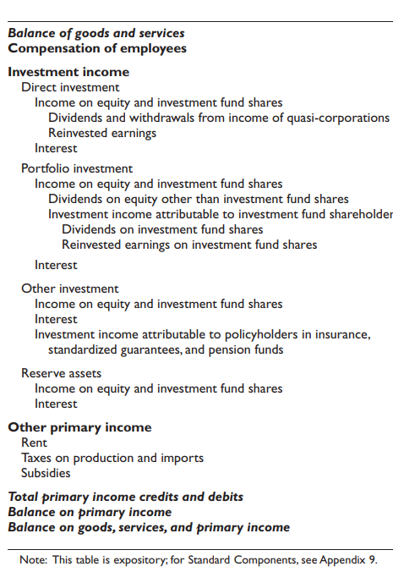
Current account: primary income account
11.1 The primary income account shows primary income flows between resident and nonresident institutional units. In the SNA, primary distribution of income is recorded in two accounts, namely, the generation of income account (which records primary income generated in the production process) and the allocation of primary income account (which records primary income allocated to institutional units for the provision of labor, financial assets, and natural resources). In the international accounts, all primary income flows relate to the allocation of primary income account.
11.2 The main components and structure of the account are shown in Table 11.1. Credit entries reflect primary income receivable by the compiling economy and debit entries reflect primary income payable by the compiling economy. The balance on primary income shows net primary income receivable by the compiling economy, which is defined as the total value of primary income receivable by the compiling economy less the total value of primary income payable.
https://www.imf.org/external/pubs/ft/bop/2007/pdf/chap11.pdf

Slide 17
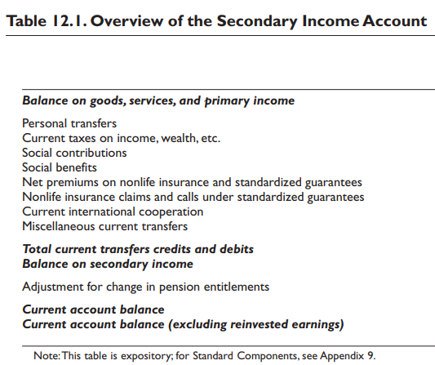
Current account: secondary income account
12.1 The secondary income account shows current transfers between residents and nonresidents. Various types of current transfers are recorded in this account to show their role in the process of income distribution between the economies. Transfers may be made in cash or in kind. Capital transfers are shown in the capital account (see paragraphs 13.19–13.34).
12.2 Whereas primary income affects national income (see paragraph 11.4 for the definition of gross national income), secondary income, together with primary income, affects gross national disposable income. Capital transfers do not affect disposable income and, hence, are recorded in the capital account.
12.3 The balance on the secondary income account presents total credits less total debits, and is called balance on secondary income.
https://www.imf.org/external/pubs/ft/bop/2007/pdf/chap12.pdf

Slide 18
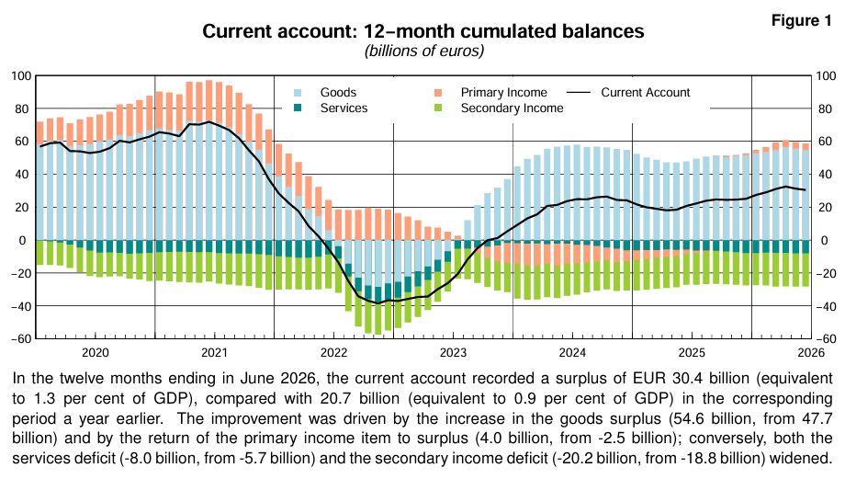
Current account (Italy)
https://www.bancaditalia.it/pubblicazioni/bilancia-pagamenti/2026-bilancia-pagamenti/en_statistiche_BDP_20260819.pdf?language_id=1

Slide 19
Capital account
13.1 The capital account in the international accounts shows (a) capital transfers receivable and payable between residents and nonresidents and (b) the acquisition and disposal of nonproduced, nonfinancial assets between residents and nonresidents.
13.2 An overview of the capital account is shown in Table 13.1. The balance on the capital account shows the total credits less debits for capital transfers and nonproduced, nonfinancial assets. In addition, the sum of the current and capital account balances can also be shown as a balancing item. The balancing item is labeled as net lending (+)/net borrowing (–) from the capital and current accounts. That sum is also conceptually equal to net lending (+)/net borrowing (–) from the financial account, as discussed in paragraph 8.4. Although conceptually equal, they may differ in practice. The current and capital accounts show nonfinancial transactions, with the balance requiring net lending or net borrowing, while the financial account shows how net lending or borrowing is allocated or financed.
https://www.imf.org/external/pubs/ft/bop/2007/pdf/chap13.pdf

Slide 20
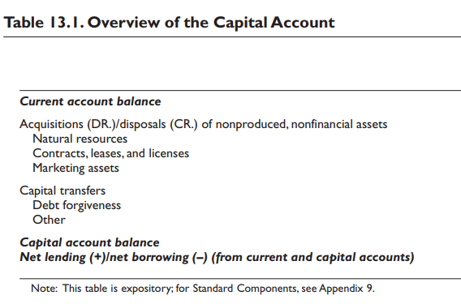
Capital account, 2
13.9 Natural resources include land, mineral rights, forestry rights, water, fishing rights, air space, and electromagnetic spectrum.
13.11 Contracts, leases, and licenses covers those contracts, leases, and licenses that are recognized as economic assets.
13.17 Marketing assets consist of items such as brand names, mastheads, trademarks, logos, and domain names
13.19 Capital transfers are transfers in which the ownership of an asset (other than cash or inventories) changes from one party to another; or which obliges one or both parties to acquire or dispose of an asset (other than cash or inventories); or where a liability is forgiven by the creditor.
https://www.imf.org/external/pubs/ft/bop/2007/pdf/chap13.pdf

Slide 21
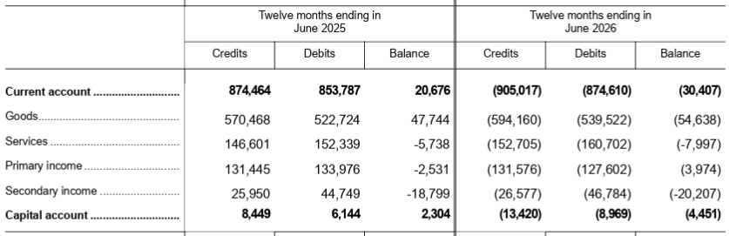
Current and capital account (Italy)
https://www.bancaditalia.it/pubblicazioni/bilancia-pagamenti/2026-bilancia-pagamenti/en_statistiche_BDP_20260819.pdf?language_id=1

Slide 22
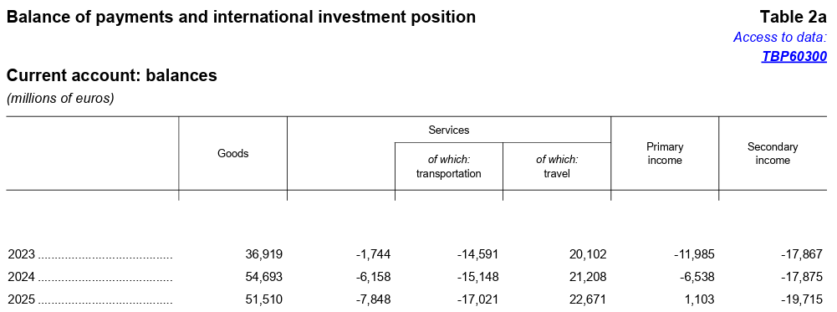
Current and capital account (Italy)
https://www.bancaditalia.it/pubblicazioni/bilancia-pagamenti/2026-bilancia-pagamenti/en_statistiche_BDP_20260819.pdf?language_id=1

Slide 23
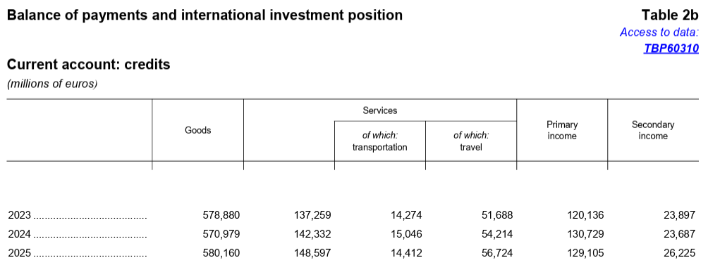
Current and capital account (Italy)
https://www.bancaditalia.it/pubblicazioni/bilancia-pagamenti/2026-bilancia-pagamenti/en_statistiche_BDP_20260819.pdf?language_id=1

Slide 24
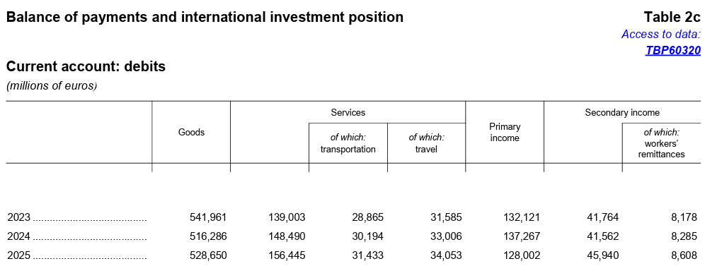
Current and capital account (Italy)
https://www.bancaditalia.it/pubblicazioni/bilancia-pagamenti/2026-bilancia-pagamenti/en_statistiche_BDP_20260819.pdf?language_id=1

Slide 25
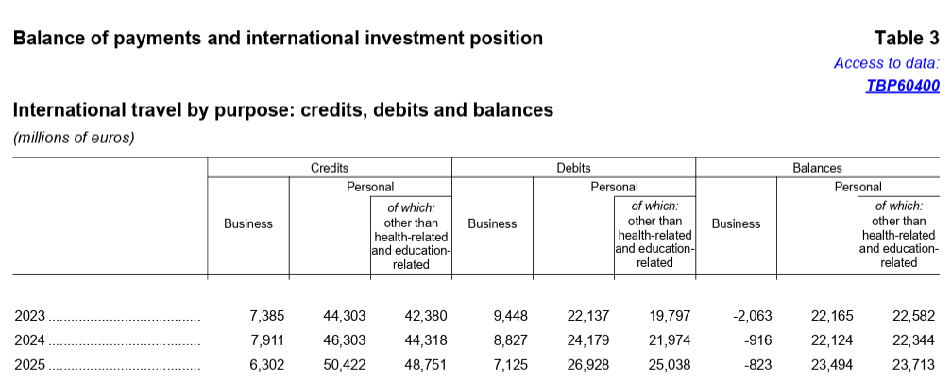
Current and capital account (Italy)
https://www.bancaditalia.it/pubblicazioni/bilancia-pagamenti/2026-bilancia-pagamenti/en_statistiche_BDP_20260819.pdf?language_id=1

Slide 26
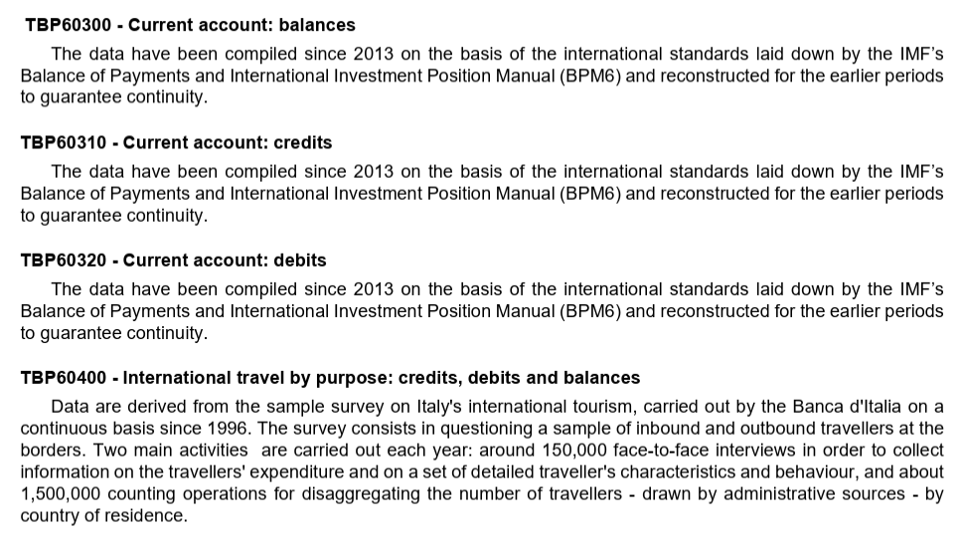
Current and capital account (Italy)
https://www.bancaditalia.it/pubblicazioni/bilancia-pagamenti/2026-bilancia-pagamenti/en_statistiche_BDP_20260819.pdf?language_id=1

Slide 27
Homework
Choose a country to your liking, find data about its balance of payments, comment them focusing on the current and capital accounts.
Try and explain why
Take a look at chapters 10, 11, 12, 13 https://www.imf.org/external/pubs/ft/bop/2007/pdf/bpm6.pdf

