Slide 1
INTEC Lecture 2
Introduction to the Balance of Payments (BOP)
Paolo Paesani
University of Rome Tor Vergata
ALEF Department
08/09/2026

Slide 2
Globalization indicators and international payments
Globalization indicators:
  Trade-based indicators: (X/Y), (M/Y), (X + M)/Y
  Price-based indicators: (P_{IMP} – P_{EXP}), transport costs
  Investment based indicators: international capital flows and stocks
  Migrants’ remittances and cross border
Many of the data used to compile globalization indicators have relate to international payments, i.e. flows of money that ‘cross’ national boundaries.

Slide 3
International payments
International payments pose a series of interesting problems
  How do countries pay for their imports?
  What happens to the export earnings?
  What are the consequences of X > M (Trade surplus)?
  What are the consequences of M > X (Trade deficit)?
  How do money and finance affect X, M and their balance?
  Is there any connection between international trade and international investment?
Answering those questions, requires a prior understanding of the Balance of payments (BOP): the official document that records those payments on quarterly and yearly basis.

Slide 4
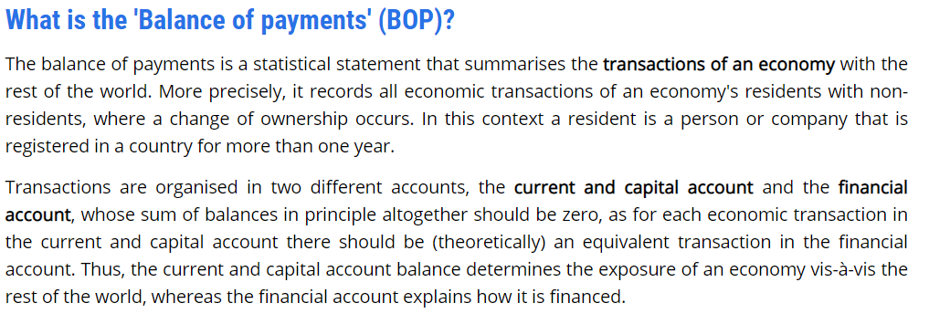
Defining the Balance of Payments
https://ec.europa.eu/eurostat/web/balance-of-payments

Slide 5
Current account: definition
The current account shows flows of goods, services, primary income, and secondary income between residents and nonresidents. It is an important grouping of accounts within the balance of payments.
The goods and services account shows transactions in goods and services.
The primary income account shows amounts payable and receivable in return for providing temporary use to another entity of labor, financial resources, or nonproduced nonfinancial assets.
The secondary income account shows redistribution of income, that is, when resources for current purposes are provided by one party without anything of economic value being supplied as a direct return to that party. Examples include personal transfers and current international assistance
https://www.imf.org/external/pubs/ft/bop/2007/pdf/bpm6.pdf

Slide 6
Capital account: definition
The capital account shows credit and debit entries for nonproduced nonfinancial assets and capital transfers between residents and nonresidents.
It records acquisitions and disposals of nonproduced nonfinancial assets, such as land sold to embassies and sales of leases and licenses, as well as capital transfers, that is, the provision of resources for capital purposes by one party without anything of economic value being supplied as a direct return to that party
https://www.imf.org/external/pubs/ft/bop/2007/pdf/bpm6.pdf

Slide 7
Financial account: definition
The financial account shows net acquisition and disposal of financial assets and liabilities (five categories).
  (Foreign) Direct investment
  (Foreign) Portfolio investment
  Derivatives
  Other investments
  Reserve assets
Financial account transactions appear in the balance of payments and, because of their effect on the stock of assets and liabilities, also in the integrated IIP statement.
https://www.imf.org/external/pubs/ft/bop/2007/pdf/bpm6.pdf

Slide 8
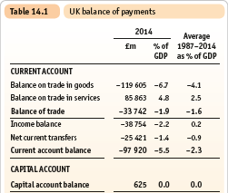
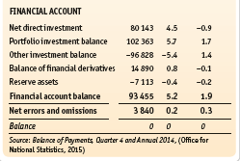
The balance of payments (example)

Slide 9
Accounting standards
Before we analyze the different parts of the balance of payments, some general considerations about the accounting principles applied to the compilation of the BOP are in order.
The International Monetary Fund since its inception has had a compelling interest in developing and promulgating guidelines for the compilation of consistent, sound, and timely balance of payments statistics. This work underpins the IMF’s other responsibilities, including conducting surveillance of countries’ economic policies and providing financial assistance that enables countries to overcome short-term balance of payments difficulties. Such guidelines, which have evolved to meet changing circumstances, have been embodied in successive editions of the Balance of Payments Manual (the Manual) since the first edition was published in 1948.
https://www.imf.org/external/pubs/ft/bop/2007/pdf/bpm6.pdf

Slide 10
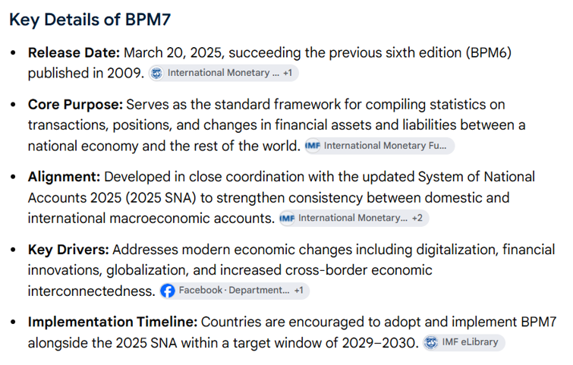
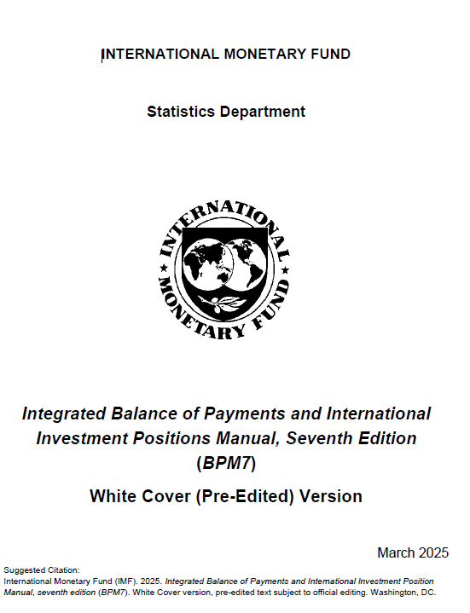
https://www.imf.org/-/media/files/data/statistics/bpm6/draft-bpm7-wcv.pdf

Slide 11
Accounting standards (basics)
BOP records payments between residents and non-residents (cross borders flows of money caused by transactions that give rise to changes in ownership) on a monthly, quarterly, yearly basis.
Double-entry principle (individual transactions)
Aggregate recording
Unit of account and currency conversion
Economic Territory, Units, Institutional Sectors, and Residence
Net errors and omissions

Slide 12
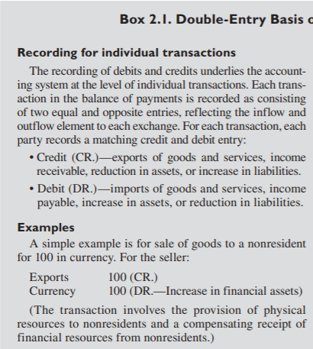
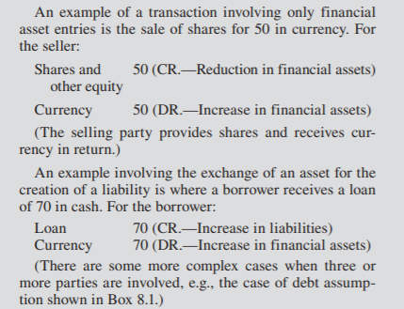
BOP and double entry
https://www.imf.org/external/pubs/ft/bop/2007/pdf/bpm6.pdf

Slide 13
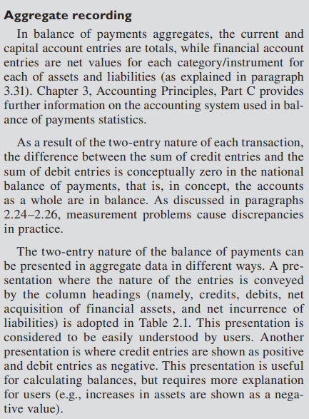
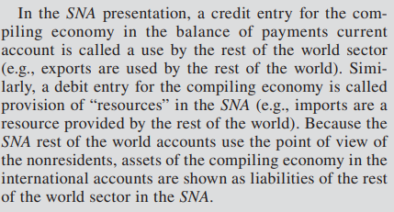
https://www.imf.org/external/pubs/ft/bop/2007/pdf/bpm6.pdf

Slide 14
Unit of account and currency conversion
3.92 Values of nonfinancial and financial transactions as well as the values of positions of financial assets and liabilities may be expressed initially in a variety of currencies or in other standards of value, such as Special Drawing Rights (SDRs). The conversion of these values into a reference unit of account is a requisite for the construction of consistent and analytically meaningful accounts.
3.93 International accounts can be compiled in the domestic currency as well as in another currency. Data in domestic currency are needed because several other macroeconomic and micro data are compiled in domestic currency, except when a foreign currency is used as a legal tender. Economic analysis often uses data from several macroeconomic statistical systems. Conversely, data in an international unit of account (a foreign currency) may be needed for international liquidity management and to address special issues for high inflation, significant exchange rate fluctuations, and multiple exchange rates. In addition, a standard or international unit of account is necessary to allow for aggregation on a global or regional basis and to facilitate international comparisons
https://www.imf.org/external/pubs/ft/bop/2007/pdf/bpm6.pdf

Slide 15
Economic Territory, Units, Institutional Sectors, and Residence
4.2 An economy consists of the institutional units that are resident in the economic territory of that economy. Most entities have strong links with only one economy, so their residence is clear, but with increasing international economic openness, a growing number of institutional units have connections to more than one economy.
4.5 The economic territory includes: (a) the land area; (b) airspace; (c) territorial waters, including areas over which jurisdiction is exercised over fishing rights and rights to fuels or minerals; (d) in a maritime territory, islands that belong to the territory; and (e) territorial enclaves in the rest of the world.
https://www.imf.org/external/pubs/ft/bop/2007/pdf/bpm6.pdf

Slide 16
Economic Territory, Units, Institutional Sectors, and Residence, 2
4.13 The main attributes of an institutional unit are that: (a) it is entitled to own goods or assets in its own right; it is, therefore, able to exchange the ownership of goods or assets in transactions with other institutional units. (b) it is able to take economic decisions and engage in economic activities for which it is itself held to be directly responsible and accountable at law. (c) it is able to incur liabilities on its own behalf, to take on other obligations or future commitments, and to enter into contracts. (d) either a complete set of accounts, including a balance sheet, exists for the unit, or it would be possible and meaningful, from both an economic and legal viewpoint, to compile a complete set of accounts if they were to be required. Institutional units are recognized in the cases of branches and notional resident units (as discussed in paragraphs 4.26–4.44) even though they may not fully satisfy criteria (a), (b), and (c).
4.14 There are two main types of units in the real world that may qualify as institutional units: (a) households—persons or groups of persons; and (b) corporations (including quasi-corporations), nonprofit institutions, and government units—legal or social entities whose existence is recognized by law or society independently of the persons,
https://www.imf.org/external/pubs/ft/bop/2007/pdf/bpm6.pdf

Slide 17
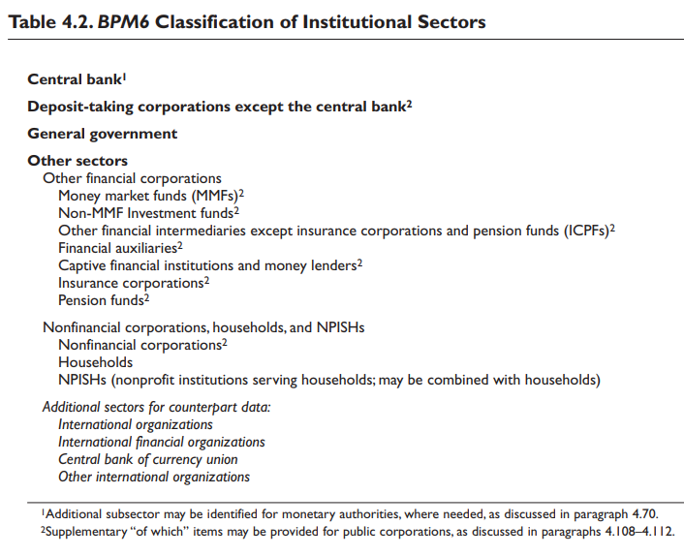
Economic Territory, Units, Institutional Sectors, and Residence, 3
4.57 Institutional units are grouped into institutional sectors. The units in each sector have similar economic objectives, functions, and behavior. The institutional sector classification is mainly applied to resident units, but it also could be applied to compiling supplementary data on the sector of the nonresident counterpart. For example, in an economy that received international aid, there may be interest in separating data on aid provided by other governments from aid provided by private sources.
https://www.imf.org/external/pubs/ft/bop/2007/pdf/bpm6.pdf

Slide 18
Economic Territory, Units, Institutional Sectors, and Residence, 4
4.113 The residence of each institutional unit is the economic territory with which it has the strongest connection, expressed as its center of predominant economic interest. Each institutional unit is a resident of one and only one economic territory determined by its center of predominant economic interest. Specific criteria for determining residence are given below. The definitions given below are designed to apply the concept of center of predominant economic interest. These definitions should be used in preference to a discretionary choice between different possible aspects of economic interest.
4.114 An institutional unit is resident in an economic territory when there exists, within the economic territory, some location, dwelling, place of production, or other premises on which or from which the unit engages and intends to continue engaging, either indefinitely or over a finite but long period of time, in economic activities and transactions on a significant scale. The location need not be fixed so long as it remains within the economic territory. Actual or intended location for one year or more is used as an operational definition; although the choice of one year as a specific period is somewhat arbitrary, it is adopted to avoid uncertainty and facilitate international consistency
https://www.imf.org/external/pubs/ft/bop/2007/pdf/bpm6.pdf

Slide 19
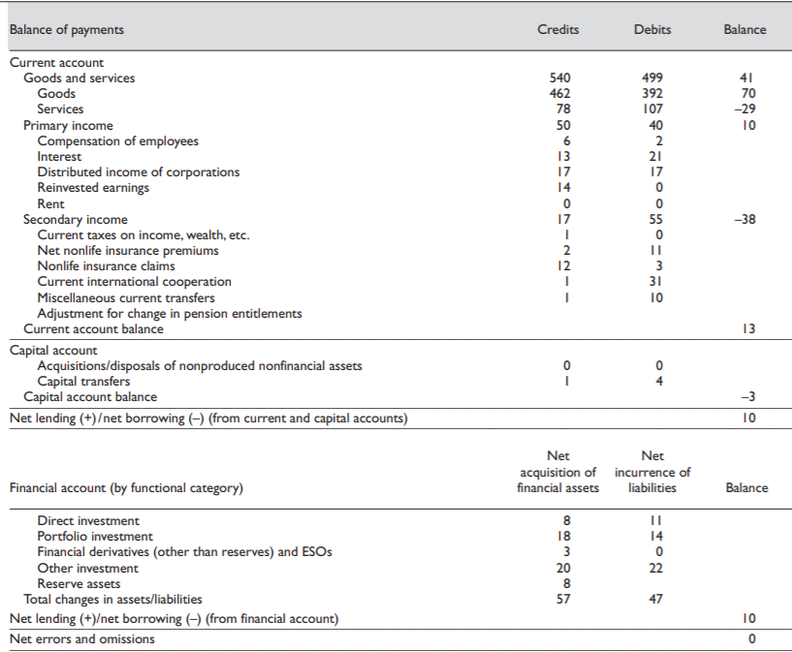
Notice that
$$CA+KA−FA+EO=0$$
13 – 3 – 10 + 0 = 0
Accounting balance

Slide 20
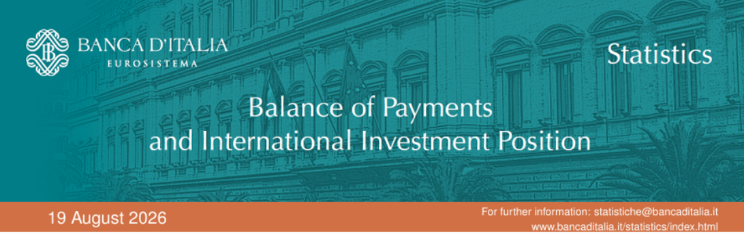
The BOP of Italy
https://www.bancaditalia.it/pubblicazioni/bilancia-pagamenti/2026-bilancia-pagamenti/en_statistiche_BDP_20260819.pdf?language_id=1

Slide 21
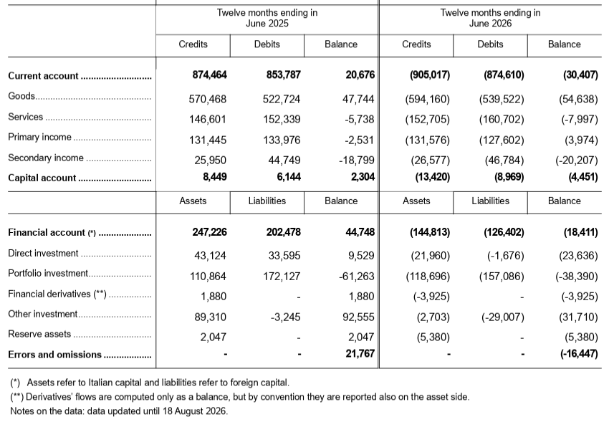
The BOP of Italy
https://www.bancaditalia.it/pubblicazioni/bilancia-pagamenti/2026-bilancia-pagamenti/en_statistiche_BDP_20260819.pdf?language_id=1

Slide 22
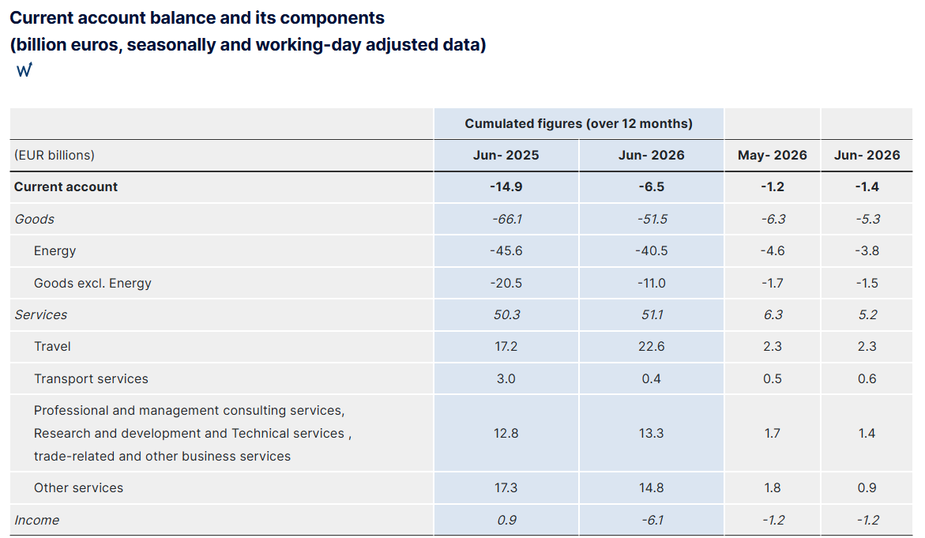
The BOP of France
https://www.banque-france.fr/en/statistics/balance-payments/frances-balance-payments-2026-06

Slide 23
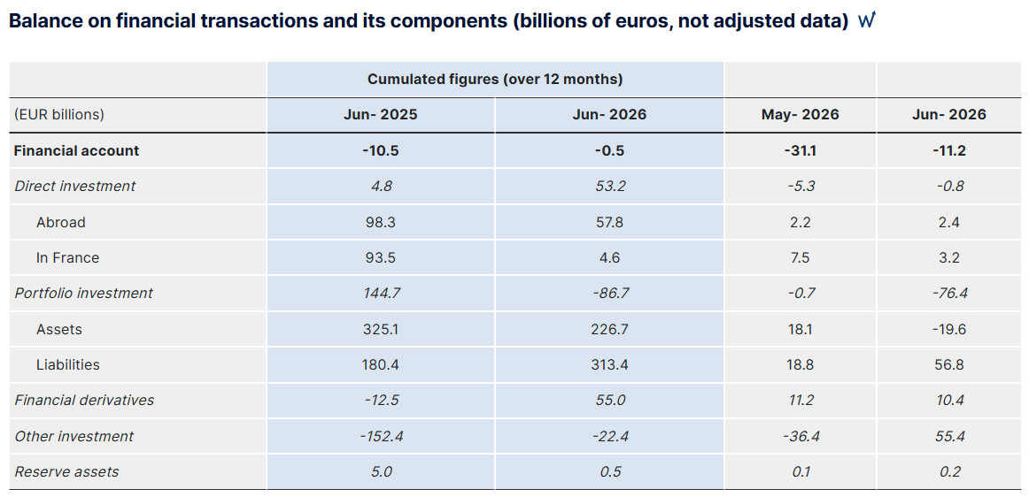
The BOP of France
https://www.banque-france.fr/en/statistics/balance-payments/frances-balance-payments-2026-06

Slide 24
Homework
Chapter 2 https://www.imf.org/external/pubs/ft/bop/2007/pdf/bpm6.pdf
Read
https://www.bancaditalia.it/pubblicazioni/bilancia-pagamenti/2025-bilancia-pagamenti/en_statistiche_BDP_20250819.pdf?language_id=1
Listen to
https://www.banque-france.fr/en/statistics/balance-payments-and-international-investment-position

