Slide 1
INTEC Lecture 5
NEO and IIP statement
Paolo Paesani
University of Rome Tor Vergata
ALEF Department
15/09/2026

Slide 2
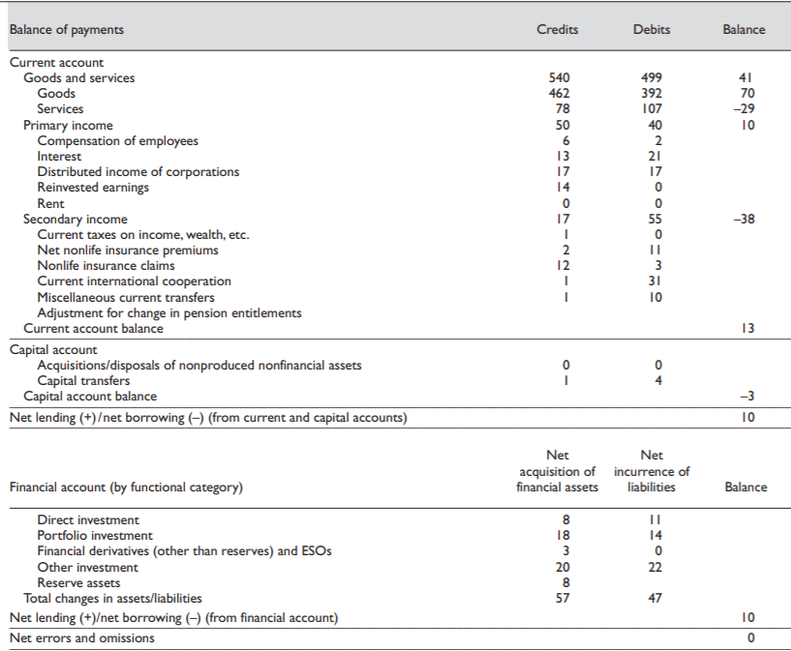

Slide 3
Current and capital account
The current account balance shows the difference between the sum of exports and income receivable (CR) and the sum of imports and income payable (DR).
  CA = (Exports + Incomes receivable) – (Imports + Incomes payable) = CR – DR
The capital account balance shows (a) capital transfers receivable and payable between residents and nonresidents and (b) the acquisition and disposal of nonproduced, nonfinancial assets between residents and nonresidents.
  KA = NPNF + NKT = (Disposal foreign assets by residents / Acquisition domestic assets by foreign residents + Capital trasfers receivable from abroad) – (Acquisition foreign assets by residents / Disposal domestic assets by foreign residents + Capital transfer payable abroad) = CR – DR

Slide 4
Financial account and Net errors and omissions
The financial account balance shows the difference between the net increase in foreign assets and the net increase in foreign liabilities (exports and imports refer to both goods and services, while income refers to both primary and secondary income).
  FA = (∆DId - ∆DIf) + (∆PId - ∆PIf) + (∆FDd - ∆FDf) + (∆OId - ∆OIf) + (∆RAd - ∆RAf) = DR – CR
2.24 Although the balance of payments accounts are, in principle, balanced, imbalances result in practice from imperfections in source data and compilation. This imbalance, a usual feature of balance of payments data, is labeled net errors and omissions and should be identified separately in published data. It should not be included indistinguishably in other items. Net errors and omissions are derived residually as net lending/net borrowing and can be derived from the financial account minus the same item derived from the current and capital accounts.

Slide 5
Main Statistical Sources for the Balance of Payments
The balance of payments is compiled by combining information from several statistical and administrative sources.
Customs and international trade statistics
Data on exports and imports of goods, based mainly on customs declarations and intra-area trade reporting systems.
Banking and payment-system data
Information reported by banks and other financial intermediaries on cross-border payments, deposits, loans and other financial transactions.
Enterprise and household surveys
Direct surveys used to measure services, foreign direct investment, portfolio investment, income flows, remittances and other cross-border transactions.
Administrative and official records
Tax records, government accounts, migration and tourism data, central-bank records, securities databases and information from other public authorities.
International and counterpart data
Partner-country statistics and international databases may be used to check, complement or estimate missing information.

Slide 6
Why Balance-of-Payments Data Do Not Match Perfectly
In principle, double-entry bookkeeping implies that all international transactions should sum to zero. In practice, measurement is imperfect.
Different sources
The two sides of the same transaction may be recorded by different institutions, using different reporting systems.
Timing differences
Exports, payments and changes in financial claims may be recorded in different accounting periods.
Valuation and exchange rates
Transactions may be reported at different prices or converted into the domestic currency using different exchange rates.
Incomplete coverage
Some transactions are not reported, are reported only above thresholds, or are difficult to observe – especially services, household transactions and complex financial operations.
Misclassification and reporting errors
Transactions may be assigned to the wrong balance-of-payments item, country, institutional sector or financial instrument.
Estimation and revision
Compilers often rely on samples and estimates. Preliminary data are subsequently revised as more complete information becomes available.

Slide 7
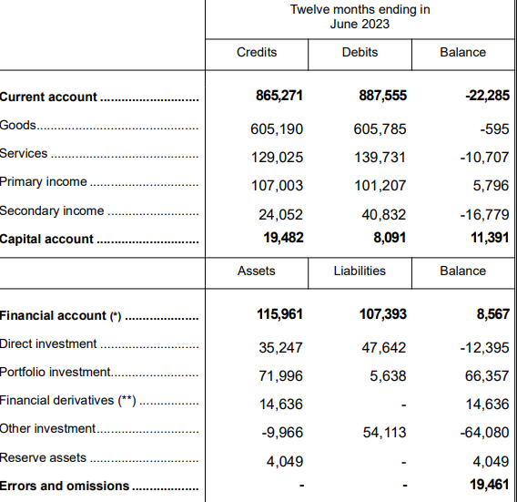
CAB + KAB – FAB + NEO = 0;
-22,285 +11,391 – 8,567 + 19,461 = 0
https://www.bancaditalia.it/pubblicazioni/bilancia-pagamenti/2022-bilancia-pagamenti/en_statistiche_BDP_20220819.pdf?language_id=1

Slide 8
Net Errors and Omissions, 1
Taking into account that NEO = FAB – CAB – KAB = Net increase in assets (DR) – Net increase in liabilities (CR) – (CR in current and capital account) + (DR in current and capital account).
A positive value of net errors and omissions indicates an overall tendency that: (a) the value of credits in the current and capital accounts is too low; and/or (b) the value of debits in the current and capital accounts is too high; and/or (c) the value of net increases in assets in the financial account is too high; and/or (d) the value of net increases in liabilities in the financial account is too low.
A negative value of net errors and omissions indicates an overall tendency that: (a) the value of credits in the current and capital accounts is too high; and/or (b) the value of debits in the current and capital accounts is too low; and/or (c) the value of net increases in assets in the financial account is too low; and/or (d) the value of net increases in liabilities in the financial account is too high.
https://www.imf.org/external/pubs/ft/bop/2007/pdf/bpm6.pdf

Slide 9
Net Errors and Omissions, 2
2.25 The values of net errors and omissions should be analyzed by compilers. The size and trends may help identify data problems, such as coverage or misreporting. Patterns in net errors and omissions may provide useful information on data problems.
For example, a consistent sign indicates a bias in one or more components. A persistent positive value of net errors and omissions suggests that credit entries have been understated or omitted or debit entries have been overstated. In contrast, a volatile pattern may suggest timing problems.
However, although net errors and omissions can help point to some problems, it is an incomplete measure because errors and omissions in opposite directions offset each other.
The term net errors and omissions should not be interpreted as meaning errors on the part of compilers; it is far more common that this discrepancy is caused by other factors, such as incomplete data sources and poor quality reporting.
https://www.imf.org/external/pubs/ft/bop/2007/pdf/bpm6.pdf

Slide 10
Net Errors and Omissions, 3
2.26 A large or volatile value of net errors and omissions hampers interpretation of the results.
While it is not possible to give guidelines on an acceptable size of net errors and omissions, it can be assessed (where possible) by compilers in relation to other items, such as GDP, positions data, and gross flows.
Statistical discrepancies also can arise in the IIP statement.
Closing values are by definition equal to the opening values plus net transactions plus net other changes during the period. However, if these components are independently measured, discrepancies may arise because of data imperfections.
https://www.imf.org/external/pubs/ft/bop/2007/pdf/bpm6.pdf

Slide 11
From the Balance of Payments to the International Investment Position
Moving from flows to stocks
Balance of Payments (BoP)
• A flow statement.
• Records economic transactions between residents and non-residents over a period of time – for example, a quarter or a year.
• The financial account records cross-border transactions in financial assets and liabilities.
International Investment Position (IIP)
• A stock statement.
• Records the value of residents’ external financial assets and liabilities vis-à-vis non-residents at a specific point in time.
• Net IIP = External financial assets − External financial liabilities.
FLOWS
→
STOCKS
The link: financial-account transactions change the stock of external assets and liabilities, but the IIP can also change because of valuation effects (prices and exchange rates) and other adjustments.

Slide 12
International Investment Position (IIP), 1
2.8 The IIP is a statistical statement that shows at a point in time the value of: financial assets of residents of an economy that are claims on nonresidents or are gold bullion held as reserve assets; and the liabilities of residents of an economy to nonresidents. The difference between the assets and liabilities is the net position in the IIP and represents either a net claim on or a net liability to the rest of the world.
2.9 The IIP represents a subset of the assets and liabilities included in the national balance sheet. In addition to the IIP, the national balance sheet incorporates nonfinancial assets as well as financial assets and liability positions between residents.
https://www.imf.org/external/pubs/ft/bop/2007/pdf/bpm6.pdf

Slide 13
International Investment Position (IIP), 2
2.10 Whereas the IIP relates to a point in time, the integrated IIP statement relates to different points in time, and it has an opening value (as at the beginning of the period) and a closing value (as at the end of the period).
The integrated IIP statement reconciles the opening and closing values of the IIP through the financial account (flows arising from transactions) and the other changes in financial assets and liabilities account (other volume changes and revaluation).
So, the values in the IIP at the end of the period result from transactions and other flows in the current and previous periods.
The integrated IIP statement consists of the accounts explained in Chapters 7–9 (i.e., the IIP, the financial account, and the other changes in financial assets and liabilities account, respectively).
https://www.imf.org/external/pubs/ft/bop/2007/pdf/bpm6.pdf

Slide 14
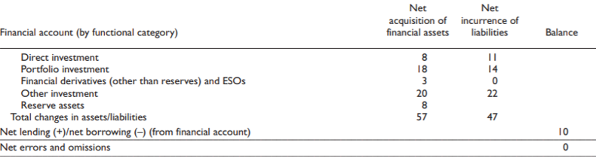
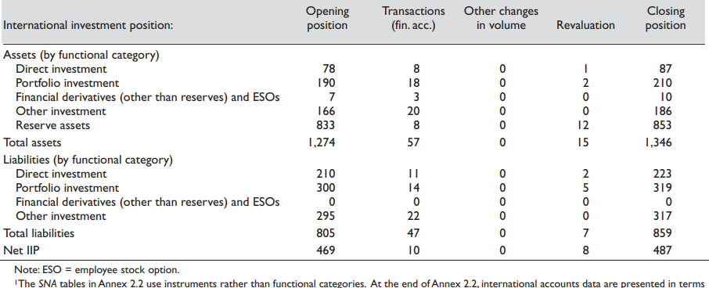
Flows between
01/01 and 31/12
Stocks
Opening position 01/01
Closing position
31/12
https://www.imf.org/external/pubs/ft/bop/2007/pdf/bpm6.pdf

Slide 15
International Investment Position (IIP), 3
7.7 This edition of the Manual reflects the increasing emphasis on the IIP in international accounts compilation and analysis. There has been growing recognition of the role of balance sheet analysis in understanding sustainability and vulnerability, including currency mismatches, the implications of sector and interest rate composition of debt, and the effect of the maturity structure on liquidity. IIP data are useful for other purposes, such as measuring rates of return, analyzing economic structure, and studying the relationship to domestic sources of financing.
7.8 Consequently, a currency composition and remaining maturity analysis of the IIP are encouraged as additional information. To meet this goal, memorandum and supplementary tables have been introduced in Appendix 9, and are shown after the standard components. These tables provide a presentation of currency composition of assets and liabilities by sector with a distribution by principal foreign currencies, including the U.S. dollar, euro, yen, and others, together with a breakdown by original maturity.
https://www.imf.org/external/pubs/ft/bop/2007/pdf/bpm6.pdf

Slide 16
International Investment Position (IIP), 4
7.12 Possible dimensions for the classification of the IIP are:
(a) Functional category—direct investment, portfolio investment, financial derivatives (other than reserves) and ESOs, other investment, and reserve assets, as defined in Chapter 6;
(b) Financial instrument—according to the broad groupings (equity and investment fund shares, debt instruments, and other financial assets and liabilities) or the full breakdown, as defined in Chapter 5;
(c) Institutional sector of resident party—at least, central bank, deposit-taking corporations except the central bank, general government, and other sectors; other sectors is split between other financial corporations and the remaining nonfinancial subsectors (nonfinancial corporations, households, and NPISHs), as defined in Chapter 4, Section D. Additional subsectoring of the financial and nonfinancial sectors may be undertaken when analytically relevant;
(d) Maturity (in the case of debt instruments)—shortterm or long-term, by original and remaining maturity, as defined in paragraphs 5.103–5.105;
(e) Currency—domestic or foreign currency, as defined in paragraphs 3.95–3.97 for debt and 3.100 for equity; and (in the case of financial derivatives) to receive or pay foreign currency, as defined in paragraph 5.108; and (f) Interest rate structure (in the case of debt instruments)—variable- or fixed-rate, as defined in paragraphs 5.109–5.114.

Slide 17
N.B. External debt, 1
The external debt of an economy represents, at any given time, the outstanding actual (rather than contingent) liabilities (and assets) vis-à-vis non-residents. External debt entails the payment of principal and/or interest by the debtor at a single or several points in the future.
The most common indicator of external debt is gross external debt, which measures the total debt a country owes to foreign creditors, i.e. it considers only the liabilities of that country. Debtors can be the government, corporations or citizens of that country.
The external debt statistics also include indicators of net external debt (i.e. gross external debt net of external assets in debt instruments). External debt is broken down by instrument, original maturity and institutional sector.
External debt is not public debt !
Gross external debt is not Net IIP !

Slide 18
External Debt vs. Public Debt
External debt refers to the total stock of a country’s debt owed to foreign creditors, including both public and private sector liabilities.
Public debt refers specifically to the government’s borrowing, regardless of whether creditors are domestic or foreign.
Key difference:
External debt = foreign dimension (public + private).
Public debt = government dimension (domestic + foreign).

Slide 19
Risks of Rising External Debt
When external debt rises excessively, countries face multiple risks:
Currency risk: depreciation increases repayment burdens.
Liquidity risk: difficulty in rolling over debt (particuarly serious if the debt is short term).
Sovereign default risk: inability to service obligations.
Crowding out: fewer resources for domestic private investment.
Loss of investor confidence, leading to capital flight.
Constraints on national sovereignty.

Slide 20
Examples of External Debt Crises
Historical cases illustrate the dangers of excessive external debt:
Latin American Debt Crisis (1980s): triggered by rising US interest rates.
Asian Financial Crisis (1997): excessive short-term foreign borrowing.
Argentina (2001): sovereign default on external bonds.
Greece (2010s): eurozone crisis linked to high external and public debt.
Sri Lanka (2022): external debt distress leading to default.

Slide 21
Ways to Reduce External Debt
Strategies to manage and reduce external debt include:
Promoting export growth to earn foreign currency.
Attracting stable FDI rather than volatile debt flows.
Negotiating debt restructuring or forgiveness.
Maintaining prudent fiscal and monetary policies.
Developing domestic capital markets to reduce reliance on foreign borrowing.

Slide 22
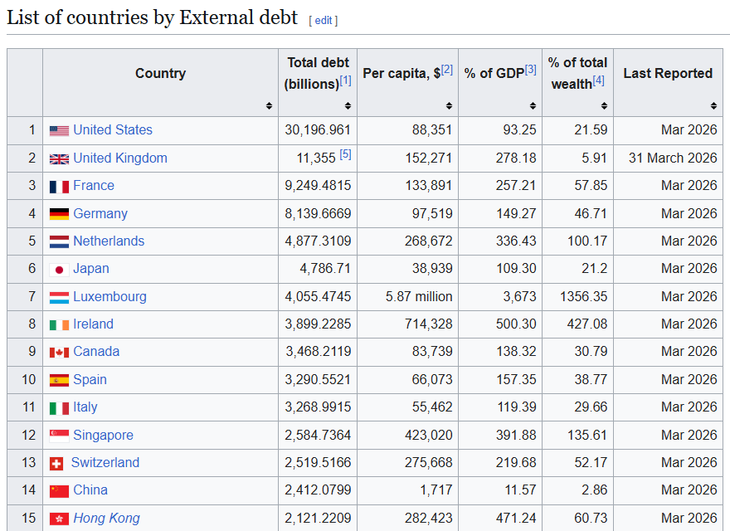
https://en.wikipedia.org/wiki/List_of_countries_by_external_debt

Slide 23
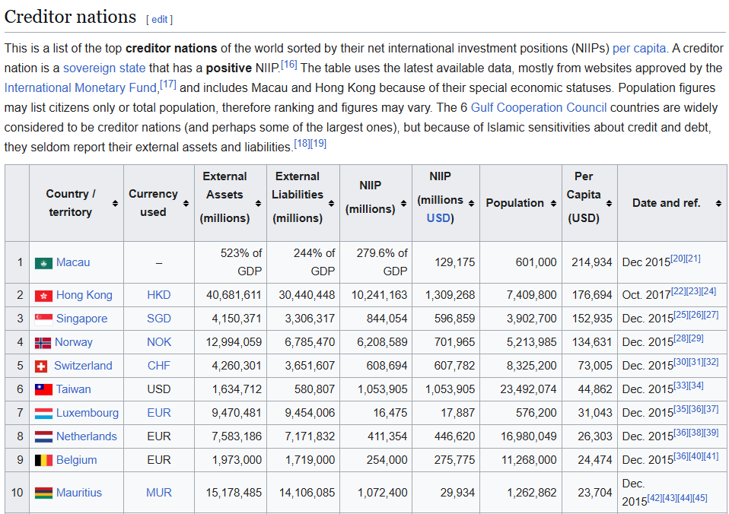
https://en.wikipedia.org/wiki/Net_international_investment_position

Slide 24
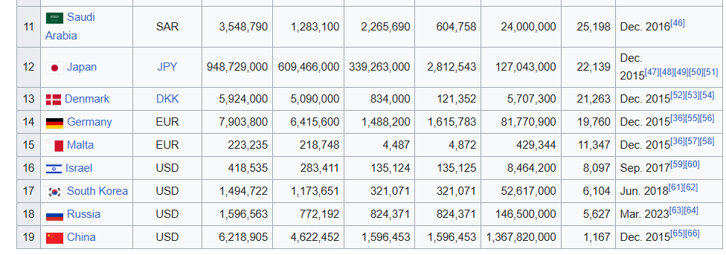
https://en.wikipedia.org/wiki/Net_international_investment_position

Slide 25
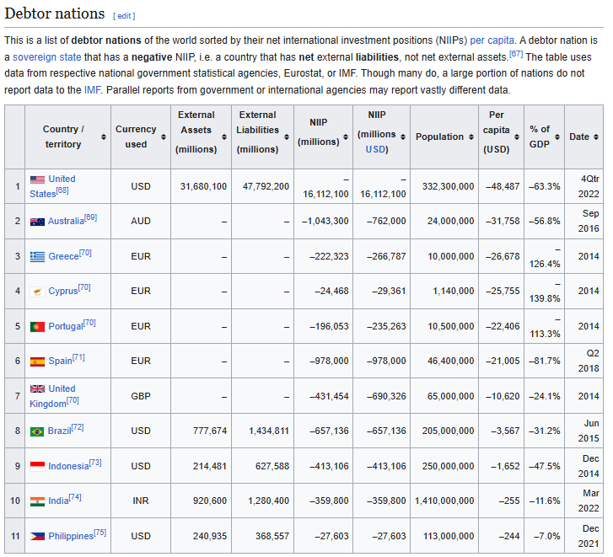
https://en.wikipedia.org/wiki/Net_international_investment_position

Slide 26
Conclusions
CAB + KAB – FAB + EO = 0
IIP (closing position) = IIP (opening position) + FAB + Changes in volume + revaluation position
FAB approximately equal to Change in International Investment Position = Change in net foreign assets = Change in foreign assets – Change in foreign liabialities.
FAB > 0 , IIP improves
FAB < 0 , IIP worsens

Slide 27
Homework
Choose a country to your liking, find data about its International investment position.
Try and explain the relationship between the balance of the financial account and the change in the coutnry’s international investment position.
Take a look at chapters 7, 9 https://www.imf.org/external/pubs/ft/bop/2007/pdf/bpm6.pdf
Take al look at
https://www.imf.org/external/np/pdr/debtres/#:~:text=Important%20indicators%20of%20the%20external,13.

