Slide 1
Introduction to
International economics
Lecture 7
Paolo Paesani
University of Rome Tor Vergata
ALEF Department
22/09/2025

Slide 2
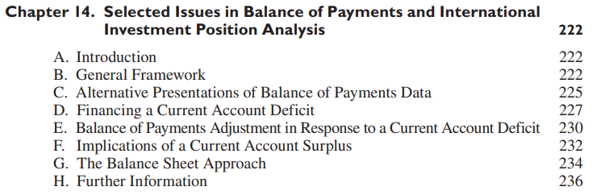
Selected Issues in Balance of Payments and International Investment Position Analysis
https://www.imf.org/external/pubs/ft/bop/2007/pdf/bpm6.pdf

Slide 3
General framework, 1
In the previous lesson, we linked the equilibrium condition between aggregate supply and demand of final goods and services (GDP = C + I + G + EX - IM) to the balance of payments (CAB + KAB + FAB + NEO = 0) and the international investment position (FAB = ∆NIIP).
The result being Stot – I + KAB = CAB + KAB = FAB = ∆NIIP
An alternative presentation of the same links is offered at the beginning of Chapter 14 of BOP 6. The two presentations are analogous but not identical and deserve to be compared.

Slide 4
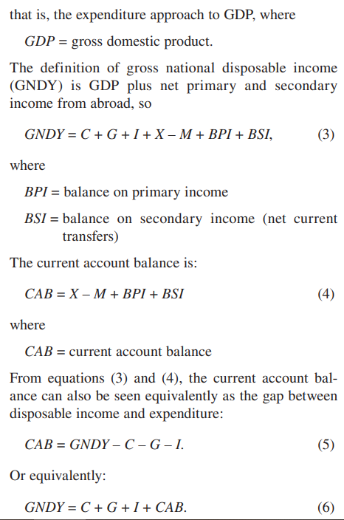
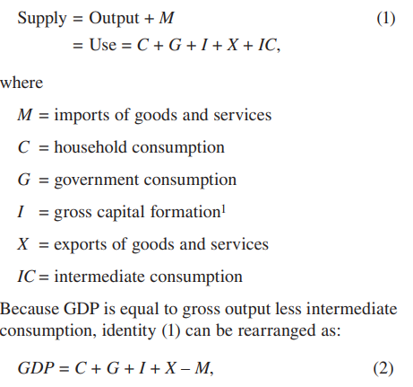
General framework, 1
https://www.imf.org/external/pubs/ft/bop/2007/pdf/bpm6.pdf

Slide 5
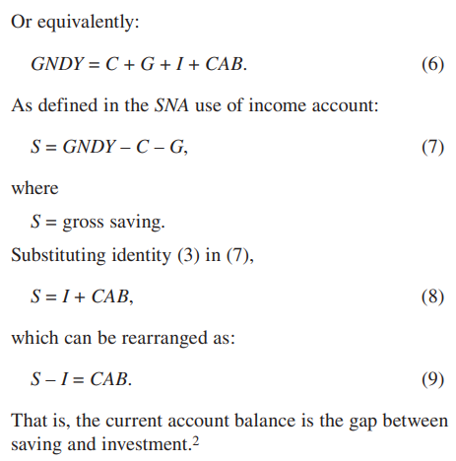
General framework, 2
14.5 Thus, the current account balance mirrors the saving and investment behavior of the economy. In analyzing changes in the current account balance of an economy, it is therefore important to understand the manner in which these changes reflect movements in saving and investment. For example, an increase in investment relative to saving will have the same impact on the current account—at least in the short run—as a decline in saving relative to investment. However, the longer-run implications for the external position of the economy may be quite different. More generally, identity (9) shows that any change in an economy’s current account balance (e.g., a larger surplus or smaller deficit) is necessarily equivalent to an increase in saving relative to investment.
This relationship highlights the importance of ascertaining the extent to which any policy measures designed to alter the current account balance directly (e.g., changes in tariffs, quotas, and exchange rates) will affect saving and investment behavior. 14.6 This link between domestic transactions and transactions with the rest of the world is shown in identity (5). The implication of this relationship for balance of payments analysis is that improvement in an economy’s current account requires a reduction in expenditure relative to income. Alternatively, it may be possible to achieve an improvement in the current account balance by means of an increase in national income that is not matched by a commensurate rise in consumption or domestic investment. Implementation of structural measures that increase the efficiency of the economy would be one way to achieve this objective.
https://www.imf.org/external/pubs/ft/bop/2007/pdf/bpm6.pdf

Slide 6
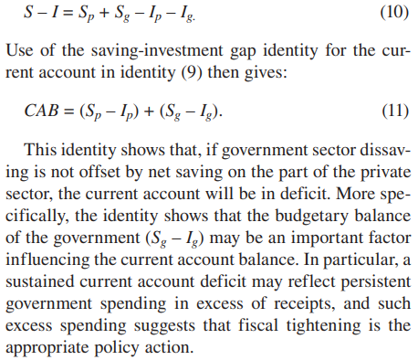
General framework, 3
14.8 The interrelationship of the current account balance with saving and investment can be seen in greater detail by distinguishing between the private and government sectors. Private saving and investment (Sp and Ip) and government saving and investment (Sg and Ig) are identified as:
https://www.imf.org/external/pubs/ft/bop/2007/pdf/bpm6.pdf

Slide 7
E. Balance of Payments Adjustment in Response to a Current Account Deficit, 1
14.39 There are many situations in which it may not be feasible to rely on private and official resources to finance a current account deficit on a sustained basis. If a deficit is unsustainable, the adjustment will necessarily happen through change in the willingness of market participants to provide financing or depletion of reserves and other financial assets, or a combination of both. Such adjustments may be abrupt and painful (up to the possibility of a balance of payments crisis). Therefore, policy measures aimed at mitigating the adjustment path may need to be considered.
14.40 For balance of payments analysis, it is therefore important to consider the possible introduction of adjustment measures to achieve a viable external payments position (i.e., conditions under which a deficit on goods, services, and income can be financed by private and official transfers, private financial inflows, and some recourse to reserve and other financial assets). The subsequent discussion illustrates some possible measures, but it is not exhaustive. It examines briefly the roles of exchange rate changes, fiscal measures, and monetary policy in achieving balance of payments adjustment.
https://www.imf.org/external/pubs/ft/bop/2007/pdf/bpm6.pdf

Slide 8
E. Balance of Payments Adjustment in Response to a Current Account Deficit, 2
14.41 In this analysis, it may be useful to rewrite identity
(9) as: S – I = CAB = BTG + BTS + BPI + BSI = NKF + RT (17)
where BTG = balance on trade in goods BTS = balance on trade in services BPI = balance on primary income BSI = balance on secondary income.
The magnitude of the necessary adjustment in the balance of payments depends, to some extent, on the nature of the components of the current account balance. For example, an economy may have been running a persistent deficit on trade in goods that was financed, in part, by borrowing from private and official sources. In this situation, the economy is also likely to be running a deficit on the balance of primary income that reflects the servicing of this debt.
A deficit for goods, services, and primary income may, however, be offset by a surplus on secondary income, which could reflect both official and private current transfers. If such inward transfers are expected to be of a long-term nature and can confidently be relied upon to finance all or part of the deficit in other components of the current account, then the extent of the necessary balance of payments adjustment may be rather small.
https://www.imf.org/external/pubs/ft/bop/2007/pdf/bpm6.pdf

Slide 9
E. Balance of Payments Adjustment in Response to a Current Account Deficit, 3
14.42 However, even in the case of a small adjustment, it is nonetheless important to be fully cognizant of the fact that foreign debt must be repaid. Thus the amortization schedule of the economy is an important factor for judging the sustainability of a particular balance of payments situation. If large amortization payments are due in the near future and expected financial inflows are not sufficient to cover payments falling due, it may be necessary to undertake adjustment measures beforehand to avoid more drastic measures required for dealing with a subsequent balance of payments crisis.
14.43 In the face of an unsustainable current account deficit in an economy with a fixed or managed exchange rate, one adjustment measure that could be considered is a depreciation of the exchange rate of the domestic currency. Such a depreciation may be necessary to offset a domestic price rise (relative to prices abroad) that—by penalizing exports and encouraging imports—worsens the balance on trade in goods. To the extent that the depreciation raises the prices of traded goods and services (i.e., exports and imports) in comparison with the prices of nontraded goods and services, depreciation will promote the substitution of domestic for imported products and stimulate foreign demand for domestic products.
https://www.imf.org/external/pubs/ft/bop/2007/pdf/bpm6.pdf

Slide 10
E. Balance of Payments Adjustment in Response to a Current Account Deficit, 4
However, because the depreciation will be accompanied by a rise in domestic prices in response to the increase in the cost of imported goods and services and the rise in demand for exports and domestically produced import substitutes, the improvement in international competitiveness generated by the exchange rate change will be partially or fully eroded. Such a development underscores the importance of supplementing the exchange rate adjustment with restrictive monetary and fiscal policies to facilitate the shift in resources signaled by the change (caused by the depreciation) in relative prices. Thus, an expenditure-switching policy in the form of exchange rate depreciation must generally be supported by expenditure-reducing measures; indeed, such measures are essential if there is no excess capacity in the economy.
14.44 The effects of such action can be seen from identity (9), which shows that any improvement in the current account must be matched by a corresponding positive change in the difference between saving and investment. An exchange rate depreciation by itself may generate such a change in the desired direction. In particular, if there is no change in the stance of monetary policy, the increase in demand generated by the depreciation will raise the demand for money. With an unchanged money supply, the greater demand for money will tend to increase nominal and real domestic interest rates. As a result, interest-sensitive expenditures will be dampened, and there could be a positive impact on saving. However, it is unlikely that this induced effect on the gap between saving and investment will itself be sufficient, particularly if the economy is at full employment, to achieve the desired improvement in the current account. Therefore, in all likelihood, it will be necessary to accompany the adjustment in the exchange rate with measures to reduce the level of domestic expenditure through tighter monetary and fiscal policies that release resources to expand output in the exporting and import-substitution industries.
https://www.imf.org/external/pubs/ft/bop/2007/pdf/bpm6.pdf

Slide 11
E. Balance of Payments Adjustment in Response to a Current Account Deficit, 5
14.45 The discussion of identity (11) pointed to fiscal deficits as one potential cause of external imbalances. Changes in government spending and taxation may therefore be necessary to achieve the required reduction in the saving-investment gap—to the extent that an exchange rate depreciation does not induce a sufficient response in the difference between total saving and investment. However, it is important that fiscal policy measures be designed to achieve the desired objective and not exacerbate the adjustment problem. For example, cuts in infrastructure investment may have the desired short-run balance of payments effect, but such cuts could have, particularly if the spending reductions are in such areas as transport or electricity, a long-run adverse impact on the supply potential of the economy and the generation and supply of energy designed to relieve bottlenecks. Moreover, tax measures that result in very high marginal tax rates or that are aimed particularly at investment income could have the undesired side effect of inducing offsetting reductions in private saving and reducing incentives to invest in the economy. Such disincentive effects can be avoided by implementing fiscal action aimed at reducing or eliminating subsidies and by cutting back on government activity that can be performed better by the private sector.
https://www.imf.org/external/pubs/ft/bop/2007/pdf/bpm6.pdf

Slide 12
E. Balance of Payments Adjustment in Response to a Current Account Deficit, 6
14.46 The stance of monetary policy plays an important role in balance of payments adjustment. The existing external imbalance may reflect an excess of domestic investment over saving (or what is the same thing—an excess of domestic spending over income) that results from an excessively expansionary monetary policy. It is, first of all, important to adjust the stance of monetary policy so that interest rates are generally positive in real terms and provide an incentive to savers and so that domestic economic conditions are sufficiently stable to encourage investment. From the perspective of aggregate supply and demand, it can be seen from identity (5) that monetary policy should ensure that the level of domestic expenditure is in line with the productive capacity of the economy. Thus, from the point of view of balance of payments analysis, the objective of monetary and fiscal policies is to limit domestic spending to what is available from domestic resources and foreign financing.
14.47 One important aspect of monetary policy in balance of payments adjustment is the link between reserve asset transactions and domestic monetary conditions. A decline in reserve assets may be associated with a current account deficit or a net financial outflow caused by an expansionary monetary policy or both. The reserve asset decline can lead to a reduction in the monetary base and therefore to a tightening in the stance of monetary policy. A more restrictive monetary policy tends to correct the payments imbalance through higher interest rates that dampen domestic demand and make domestic assets more attractive to investors. However, this built-in adjustment mechanism can be short-circuited if the monetary authorities offset the effect of the loss of reserve assets on the monetary base by increasing the domestic component of the base (e.g., through open-market purchases of securities held by the banking system). Such offsetting action tends to prevent domestic interest rates from rising and thereby contributes to the persistence of the balance of payments deficit.
https://www.imf.org/external/pubs/ft/bop/2007/pdf/bpm6.pdf

Slide 13
F. Implications of a Current Account Surplus, 1
14.48 The foregoing discussion focuses entirely on an economy that faces an actual or incipient balance of payments problem in the form of a persistent current account deficit. Of course, for the world as a whole, the current account deficits of economies in deficit are exactly offset by the surpluses of other economies.
Although surpluses typically do not lead to crises in the countries that run them, an analysis of some aspects of a surplus balance of payments situation is useful as surpluses may raise important issues associated with domestic monetary management and vulnerabilities and the speed of adjustment toward more balanced external accounts.
As can be seen from identity (13), a surplus in the current account is reflected in an increase in net claims held by the private sector or government (NKF) on nonresidents or an increase in official reserve assets (NRT), or both. The change in the net foreign asset position may be due to a reduction in liabilities to nonresidents rather than to an increase in gross claims. Such a reduction may well be a desirable development if a previous large buildup of liabilities has imposed a severe debt service burden on the economy. In this case, a current account surplus can be an appropriate step toward achieving a viable balance of payments.
https://www.imf.org/external/pubs/ft/bop/2007/pdf/bpm6.pdf

Slide 14
F. Implications of a Current Account Surplus, 2
14.49 The case of an economy with no recent current account deficits and an increase in its gross private claims on the rest of the world reflects an excess of aggregate saving over domestic investment. If the government’s fiscal balance is in deficit, private sector saving will exceed domestic investment. The allocation of part of saving to foreign assets presumably reflects the fact that investors find the rate of return on these assets more attractive, at the margin, than investment opportunities in the domestic economy. The provision of resources to the rest of the world in the form of a buildup of net claims on nonresidents will, by and large, result in an efficient allocation of the domestic economy’s saving as long as the buildup of net claims reflects the operation of market forces rather than government policies designed directly or indirectly to increase such claims.
14.50 Thus, for analyzing the balance of payments of an economy in persistent surplus, one key consideration is whether government policies distort saving and investment decisions and thereby bias an economy toward a current account surplus. Such distortions can take many forms. First, there are measures that directly influence the current account. Examples are tariffs and quotas that limit imports, restrictions on payments abroad, and export subsidies and government procurement policies that give preference to domestic producers. Moreover, an exchange market intervention policy may bias the value of the currency downward. Finally, there may be measures that limit foreign acquisition of domestic assets—a limitation that would tend to bias the financial account toward a net outflow and thereby shift the current account in the direction of a surplus.
https://www.imf.org/external/pubs/ft/bop/2007/pdf/bpm6.pdf

Slide 15
F. Implications of a Current Account Surplus, 3
14.51 These measures may, in fact, not lead to a larger current account surplus. Policy actions aimed at particular components of the balance of payments will, over time, lead to offsetting movements in other components in the absence of changes in the underlying determinants of saving and investment. In any event, if a large and persistent current account surplus appears to arise from such distortionary measures, the appropriate policy action is the reduction and eventual removal of these distortions. If a persistent surplus remains after such measures are eliminated, then the accumulation of net claims on the rest of the world would appear to manifest the saving and investment propensities of the economy. If, in this case, one were to identify the surplus as a problem, it would generally be necessary to establish that private saving or government saving was excessively high or that domestic investment was too low. It is considerably more difficult to arrive at such a conclusion than to identify the previously enumerated distortions that relate directly to international transactions.
https://www.imf.org/external/pubs/ft/bop/2007/pdf/bpm6.pdf

Slide 16
F. Implications of a Current Account Surplus, 4
14.52 A current account surplus, while reflecting entirely a response to market forces, may cause economic difficulties for an economy. For example, an economy with a “resource curse” experiences either a natural resource discovery or a substantial improvement in the terms of trade for the natural resources sector. The expanding sector or terms of trade gains lead to an improvement in the current account and an appreciation of the exchange rate. This development tends to make other sectors of the economy contract and be less competitive internationally. If the newly discovered resources are expected to be depleted fairly rapidly and the gains in terms of trade to be transitory, it may be appropriate to protect the sectors adversely affected. One way to achieve this objective is through exchange market intervention to prevent or moderate the exchange rate appreciation. The accumulation of reserve assets or special funds tends to insulate the real economy from having to adjust to the short-run disturbance.
https://www.imf.org/external/pubs/ft/bop/2007/pdf/bpm6.pdf

Slide 17
F. Implications of a Current Account Surplus, 5
14.53 Current account surpluses may also create other difficulties in the domestic economy, such as difficulties in monetary management and increases in vulnerabilities associated with large and rapid monetary expansions. When a current account surplus causes an increase in reserve assets, the economy’s monetary aggregates expand and a credit expansion will tend to take place. If this credit expansion is too large and rapid, the economy may overheat (leading to inflationary pressures) or vulnerabilities in the financial sector may emerge, particularly if there are weaknesses in financial sector supervision. Sterilization of the buildup in reserves—that is, offsetting its monetary impact through, typically, sales of domestic securities—can help mitigate this effect, but not forever, and often at significant cost. These costs typically arise because the domestic securities will carry a higher interest rate than the (usually low) rate received by the monetary authorities for their reserves. Moreover, if the currency were to appreciate in the future, the monetary authority would experience a decline in net worth, because the value of the reserves would fall relative to the value of the domestic securities used for the sterilization operations.
https://www.imf.org/external/pubs/ft/bop/2007/pdf/bpm6.pdf

Slide 18
F. Implications of a Current Account Surplus, 6
14.54 A conclusion of the preceding analysis is that, when a current account surplus is not the result of government policy actions, it may be difficult to establish that an economy is investing too much of its saving abroad and whether, therefore, specific policy changes are needed when a country is facing a current account surplus. Some guidance may be obtained, however, from the behavior of reserve assets. When a current account surplus is reflected in a buildup of foreign reserve assets rather than in a rise in net foreign assets held by the private sector, the buildup represents specific government policy action in the form of foreign exchange market intervention. Intervention, which involves the sale of domestic currency in exchange for foreign currency, has the tendency to keep the foreign exchange value of the domestic currency lower than it otherwise would be. The accumulation of reserve assets may therefore limit the extent to which the currency appreciates and—particularly when accompanied by sterilization—prevent the operation of the selfcorrecting mechanism that would tend to reduce the current account surplus
https://www.imf.org/external/pubs/ft/bop/2007/pdf/bpm6.pdf

Slide 19
F. Implications of a Current Account Surplus, 7
14.55 Thus, one aspect of balance of payments analysis for an economy with a persistent current account surplus involves an appraisal of the level of reserve assets held by monetary authorities. The accumulation of such assets is excessive if the assets exceed, by a wide margin, the amount required to finance possible future short-run deficits. In such a situation, the economy’s resources may well be more efficiently used if devoted to domestic consumption or capital formation rather than exports. If the private and government sectors are unlikely to increase domestic capital formation, cessation of reserve asset accumulation would lead to an increase in domestic absorption or to a rise in net foreign investment by residents or both.11 In either case, allocation of the economy’s resources would tend to be more efficient as the allocation would be responding to market forces.
https://www.imf.org/external/pubs/ft/bop/2007/pdf/bpm6.pdf

Slide 20
F. Implications of a Current Account Surplus, 8
14.56 As in the case of an economy exhibiting a current account deficit, monetary, fiscal, and exchange rate policies have an important role in the adjustment of an economy with a current account surplus. In principle, the surplus could be reduced through expenditure-expanding policies (e.g., expansionary fiscal and monetary policies) or through expenditure-switching policies that would drive consumption toward foreign goods and away from domestic goods (e.g., a currency appreciation). Nevertheless, expansionary fiscal and monetary policies could have the unwanted implication of fueling the credit boom, which would cause increased inflationary pressures and possibly heighten credit-related vulnerabilities. A currency appreciation would, on the contrary, moderate the credit expansion by increasing consumers’purchasing power in terms of foreign goods (which would drive demand toward the consumption of foreign goods), and by limiting the creation of new base money (because the monetary authority would be limiting its intervention in the foreign exchange market). Given that the currency appreciation would also make domestic goods less attractive abroad, a gradual appreciation process may be needed in order to achieve a smooth adjustment of the external accounts.
https://www.imf.org/external/pubs/ft/bop/2007/pdf/bpm6.pdf

