Slide 1
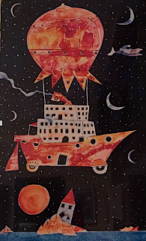

Transformations to Just and Sustainable Futures
Workshop day 1:
Introduction and presentations
Selection of case study
Desirable futures
Clara Saglietti
23/02/2026

Slide 2
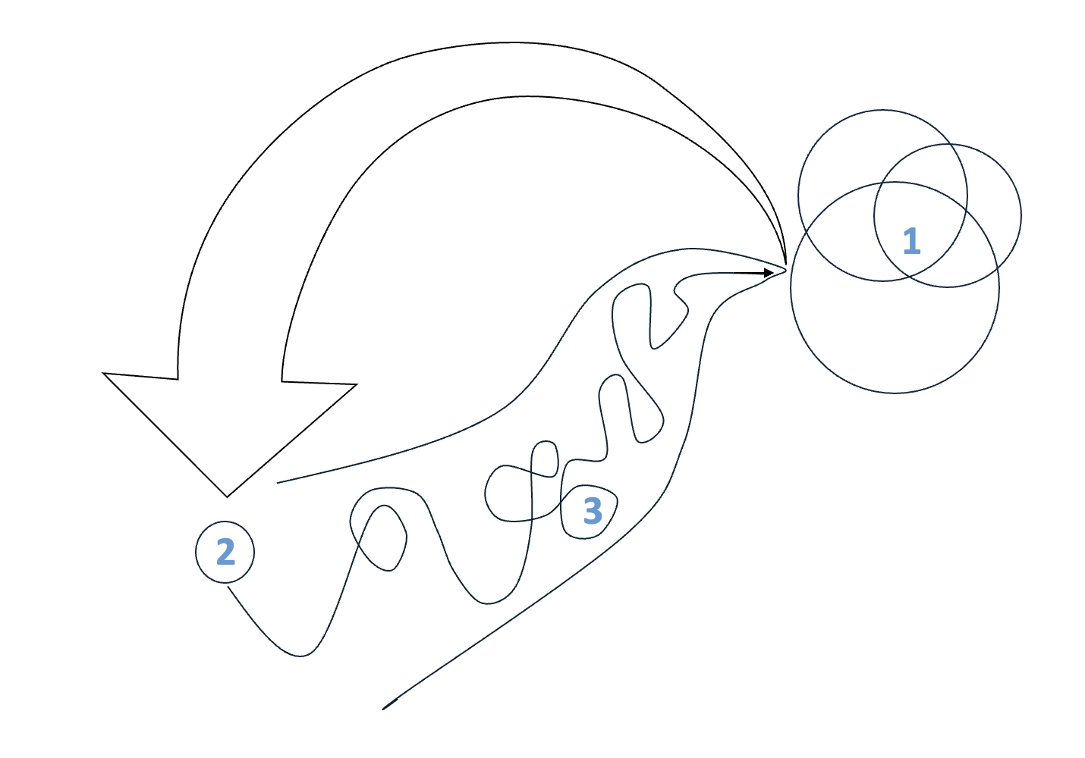
Suggested structure
Day 1
Day 4
Desirable futures
Reflections and collective learning
Co-creation of shared visions of desirable futures
What is important/should be?
Day 2
Present situation
Day 3
Identification of gaps, obstacles, and leverage points in the present compared to the desirable futures
What is and is not, why?
What could be different, where?
Transformative interventions
Prefigurative experimentation and interventions in areas with transformative potential
What can be, how?

Slide 3

Getting to know each other
What are your expectations?
Are there things you would like to learn, skills you would like to develop?
Do you have a favourite form of artistic/creative expression or any you would like to explore?
What is your name?
Do you have any preferred prononuns (e.g., she/they, he/him, any/all, no pronouns)?
Do you have any special needs? Is there anything you would like us to know to make this environment supportive?
Why are you interested in this workshop?
What motivates you e.g. in relation to your thesis topic, future studies, etc?

Slide 4

Case work

Slide 5
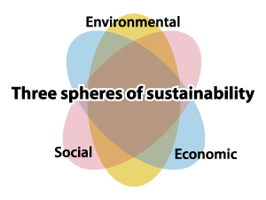

Slide 6
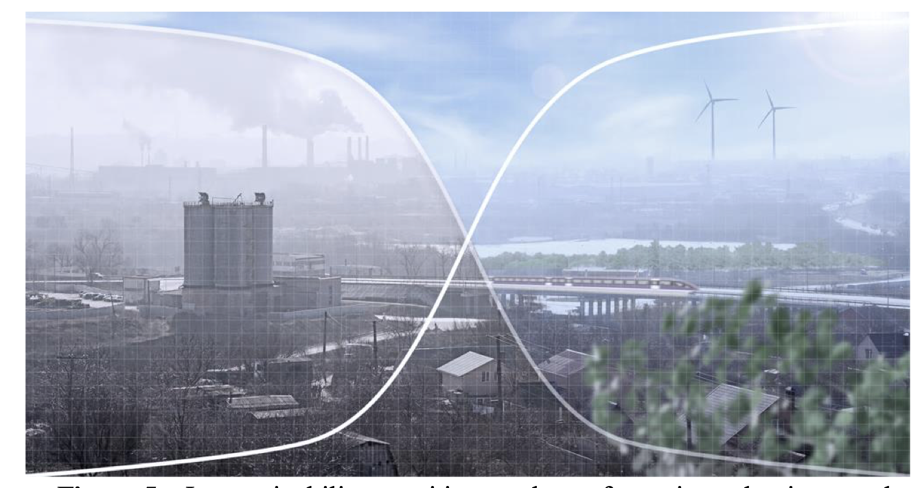

Slide 7
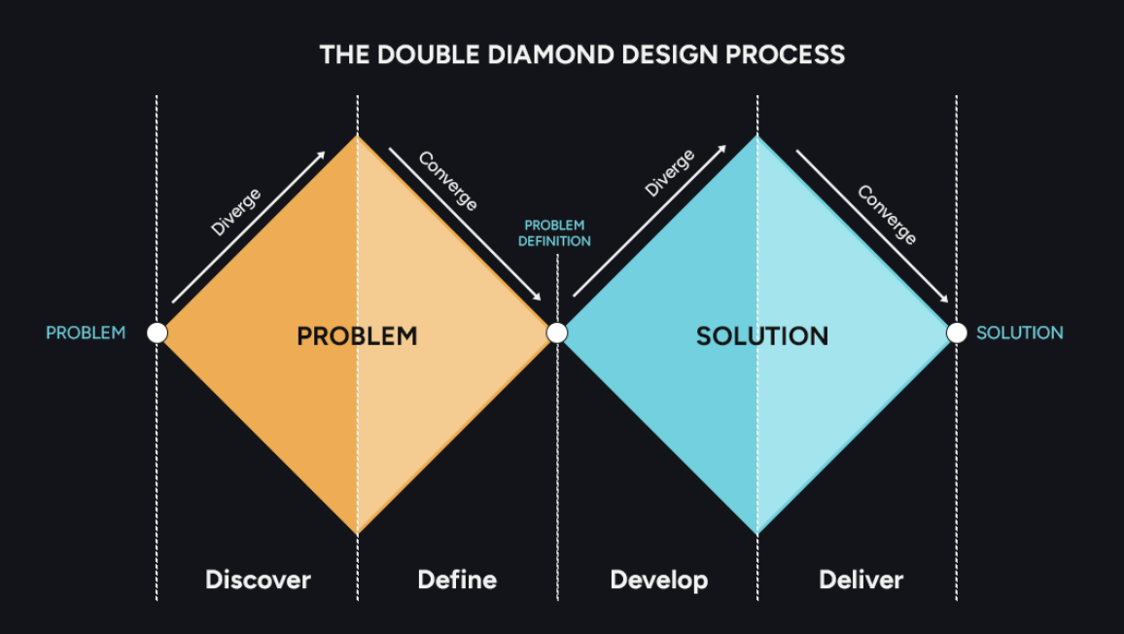

Slide 8
Campus walk
Groups of 3/4 : Focus on gathering impressions about challenges at campus
Think about:
Sustainability and unsustainability
Potential for change
1) Try to practice silent observation about challenges. Take impressions, photos, thoughts
2) Exchange your thoughts about challenges
What do you observe? What is problematic? What is missing?
What do you care/are concerned about? What issues do you want to contribute to?
What existing knowledge/skills do you bring?
What else do you want to learn and what new skills do you want to develop? What do you want to help other group mates with?
Are there societal actors or ongoing processes to address this challenge that you want to connect with?

Slide 10
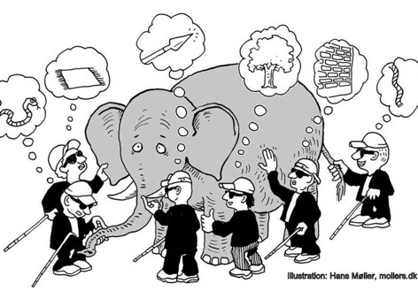

Slide 11
Lunch break

Slide 12
Space 1: desirable futures
1
Desirable futures
3
2
Present situation
Transformative interventions

Slide 13
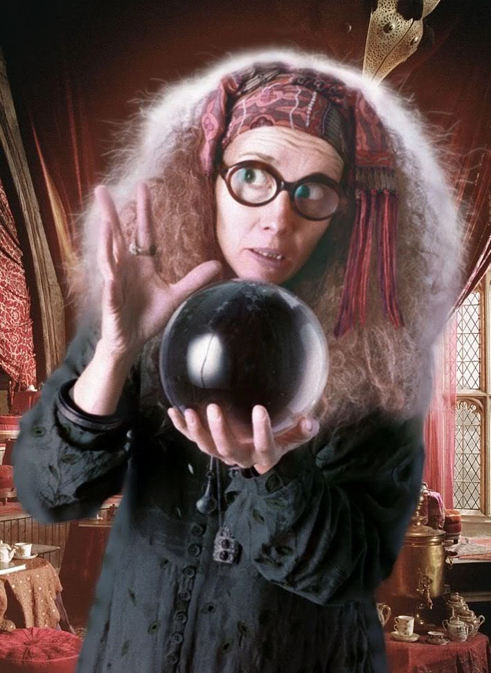
Things are good and getting better
I feel optimisitic about futures.
And it is not up to me/us to change things.
I feel optimisitic about futures
And I/we can influence them for the better
I can’t influence things
I can influence things
I feel pessimisitic
about futures
And I/we do not have power to influence them
I feel pessimisitic
about futures
But I/we can act to change things for the better
Things are getting worse

Slide 14
Futures
“The term future used alone, in the singular and without context, seems to suggest that it is all about looking ahead. The word itself does not suggest that looking beyond the horizon also involves being aware of what lies before and beneath the horizon”
Ziauddin Sardar

Slide 15
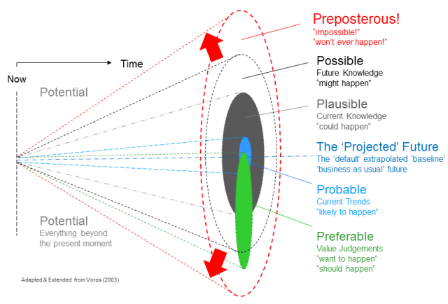

Slide 16
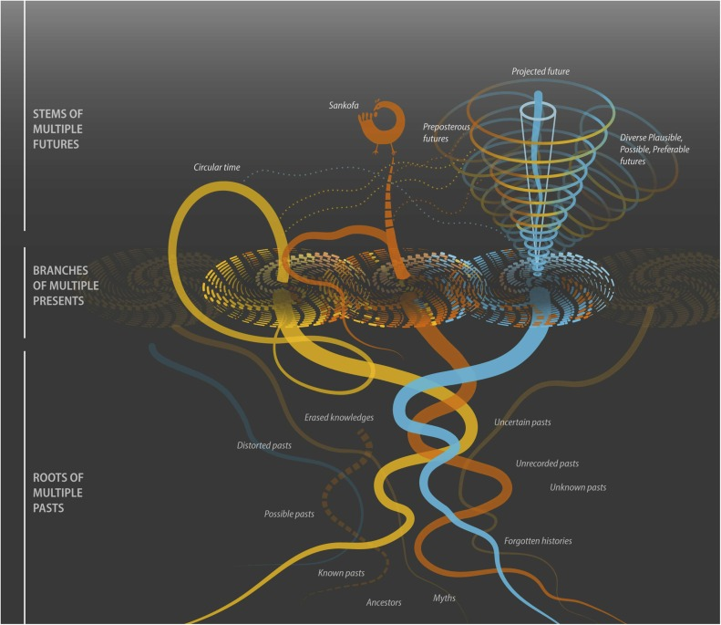

Slide 17
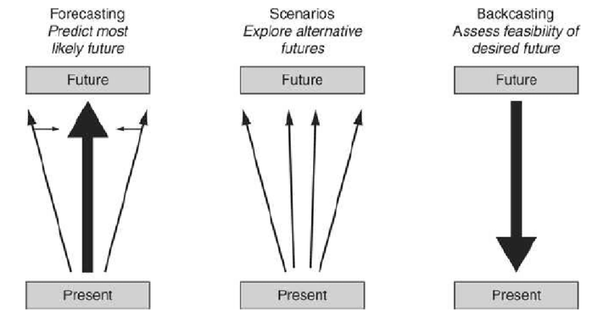

Slide 18
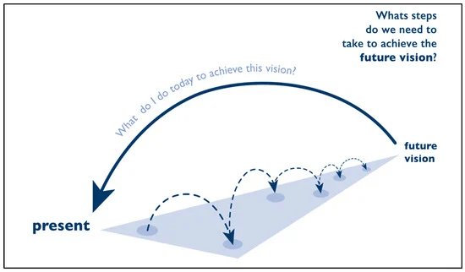
Backcasting evolution
Energy planning
Sustainability challenges
Participatory approach
Prefigurative

Slide 19
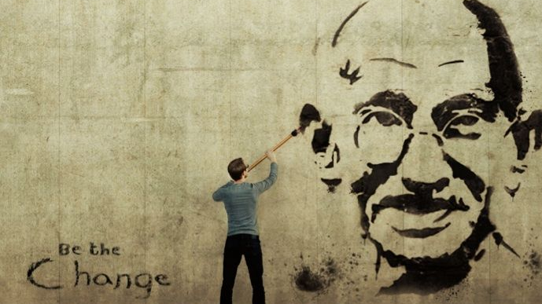

Slide 20
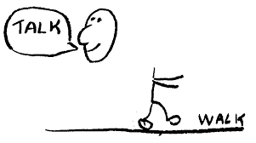
Prefigurative backcasting

Slide 21
How to explore desirable futures?
Storytelling and metaphors
Visions and visual representations
Embodyment of guiding principles and values
Sounds and other artistic forms of experssion
Cognitive frames/how we look at the world
Role playing and experiential futures

Slide 22
Thank you
For any questions or thoughts: clara.saglietti@chalmers.se
+39 3920719864 (Signal only)
+46 763905061 (SMS)

