Slide 1
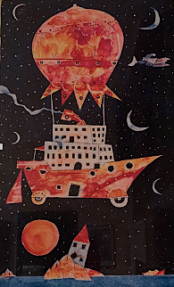

Transformations to Just and Sustainable Futures
Workshop day 2:
Creation of groups for cases
Desirable futures
Understanding the present
Clara Saglietti
24/02/2026

Slide 2
Poll results: mobility community spaces

Slide 3
Space 1: desirable futures
1
Desirable futures
3
2
Present situation
Transformative interventions

Slide 4
What characterises a good life on campus that is also socially, economically and ecologically sustainable?

Slide 5
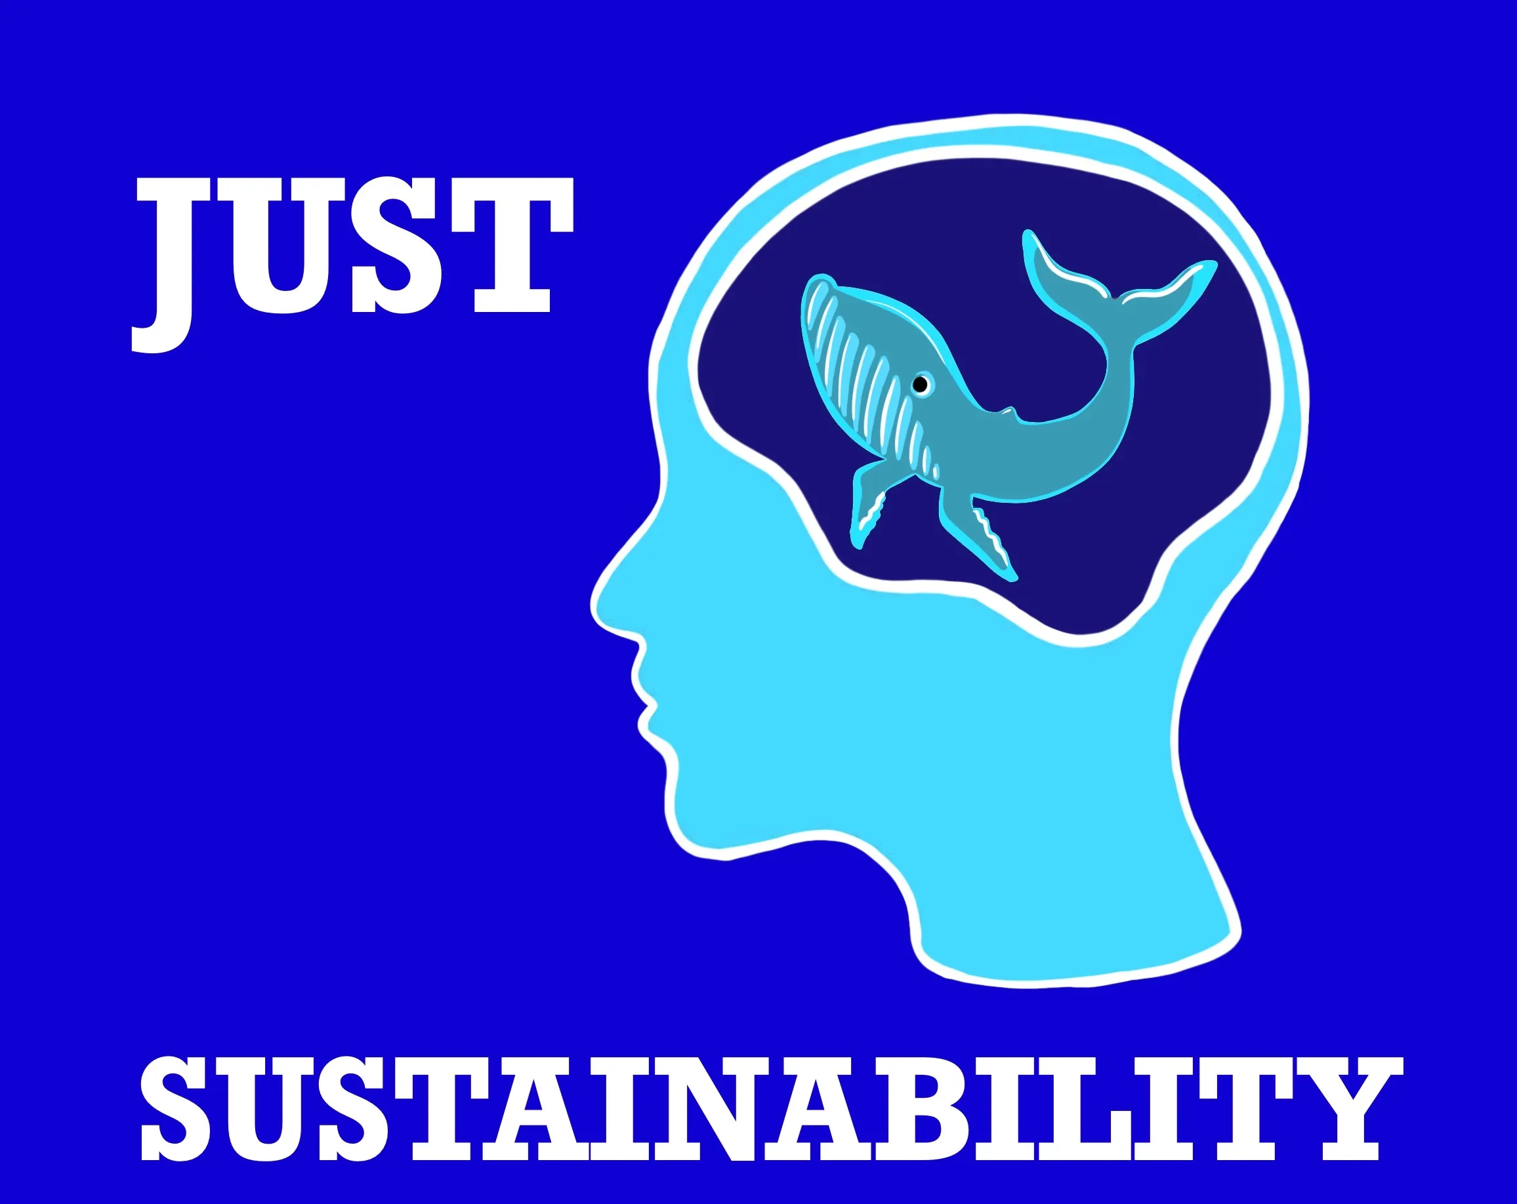

Slide 6

What is a good life?
Human needs & wellbeing
Social
How can we live together?
Economic
How can capital/resources be managed for the future?
Ecological
How can society’s actitivies fit within nature’s carrying capacity?
Holmberg & Holmén-Larsson (2018)

Slide 7
World café (not group specific)
A
B
C
D
Wellbeing
Social
Economic
Ecological

Slide 8
World café
Three steps in each station:
Think in silence about what can characterise the dimension of the lighthouse and note down keywords on post-its
Open up: Present thoughts to each other and ask questions
Close down: Cluster and group characteristics

Slide 9
What is a good life?
Subsistence
Protection
Affection
Understanding
Participation
Idleness
Creation
Identity
Freedom
Human needs & wellbeing
Max-Neef et al (1989)
Social
How can we live together?
Economic
How can capital be managed for the future?
Horizontal relations
Vertical relations
Equity/justice
Natural capital
Man-made capital
Human capital
Financial capital
Examples
Ecological
How can society’s actitivies fit within nature’s carrying capacity?
Holmberg et al (1996)
Substances from earth’s crust
Substances from societal production
Physical means
Holmberg & Larsson (2018)

Slide 10
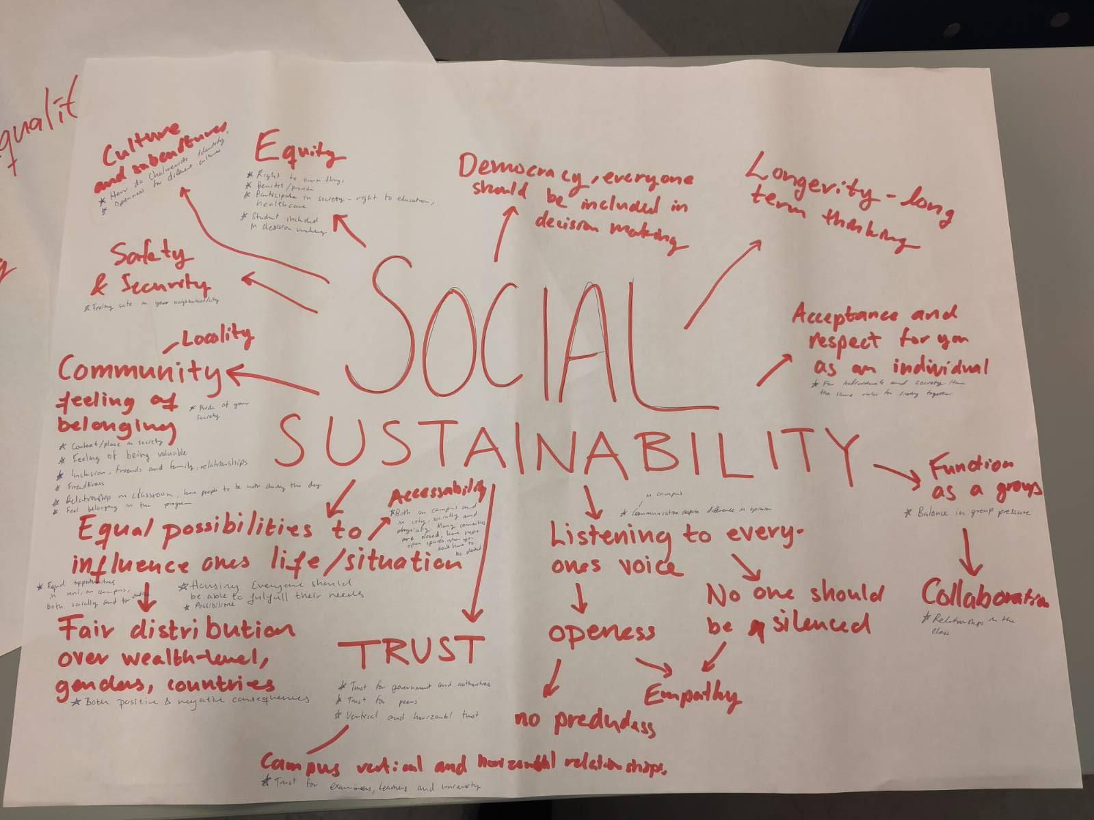

Slide 11
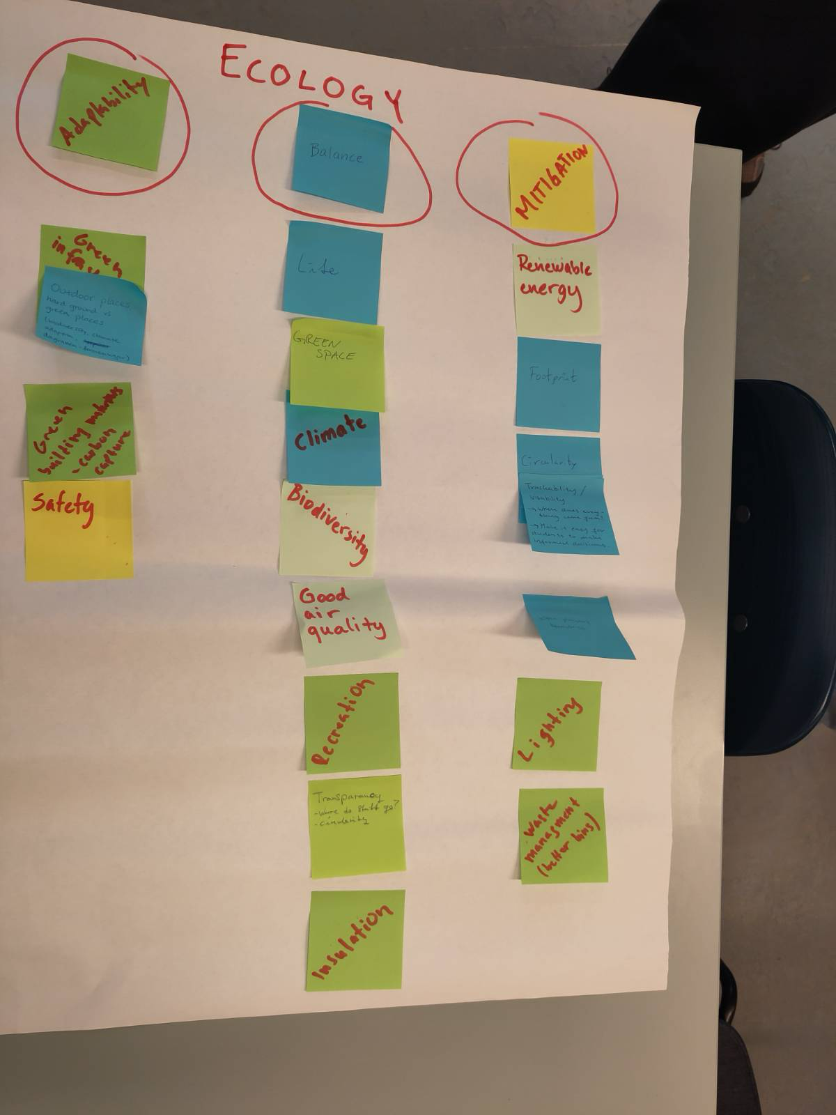

Slide 12
Lunch break

Slide 13
What is a good life?
Human needs & wellbeing
Social
How can we live together?
Economic
How can capital/resources be managed for the future?
Ecological
How can society’s actitivies fit within nature’s carrying capacity?
Holmberg & Holmén-Larsson (2018)

Slide 14
What is relevant for the future of your case?
Explore what guiding principles and values can be adapted for your case and further developed:
  Are some principles/values more important than others?
  Are there any missing?
  Are there any ethical implications to be mindful about? (Positionality?)
  Are there some dimensions that would be better grasped using non-verbal means?
  How can you best represent/embody them with more creative methods?

Slide 15
How to explore desirable futures?
Storytelling and metaphors
Visions and visual representations
Embodyment of guiding principles and values
Sounds and other artistic forms of experssion
Cognitive frames/how we look at the world
Role playing and experiential futures

Slide 16
Thank you
For any questions or thoughts: clara.saglietti@chalmers.se

