Slide 1


Transformations to Just and Sustainable Futures
Workshop day 3:
Present situation
Gaps and challenges
Leverage points
Clara Saglietti
25/02/2026

Slide 2
Space 2: present situation
1
Desirable futures
3
2
Present situation
Transformative interventions

Slide 3
Understanding the present situation
“We do not describe the world we see, but we see the world we describe”
David Bohm
“In any complex setting, people typically focus their attention on the parts of the system most visible from their own vantage point. This usually results in arguments about who has the right perspective on the problem. Helping people see the larger system is essential to building a shared understanding of complex problems. This understanding enables collaborating organizations to jointly develop solutions not evident to any of them individually and to work together for the health of the whole system rather than just pursue symptomatic fixes to individual pieces.”
Peter Senge

Slide 4
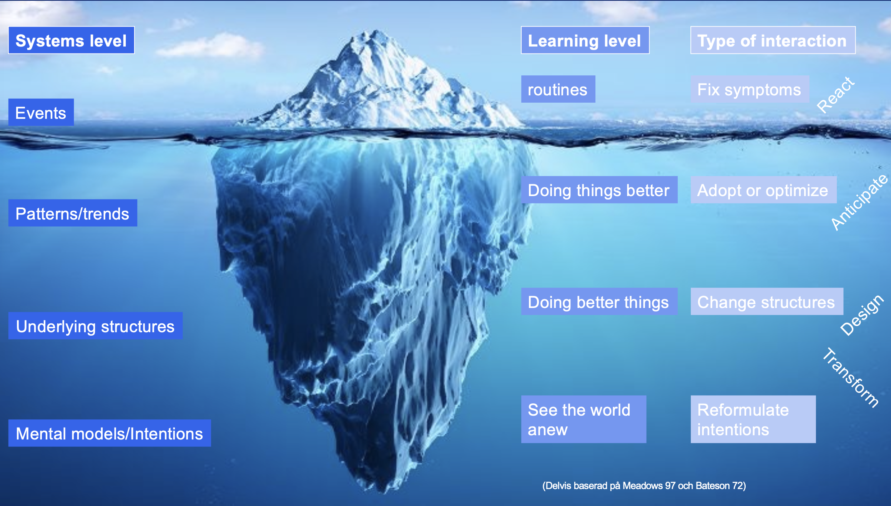
To solve a big problem, make it bigger
Notes:
System thinking v reductioninsm and division in parts

Slide 5
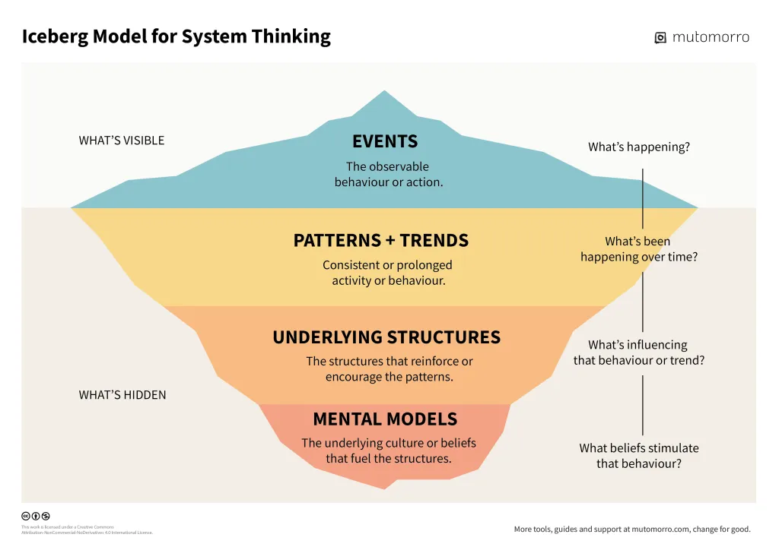

Slide 6
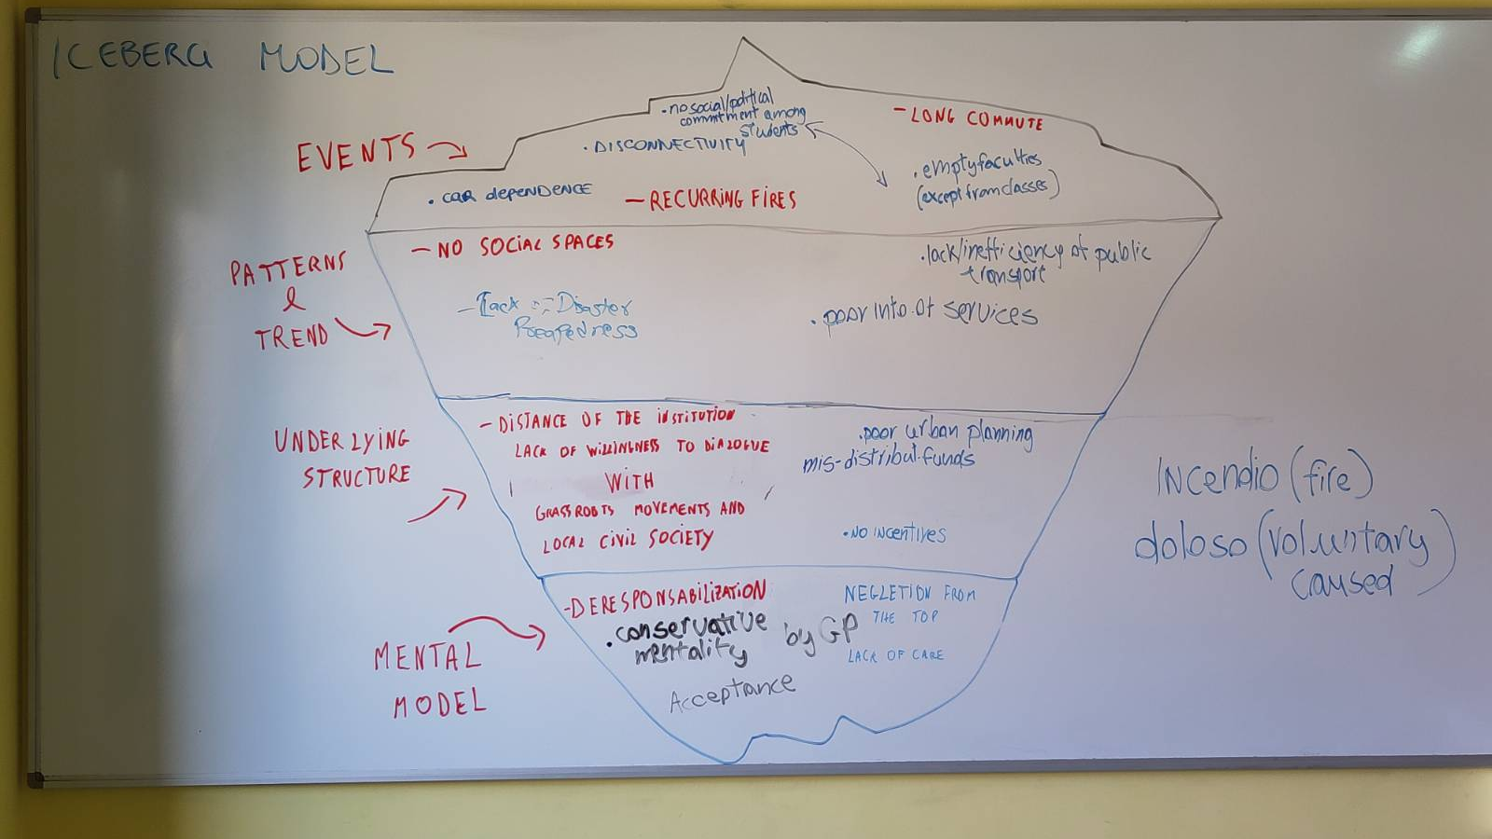

Slide 7
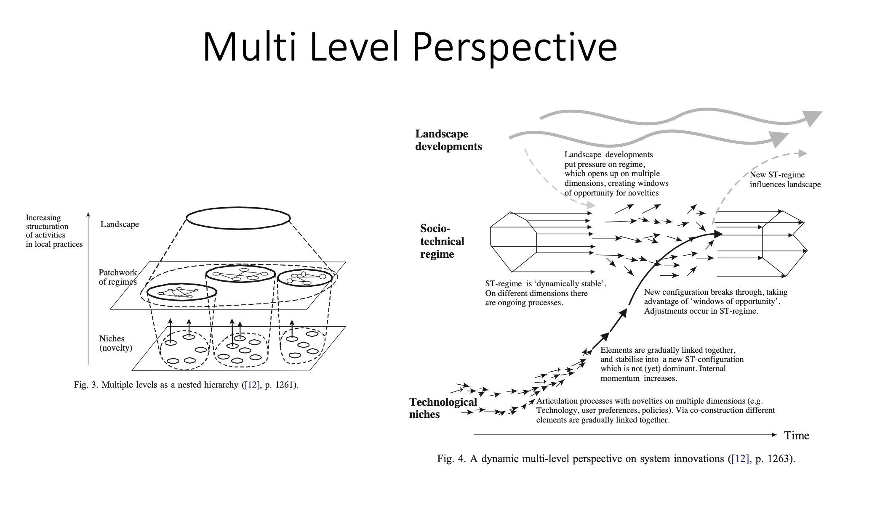

Slide 8
Lunch break

Slide 9

Gaps and challenges

Slide 10
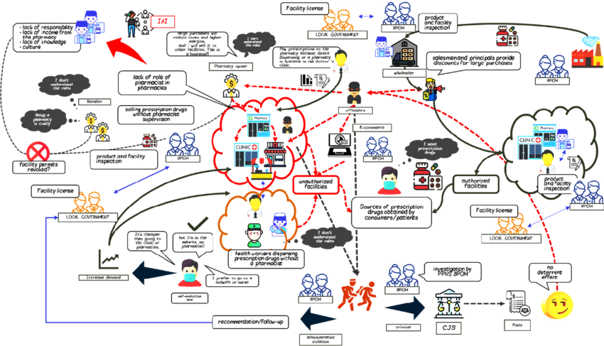
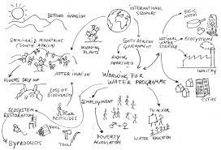
Rich pictures
Soft systems methodology to co-develop a holistic understanding of a situation, identify key aspects, organize complex information with a systemic approach, and sketching a starting point for more structured analysis

Slide 11
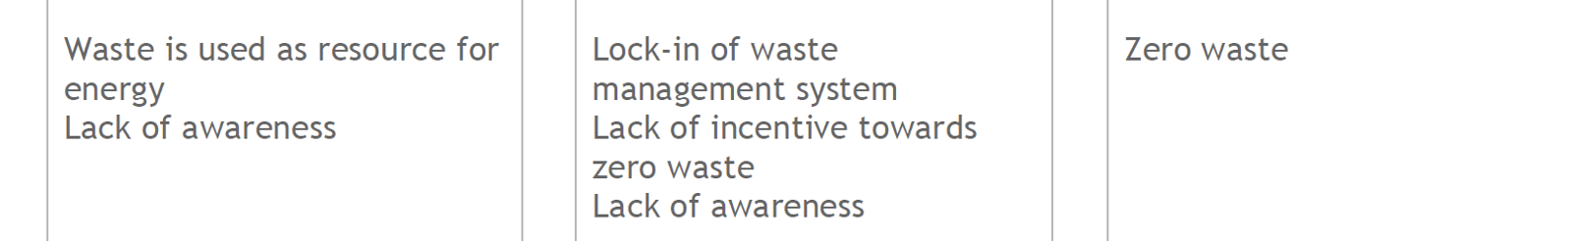


Gaps and challenges
Current situation | Gap/challenge Systemic/local manifestation | Guiding principles

Slide 12
How to explore and understand presents?
Storytelling and metaphors
Visions and visual representations
Embodyment of guiding principles and values
Sounds and other artistic forms of experssion
Cognitive frames/how we look at the world
Role playing and experiential futures
Notes:
Provide examples, plan how to do it, start representing the desired futures

Slide 13

What can be different, where?
What can be different, where?
Notes:
What can be different, where?

Slide 14
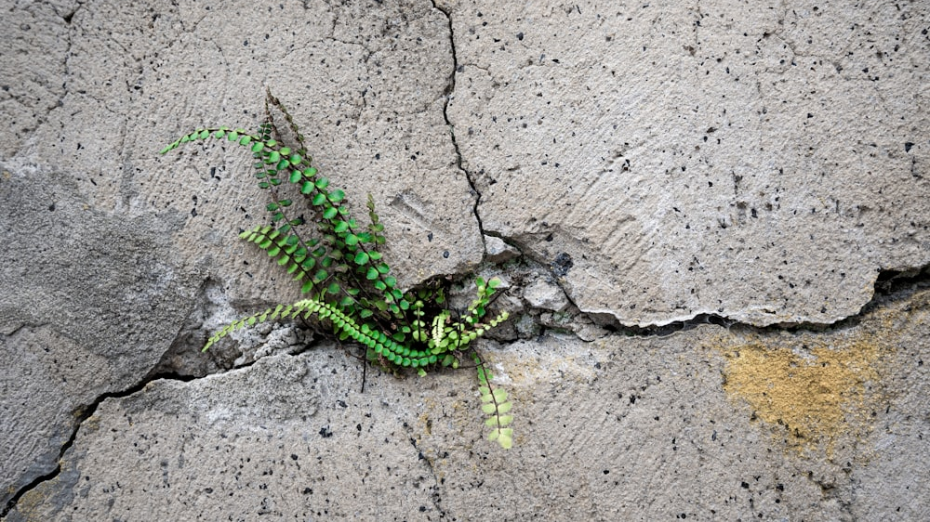

Slide 15
Leverage points
Leverage point: An “area with potential” in a system where a smaller intervention can lead to larger changes

Slide 16
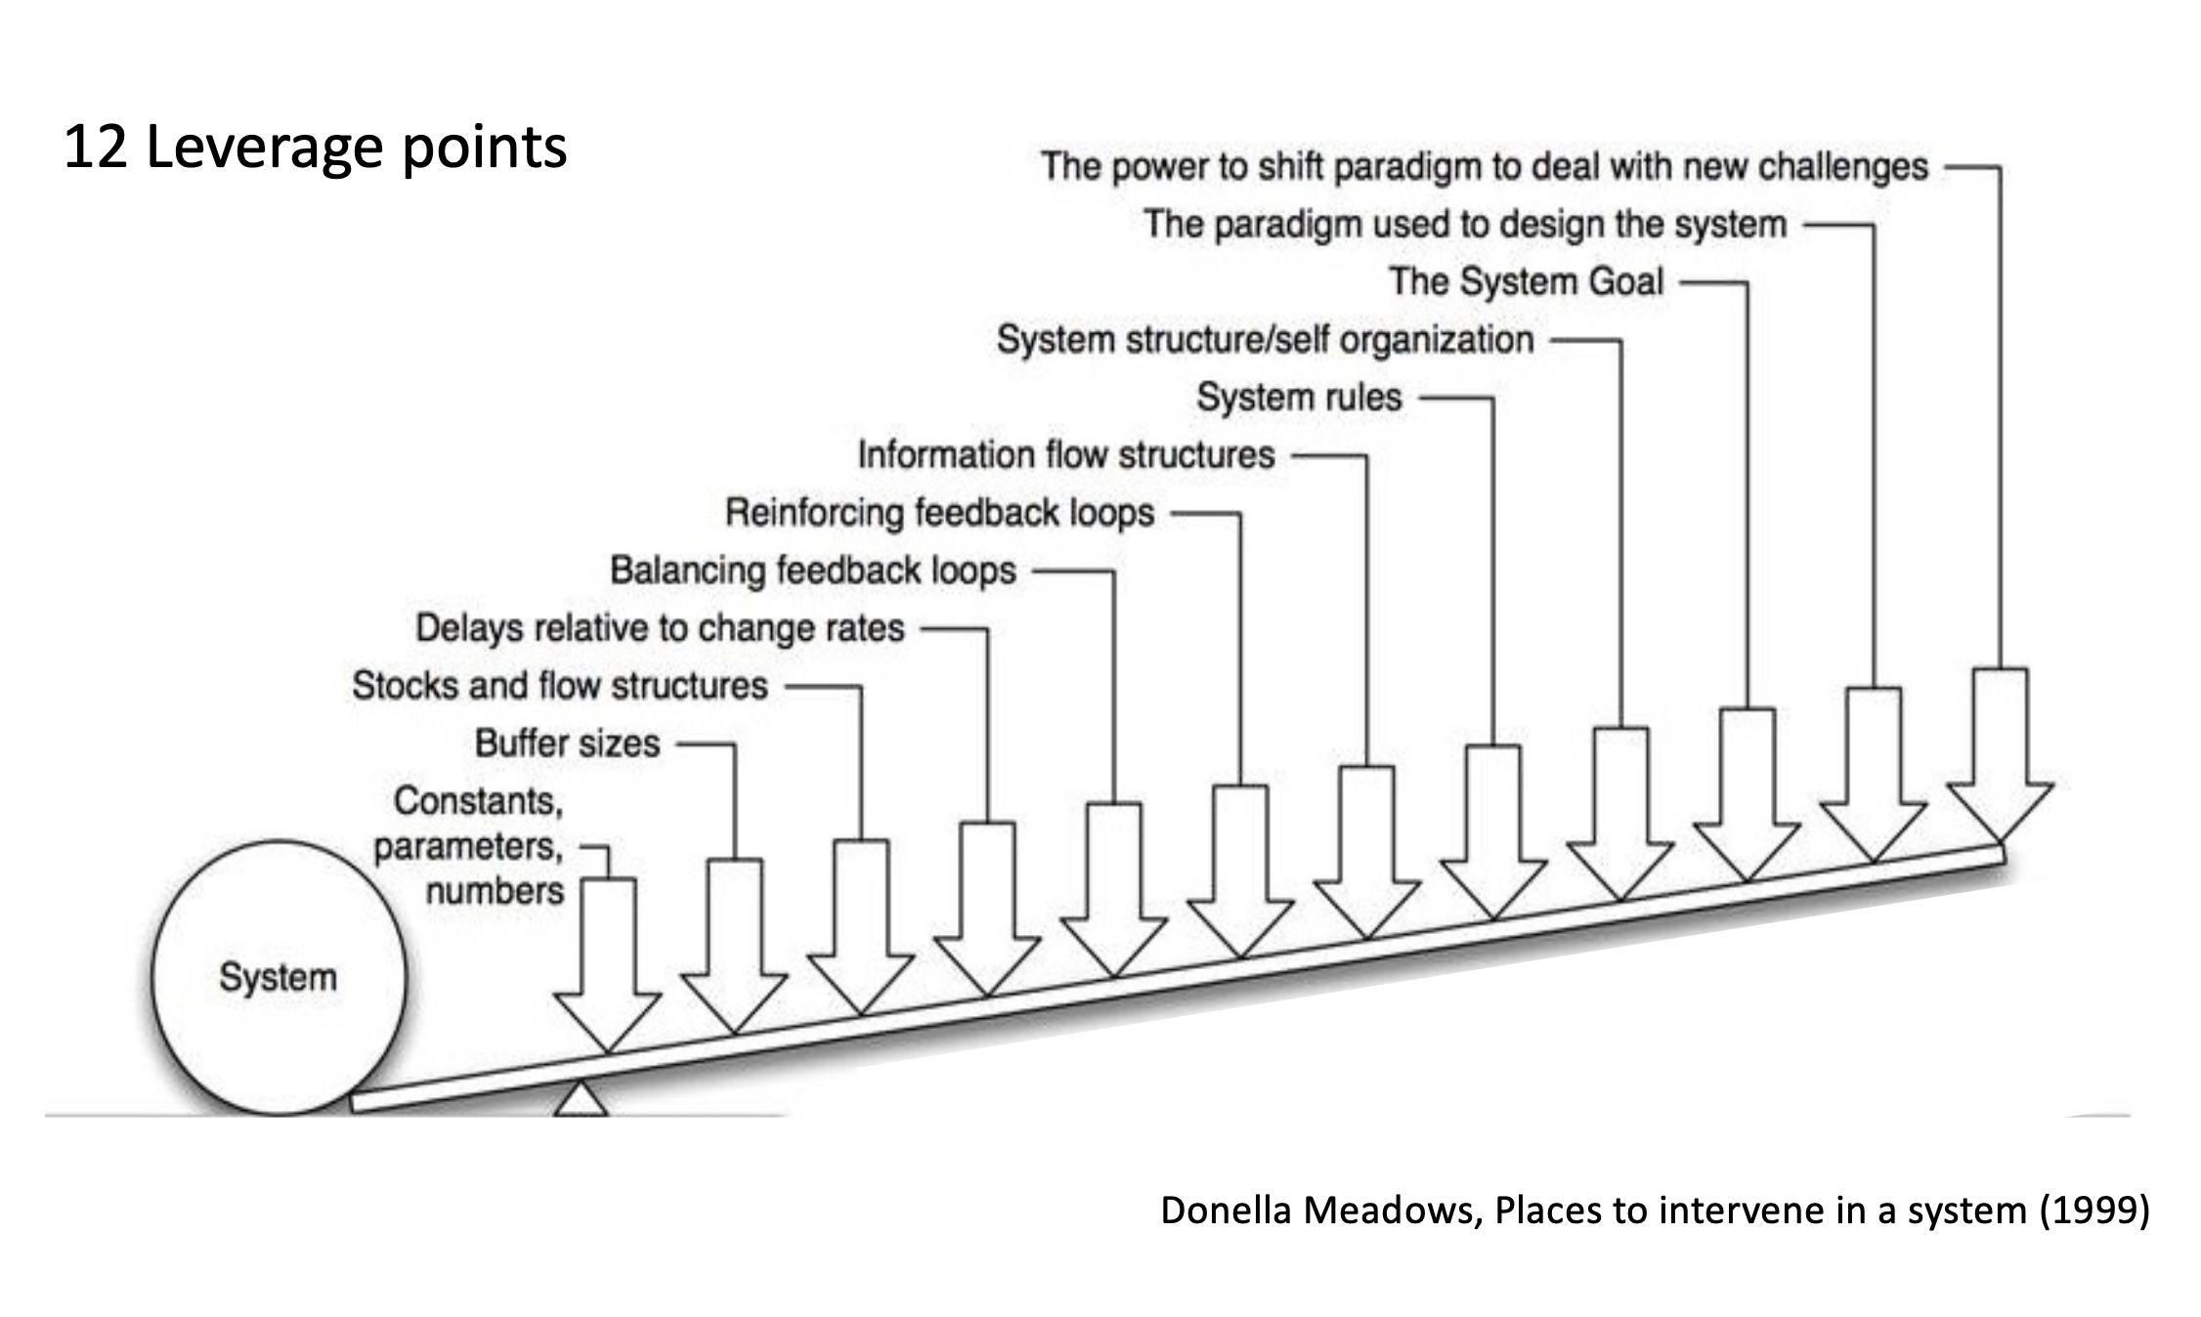

Slide 17
Leverage points
Meadows (2008) places to intervene. Inspiring the following table:
Increase cost of car, subsidies
Infrastructure: Making it easier for bikes, more difficult for cars
9. Numbers (subsidies, taxes, standards).
8. Material stocks and flows.
7. Regulating negative feedback loops.
6. Driving positive feedback loops.
5. Information flows.
4. The rules of the system (incentives, punishment, constraints).
3. The power of self-organization.
2. The goals of the system.
1. The mindset or paradigm out of which the goals, rules, feedback structure arise.
“Shallow”
Increasing safety
Tech. innovation in bikes
Increase awareness on health benefits,
Grocery store incentivize cyclists
’Critical Mass’ protests, bike-repair cafes
Make biking a lifestyle, identity, community, social norm
“Deep”

Slide 18
Thinking in leverage
4
Identify leverage points = areas of intervention where there is potential for (sustainability transformative) change (rather than suggesting particular solution at this stage)
Formulate open-ended compelling questions that represent the leverage point, e.g. on the form “how might we…?”
Think of feasibility given where we have agency to influence in our local context (i.e. scope + available stakeholders, resources and interest)
Notes:
Areas of intervention, not particular solution points
Important to move from what a challenge, to ”how we might”

Slide 19
How might we...
…[direction] [factor] for [who] in order to [what you want to achieve]?
Decrease
Increase
Introduce
Remove

Slide 20
How might we...
…[direction] [FACTOR] for [who] in order to [what you want to achieve]?
Perceived level of XX
Availability of YY
Use of ZZ
Number of NN
Likelihood to do MM
…

Slide 21
How might we...
…[direction] [factor] for [WHO] in order to [what you want to achieve]?
Students
Tor Vergata visitors
Workers
…

Slide 22
How might we...
…[direction] [factor] for [who] in order to [WHAT YOU WANT TO ACHIEVE]?
Select X over Y
Start doing Z
Improve ZZ

Slide 23
How might we...
Increase the awareness among students and staff about water consumption in order to make them more mindful about their water usage?
Increase students’ awareness about knowledge sharing activities in order to inspire them to learn?
Increase involvement of students in extracurricular activities in order to increase campus relations and cultural integration?
Notes:
Should be at the level of area in system, not solution

Slide 24
What makes a good leverage point?
Think big
Start small, act now
Broad
Strategic/high-level
Organisational/collaboration
Vague/abstract
Narrow
Operational/on-the-ground
Technical
Specific/concrete

Slide 25
Suggested steps
1. Open up
Think individually, brainstorm in your group, and open discussion to identify potential leverage points, try to formulate questions that might guide you
2. Narrow down
Start process of selection by thinking what makes a good leverage point, refine the selected questions
3. Reflection
What is missing/to be improved? Think about what doubts and questions you might have for another group

Slide 26
How to enact desirable futures?
Storytelling and metaphors
Visions and visual representations
Embodyment of guiding principles and values
Sounds and other artistic forms of experssion
Cognitive frames/how we look at the world
Role playing and experiential futures
Notes:
Provide examples, plan how to do it, start representing the desired futures

Slide 27
Thank you
For any questions or thoughts: clara.saglietti@chalmers.se

