Slide 1
Population, Development and Economic Growth
Changes in pop affect consumption needs and productive capacity of economy
If Labor only factor of production, CRS →double Labor means double Y →y constant.
With factors in fixed supply(eg land): more labor lower GDP per capita This is the rational for including pop in models that attempt to explain income per capita.
Size of population versus growth
Japan: between 1980 and 2000, population growth –a low rate of 0.4% per year-But population density in 2000 was very high, 338 per squared kilometer.-Kenya, population growth over 1980-2000 was very high, 3.0% per year-But, by year 2000 population density was still low, only 53 people per squared kilometer.

Slide 2
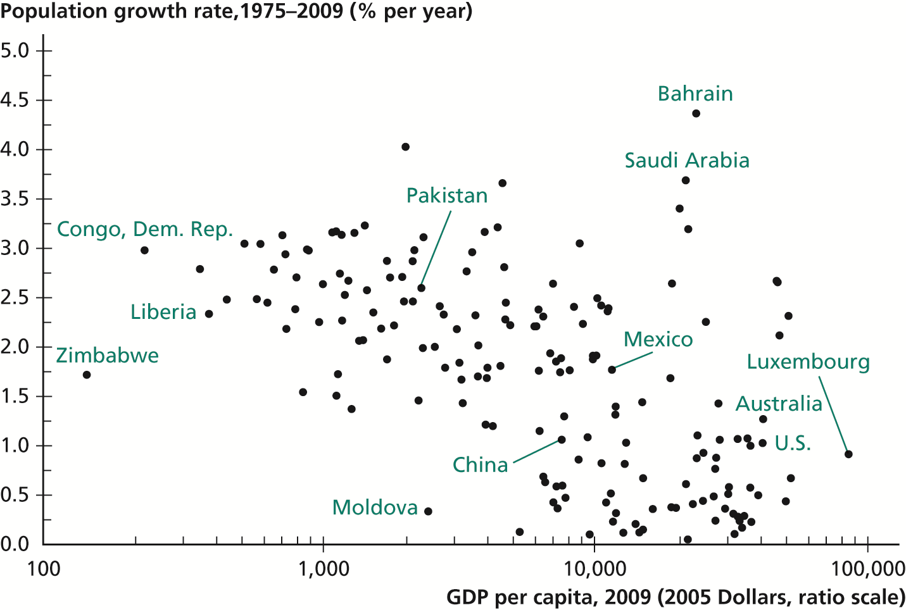
Figure 1 Relationship Between Income per Capita and Population Growth

Slide 3
Figure 1: Reveals a strong relationship between population growth and income per capita. However as usual we must investigate about he direction of causality.

Slide 4
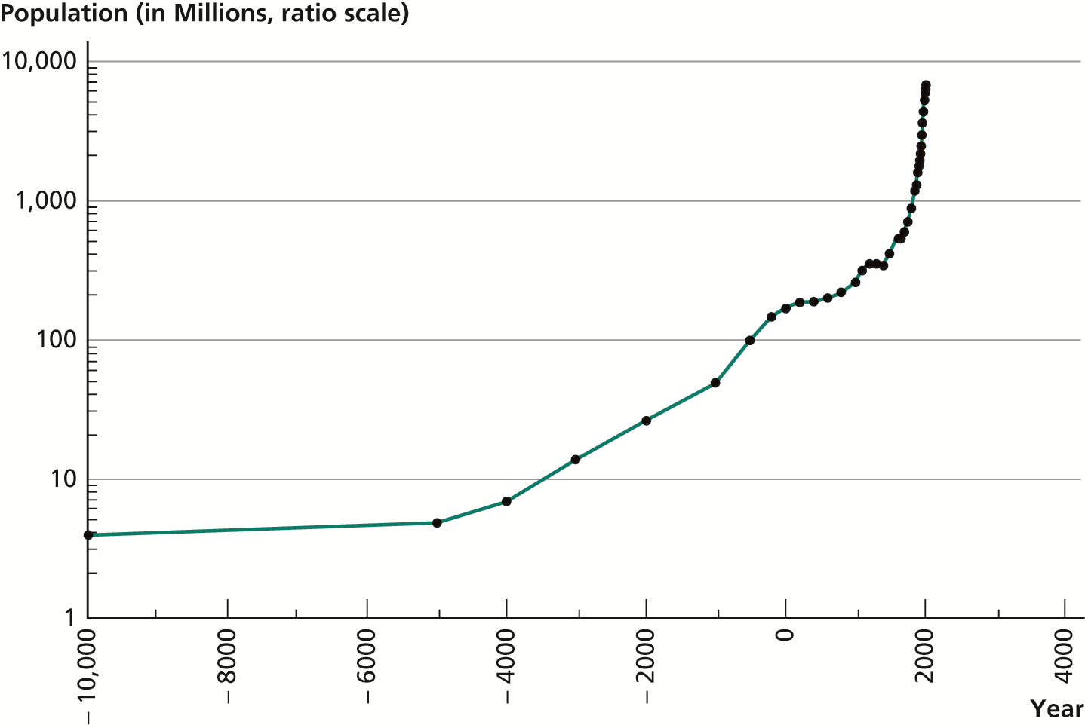
Figure 2 World Population, 10,000 B.C. to A.D. 2010

Slide 5
. Population Over Long Run
Figure 2: size of population from year 10,000 BC.
Striking: small population for most of history
Striking: slow pop growth for most history:
Between 10,000 BC and 0 -only .04% per year, 1% every 25 years
Between 0 and 1800 .09% per year
Only in last 200 years pop growth has taken off: 0.6% in 19th century-0.9% in the first half of 20thcentury 1.8% over the last 50 years.-Population growth is a relatively new phenomenon historically.

Slide 6
The Malthusian Model
Malthus(1766-1834): An explanation for historical constancy of pop:-
Basic assumption: positive potential fertility. But limited available resources –fixed amount of land.
-The smaller pop/land ratio, the better off people would be.-The better off people were, the faster population would grow.
•As pop grew, land/pop would fall, and people would become poorer. This poverty would limit population growth. …..Eventually reach income that is consistent with constant population.

Slide 7
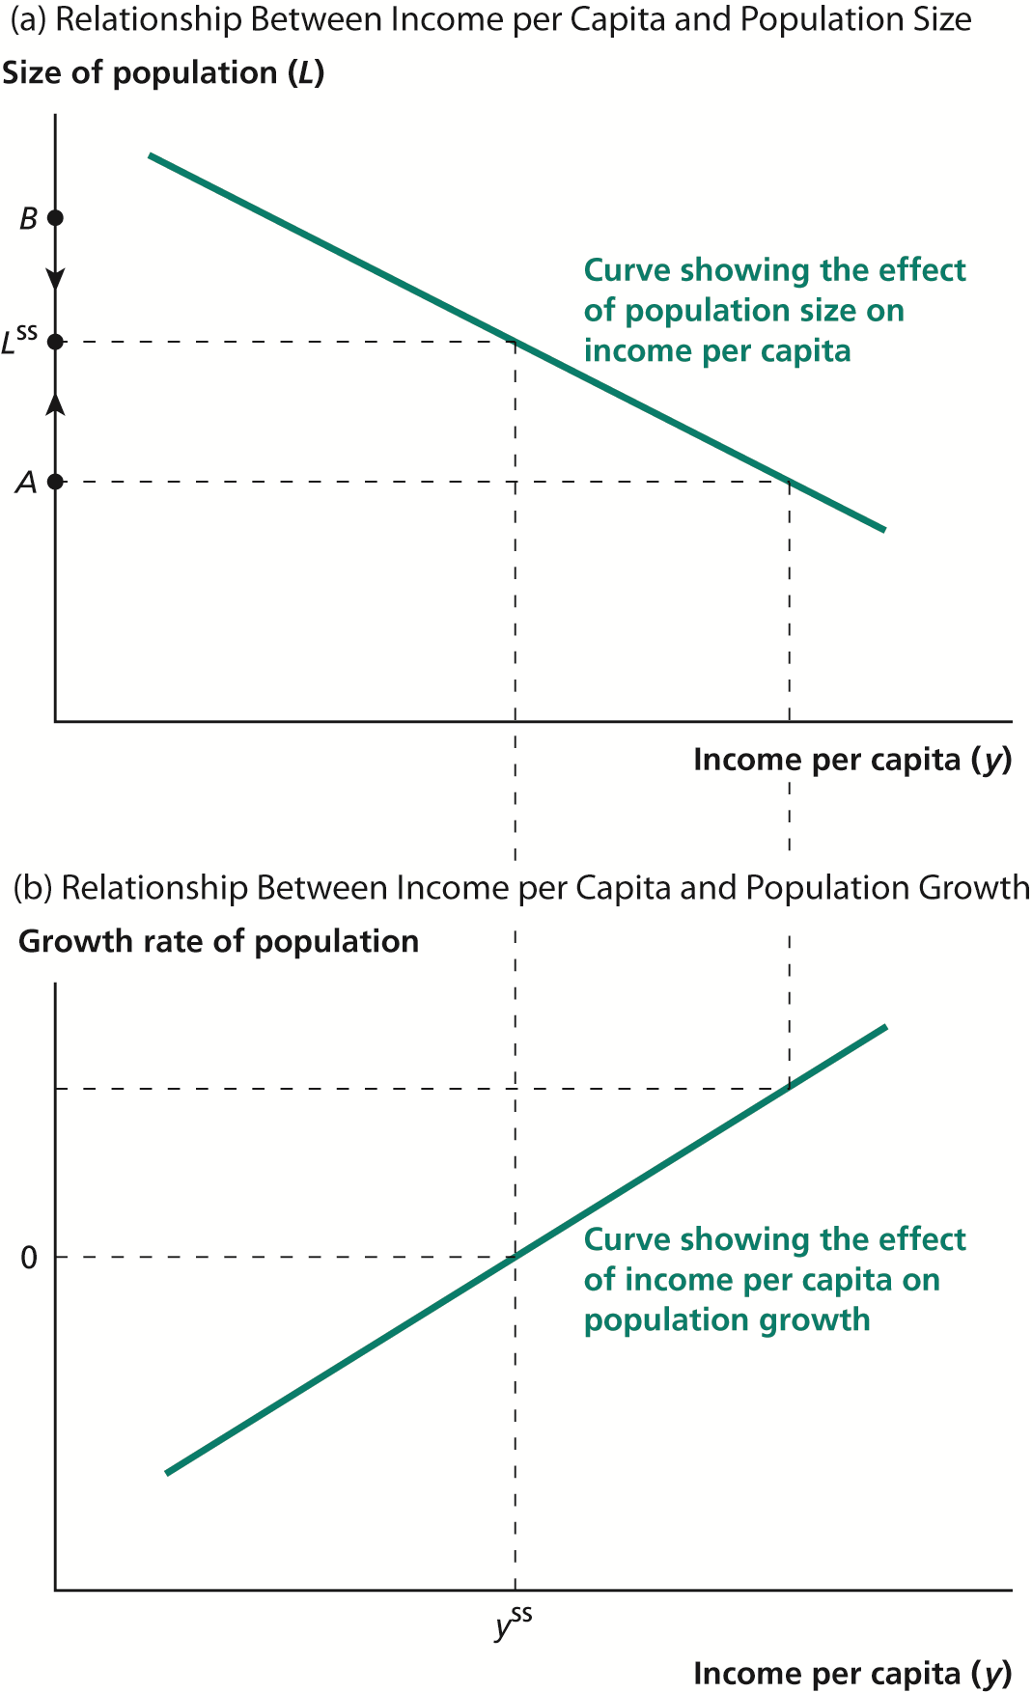
Figure 3 The Malthusian Model

Slide 8
Figure 3: A graphical representation of the Malthusian model: no matter what a country’s initial level of population, it will end up at the steady state.

Slide 9
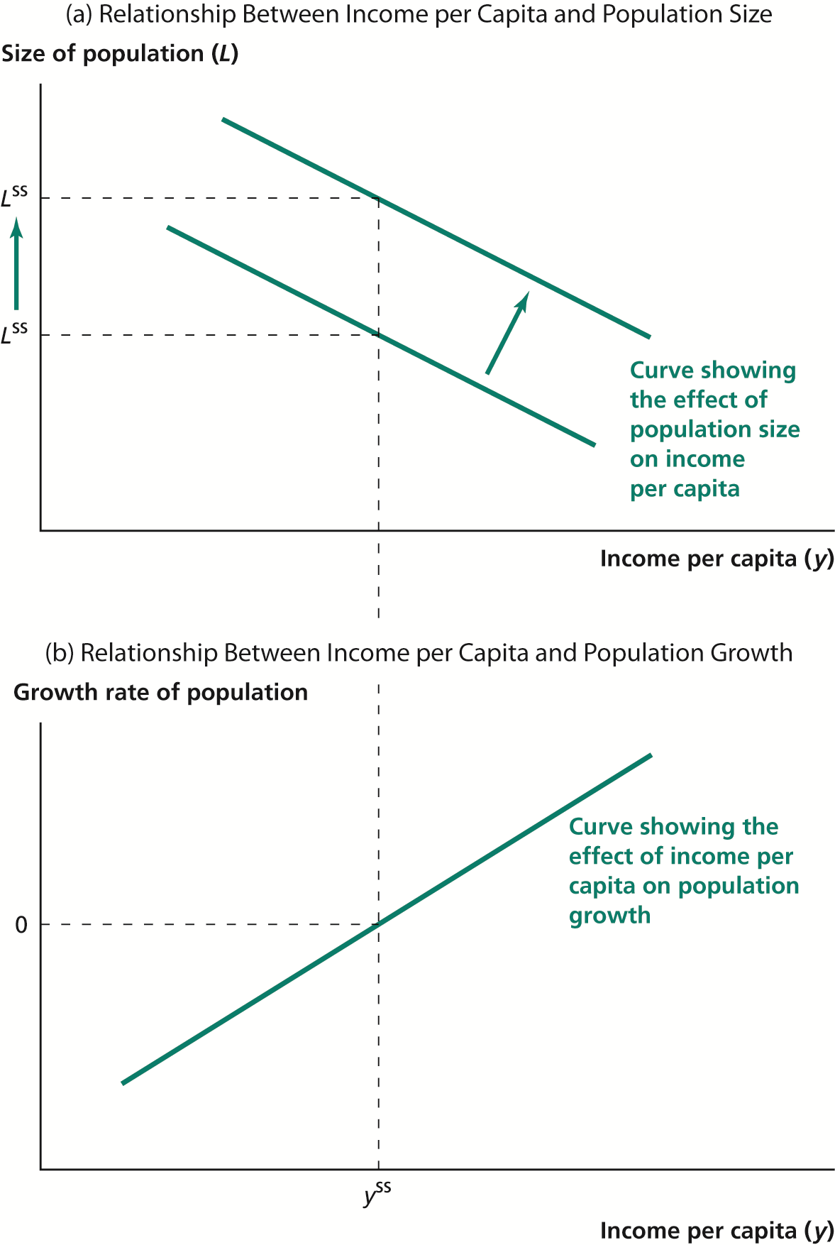
Figure 4 Effect of Productivity Improvement in the Malthusian Model

Slide 10
Figure 4:
The effect of a change in the environment (productivity, e.g irrigation or a new crop or new land): countries with higher productivity will not have higher living standards, but only more people.
Consistent historical episodes: China in year 1000 AD, the introduction of the potato into Ireland.
What was Malthus’s idea for escape from the trap? “moral restraint”:

Slide 11
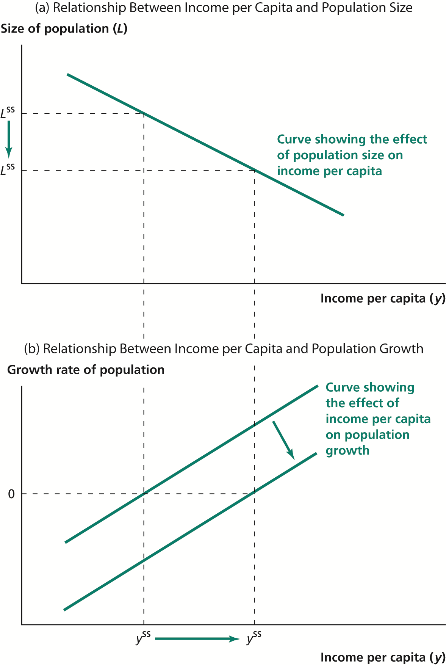
Figure 5 Effect of “Moral Restraint” in the Malthusian Model

Slide 12
The Breakdown of the Malthusian Model
Living standards have risen dramatically. Contrary to Malthus’s prediction nowadays positive relationship:
•Rich countries have lowest pop growth, why? The two mechanisms, pop = f (y) and y = g (land), have weakened:
•Growth in income due to technological progress
•Improvements in y did not lead to large increases in pop growth
Figure 6: Economic growth faster then pop growth. In late 19thcentury a puzzle: as growth accelerated, pop growth began to fall. This pattern was repeated in many countries all over world.

Slide 13
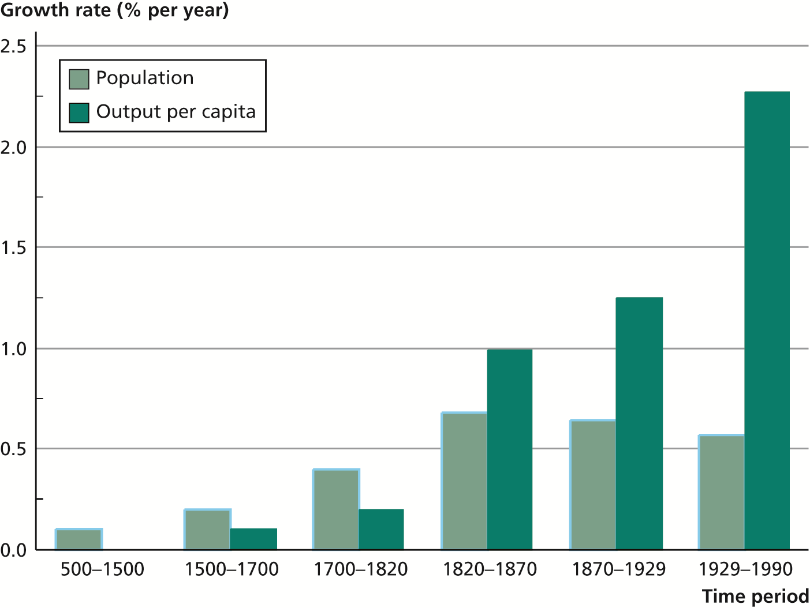
Figure 6 Breakdown of the Malthusian Model in Western Europe

Slide 14
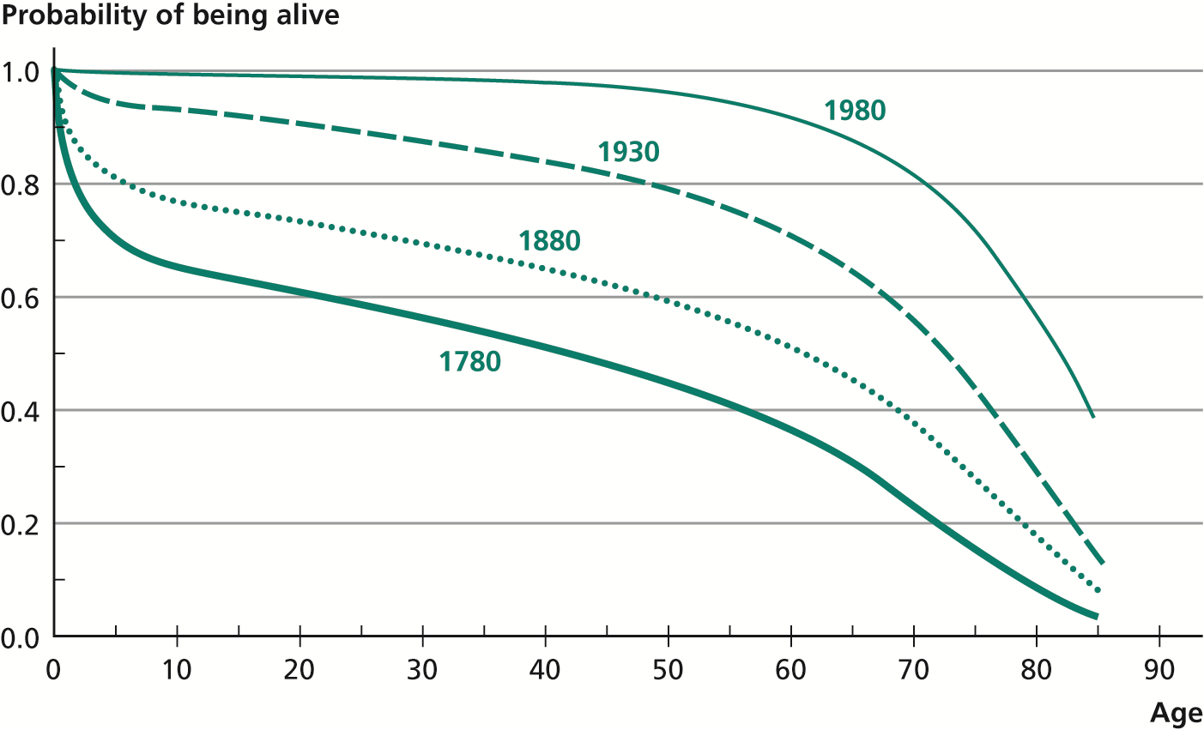
Figure 7 The Survivorship Function for Women in Sweden

Slide 15
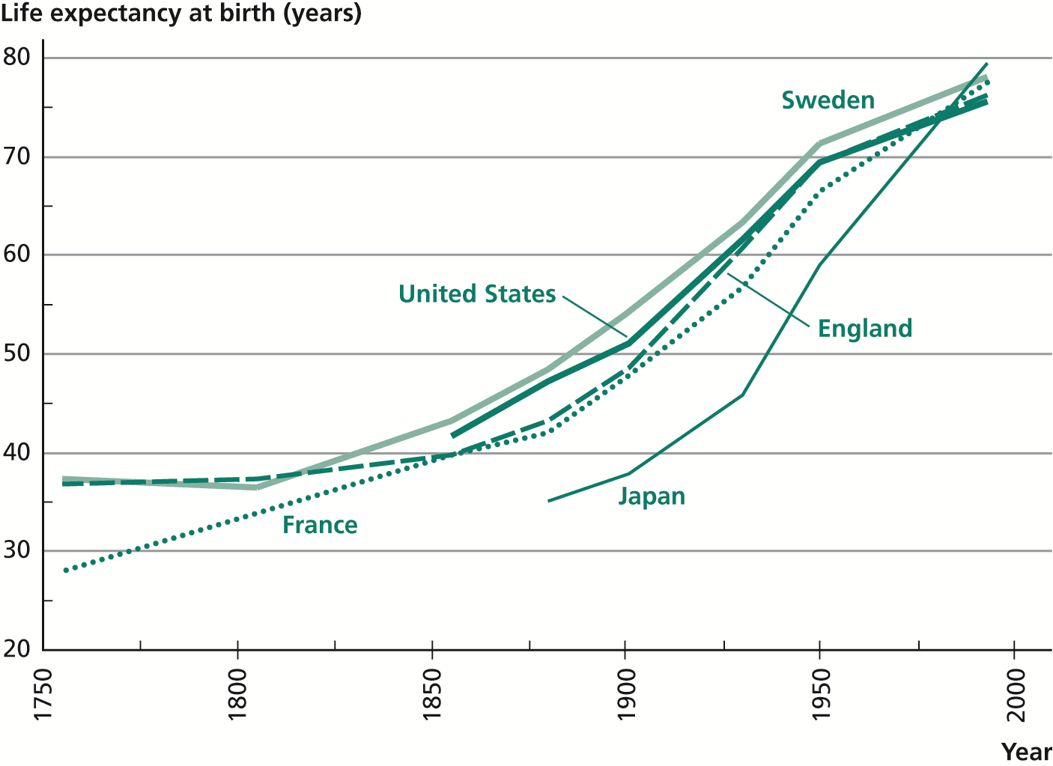
Figure 8 Life Expectancy in Developed Countries

Slide 16
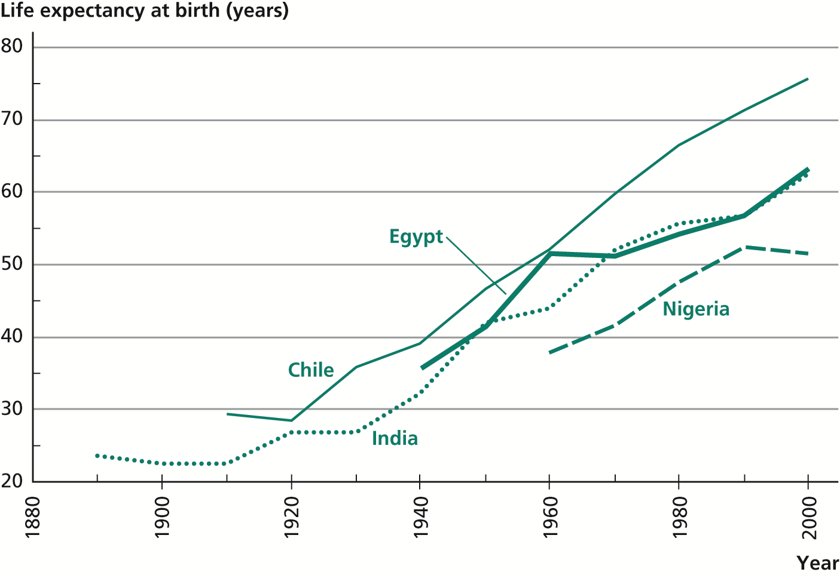
Figure 9 Life Expectancy in Developing Countries

Slide 17
LE in DC, no improvement before 18th century
LE in DEVC, more rapid than in DC. India: LE up from 26.9 in 1930 to 55.6 in 1980. France: LE up from 27.9 in 1755 to 56.7 in 1930. Also, Mortality Transition in DEVC is occurring at low income.

Slide 18
What explains the Mortality Transition in 19th century?
Improvements in the standard of living, quantity and quality of food.
•Decline in chronic malnourishment, improved resistance to disease.
•Improvements in public health: water and sanitation.
•Better medical treatments in curing diseases.
•These improvements occurred sequentially.
Robert Fogel: Nutritional status explains 90% of mortality decline in England and France, 1775-1875:
•Modern sewage and water in 19threduced incidence of diseases such as cholera and typhus.
•In 20th improved medical treatment improved life expectancy.
•In DEVC: changes arrived all at once, before and after World WarII

Slide 19
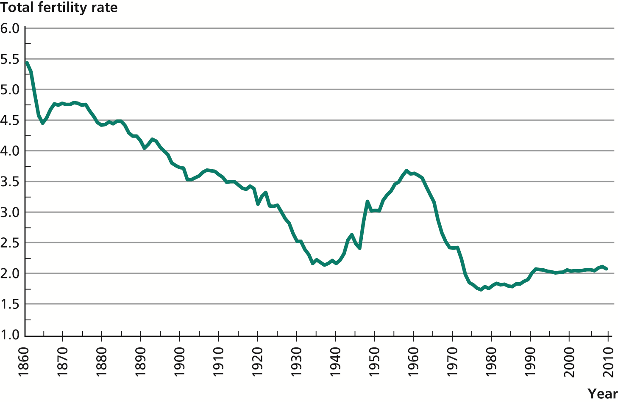
Figure 10 Total Fertility Rate in the United States, 1860–2008

Slide 20
Fertility Transition
Age-specific fertility rate, F(i): The average number of births in a given year by women of a given age.
Total fertility rate (TFR): the number of children a woman have if experienced the current age-specific fertility rates:
TFR = ∑ⁿF(i): area under the age specific fertility rates curve.
TFR US = 2.1 TFR US since 1860. in Fig. 10, TFR fell from 5 to 2, no smooth trend, Baby Boom 1946-64, similar in other DC. TFR decline in DEVC took less time: TFR decline from 5 to 3: US from 1862-1925, Indonesia 1975-1990.

Slide 21
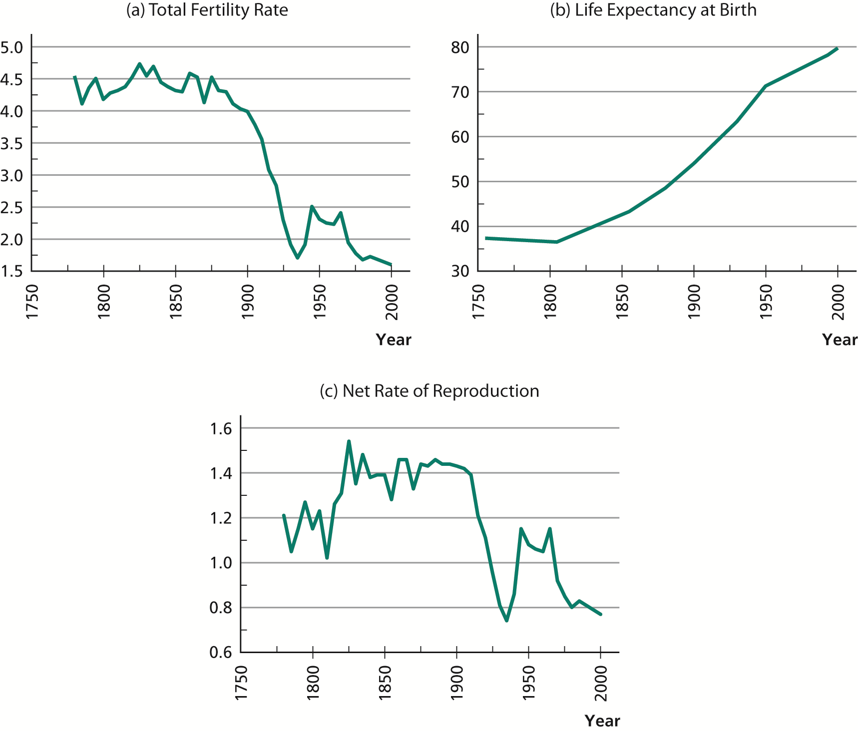
Figure 11 Fertility, Mortality, and the Net Rate of Reproduction in Sweden

Slide 22
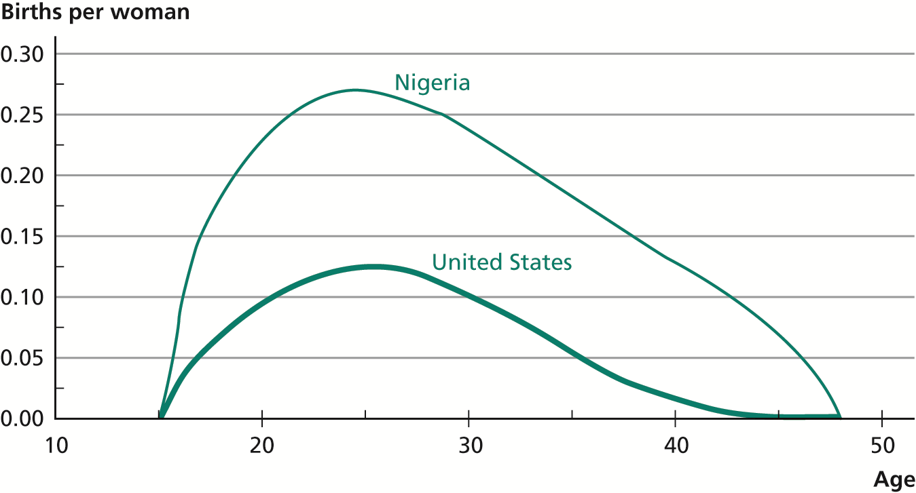
Age-Specific Fertility Rates

Slide 23
The Interaction of Fertility and Mortality
TFR in Europe/US was high but pop growth was never as high as in DEVC, why?
Given the survivorship function -π(i), and age-specific fertility rates -F(i), net rate of reproduction= NRR =(1/2)∑ⁿπ(i)F(i): the expected # of girls for a woman.
It is the factor by which the number of girls in each generation will increase. NRR=1, constant population, zero pop growth, NRR=2, Number of girls, and thus population, doubles every generation. If mortality reduced, say all woman instead of half survived their reproductive years: NRR would double! Figure 11: mortality and fertility interaction in Sweden.
NRR=1.20 in 1780, 1915 and 1965 but TFR and MR were very different.
NRR>1 because of mismatch in timing of MR and TFR decline.

Slide 24
Explaining the Fertility Transition
▪Children are more desirable as income rise.
▪Why, then, as income per capita increased, fertility declined? Reduced Fertility:
The Means: Birth control methods: -Vaginal suppositories in 1850 BC, -The Bible mentions the use of withdrawal to avoid conception, -Ancient Greek medical texts discuss contraceptive potions, barriers, and suppositories, rhythm method and techniques for abortion.-Abandonment of children from Greek time to the Middle Ages-Late Marriage: median age at first marriage in 17th century Britain was 28 for men and 27 for women. -In many cultures, long period of breast-feeding suppress fertility, (in Indonesia, 1999, median is 24 months)
Last two centuries: improved technology of fertility control:

Slide 25
Last two centuries: improved technology of fertility control:-Improved condoms -invention of vulcanized rubber in 1844,-The cervical cap -1838, diaphragm -1882, IUD –1909,Contraceptive pill -1960s.
-Changes in the attitudes of society and gov toward fertility control.
-First US family planning clinic, 1916 –arrest on obscenity charges. -In 1965, Supreme Court’s decision: anti-contraception laws in the US ruled unconstitutional. Europe: policies hostile toward birth control .

Slide 26
Does availability of contraceptives explain fertility transition?-In Europe the major fertility decline achieved before modern contraception widely available: Ex: British TFR decline, early 20thcent, only 16% used contraception,-DEVC post-World War II decline in fertility coincide with increased use of birth control: 1960-1998, rate of contraceptive prevalence rose from 9% to 55%.-This fact does not prove causal effect of availability of contraceptives.

Slide 27
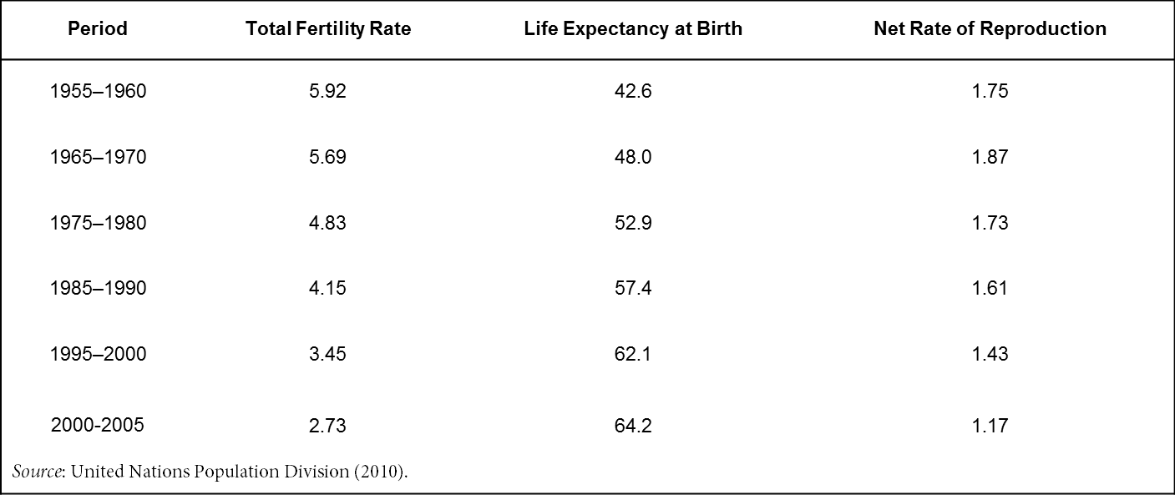
Table 1 Demographic Data for India

Slide 28
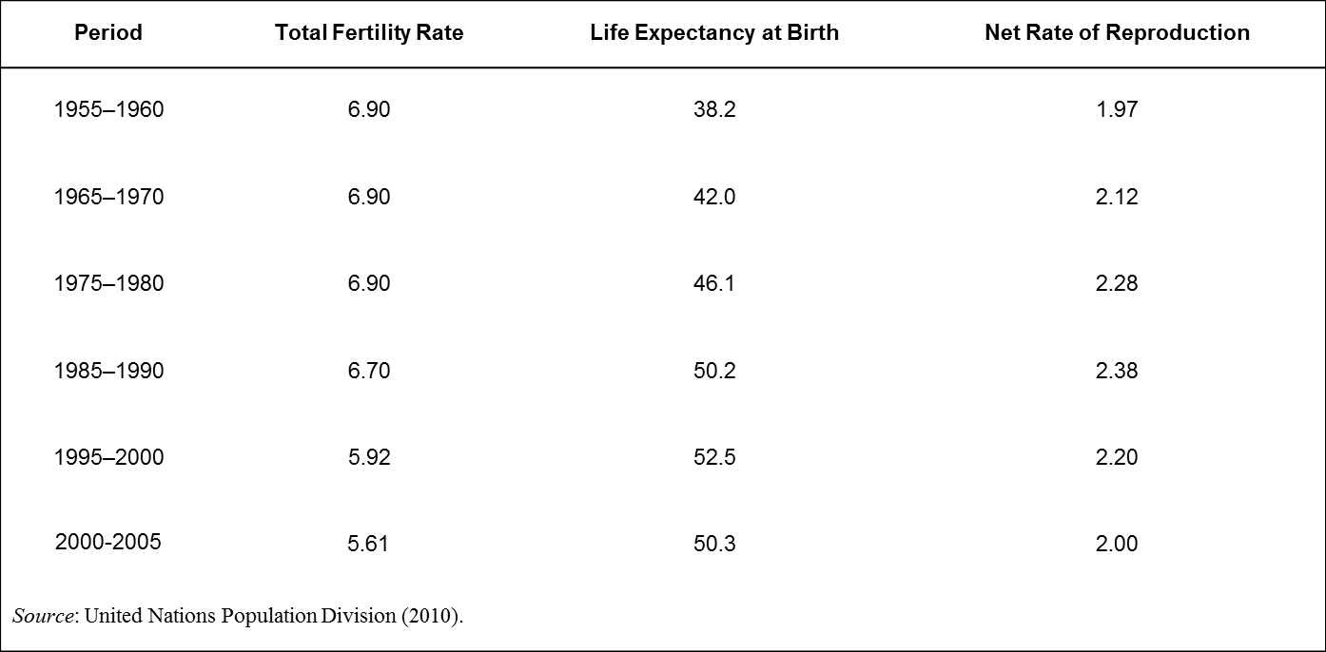
Table 2 Demographic Data for Nigeria

Slide 29
DEVC: since World War II: policies to encourage fertility restriction.China’s “one-child”policy, 1979, TFR 5.99 in 1965-70, 1.76 in 1995. -India, 1970s sterilizations, unpopular, halted.-Mexico, India, Indonesia: education and persuasion.-Indonesia, 70s and 80s, free contraceptives and educational materials: birth control up from 400,000 couples in 1972 to 18.6million in 1989,TFR from 5.6 to 3.4 children per woman.-Ethiopia: opposed family planning, religious and ethnic reasons,1975-1995, TFR rose from 5.2 to 7.4.

Slide 30
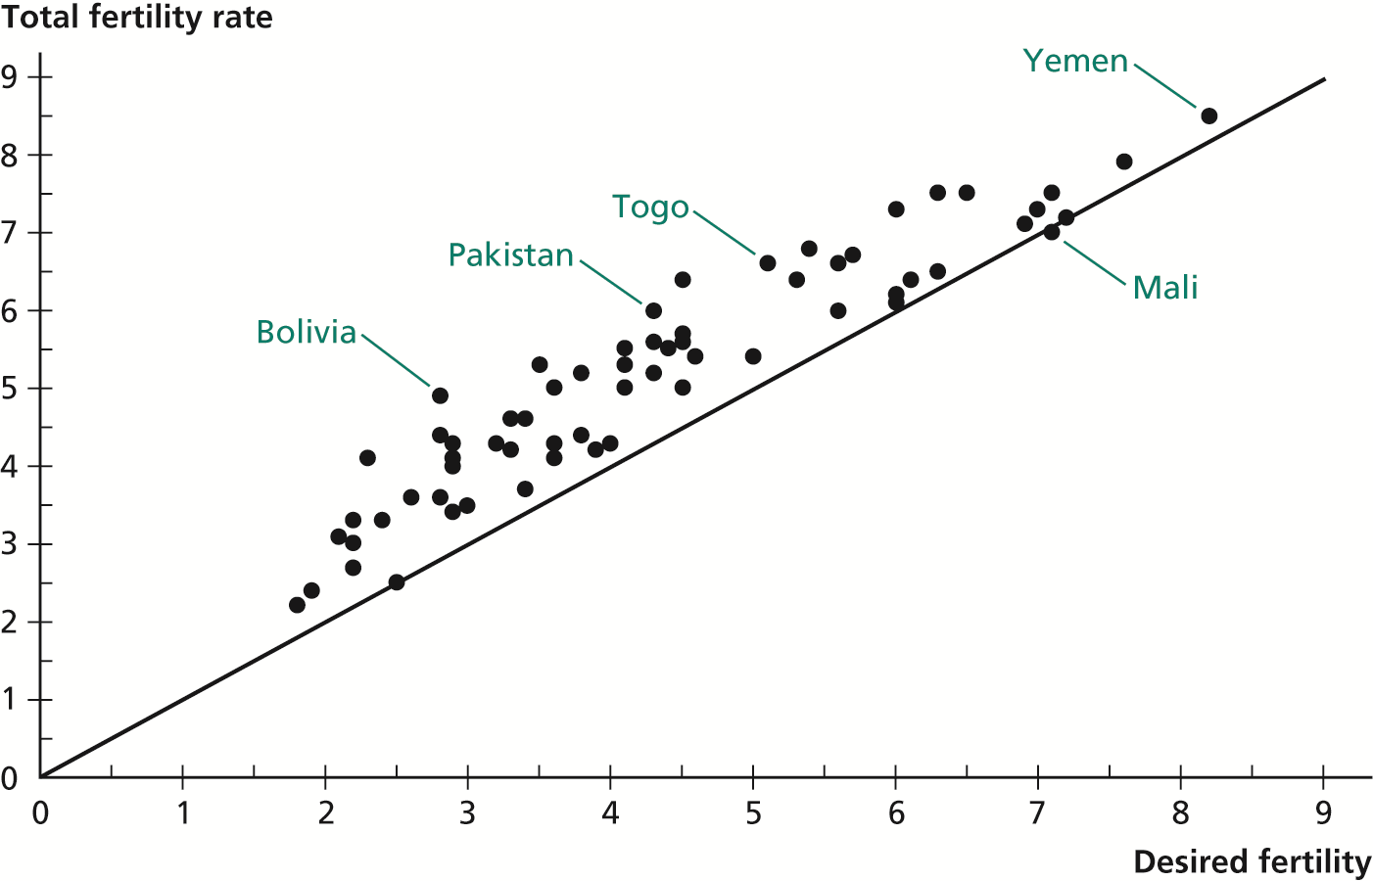
Figure 12 Desired Fertility versus Total Fertility Rate in Developing Countries

Slide 31
-The rest of the decline in fertility is explained by changes in desired fertility –that is, in the number of children that families wanted to have: Figure 12.-Small differences between desired and actual TFR: limited scope for reducing fertility in DEVC through better provision of contraceptives. -Causal estimated effect suggest that contraceptives explain 10%-40% of the decline,-Focus should be: why desired fertility falls?

Slide 32
Reduced Fertility: The Motives-
The Effect of Mortality Reduction on Desired fertility: Reduced MR higher Number of children that survive lower fertility.
-It takes time to recognize that MR fell > lag to adjust their fertility.
-Replacement versus Hoarding, gender preferences
Income and Substitution Effects-why doesn’t fertility rise as income rises? -Income growth raises the price of children: children demand for parents’time, opportunity cost of time –wage a parent could earn.

Slide 33
N -# of children, C -all market goods, w -wage per unit of time: Indifference curve, set of combinations of N and C with same utility.-Over the course of economic development wages rise, but also relative wage of women rise, In US 1890-1988: women relative wage up from 46% to 67% of men’s wages.-This effect was reinforced by the rise in the education of women and also because the incentive to invest in girls education rises (given increase in their life expectancy ). Also education empowers women -Education effect on controlling fertility.

Slide 34
Resources Flows Between Parents and Children
•The economic benefits from children decline as the economy develop.
•The cost of children rises.
•IN DEVC children often work at young age,
•Support parents in old age –no other sources of old-age support available,
•Producing children (sons) is an economic necessity.
•IN DC financial markets developed, people save for old age.
•This change in relative costs & benefits of children is part of the explanation of the decline in desired fertility.

Slide 35
Parents today spend much more on their children than in the past. Why? Quality-Quantity Trade-offs
•Investments in the quality of the child:-Higher quality > higher wages > better old age providers,-Higher quality > happier children > happier parents.
•Change in the mix of quality and quantity > declined fertility:-Development reduces mortality > improved incentive to invest in child education-Development increases the return to education > increased incentive to educate children.
Peer effects: If other children are educated I want mine to be
A collective taste for education

Slide 36


Effect of the wage W on number of children
Choose N, number of children and C consumption to max utility:
-1< ρ for concavity.
Given budget constraint: C=W(1-zN), z=time for raising children.
From totally diff solution:
The sign of this expression depends on the value of ρ: If it is less than zero then an increase in w will lead to a rise in N,If it is greater then zero then higher w will mean fewer children. 1/(1-ρ)= elasticity of substitution between children and consumption.

