Slide 1
unione europea: QUADRO REGOLAMENTARE
Corso di
Diritto pubblico dell’economia
UNIVERSITA’ DI ROMA TOR VERGATA
Prof.ssa Biancamaria Raganelli
biancamaria.raganelli@uniroma2.it

Slide 2
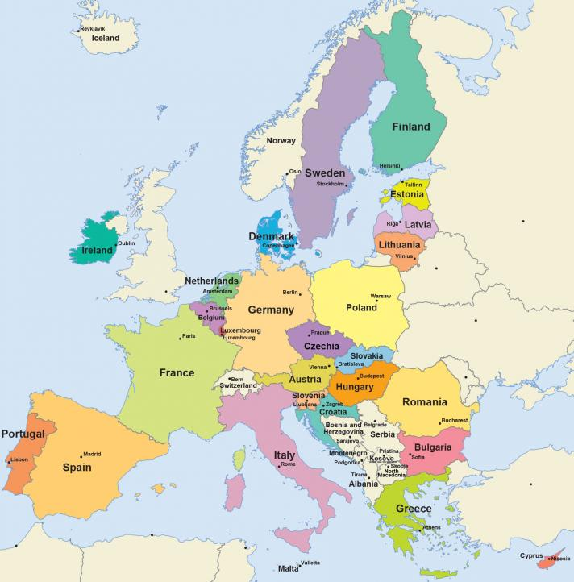
The European Union
Source: https://european-union.europa.eu/easy-read_en

Slide 3
THE IDEA OF EU
Idea if EU
Idea of Sovereign State

Slide 4
IDEA OF EU
L’idea di Unione Europee è vecchia quanto quella di sovranità dello Stato.
Quest’ultima è stata travolta dalle ultime due guerre mondiali nel XX secolo e dagli effetti della globalizzazione.
Il declino dello Stato monade – l’espansione della cooperazione tra Stati.
Da un diritto internazionale della COESISTENZA a uno della COOPERAZIONE.
Notes:
Globalization (or globalisation) is the process of international integration arising from the interchange of world views, products, ideas, and other aspects of culture.
In 2000, the International Monetary Fund (IMF) identified four basic aspects of globalization:
trade and transactions,
capital and investment movements,
migration and movement of people and
the dissemination of knowledge.

Slide 5
STATO SOVRANO
Uno Stato sovrano è un’entità giuridica del sistema legale internazionale rappresentata da un governo centrale che esercita un’autorità indipendente e suprema su una certa area geografica.

Slide 6
EUROPEAN UNION
è
Un’unione economica e politica di 27 Stati membri localizzati principalmente in Europa
Un soggetto di diritto internazionale
Creato attraverso Trattati siglati dagli SM
Governata da Istituzioni Europee
Notes:
ECONOMIC: almost all member states of EU join EMU: except Denmark and UK. Common market – EMU
POLITICAL: The Politics of the European Union are different from other organisations and states due to the unique nature of the European Union (EU). The EU is similar to a confederation, where many policy areas are federalised into common institutions capable of making law; however the EU does not, unlike most states, control foreign policy, defence policy or the majority of direct taxation policies

Slide 7
unione eUROPEA
L'Unione europea (UE) è un'unione economica e politica, unica nel suo genere, tra paesiche coprono buona parte del continente.
All’indomani della Seconda guerra mondiale nasce l’idea di EUROPA UNITA (dalla coesistanza alla cooperazione) con l’obiettivo di promuovere innanzitutto la cooperazione economica partendo dal principio che il commercio produce un’interdipendenza tra i paesi che riduce i rischi di conflitti.
Seguita la creazione di un mercato unico

Slide 8
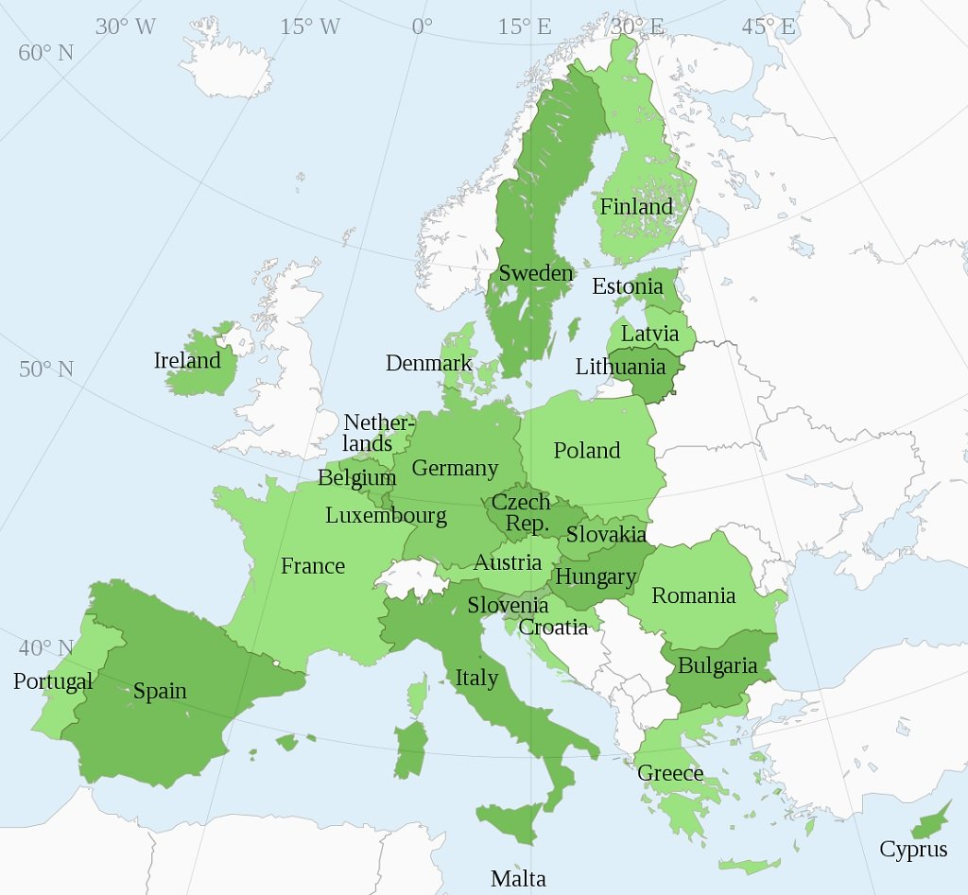
Attuale estensione dell’unione europea

Slide 9
unione eUROPEA
Quella che era nata come un'unione puramente economica è diventata col tempo un'organizzazione attiva in tutta una serie di settori che vanno dal clima, all’ambiente, alla salute, alle relazioni esterne, alla sicurezza, alla giustizia e all’immigrazione.
Per riflettere questo cambiamento, nel 1993 il nome di Comunità economica europea (CEE) è stato sostituito da Unione europea (UE).
L'Unione europea si fonda sul principio dello Stato di diritto

Slide 10
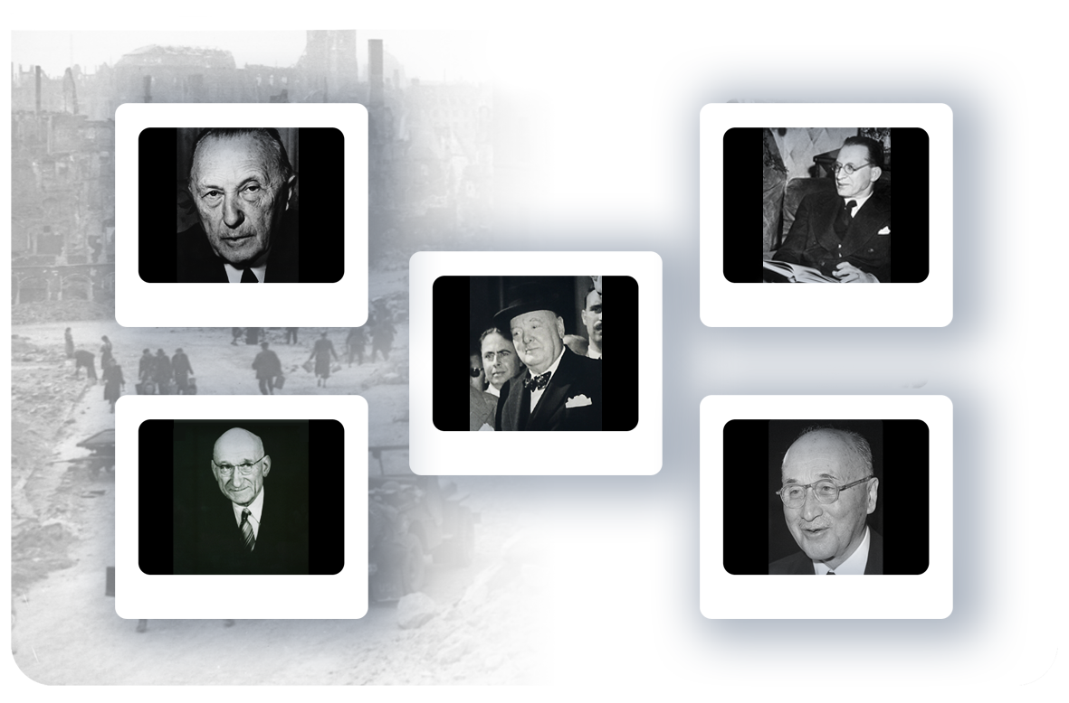
Founders
New ideas for lasting peace and prosperity…
Konrad Adenauer
Alcide De Gasperi
Winston Churchill
Robert Schuman
Jean Monnet

Slide 11
FIRST STEP
1951:
Treaty of Paris of (18 April 1951)
The European Coal and Steel Community (ECSC) was set up by the six founding members:
ITALY, GERMANY, FRANCE, BELGIUM, NEDERLANDS, LUXEMBOURG
The aim: to secure peace between European nations and bring them together as equals, cooperating within shared institutions.

Slide 12
SECOND STEP
1957:
The same six countries sign the Treaty of Rome (25 March 1957), setting up:
the European Economic Community (EEC)
EEC would involve building a wider common market covering a whole range of goods and services.
the European Atomic Energy Community (Euratom).
Notes:
EEC would involve building a wider common market covering a whole range of goods and services.
Customs duties between the six countries were abolished on 1 July 1968 and common policies, notably on trade and agriculture, were also put in place during the 1960s.

Slide 13
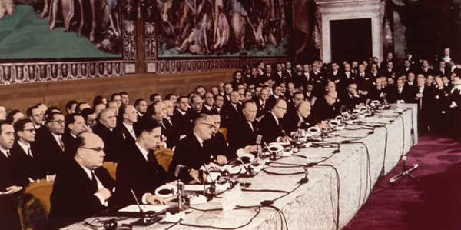

1957
Treaty of Rome
The six founding countries expanded cooperation to other economic sectors, creating the European Economic Community (EEC) – or “common market.”
As a result, people, goods, services, and capital today move freely across the Union.
Signing of the Treaty of Rome

Slide 14
EURATOM
The principal aims of the Euratom Treaty include:
the promotion of investment in the nuclear energy industry;
the establishment of uniform safety standards for the protection of workers and the general public from atomic hazards;
ensuring that nuclear materials are not diverted for aims other than peaceful purposes.

Slide 15
Third, forth, fifth steps
1973: 9 Stati membri e introdotte più politiche comuni (Danimarca, Irlanda, UK)
1979: prima elezione a sufraggio universale diretto.
1981: primo allargamento
(1981: GREECE, 1986: SPAIN, PORTUGAL)
Notes:
New social and environmental policies were introduced, and the European Regional Development Fund (ERDF) was set up in 1975.

Slide 16
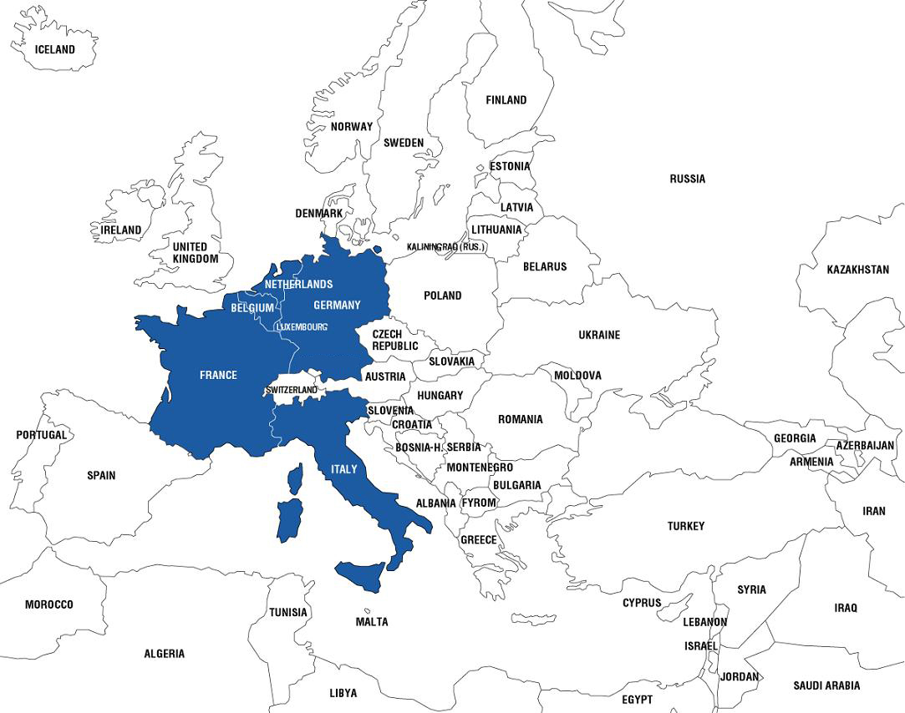
1951
Founding Members
Belgium
France
Germany
Italy
Luxembourg
Netherlands

Slide 17
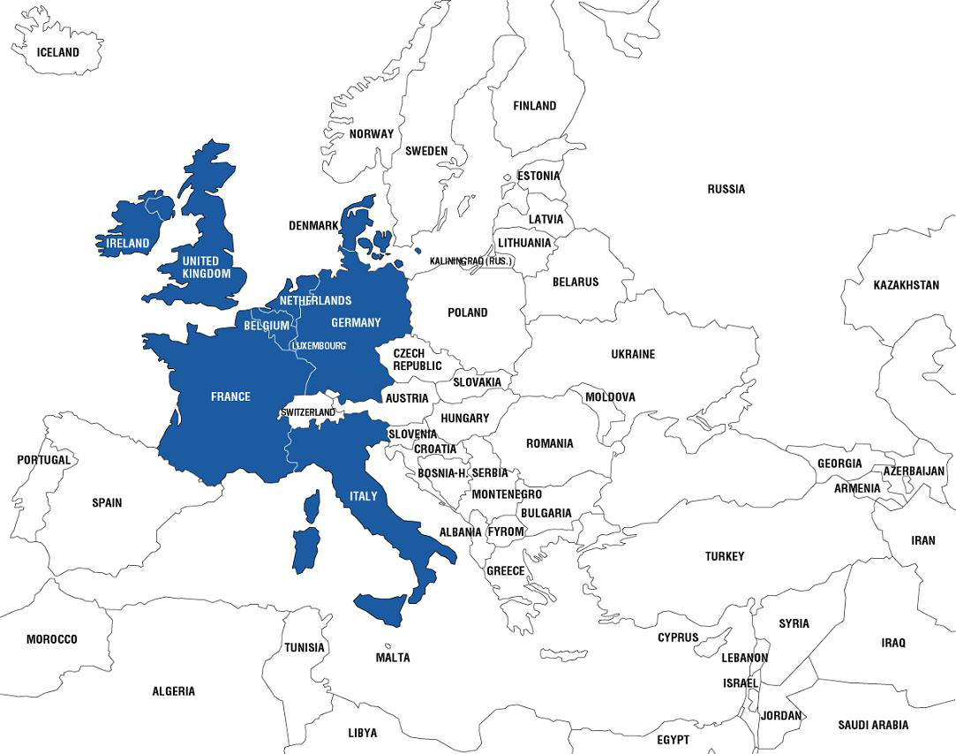
1973
Denmark
Ireland
United Kingdom

Slide 18
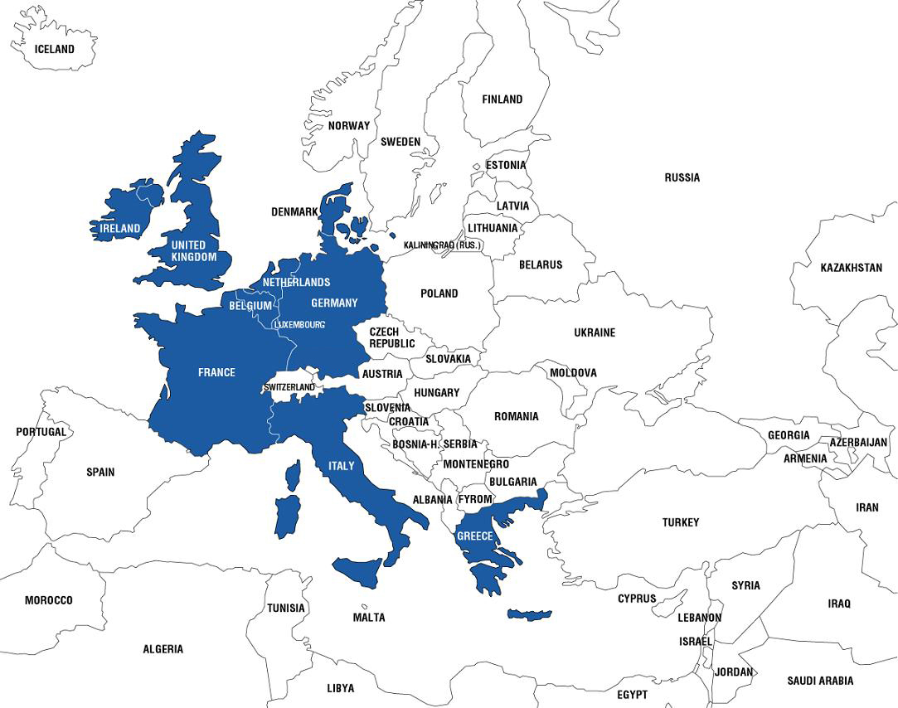
1981
Greece

Slide 19
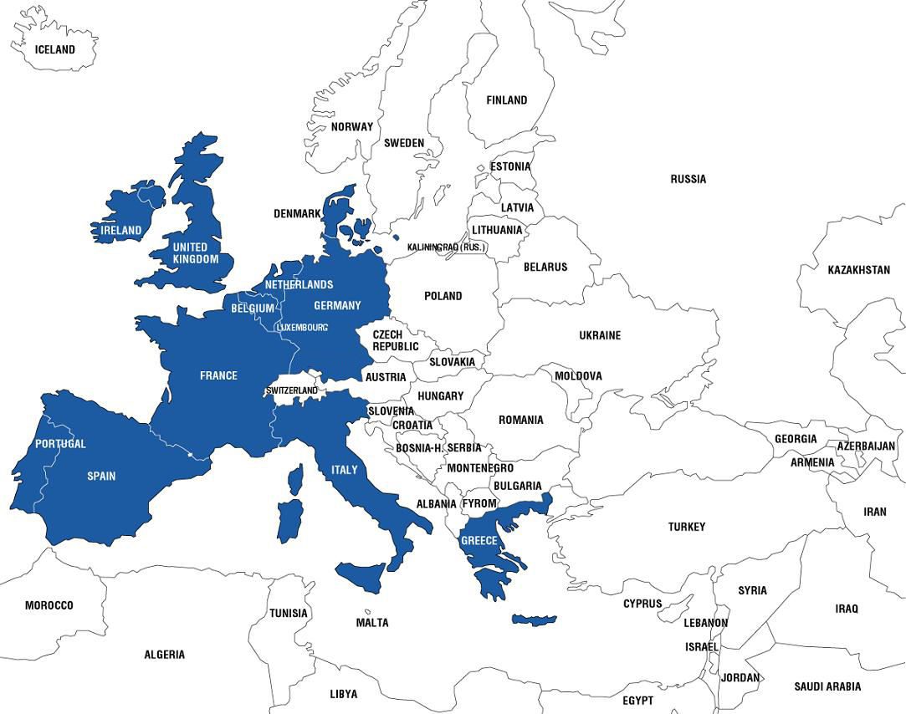
1986
Portugal
Spain

Slide 20
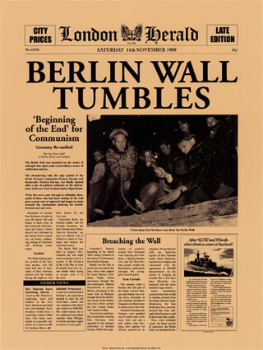
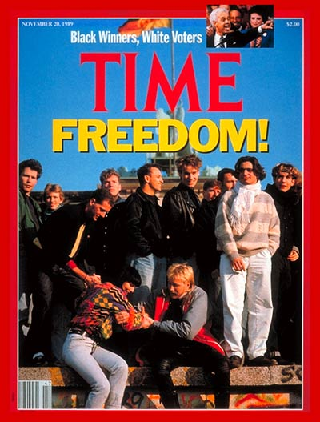
November 1989
Fall of the
Berlin Wall
sets the
stage for
unifying
Europe and
EU enlargement

Slide 21
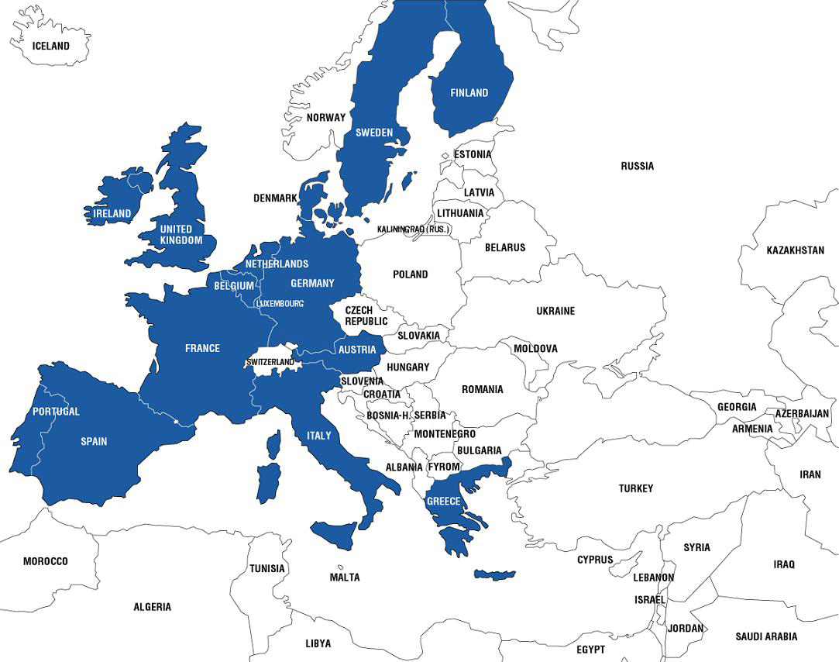
1995
Austria
Finland
Sweden

Slide 22
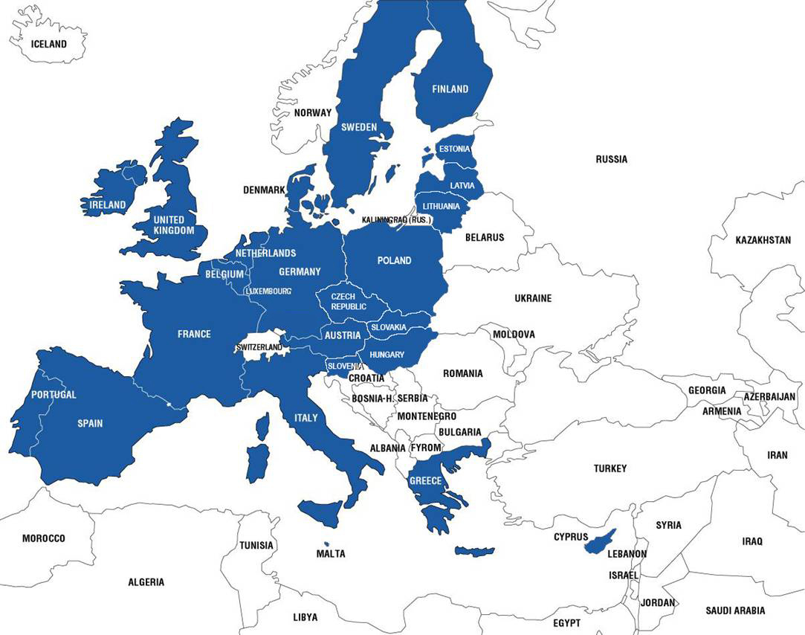
2004
Cyprus
Czech Republic
Estonia
Hungary
Latvia
Lithuania
Malta
Poland
Slovakia
Slovenia

Slide 23
enlargment
Each Treaty admitting a new member requires the UNANIMOUS APPROVAL of all member states.
In addition, in advance of each new enlargement, the EU must assess its capacity to absorb the new member(s) and the ability of its institutions to continue to function properly.

Slide 24
Sixth step
1986: SINGLE EUROPEAN ACT
The European single market has been completed in 1992
Notes:
The worldwide economic recession in the early 1980s brought with it a wave of ‘euro-pessimism’. However, hope sprang a new in 1985 when the European Commission, under its President Jacques Delors, published a White Paper setting out a timetable for completing the European single market by 1 January 1993. This ambitious goal was enshrined in the Single European Act, which was signed in February 1986 and came into force on 1 July 1987.

Slide 25
Seventh STEP
1993:
The Treaty of Maastricht establishes the
European Union (EU)
THREE PILLARS SYSTEM

Slide 26
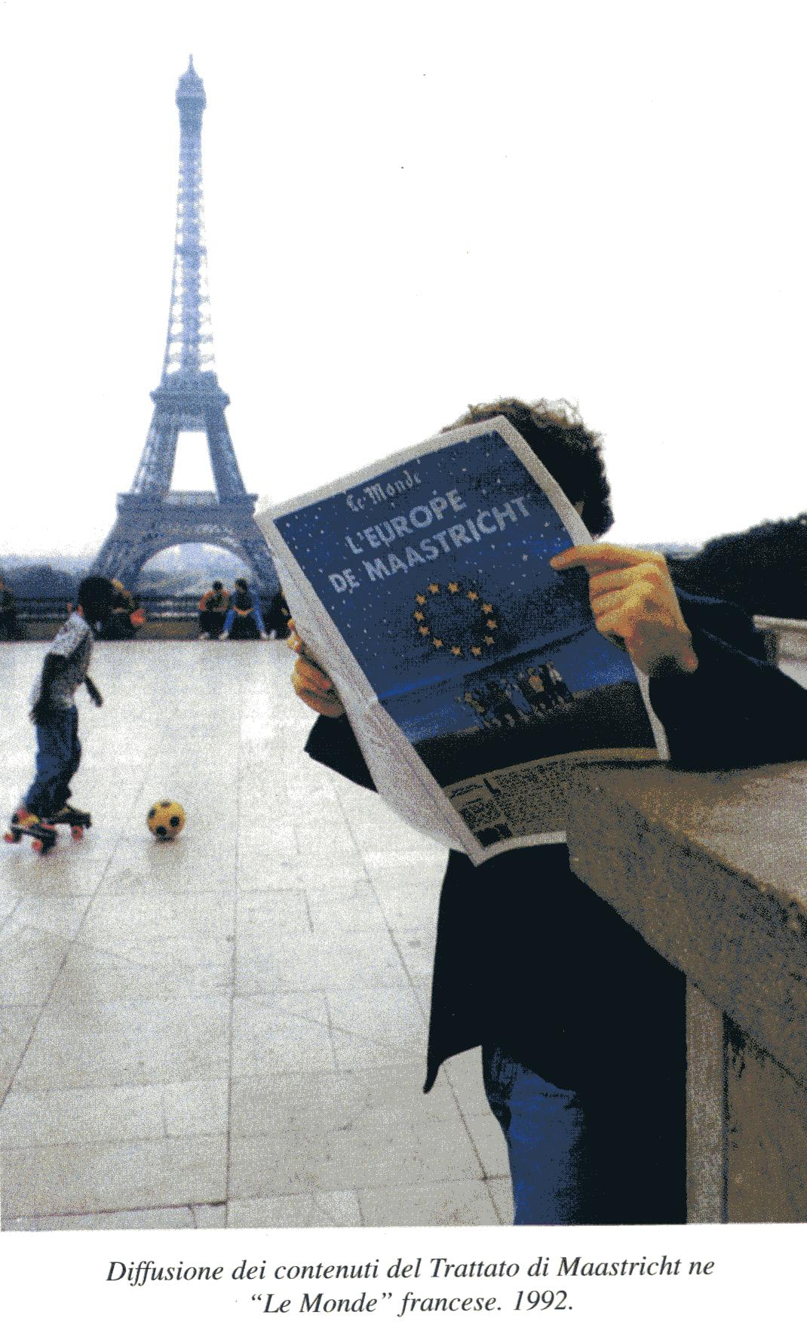

Slide 27
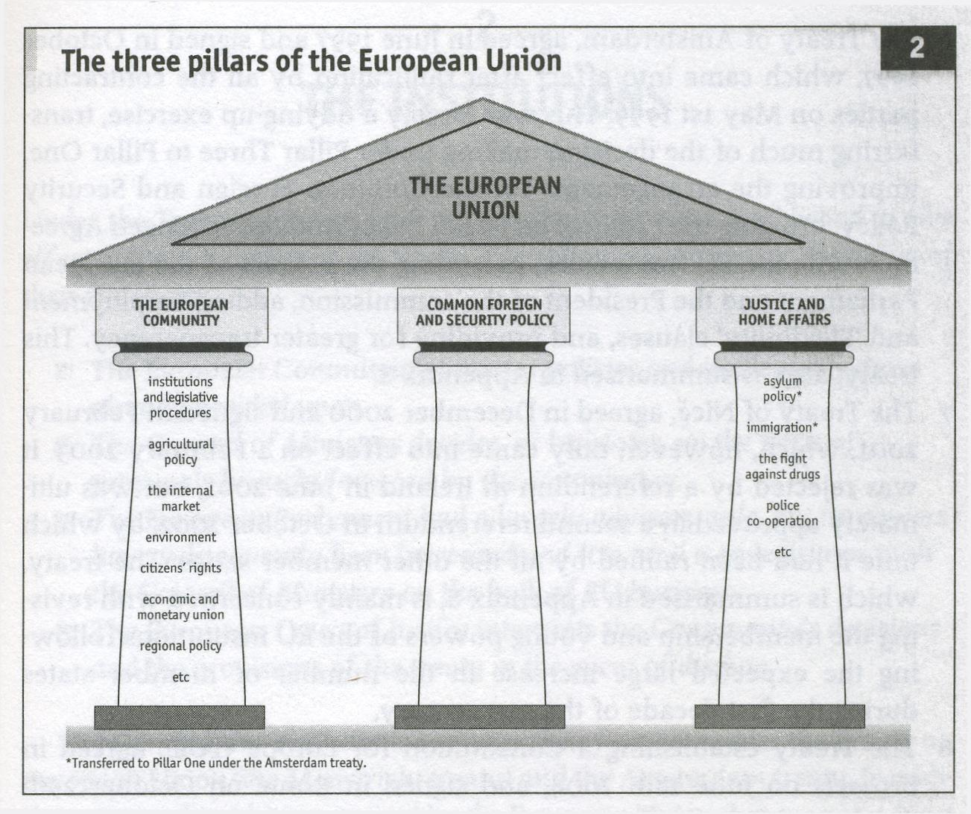

Slide 28
EIGHTH and NINTH STEPS
2002: Entra in circolazione l’euro (12 Paesi) EMU completed
2007: L’UE ha 27 SM
Notes:
CHALLANGES OD GLOBALIZATION
unemployment and the rising cost of pensions were putting pressure on national economies,

Slide 29
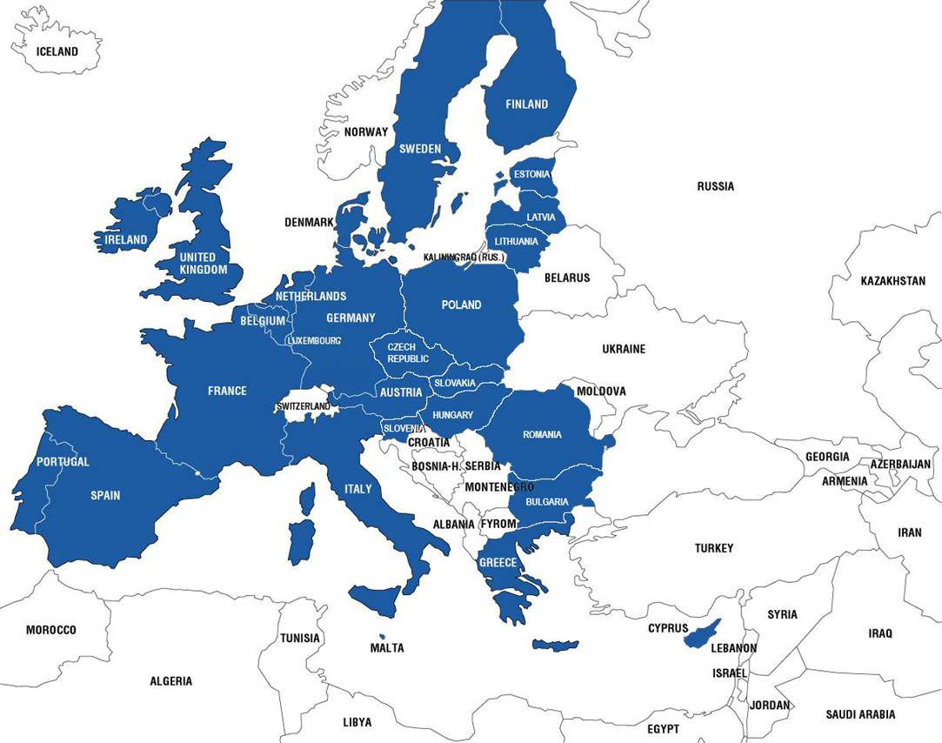
2007
Bulgaria
Romania
2020
UK left the EU

Slide 30
FROM 1957 TO 2007
1957 2007
Member States 6 27
Population 174 million 493 million
Languages 4 23

Slide 31
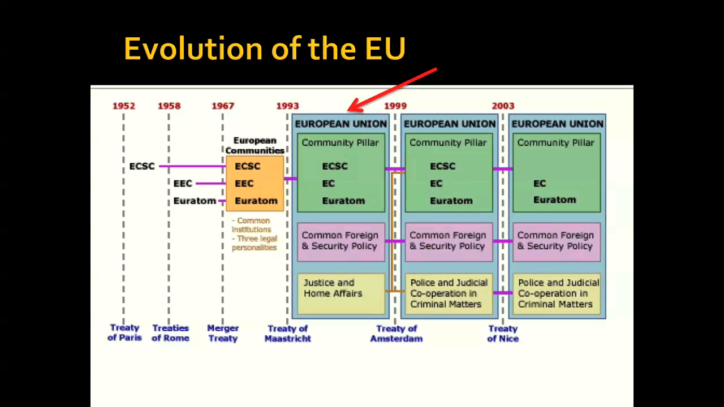

Slide 32
The PROCESS TO THE treaty of lisbon
Ottobre 2004: progetto Costituzione europea
Per affrontare questioni complesse nel 21 secolo, l’allargamento dell’Europa richiede un metodo più semplice ed efficenze di acquisizione delle decisioni
Rigettato da due referendum costituzionali nel 2005.
La Costituzione è stata sostituita dal Trattato di Lisbona.
It amends but does not replace the previous Treaties
It introduces most of the changes that featured in the Constitution

Slide 33
Tenth step
2009:
LISBON TREATY
entra in vigore il 1 Dicembre 2009

