Slide 1
The Italian growth problem
Fabiano Schivardi
LUISS
Notes:
Problema produttività
Imprese italiane piccole
Perché la dimensione conta: Questione dimensionale rivisitata, terziarizzazione
Efficienza allocativa scarsa-riallocazione
Focus su finanza e proprietà
Imprese familiari possono essere un problema
Finanza non sempre il colpevole
Che fare:
Di lungo: operare sul contesto
Di breve: aiutare le imprese in crisi ma attenzione a non bloccare il processo di riallocazione, bensì assecondarli

Slide 2
Italy: a gradual growth slowdown
Average yearly growth in the ‘50s: 5,5%. Down by some 1 ppt per decade, since then. Potential growth zeroed as of today.

Slide 3
Unexpected stop
The slowdown was expected
In the post-war period, Italy benefitted from the «catching-up» effect
Cheap labor, adopt technologies from leaders
Italy was the China of the fifties
Problem: it did not slow down: it almost stopped!

Slide 4
Slowdown More pronounced for Italy than for other large EU countries. End of grace period: ≈ early 1990s

Slide 5
Gdp growth since 1990

Slide 6
Mostly a question of productivity growth disappearance
Growth rates | Per capita Gdp | Gdp per hour worked | Hours per potential worker | Potential workers per capita
1971-80 | +3.2 | +2.9 | +0.3 | +0.0
1981-90 | +2.3 | +1.7 | +0.0 | +0.6
1991-00 | +1.5 | +1.5 | +0.2 | -0.1
2001-10 | -0.2 | +0.1 | +0.0 | -0.3

Slide 7
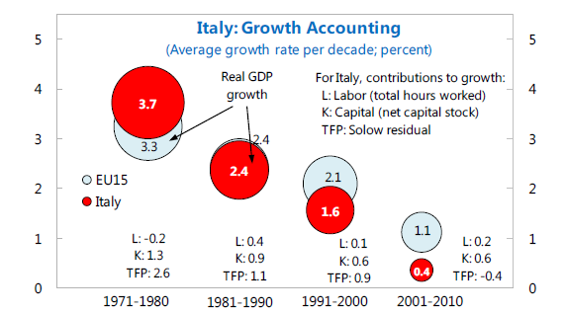
Role of TFP growth

Slide 8
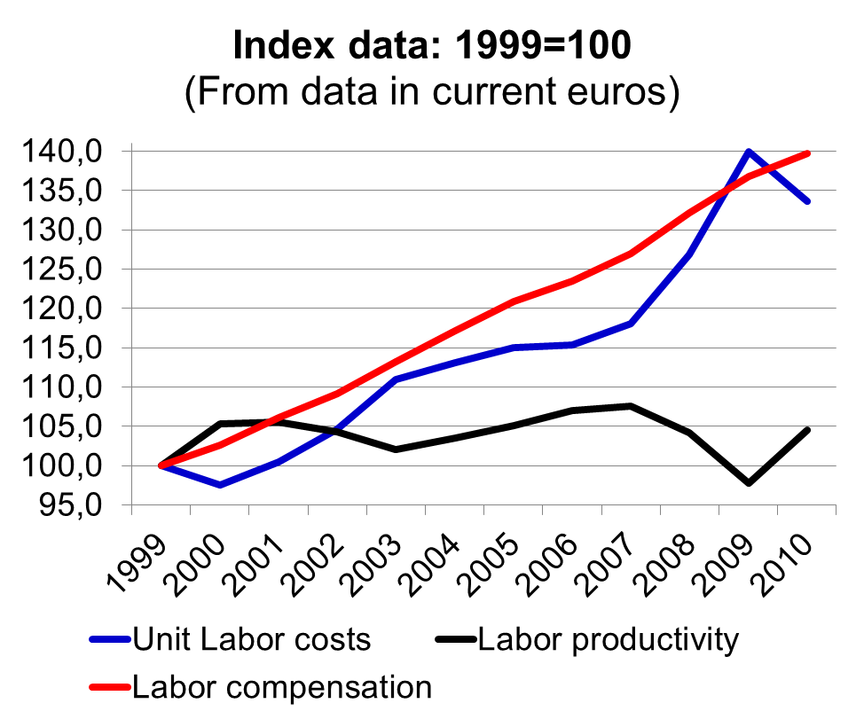
Stagnating productivity + rising wages = loss of competitiveness
Italy’s manufacturing unit labor costs rising very fast with the euro
1999-2010: +33.6
Why so fast?
Wages up by 39%
Labor productivity up by a mere 5% (0% since 2000)
E.g. Germany:
unit labor costs stayed constant, productivity and wages up by 28%

Slide 9
Is it a question of sectoral specialization?
Surely, being specialized in low tech productions does not help
But is it just the issue?
No! The Italian performance is lower also within sector
So it is a more general problem of the whole production system

Slide 10
Productivity growth by sector
 |  | Francia | Germania | Italia | Usa
 |  | 1996-2010 | 1996-2010 | 1996-2010 | 1996-2007
Total |  | 1.30 | 1.54 | 0.36 | 1.97
Total Manufacturing |  | 3.22 | 2.79 | 0.73 | 5.05
o/w | Food. Beverages & Tobacco | 0.63 | -0.86 | 0.80 | 0.84
 | Textile & Fabric Mills | 3.53 | 3.11 | 1.35 | 3.79
 | Chemicals | 3.63 | 5.04 | 1.67 | 5.15
 | Optical and Electrical Equipment | 5.98 | 6.64 | 0.61 | 16.98
 | Machinery | 3.41 | 0.56 | 0.72 | 3.67
 | Transportation Equipment | 2.04 | 2.43 | 0.40 | 5.03
Utilities (electrical power, natural gas, water) |  | 0.70 | 2.47 | 0.43 | 2.77
Construction |  | -0.91 | -0.03 | -1.20 | -3.10
Market services |  | 1.11 | 1.06 | 0.19 | 2.60
o/w | Trade | 1.33 | 2.74 | 0.10 | 4.33
 | Telecommunication | 9.32 | 9.38 | 8.44 | 5.20
 | Finance and Insurance services | 2.13 | 0.31 | 2.76 | 3.04
 | Professional, Scientific, Technical and Administrative Services | -0.19 | -1.77 | -2.03 | 2.00

Slide 11
Have the endowmnents got worse?
The country undetook many reforms
Product and labor market regulation, pensions, public expenditure, share of graduates….

Slide 12
Perché l’economia ristagna?
Il «puzzle» è semmai perché nonostante tutto ciò la crescita è peggiorata
Due co-indiziati:
  Un settore pubblico che «sterilizza» nella pratica gli effetti delle riforme (vedi indicatori Banca Mondiale Doing business basati sulle percezioni che dicono una storia diversa da quelli OCSE basati sui regolamenti)
  Un sistema produttivo con caratteristiche che poco si adattano al nuovo contesto economico

Slide 13
Traditional Model: Small Business
Well-known prevalence of small businesses in Italy
Common to all sectors
Successful model in traditional sectors with medium-low level of technology
  Economies of scale not much relevant
  Strong efficiency in production, thanks to several externalities (industrial districts)
  Role of exports; competitive devaluations

Slide 14
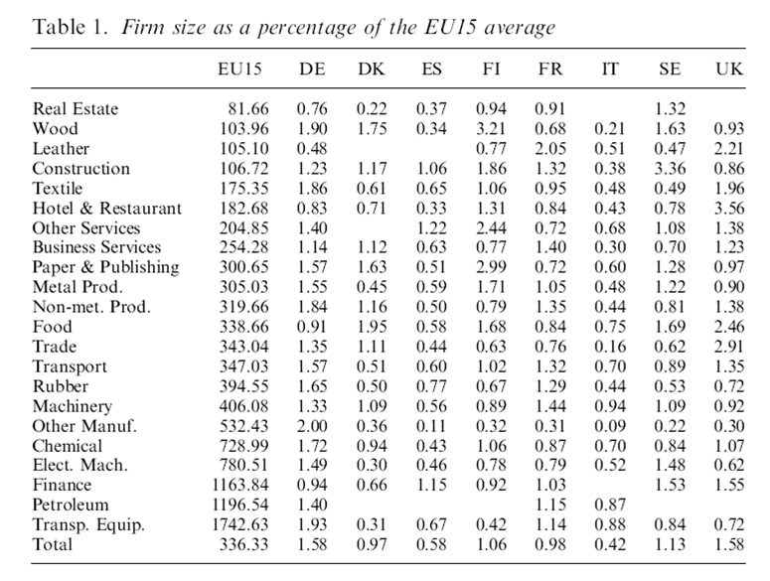

Slide 15
What Has Changed?
Technology: ICT
  New technologies best fitting in firms with a “standardized knowledge”
Globalization
  New competitors with low production costs
Euro
  Competitive devaluation no longer an option

Slide 16
Why Firm Size is Important?
Pure price competition is not sustainable
Firms with market power are favoured in the new competitive environment
In manufacturing market power depends on product differentiation
Typical case: high tech sectors
  Competition on product innovation
  Pagano-Schivardi (2003): business size is key to grow in innovative sectors
  Italian comparative advantage in other sectors

Slide 17
“Tertiarization” within Manufacturing Industries
Nowadays scale is fundamental in all sectors
Supporting evidence from a joint research project with Bank of Italy: successful manufacturing firms are moving their boundary closer to the “tertiary sector”:
  strategy focused on activities that support (precede or follow) the production process: engineering, branding, assistance and distribution
  Resulting product differentiation reduces demand elasticity and allows to face international competition
  Investment in intangible assets

Slide 18
“Tertiarization…”: II
Same arguments becoming relevant even in traditional activities
Old model mainly based on production efficiency is failing
Even in traditional sectors there is evidence that successful firms rely more on “tertiary” activities
Success often depends on factors unrelated to the strict manufacturing process
Evidence of an ongoing process?

Slide 19
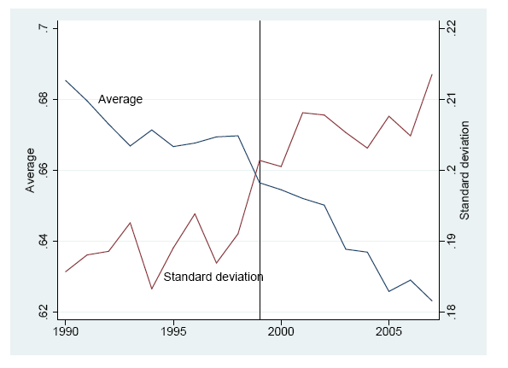
Fig. 2: Average Share of Blue Collars in Italian Manufacturing
Source: Bugamelli, Schivardi & Zizza, 2008, “The euro and firm restructuring”

Slide 20
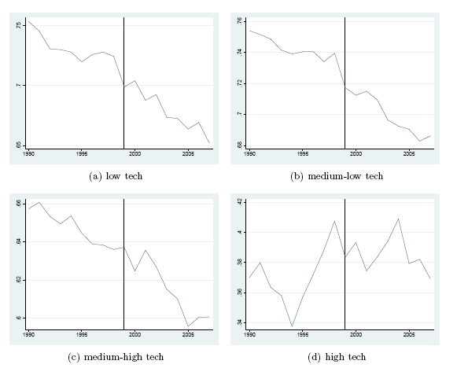
Fig. 3: Blue Collar Share by Technological Intensity
Fonte: Bugamelli, Schivardi e Zizza, 2008, “The euro and firm restructiuring”

Slide 21
Intangible Assets in SME
as % of total assets for firms with sales btw 2-50 €mln

Slide 22
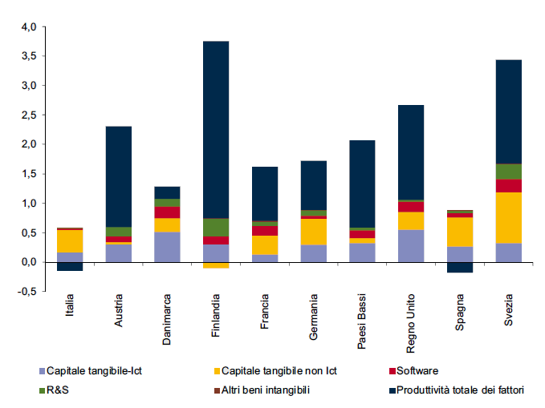
At the aggregate level, reasons for low growth performance
Physical Capital – ICT
R&S
Physical Capital – non ICT
Other Intangibles
Software
TFP

Slide 23
Result #1:
Key Role of Intangibles vs. Physical Capital
Implications for:
  Aid to firms – 488, Legge Sabbatini
  Tangibles vs. Intangibles Infrastructures
  Institutional framework: Intangibles need more legal protection

Slide 24
Firm Size, revisited
Fixed costs are increasingly fundamental
Size also important in terms of “customer base” and brand awareness
Key is not to have firms with many employees
… but firms investing in intangible assets to achieve market power
Example: Nero Giardini

Slide 25
(In)Efficient Resource Allocation
Pareto efficiency: good firms grow, bad firms exit
Italy: lack of Pareto efficiency?
Evidences of restructuring before the crisis:
  Strong increase in productivity and profitability dispersion
  No evidence of a job reallocation increase
… see next two figures

Slide 26
Misallocation: The variance of TFP has increased
Source: Calligaris, Del Gatto, Hassan, Ottaviano and Schivardi 2018

Slide 27
A country, rather than a regional problem

Slide 28
Productivity gains from equalizing TFP dispersion to its 1995 value

Slide 29
Missing Growth Opportunities
Size is not the problem, rather:
  Growth opportunities not exploited
  Bad firms survive in the market
What does hinder allocation efficiency?
A long list: fiscal burden, labour market, bureaucracy …
They where already there, but with a more “complicated” world, they have become more important

Slide 30
Result #2:
Importance of Allocation Efficiency/Business Growth
Implications:
  Policies to support businesses
  Welfare policies enabling factors mobility
  ACE, JOBS ACT

Slide 31
Corporate governance, finance and management
Intangible Assets:
  High Risk
    Family owned businesses feature low diversification
    Require equity investment
  Require specific managerial skills
    Need to hire managers outside the family circle
  Require huge financial resources
    Size and capitalization
Italian businesses lack these characteristics: SME form the main structure, but cannot be left alone and the framework must be expanded

Slide 32
Focus: Corporate governance and finance
Two related and important aspects
Case studies: family entrepreneurs very cautious in adopting growth strategies
Priority is not to loose firm control
Tend to be hostile to equity and managerial outside contributions
Difficulties in management turnover, though with some positive recent evidence (Tab.4, Fig.4)

Slide 33
Firm Size
% of exporting firms, by size
Source: The Global Operations of European Firms, Navaretti Bugamelli Schivardi
Small Italian firms more export oriented but size is a weakness
Export would increase by 37% with the German size structure
Size Class | AUT | FRA | GER | HUN | ITA | SPA | UK
10-19 | 69.8 | 44.7 | 45.7 | 58.0 | 65.4 | 51.2 | 54.9
20-49 | 63.8 | 59.1 | 65.4 | 64.7 | 73.3 | 63.5 | 62.8
50-249 | 88.6 | 75.4 | 78.2 | 79.3 | 86.6 | 76.2 | 76.8
more than 249 | 90.8 | 87.6 | 84.0 | 97.4 | 92.6 | 88.0 | 80.7
Total | 72.6 | 57.9 | 63.4 | 67.3 | 72.2 | 61.1 | 64.0

Slide 34
Control and Finance, 2
Market for corporate control undeveloped
  Family owned firms are good in some context, bad in other
  Especially not well behaving when facing the opportunity to grow in scale
  Bank debt is good to finance physical capital, not for intangibles
  More equity needed

Slide 35
Ownership and Finance
Ownership and Financial Structure of Firms in 7 European Countries, 2008
 | AUT | FRA | GER | HUN | ITA | SPA | UK
% of firms:
Foreign Ownership | 12.8 | 10.3 | 6.3 | 19.8 | 4.1 | 4.5 | 12.2
Venture Capital | 2.2 | 1.9 | 1.3 | 0.9 | 0.5 | 1.0 | 5.7
% Bank debt to Total Debt | 87.0 | 78.7 | 83.9 | 82.9 | 87.5 | 86.4 | 65.2
Source: The Global Operations of European Firms, Navaretti Bugamelli Schivardi

Slide 36
Ownership and Control
Family Owned & Family Managed Firms
 | Family owned Firms (%) | Family Owned Only:
 |  | CEO from the family (%) | Management within family (%)
France | 80.0 | 62.2 | 25.8
Germany | 89.8 | 84.5 | 28.0
Italy | 85.6 | 83.9 | 66.3
Spain | 83.0 | 79.6 | 35.5
UK | 80.5 | 70.8 | 10.4
Source: Bugamelli et al., Bank of Italy, EFIGE data

Slide 37
Result #3:
Business Ownership, Control and Finance model exhibit excess dependence from family and banking system
Implications:
  Market for corporate control
  Equity vs. bank debt
  Institutional/ Foreign investors
  Management

Slide 38
“De profundis” for Small Businesses?
Can Networks help overcome size weaknesses?
Network Agreements: develop common investments in intangibles
Much discussed
It works for food brands
Is it true in general? Common Brands? Distributional Networks?

Slide 39
An emerging hierarchy in Districts?
  A Leader is large enough to bear investment in intangibles
  It relies on a fringe of small traditional firms
  It would explain the transition toward simpler organizational forms (evidence in SOSE data)
  In line with Focus Groups on a strategic supplier
  Is there a role for Small Firms in an integrated productive system?
Notes:
Gerarchia termine usato molto anche nel capitolo sui focus group

Slide 40
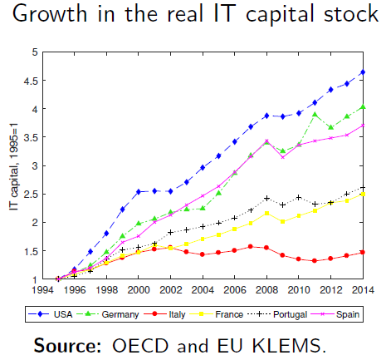
Focus: La rivoluzione IT
Dalla metà degli anni novanta le IT sono comparse anche nelle statistiche
Meno nei paesi del sud Europa: perché?
Non è un problema di offerta
Basato su un lavoro in corso con Tom Schmitz (Bocconi)

Slide 41
Adozione di IT in Italia e Germania

Slide 42
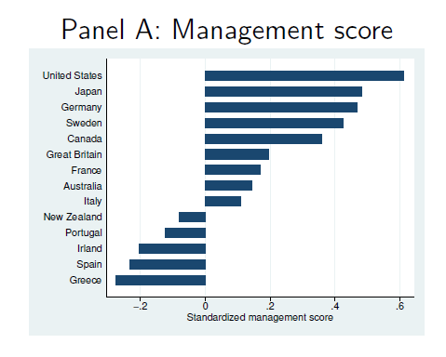
Evidenza sulle pratiche manageriali dalla WMS
Evidenza: IT è complementare alla qualità delle pratiche manageriali
(Perché? Non affrontato in questo lavoro. Ruolo importante della corporate governane and control)
Ipotesi: questa complementarietà penalizza le imprese del sud Europa, che hanno pratiche mediamente peggiori

Slide 43
Crescita della produttività e pratiche manageriali prima e dopo la rivoluzione IT

Slide 44
Quanto può spiegare della divergenza Nord-Sud Europa?
Costruiamo un modello in cui la sola differenza fra paesi è nelle pratiche manageriali
ICT e pratiche manageriali sono complementari
Pratiche manageriali formali richiedono lavoratori istruiti
Il progresso tecnologico aumenta la produttività delle IT
Calibriamo il modello con vari dati micro e macro
Risultati principale: Lo svantaggio in termini di pratiche manageriali diventa più saliente con la rivoluzione IT

Slide 45
Risultati da un modello calibrato: 1995- 2008
l’Italia crescerà i 2/3 della Germania e la metà degli USA (relativamente al contributo alla crescita di IT)

Slide 46
Quali politiche possono aiutare?
Abbiamo simulato una serie di politiche: sussidio all’adozione di IC (Industria 4.0) e sussidio all’istruzione per accrescere i laureati che possono fare i managers (borse di studio)
Non migliorano la situazione – sussidi all’istruzione contribuiscono alla «fuga dei cervelli»
  Motivo: il basso tasso di adozione/laureati è un sintomo della minor efficienza delle imprese nell’utilizzo delle IT, non una causa
Curare il sintomo non aiuta: bisogna lavorare sulla causa del malessere

Slide 47
Qualcosa si muove sul fronte capitalizzazione
e accesso a finanza
Rapporto Cerved PMI 2017:
  Il leverage delle imprese è diminuito sensibilmente, in buona parte per conferimenti di capitale di rischio, e con esso la rischiosità delle imprese
  Abbiamo stimato che 52.000 PMI potrebbero aumentare l’indebitamento per circa 100 miliardi complessivi mantenendo un profilo di rischio estremamente contenuto

Slide 48
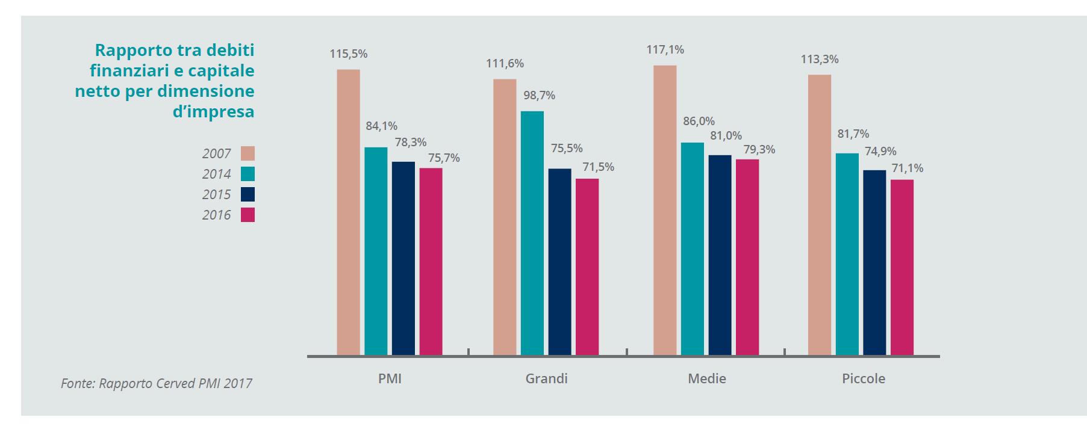
Forte rafforzamento struttura pratrimoniale

Slide 49
Ma rimane una tendenza a chiudersi a capitale e competenze esterne
Aumento equity prevalentemente da fonti interne (?)
Sviluppo di finanza alternativa langue:
  Raccolta private equity e venture capital pari a 1.313 milioni di euro (-47%) rispetto ai 2.487 milioni del 2015 (Fonte AIFI)
  Raccogliamo per VC una frazione della Spagna
Sono importanti non solo per capitale ma anche perché immettono competenze
Management esterno nelle imprese familiari: abbiamo evidenza aneddotica di entrambe le strade (Zambon e Lavazza vs. Ferrero e Pesenti), ma poca evidenza sistematica

Slide 50
CONCLUSIONE
Non è il paese che è peggiorato
Il mondo è cambiato in una direzione sfavorevole rispetto alle nostre «dotazioni»
Abbiamo bisogno di un sistema imprenditoriale che si affranchi dal modello famiglia-banca e si apra ad apporti di capitale e di competenze esterne all’ambito familiare

