Slide 1
United Nations and Collective Security System
Global Law
(Module 1 -Topic 2)
Fiammetta Borgia

Slide 2
Sources of the law on the use of armed force
Customary international law
General principles of law common to nations, e.g. necessity, proportionality, reasonableness, humanity.
The Kellogg/Briand Pact, 1928
The United Nations Charter, 1945
2

Slide 3
1945 United Nations Charter
A new beginning: “to save succeeding generations from the scourge of war”
Charter establishes a system of collective security and forbids unilateral resort to force
However, preserves the right of self- defence
3

Slide 4
Use of armed force (UN Charter)
Consists of three pillars:
  Prohibition of use of force (art. 2(4))
  Reservation of the right of individual and collective self-defense until Security Council can act effectively (art. 51)
  Powers of the Security Council to deal with breaches of the peace or threats to peace (artt. 39-42)
4

Slide 5
The prohibition – article 2(4)
“All Members shall refrain in their international relations from the threat or use of force against the territorial integrity or political independence of any State, or in any other manner inconsistent with the Purposes of the United Nations”.
5

Slide 6
Self-defense
Article 51
– “Nothing in the present Charter shall impair the inherent right of individual or collective self-defence if an armed attack occurs against a Member of the United Nations, until the Security Council has taken measures necessary to maintain international peace and security….”

Slide 7
Self-defence
What is an “armed attack”?
Proportional, necessary, immediate
What Security Council action ends the right of self-defence?
– Example - the Falklands/Malvinas conflict
Interpreting the Charter in the light of modern weapons capability

Slide 8
Necessity
The State attacked must not have had any means of halting the attack other than recourse to armed force. (No other choice)
If it had been able to achieve the same result by measures not involving the use of armed force, it would have no justification for using armed force in self-defence.

Slide 9
Proportionality
It is the general principle of law that the defensive action must be commensurate with and in proportion to the armed attack which gave rise to the exercise of the right of self-defence.

Slide 10
Imminence
It provides for the use of force in self-defence only in case of an actual attack against a Member State
Current problems: anticipatory self-defence
  A) Preemptive self-defence: a necessity of self-defense, instant, overwhelming, leaving no choice of means and no moment for deliberation
  B) Preventive self-defense seeks to halt the development of a future threat, often without having precise information about where or when the attack might occur.

Slide 11
Objectives of self-defence
(I) fending off current, persistent attacks;
(ii) fending off and protection from further attacks which constitute an integral part of the continuum of hostilities; and
(iii) the restoration of the territorial status quo ante bellum.
Once the above objectives have been achieved, there is a duty to end defensive measures.

Slide 12
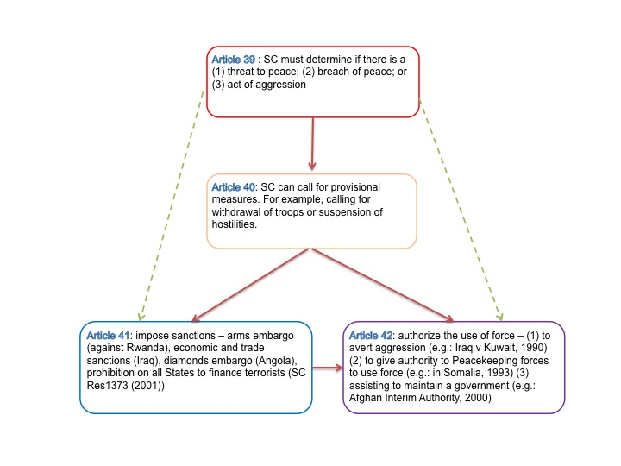
UN Collective security system

Slide 13
Powers of the Security Council
Article 39
– “The Security Council shall determine the existence of any threat to the peace, breach of the peace, or act of aggression and shall make recommendations, or decide what measures shall be taken in accordance with articles 41 and 42 to maintain or restore international peace and security.”
13

Slide 14
Powers of the Security Council
Article 41
– “The Security Council may decide what measures not involving the use of armed force are to be employed to give effect to its decisions, and it may call upon the Members of the United Nations to apply such measures. These may include complete or partial interruption of economic relations and of rail, sea, air, postal, telegraphic, radio, and other means of communication, and the severance of diplomatic relations.”

Slide 15
Powers of the Security Council
Article 42
– “Should the Security Council consider that measures provided for in article 41 would be inadequate or have proved to be inadequate, it may take such action by air, sea, or land forces as may be necessary to maintain or restore international peace and security. Such action may include demonstrations, blockade, and other operations by air, sea, or land forces of Members of the United Nations.”

Slide 16
Permanent agreements (art. 43)
All Members of the United Nations, in order to contribute to the maintenance of international peace and security, undertake to make available to the Security Council, on its call and in accordance with a special agreement or agreements, armed forces, assistance, and facilities, including rights of passage, necessary for the purpose of maintaining international peace and security.

Slide 17
Military Staff Commettee (art. 47 ff.)
The role of the Committee is “to advise and assist the Security Council on all questions relating to the Security Council’s military requirements for the maintenance of international peace and security, the employment and command of forces placed at its disposal, the regulation of armaments, and possible disarmament.”

Slide 18
UN Practice
Security Council resolution which authorise the use of force:
  States and coalisations of states
  Regional organisations
  General secretary?

Slide 19
The Security Council in action: Iraq
SECURITY COUNCIL RESOLUTION 660 (2 AUGUST 1990):
  “The Security Council…determining that there is a breach of the peace by the Iraqi invasion of Kuwait…
  1. Condemns the Iraqi invasion…
  2. Demands that Iraq withdraw immediately…”

Slide 20
Security Council Res. 661 (6 August 1990)
“The Security Council …decides that all states shall prevent:
(A) the import…of all commodities …originating in Iraq or Kuwait…
(B) any activities by their nationals which … promote the export or transshipment of any commodities … from Iraq or Kuwait …
(C) the sale or supply of any commodities …including weapons or any other military equipment …but not including supplies intended strictly for medical purposes, and in humanitarian circumstances, foodstuffs, …to Iraq or Kuwait…”

Slide 21
Security Council Res. 665 (25 August 1990)
“The Security Council …1. Calls upon states …deploying maritime forces to the area to use such measures commensurate to the specific circumstances as may be necessary under the authority of the Security Council to halt all inward and outward maritime shipping … to inspect and verify their cargoes and destinations to ensure strict implementation of Res. 661.”

Slide 22
Security Council Res. 678 (29 November 1990)
“The Security Council:
  Recalling and reaffirming its resolutions 660, 661, 662, 664, 665, 666, 667, 669, 670, 674,
and 667,
  Noting that, despite all efforts by the United Nations, Iraq refuses to comply with its obligations to implement resolution 660 (1990) and subsequent resolutions, in flagrant contempt of the Council …”

Slide 23
Security Council Res. 678 (29 November 1990)
“Acting under Chapter VII of the Charter of the United Nations,
– 1. Demands that Iraq comply fully with … all relevant resolutions and decides, while maintaining all its decisions, to allow Iraq one final opportunity as a pause of good will to do so;

Slide 24
Security Council Res. 678 (29 November 1990)
“2. Authorizes Member States cooperating with the Government of Kuwait, unless Iraq on or before January 15, 1991, fully implements … the foregoing resolutions, to use all necessary means to uphold and implement Security Council resolution 660 and all subsequent relevant resolutions and to restore international peace and security in the area; …”

Slide 25
Security Council Res. 678 (29 November 1990)
“3. Requests all states to provide appropriate support for the actions undertaken in pursuance of paragraph 2 of this Resolution …”
[See also Charter, article 49: “The Members of the UN shall join in affording mutual assistance in carrying out the measures decided upon by the Security Council.”]

Slide 26
“Coalitions of the Willing and Able”
The scheme for a permanent UN force (Charter, articles 43-47) has not been put into effect.
Forces must be assembled ad hoc from those states willing and able to provide armed forces personnel and equipment
Political considerations

Slide 27
The invasion of Iraq 2003
Absolutely illegal?
  Article 2(4) of the Charter;
  No prior Iraqi attack justifying immediate self- defence;
  No authorization by the UN Security Council.

Slide 28
Iraq (cont’d)
US justification as an act of pre-emptive self-defence against the feared future use by Iraq of WMDs.
British justification: authorized by the Security Council by implication from the wording of previous resolutions.

Slide 29
Iraq (cont’d)
A possible alternative justification on basis of the “wriggle room” in the interpretation of article 2(4) of the Charter:
– Was the invasion aimed at the territorial integrity and political independence of Iraq or at the removal of a tyrant who was defying Security Council resolutions?

