Slide 1
Regional Tax
ECLI:EU:C:2009:709
Ilia Azizi
Federico Cutrone

Slide 2

Case Introduction
Article 4; Law number 4 of Region Of Sardinia
‘ Regional legislation establishing a tax on stopovers for tourist purposes by aircraft used for the private transport of persons, or by recreational craft, to be imposed only on operators whose tax domicile is outside the territory of that region.’

Slide 3
Let get Untechnical
Article 4; Law number 4 of Region Of Sardinia
‘ Regional legislation establishing a tax on stopovers for tourist purposes by aircraft used for the private transport of persons, or by recreational craft, to be imposed only on operators whose tax domicile is outside the territory of that region.’

Slide 4


What are we talking about?
Is Sardinian tax legislation consistent with Community law, to be precise, with the freedom to provide services (Article 49 EC) and the prohibition of State aid (Article 87 EC)?

Slide 5
How much was the tax?
Tax in € | 4 Passengers | 5-12 Passengers | 12 Passengers or more | 14 to 15.99 metres inclusive | 16 to 19.99 metres inclusive | 20 to 23.99 metres inclusive | 24 to 29.99 metres inclusive | 30 to 60 metres inclusive | 60 & above metres inclusive
Aircraft | 150 | 400 | 1,000 | - | - | - | - | - | -
Watercraft | - | - | - | 1,000 | 2,000 | 3,000 | - | - | -
Vessels | - | - | - | - | - | - | 5,000 | 10,000 | 15,000

Slide 6
Concerning Articles
European: 49, 50 (1), 87 (1), 10 , 3 (1) (g)
Italian constitution: 117
Regional law: Article 4 of Law No 4 of the Region of Sardinia of 11 May 2006

Slide 7
Article 49: Freedom to Provide Services
‘Within the framework of the provisions set out below, restrictions on freedom to provide services within the Community shall be prohibited in respect of nationals of Member States who are established in a State of the Community other than that of the person for whom the services are intended.’

Slide 8
Article 50 (1): Services Definition
‘Services shall be considered to be “services” within the meaning of this Treaty where they are normally provided for remuneration, in so far as they are not governed by the provisions relating to freedom of movement for goods, capital and persons’

Slide 9
Article 87 (1): State aid
‘Save as otherwise provided in this Treaty, any aid granted by a Member State or through State resources in any form whatsoever which distorts or threatens to distort competition by favouring certain undertakings or the production of certain goods shall, in so far as it affects trade between Member States, be incompatible with the common market.’

Slide 10
Article 3 (1) (g) & Article 10
3 (1) (g) → ‘A system ensuring that competition in the internal market is not distorted.’
10 → ‘ Member States shall take all appropriate measures […] to ensure fulfilment of the obligations arising out of this Treaty or resulting from action taken by the institutions of the Community.

Slide 11
Article 117
‘Legislative power shall be exercised by the State and the Regions in accordance with the Constitution and within the limits set by Community law and international obligations.’

Slide 12
Article 4 of law number 4; 11th may 2006
‘ Regional legislation establishing a tax on stopovers for tourist purposes by aircraft used for the private transport of persons, or by recreational craft, to be imposed only on operators whose tax domicile is outside the territory of that region.’

Slide 13
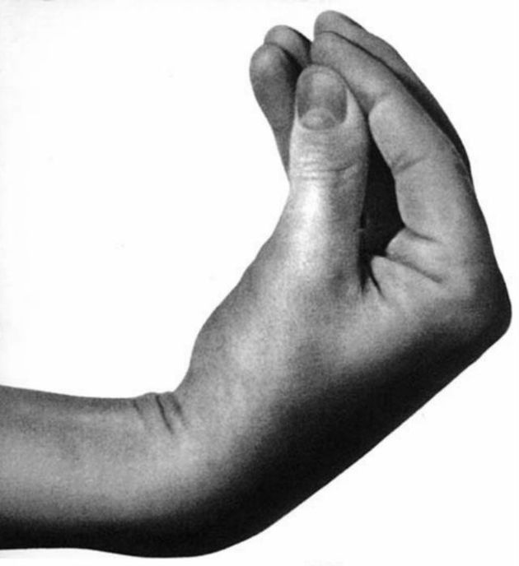
From Non-residents to All to None!

Slide 14
Law Hierarchy
Principle of Supremacy of European Laws

Slide 15
How does the Regional and European law Work?
T.U.E & T.F.U.E
Primary level State law
Law Binding
Constitutional Level
Primary level (State Law)
Secondary level
Sardinia, Sicily, Friuli Venezia Giulia, Trentino Alto Adige and Valle d'Aosta
They have a Constitutional Statute (article 138)
All the regions → Legislative assembly with one chamber → Elected directly by citizen of the region.

Slide 16
Questions
Raised by constitutional court

Slide 17
Brief review
Constitutional Court
Questions 1 & 2
Questions 3 & 4
Article 49 EC (freedom to provide services) and Article 87 EC (state aid)
Article 49 EC (freedom to provide services) and Article 87 EC (state aid)
Aircraft only on undertakings
Recreational craft

Slide 18
Questions: 1 & 3
1. Is Article 49 EC to be interpreted as precluding the application of a rule under which the regional tax on stopovers for tourist purposes by aircraft is levied only on undertakings, which have their tax domicile outside the territory of the Region of Sardinia?
3. Is Article 49 EC to be interpreted as precluding the application of a rule under which the regional tax on stopovers for tourist purposes by recreational craft is levied only on undertakings, which have their tax domicile outside the territory of the Region of Sardinia?

Slide 19
Answers to: 1 & 3
Sardinia
Everybody benefits but not everybody pays
Offset additional cost for Sardinia's geographical and economic features for non-residents
Restrictions based on Public health, “Polluter’s pay”
European Union
Objectively comparable irrespective of residence
Not the same nature of taxation even if the contribution of residence is made through income taxation
Not preoperative for attainment of main objectives

Slide 20

Further clarifications by Advocate General
Meet Juliane kokott
For what concerns Aircrafts
For what concerns Recreational craft

Slide 21
Questions: 2 & 4
2. Does Article 4 of Regional Law No 4/2006 constitute, within the meaning of Article 87 EC, State aid to undertakings carrying on the same activities which have their tax domicile in the Region of Sardinia, in respect of stopovers for tourist by aircraft?
4. Does Article 4 of Regional Law No 4/2006, in respect of stopovers by recreational craft and whose commercial operations consisting in making such craft available to third parties, constitute, within the meaning of Article 87 EC, State aid to undertakings carrying on the same activities which have their tax domicile in the Region of Sardinia?’

Slide 22
State aid criteria: Article 87
FOUR CONDITIONS FOR CUMULATIVE AID DEFINITION:
There must be an intervention by the State or through State resources;
The intervention must be liable to affect trade between Member States;
It must confer an advantage on the recipient;
It must distort or threaten to distort competition.

Slide 23
Answers to: 2 & 4
Sardinia
The tax cannot be regarded as State aid, both because it does not involve the use of State resources and because it is not selective in nature.
Not selective since its ‘General nature’ of the measure should be assessed is that of the infra-State body, if it enjoys sufficient autonomy
European Union
It is a state aid even if it does not involve the transfer of State resources, since it involves the renunciation by the authorities.
Satisfies the condition of a selective advantage as the nature is not general, since it does not apply to all operators of aircraft or pleasure boats who make a stopover at Sardinia.

Slide 24
Final Judgment
1st and 3rd Question → Article 49 EC precludes legislation of an autonomous region under which a tax, based principally on environmental policy, on stopovers for tourist purposes by aircraft and recreational craft is imposed only on undertakings which have their tax domicile outside that region.
2nd and 4th Question → Regional legislation such as that of the Autonomous Region of Sardinia, constitutes aid within the meaning of Article 87(1) EC in favour of undertakings carrying out the same activity and having their tax domicile within that region.

Slide 25
References
Application: http://curia.europa.eu/juris/document/document.jsf?text=&docid=69208&pageIndex=0&doclang=en&mode=req&dir=&occ=first&part=1&cid=398314
Opinion
ECLI:EU:C:2009:420: http://curia.europa.eu/juris/document/document.jsf?text=&docid=72766&pageIndex=0&doclang=en&mode=req&dir=&occ=first&part=1&cid=398314
Judgment
ECLI:EU:C:2009:709 http://curia.europa.eu/juris/document/document.jsf?text=&docid=73491&pageIndex=0&doclang=en&mode=req&dir=&occ=first&part=1&cid=398314
Judgment (Summary)
ECLI:EU:C:2009:709 http://curia.europa.eu/juris/document/document.jsf?text=&docid=80898&pageIndex=0&doclang=en&mode=req&dir=&occ=first&part=1&cid=398314
Judgment (OJ) http://curia.europa.eu/juris/document/document.jsf?text=&docid=74627&pageIndex=0&doclang=en&mode=req&dir=&occ=first&part=1&cid=398314

