Slide 1
The government of gibraltar's reform of corporate tax
ROMAN KURBATOV
LORENZO BARTOLO

Slide 2
Agenda
Foreword
The content of the Gibraltar tax reform
Combined effects on specific groups of
companies(data)
Parties
History
Legal action
Decision of the Court

Slide 3
Foreword
When the Gibraltar Government decided to
reform its corporate income tax system, it did
not expect to be involved in a legal battle with
the EU that would last almost four years.
Finally, on 18 December 2008 the European
Court of First Instance has declared that
Gibraltar is able to legislate on matters of
taxation and has autonomy in economic,
financial and fiscal matters.
The Court of First Instance has refuted the
Commission’s case in its entirety

Slide 4
The content of the Gibraltar tax reform
The reform aimed at replacing the classical corporate tax system
(based on taxation of profit) which had been currently in force by a payroll
tax andbusiness property occupation tax (hereinafter‘BPOT’).
All companies registered in Gibraltar would have to pay GBP 3000
per full time employee and additional 100% of their current tax on their
real estate property. However, the reform foresaw that the total tax
liability of a company would be capped at 15% of its profits.
Originally, the tax had been capped at GBP 500 000 as well, but
this feature was removed after the Commission had opened
its formal investigation procedure. Two sectors would face a top-up tax.
First, financial services were originally to be taxed at least at
the rate of 8% on their profits.

Slide 5
The content of the Gibraltar tax reform
This was subsequently changed as a reaction to abandoning
the GBP 500 000 cap to a rate that shall be fixed in the future between4-6%.
The top-up tax was credited to the payroll tax and to the BPOT
and the cap of 15% applied to the total taxation (top-up,
payroll and BPOT), so that a company's tax liability for
its financial activities was at least 4 to 6% (for simplification let
us further assume it would be 5%)
and at most 15% of its profits from this activity.
The second sector that incurred top-up tax were the utilities
(water, sewage, electricity, gas, telecommunications, etc.), which are
mostly not mobile and occupy a monopolistic position.
They were taxed at a flat rate of 35%

Slide 6
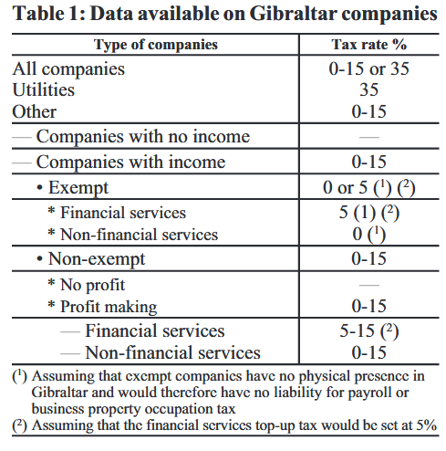
Combined effects on specific groups of companies(Data)

Slide 7
Parties
EUROPEAN COMMISSION
UNITED KINGDOM
GOVERNMENT OF GIBRALTAR
IRELAND
KINGDOM OF SPAIN

Slide 8
History
On 11 July 2002, the European Commission informed the United
Kingdom that it would initiate investigation procedures
into Gibraltar exempt and qualifying companies as according to
the Commission these tax concessions constituted
state aid, contrary to the rules of the common market
The Court of First Instance overturned the Commission’s
decision with regard to exempt companies however it did
accept the Commission’s view with regard to qualifying companies.

Slide 9
History
It was therefore agreed that the qualifying company regime
would be terminated in the short term, but existing exempt
companies would be phased out by December 2010.
The Gibraltar Government then sought to reform its corporate
income tax system which would be applicable to all companies
incorporated in Gibraltar.
On 30 March 2004, the Commission decided that the proposed
tax reforms constituted state aid incompatible with the common
market and rejected the proposals.

Slide 10
History
The Commission considered the reform proposals to be :
(1) ‘regionally selective’ in that they conferred tax advantages on
companies in Gibraltar compared with companies in
the United Kingdom (therefore implying that Gibraltar
is a mere region of the United Kingdom and not an independent
territory for tax purposes and
(2) ‘materially selective’ in that specific features conferred
tax advantages on some companies as opposed to others in Gibraltar.

Slide 11
Legal action
The Governments of Gibraltar and the United Kingdom brought
an action against the European Commission on 9 June 2004
contesting the Commission’s decision of 30 March 2004.
The Governments argued that their tax jurisdictions are
entirely separate so that Gibraltar’s tax laws cannot be treated as
derogations from the tax laws applicable in the United Kingdom.
Furthermore, the Government of Gibraltar argued that
the reform proposals cannot be treated as derogations from
the common tax regime resulting in favouring certain
undertakings in Gibraltar.

Slide 12
Decision
On 18 December 2008 the Court of First Instance
has annulled ‘in its entirety’ the Commission’s decision.
The Court concluded that the tax reform proposals cannot
be deemed to be considered regionally selective
.

Slide 13
Decision
The Court also concluded that the classification by the Commission of
the Gibraltar proposed tax measures as materially selective
was incorrect because the Commission had not established the
existence of selective advantage for these measures.
The Commission may appeal only on points of law within two months
after notification. The Court furthermore awarded all costs
against the Commission. (Ho-ho!)

Slide 14
Sources & references
https://www.pwc.gi/publications/assets/taxbulletingibraltareucourtcasedecember2008.pdf
http://ec.europa.eu/competition/publications/cpn/2004_2_97.pdf
Judgment of the Court(Grand Chamber, 15 November 2011)
presented by Professor.

Slide 15


