Slide 1





Business Model Innovation
Amirhossein Saghezchi
Rubén Arriaga Vilches
Lucía Llorente López
Ana Del Real Espinar
Isabel Gómez Blanco Andrés
A.Y 19/20
Emilio Sassone Corsi
Stephen Trueman

Slide 2
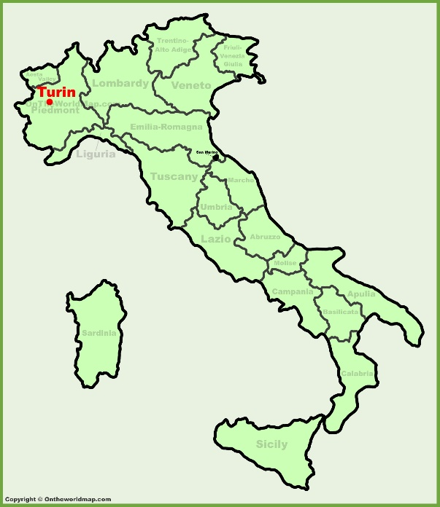

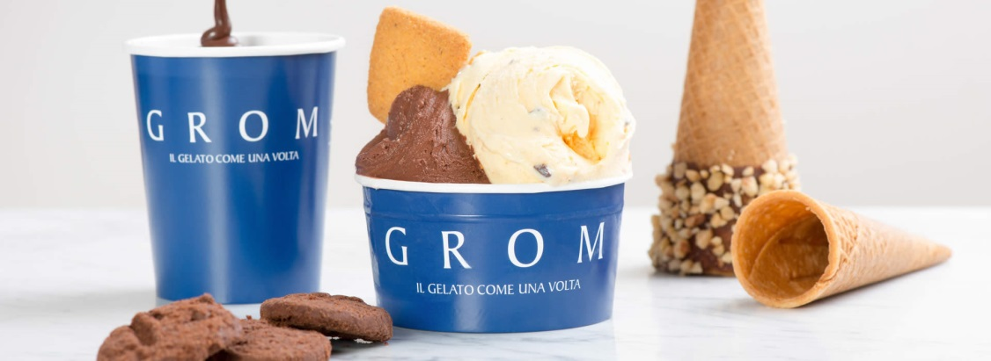

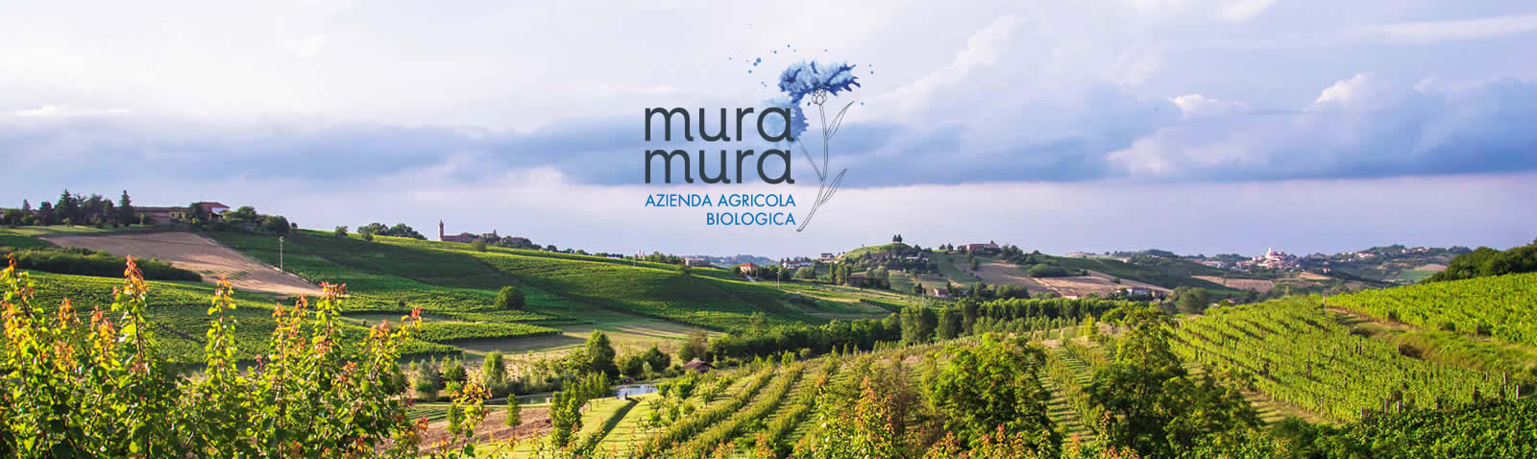
WHAT IS GROM?
GROM
FOUNDERS
ORGANIC FARM

Slide 3
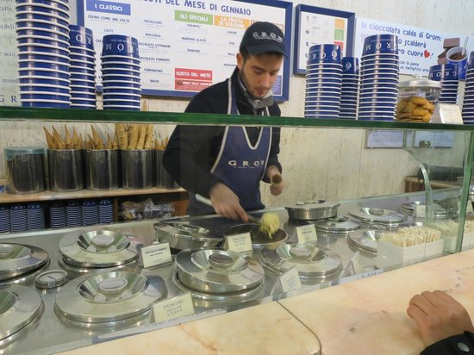
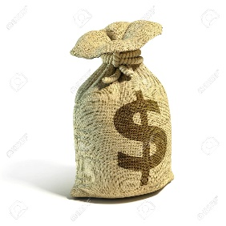

GROM IN NUMBERS
GROM IS LOCATED ON 65 COUNTRIES
GROM
WAS ACQUIRED ON 2015 BY:
EMPLOYEES:
+260
REVENUES: 23 MILLION $

Slide 4
Services
Flavor of gelato and sorbets
CLASSICS
SEASONAL FRUIT SORBETS
FLAVOUR OF THE MONTH
SPECIALS
HOT CHOCOLATE
YOGURT
GIANDUIA
CREMA DI GROM
PISTACCHIO
TORRONCINO
NOCCIOLA
CREMA COME UNA VOLTA
FIORDILATTE
CIOCCOLATO
STRACIATELLA
CAFFÉ
MAARONS GLACÉS
CARAMELLO AL SALE
LIMONE MANDARINO CACHI PERA
FONDENTE
GIANDUIA
LATTE
FIORDILATTE & AMARENE

Slide 5
Services
They put their gelato and their experience in serving it
BIRTHDAY PARTIES
GRADUATION PARTIES
WEDDINGS
CORPORATE EVENTS
CHILDREN PARTIES
THE MOBILE GELATO COUNTER
A real galeria corner. Your personal menu with six flavors
PARTY BOX
Miniature gelateria, with two different flavors
SWEET BIKE
A bike that brings gelato and sorbet. Six flavors of gelato
GROM CUP
A big cup with six different flavors of gelato.

Slide 6





COMPETITORS

Slide 7
SWOT
STRENGTHS
WEAKNESSES
THREATS
OPPORTUNITIES
·Quality of the products
·Brand Image
·Market knowledge
·Own raw materials from his farm
· High Price ( but according with quality)
· Seasonal product
·OneSupplier
·New segment ( Child with the combo)
·Market growth (kindergarten, scolars)
·
· High competition
· Change in consumer taste
·Strong Rivals

Slide 8
PORTER´S FIVE FORCES
COMPETITIVITY
HIGH
BARIERS TO ENTRY
LOW
BARGINING POWER OF BUYERS
HIGH
THREAT OF SUBSTITUTES
THERE ISNT
BARGINING POWER OF SUPPLIERS
LOW

Slide 9

Marketing Mix
Product
Price
Placement
Promotion
Features
Quality
Branding
Packaging
Services
Price strategy
Discounts
Payment terms
Channels
Market coverage
Location
Inventory
Sales Promotion
Advertising
Marketing
People
Process
Supply chain
Producing
Final product
Relations
Recruitment
Training
Uniforms

Slide 10
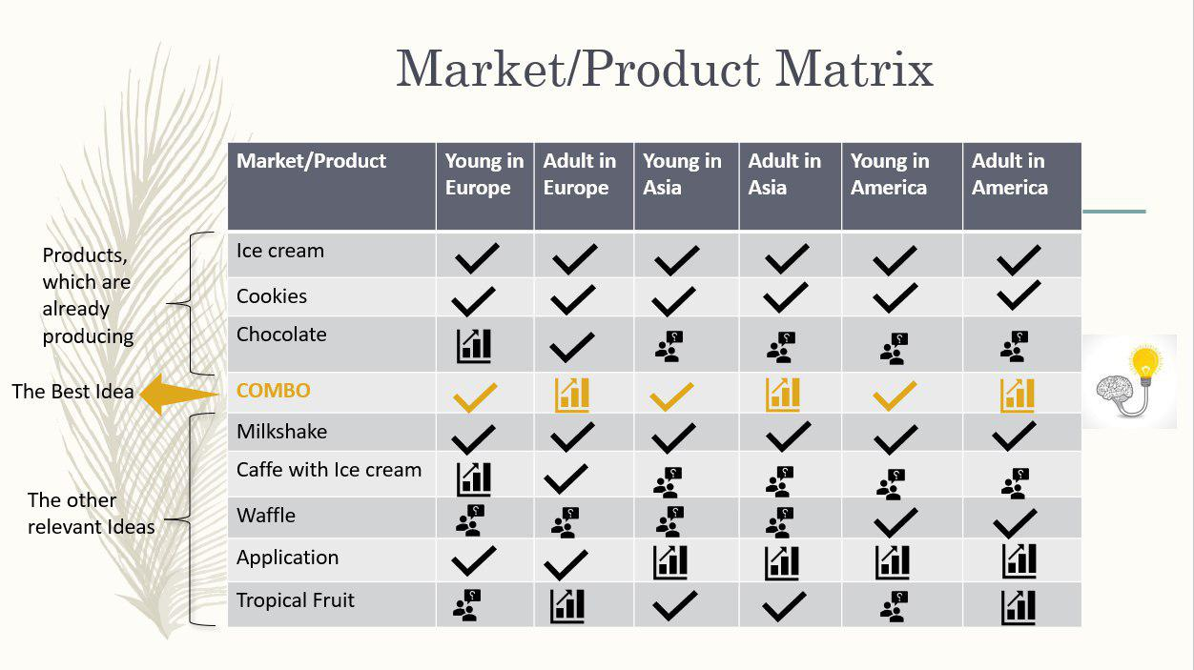








Market/Product Matrix
Market/Product | Young in Europe | Adult in Europe | Young in Asia | Adult in Asia | Young in America | Adult in America
Ice cream
Cookies
Chocolate
COMBO
Milkshake
Caffe with Ice cream
Waffle
Application
Tropical Fruit
Products, which are already producing
The Best Idea
The other relevant Ideas

Slide 11

When I should deliver
How can I finance my project
How
Financing
Partnership
Deliverables
How to Supply
Who are the main suppliers
Costs &Benefits
COMBO In GROM Store
Profitability
Which Tech do I need
NPV
Tech
Do I have them
How to choose branches
Testing in branches
Price
Marketing
Which is my pricing Model
Market Segmentation
Change Value
How it effects on
previous values?
Can I reduce the price?
Method of payment

Slide 12
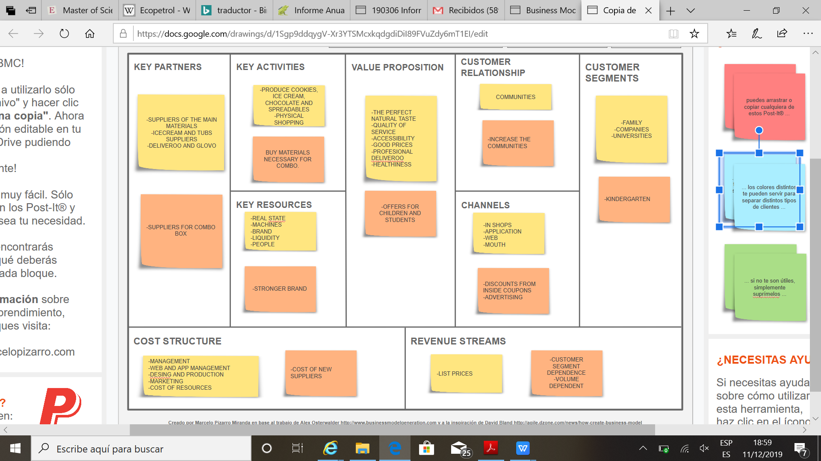
BUSINESS MODEL CANVAS

Slide 13

Value Proposition
What value does the costumer perceive in the market? High quality at an affordable price
What needs are met? Hunger for something good and sweet
What are the advantages? Parents and children are happy with the result: Quality/Good price/Different flavors
What other needs could be met? Enjoy a good time with someone you love
What would make the costumer real happy? A good service accompanied by a good product

Slide 14
Cost Analysis
The Cost Analysis refers to the measure of the cost. The economists are concerned with determining the cost incurred in hiring the inputs and how well these can be re-arranged to increase the productivity (output) of the firm.
1
4
7
Review previous cost analysis reports, if available
Organize costs to reflect the purpose of your analysis
Allocate indirect costs to the program you're analyzing
10
2
5
8
Make conclusions based on the findings
List all direct costs of the program you're evaluating
Gather financial records and information
Calculate depreciation of assets
3
6
9
Include indirect costs
Total direct costs for the program
Factor in hidden costs

Slide 15

The tasting
- Value for the money/Purchase interest: they interested a lot for their children (suitable price)
Purchase quantity/Purchase frequency: 1 a week
Uniqueness: very unique, the other aren’t using it
Overall liking: adult and children liked it
Believability: it’s fairly realistic
Confusion: there isn’t
Brand fit: the idea helps to improve our brand
Purchase interest by variety: extremely interested

Slide 16
Strategy Map
FINANCIAL
MAXIMICING PROFITS IN TEARMS OF COMBINING PRODUCTS
INCREASING CAPITAL
COSTUMERS
INCREASE SATISFACION
NEW EXPERIENCE
REDUCE PRICE
INTERNAL BUSINESS PROCECESS
IMPROVING THE PRODUCT SERVICE OFFERT
INCREASE OUR CHANNELS AND EFFECTIVNESS
LEARNING AND GROWTH
OPTIMIZING RESOURCES
TRAINING MRK STAFF

Slide 17
LAUNCH
questioner divice
POST-RELEASE
increase our qualities
specificts offers for loyal customers
growth with inovation
analys program
RELEASE
events
discounts
advertaisment on social media
free ice cream for first days of offers
PRE-RELEASE
marketing campeing
calling to companies
social media
influencer
relation
e-maillist buldin to companys

Slide 18

THANK YOU
FOR YOUR
ATTENTION!!

