Slide 1



By Dr.
Claudia Armenise
& MSc BA Prof.
Sandro Brunelli
The Financial Due Diligence Process from the Consultancy Firm Lenses
April 11, 12, 18 and May 16, 2023 – Book your seat now!
Info: brunelli@economia.uniroma2.it

Slide 2
The Financial Due Diligence Process from the Consultancy Firm Lenses
Aims and Purposes
Observing as a whole firms’ overall health is a complex, rather than complicated, task to address.
Most of times, only during extraordinary firm-life moments (mergers, liquidation, acquisition, etc.) firms going globally under the lenses of analysts with the aim to extrapolate its health, potentials and perspectives.
In that instant Economist, lawyers, interested investors, potential sellers and all people/organizations involved in the transaction, would like to know more and more about the firm.
As a result, often a financial advisor is appointed to this end.
Whatever will be your future career, you will meet context where a certain degree of judgement is required to outline valutation and assessment, even partially, about different business.
The aim of this course is to outline a basic and rigorous framework for leading a reliable financial due diligence for different purposes.
BOOK YOUR SEAT AT: https://docs.google.com/forms/d/e/1FAIpQLSftvaqJp22bSuYHZYAE5kxwYwDVuRmZ6whI_yHryTNovHpqCw/viewform?usp=sf_link

Slide 3
The Financial Due Diligence Process from the Consultancy Firm Lenses
Full Programme
11th April 2024 – 9am-2pm 1.FDD at a glance. Base financial data and reclassification
  The deal continuum;
  The Financial Due Diligence
  Vendor vs Buy Side Due Diligence;
  Our clients;
  Integrity, validation and comprehension of financial data;
  Balance sheet and income statement reclassification;
  DD Report structure
  Groups formation for conducting a real FDD.
  12th May 2024 - 9am-2pm 2. Balance sheet and net debt analysis
  Focus on balance sheet;
  Focus on working capital;
  Net Debt and adjusted net financial position;
  Case study.
18th April 2024 – 9am-1pm 3.Income statement and Cash flow
  Historical performance analysis;
  Volume/Price effect and other analysis;
  Quality of Earnings;
  Overview of cash flow;
  Case study.
  16th May 2024 9am-1pm
  Drop of Curricula and colloquium with consultant Partner and Human Capital of Deloitte Advisory team about the recruitment process;
  Visit at Deloitte Advisory Rome Headquarter (to be confirmed)
  Project works presentation and final remarks.

Slide 4
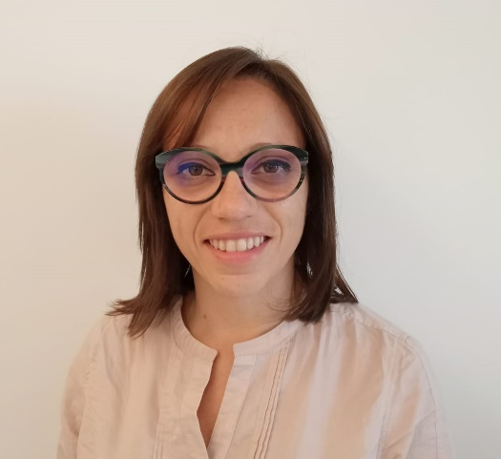
Main Lecturer
Claudia Armenise
  Claudia is a Director at Deloitte Finacial Adivory - Transaction Support Group.
  She has been working as an auditor at PwC (2007-2014), where she has been in charge of procedures regarding auditing of Italian GAAP, IFRS/IAS e US GAAP annual reports and SOX testing.
  Since 2014 she is fully dedicated to transaction services. She developed professional experience in financial due diligence services (both sell-side and buy-side) across a wide range of industries (energy, public utilities, telecommunications, retail, luxury, defense, manufacturing, gaming) for major national and international investors and private equity firms.
  Her clients are, amongst others, Enel Green Power, F2i, Fondo Italiano di Investimento, Capvest, HIG, Investindustrial, Telespazio, Cementir, Angel Group, Aspi, Toyota, Armonia, A2A, Sisal, Goldbet, Green Network, Vianini Group, Chiquita, Wind, Ferrovie dello Stato Italiane, Marguerite.

Slide 5
The Financial Due Diligence Process from the Consultancy Firm Lenses
Further Information and Advice
For further information please contact the Control, Auditing & Risk Management track coordinator, Prof. Sandro Brunelli at
brunelli@economia.uniroma2.it

