Slide 1
Consumer Choices
DAY1 - Introduction
Professor Ilijana Petrovska
Visiting professor Tor Vergata University

Slide 2

Prof. Ilijana Petrovska
  Full Marketing Professor at University American College Skopje
  Visiting professor at BAE Tor Vergata University since 2016
  Programme Leader Digital Marketing MSc at Northumbria University Qatar 2023/24
  Research areas: Digital and integrated marketing communications, entrepreneurship, online consumer behavior, sustainability and digitialization.
  Executive Education– Digital marketing at Columbia Business School in 2022, Northwestern Kellogg Business School in 2019, Harvard Business School training at EFER EEC Barcelona 2010
  Previous work experience – University of Derby, Stenden University, Qatar University and ten years as a Bank’s Marketing manager and worked in Advertising Agency S Team Bates Saatchi&Saatchi
  Passions: Sport –Running, Tennis, Hiking, Yoga…, Reading a good Book, Traveling, Music listening and Inspiring People.

Slide 3
DAY 1 Overview
1. Introduction to the course
2. Students’ introduction
3. Introduction for Consumer choices
4. Relevance for Marketing
5. Trends in Consumer Choices & Starting the 1st Assignment

Slide 4
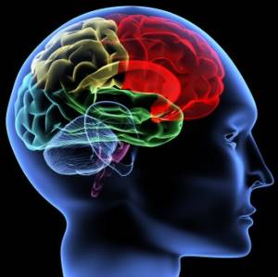
The purpose of this Course
Provide you with understanding of contemporary Consumer Choices, Behavior, Analytics
and how to use it for Marketing

Slide 5
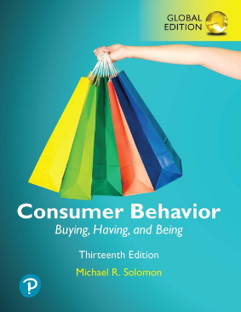
Basic textbook
Additional readings and
articles are expected

Slide 6
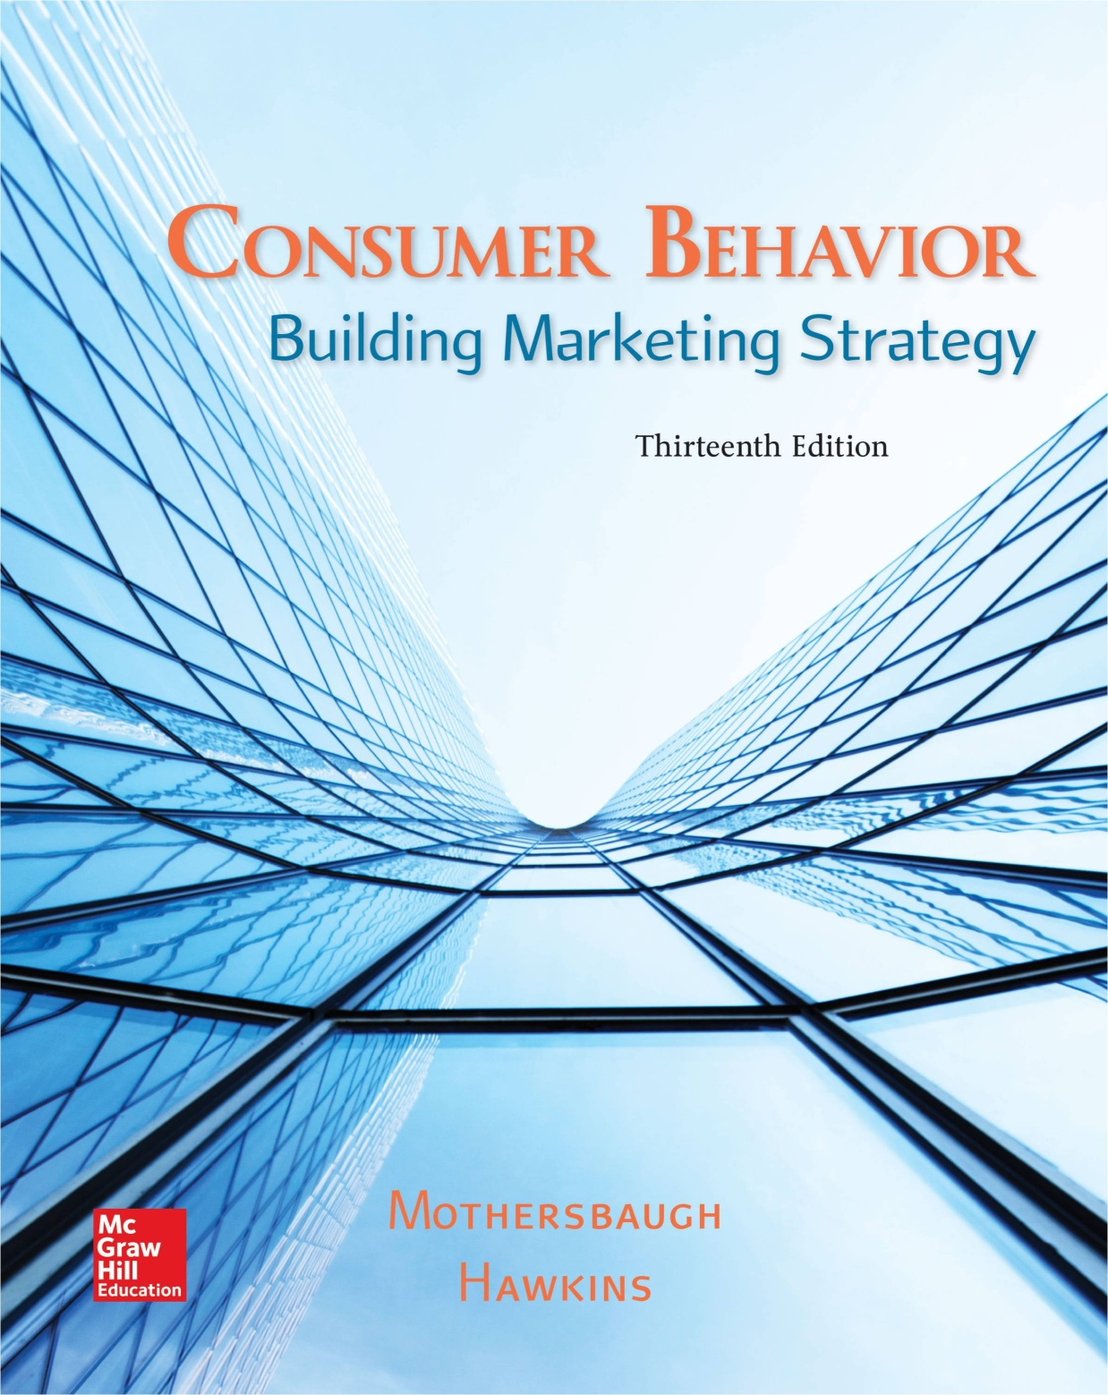

Additional literature

Slide 7
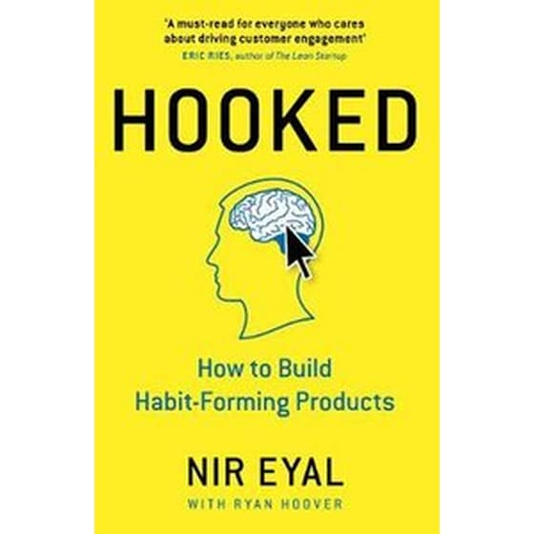
Crowdsourcing & Co-creation!!!
Online resources
ChatGPT
Google scholar
Online libraries

Slide 8
Learning objectives
Learn the fundamental principles and theories in consumer behaviour and consumer choices
Develop abilities to apply consumer behaviour concepts to marketing problems;
Understand the basic analytical tools that can be used to investigate consumer choices.

Slide 9
Learning outcomes
Conduct small scale independent research
Develop customer journey mapping relevant to marketing;
Critically apply the knowledge in the decision connected to various consumer behaviour situations.

Slide 10
Course delivery
Lectures & Co-creation
Student group presentations
Case discussions
Group work activities
Team building games
Videos
Real case Project assignment

Slide 11
Course assessment criteria
Group presentation on Consumer trends - 30% - every class
Final project is consisted of Market research on a Luxury brand – 70%
  Final project Group presentation – 30% - 14th and 15th of May
  Final project Group written report - 40% - May (TBD)
Class participation:
Expected is at least 2/3 of the class participation.
Non attending students – EXAM – Company case analysis

Slide 12

Pitch yourself!
Write / Draw
Present Yourself as Another Life Being
Animal, Bird, Insect, Lizard… 5 min
BRAND YOURSELF!
Notes:
15 mintues

Slide 13
Present Yourselves
Who you are?
What do you like?
What are you Best in?
What would you like to improve?
Do you have any specific expectations from this course?
Include photo, drawing and short explanation!
UPLOAD IT!

Slide 14
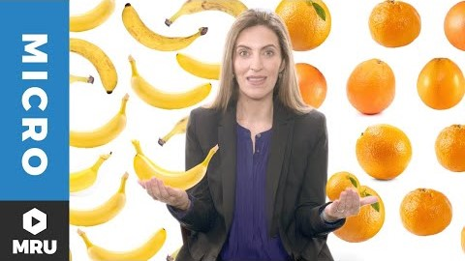
3. Intro to Consumer Choice

Slide 15
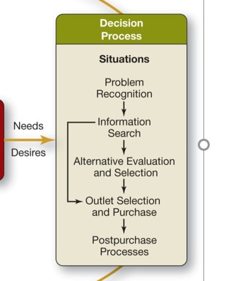
What choices we have? What decisions we make in each stage?

Slide 16
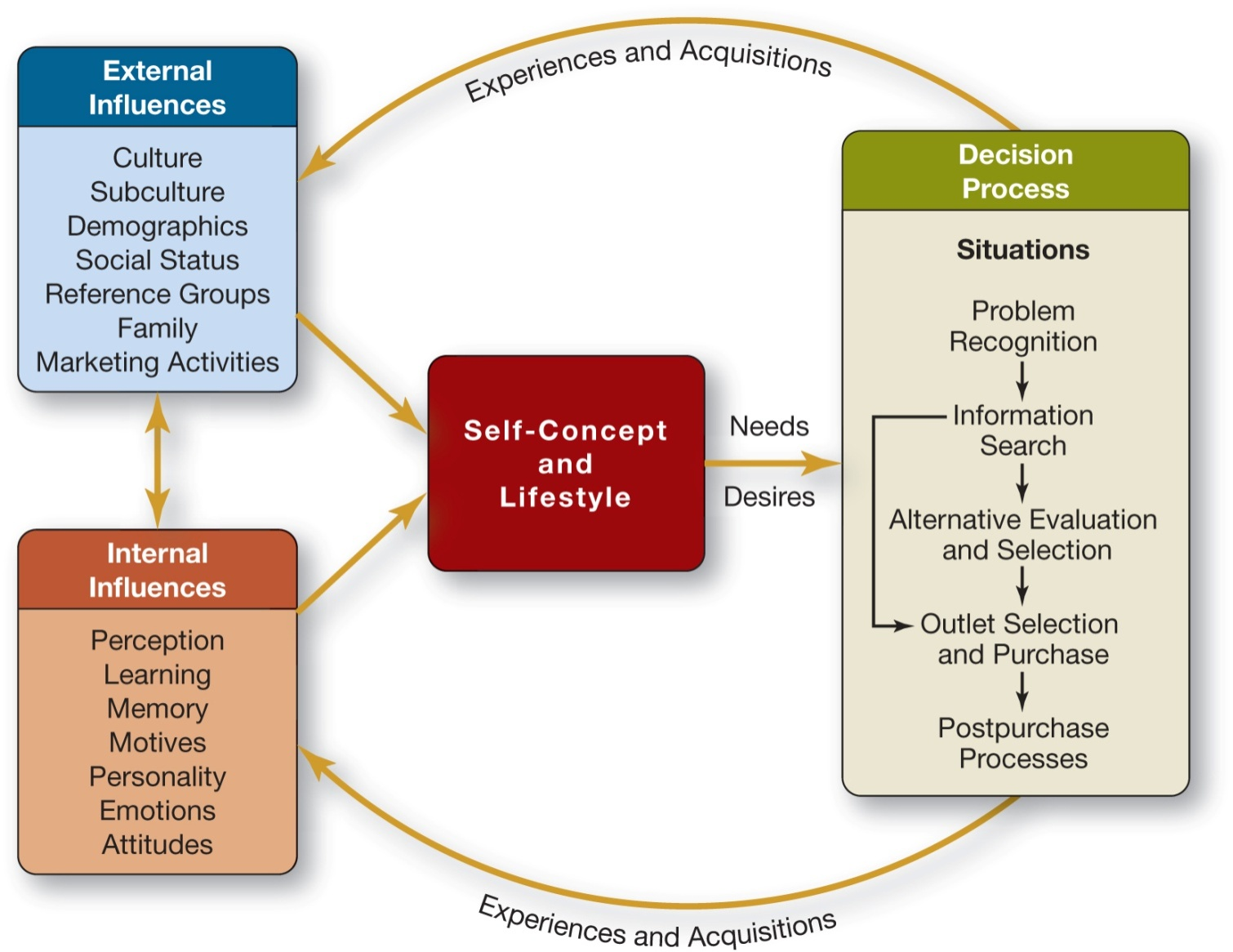
PART I: INTRODUCTION
1-16
Notes:
How the life in 21st century influence on the Decision process? Different types of problems, Different and multimedia information search, different and multi channel outlets, different post-purchase communication
Marketing 2 Consumers shift into Marketing4 Consumers

Slide 17
What Is Consumer Behavior?
The study of the processes involved when individuals or groups select, purchase, use, or dispose of products, services, ideas, or experiences to satisfy needs and desires.

Slide 18
Figure 1.1 Stages in the Consumption Process
Notes:
We call the person who identifies a need or desire, makes a purchase, and then disposes of the product as a consumer. The purchaser or user might be the same person, or not. You can see in the slide that there are three key stages: 1) prepurchase, 2) purchase, and 3) postpurchase. Marketers need an understanding of all three stages.

Slide 19

Micro moments & behavioral marketing

Slide 20
Why we need to understand the customer choices?
What is the connection with marketing?

Slide 21
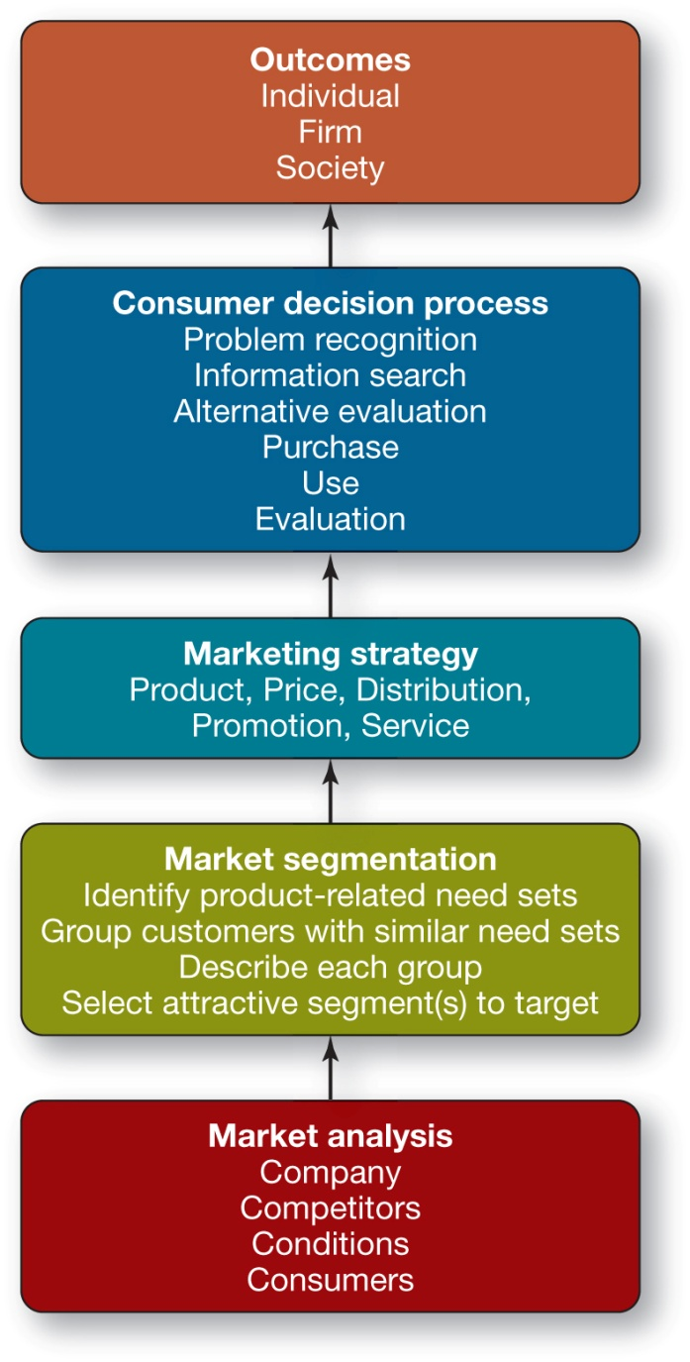
4. Marketing Strategy and Consumer Behavior
1-21

Slide 22
Market Analysis Components
The Consumers
The Company
The Competitors
The Conditions
1-22

Slide 23

Market Segmentation
Market segmentation is a portion of a larger market whose needs differ from the larger market.
1-23

Slide 24
Market Segmentation
Market Segmentation Involves Four Steps:
Identifying Product-Related Need Sets
Grouping Customers with Similar Need Sets
Describing Each Group
Selecting an Attractive Segment(s) to Serve
1-24
Notes:
Need sets – Watch or Rolex?

Slide 25
Questions
How many of you is doing any sport?
How many of you is reading a book?
How Many of you is watching Netflix?
How many of you is using Spotify?
How many of you bought something online in the last 2 days?
How many of you is using ChatGPT?

Slide 26
GROUP WORK
Segment the class
According to…
What sport do you like to do?
What is your hobby?
What kind of music you prefer to listen?

Slide 27
Marketing strategy
Marketing Strategy is the answer to the question:
How will we provide superior customer value to our target market?
      Segmentation – KNOW YOUR MARKET
      Targeting - KNOW YOUR CONSUMER
      POSITIONING – Develop superior customer value
This requires the formulation of a consistent marketing mix:
  Product
  Communications
  Price
  Distribution, and
  Service
1-27

Slide 29
Consumer Decisions
The consumer decision process intervenes between the marketing strategy, as implemented in the marketing mix, and the outcomes.
The firm can succeed only if consumers:
see a need that its product can solve,
become aware of the product and its capabilities,
decide that it is the best available solution,
proceed to buy it, and
become satisfied with the result of the purchase.
1-29

Slide 30
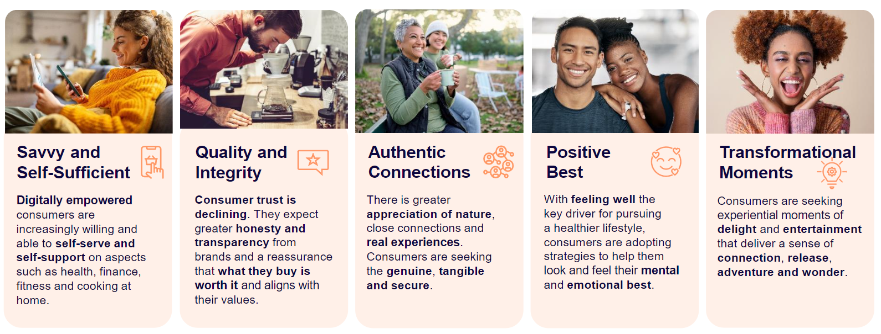
Customer insights
Notes:
https://www.innovamarketinsights.com/trends/top-food-trends-2025/

Slide 31
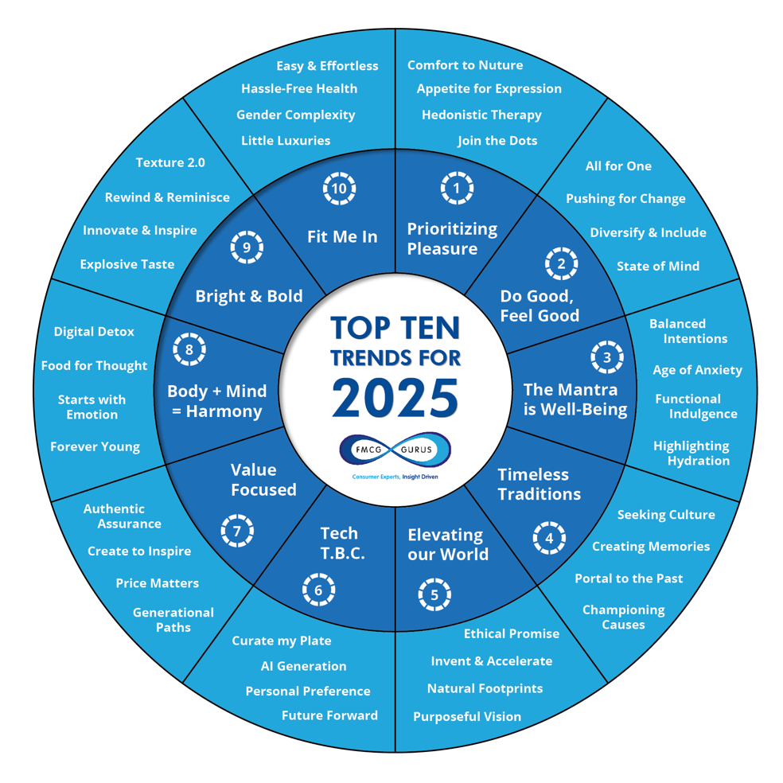
FMCG Gurus Top Ten Trends for 2025
Notes:
FMCG Gurus Top Ten Trends for 2025 are:
https://bakingbiscuit.com/fmcg-gurus-announces-top-10-trends-for-2025/

Slide 32
Trends by Forbes
The Consumer Trends For 2025 Shaping Business
AI Acceleration
There’s A Bad Mood Rising
Influencing The Influencers
Aging Up
Transformation

Slide 33
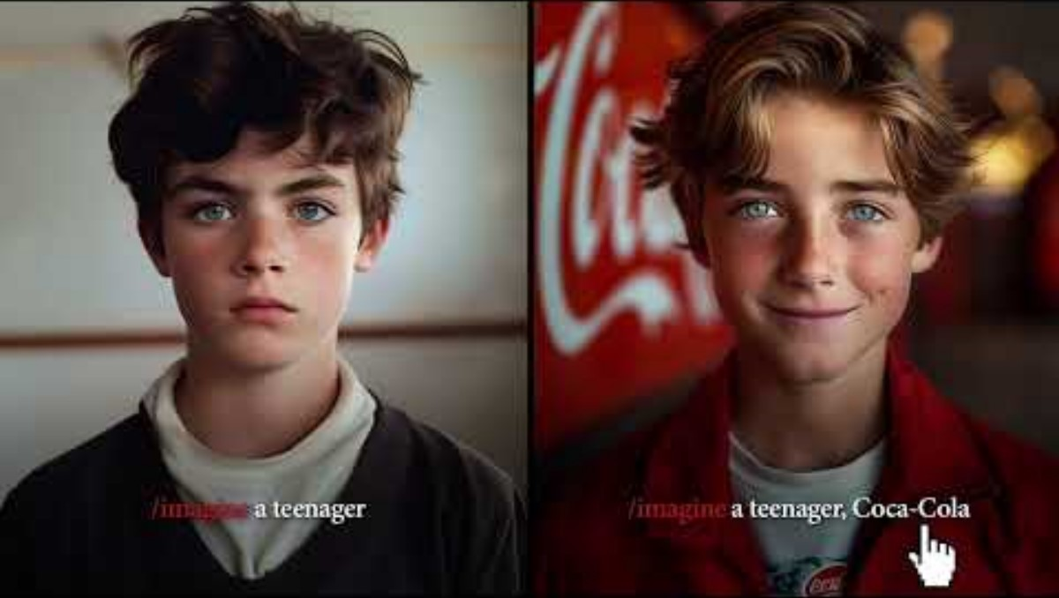
SoMo Borac наградени кампањи

Slide 34
🌐 2. Use Google Trends
Go to: https://trends.google.com/
Fill in the following based on your search:
• Search Term(s) used:
• Interest over time:
• Top countries or regions:
• Related queries/topics:
• Surprising insight:

Slide 35
Why is analyzing consumer behavior important?
Predicting trends
Customer differentiation
Understanding competition
Customer retention
Customer service improvements
Notes:
https://www.determ.com/blog/consumer-behavior-analysis-101-how-to-learn-more-about-your-customers/

Slide 36
What Influence Consumer Choices?
Personal factors
Psychological factors
Social factors
Situational factors

Slide 37
5. Define your topic to research
Select one topic from the list
You will work in groups with the people defined on the list
4-5 members per group
Check your date to present
Start searching and reading about the topic and Present only the TRENDS on your topic – practical cases and examples how the theory is applied in the real world

Slide 38
Expectations
Start from the basic theories, But focus on the Newest Findings & Trends
Be analytical, But the most important Be CREATIVE
DO YOUR BEST TO SHARE YOUR FINDINGS FOR YOUR CLASSMATES!
Presentation maximum 15 minutes
So, you will learn from each other…

Slide 39
Summary
Consumer Choices in each stage of Customer decision process
Marketers have to understand the wants and needs of different consumer segments.
Marketing influence on Culture vice versa
NEW Market Reality and TRENDS

Slide 40
Read the case For tomorrow
Nike marketing case study
Nike – Trend-Driven Innovation
Notes:
https://www.promptcloud.com/blog/nike-trend-analysis-strategy/

Slide 41



Thank you!
Any questions?
e-mail petrovska@uacs.edu.mk
Transform Engagement into Partnerships
Build the Future Together!

