Slide 1
Nations and Nationalism
State and Nations: Differences
State and Nations:
Relations and Interferences
Political relevance of nations
Effect of the centre-periphery conflict
Nationalist parties
1
Notes:
1

Slide 2
Definitions
«Modern State»
WEBER (1922): that human community which, within a given territory - and ‘territory’ is a characteristic element - claims for itself (successfully) the monopoly of the legitimate use of physical force
Notes:
2

Slide 3
Dimensions of the State
-Sovereignty: exercise of power and monopoly of force
-Territory: more rigid characters than in the past (borders)
-Centralisation and administration
-Separation between state and civil society
-Citizenship: collectivist criterion of exclusion. Ius loci and ius sanguinis
Notes:
3

Slide 4
Different State models
-On the one hand, the centralist tradition pursued by the ideas of the French Revolution, but with solid roots in absolutism, i.e. in those principles of centralisation, hierarchy and statehood that are opposed to the fragmented and corporate reality of late-feudal society.
- On the other hand, the deviant experiences in Switzerland, where a confederation of republics was formed from 1291 for defensive purposes, founded on a pact between peoples of different territories and surviving until the early 19th century, and that of the Netherlands, whose northern provinces had formed themselves into leagues of free communities since the 16th century.
4
Notes:
4

Slide 5
State and Nations
Nation states
cultural, quantitative and qualitative homogeneity;
equal borders;
small and politically ‘uninvolved’ minorities.
State nations
Multicultural or multinational entities;
Common ‘local’ identities, common identities and loyalties to the state, also achieved through accommodation and integration policies;
Loyalty to one's national group is not considered incompatible with loyalty to the state.
5
Notes:
5

Slide 6
The strength of the nation-state
-Historical experience
-Institutions
-Citizen involvement/political participation
-Assimilation of minorities
Notes:
6

Slide 7
Challenges to the State
-From below: regionalisms, localisms, nationalisms, centrifugal tendencies
-From above: forms of integration (EU), globalisation
-Results:
-State fragmentation (post-1989)
-Erosion of state sovereignty
-Lower control of territory and borders
-Politics on the defensive with respect to the economy
Notes:
7

Slide 8
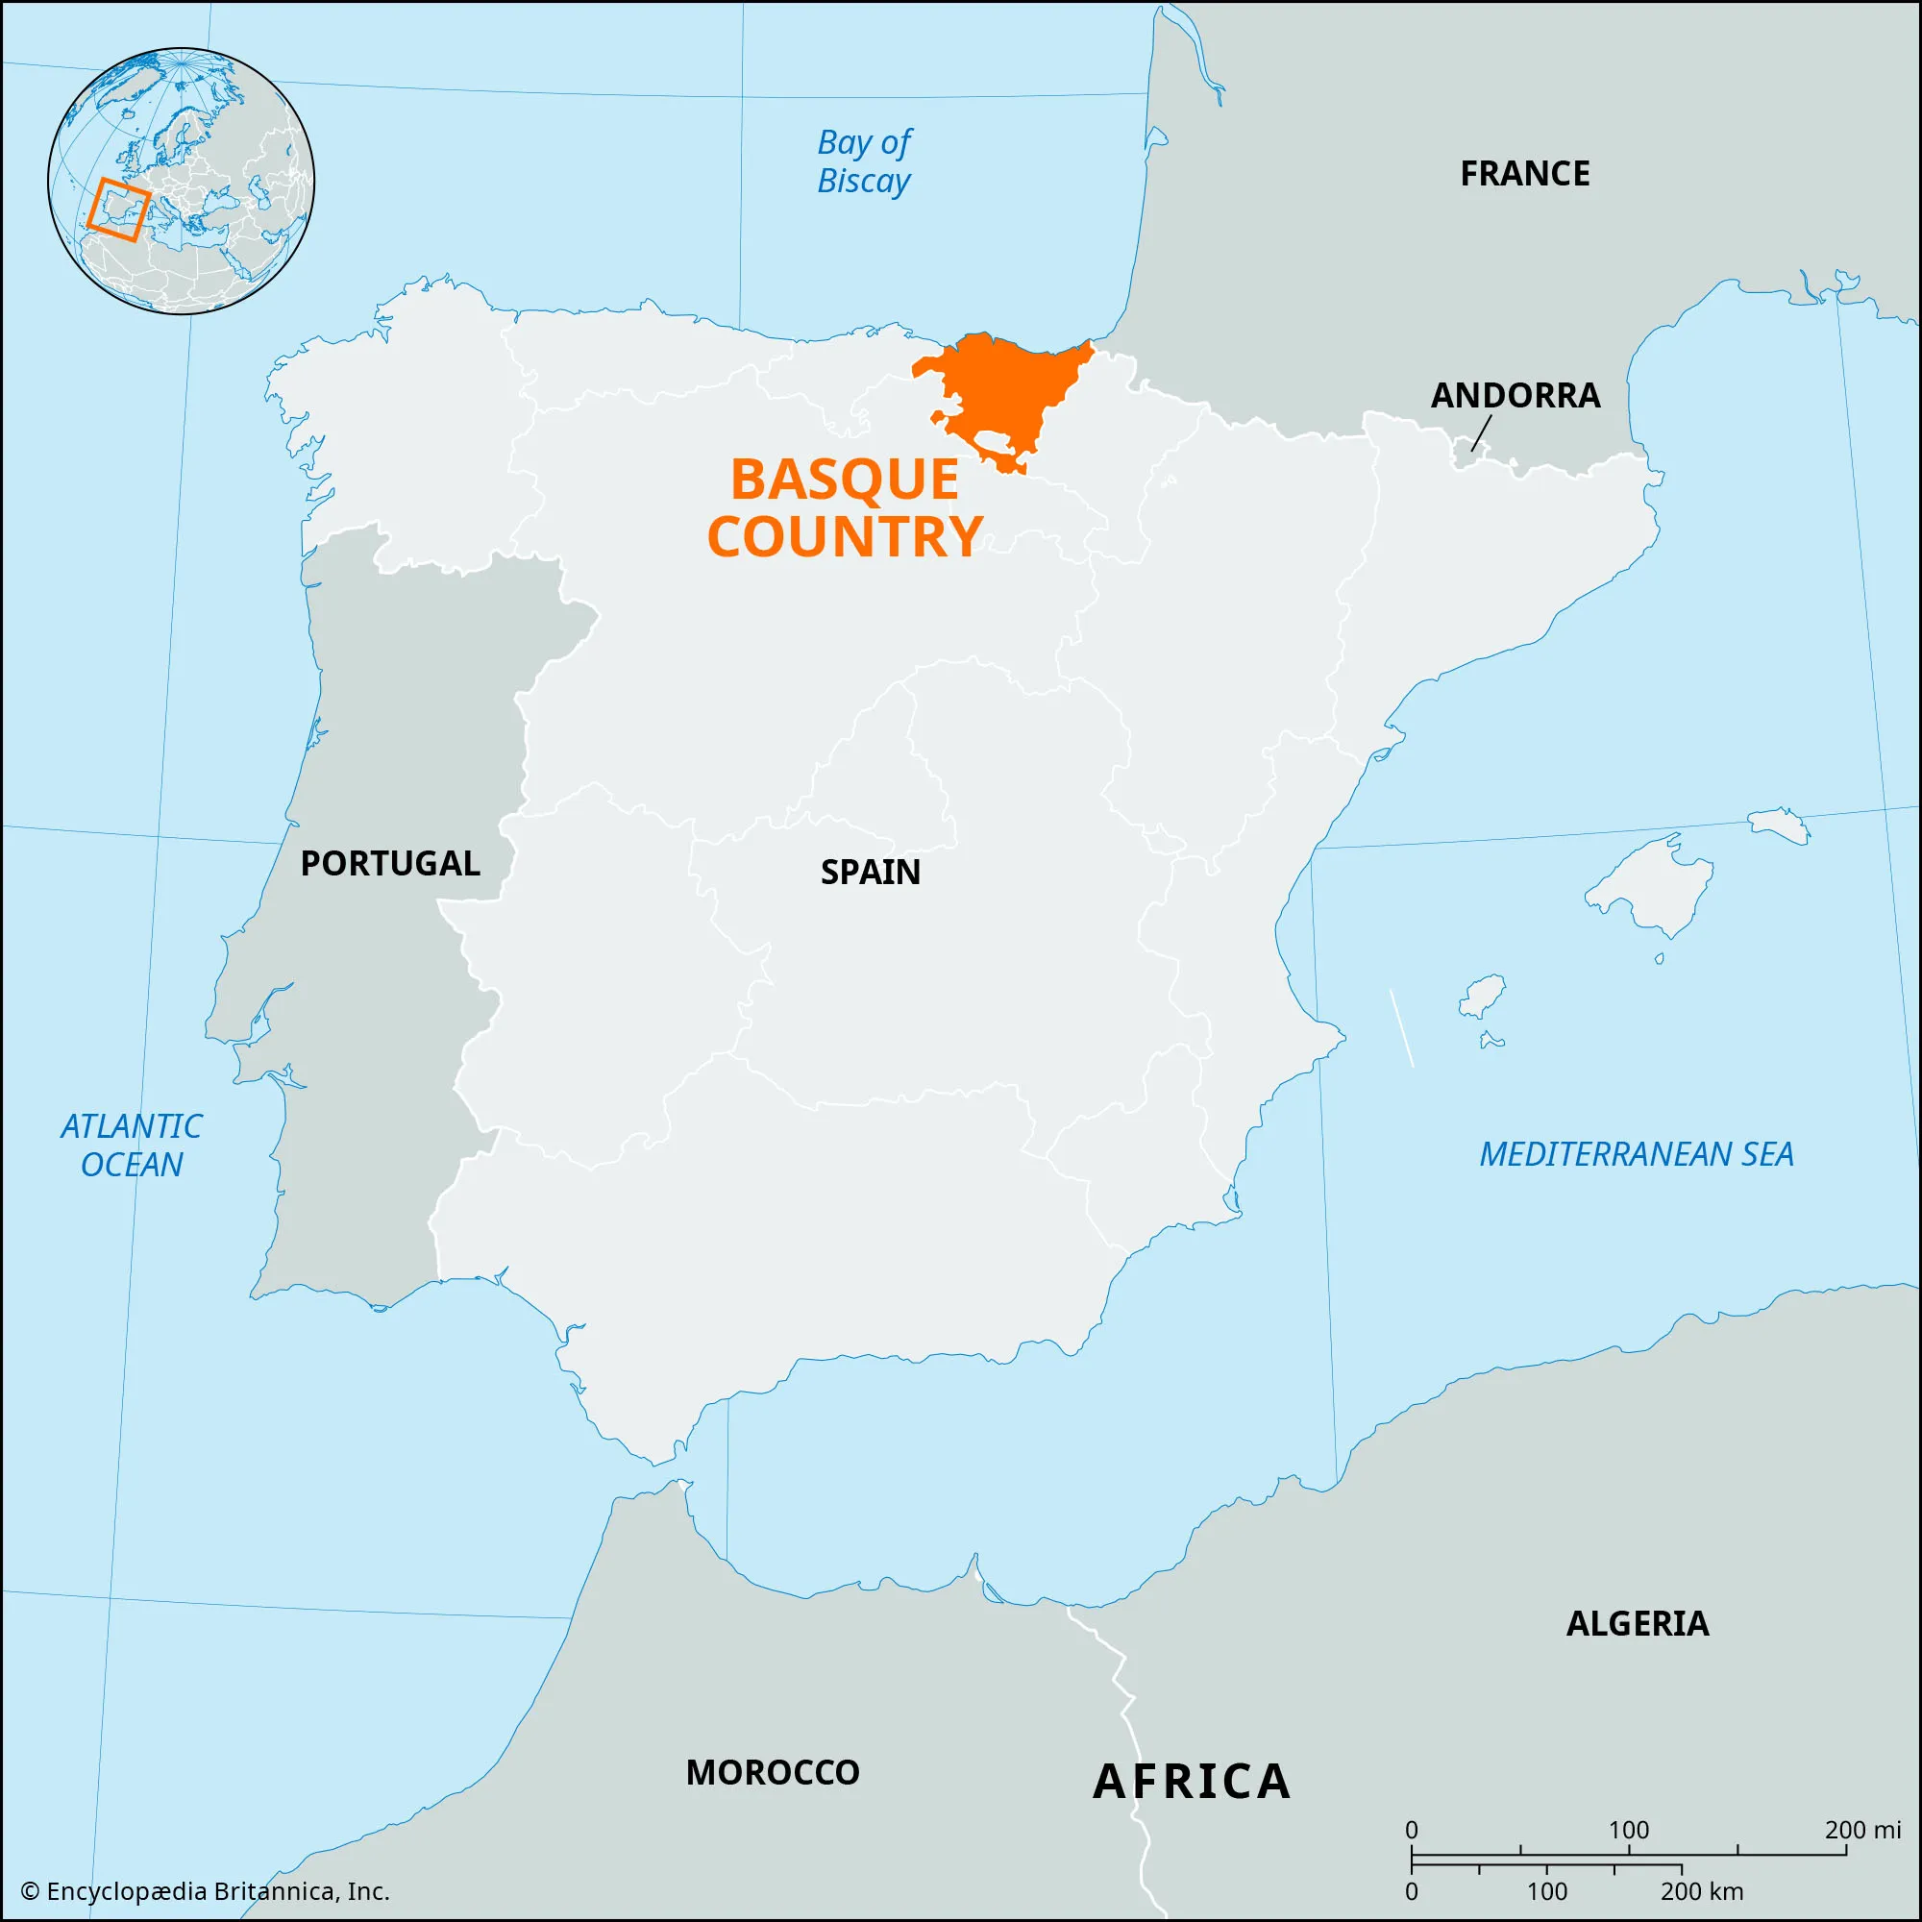

Slide 9
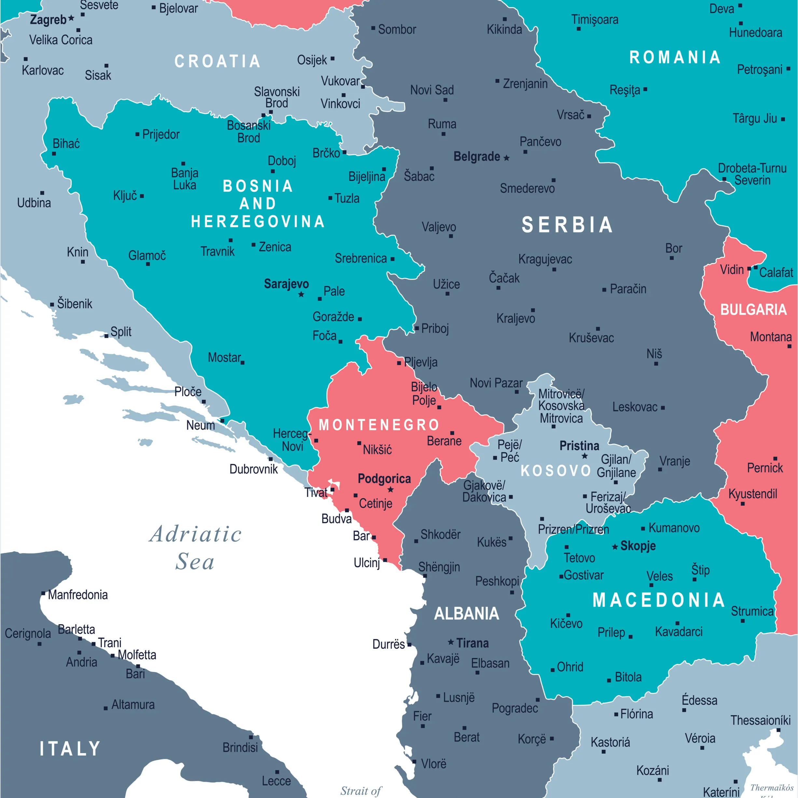

Slide 12
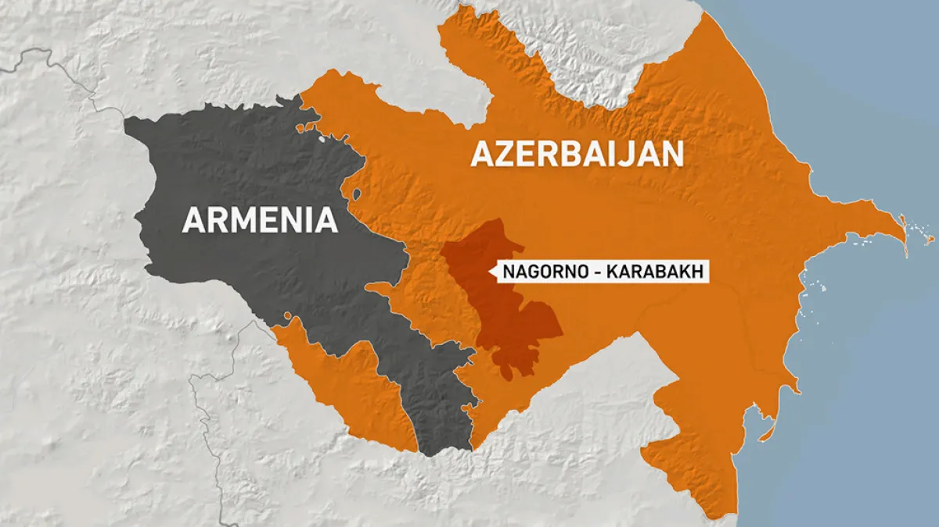
Nagorno-Karabach
Notes:
12

Slide 13


