Slide 1
Democratic regimes

Slide 2
Defining democracy
A very ancient notion
Too many criteria
Backsliding

Slide 3
The dichotomies of democracy
-Democracy of the ancients and democracy of the moderns
-Direct democracy and representative democracy
Empirical or real democracy and normative or ideal democracy
Substantive' democracy and “procedural” democracy

Slide 4
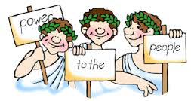
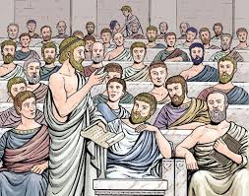
Greek democracy
-Citizens participate:
-Voting;
-Public debates;
-Policy-making
-Popular juries
-Public offices
-Direct democracy

Slide 5
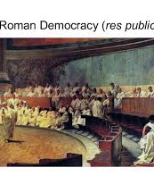
Roman democracy
-Equality in law enforcement
-Written laws
-Republic=representative democracy
Indirect democracy

Slide 6
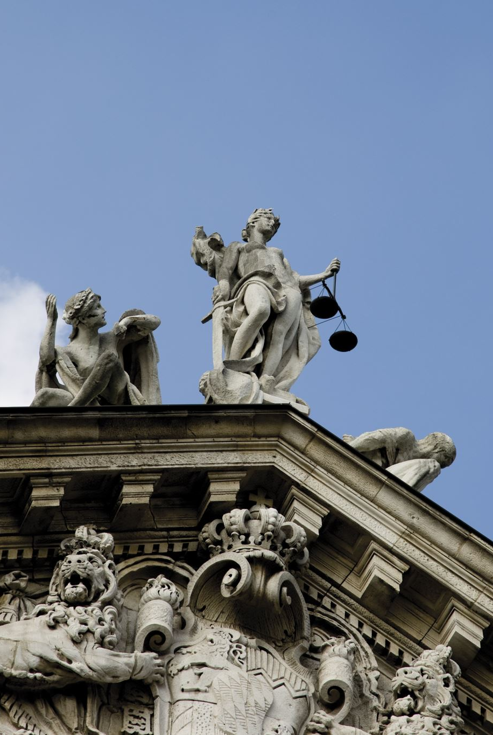
Democracy
-Institutions
-Representative institutions
-Separation of powers
-Function of the judiciary
-Civil and political rights
-Participation

Slide 7

Origin and spread of democracy
Form of social organization
Evolution and growth
Structural process of the system, long-term

Slide 8
Origin and spread of democracy
The democratic lineage
-Where democracy comes from and where it goes?
The quest for a“a nicer world”

Slide 9
Origin and spread of democracy
-Early experiments
Primitive democracies; core of principles;
Athens
-Strengthening and consolidation of the base
Renaissance; wars of religion; Industrial Revolution;
-Diffusion
From the 19th century the base spreads

Slide 10
Spread of democracy
-Horizontal spread (quantity of democracy)
-Vertical spread (quality of democracy)

Slide 11
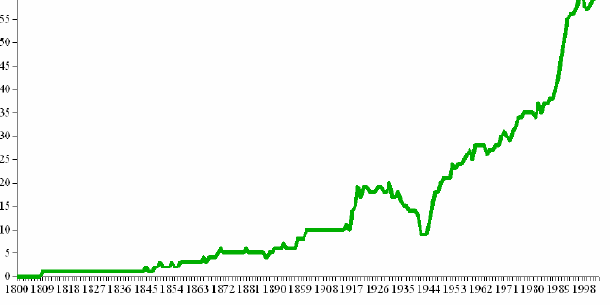

Slide 12
Socio-economic conditions favourable to democracy
-social pluralism
-widespread literacy
-economic development (Lipset 1959)
-absence of extreme economic inequalities
-civil society and middle classes
Notes:
12

Slide 13
Basic requirements
All regimes are democratic if they have at least:
-universal male and female suffrage;
-free, competitive, recurring and fair elections;
-inclusion of all political offices in the democratic process;
-autonomy of institutions and decision-making processes from any form of subjection to non-elective or external powers;
--party pluralism;
-freedom of expression, participation, association, dissent and opposition, and respect for personal rights;
-freedom and pluralism of information.

Slide 14
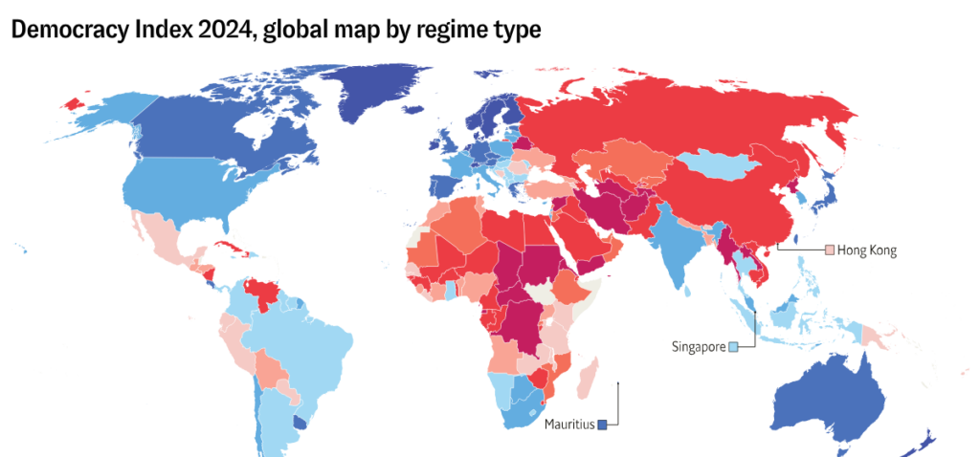

Slide 15
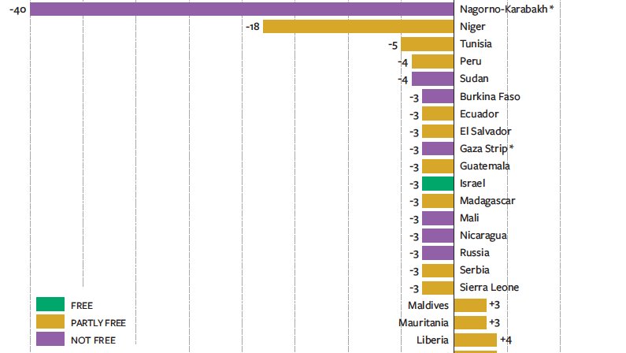

Slide 16
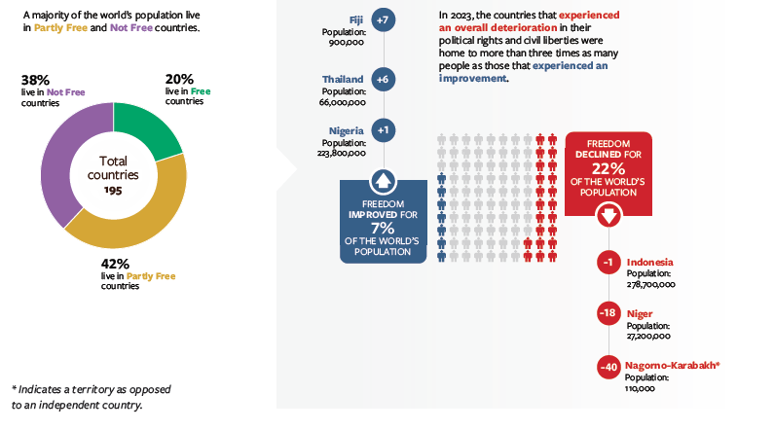

Slide 17
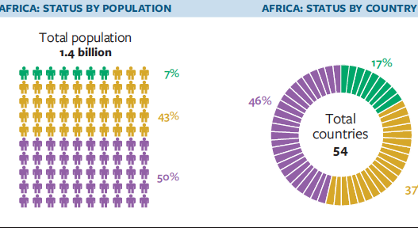

Slide 18
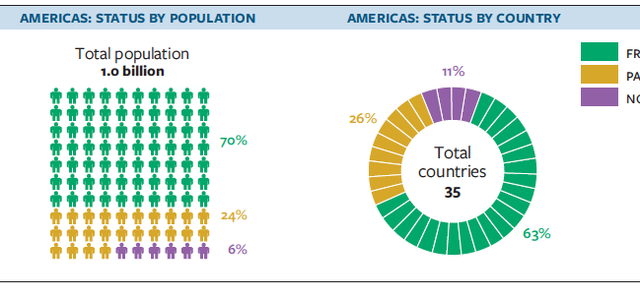

Slide 19
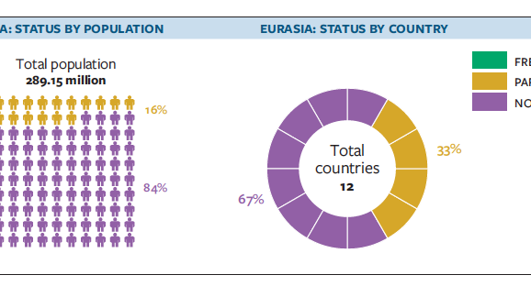

Slide 20
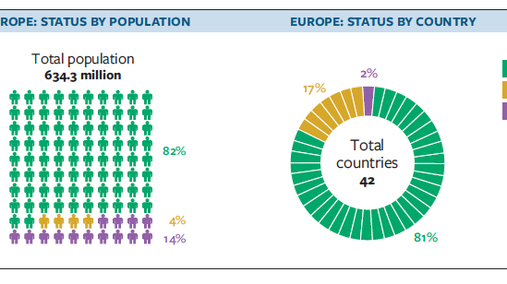

Slide 21


