Slide 1
How to Research

Slide 2


Slide 3
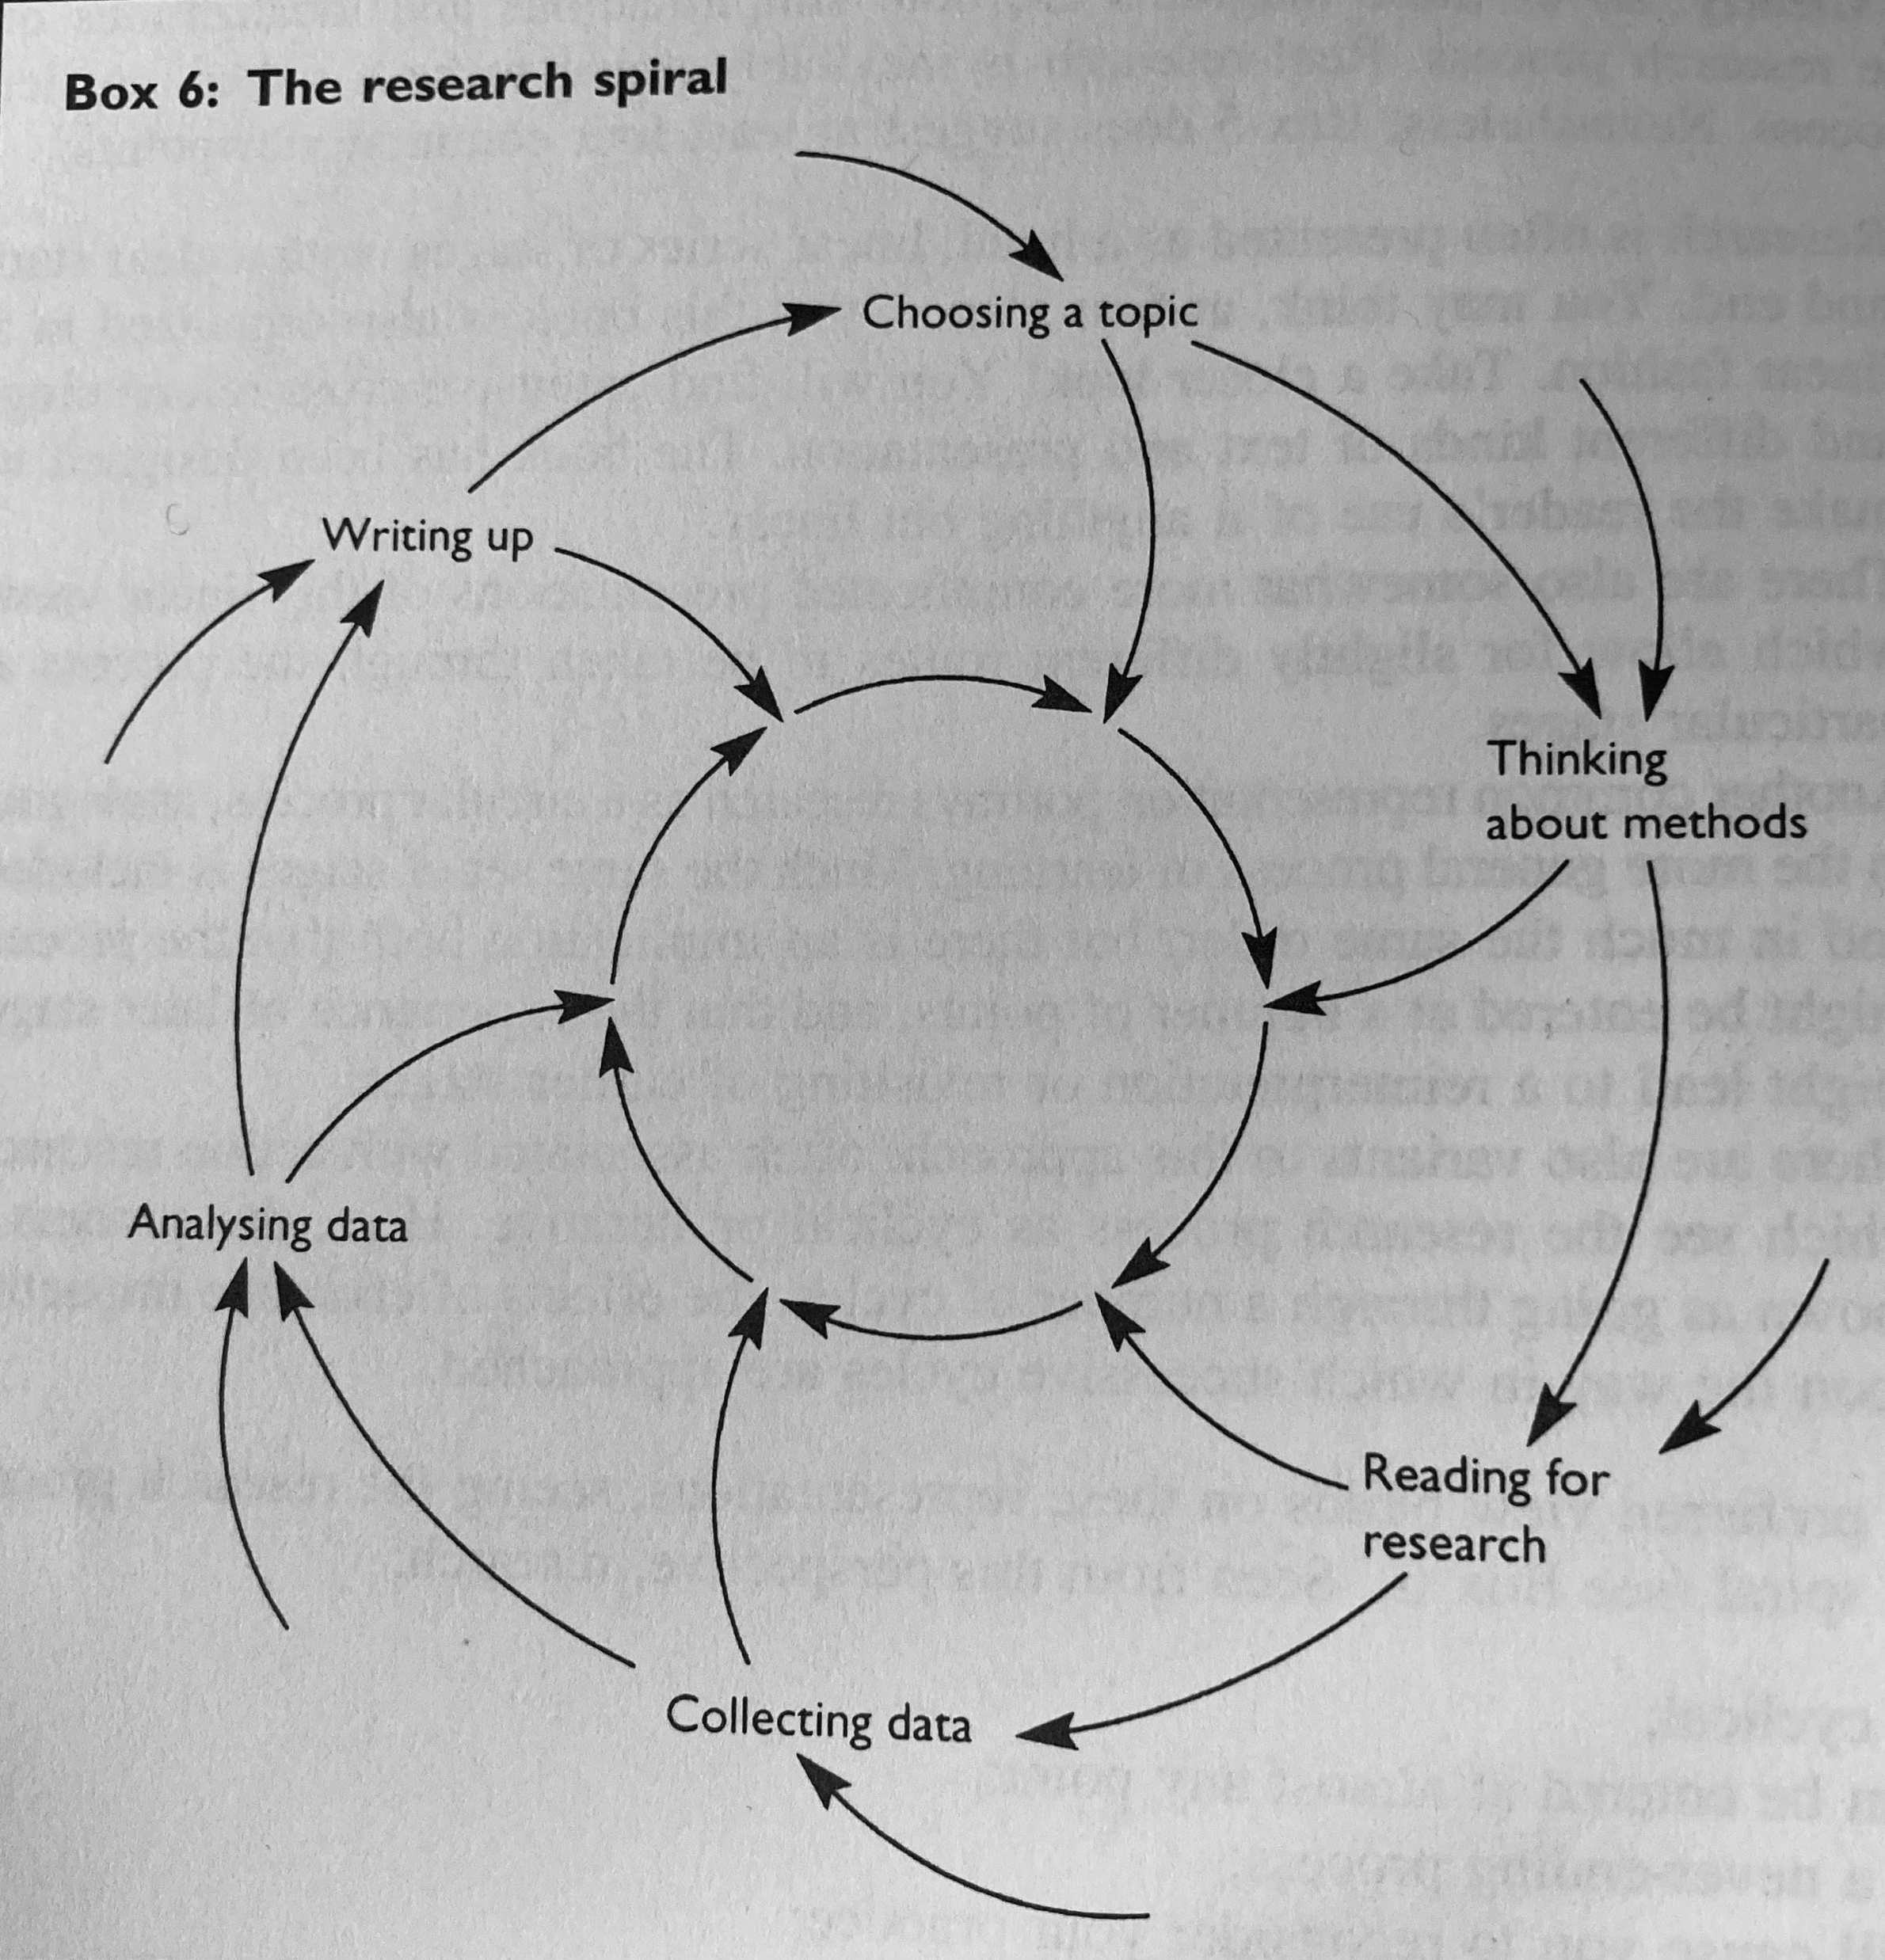

Slide 4
Key Issues for Group Research
Does the group need a leader?
Who is responsible for the different roles and tasks? All clear?
Who will ‘chase up’ progress?
Strengths and weaknesses of the group?
Is everyone happy with the plan?

Slide 5
Everyday life skills for research
Reading
Listening
Watching
Choosing
Questioning
Summarising
Organising
Writing
Reflecting
Presenting

Slide 6
Where you start –
Reading and Literature Review
Wha are the key theories, concepts and ideas?
What are the main questions and problems that have been addressed?
What are the approaches to the issues?
What are the origins and definitions of the topic?
What are the major issues and debates about the topic?

Slide 7
Research ‘Families’
Primary and Secondary Research
Fieldwork or Deskwork
Quantiative or Qualitative

Slide 8
Quantitative
Seeks the facts/causes of phenomena
Controlled measurement
Objective
Researcher removed from the data
Outsider perspective
Reliable, hard and replicable data
Generalisable

Slide 9
Qualitative
Concerned with understanding behaviour
Naturalistic and uncontrolled observation
Subjective
Close to the data – insider perspective
Valid – real, rich, deep data
Ungeneralisable – but lessons learned
Holistic

Slide 10
Research Approaches
Action research
Case studies
Experiments
Surveys

Slide 11
Research Techniques
Documents
Interviews
Observation
Questionnaires

Slide 12
Which method(s!) to choose?
Survey
Questionaire
Interviews
Focus Group
Other – experiment, observation…
Mixed methods…

Slide 13
Advantages of surveys
Designed so that individual interviews can be added together for a whole sample
Questions are designed to be unbiased
Surveys can be replicated in the future

Slide 14
Possible disadvantages of surveys
Data best in form of tables, pie charts and statistics becomes the main focus
Possible loss of linkage to wider theories
More of a snapshot in time than looking at underlying processs and changes.
Researcher cannot check for understanding
Relies on breadth rather than depth for its validity

Slide 15
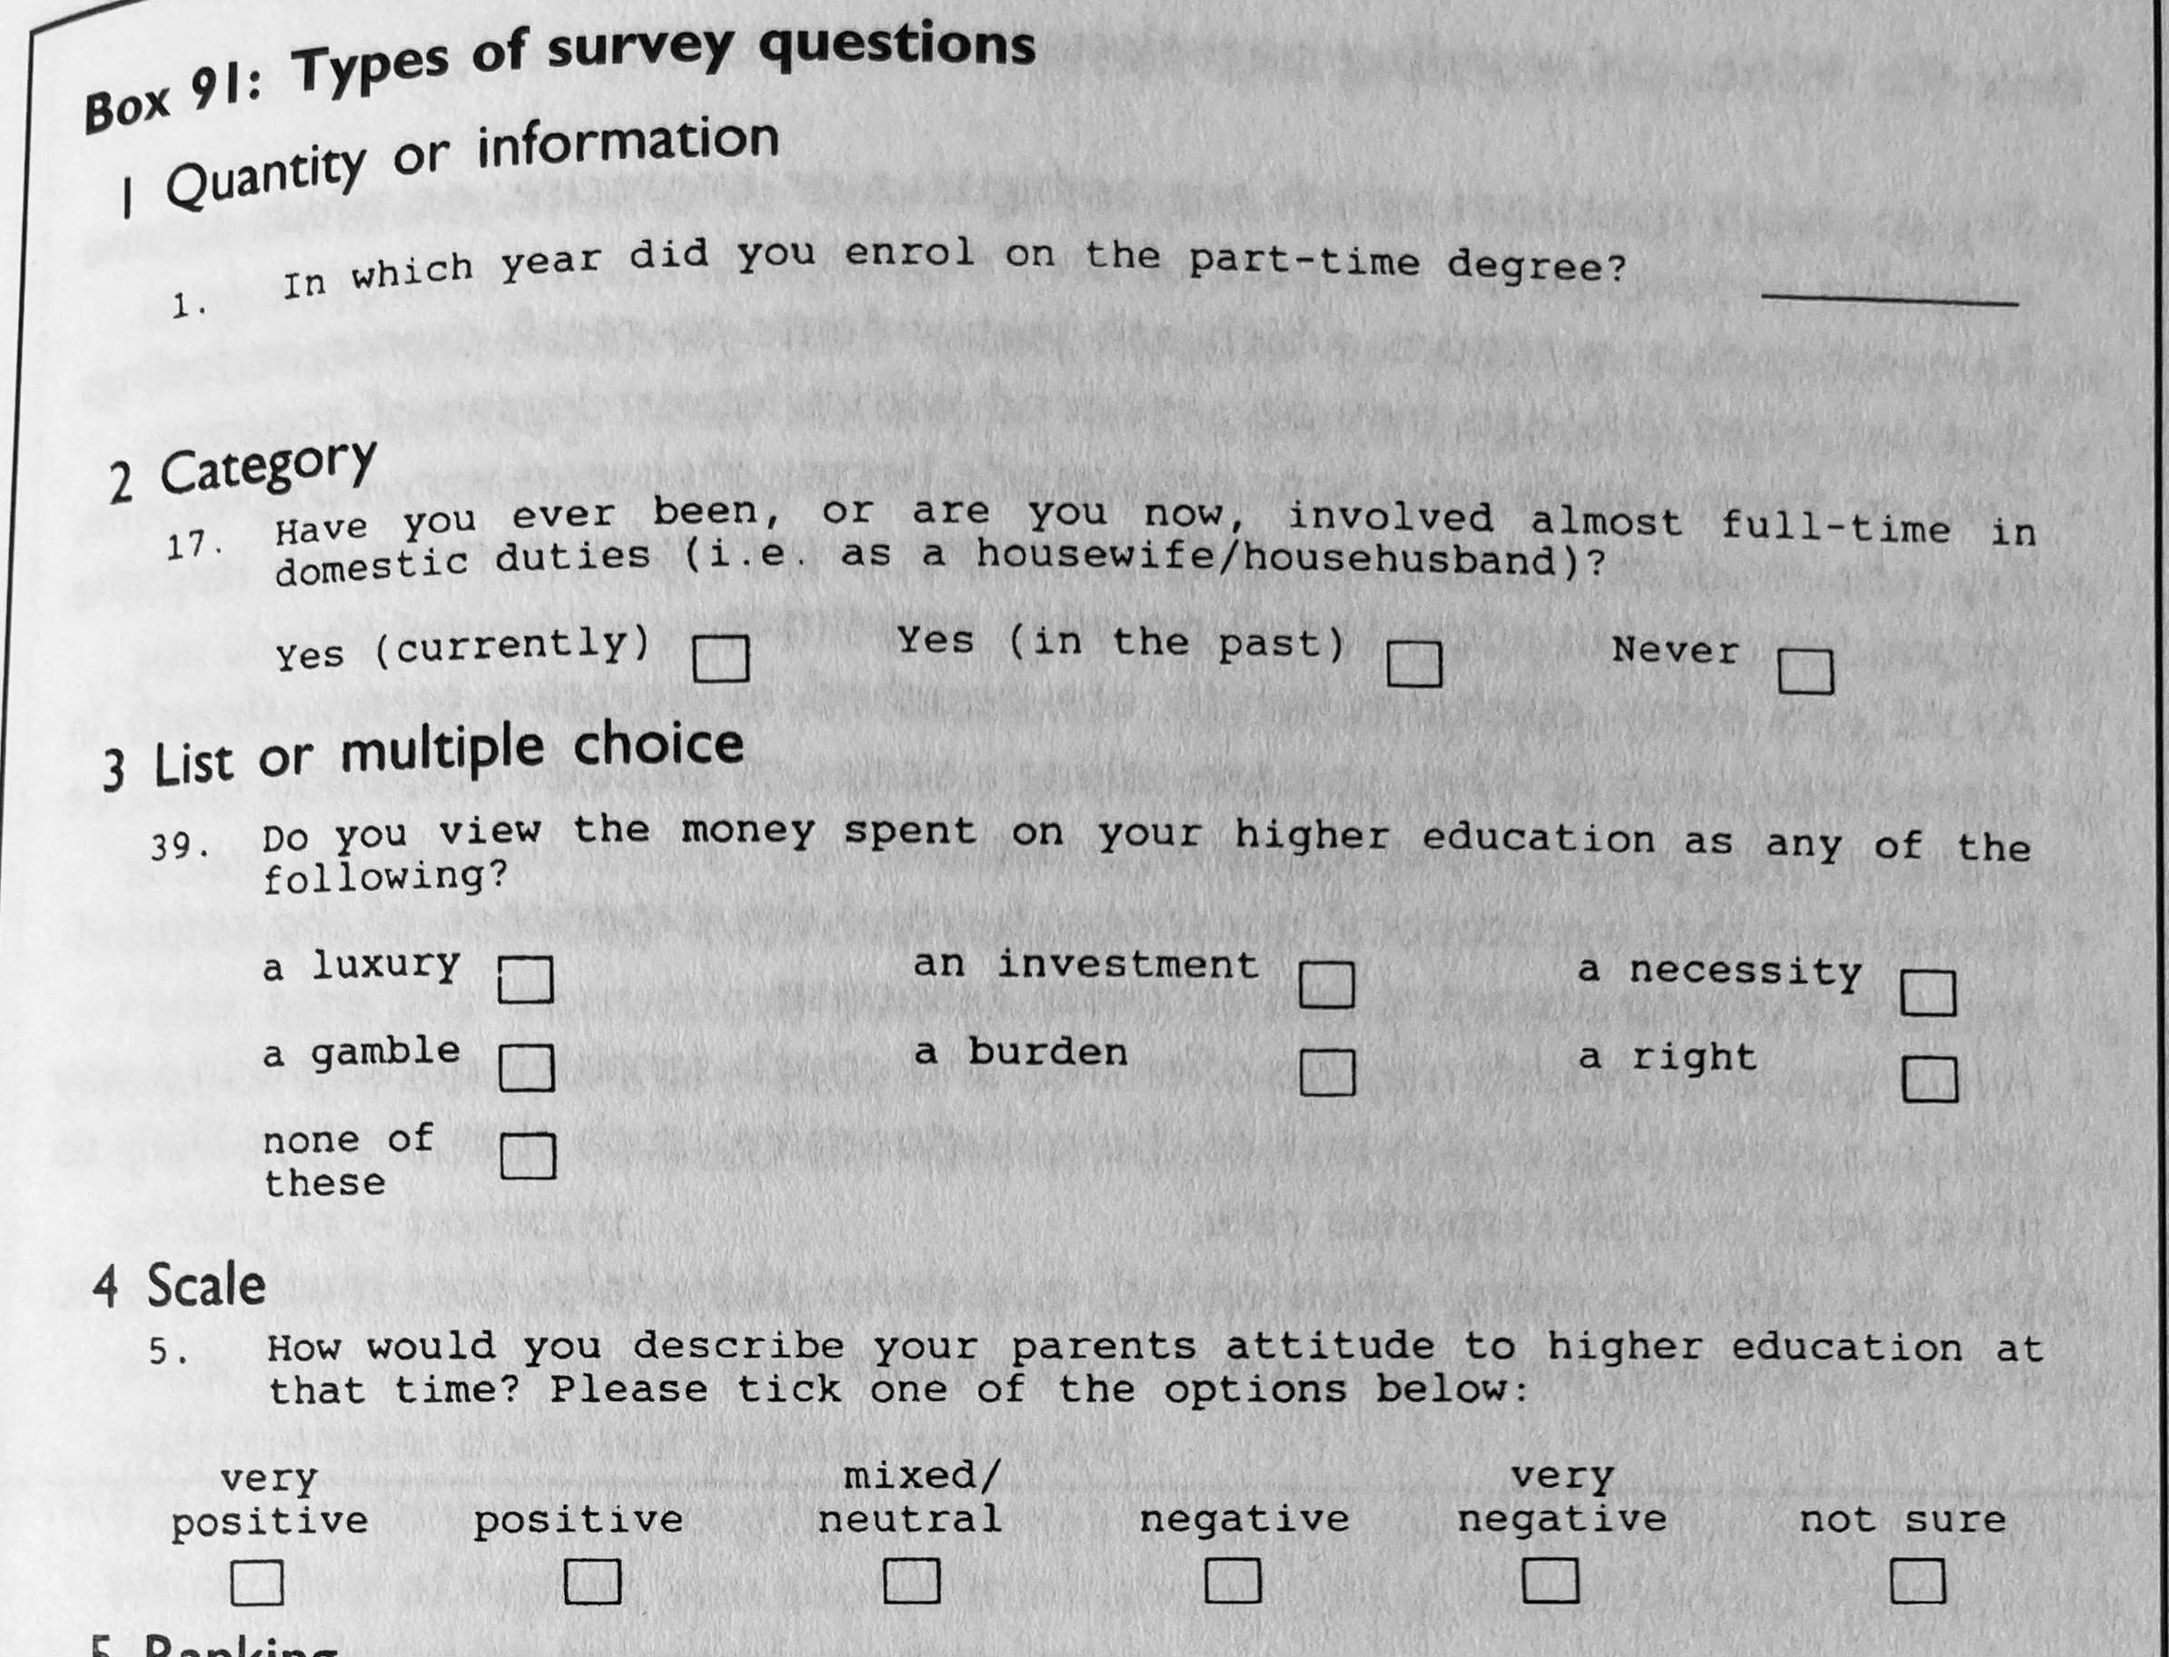

Slide 16
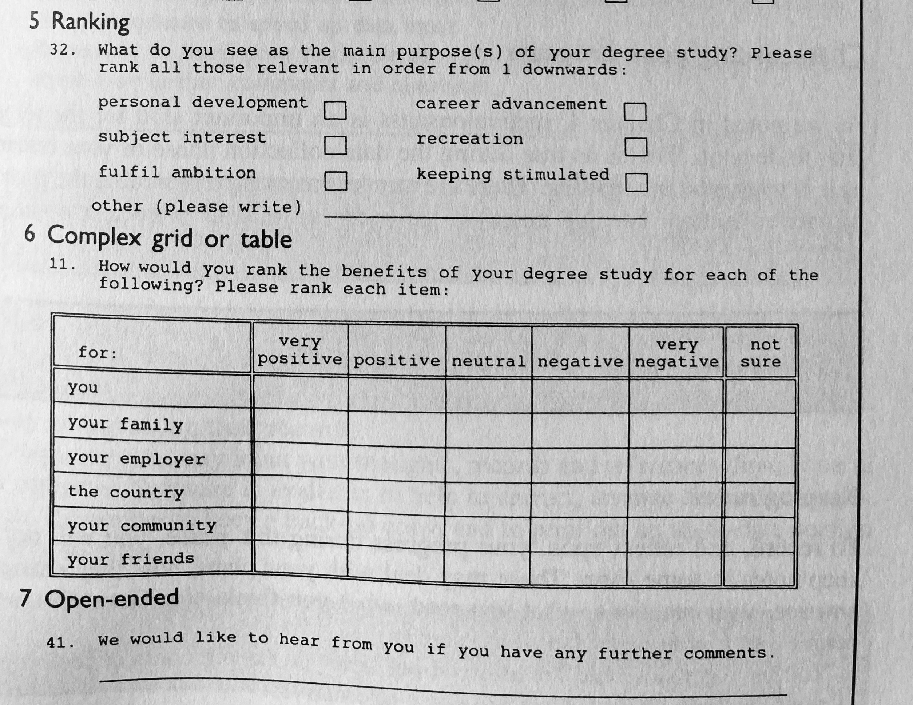

Slide 17
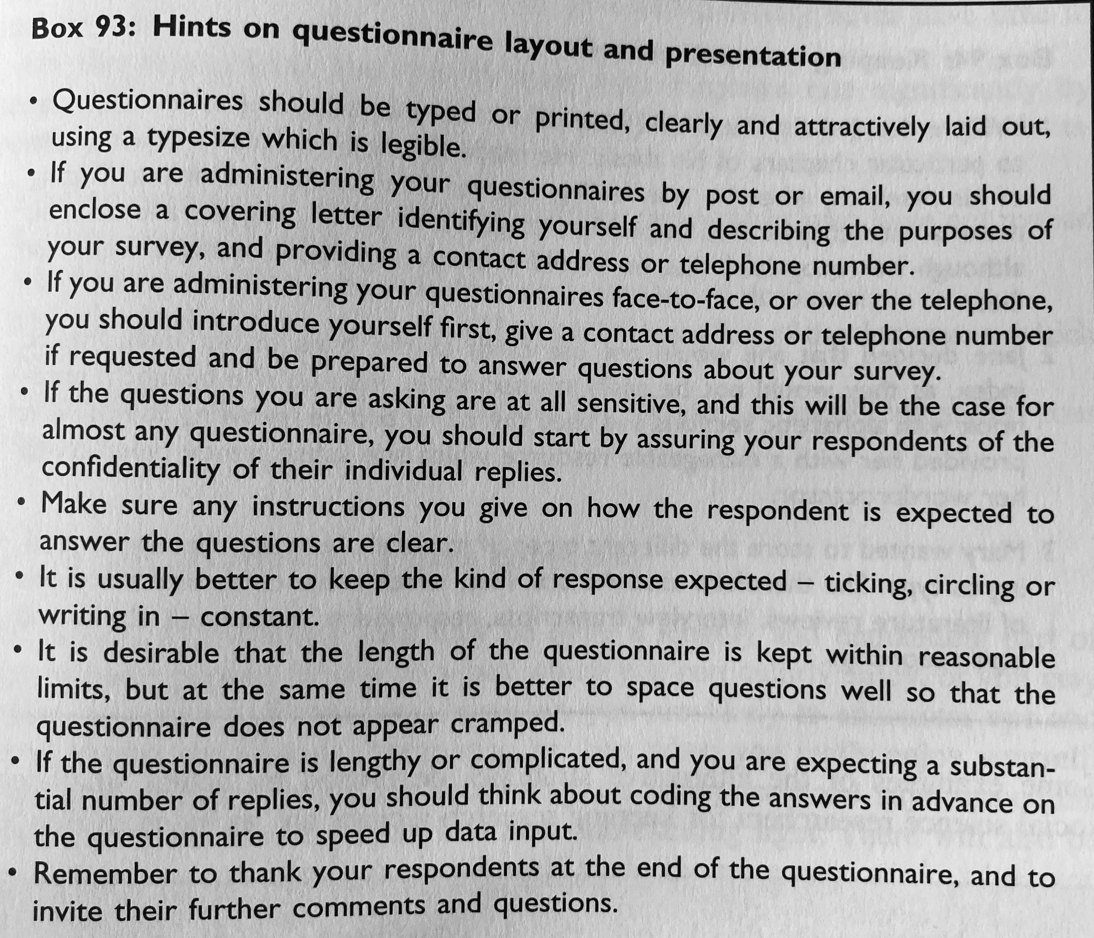

Slide 18
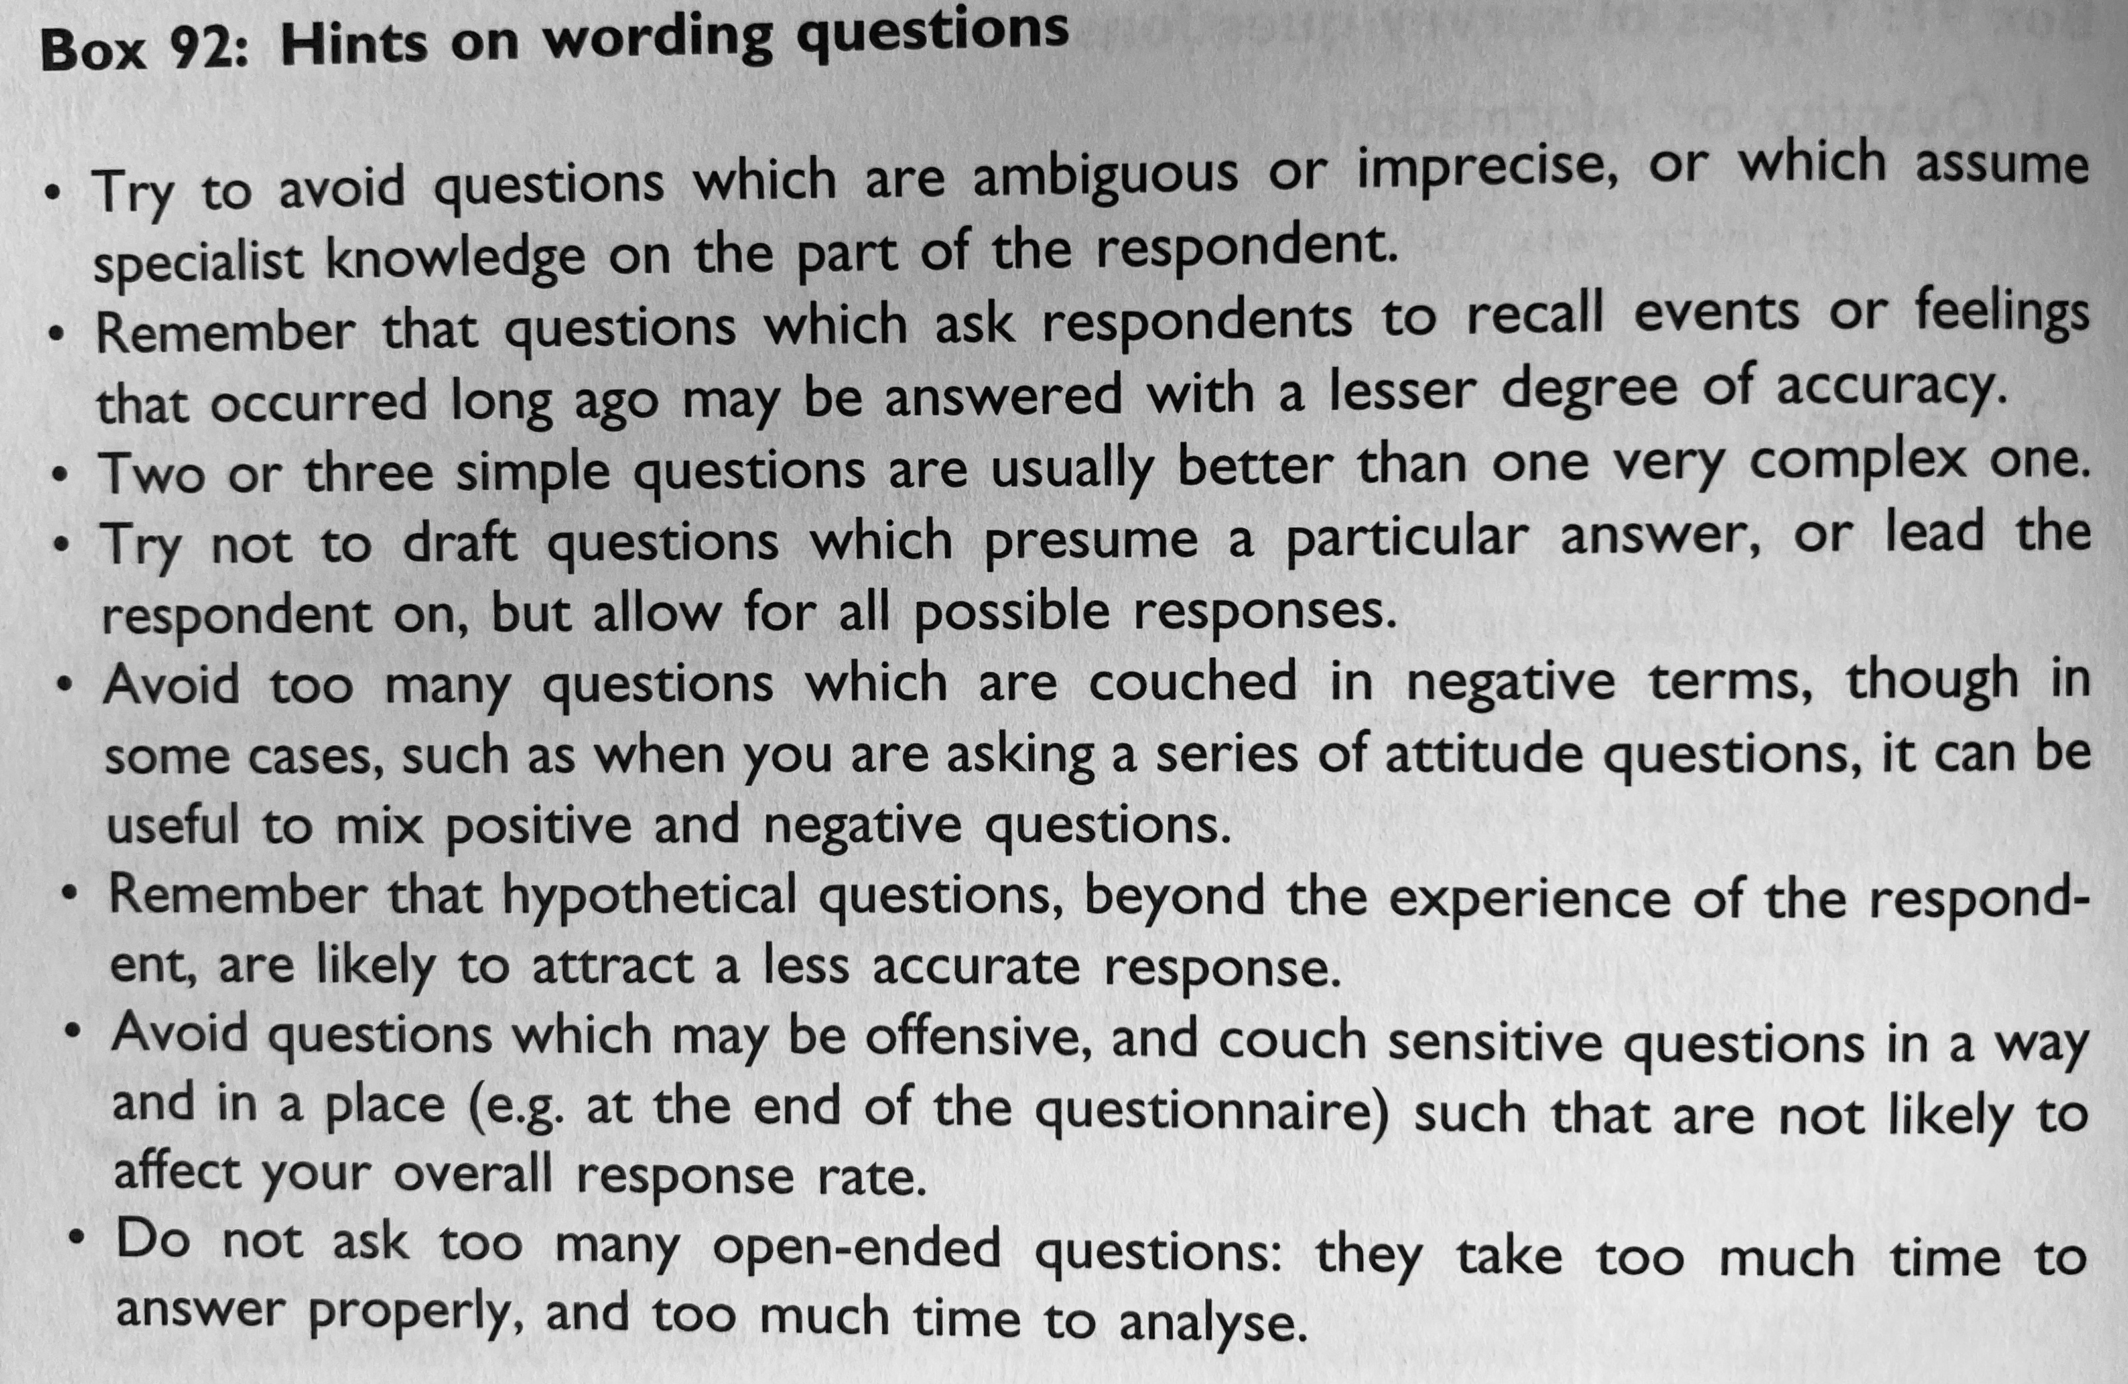

Slide 19
Interviewing
May take place face-to-face or at a distance, over the phone or by email
Take place at home, interviewer’s home, place or work, in the street or a chosen neutral place
Can be tightly structured with a set of questions (a questionnaire)
Or open-ended, like a discussion
Semi-structured interviews

Slide 20
Interviewing
Prompts can be used (like photographs) for stimulating a discussion
Can be just the interviewer and interviewee or more
Can be for courtroom, clinical questioning, criminal interrogation and journalistic interviewing… or the classroom.

Slide 21
Interviewing
Interviewee may be given advance notice or a briefing
May be recorded in a variety of ways – taped and transcribed, or take notes
Following up – transcription sent for comment, further questions, reaction to other interviewees…

Slide 22
How to ask sensitive questions?
Their age
Their ethnic group
Their marital status
Their sexuality
Their income
Their social class
Their education level
Personal details

Slide 23
Sampling
Simple random sampling, systematic sampling, stratified sampling, cluster and stage sampling. Convenience, voluntary, quota, purposive, dimensional, snowball sampling. Event sampling and time sampling….

Slide 24
Common Ethical Issues
Professionalism
Legality
Confidentiality
Anonymity

Slide 25
To consider in report and findings:
Significance
Generalisability
Reliability
Validity

Slide 26
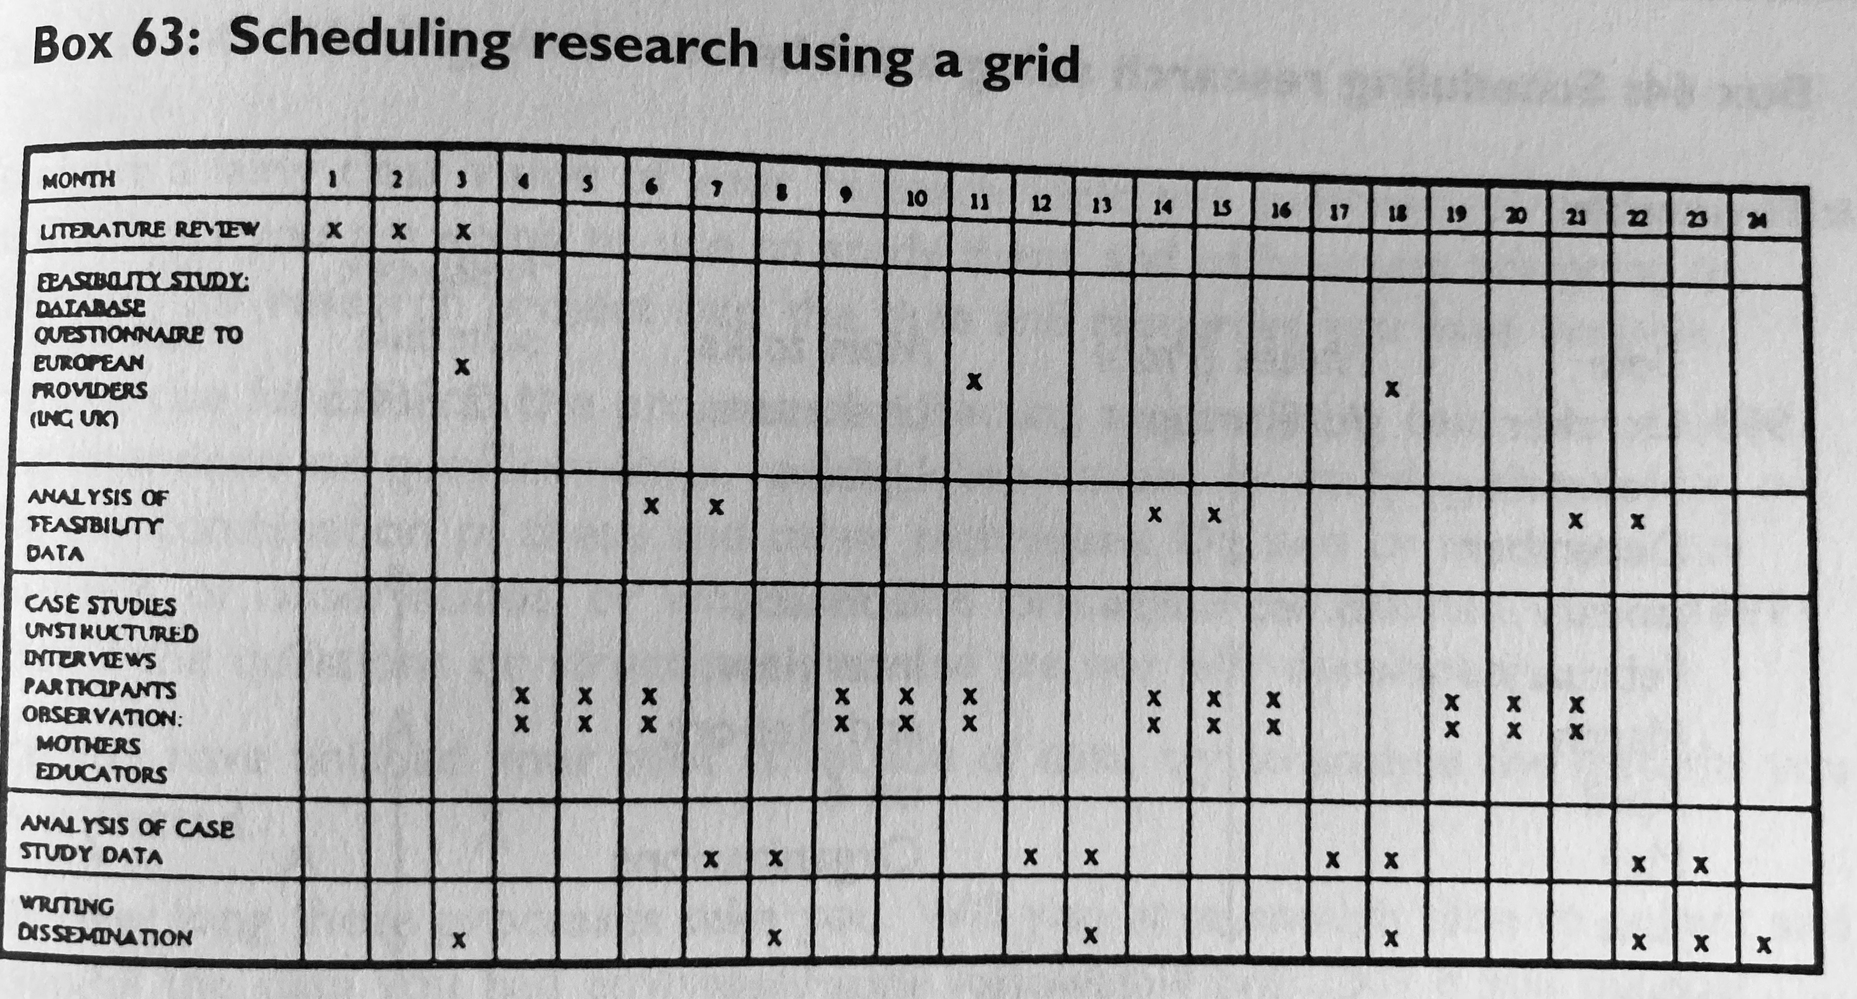

Slide 27


