Slide 1

Human Resource Management Strategy in Family Business
Prof. Giulia Flamini

Slide 2
Interpersonal relationships and conflict in the family firm: managing conflicts
Lecture 13

Slide 3
Agenda
Why family firms are fertile contexts for conflict
Types of conflict
Conflict dynamics
Conflict-management styles
Communication strategies
How to behave in the face of conflict

Slide 4
Why family firms are fertile contexts for conflict
Intertwinement of multiple systems with conflicting logics
Absent or blurred context markers (same people occupy multiple roles)
Spillover effects from one system too another of interpersonal dynamics
Unforeseen types of conflict (sibling rivalry, children’s desires to differentiate themselves from their parents, marital discord and identity conflict)
People with high levels of informal power
Insider information
Sustained conflict over time and across domains
High exit costs: except in the case of spousal couples, it is virtually impossible to leave one’s family

Slide 5
Types of conflict
Relationship conflict
  Interpersonal incompatibilities among individuals. It reflects personality differences as well as differences of opinion and preferences regarding non-task issues. It is a dysfunctional form of conflict that includes affective components, such as annoyance, frustration, personal animosity, incompatibility and irritation with others ➔ time spent on interpersonal aspects rather than on technical and decision-making tasks
Task conflict
  Disagreements among group members about the task being performed, including differences in viewpoints, ideas and opinions ➔ diverging views about appropriate behaviors and strategies with regard to the firm➔ facilitates the critical evaluation of issues, and ensures that superior alternatives are not overlooked and creative solutions are considered
While relationship conflicts can unfold in particularly destructive ways in family firms and have no apparent positive effect, task conflicts are an important and valuable part of family firm conduct
What may start as a constructive task conflict may turn into personal animosity and, finally, a heated relationship conflict
Relationship conflict may thus impede the positive effects of moderate levels of task conflict on firm performance

Slide 6
Conflict dynamics
Conflicts have a topic and happen within relationships
The topic is not always clear ➔ distinguish between topic and people
After the topic is delineated, debates are less likely to escalate
In addition to the issue and relationships, conflicts have a third critical dimension: time

Slide 7
The role of time in conflicts
Conflicts always take place in the present, but they normally deal with the past or the future
People fight about the temporal order of events because their understanding of the past allows them to legitimize their present behavior
As people tend to remember the past very selectively and as the subjectively memorized past is important for people’s perceptions about fair behavior today, discussions about the past are often not useful for resolving conflicts or deriving solid plans for the future
If discussions about the past take place, they should occur without time pressure, as they could be abused and may lead to biased decisions related to the future

Slide 8
Conflict and the lifecycle of the firm
In the founding phase ➔ task conflicts on feasibility of the venture, raising of capital and willingness of family members to invest capital
In the growth phase ➔ task conflicts on mobilization of resources, who on to hire, which technology to adopt, which machinery to buy and where to establish the firm ➔ demands from work may interfere with demands from the family and vice versa ➔ feelings of stress and guilt because both the demands are not satisfied at the same time
After a firm is established ➔ task conflicts on professionalization, delegation of authority and efficiency ➔ relationship conflicts on cooperation within the top management team
In the maturity stage ➔ task conflicts on rejuvenation and continued innovation ➔ From a family business perspective, succession takes stage, giving rise to questions about who should take over the business, when, in what role(s), and under what conditions ➔ relationship conflicts on involvement of the next generation

Slide 9
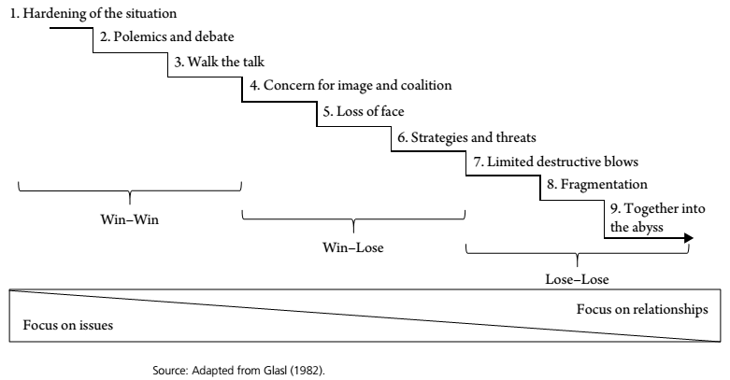
Conflict escalation
Nine steps of conflict escalation from the hardening of the situation at the outset to a status in which both parties seek mutual destruction
In the early stages, the parties are able and willing to end the process in a way that will enable them both to exit the conflict with their heads held high ➔ win-win outcome is possible
In later stages, the conflict becomes more heated and confrontational, the parties come to understand that only one of them can exit the dispute as a winner. Relational issues interfere with task-related issues, which undermines the potential benefits of task-related discussions

Slide 10
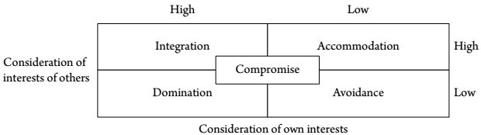
Conflict-management styles
Integration: conflicting parties try to integrate their mutual interests in order to achieve a solution in which everyone wins
Accommodation: managing conflicts in cooperative ways. It is based on concern for others than oneself, and may even include a willingness to neglect personal desires
Compromise: forging a compromise requires assertiveness and cooperativeness ➔ considering one’s own interest as well as those of others, so that no one can be viewed as a winner or loser
Domination: assertive and uncooperative conflict-management style ➔ unlikely to build relationships, accommodate varied interests or lead to positive family outcomes
Avoidance: lack of interest in one’s own position or those of others ➔ failure to address a conflict. Individuals may deny that conflicts exist or simply avoid discussing them

Slide 11
Which conflict-management style is best in the family business context?
Integration offers the highest likelihood of lasting, positive effects for both the family and the business
Accommodation and compromise are highly correlated with positive family outcomes, but they lead to performance shortfalls ➔ Businesses with negative business/positive family outcomes seem to place a premium on resolving conflict and maintaining family relationships. They appear to accept poorer performance in exchange for family functioning
The worst outcomes for business and family are found for the avoidance strategy
Families in business view the use of a mediator as taboo for privacy reasons, or because engaging a mediator signals an inability to solve a problem on one’s own

Slide 12
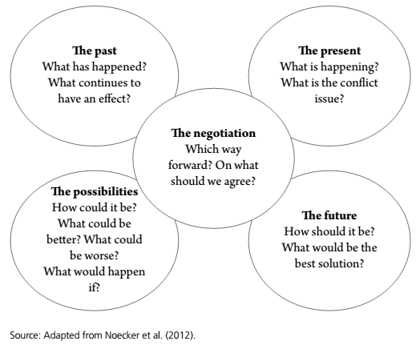
Communication strategies
Not all conflict is destructive
One way of taking into account the effect of time in the face of conflict is to segregate discussions based on whether they deal with the past, the present or the future
Locate conflict communication in five different rooms

Slide 13
Principles of constructive and destructive communication
Constructive communication:
Everyone gets about the same time to speak
Listen
Saying nothing equals agreement
Right to take a break
Speak nondefensively
Validate
Overlearn
Destructive communication:
Criticism
Defensiveness
Contempt
Stonewalling

Slide 14
How to behave in the face of conflict
Slow down
Gentle in manner, firm in action
Try to ensure a gain for your opponent in an aspect that matters to that opponent
Think about the worst-case scenario before you act
Take the risk of attributing positive motives to your opponent and be prepared to be disappointed
A third (external) party is most useful when the escalation of the conflict is costly for the parties
If you are the third party in a conflict and you are equipped with authority over the other parties, set clear limits to the conflict
If you are the third party in a conflict and you are not equipped with authority over the other parties (e.g. you are brought in as an advisor), stay neutral and hand responsibility for resolving the conflict over to the opponents
You may have a solution in mind
Look for the acceptable solution
Watch out when things start moving

