Slide 1
INTRODUCTION TO
ARTIFICIAL NEURAL NETWORKS
(ANN)
Mohammed Shbier

Slide 2
Outline
Definition, why and how are neural networks being used in solving problems
Human biological neuron
Artificial Neuron
Applications of ANN
Comparison of ANN vs conventional AI methods

Slide 3
The idea of ANNs..?
NNs learn relationship between cause and effect or organize large volumes of data into orderly and informative patterns.
It’s a frog
frog
lion
bird
What is that?

Slide 4
Neural networks to the rescue…
Neural network: information processing paradigm inspired by biological nervous systems, such as our brain
Structure: large number of highly interconnected processing elements (neurons) working together
Like people, they learn from experience (by example)

Slide 5
What are Neural Networks?
Models of the brain and nervous system
Highly parallel
  Process information much more like the brain than a serial computer
Learning
Very simple principles
Very complex behaviours
Applications
  As powerful problem solvers
  As biological models

Slide 6
Biological Neural Nets
Pigeons as art experts (Watanabe et al. 1995)
  Experiment:
    Pigeon in Skinner box
    Present paintings of two different artists (e.g. Chagall / Van Gogh)
    Reward for pecking when presented a particular artist (e.g. Van Gogh)

Slide 7
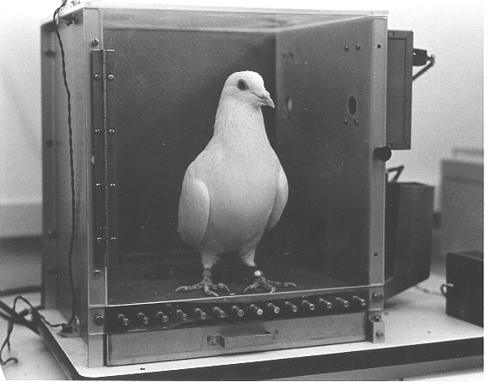

Slide 8
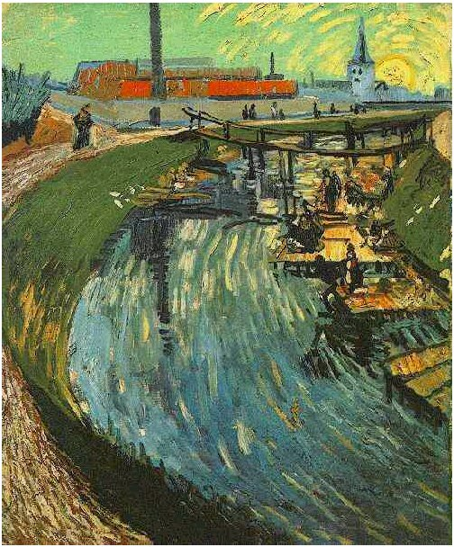
Notes:
Canal with Women Washing, 1888

Slide 9
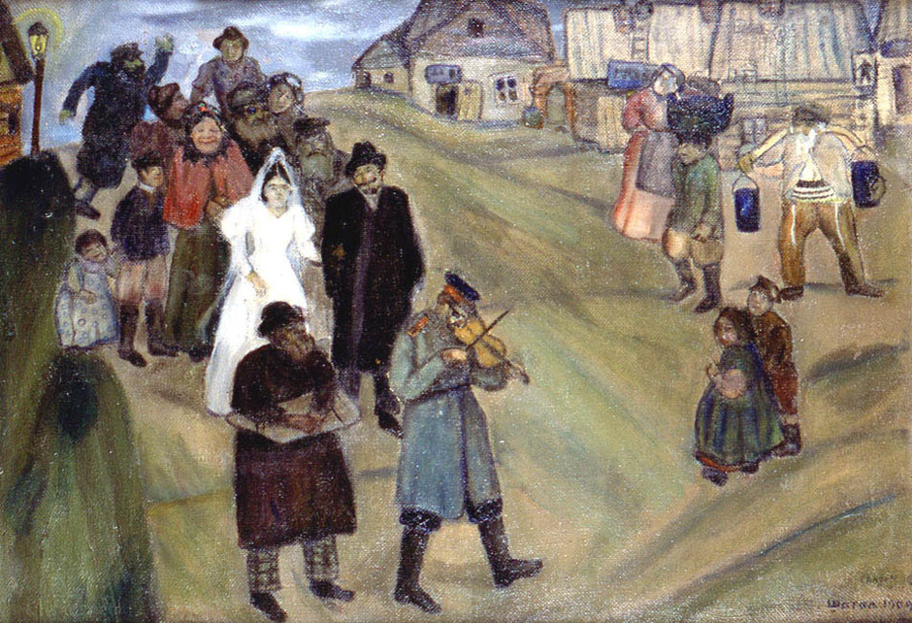

Slide 10
Pigeons were able to discriminate between Van Gogh and Chagall with 95% accuracy (when presented with pictures they had been trained on)
Discrimination still 85% successful for previously unseen paintings of the artists
Pigeons do not simply memorise the pictures
They can extract and recognise patterns (the ‘style’)
They generalise from the already seen to make predictions
This is what neural networks (biological and artificial) are good at (unlike conventional computer)

Slide 11
Definition of ANN
“Data processing system consisting of a large number of simple, highly interconnected processing elements (artificial neurons) in an architecture inspired by the structure of the cerebral cortex of the brain”
(Tsoukalas & Uhrig, 1997).

Slide 12
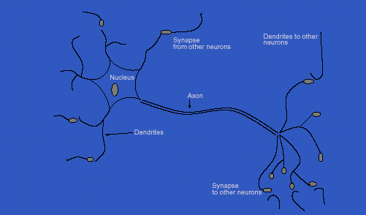
Inspiration from Neurobiology
Human Biological Neuron

Slide 13
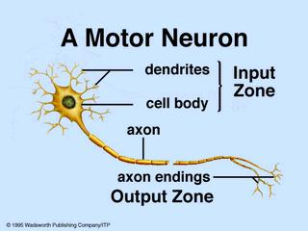
Biological Neural Networks
A biological neuron has three types of main components; dendrites, soma (or cell body) and axon.
Dendrites receives signals from other neurons.
The soma, sums the incoming signals. When sufficient input is received, the cell fires; that is it transmit a signal over its axon to other cells.

Slide 14
Artificial Neurons
ANN is an information processing system that has certain performance characteristics in common with biological nets.
Several key features of the processing elements of ANN are suggested by the properties of biological neurons:
  The processing element receives many signals.
  Signals may be modified by a weight at the receiving synapse.
  The processing element sums the weighted inputs.
  Under appropriate circumstances (sufficient input), the neuron transmits a single output.
  The output from a particular neuron may go to many other neurons.

Slide 15
Artificial Neurons
ANNs have been developed as generalizations of mathematical models of neural biology, based on the assumptions that:
  Information processing occurs at many simple elements called neurons.
  Signals are passed between neurons over connection links.
  Each connection link has an associated weight, which, in typical neural net, multiplies the signal transmitted.
  Each neuron applies an activation function to its net input to determine its output signal.

Slide 16
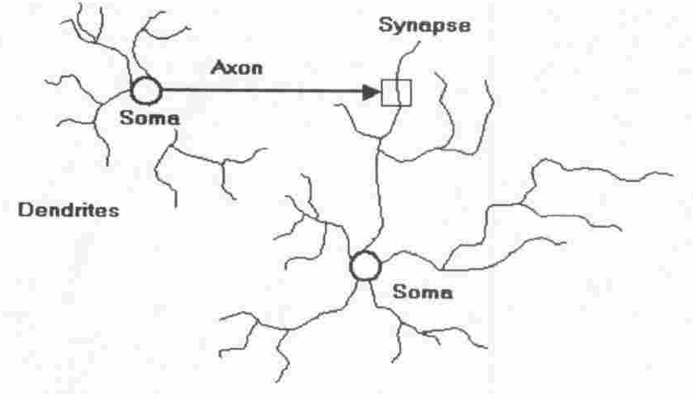
Artificial Neuron
Four basic components of a human biological neuron
The components of a basic artificial neuron

Slide 17
Model Of A Neuron
W_{a}
X₁
μ
W_{b}
f(μ)
Y
X₂
W_{c}
X₃
Input units
Connection weights
Summing function
computation
(dendrite)
(synapse)
(axon)
(soma)

Slide 18
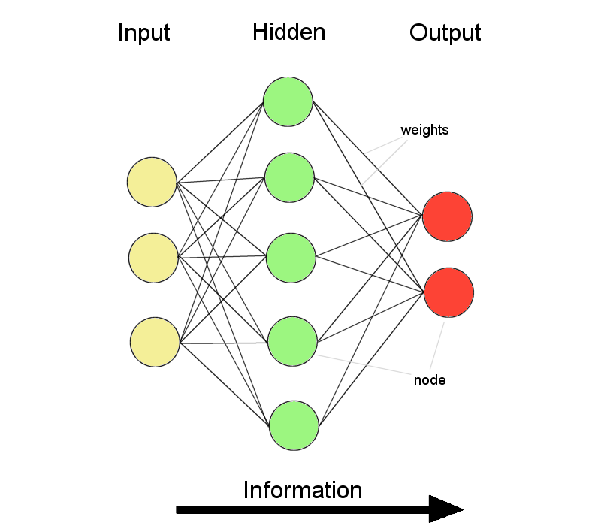
AGAIN….
REPETITA JUVANT….
BY THE WAY….

Slide 19
ANNs – The basics
ANNs incorporate the two fundamental components of biological neural nets:
Neurones (nodes)
Synapses (weights)

Slide 20
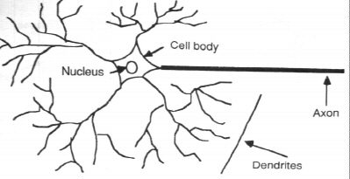
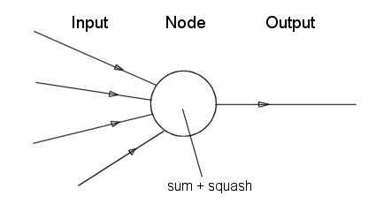
Neurone vs. Node

Slide 21
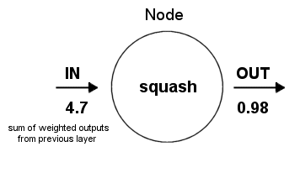
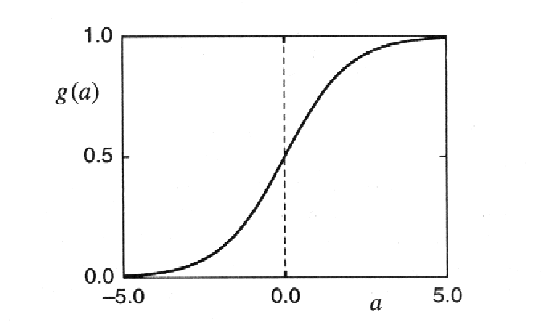
Structure of a node:
Squashing function limits node output:

Slide 22
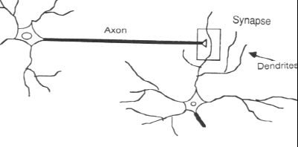
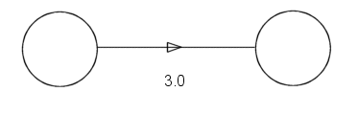
Synapse vs. weight

Slide 23
A neural net consists of a large number of simple processing elements called neurons, units, cells or nodes.
Each neuron is connected to other neurons by means of directed communication links, each with associated weight.
The weight represent information being used by the net to solve a problem.

Slide 24
Each neuron has an internal state, called its activation or activity level, which is a function of the inputs it has received. Typically, a neuron sends its activation as a signal to several other neurons.
It is important to note that a neuron can send only one signal at a time, although that signal is broadcast to several other neurons.

Slide 25
Neural networks are configured for a specific application, such as pattern recognition or data classification, through a learning process
In a biological system, learning involves adjustments to the synaptic connections between neurons
➔ same for artificial neural networks (ANNs)

Slide 26
Artificial Neural Network
Synapse
Nukleus
x₁
w₁
∑
ƒ
y
Axon
x₂
w₂
Activation Function:
ƒ(y-in) = 1 if y-in >= θ
and ƒ(y-in) = 0
y_{in} = x₁w₁ + x₂w₂
Dendrite
    A neuron receives input, determines the strength or the weight of the input, calculates the total
    weighted input, and compares the total weighted with a value (threshold)
    The value is in the range of 0 and 1
    If the total weighted input greater than or equal the threshold value, the neuron will produce the
    output, and if the total weighted input less than the threshold value, no output will be produced

Slide 27
History
1943 McCulloch-Pitts neurons
1949 Hebb’s law
1958 Perceptron (Rosenblatt)
1960 Adaline, better learning rule (Widrow, Huff)
1969 Limitations (Minsky, Papert)
1972 Kohonen nets, associative memory

Slide 28
1977 Brain State in a Box (Anderson)
1982 Hopfield net, constraint satisfaction
1985 ART (Carpenter, Grossfield)
1986 Backpropagation (Rumelhart, Hinton, McClelland)
1988 Character recognition (Fukushima)

Slide 29
Characterization
Architecture
  a pattern of connections between neurons
    Single Layer Feedforward
    Multilayer Feedforward
    Recurrent
Strategy / Learning Algorithm
  a method of determining the connection weights
    Supervised
    Unsupervised
    Reinforcement
Activation Function
  Function to compute output signal from input signal

