Slide 1
Macroeconomics
Lecture 1
22.04.24
Paolo Paesani
University of Rome Tor Vergata
Department of Economics and Finance

Slide 2
Teacher and textbook
The teacher
  Prof. Paolo Paesani, Ph.D.
  Main field of research: HET, European political economy.
  Teaching: UTV, Luiss, UNL2 (Lyon), RGSL (Riga).
  Office hours and thesis: paolo.paesani@uniroma2.it
The textbook
  CORE The Economy (selected chapters): https://www.core-econ.org/
  Selected Chapters and selected parts within each chapter
  Slides and notes

Slide 3
Course presentation
Macroeconomics = branch of economics that deals with the structure and performance of aggregate economy (basically, nation states)
Focus on (1) advanced (2) market-based (3) mixed (4) open economies.
  Advanced: Developed (Mature), Technology (II), Finance
  Market-based = Capitalist (PPR, CML, FIRM, DEX, PPL, CNF)
  Mixed = State as a powerful economic actor (RPRS, TAX, TR, G)
  Open: Trade (GS), Finance (MF), Migration (LK)
Prelude to International economics

Slide 4
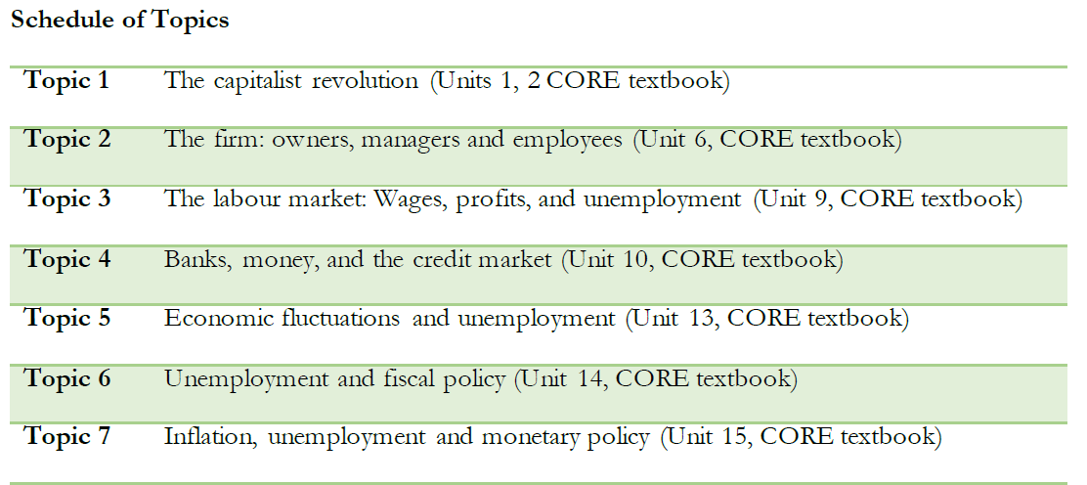

Slide 5
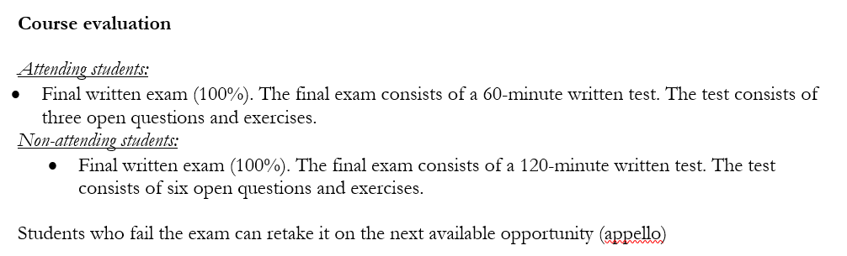
Evaluation
Questions?

Slide 6
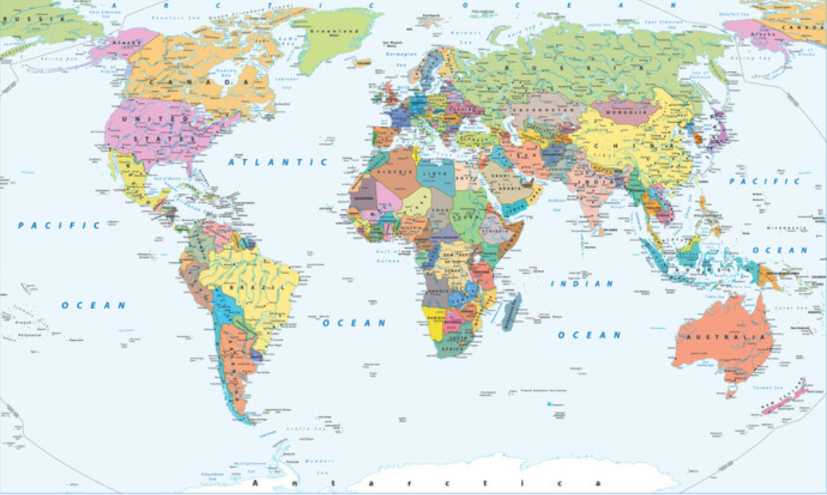
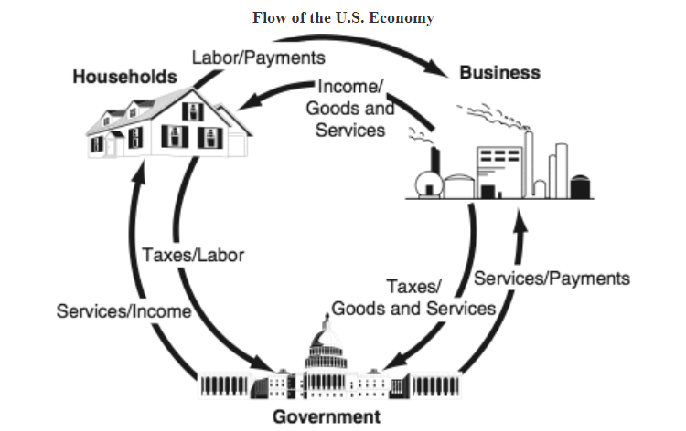
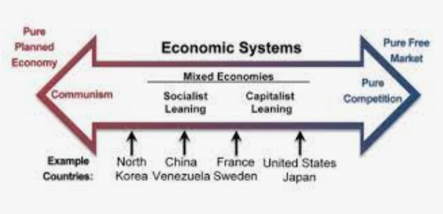
Economic system
https://triand.com/bundles/158669-gee-21-2008-2011-grade-11-social-studies

Slide 7
Measuring economic systems, 1
Economic indicators (Statistics)
  Economic activity: GDP, growth rate, Consumption
  Population, Labor force, Employment, Unemployment
  Data on Production, Industries, Firms
  Government expenditure, taxes, public debt
  Balance of Payments and International Investment position
  Prices, Wages, Financial data
Focus on GDP and GDP per capita
  Standard measures of economic activity

Slide 8
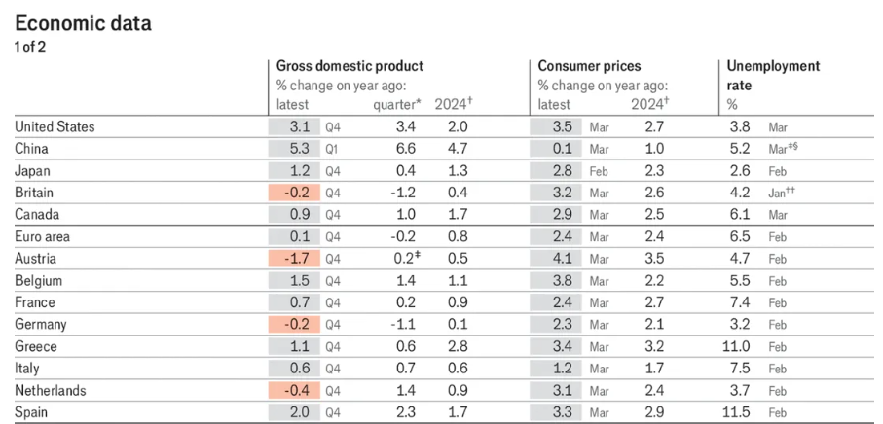
Measuring economic systems, 2
https://www.economist.com/economic-and-financial-indicators/2024/04/18/economic-data-commodities-and-markets

Slide 9
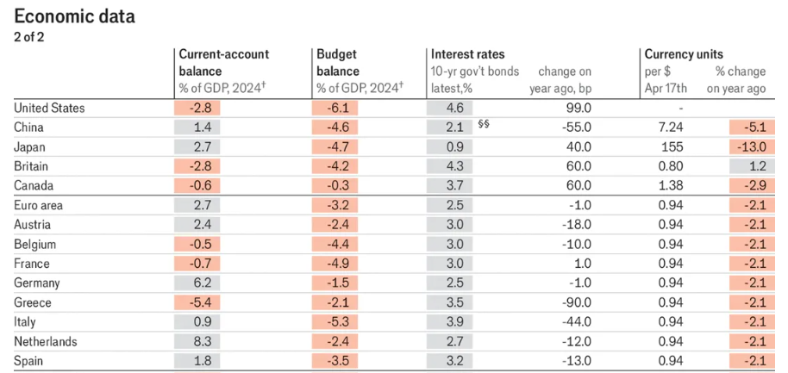
Measuring economic systems, 3
https://www.economist.com/economic-and-financial-indicators/2024/04/18/economic-data-commodities-and-markets

Slide 10
GDP
GDP = Gross Domestic Product
GDP in nominal terms = total value of final goods and services produced within a country, in a given period of time, evaluated at market prices
  Total value at market prices : GDP adds up the value of all final goods and services produced in a country over a given period of time (value = Q*P)
  Within a country: D (domestic)
  In a given period of time: GDP refers to a period of time (yearly GDP, quarterly GDP). As such, it is a flow variable
Synonims for GDP = Aggregate income
  Aggregate?

Slide 11
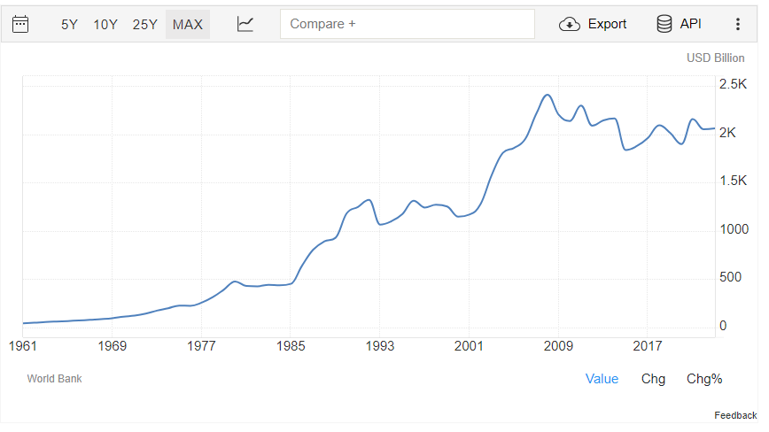
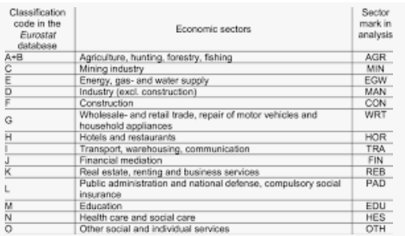
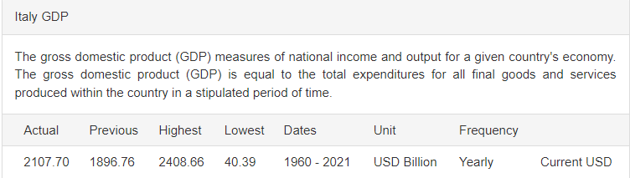
GDP and Economic sectors, 1
https://tradingeconomics.com/italy/gdp

Slide 12


GDP and Economic sectors, 2
Production line
1
3
5
Primary sector (Agriculture)
Secondary sector
(Industry)
Tertiary sector
(Services)
2
4
6
50 million
100 million
150 million
Primary sector sells COTTON to the Secondary sector, earning EUR 50 million (1 ; 2)
Secondary turns COTTON into CLOTHES, earnining EUR 100 million (3 ; 4)
Tertiary sectors sells CLOTHES TO to consumers earninig EUR 150 million (5 ; 6)
Goods and services that cross the production line are called FINAL (C, I, G, X)
Goods and services that do not cross the production line are called INTERMEDIATE
GDP takes only final goods and services into account !
GDP can be measured at current prices, at constant prices, or in terms of PPP prices (See Box)

Slide 13
Flash questions
What is the difference between intermediate and final goods?
Total value of goods exchanged in the economy at current prices?
GDP at current prices?
What happens to the 50 millions earned by the primary sector?
What happens to the 100 millions earned by the secondary sector?
What happens to the 150 million earned by tertiary sector?
What is the total income of the three sectors together?
How does aggregate income compare with GDP?

Slide 14
Methods to calculate nominal GDP
Method 1 (Total value added) = VaPS (50 millions) + VaSS (50 millions)+ VaTS (50 millions) = 150 millions GDP
  Based on surveys of companies in different sectors of the economy
  Surveys are conducted by the National Statistical Office
Method 2 (Total Income) = IncPS (50 millions) + IncSS (50 millions) + IncTS (50 millions) = 150 millions GDP
  Based on surveys of companies in different sectors of the economy but also on date coming from tax authorities and banks
  Surveys are conducted by the National Statistical Office
Method 3 (Total spending on final goods) = 150 millions (consumption)
  Based on surveys of companies and of places whetre final goods and services are sold (e.g. supermarkts, shopping centres …)
  Surveys are conducted by the National Statistical Office

Slide 15
GDP per capita
GDP per capita = GDP / POP
  Synonims for GDP per capita = Income per capita
  GDP = Income? (Wait till next slide)
GDP per capita takes into account the size of a country’s economy (GDP) and the size of the same country’s population.
As such, GDP per capita is often use to compare countries in terms of their living standards.
Italy’s GDP: 1.700 billion EUR
Italy’s population: 60 million
Italy’s GDP per capita?: 28.300 euros per year or 2.360 per month

Slide 16
Flash questions
If GDP is 150 million and population is 10.000, what is GDP per capita?
If GDP increases by 10% and population increases by 5%, what happens to GDP per capita and why?
If GDP increases by 5% and population increases by 10%, what happens to GDP per capita and why?
If GDP decreases by 10% and population decreases by 5%, what happens to GDP per capita and why?
If GDP decreases by 5% and population decreases by 10%, what happens to GDP per capita and why?

Slide 17
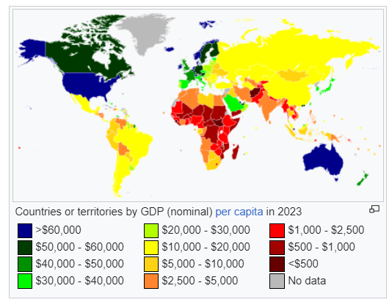
https://en.wikipedia.org/wiki/List_of_countries_by_GDP_(nominal)_per_capita

Slide 18
Key concepts
Economic system
GDP in nominal terms
Definition of GDP
Intermediate vs. Final goods and services
Primary, seconday and tertiary sector
GDP and income
GDP per capita and Income per capita (average)
Reference: Textbook Ch. 1, pp. 1 - 10 (including EINSTEIN BOX)

