Slide 1
Introduction to
International economics
Lecture 1
Paolo Paesani
University of Rome Tor Vergata
ALEF Department
09/09/2025

Slide 2
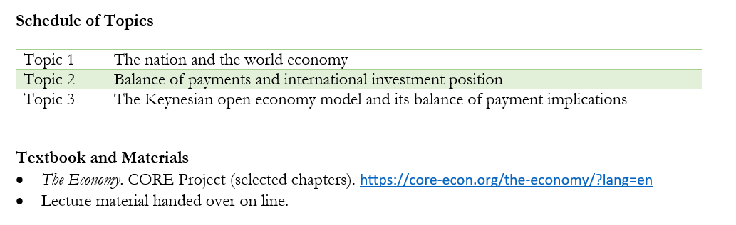
Course presentation

Slide 3
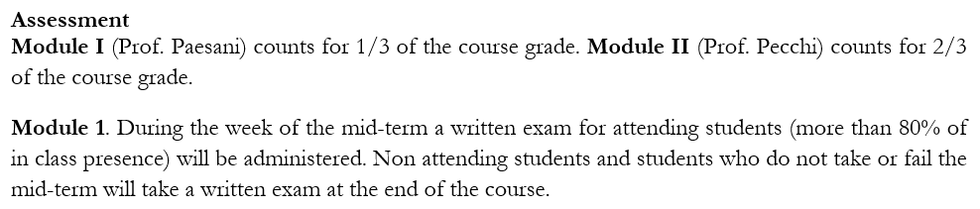
Course assessment
Office hours: write to paolo.paesani@uniroma2.it
Questions?

Slide 4
Introduction
Follow-up on Macroeconomics
From the national to the global economy (but the focus remains on the nation state)
Economic agents: Households, Firms (Economic sectors), Government, Banks and financial markets, Intermediate bodies, Supranational institutions.
Markets: Labour market, Market for goods and services, financial markets.

Slide 5

International economics?
International economics:
  International trade
  International production and offshoring
  International finance
  Migration and economic development
Globalization and de-globalization
Globalization is a term referring to the integration of the world’s markets in goods and services, as well as flows of investment and people across national boundaries

Slide 6
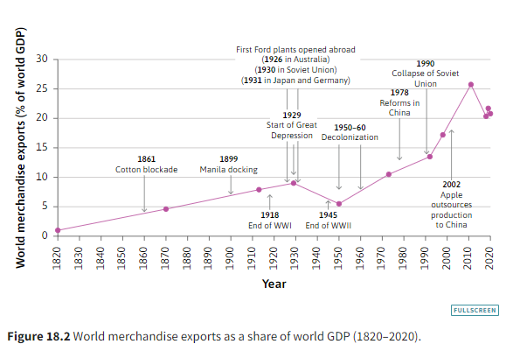
International trade indicators
Y = C + I + G + X – M
T1 = X / Y
T2 = M / Y
T3 = (X + M) / Y
Exports and imports
  Merchandise trade (Goods)
  Services (Tourism, shipping services, financial services, education)

Slide 7
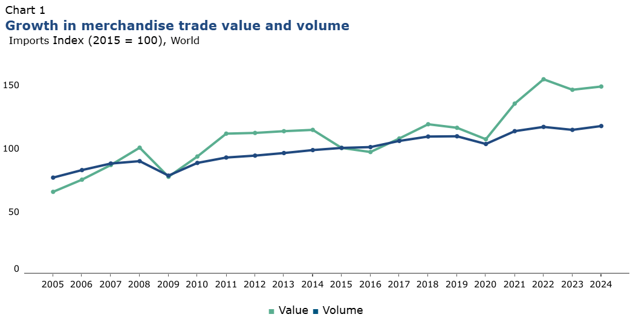
Source. https://www.wto.org/

Slide 8
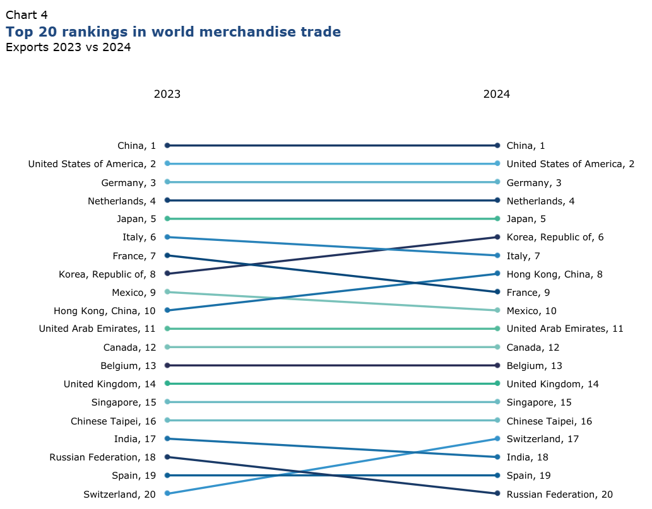
Source. https://www.wto.org/

Slide 9
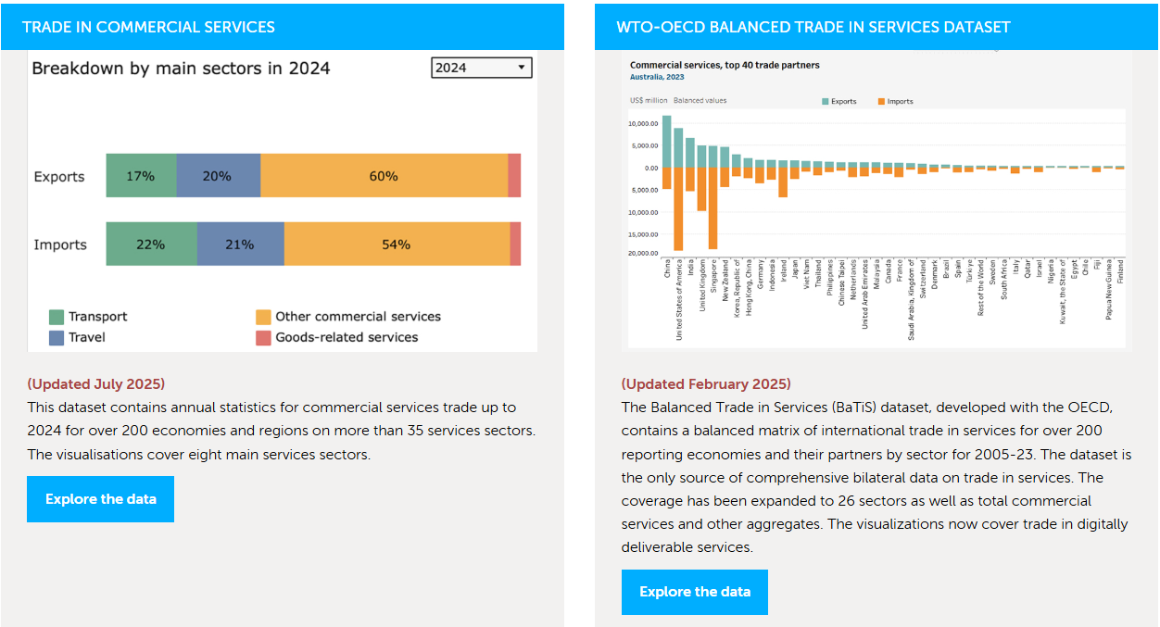
https://www.wto.org/english/res_e/statis_e/services_trade_data_hub_e.htm

Slide 10
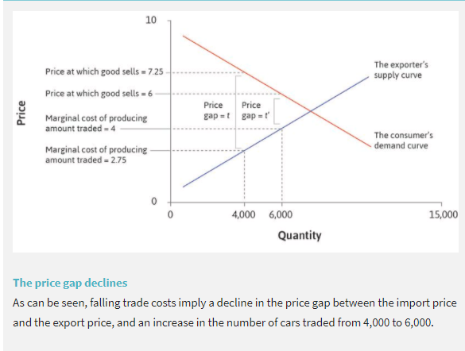
International price indicators
Simplifying assumption:
  There are the two only countries in the world (US, JP), that the Japanese do not consume cars, and that the US does not produce any cars itself. This means that everything that is produced is traded. Equilibrium through arbitrage PM = PX + t
Arbitrage: Buy cheap, sell dear
P_{EXP} = Domestic cost of production = C(q)
P_{IMP} = Foreign cost of production + shipping costs + insurance costs + … = C(q) + t
P_{IMP} – P_{EXP} = t
↓ t → ↑ Globalization
Advantages of ↓ t
  Advantages to domestic consumers
  Advantages to domestic producers

Slide 11
International price indicators, 2
Globalization should lead to falling import prices: But if we observe falling import prices, this does not necessarily mean that globalization is occurring. The demand for the good in question may simply have declined (or the supply may have increased).
Globalization should also lead to rising export prices: But rising export prices do not necessarily imply globalization. Demand for the good in question may simply be rising (or the supply may have declined).
Declining price gaps between importing and exporting countries are a much surer sign of globalization: This is particularly true if we can also observe rising trade volumes.

Slide 12
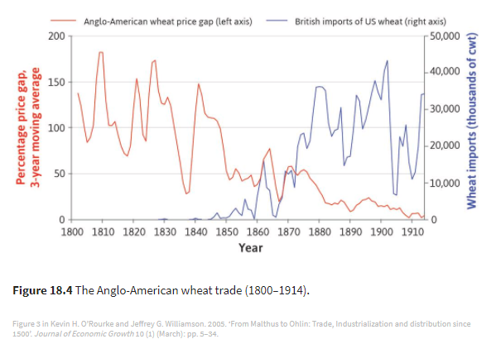
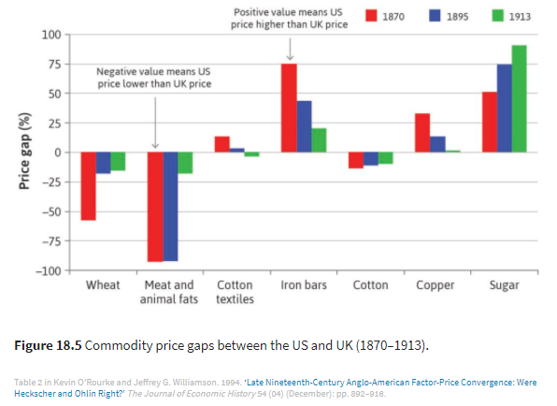
International price indicators, 3

Slide 13
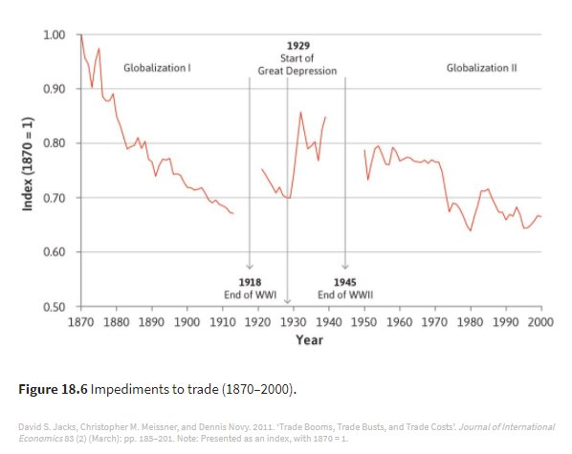
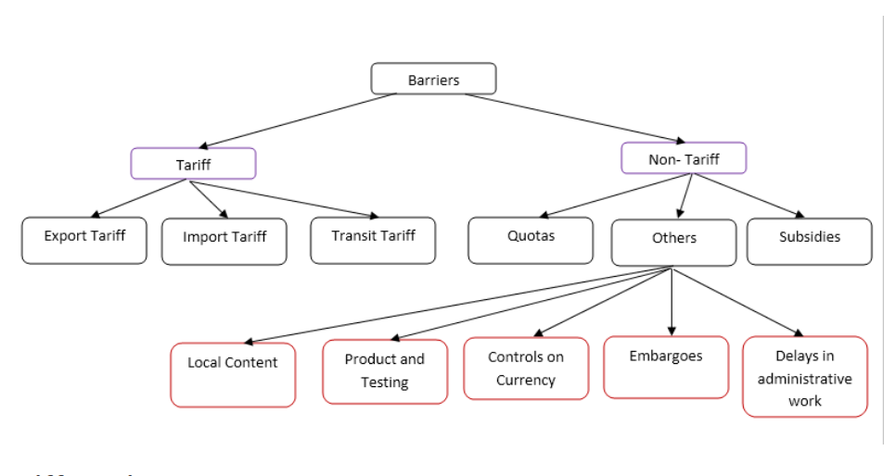
Barriers to international trade
https://www.econposts.com/economics/trade-barriers/

Slide 14
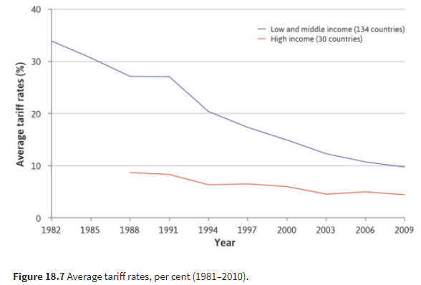
Globalization: tariff indicators
Tariff?
Tax on imports / exports / transit aimed at protecting domestic producers against foreign competition.
P_{IMP} – P_{EXP} = t + tariff
Tariff reduction and the WTO
https://www.wto.org/english/tratop_e/tariffs_e/tariffs_e.htm
https://www.wto.org/english/thewto_e/whatis_e/tif_e/fact2_e.htm

Slide 15
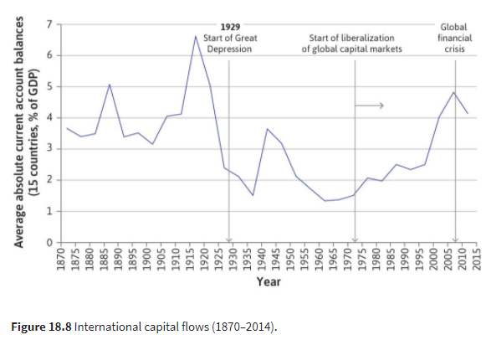
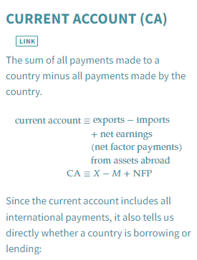
International investment indicators

Slide 16
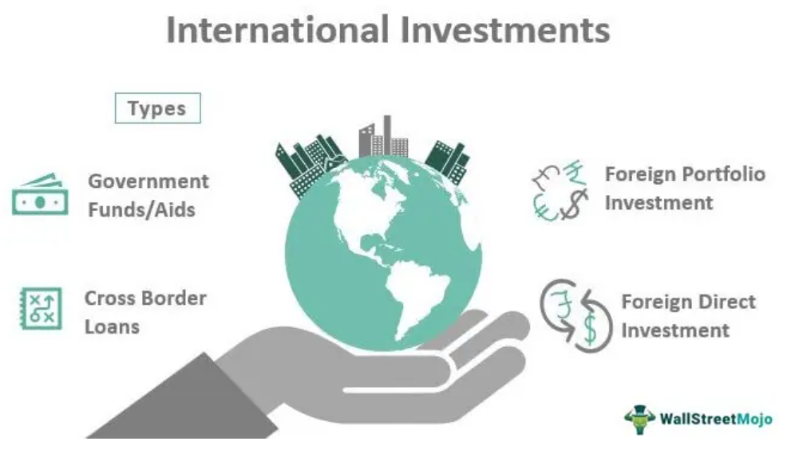
https://www.wallstreetmojo.com/international-investments/

Slide 17
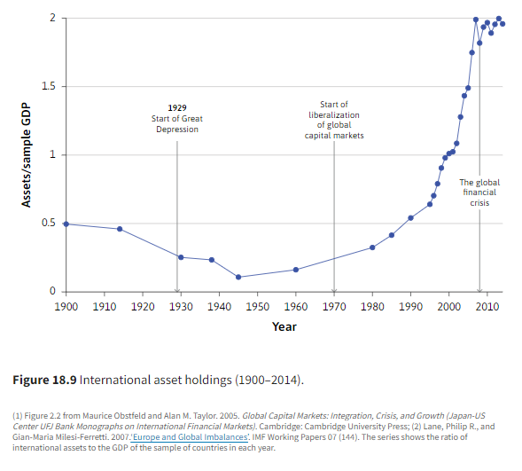
International investment indicators (stocks)

Slide 18
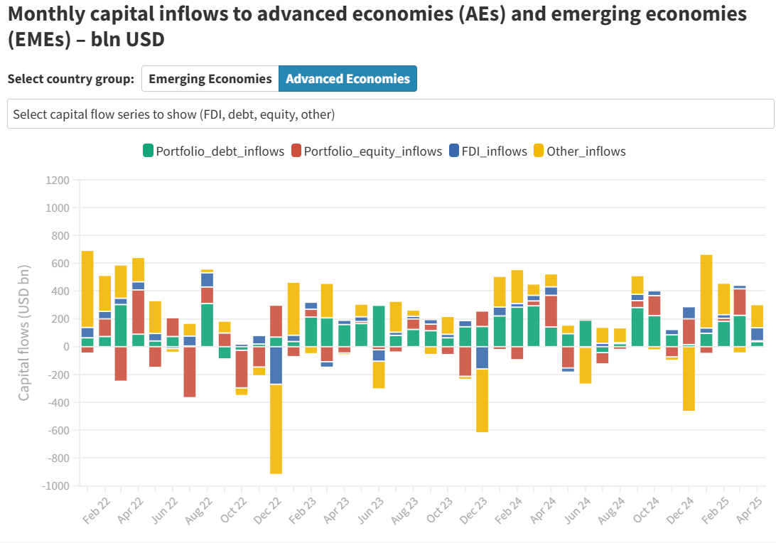
Source. https://www.oecd.org/en/topics/capital-flows-and-investment-standards.html

Slide 19
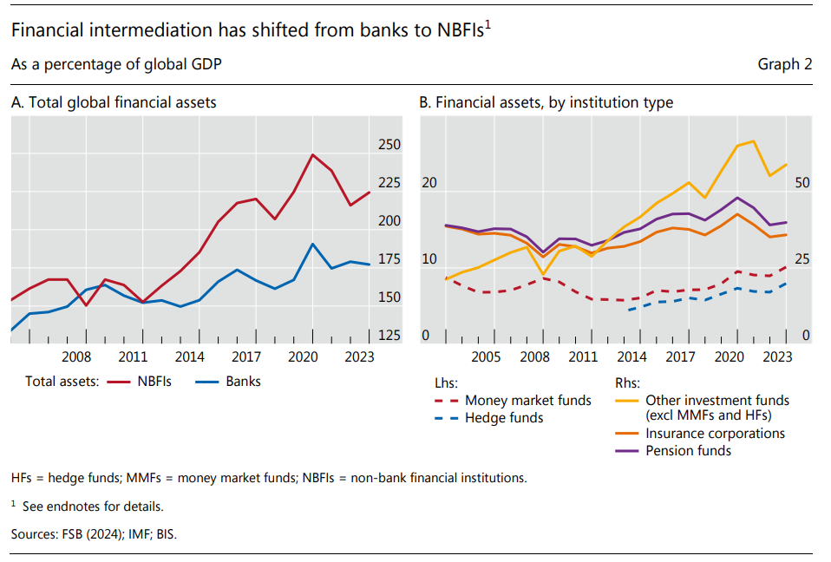
Source. https://www.bis.org/publ/arpdf/ar2025e.pdf

Slide 20
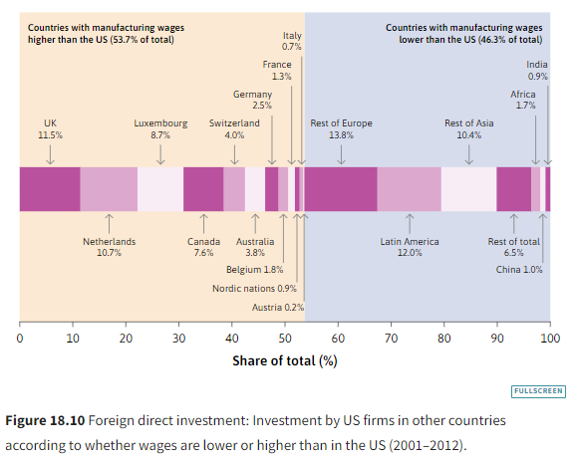
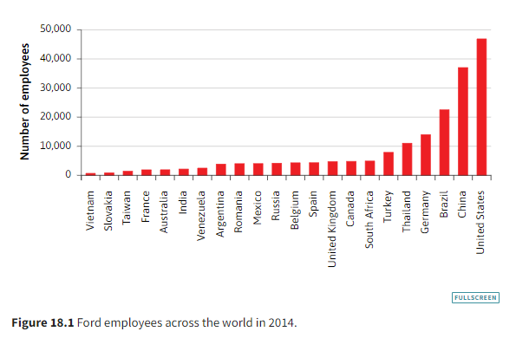

Slide 21
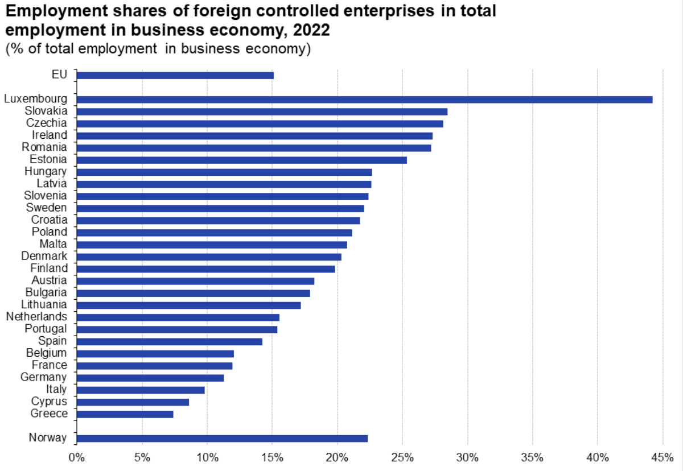
https://ec.europa.eu/eurostat/statistics-explained/index.php?title=Economic_globalisation_indicators#Global_value_chains

Slide 22
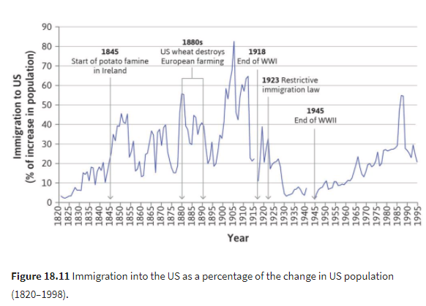
Migration indicators

Slide 23

https://worldmigrationreport.iom.int/msite/wmr-2024-interactive/

Slide 24
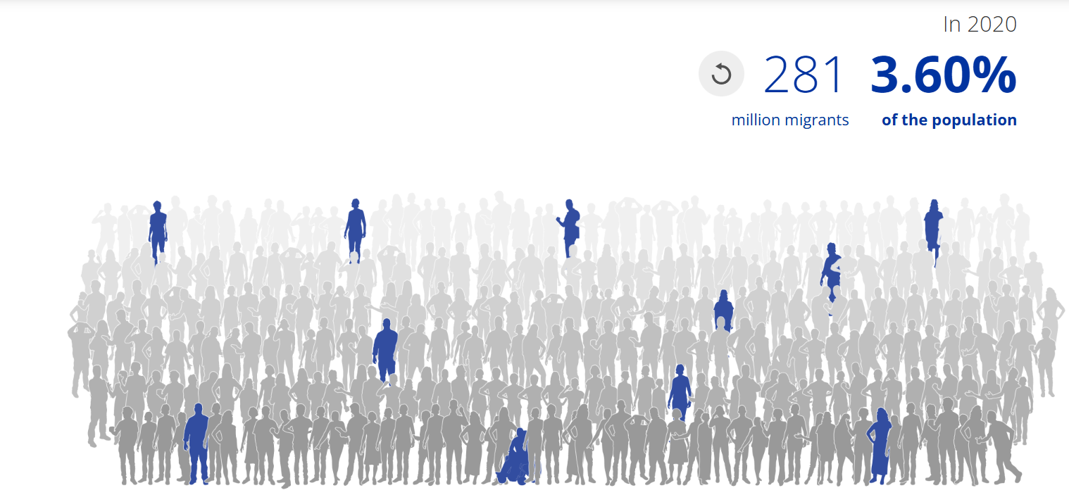
https://worldmigrationreport.iom.int/msite/wmr-2024-interactive/

Slide 25
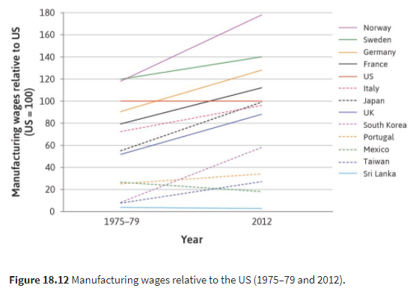
Globalization: migration indicators (3)

Slide 26
Connection with Prof. Pecchi’s course
Professor Pecchi's course covers international trade theory, protectionism, and the short- and long-term determination of exchange rates, as well as some topics in international monetary economics in relation to globalisation.
These are in-depth issues that you will only briefly cover with me.
In this sense, my part of the course provides an introduction to Prof. Pecchi's.

Slide 27
Connection with Prof. Chiarini’s course
Il prof. Chiarini is an introduction to game theory. The criterion of dominance and the equilibrium of Nash will be analysed with pure strategies and mixed strategies, as well as different refinements of the equilibrium (Backwards Induction, subgame perfect Nash equilibrium). An introduction to Bayesian equilibrium and repeated games will also be provided.
The lessons use several examples in the field of economics, politics and economic policy. This year we will use strategic frameworks to analyze the conflict between Ukraine and Russia.
In this case, establishing the connection between the two parts of the course necessitates a more sybtle process involving the concept of strategic interaction between the relevant actors in world economy.

Slide 28
Homework
CORE The Economy Section 18.1, 18.2, 18.3
Answer questions contained in the relevant sections

