Slide 1
INTEC Lecture 1
Course introduction and globalization indicators
Paolo Paesani
University of Rome Tor Vergata
ALEF Department
07/09/2026

Slide 2
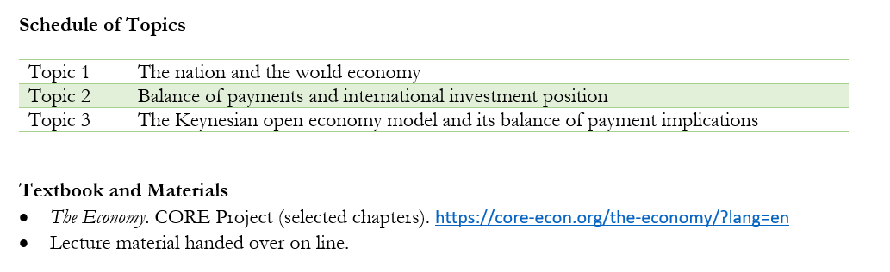
The teacher and the course
Prof. Paolo Paesani, BA, M.Sc., Ph.D.
UTV, LUISS, Sapienza
Main fields of research: HET (Macroeconomics, 20th century), Cambridge economics, European Economy
paolo.paesani@uniroma2.it

Slide 3
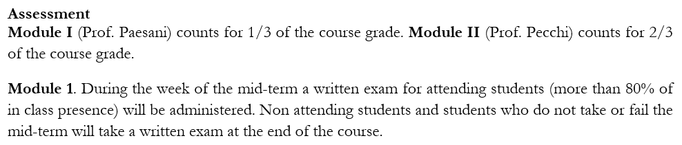
Course assessment
Office hours: write to paolo.paesani@uniroma2.it
Questions?

Slide 4
Connection with Prof. Pecchi’s course
Professor Pecchi's course (Global International Economics) covers international trade theory, protectionism, and the short- and long-term determination of exchange rates, as well as some topics in international monetary economics in relation to globalisation.
These are iissues that you will only briefly cover with me.
In this sense, my part of the course provides an introduction to Prof. Pecchi's lectures.

Slide 5
Connection with Prof. Chiarini’s course
Prof. Chiarini’s course (Global Strategic Theory) is an introduction to game theory. The criterion of dominance and the equilibrium of Nash will be analysed with pure strategies and mixed strategies, as well as different refinements of the equilibrium (Backwards Induction, subgame perfect Nash equilibrium). An introduction to Bayesian equilibrium and repeated games will also be provided.
The lessons use several examples in the field of economics, politics and economic policy.
In this case, establishing the connection between the two parts of the course necessitates a more subtle process involving the concept of strategic interaction between the relevant actors in world economy.

Slide 6
International economics and globalisation indicators

Slide 7
Introduction to International economics
Follow-up on Macroeconomics
From the national to the global economy (but the focus remains on the nation state)
Economic agents: Households, Firms (Economic sectors), Banks and non-bank financial intermediaries, Intermediate bodies (e.g. trade unions),
Central and local governments, central banks, Supranational institutions (e.g. WTO, BIS, IMF, WB …).
Markets: Labour market, Market for goods and services, financial markets.

Slide 8

International economics?
International economics:
  International trade
  International production and offshoring
  International finance
  Migration and economic development
Globalization and de-globalization
Globalization is a term referring to the integration of the world’s markets in goods and services, as well as flows of investment and people across national boundaries

Slide 9
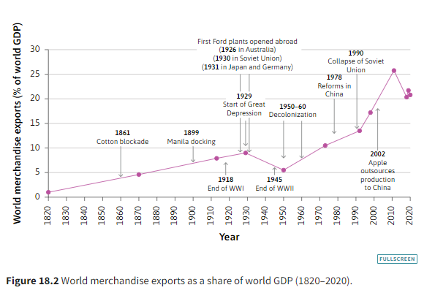
International trade indicators
Y = C + I + G + X – M
T1 = X / Y
T2 = M / Y
T3 = (X + M) / Y
Exports and imports
  Merchandise trade (Goods)
  Services (Tourism, shipping services, financial services, education)

Slide 10
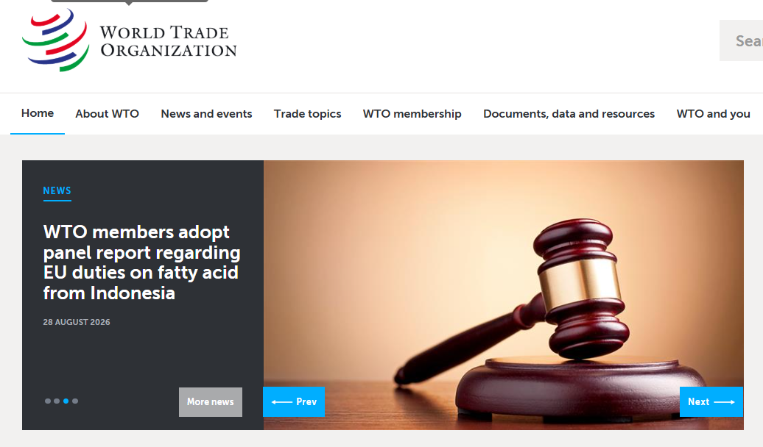

Slide 11
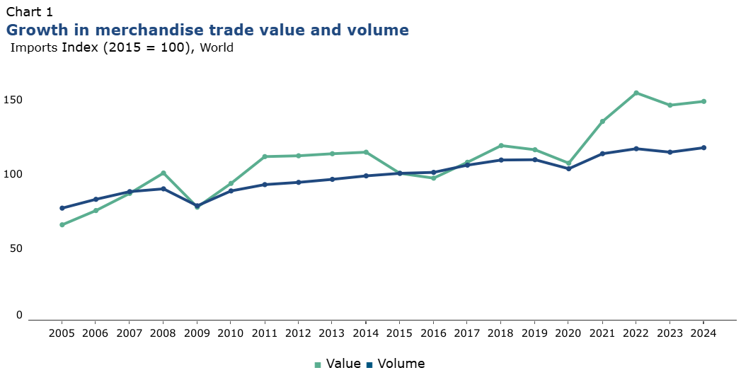
Source. https://www.wto.org/

Slide 12
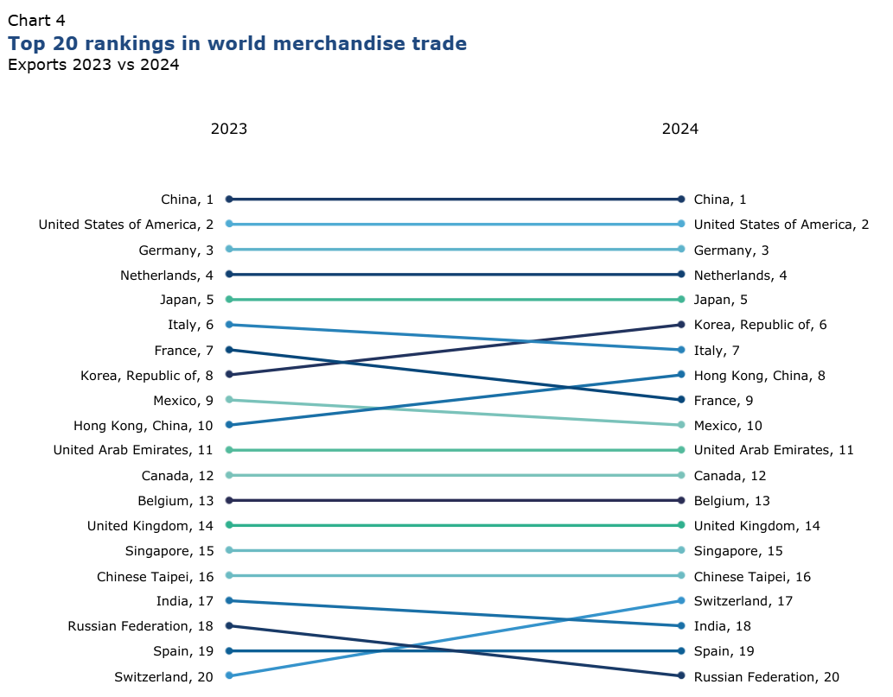
Source. https://www.wto.org/

Slide 13
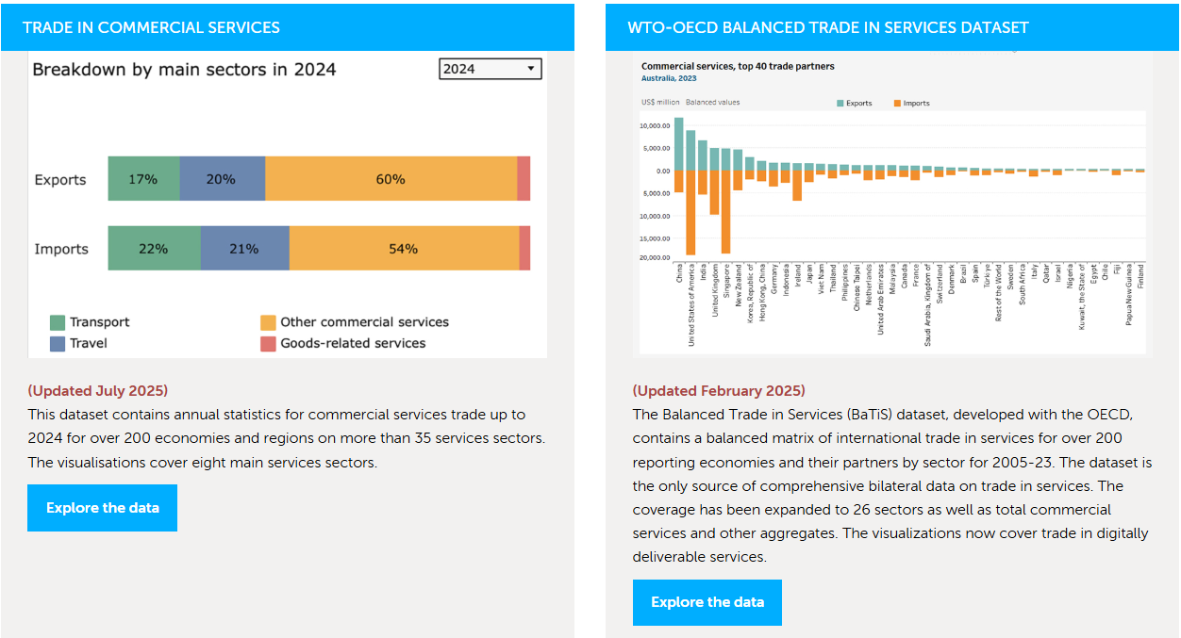
https://www.wto.org/english/res_e/statis_e/services_trade_data_hub_e.htm

Slide 14
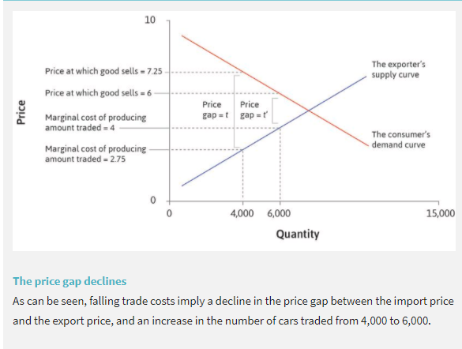
International price indicators
Simplifying assumption:
  There are the two only countries in the world (US, JP), that the Japanese do not consume cars, and that the US does not produce any cars itself. This means that everything that is produced is traded. Equilibrium through arbitrage PM = PX + t
Arbitrage: Buy cheap, sell dear
P_{EXP} = Domestic cost of production = C(q)
P_{IMP} = Foreign cost of production + shipping costs + insurance costs + … = C(q) + t
P_{IMP} – P_{EXP} = t
↓ t → ↑ Globalization
Advantages of ↓ t
  Advantages to domestic consumers
  Advantages to domestic producers

Slide 15
International price indicators, 2
Globalization should lead to falling import prices: But if we observe falling import prices, this does not necessarily mean that globalization is occurring. The demand for the good in question may simply have declined (or the supply may have increased).
Globalization should also lead to rising export prices: But rising export prices do not necessarily imply globalization. Demand for the good in question may simply be rising (or the supply may have declined).
Declining price gaps between importing and exporting countries are a much surer sign of globalization: This is particularly true if we can also observe rising trade volumes.

Slide 16
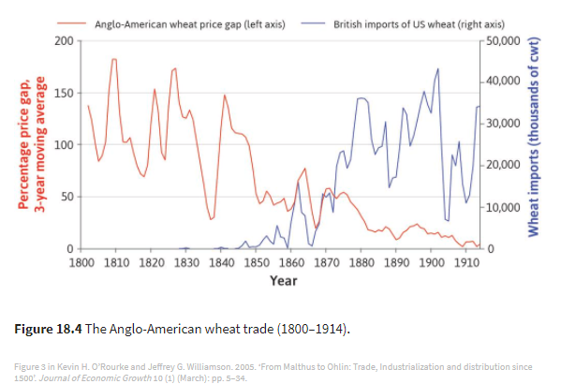
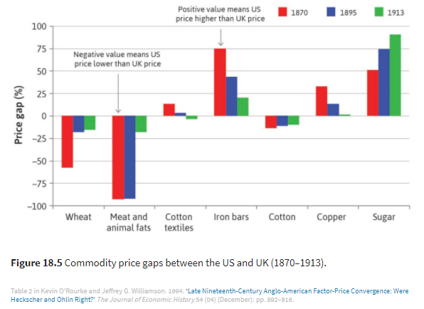
International price indicators, 3

Slide 17
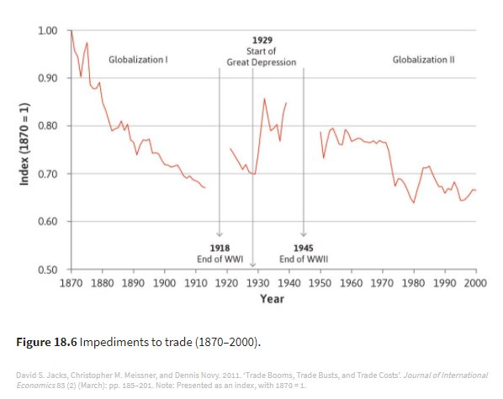
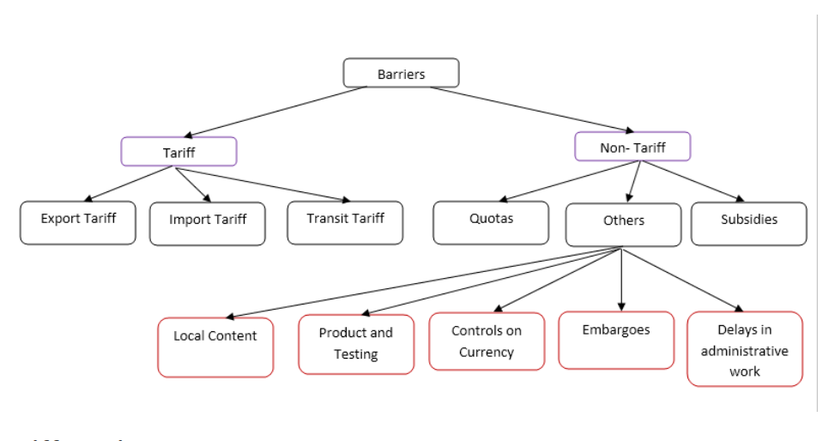
Barriers to international trade
https://www.econposts.com/economics/trade-barriers/

Slide 18
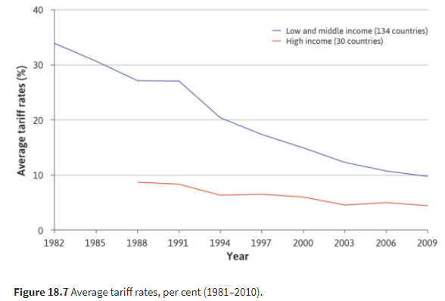
Tariff indicators
Tariff?
Tax on imports / exports / transit aimed at protecting domestic producers against foreign competition.
P_{IMP} – P_{EXP} = t + tariff
Tariff reduction and the WTO
https://www.wto.org/english/tratop_e/tariffs_e/tariffs_e.htm
https://www.wto.org/english/thewto_e/whatis_e/tif_e/fact2_e.htm

Slide 19
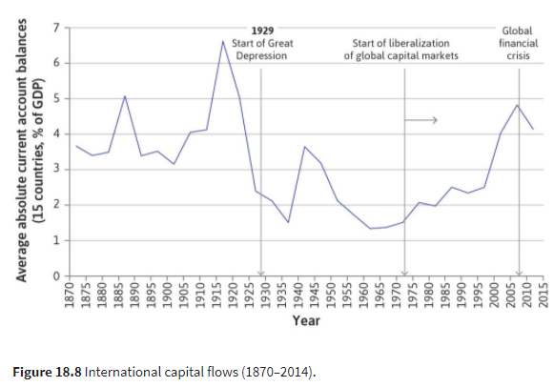
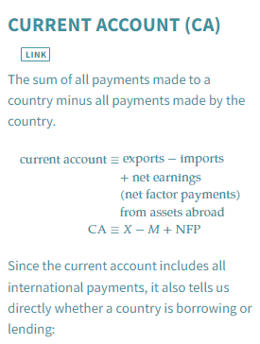
International investment indicators

Slide 20
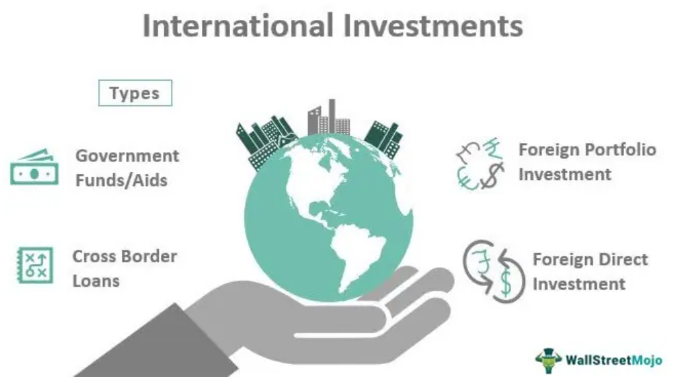
https://www.wallstreetmojo.com/international-investments/

Slide 21
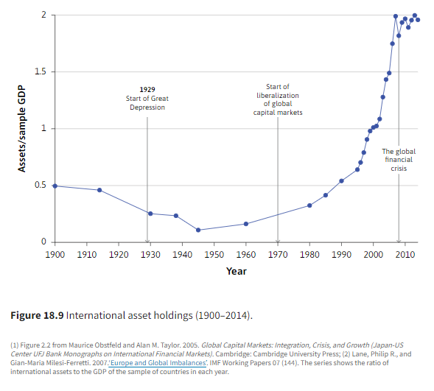
International investment indicators (stocks)

Slide 22
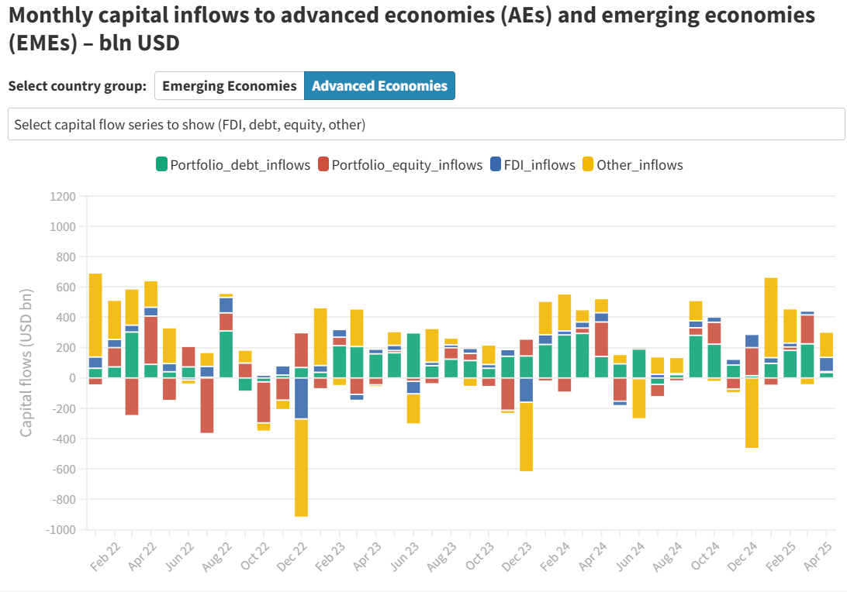
Source. https://www.oecd.org/en/topics/capital-flows-and-investment-standards.html

Slide 23
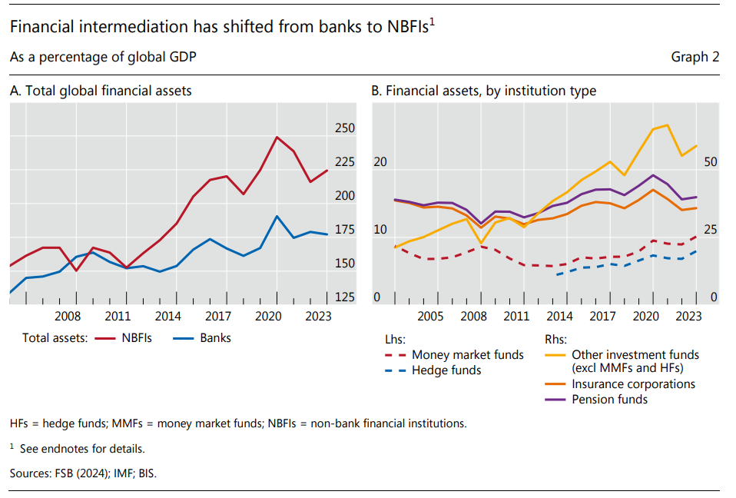
Source. https://www.bis.org/publ/arpdf/ar2025e.pdf

Slide 24
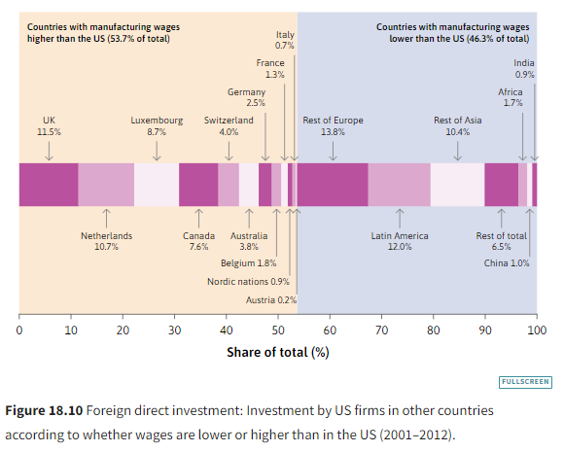
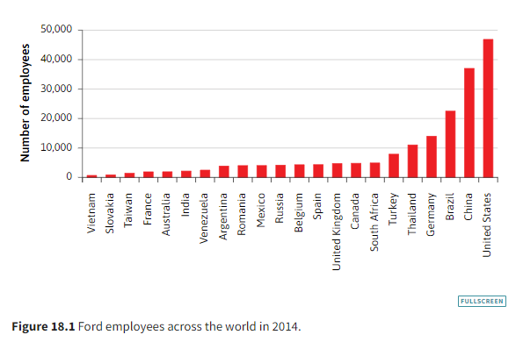

Slide 25
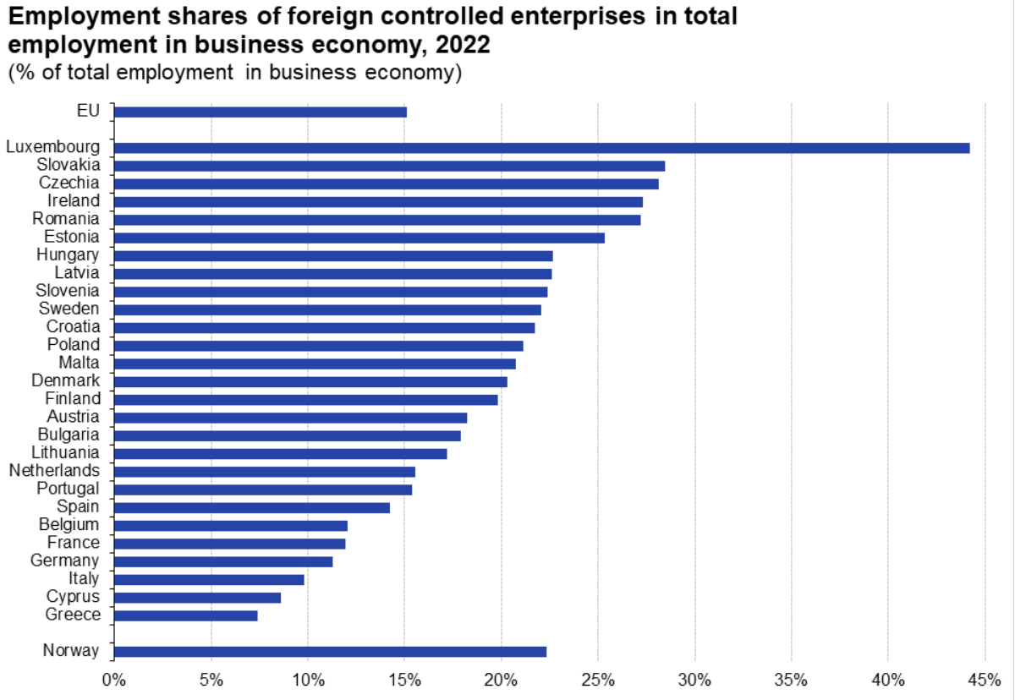
https://ec.europa.eu/eurostat/statistics-explained/index.php?title=Economic_globalisation_indicators#Global_value_chains

Slide 26
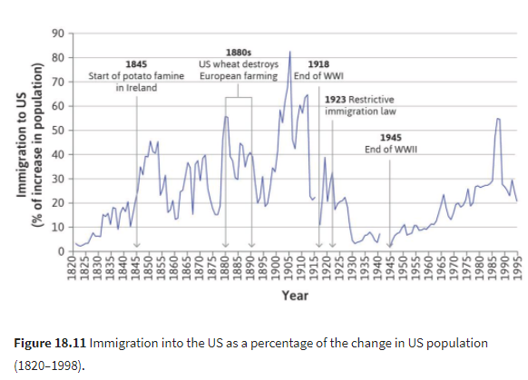
Migration indicators

Slide 27

https://worldmigrationreport.iom.int/msite/wmr-2024-interactive/

Slide 28
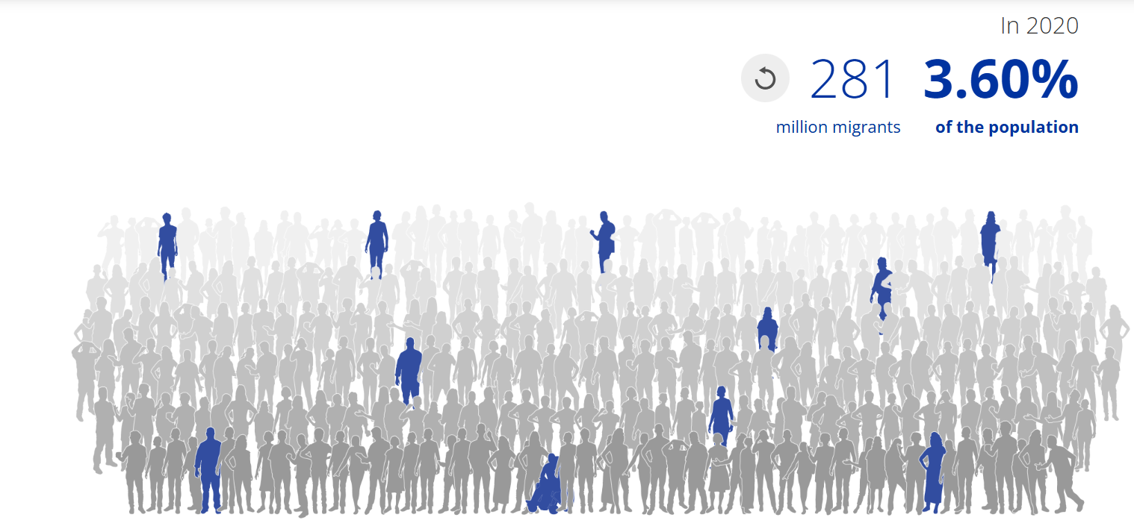
https://worldmigrationreport.iom.int/msite/wmr-2024-interactive/

Slide 29
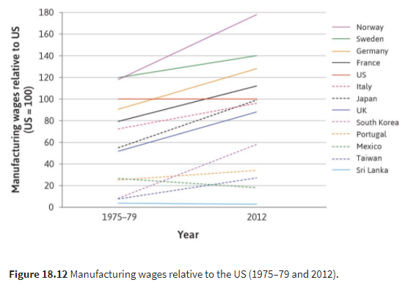
Globalization: migration indicators (3)

Slide 30
Homework
CORE The Economy Section 18.1, 18.2, 18.3
https://books.core-econ.org/the-economy-v1/book/text/18.html?bookmarks=31-139-8-0-0-0-0-0-0-10-171-174-5-0-67-191-166-163-2-0-0-0
Answer questions contained in the relevant sections

