Slide 1
INTEC Lecture 4
The financial account
Paolo Paesani
University of Rome Tor Vergata
ALEF Department
14/09/2026

Slide 2
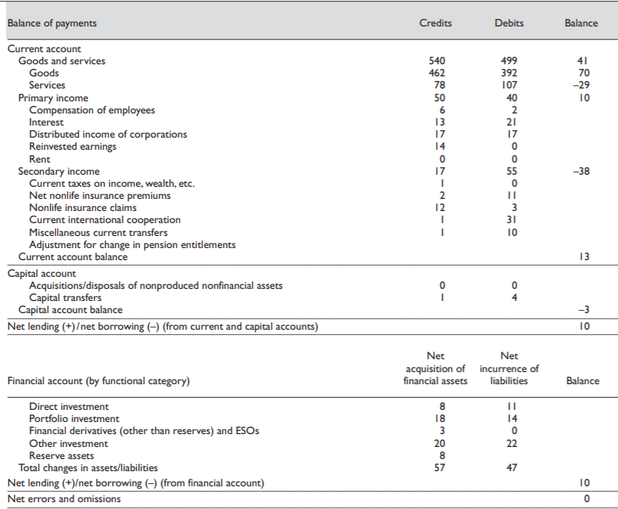

Slide 3
The Financial Account: Two Types of Transactions
The financial account records changes in residents’ financial assets and liabilities vis-à-vis non-residents.
TYPE 1 — Financial counterpart of a real/transfer transaction
One entry is recorded in the current account or capital account; the counterpart is recorded in the financial account.
Example: an Italian firm exports machinery worth €1 million and receives a foreign bank deposit.
• Current account: +€1m export of goods
• Financial account: +€1m acquisition of a foreign financial asset
TYPE 2 — Purely financial transaction
Both sides of the transaction concern financial assets or liabilities, so both entries belong to the financial account.
Example: an Italian resident buys €1 million of US bonds and pays by reducing a US bank deposit.
• +€1m foreign bonds
• −€1m foreign bank deposits
Key point: the financial account is not limited to financing current-account transactions.
It also records exchanges of one financial instrument for another.

Slide 4
Double-Entry Bookkeeping and the Balance of Payments
Current Account Balance + Capital Account Balance = − Financial Account Balance
in the absence of errors and omissions
1 — WHY THE BALANCES OFFSET
Every current- or capital-account transaction has a financial counterpart.
Therefore, the combined current + capital account balance and the financial account balance are equal in absolute value and opposite in sign.
Purely financial transactions do not affect the net financial-account balance: one financial entry is offset by another.
Example: buying a US bond by reducing a US bank deposit increases one foreign asset and decreases another by the same amount → net effect = 0.
2 — ACCOUNTING SIGN CONVENTION
Current + Capital Account balance:
Credits − Debits
Financial Account balance:
Net acquisition of financial assets − Net incurrence of liabilities
Assets are recorded as debits: acquiring a foreign asset implies an outward payment.
Liabilities are recorded as credits: incurring a liability to a non-resident implies an inward payment.
In practice, statistical discrepancies are captured by Net Errors and Omissions.

Slide 5
Financial Transactions and Primary Income
The purchase or sale of a financial asset is recorded in the Financial Account.
The income subsequently generated by that asset is recorded as Primary Income in the Current Account.
EXAMPLE 1 — Foreign bond
An Italian resident buys a US bond.
Financial Account → acquisition of a foreign asset.
Later, the bond pays €40,000 interest.
Current Account → primary income credit: +€40,000.
EXAMPLE 2 — Foreign direct investment
An Italian company acquires an equity stake in a French company.
Financial Account → outward direct investment.
Later, it receives €100,000 in dividends.
Current Account → primary income credit: +€100,000.
STOCK / TRANSACTION → Financial Account
INCOME FLOW generated by the asset → Current Account (Primary Income)

Slide 6
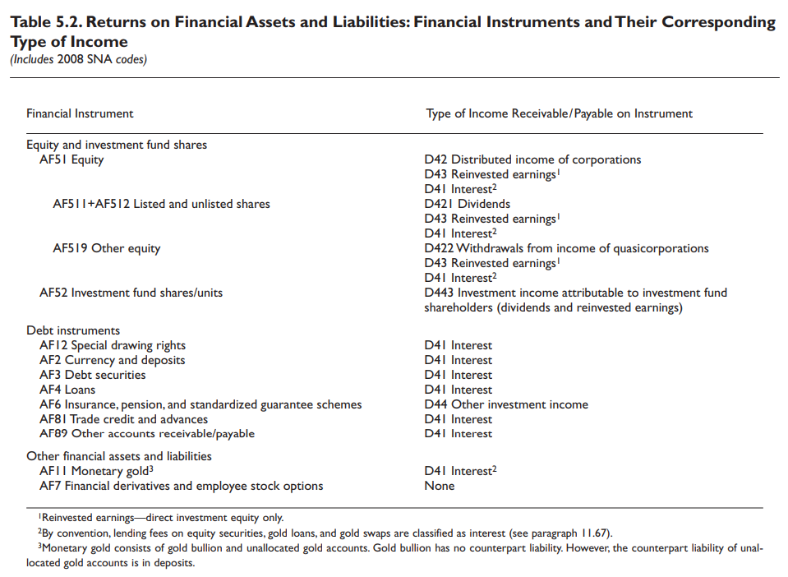
https://www.imf.org/external/pubs/ft/bop/2007/pdf/chap5.pdf

Slide 7
Financial account
8.1 The financial account records transactions that involve financial assets and liabilities and that take place between residents and nonresidents. The financial account indicates the functional categories, sectors, instruments, and maturities used for net international financing transactions.
8.2 Entries in the financial account can be corresponding entries to goods, services, income, capital account, or other financial account entries. For example, the corresponding entry for an export of goods is usually an increase in financial assets, such as currency and deposits or trade credit. Alternatively, a transaction may involve two financial account entries. Sometimes, the financial account transaction involves the exchange of one asset for another, for example, a bond may be exchanged for currency and deposits. In other cases, the transaction may involve the creation of a new financial asset and corresponding liability.
https://www.imf.org/external/pubs/ft/bop/2007/pdf/chap8.pdf

Slide 8
Financial account, 2
8.3 The overall balance on the financial account is called net lending/net borrowing. Net lending means that, in net terms, the economy supplies funds to the rest of the world, taking into account acquisition and disposal of financial assets and incurrence and repayment of liabilities. (Net borrowing means the opposite.) Despite the lending-oriented terms, net lending/net borrowing is a balance that takes into account equity, financial derivatives, and monetary gold, as well as debt instruments. Also, net lending includes reduction of liabilities and net borrowing includes reduction in assets. Net lending/ net borrowing can be derived from either the sum of the balances on the current and capital accounts or from the balance on the financial account. In concept, the values should be equal. For a surplus of credits over debits in the current and capital accounts, there is a balancing net acquisition of financial assets or reduction of liabilities, which is shown in the financial account. Net lending/net borrowing of the international accounts is also equal to the net lending/net borrowing for the sum of the resident sectors of the national accounts.
8.7 Net recording in the financial account means aggregations whereby all debit entries of a particular asset or a particular liability are netted against all credit entries in the same asset type or in the same liability type. However, changes in financial assets should not be netted against changes in liabilities, with the possible exception for financial derivatives noted in paragraph 8.34 and in the balancing item.
https://www.imf.org/external/pubs/ft/bop/2007/pdf/chap8.pdf

Slide 9
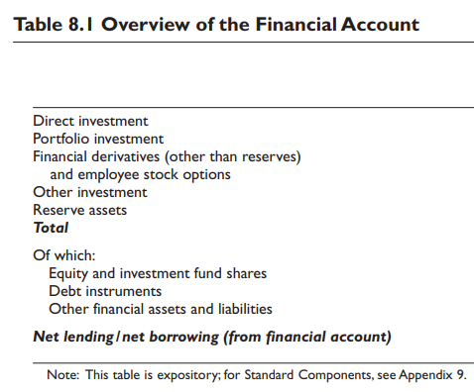
Functional categories in the financial account
6.1 The functional categories are the primary classification used for each of financial transactions, positions, and income in the international accounts. Five functional categories of investment are distinguished in the international accounts: (a) direct investment, (b) portfolio investment, (c) financial derivatives (other than reserves) and employee stock options, (d) other investment, and (e) reserve assets.
Functional categories take into consideration the nature and reasons for the financial transaction and the legal identity of the parties involved.
The same financial instrument can be used to conduct financial transactions belonging to different functional categories (see slide 13).
https://www.imf.org/external/pubs/ft/bop/2007/pdf/chap6.pdf

Slide 10
Functional categories in the financial account, 2
6.4 Direct investment is related to control or a significant degree of influence, and tends to be associated with a lasting relationship. As well as funds, direct investors may supply additional contributions such as know-how, technology, management, and marketing. Furthermore, enterprises in a direct investment relationship are more likely to trade with and finance each other.
6.5 In contrast to direct investors, portfolio investors typically have less of a role in the decision making of the enterprise with potentially important implications for future flows and for the volatility of the price and volume of positions. Portfolio investment differs from other investment in that it provides a direct way to access financial markets, and thus it can provide liquidity and flexibility.
6.6 Reserve assets are shown separately because they serve a different function and thus are managed in different ways from other assets. Reserve assets include a range of instruments that are shown under other categories when not owned by monetary authorities. As reserve assets, however, they have the distinct motive to meet balance of payments financing needs and undertake market intervention to influence the exchange rate.
https://www.imf.org/external/pubs/ft/bop/2007/pdf/chap6.pdf

Slide 11
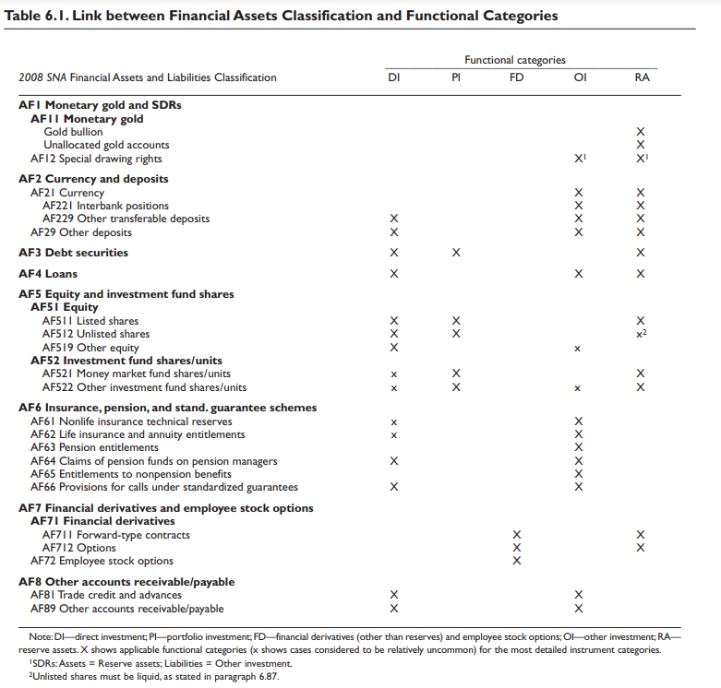
https://www.imf.org/external/pubs/ft/bop/2007/pdf/chap6.pdf

Slide 12
Direct Investment (DI)
FA = DI + PI + FD + OI + RA
6.8 Direct investment is a category of cross-border investment associated with a resident in one economy having control or a significant degree of influence on the management of an enterprise that is resident in another economy. As well as the equity that gives rise to control or influence, direct investment also includes investment associated with that relationship, including investment in indirectly influenced or controlled enterprises (paragraph 6.12), investment in fellow enterprises (see paragraph 6.17), debt (except selected debt set out in paragraph 6.28), and reverse investment (see paragraph 6.40). The Framework for Direct Investment Relationships (FDIR) provides criteria for determining whether cross-border ownership results in a direct investment relationship, based on control and influence.
6.9 A direct investment relationship arises when an investor resident in one economy makes an investment that gives control or a significant degree of influence on the management of an enterprise that is resident in another economy

Slide 13
Determinants of FDI (incoming)
Determinant | Mechanism | Example
Market Size & Growth | Larger and faster-growing markets attract more FDI. | India’s large consumer market attracts retail FDI.
Labour Costs & Skills | Low wages or skilled labour pools draw investment. | FDI in Vietnam for low-cost manufacturing.
Exchange Rates | Stable or undervalued currencies can encourage FDI. | Dollar strength influences US outward FDI.
Trade Openness | Open trade regimes attract export-oriented FDI. | Mexico’s openness under NAFTA attracts carmakers.
Infrastructure Quality | Good transport, energy, and digital infrastructure reduce costs. | Singapore’s infrastructure attracts logistics hubs.
Political & Institutional Stability | Stable governance lowers investment risk. | FDI in Switzerland due to political stability.
Taxation & Incentives | Favourable tax regimes and subsidies encourage FDI. | Ireland’s low corporate tax attracts tech firms.
Natural Resources | Resource availability attracts resource-seeking FDI. | Oil reserves attract FDI in Nigeria.
Financial Market Development | Developed capital markets facilitate investment. | London attracts FDI through deep financial markets.
Regional Integration | Membership in trade blocs increases attractiveness. | FDI in Poland due to EU market access.
https://chatgpt.com/

Slide 14
Examples of Foreign Direct Investment (FDI)
Toyota’s automobile plants in the United States (market-seeking FDI).
Apple’s R&D centres in India (efficiency-seeking FDI).
Shell’s offshore oil projects in Nigeria (resource-seeking FDI).
Volkswagen’s assembly plants in Brazil (market and efficiency-seeking).
Samsung’s semiconductor facilities in Vietnam (integration into global value chains).

Slide 15
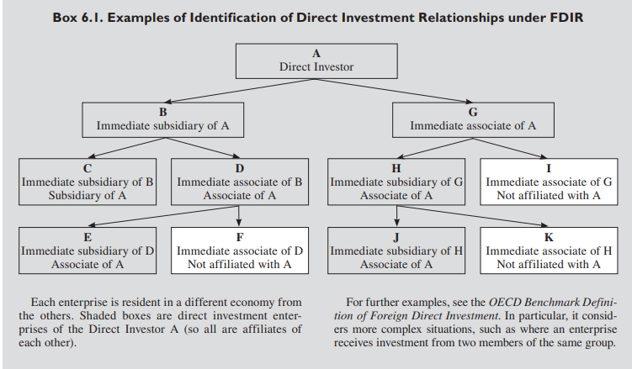
https://www.imf.org/external/pubs/ft/bop/2007/pdf/chap6.pdf

Slide 16
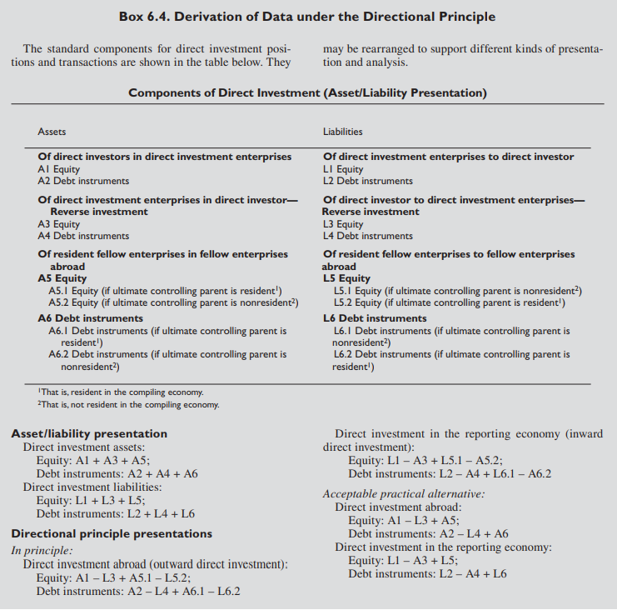
https://www.imf.org/external/pubs/ft/bop/2007/pdf/chap6.pdf

Slide 17
Portfolio investment (PI), 1
FA = DI + PI + FD + OI + RA
6.54 Portfolio investment is defined as crossborder transactions and positions involving debt or equity securities, other than those included in direct investment or reserve assets. […] The negotiability of securities is a way of facilitating trading, allowing them to be held by different parties during their lives. Negotiability allows investors to diversify their portfolios and to withdraw their investment readily. Investment fund shares or units (i.e., those issued by investment funds) that are evidenced by securities and that are not reserve assets or direct investment are included in portfolio investment. Although they are negotiable instruments, exchange traded financial derivatives are not included in portfolio investment because they are included in their own separate category.

Slide 18
Portfolio investment (PI), 2
FA = DI + PI + FD + OI + RA
6.56 Portfolio investment covers, but is not limited to, securities traded on organized or other financial markets. Portfolio investment usually involves financial infrastructure, such as a suitable legal, regulatory, and settlement framework, along with market-making dealers, and a sufficient volume of buyers and sellers. However, acquisition of shares in hedge funds, private equity funds, and venture capital are examples of portfolio investment that occurs in less public and more lightly regulated markets. (However, shares in these funds are included in direct investment when the holdings reach the 10 percent threshold, and in other equity in other investment when investment is not in the form of a security and not included in direct investment or reserve assets.) Portfolio investment is distinctive because of the nature of the funds raised, the largely anonymous relationship between the issuers and holders, and the degree of trading liquidity in the instruments

Slide 19
Determinants of Portfolio Investment
Determinant | Mechanism | Example
Interest Rates | Higher domestic interest rates attract foreign capital seeking returns. | US rate hikes attract bond inflows.
Exchange Rate Expectations | Stable or appreciating currencies attract investors. | Strong yuan expectations draw portfolio inflows.
Economic Growth Prospects | Higher GDP growth signals profitable opportunities. | Brazil’s growth attracts equity investors.
Inflation | Low and stable inflation preserves real returns. | Germany’s low inflation attracts bond investors.
Financial Market Depth & Liquidity | Well-developed, liquid markets are more attractive. | London attracts equity inflows due to market depth.
Political & Institutional Stability | Stable institutions reduce investment risk. | Switzerland attracts portfolio investors.
Taxation & Capital Controls | Favourable tax policies and fewer restrictions promote inflows. | Singapore’s tax regime attracts investors.
Global Risk Appetite | When global risk appetite is high, flows go to emerging markets. | Low US volatility boosts EM inflows.
Diversification Opportunities | Unique assets or markets attract diversification-seeking investors. | Investors buy Indian equities for diversification.
Sovereign Credit Rating | Higher credit ratings signal lower risk and attract bond investors. | Japan’s high rating supports JGB demand.
https://chatgpt.com/

Slide 20
Examples of Portfolio Investment
Foreign investors purchasing US Treasury securities (safe-haven asset).
Japanese pension funds acquiring European corporate bonds (yield differentials).
US mutual funds investing in Indian equities (emerging market growth).
Hedge funds holding shares of Chinese technology firms (innovation prospects).
Global investors buying ETFs linked to the German DAX index (diversification).

Slide 21

Financial derivatives (FD)
FA = DI + PI + FD + OI + RA
5.80 A financial derivative contract is a financial instrument that is linked to another specific financial instrument or indicator or commodity and through which specific financial risks (such as interest rate risk, foreign exchange risk, equity and commodity price risks, credit risk, and so on) can be traded in their own right in financial markets. Transactions and positions in financial derivatives are treated separately from the values of any underlying items to which they are linked.
6.58 The definition of the functional category financial derivatives and employee stock options (other than reserves) largely coincides with the corresponding financial instrument class, which is discussed in detail in paragraphs 5.79–5.98. The difference in coverage between the functional category and the financial instrument is that financial derivatives associated with reserve asset management are excluded from the functional category and included in reserve assets (see paragraph 6.91). This category is identified separately from the other categories because it relates to risk transfer, rather than supply of funds or other resources.
https://www.imf.org/external/pubs/ft/bop/2007/pdf/chap5.pdf

Slide 22
Examples of Derivatives Operations in International Economic Relations
Derivatives are financial instruments whose value derives from an underlying asset, widely used in international trade and finance for risk management. Examples include:
A US exporter using currency futures to hedge against euro depreciation.
An airline purchasing oil futures to stabilise fuel costs.
A multinational bank arranging interest rate swaps in emerging markets.
A hedge fund trading options on global stock indices.
A corporation utilising credit default swaps to manage sovereign debt risk.
https://chatgpt.com/

Slide 23
Other investment (OI)
FA = DI + PI + FD + OI + RA
6.61 Other investment is a residual category that includes positions and transactions other than those included in direct investment, portfolio investment, financial derivatives and employee stock options, and reserve assets. To the extent that the following classes of financial assets and liabilities are not included under direct investment or reserve assets, other investment includes: (a) other equity; (b) currency and deposits; (c) loans (including use of IMF credit and loans from the IMF); (d) nonlife insurance technical reserves, life insurance and annuities entitlements, pension entitlements, and provisions for calls under standardized guarantees; (e) trade credit and advances; (f) other accounts receivable/payable; and (g) SDR allocations (SDR holdings are included in reserve assets).

Slide 24
Reserve assets (RA), 1
FA = DI + PI + FD + OI + RA
6.64 Reserve assets are those external assets that are readily available to and controlled by monetary authorities for meeting balance of payments financing needs, for intervention in exchange markets to affect the currency exchange rate, and for other related purposes (such as maintaining confidence in the currency and the economy, and serving as a basis for foreign borrowing). Reserve assets must be foreign currency assets and assets that actually exist. Potential assets are excluded. Underlying the concept of reserve assets are the notions of “control,” and “availability for use,” by the monetary authorities. The composition of reserve assets and reserve-related liabilities is shown in Box 6.5.
6.65 In accordance with the residence concept, reserve assets, other than gold bullion, must be claims on nonresidents. Conversely, the authorities’ foreign currency claims on residents, including claims on resident banks, are not reserve assets.
6.66 The functional concept of monetary authorities is essential for defining reserve assets. Monetary authorities encompass the central bank (which subsumes other institutional units included in the central bank subsector, such as the currency board) and certain operations usually attributed to the central bank but sometimes carried out by other government institutions or commercial banks, such as government-owned commercial banks

Slide 25
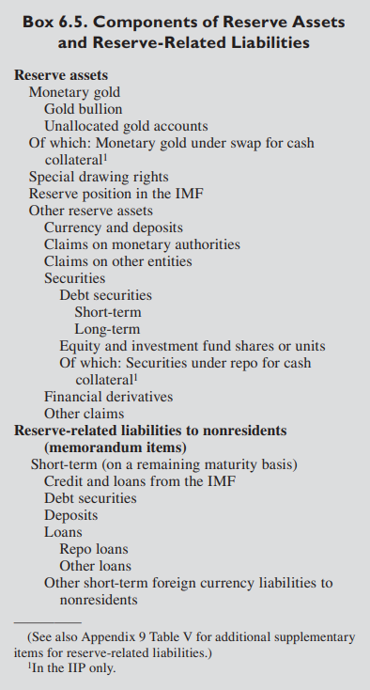
Reserve assets (RA), 2
6.76 Reserve assets consist of monetary gold, SDR holdings, reserve position in the IMF, currency and deposits, securities (including debt and equity securities), financial derivatives, and other claims (loans and other financial instruments).
6.77 Monetary gold, SDR holdings, and reserve position in the IMF are considered reserve assets because they are assets readily available to the monetary authorities in unconditional form. Currency and deposits, securities, and other assets in many instances are equally available and therefore qualify as reserve assets.
https://www.imf.org/external/pubs/ft/bop/2007/pdf/chap6.pdf

Slide 26
Global Composition of Foreign Reserves
According to IMF COFER data (2024–2025), global official reserves amount to around USD 12 trillion. The composition remains dominated by a few key currencies:
• US dollar ≈ 58% of allocated reserves.
• Euro ≈ 20%.
• Japanese yen ≈ 5%.
• Pound sterling ≈ 5%.
• Chinese renminbi ≈ 3% (but slowly rising).
• Other currencies (Canadian dollar, Australian dollar, Swiss franc, etc.) ≈ 9%.
https://chatgpt.com/

Slide 27
Main Economic Functions of Foreign Reserves
Ensuring confidence in the country’s currency and payment capacity.
Intervening in foreign exchange markets to stabilise the exchange rate.
Providing liquidity for international transactions and external debt repayment.
Supporting monetary policy credibility and financial stability.
Acting as insurance against sudden capital outflows or balance-of-payments crises.
https://chatgpt.com/

Slide 28
Strategic Considerations of Foreign Reserves
Geopolitical tool: Large reserves (e.g. China) enhance global influence.
Diversification: Shifting away from the US dollar reduces dependence and vulnerability.
Sovereign wealth management: Some countries allocate part of reserves to sovereign wealth funds.
Security buffer: High reserves strengthen resilience against financial sanctions or external shocks.
Policy autonomy: Ample reserves give central banks flexibility in crisis management.

Slide 29
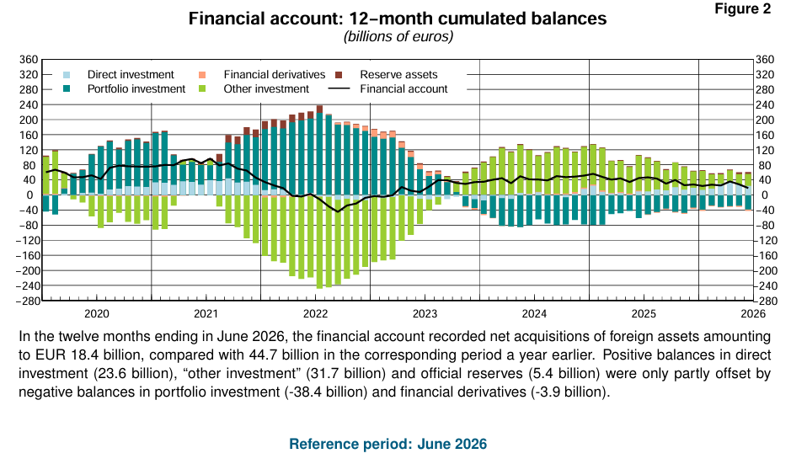
Financial account (Italy), 1
https://www.bancaditalia.it/pubblicazioni/bilancia-pagamenti/2026-bilancia-pagamenti/en_statistiche_BDP_20260819.pdf?language_id=1

Slide 30
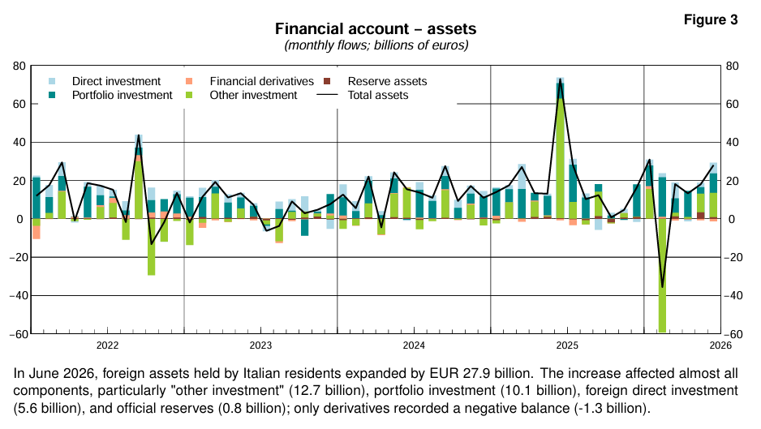
Financial account (Italy), 2
https://www.bancaditalia.it/pubblicazioni/bilancia-pagamenti/2026-bilancia-pagamenti/en_statistiche_BDP_20260819.pdf?language_id=1

Slide 31
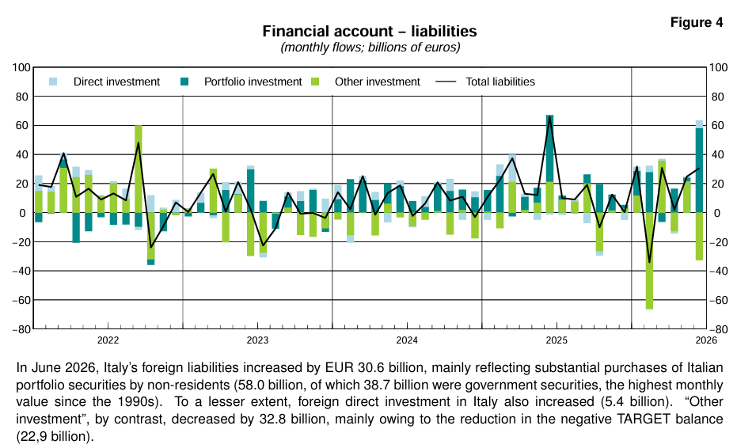
Financial account (Italy), 3
https://www.bancaditalia.it/pubblicazioni/bilancia-pagamenti/2026-bilancia-pagamenti/en_statistiche_BDP_20260819.pdf?language_id=1

Slide 32
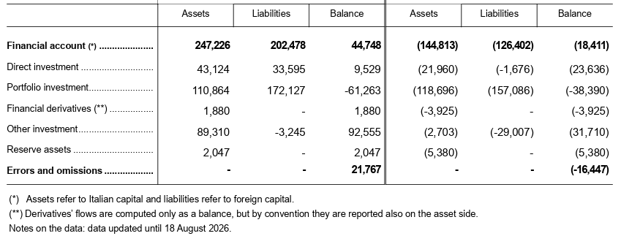
https://www.bancaditalia.it/pubblicazioni/bilancia-pagamenti/2026-bilancia-pagamenti/en_statistiche_BDP_20260819.pdf?language_id=1

Slide 33
Homework
Choose a country to your liking, find data about its balance of payments, comment them focusing on the financial account.
Try and explain the relationship between the balance of the financial account and the notions of net lending / net borrowing
Compare Direct Investment and Portfolio Investment, highlighting similarities and differences.
Take a look at chapters 5, 6, 8 https://www.imf.org/external/pubs/ft/bop/2007/pdf/bpm6.pdf

