Slide 1
INTEC Lecture 8
The Keynesian open economy model
Paolo Paesani
University of Rome Tor Vergata
ALEF Department
22/09/2026

Slide 2
The Keynesian Open Economy Model: The Basic Idea
In the short run, output and employment are determined by aggregate demand rather than by the economy’s productive capacity.
Firms respond to changes in demand by adjusting production and employment.
In an open economy, aggregate demand includes domestic expenditure and net exports:
  Y = C + I + G + X − M
Domestic activity therefore depends not only on consumption, investment and fiscal policy, but also on foreign demand and imports.
The model asks: what determines equilibrium GDP, and how does a change in autonomous expenditure affect it?
Keynesian short-run analysis: demand → output → income

Slide 3
The Principle of Effective Demand
Autonomous
expenditure
Aggregate
demand
Production &
employment
Income
Consumption
Savings
G-T, X-M
Effective demand determines actual output in the short run.
Higher demand creates income; higher income induces additional consumption, generating further demand.
Equilibrium is reached when planned aggregate expenditure equals output.
The causal sequence runs from expenditure to output and income.

Slide 4
The Multiplier Principle
An autonomous increase in expenditure produces a more than proportional increase in equilibrium income.
Why? One person’s expenditure becomes another person’s income.
Part of each additional round of income is spent again on consumption, creating successive rounds of expenditure and income.
The process becomes progressively smaller because part of each additional unit of income leaks out of the expenditure stream.
Initial ΔA: 100
Round 2: c × 100
Round 3: c² × 100
…: …
Closed economy:
k = 1 / (1 − c)
The multiplier measures the total change in income generated by an autonomous change in expenditure.

Slide 5
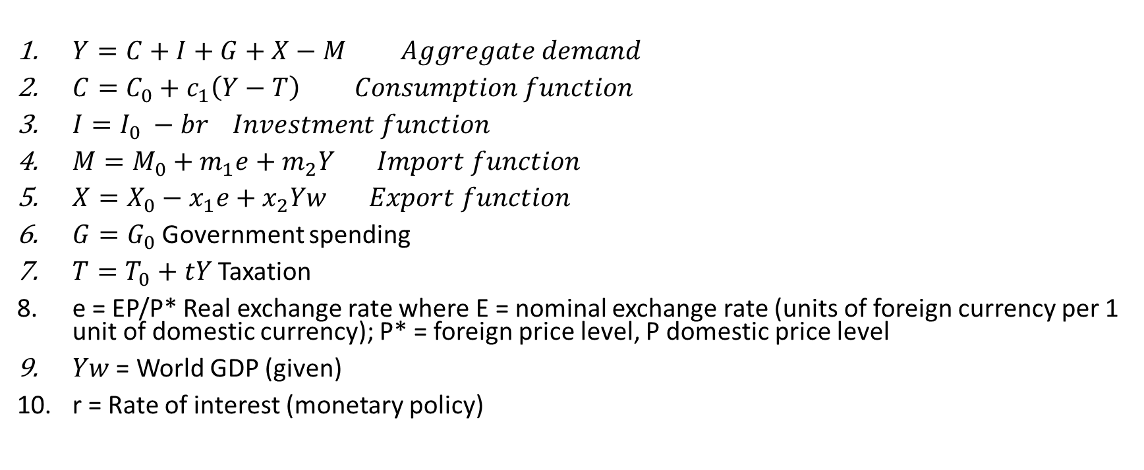
The Keynesian open economy model
$Y=C+I+G+X−M Aggregate demand$
$C=C_{0}+c_{1}\left(Y−T\right) Consumption function$
$I=I_{0} −br Investment function$
$M=M_{0}+m_{1}e+m_{2}Y Import function$
$X=X_{0}−x_{1}e+x_{2}Yw Export function$
$G=G_{0}$ Government spending
$T=T_{0}+tY$ Taxation
e = EP/P* Real exchange rate where E = nominal exchange rate (units of foreign currency per 1 unit of domestic currency); P* = foreign price level, P domestic price level
$Yw$ = World GDP (given)
r = Rate of interest (monetary policy)

Slide 6
The consumption function
Household consumption spending depends on post-tax income. The government charges a tax t, which we assume is proportional to income. The income left after the payment of tax, Y - T, is called disposable income. The marginal propensity to consume, c₁, is the fraction of disposable income (not pre-tax income) consumed. This means that in the aggregate consumption function:
Spending on consumption is written as: C = c₀ + c₁(1 − t)Y - c₁T₀ .
All of the influences on consumption apart from current disposable income are included in autonomous consumption, c₀, and will therefore shift the consumption function in the multiplier diagram. These include wealth and target wealth, collateral effects, and changes in the interest rate.

Slide 7
The investment function
We have just seen that investment spending will be influenced by the interest rate (and by expected post-tax rate of profit). In the aggregate investment function:
Spending on investment is a function of the interest rate and the expected post-tax rate of profit.
Ceteris paribus, a higher interest rate reduces investment spending, shifting down the aggregate demand curve.
A higher expected post-tax rate of profit raises investment spending, shifting up the aggregate demand curve.

Slide 8
Government budget balance
The government budget balance is the difference between government revenue less transfers, T, and government spending, G, that is, (T − G). As we have seen, if the economy is in recession, government transfers, like unemployment benefits, rise while tax revenues fall, so the government’s budget balance deteriorates and may become negative.
When the government’s budget balance is negative, this is called a government budget deficit government spending on goods and services, including investment spending, plus spending on transfers (such as pensions and unemployment benefits) is greater than government tax revenue. A government budget surplus is when tax revenue is greater than government spending. To summarize:
Budget in balance: G = TAX
Budget deficit: G > TAX
Budget surplus: G < TAX
The worsening of the government’s budgetary position in a recession is part of its stabilizing role. Conversely, when the government chooses to override the stabilizers to reduce its deficit, this may amplify fluctuations in the economy.

Slide 9
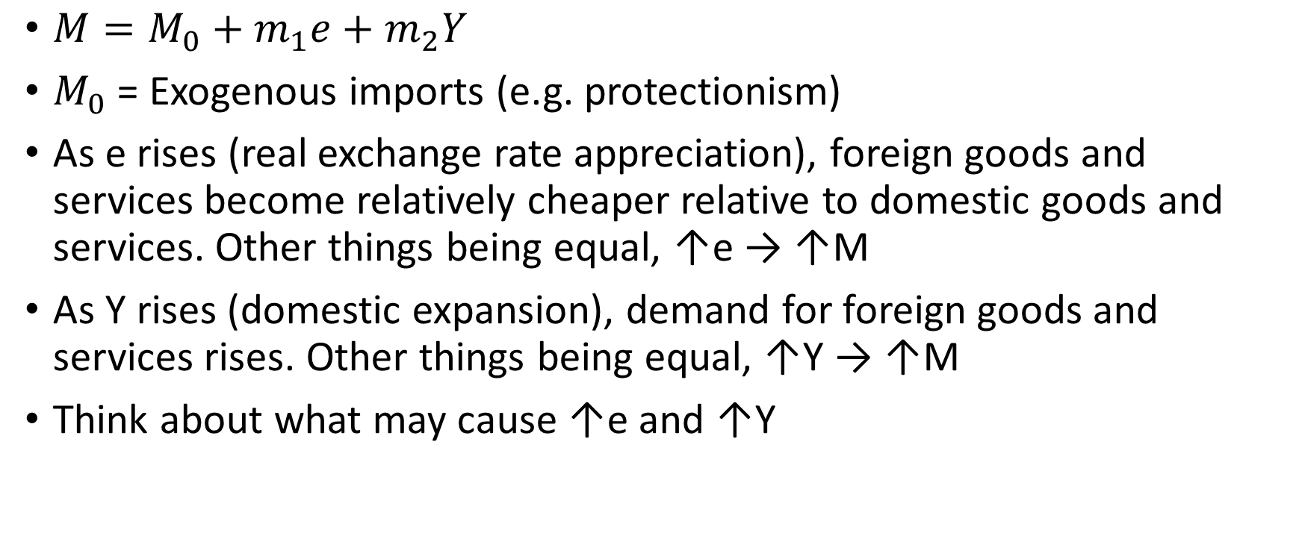
The import function
$M=M_{0}+m_{1}e+m_{2}Y$
$M_{0}$ = Exogenous imports (e.g. protectionism)
As e rises (real exchange rate appreciation), foreign goods and services become relatively cheaper relative to domestic goods and services. Other things being equal, ↑e → ↑M
As Y rises (domestic expansion), demand for foreign goods and services rises. Other things being equal, ↑Y → ↑M
Think about what may cause ↑e and ↑Y

Slide 10
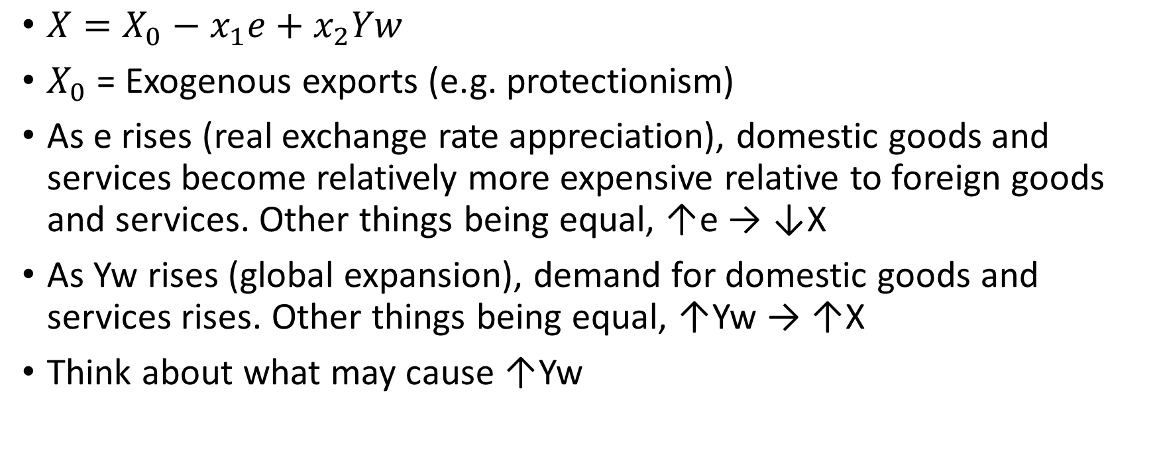
The export function
$X=X_{0}−x_{1}e+x_{2}Yw$
$X_{0}$ = Exogenous exports (e.g. protectionism)
As e rises (real exchange rate appreciation), domestic goods and services become relatively more expensive relative to foreign goods and services. Other things being equal, ↑e → ↓X
As Yw rises (global expansion), demand for domestic goods and services rises. Other things being equal, ↑Yw → ↑X
Think about what may cause ↑Yw

Slide 11
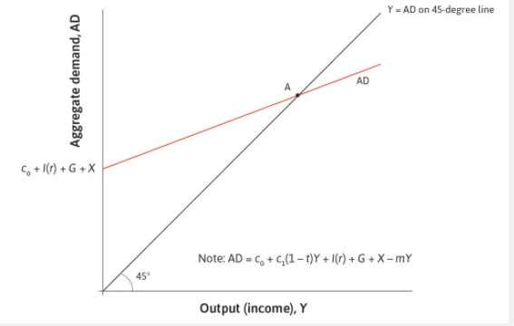
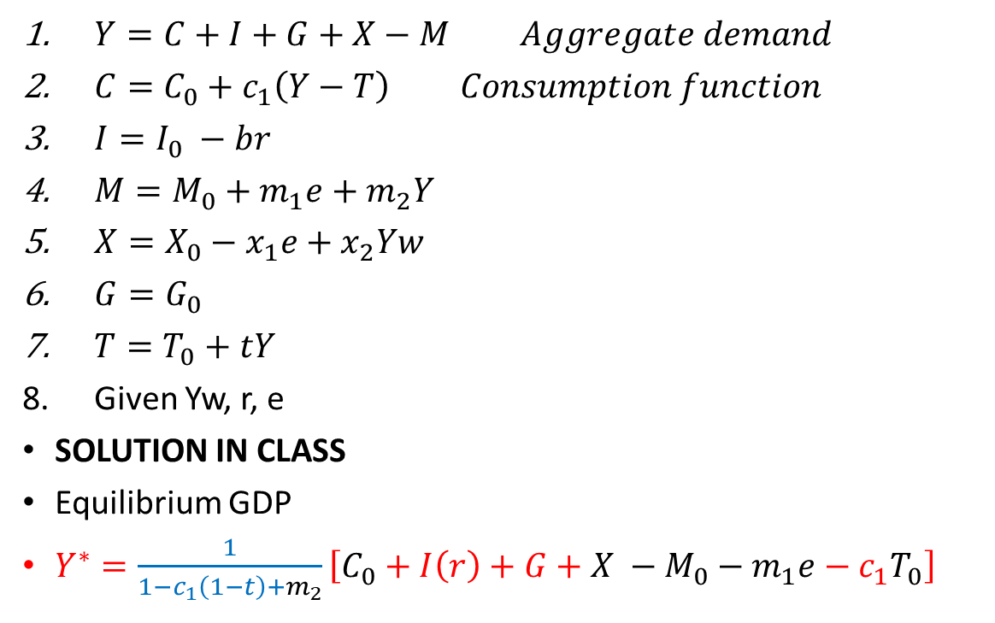
The multiplier model including government and net exports
$Y=C+I+G+X−M Aggregate demand$
$C=C_{0}+c_{1}\left(Y−T\right) Consumption function$
$I=I_{0} −br$
$M=M_{0}+m_{1}e+m_{2}Y$
$X=X_{0}−x_{1}e+x_{2}Yw$
$G=G_{0}$
$T=T_{0}+tY$
Given Yw, r, e
SOLUTION IN CLASS
Equilibrium GDP
$Y^{∗}=\frac{1}{1−c_{1}\left(1−t\right)+m_{2}}\left[C_{0}+I\left(r\right)+G+X −M_{0}−m_{1}e−{c_{1}T}_{0}\right]$

Slide 12
Openness and Taxation Effects
In an open economy, part of domestic demand 'leaks out' as imports.
With taxation, part of income is withdrawn by the government.
Leakages from the income–expenditure circuit include:
– Saving (S)
– Taxes (T)
– Imports (M)
The multiplier is therefore smaller than in a closed economy without taxes.

Slide 13
Formula and Policy Implications
General formula in an open economy with taxation:
k = 1 / [1 – c(1 – t) + m]
where:
c = marginal propensity to consume
t = tax rate
m = marginal propensity to import
Higher t or m reduces the multiplier (why).
Fiscal policy is less powerful in open economies with taxation than in closed economies without taxation.

Slide 14
From a Closed to an Open Economy: Leakages Matter
Closed economy
Open economy
With no government and no foreign trade, the main leakage is saving.
Every additional unit of income is either consumed or saved.
Multiplier: k = 1 / (1 − c)
Taxes reduce disposable income and induced consumption.
Imports are expenditure on foreign rather than domestic production.
Leakages: saving + taxes + imports.
Multiplier: k = 1 / [1 − c(1 − t) + m]
Openness adds an import leakage: part of additional domestic expenditure generates income abroad.

Slide 15
Why Is the Open-Economy Multiplier Smaller?
k = 1 / [1 − c(1 − t) + m]
c = marginal propensity to consume → a higher c strengthens induced expenditure and raises the multiplier.
t = proportional tax rate → a higher t reduces disposable income and lowers the multiplier.
m = marginal propensity to import → a higher m diverts additional expenditure towards foreign goods and lowers the domestic multiplier.
Therefore, the same autonomous increase in domestic expenditure generates a smaller increase in domestic GDP when the economy is more open to imports.
Important: the ‘lost’ domestic demand is not destroyed — it becomes demand for production and income abroad.
This provides the basis for analysing fiscal policy, trade flows and international transmission in the Keynesian open-economy model.

Slide 16
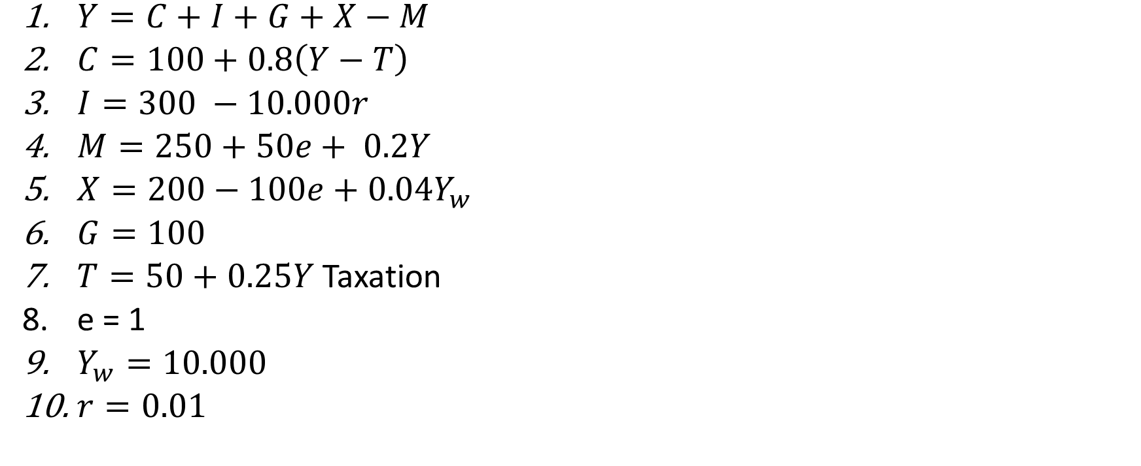
Flash exercise
$Y=C+I+G+X−M$
$C=100+0.8\left(Y−T\right)$
$I=300 −10.000r$
$M=250+50e+ 0.2Y$
$X=200−100e+0.04Y_{w}$
$G=100$
$T=50+0.25Y$ Taxation
e = 1
$Y_{w}=10.000$
$r=0.01$

Slide 17
Questions
What is the tax rate?
What is the value of the MPC? What is the value of the MPS?
What does the value of the MPC imply?
What is the value of the Keynesian multiplier?
What is the value of autonomous demand?
What is the value of equilibrium GDP?
Equilibrium consumption? Equilibrium savings? Equilibrium imports?
Government budget balance? Int.l trade balance?
IF KAB = 0, NEO = 0, PRINC balance = 150, SECINC balance = - 200, is the country a net borrower or a net lender?

