Slide 1
Introduction to
International economics
Lecture 6
Paolo Paesani
University of Rome Tor Vergata
ALEF Department
22/09/2025

Slide 2
Reconciliation of National Accounts and Balance of Payments, 1
GDP = C + I + G + EX – IM
EX = Exports of goods and service
IM = Imports of goods and services
EX – IM = Trade balance (a.k.a. Net exports)
GDP (definition) = Gross Domestic Income
2. GDP + PRI + SEC + KAB = GNI = C + I + G + CAB + KAB
GDP + PRI + SEC + KAB = Gross National Income (GNI)
(EX – IM + PRI + SEC) + KAB = CAB + KAB = Money flowing from foreign countries into the country + Money flowing to foreign countries from the country
GNI = GDP + Net Payments by foreign residents to residents

Slide 3
Reconciliation of National Accounts and Balance of Payments, 2
3. GNI = C + I + G + CAB + KAB
Add Government transfers and subtract taxes from both sides
4. GNI + GTR – TAX = C + I + (G + GTR – TAX )+ CAB + KAB = GNDI
GNI + GTR – TAX = Gross National Disp Income (net of GTR and taxes)
G + GTR – TAX = Government budget balance = ∆Public debt
  TAX – G – GTR = Savings of the public sector = Spub (including capital account expenditure and revenues)
  If G + GTR > TAX = Government budget deficit = Public debt rises (Spub is negative)
  If G + GTR < TAX = Government budget surplus = Public debt falls (Spub is positive)

Slide 4
Reconciliation of National Accounts and Balance of Payments, 4
5. GNDI = C + I - Spub+ CAB + KAB
Subtract private consumption from both sides
DNI – C = Savings of the private sector = Spri
Remember that CAB + KAB = FAB
6. Spri = I – Spub + FAB
7. Spri + Spub = Stot = I + FAB
8. Stot – I = FAB = ∆NIIP
  Stot – I > 0, FAB > 0 (Country is a net lender), ∆IIP > 0
  Stot – I < 0, FAB < 0 (Country is a net borrower), ∆IIP < 0

Slide 5
Reconciliation of National Accounts and Balance of Payments, 5
9. Stot – I + KAB = FAB ≈ ∆NIIP
  CAB + KAB – FAB + NEO = 0, if NEO = 0 then CAB + KAB ≈ FAB
  ∆NIIP = FAB + Changes in volume + Changes in value
Net lending/net borrowing (from the sum of the current account balance and capital account balance) is conceptually equal to net lending/net borrowing from the financial account.
Alternatively, it could be said that the current account balance is equal to the sum of balances on the capital and financial accounts (with signs reversed, if necessary, depending on the presentation used) including reserve assets.

Slide 6
BOP and IIP: financial implications
CAB+ KAB – FAB + NEO = 0 → CAB + KAB + NEO = FAB → CAB ≈ FAB ≈ ΔNIIP
Situation 1: FAB > 0 (Country is Net lender)
  The country’s international investment position improves
  Net Foreign Assets rise = Foreign assets rise, foreign liabilities fall
  The country international financial position strengthens / Macro consequences
Situation 2: FAB < 0 (Country is Net borrower)
  The country’s international investment position worsens
  Net Foreign Assets fall = Foreign assets fall, foreign liabilities rise
  The country international financial position weakens / Macro consequences
Situation 2: FAB = 0 (Balance)

Slide 7
Alternative uses of the previous identities
Use 1: FAB = Stot – I = ∆NIIP (focus on the country’s net international investment position. If total domestic savings exceed domestic investment, the difference is ‘invested’ abroad, net foreign assets rise. If total domestic savings fall short of domestic investment, the difference is ‘borrowed’ abroad, net foreign assets fall)
Use 2: I = Spri + Spub - FAB (focus on domestic investment and who finances it). Recall that if foreign residents finance investment in the country this implies a negative FAB (and a positive – FAB). The country’s foreign liabilities rise and its net foreign assets.
Use 3: G + TR - TAX = (Spr – I) – FAB (focus on the country’s government budget deficit, which can be financed by residents or by foreigners.

Slide 8
BOP and the FOREX market, 1
Demand for foreign currency arises from: import of goods and services, payment of income and transfers to foreign residents, financial investments from the country to foreign countries, bull speculation on the foreign currency, bear speculation on the domestic currency, and reductions in official reserves. All these transactions give rise to outgoing payments recorded as debit items in the balance of payments.
Supply of foreign currency originates from: export of goods and services, payment of income and transfers to domestic residents, financial investments from abroad into the country, bull speculation on the domestic currency, bear speculation on the foreign currency, and increases in official reserves. All these transactions give rise to incoming payments and are recorded as credit items in the balance of payments.

Slide 9
BOP and the FOREX market, 2
Persistent imbalances between outgoing and incoming payments can affect the country's exchange rate - that is the value of it currency relative to those of other countries.
In order to understand how this can happen, we must first define exchange rates and exchange rate regimes, and understand how the foreign exchange market operates under floating and fixed exchange rates.
At this stage, we can anticipate that, other things being equal, a flexible exchange rate will result in excess outgoing payments depreciating the domestic currency and excess incoming payments appreciating it. Under a fixed exchange rate, however, the central bank must intervene by selling reserves when demand for foreign currency exceeds supply (risking reserve depletion and forced devaluation), or buying reserves when supply exceeds demand (expanding the money supply).

Slide 10
BOP and the FOREX market, 3
Outgoing payments = Imports of G/S + Incomes/Transfers payable + Investments abroad excluding change in official reserves (DI, PI, FD, OI)
Incoming payments = Exports of G/S + Incomes/Transfers receivable from abroad + Investments into the country excluding change in official reserves (DI, PI, FD, OI)
Incoming payments – Outgoing payments = CAB + KAB – (DI + PO + FD + OI) = Change in official reserves
If the country’s official reserves fall, sooner or later the country’s currency will depreciate (if allowed by the ER ragime).
If the country’s official reserves rise, sooner or later the country’s currency will appreciate (if allowed by the ER ragime).
 | Outgoing payments > Incoming payments Negative FAB | Incoming payments > Outgoing payments Positive FAB
Floating ER regime | Domestic currency depreciates relative to Foreign currencies Official reserves fall | Domestic currency appreciates relative to Foreign currencies Official reserves rise
Fixed ER regime | Official reserves fall | Official reserves rise

Slide 11
Nominal Bilateral Exchange Rates
Definition:
The price of one country’s currency expressed in terms of another’s.
Quotation methods:
Direct quote: domestic currency per unit of foreign currency.
Indirect quote: foreign currency per unit of domestic currency.

Slide 12
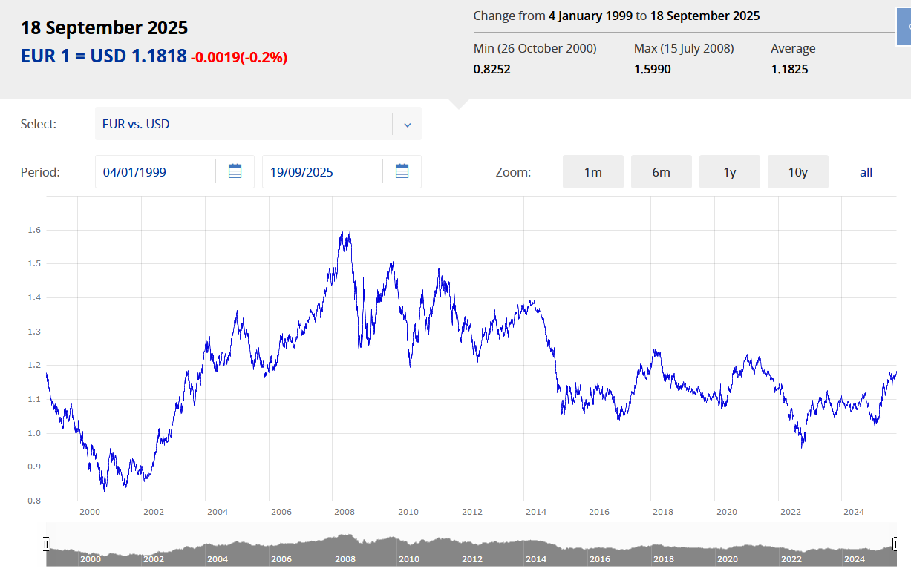
https://www.ecb.europa.eu/stats/policy_and_exchange_rates/euro_reference_exchange_rates/html/eurofxref-graph-usd.en.html

Slide 13
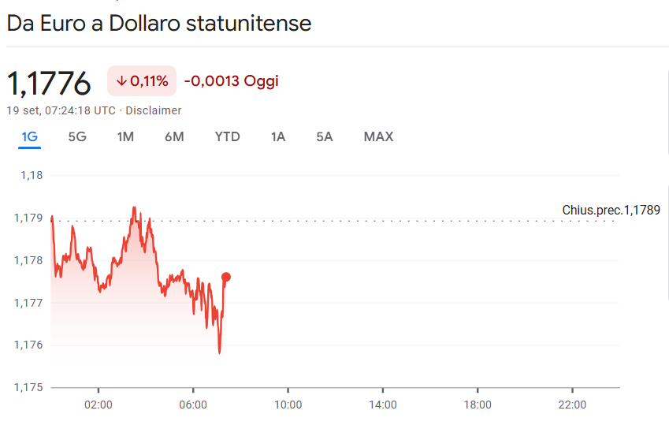
https://www.google.com/finance/quote/EUR-USD?sa=X&ved=2ahUKEwjyneXUpeSPAxU_gf0HHaK0NDgQmY0JegQIDRAv

Slide 14
Nominal Effective Exchange Rate (NEER)
Definition:
Weighted average of a currency’s bilateral exchange rates against a basket of foreign currencies.
Computation:
Select relevant trading partners.
Assign trade-weighted shares.
Calculate geometric or arithmetic average of exchange rates.

Slide 15
Example: Calculation of NEER
Suppose a country trades with two partners, A and B.
Trade shares: A = 60%, B = 40%.
Bilateral exchange rate changes:
Currency appreciates 10% against A.
Currency depreciates 5% against B.
NEER change = (0.6 × 10%) + (0.4 × -5%) = +4%.
Interpretation: The domestic currency has appreciated by 4% in effective terms.

Slide 16
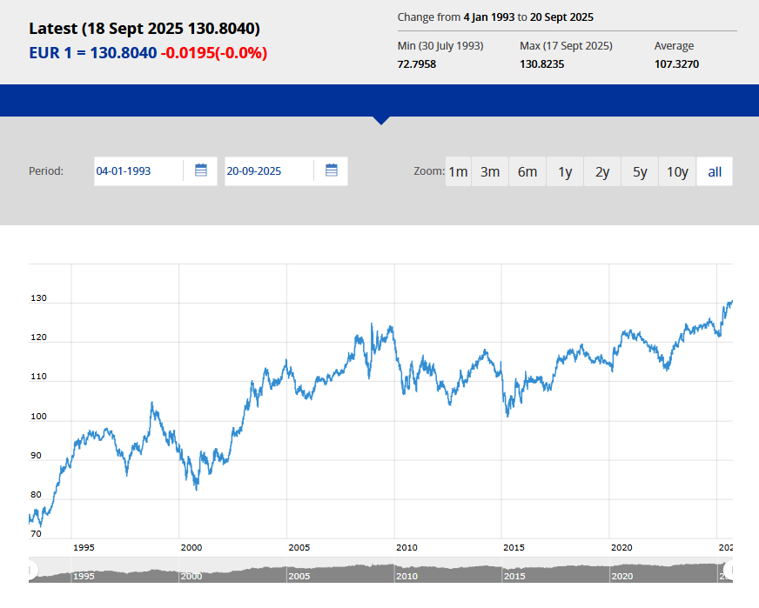
https://www.ecb.europa.eu/stats/balance_of_payments_and_external/eer/html/index.en.html

Slide 17
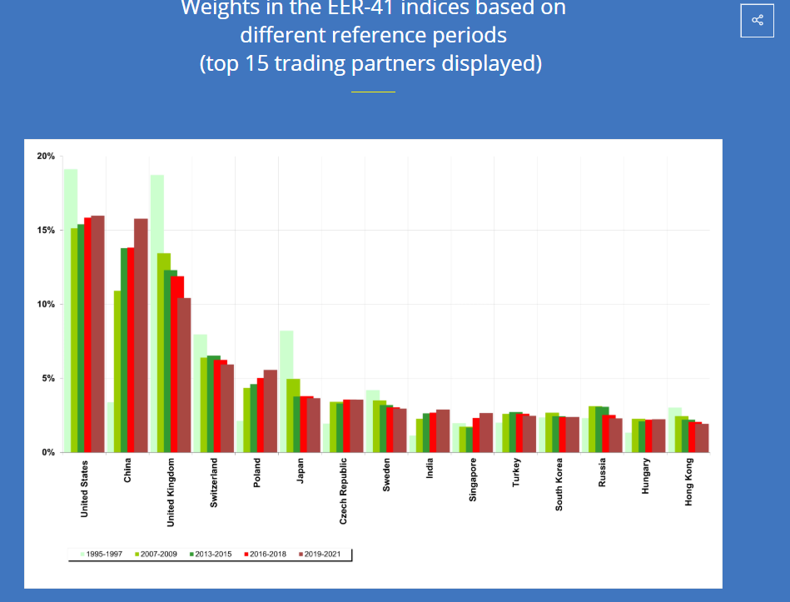
https://www.ecb.europa.eu/stats/balance_of_payments_and_external/eer/html/index.en.html

Slide 18
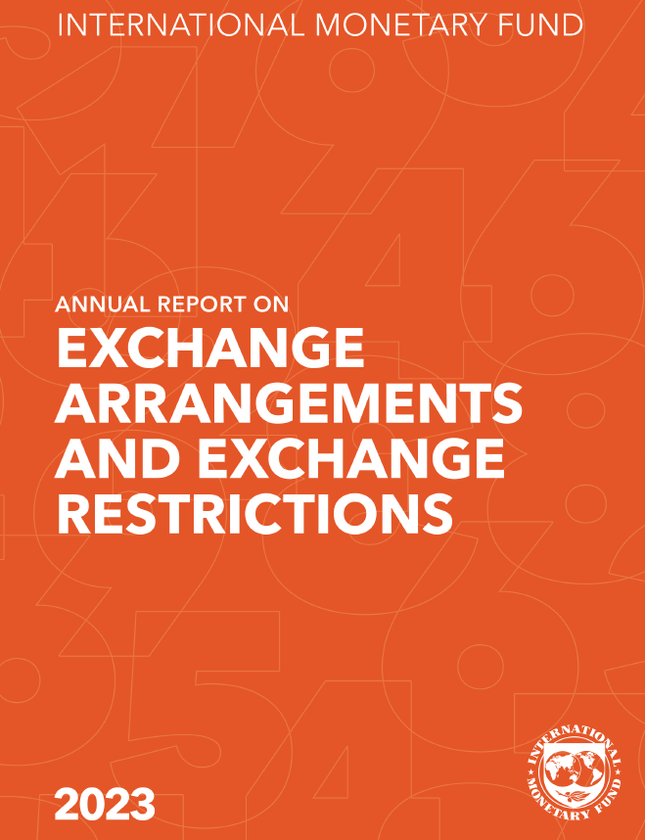
Exchange Rate Regimes
Definition: Institutional framework governing currency valuation.
Main types:
Free/floating regime.
Managed (Dirty) float.
Fixed or pegged regime.
Adjustable peg or crawling peg.
Currency union or dollarisation.

Slide 19
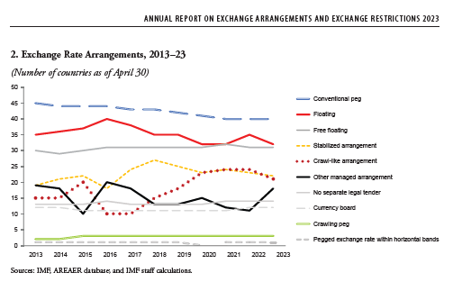
https://www.elibrary.imf.org/display/book/9798400260391/9798400260391.xml?cid=lk-com-dsp-imf.org

Slide 20
https://www.elibrary.imf.org/display/book/9798400260391/9798400260391.xml?cid=lk-com-dsp-imf.org

Slide 21
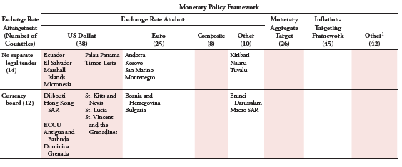
https://www.elibrary.imf.org/display/book/9798400260391/9798400260391.xml?cid=lk-com-dsp-imf.org

Slide 22
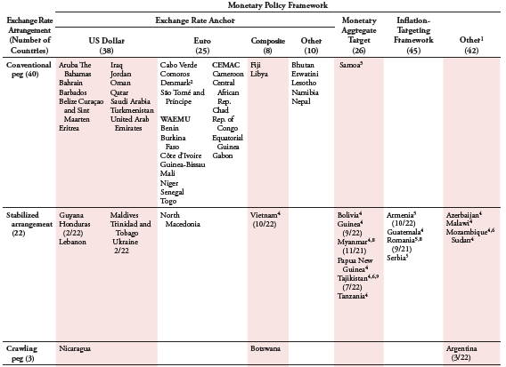
https://www.elibrary.imf.org/display/book/9798400260391/9798400260391.xml?cid=lk-com-dsp-imf.org

Slide 23
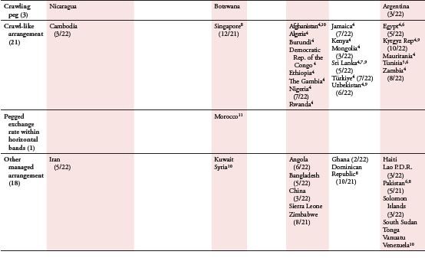
https://www.elibrary.imf.org/display/book/9798400260391/9798400260391.xml?cid=lk-com-dsp-imf.org

Slide 24
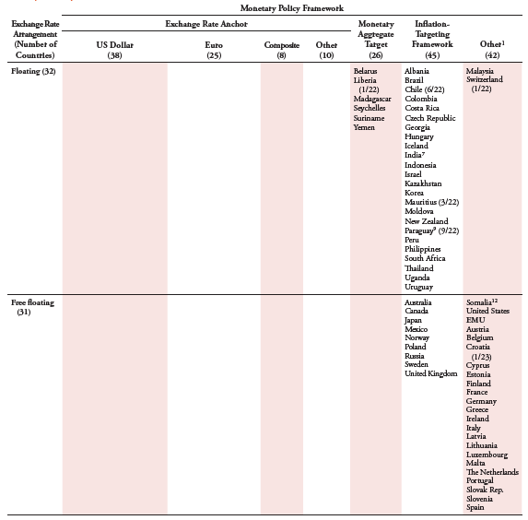
https://www.elibrary.imf.org/display/book/9798400260391/9798400260391.xml?cid=lk-com-dsp-imf.org

Slide 25
Importance of Understanding Exchange Rates and Regimes
Trade Competitiveness – Exchange rates (both nominal and real) affect the relative prices of exports and imports, influencing a country’s trade balance.
Investment Decisions – Investors assess exchange rate risks when choosing where to allocate capital (both DI and PI).
Inflation Control – Exchange rate movements can affect domestic inflation through the cost of imported goods and services and their influence on aggregate demand.
Monetary Policy – Exchange rate regimes constrain or enable central banks in pursuing independent monetary policies (more on this in Lecture 7).
External Debt Servicing – Countries with foreign-denominated debt are directly affected by exchange rate fluctuations.
Foreign Exchange Reserves Management – Fixed or managed regimes require active reserve policies, while flexible regimes reduce this burden (more on this in Lecture 7).
Economic Stability – Exchange rate misalignments can lead to crises, capital flight, or speculative attacks.
Tourism and Remittances – Exchange rates influence tourism flows and the real value of remittances sent home.
Global Competitiveness Rankings – Exchange rate stability or volatility shapes perceptions of a country’s economic credibility.
Policy Coordination – Knowledge of exchange rate regimes is essential for international negotiations, trade agreements, and regional economic cooperation
https://chatgpt.com/

Slide 26
Appreciation and Depreciation (Floating)
Appreciation: Increase in domestic currency value relative to foreign currency.
Depreciation: Decrease in domestic currency value relative to foreign currency.
Bilateral concept.
Determined by supply and demand in foreign exchange markets (Lecture 7).

Slide 27
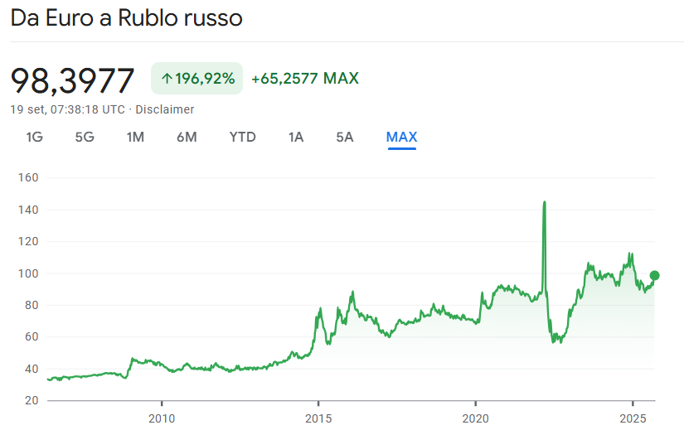
https://www.google.com/finance/quote/EUR-RUB?sa=X&ved=2ahUKEwjHnNWAqeSPAxVPlP0HHQ0WIooQmY0JegQIDRAu&window=MAX

Slide 28
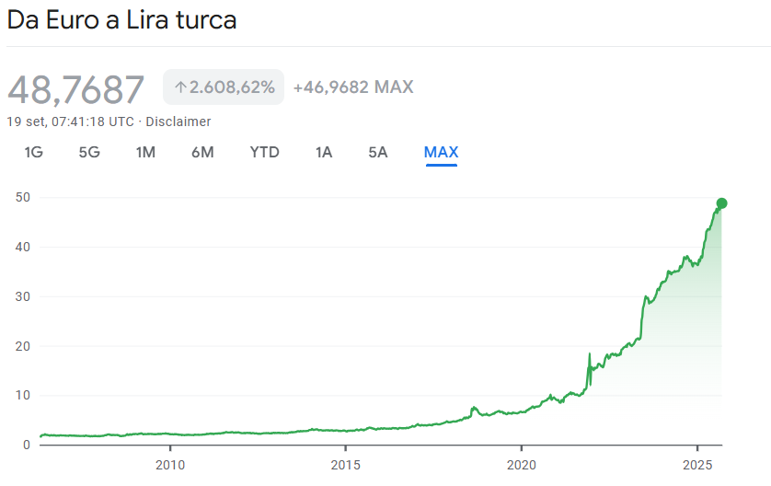
https://www.google.com/finance/quote/EUR-TRY?sa=X&ved=2ahUKEwjcrqvKqeSPAxWP9rsIHaMtCGwQmY0JegQIHBAu&window=MAX

Slide 29
Revaluation and Devaluation (Fixed but Adjustable)
Revaluation: Official upward adjustment of domestic currency value relative to foreign currency.
Devaluation: Official downward adjustment of domestic currency value relative to foreign currency.
Applied in fixed but adjustable exchange rate systems to correct imbalances.

Slide 30
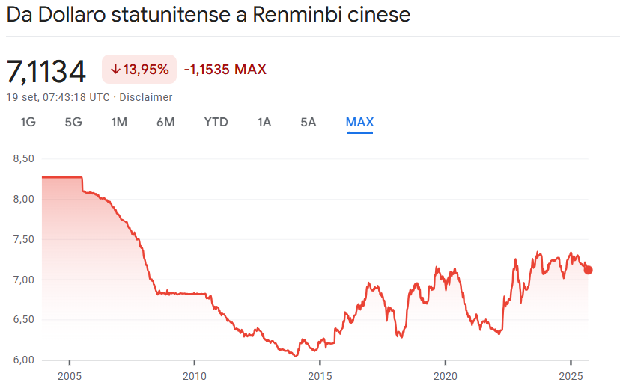
https://www.google.com/finance/quote/USD-CNY?sa=X&ved=2ahUKEwjNpuj0qeSPAxWygf0HHVpnHFMQmY0JegQIIRAv&window=MAX

Slide 31
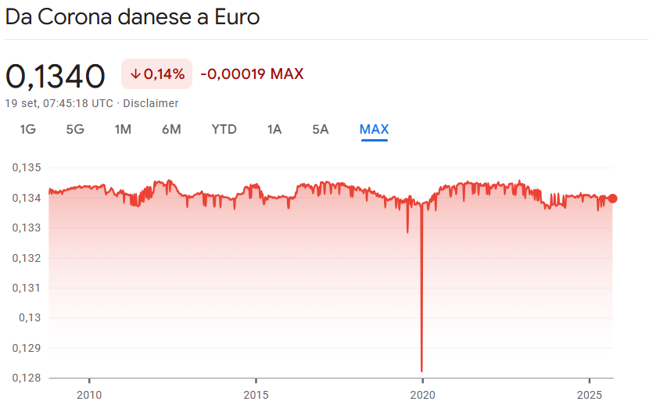
https://www.google.com/finance/quote/DKK-EUR?sa=X&ved=2ahUKEwiZ65e2quSPAxUdgf0HHYwcJ10QmY0JegQIDRAu&window=MAX

