Slide 1


Transformations to Just and Sustainable Futures
Workshop day 4:
Finalise interventions
Presentations
Final reflections
Clara Saglietti
26/02/2026

Slide 2
Space 3: transformative interventions
1
Desirable futures
3
2
Present situation
Transformative interventions

Slide 3
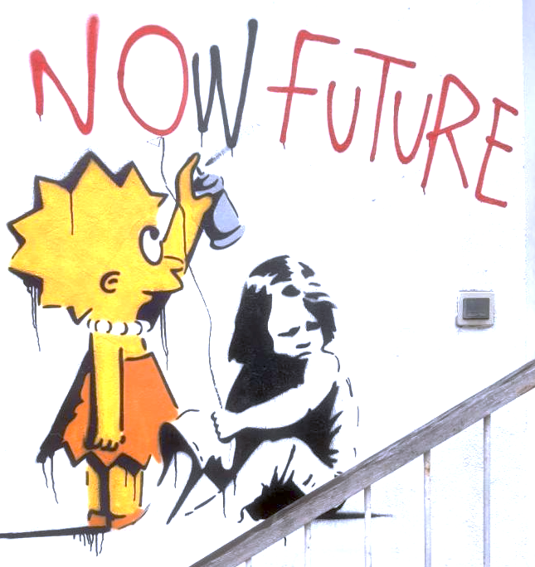

Slide 4
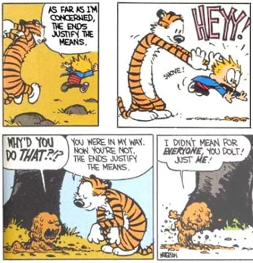
Relation between means and ends
Means-ends equivalence
Means-ends coherence
Beginnings without ends

Slide 5
Strategies
Symbiotic strategies
Taming capitalism:
Changing the rules of the game
Ruptural strategies
Smashing capitalism:
Changing the game itself
Interstitial strategies
Escaping or resisting capitalism:
Avoiding the game or starting another one on the side

Slide 6

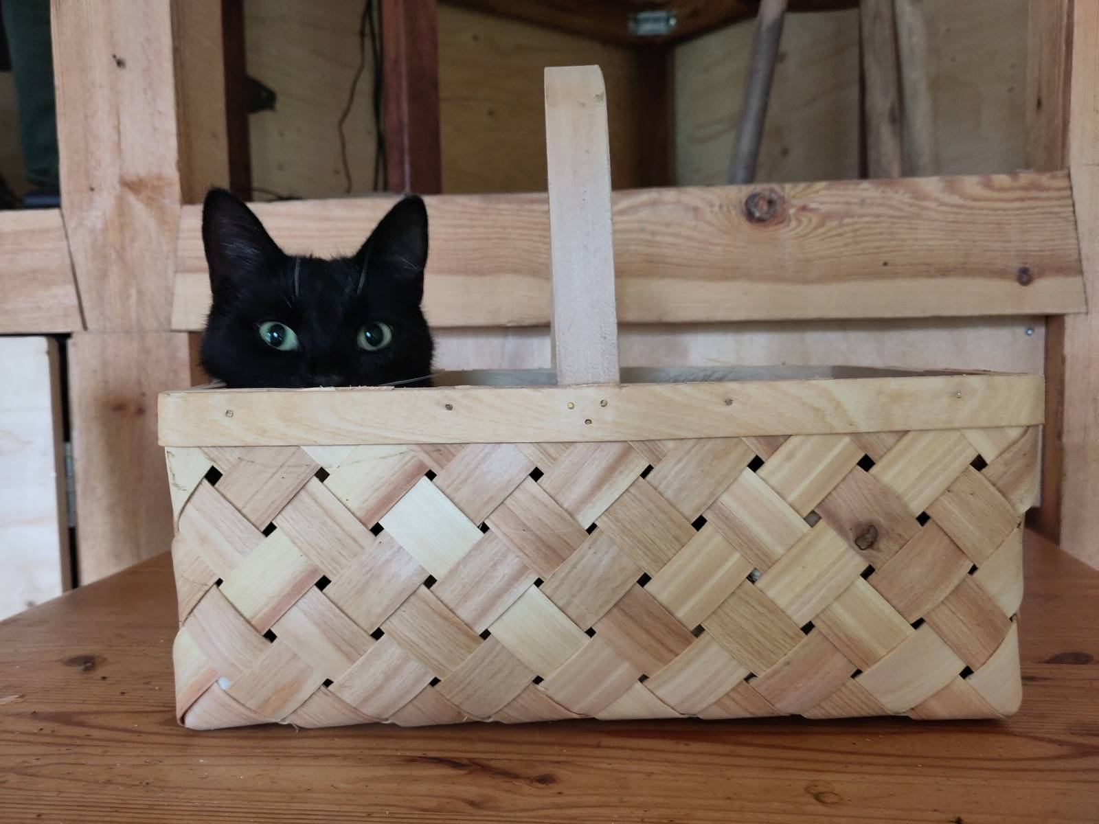
Positioning with respect to systems

Slide 7
Interventions
Intervention: purposeful action by an agent to influence change; e.g. also includes what/how to go about it, and internal motivation, reasons and ethics

Slide 8

Connect
Are there societal actors to connect with? (e.g., responsible organisations, institutions, movements, etc)
Are there already ongoing processes on site to link to?
Are there inspiring examples elsewhere to involve or learn from?
Anyone else you would like to involve in the process? (e.g., key actors, audience, target)

Slide 9
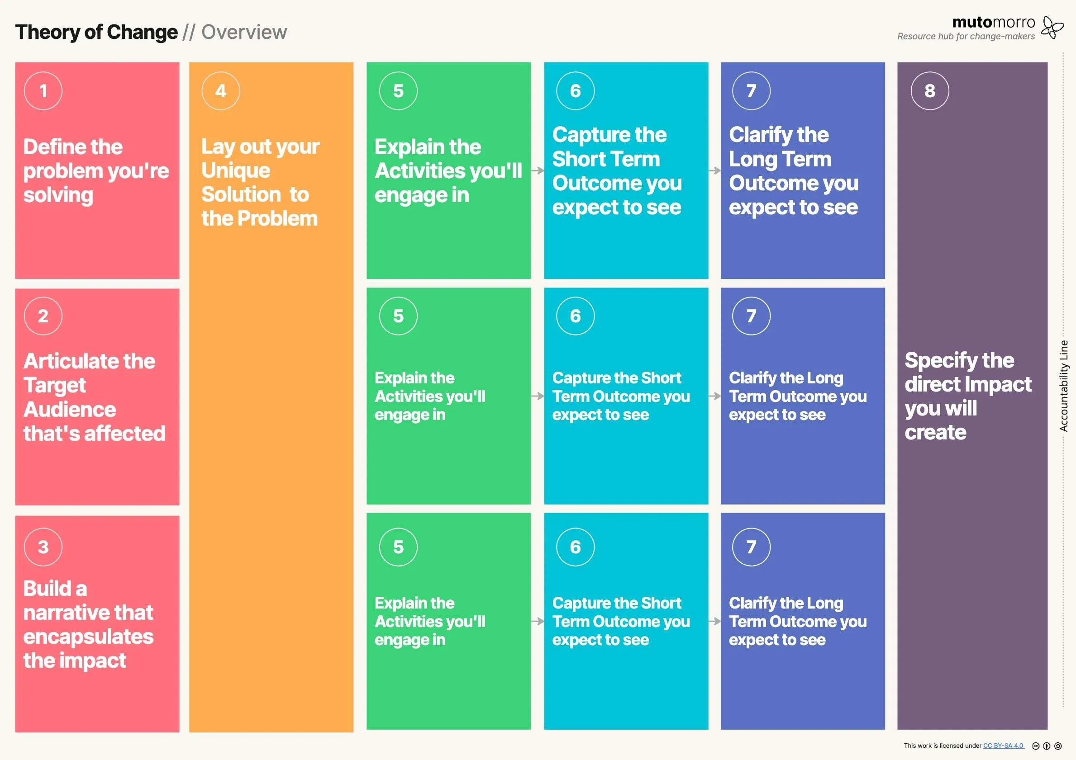
Theory of change template

Slide 10
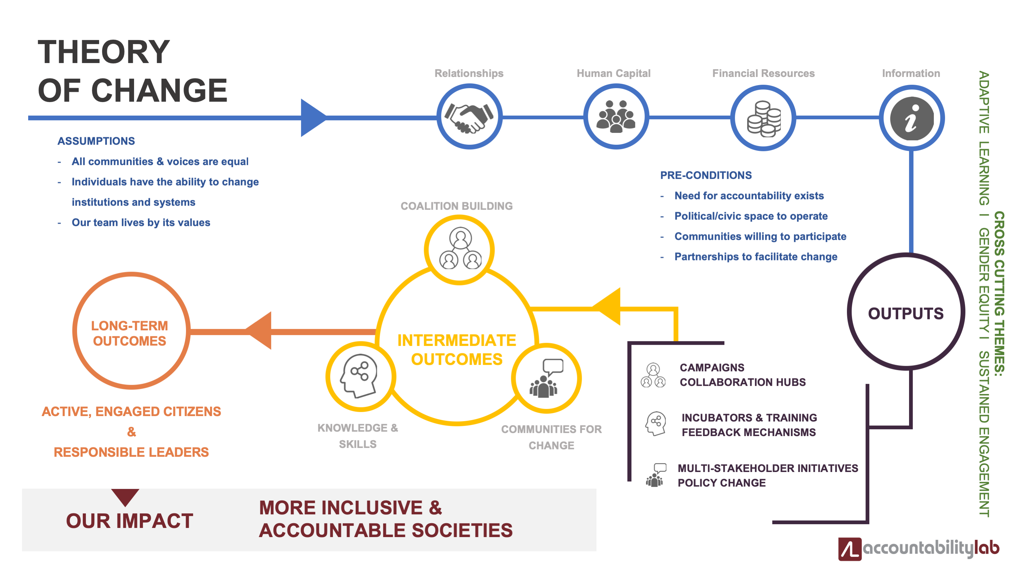

Slide 11
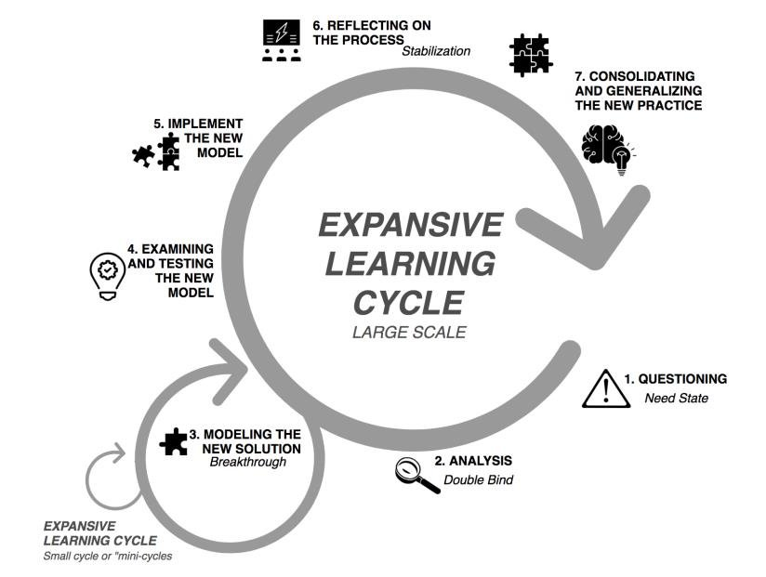

Slide 12
How to enact desirable futures?
Storytelling and metaphors
Visions and visual representations
Embodyment of guiding principles and values
Sounds and other artistic forms of experssion
Cognitive frames/how we look at the world
Role playing and experiential futures

Slide 13
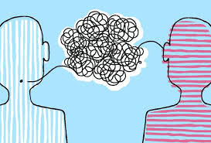

Slide 14
Thank you
For any questions or thoughts: clara.saglietti@chalmers.se

