Slide 1
Consumer Choices
DAY1 - Introduction
Professor Ilijana Petrovska
Visiting professor Tor Vergata University

Slide 2

Coca-Cola | Holidays Are Coming

Slide 3

Prof. Ilijana Petrovska
  Full Marketing Professor at University American College Skopje
  Visiting professor at BAE Tor Vergata University since 2016
  Programme Leader Digital Marketing MSc at Northumbria University Qatar 2023/24
  Research areas: Digital and integrated marketing communications, entrepreneurship, online consumer behavior, sustainability and digitialization.
  Executive Education– Digital marketing at Columbia Business School in 2022, Northwestern Kellogg Business School in 2019, Harvard Business School training at EFER EEC Barcelona 2010
  Previous work experience – University of Derby, Stenden University, Qatar University and ten years as a Bank’s Marketing manager and worked in Advertising Agency S Team Bates Saatchi&Saatchi
  Passions: Sport –Running, Tennis, Hiking, Yoga…, Reading a good Book, Traveling, Music listening and Inspiring People.

Slide 4
DAY 1 Overview
1. Introduction to the course
2. Students’ introduction
3. Introduction for Consumer choices
4. Relevance for Marketing
5. Trends in Consumer Choices &
6. Starting the 1st Assignment

Slide 5

The purpose of this Course
Provide you with understanding of contemporary Consumer Choices, Behavior, Analytics
and how to use it for Marketing

Slide 6
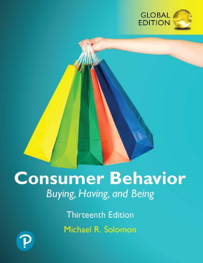
Basic textbook
Additional readings and
articles are expected

Slide 7
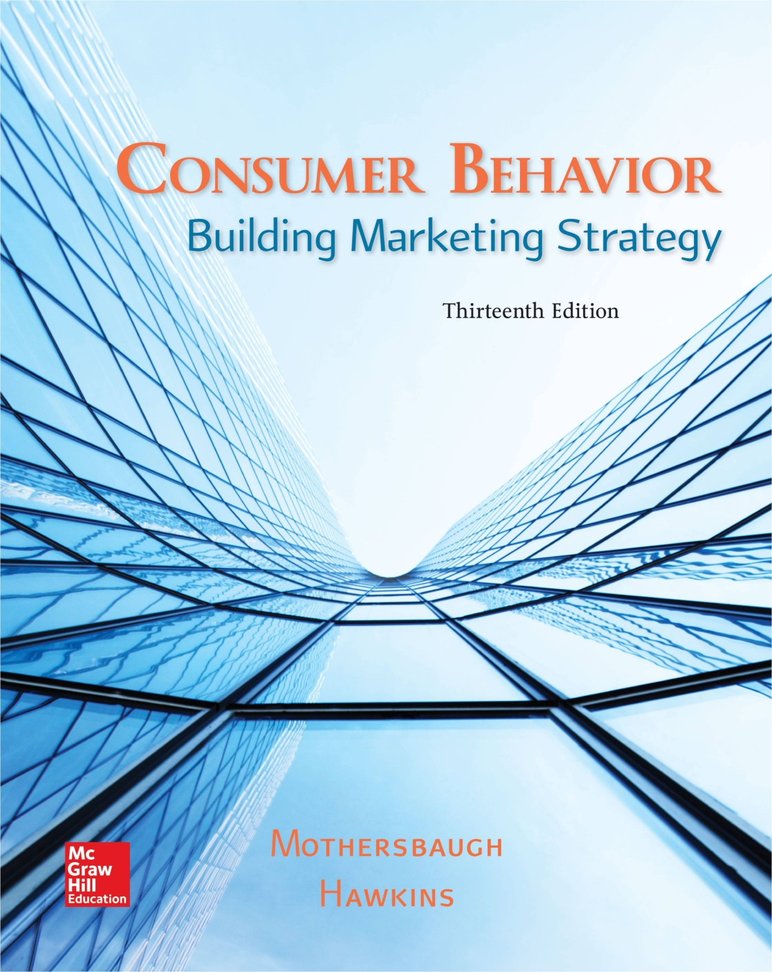

Additional literature

Slide 8
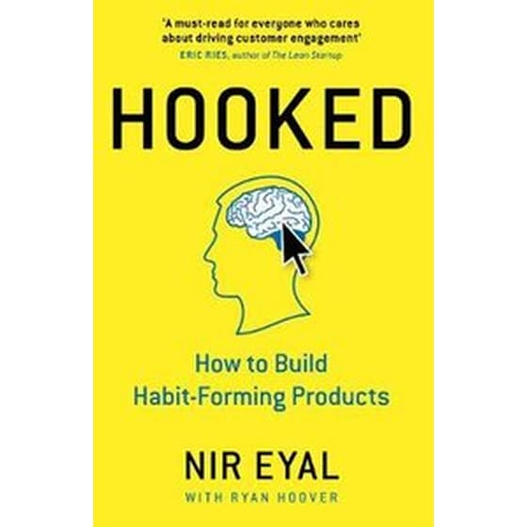
Crowdsourcing & Co-creation!!!
Online resources
GenAI
Google scholar
Online libraries

Slide 9
Learning objectives
Learn the fundamental principles and theories in consumer behaviour and consumer choices
Develop abilities to apply consumer behaviour concepts to marketing problems;
Understand the basic analytical tools that can be used to investigate consumer choices.

Slide 10
Learning outcomes
Conduct small scale independent research
Develop customer journey mapping relevant to marketing;
Critically apply the knowledge in the decision connected to various consumer behaviour situations.

Slide 11
Course delivery
Lectures & Co-creation
Student group presentations
Case discussions
Group work activities
Team building games
Videos
Guest Speaker
Real case Project assignment

Slide 12
Course assessment criteria
Group presentation on Consumer trends - 30% - every class different group of students
Final project is consisted of Market research on a Luxury brand – 70%
  Final project Group presentation – 10% - the last class
  Final project Group written report - 20% - 1 week after the last class
3. Reflection Logs – 10%
4. Final Exam – 30%
Class participation:
Expected is at least 2/3 of the class participation.
The most Active students will be Awarded

Slide 13

Pitch yourself!
Write / Draw
Present Yourself as Another Being
Animal, Bird, Insect, Lizard… 5 min
BRAND YOURSELF!
Notes:
15 mintues

Slide 14
Present Yourselves
Who are you?
What do you like?
What are you Best in?
What would you like to improve?
Do you have any specific expectations from this course?
Include photo, drawing and short explanation!
UPLOAD IT! Upload the photo and the self presentation on MS Teams Profiles folder

Slide 15
MS TEAMS CODE taegu88

Slide 16
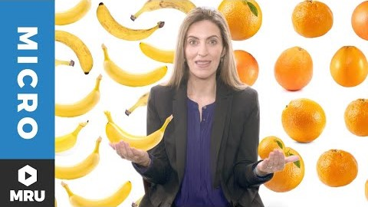
3. Intro to Consumer Choice

Slide 17
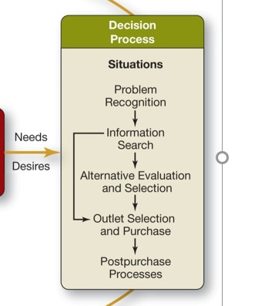
What choices we have? What decisions we make in each stage?

Slide 18
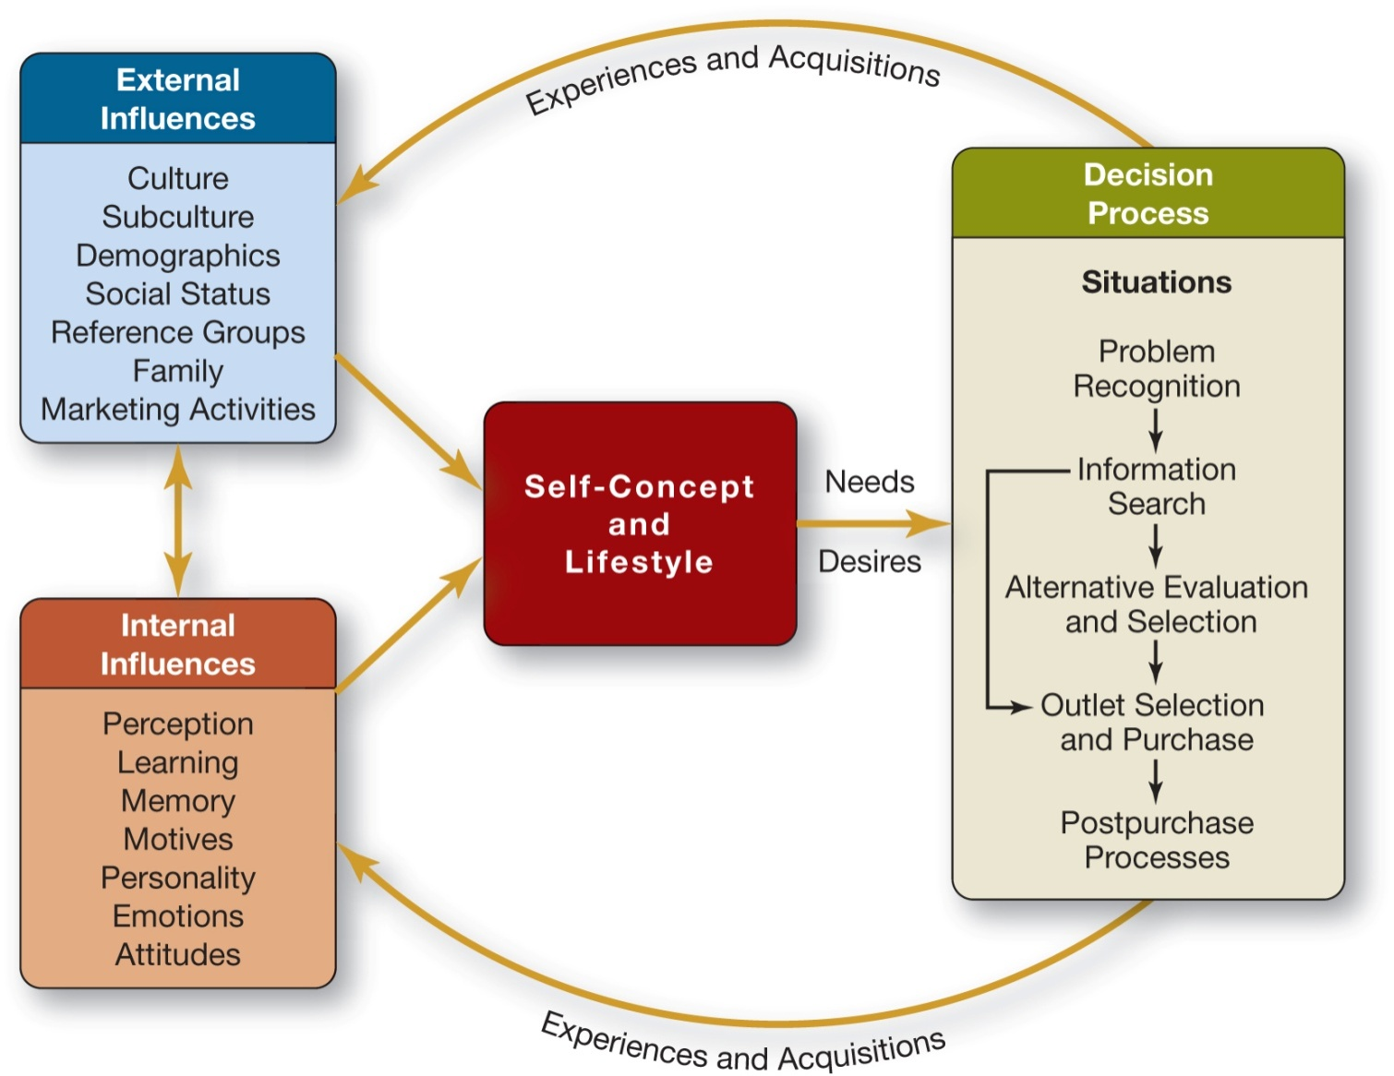
PART I: INTRODUCTION
1-18
Notes:
How the life in 21st century influence on the Decision process? Different types of problems, Different and multimedia information search, different and multi channel outlets, different post-purchase communication
Marketing 2 Consumers shift into Marketing4 Consumers

Slide 19
What Is Consumer Behavior?
The study of the processes involved when individuals or groups select, purchase, use, or dispose of products, services, ideas, or experiences to satisfy needs and desires.

Slide 20
Figure 1.1 Stages in the Consumption Process
Notes:
We call the person who identifies a need or desire, makes a purchase, and then disposes of the product as a consumer. The purchaser or user might be the same person, or not. You can see in the slide that there are three key stages: 1) prepurchase, 2) purchase, and 3) postpurchase. Marketers need an understanding of all three stages.

Slide 21
Why we need to understand the customer choices?
What is the connection with marketing?

Slide 22
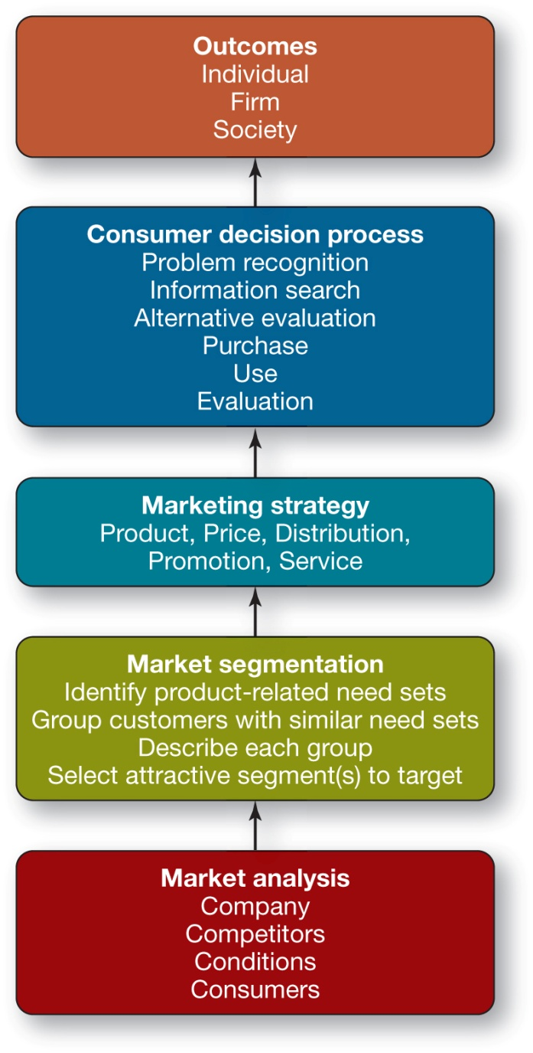
4. Marketing Strategy and Consumer Behavior
1-22

Slide 23
Market Analysis Components
The Consumers
The Company
The Competitors
The Conditions
1-23

Slide 24

Market Segmentation
Market segmentation is a portion of a larger market whose needs differ from the larger market.
1-24

Slide 25
Market Segmentation
Market Segmentation Involves Four Steps:
Identifying Product-Related Need Sets
Grouping Customers with Similar Need Sets
Describing Each Group
Selecting an Attractive Segment(s) to Serve
1-25
Notes:
Need sets – Watch or Rolex?

Slide 26
Questions
How many of you is doing any sport?
How many of you is reading a book?
How Many of you is watching Netflix?
How many of you is using Spotify?
How many of you bought something online in the last 2 days?
How many of you is using ChatGPT?

Slide 27
Marketing strategy
THE MOST IMPORTANT!!!
Marketing Strategy is the answer to the question:
How will we provide superior customer value to our target market?
      Segmentation – KNOW YOUR MARKET
      Targeting - KNOW YOUR CONSUMER
      POSITIONING – Develop superior customer value
This requires the formulation of a consistent marketing mix:
  Product
  Communications
  Price
  Distribution, and
  Service
1-27

Slide 28
Consumer Decisions
The consumer decision process intervenes between the marketing strategy, as implemented in the marketing mix, and the outcomes.
The firm can succeed only if consumers:
see a need that its product can solve,
become aware of the product and its capabilities,
decide that it is the best available solution,
proceed to buy it, and
become satisfied with the result of the purchase.
1-28

Slide 29
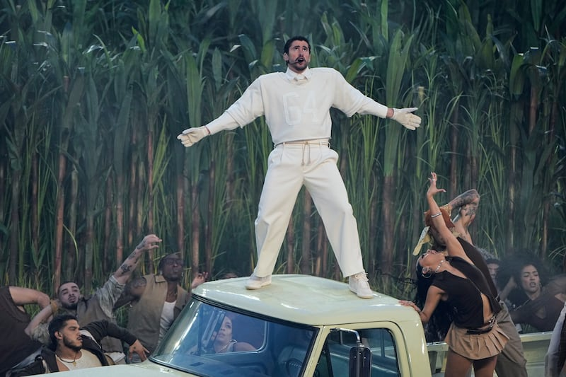
“Bad Bunny” effect

Slide 30
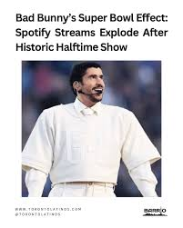
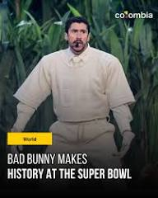
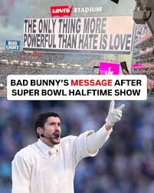

Slide 31
IS MARKETING AFFECTING CULTURE?
OR
CULTURE AFFECTs MARKETING?

Slide 32



Thank you!
Any questions?
e-mail: ilijanata@gmail.com
Transform Engagement into Partnerships
Build the Future Together!

