Slide 1


Consumer Choices
DAY 2
Perception
Professor Ilijana Petrovska
Visiting professor @ Tor Vergata
ilijanata@gmail.com

Slide 2
AGENDA
1st day review
1st Assignments
Perception – Senses
GenAI Ethical Use
Q&A
Trends
Perceptual Process

Slide 3

Dove Mothermonials

Slide 4
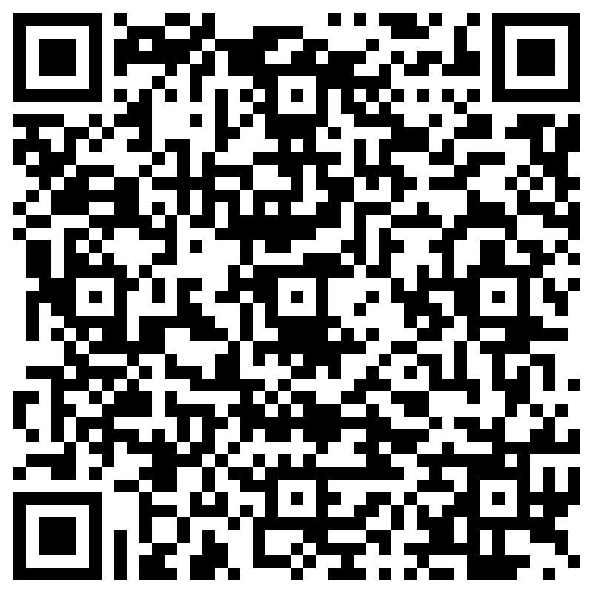
What was the most memorable from day 1

Slide 5
GROUP WORK
Segment the class
According to…
Your Profile Being

Slide 6
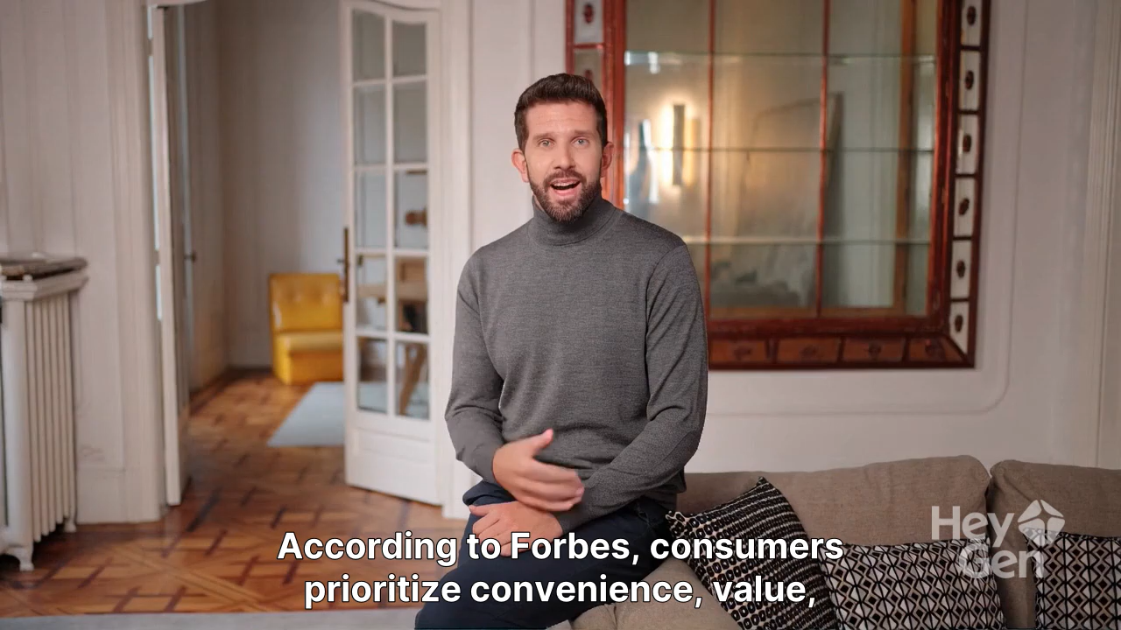
Consumer Trends 2026 by Forbes

Slide 7
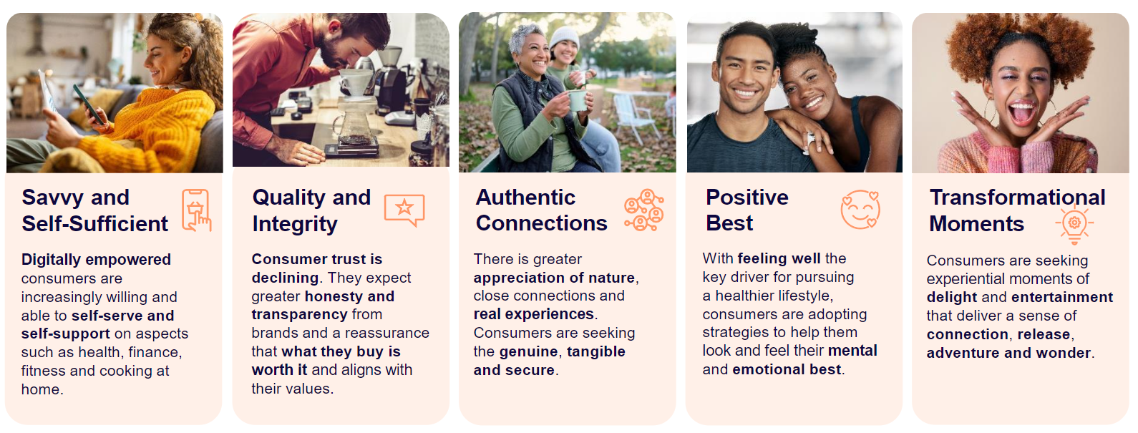
Customer insights
Notes:
https://www.innovamarketinsights.com/trends/top-food-trends-2025/

Slide 8
Forbes – Consumer trends in 2026
1. Affordable Indulgences: The “Lipstick Effect” Get a Wellness Upgrade
2. Nostalgia Shopping And The Rise Of The “Kidult”
3. Home As A Comfort Investment
4. AI As The New Personal Shopper
5. Shopping That Engages The Senses
6. Localism And Value-Driven Buying
7. Social Wellness Becomes The New Going Out

Slide 9
🌐 2. Use Google Trends
Go to: https://trends.google.com/
Fill in the following based on your search:
• Search Term(s) used:
• Interest over time:
• Top countries or regions:
• Related queries/topics:
• Surprising insights:

Slide 10

What could the future look like?
BBC My World

Slide 11

Be Visionary!

Slide 12
Why is analyzing consumer behavior important?
Predicting trends
Customer differentiation
Understanding competition
Customer retention
Customer service improvements
Notes:
https://www.determ.com/blog/consumer-behavior-analysis-101-how-to-learn-more-about-your-customers/

Slide 13
What Influence Consumer Choices?
Personal factors
Psychological factors
Social factors
Situational factors

Slide 14
Gen Z, Gen Alpha & Post-Digital Consumption
Attention economy
Meme culture
Authenticity fatigue
Parasocial relationships with influencers
Anti-brand branding (Duolingo, Ryanair, TikTok brands)

Slide 15
Gen Z consumer choices trends
Using any of Your GenAI platform, identify 2-3 reliable academic sources
Read the original papers and write a short summary
Use APA referencing style – 150 words only
Make a word doc with your own text and GenAI text for the summary, clearly identifying which is yours and which is GenAI generated
Save it in format: YourFullName_GenZConsumerTrendsSummary.doc
Upload it in GenZConsumer Trends summary due

Slide 16
5. Define your topic to research
Select one topic from the list
You will work in groups with the people defined on the list
Up to 5 members per group
Check your date to present
Start searching and reading about the topic and prepare a presentation for the TRENDS on your topic – practical cases and examples how the Theory is applied in the real world!!! First date Friday, 20th Feb

Slide 17
Expectations
Start from the basic theories, But focus on the Newest Findings & Trends
Be analytical, But the most important Be CREATIVE
DO YOUR BEST TO SHARE YOUR FINDINGS FOR YOUR CLASSMATES!
Presentation maximum 15 minutes
So, you will learn from each other…

Slide 18
Summary
Consumer Choices in each stage of Customer decision process
Marketers have to understand the wants and needs of different consumer segments.
Marketing influence on Culture vice versa

Slide 19
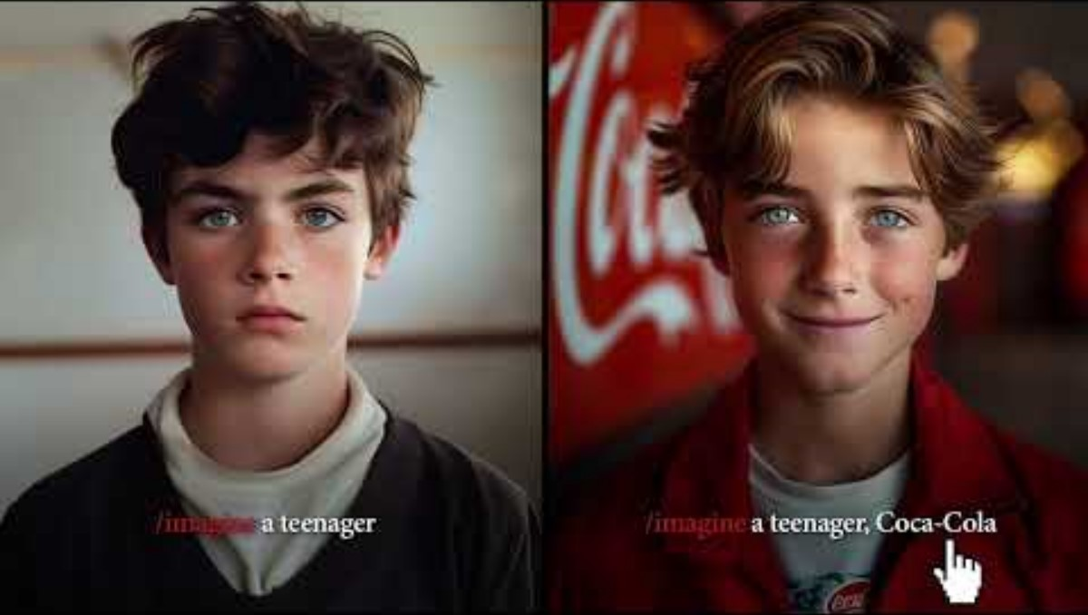
SoMo Borac наградени кампањи

Slide 20
PERCEPTION
What are the major senses that are part of perception?

Slide 21
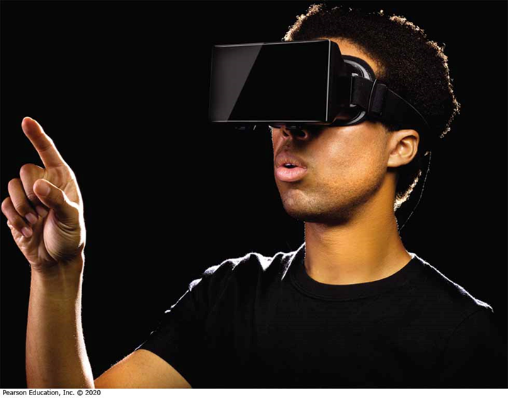
Sensation
Vision
Scent
Sound
Touch
Taste
Notes:
Our senses play quite a role in the decisions marketers make. For instance, marketers rely heavily on visual elements in advertising, store design, and packaging. They communicate meanings on the visual channel through a product’s color, size, and styling. An interest in scent has spawned new products. Some brands utilize scent easily. For instance, Starbucks requires baristas to grind a batch of coffee each time they brew a post instead of just once each morning to ensure customers have that intense smell during their Starbucks’ experience. Stores and restaurants often play certain kinds of music to create a certain mood. Recent research found that participants who simply touch an item for 30 seconds or less had a greater level of attachment with the product. This connection in turn boosted what they were willing to pay for it. A food item’s image and the values we attach to it influence how we experience the actual taste. These aspects can be called a brand’s sensory system. We’ll cover these 5 aspects of branding in learning objectives one and two.
The Coca-Cola bottle also illustrates an example of how design can facilitate product success.

Slide 22
Sensory Marketing
Companies think carefully about the impact of sensations on our product experiences.
Determining the properties of stimuli using vision, hearing, taste, smell, and touch.
Factors in visual perception
  Size and shape
  Lettering
  Image location on package
  Color
  Appearance of being new or worn
Notes:
Marketers rely heavily on visual elements in advertising, store design, and packaging. Many of our reactions to color come from learned associations. These are cultural connotations such as the color black for mourning. But other reactions are biological. Women tend to be drawn to brighter colors, for instance. Because colors are so powerful, they are an important concern in packaging design. Ultimately they can become a part of a company’s trade dress.

Slide 23
Vision (2 of 2)
Table 3.1 Marketing Applications of Colors
Color | Associations | Marketing Applications
Yellow | Optimistic and youthful | Used to grab window shoppers’ attention
Red | Energy | Often seen in clearance sales
Blue | Trust and security | Banks
Green | Wealth | Used to create relaxation in stores
Orange | Aggressive | Call to action: subscribe, buy or sell
Black | Powerful and sleek | Luxury products
Purple | Soothing | Beauty or anti-aging products
Source: Adapted from Leo Widrich, “Why Is Facebook Blue? The Science Behind Colors in Marketing,” Fast Company (May 6, 2013), fastcompany.com accessed February 23, 2015.

Slide 24

What do you See on a first look?

Slide 25
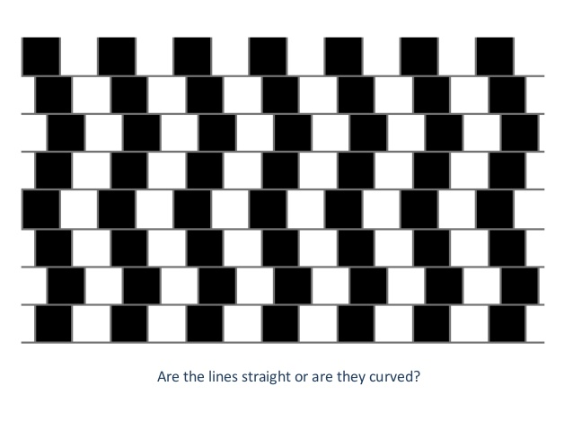

Slide 26
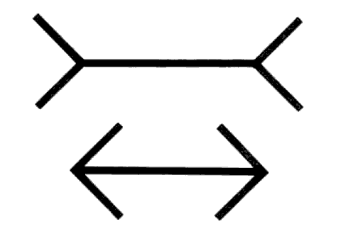
Which line is longer?

Slide 27
Sound perception
Elements in sound perception
  Sound symbolism - Inference of product attributes and evaluations
    Using information obtained from hearing a brand’s sounds, syllables, and words

Slide 28
Key Concepts in Use of Sound
Sonic identity
  Use of specific sounds to identify a brand known as Audio watermarking, too
Sound symbolism
  to influence brand image with sound. Sounds can even influence how we feel about size
Phonemes
  any of the perceptually distinct units of sound in a specified language that distinguish one word from another, for example p, b, d, and t in the English words pad, pat, bad, and bat.
  Consumers are more likely to recognize brand names that begin with a hard consonant (K or P). Vowel and consonant sounds (or phonemes) can even be associated with perceptions of large and small.
Notes:
There are many aspects of sound relevant to marketers. Brands can use audio watermarking to encourage the retention of the message - when producers weave a sound/motif into a piece of music that acts like an earworm we compulsively hum.
Sound symbolism as a way to influence brand image with sound. Sounds can even influence how we feel about size! Consumers are more likely to recognize brand names that begin with a hard consonant (K or P). Vowel and consonant sounds (or phenomes) can even be associated with perceptions of large and small.

Slide 29
Dollars and Scents
Effect on physiological responses, liking, product trial, and buying
Like color, odor can also stir emotions and memory.
Scent Marketing is a form of sensory marketing that we may see in lingerie, detergents, and more.
Notes:
Marketers are seeking ways to exploit the power of scent. You may notice products with scent such as aircraft cabins. A consistent scent could ultimately register with consumers as a brand’s sensory signature.

Slide 30
Taste
  Varying perceptions of food
  Different cultural backgrounds influence taste preference
  In-store marketing tactic of tasting or sampling of food

Slide 31
Key Concepts in the Use of Touch
Endowment effect
Haptic – touch effect when buying
Kansei engineering
  Some Japanese companies take this idea a step farther with their practice of Kansei engineering, a philosophy that translates customers’ feelings into design elements.
Liking of some products because of their feel
Perceived ownership of the item increases
Consumer reaction to touch differs across cultures
Notes:
Research has shown that when consumers touch a product, they then have a higher level of attachment to the product. Touch can even influence sales interactions. Consumer researchers are studying the role that haptic sense (touch) plays in consumer behavior. Basically, we are more sure about what we perceive if we can touch it. We have a tendency to want to touch objects. The philosophy of computer design related to touch is known as natural user interface and it incorporates habitual human movements that we don’t have to learn.
Some Japanese companies take this idea a step farther with their practice of Kansei engineering, a philosophy that translates customers’ feelings into design elements.

Slide 32
PERCEPTUAL PROCESS

Slide 33
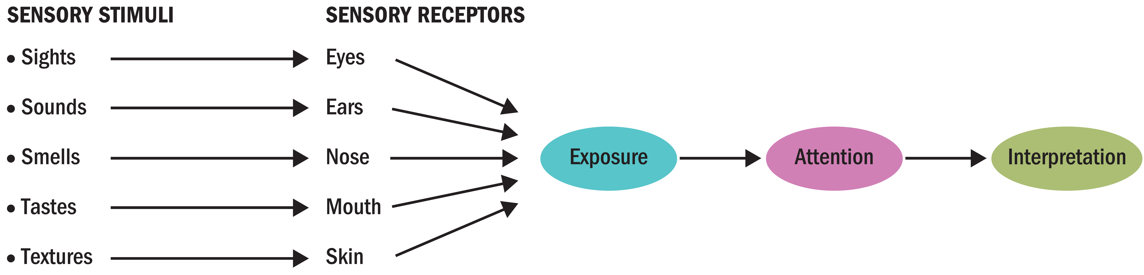
Figure 3.1 - Perceptual Process
Notes:
Figure 3.1 shows how as consumers we are exposed to sensory stimuli through our sensory receptors. We then interpret those stimuli to which we paid attention. This image also emphasizes the three key stages of perception: exposure, attention, and interpretation.

Slide 34
From Exposure to Comprehension
Exposure
Selective
Attention
Focal, nonfocal, pre-attentive
Perception
Sensory
Comprehension
Gaining
Perceptual threshold
Perceptual organization
Source identification
Message comprehension
Consumer inferences

Slide 35
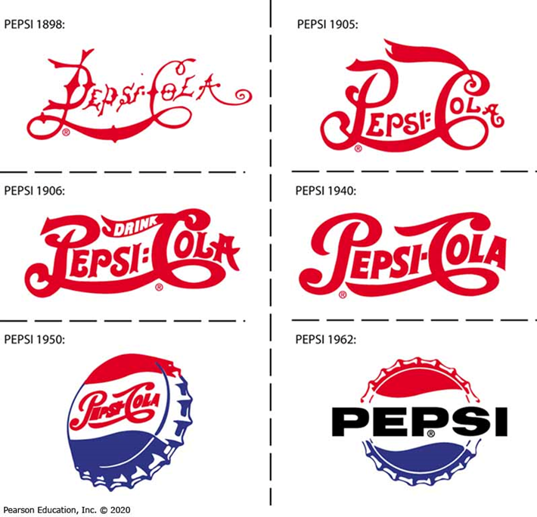
Exposure
The Pepsi Logo over Time
Notes:
Exposure occurs when a stimulus comes within the range of someone’s sensory receptors. Consumers concentrate on some stimuli, but are unaware of others. There are some stimuli we simply cannot perceive. Psychophysics is the science that explains how the physical environment is integrated into our personal, subjective world. When we define the lowest intensity of a stimulus that our brains can register we are speaking of its threshold. The images in the slide illustrate how Pepsi has changed its logo over the years. If the difference didn’t pass our sensory threshold, we wouldn’t notice the logo had changed.

Slide 36
Exposure
Consumer comes into physical contact with a stimulus
Marketing stimuli: Information about offerings communicated by the marketer or by nonmarketing sources
Factors of influence
  Position of an ad within a medium
  Product distribution
  Shelf placement

Slide 37
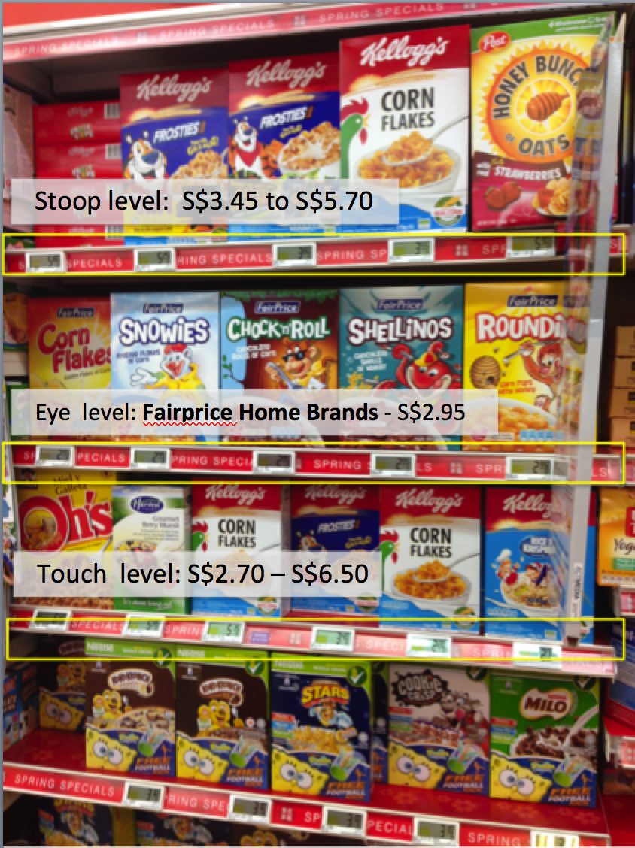
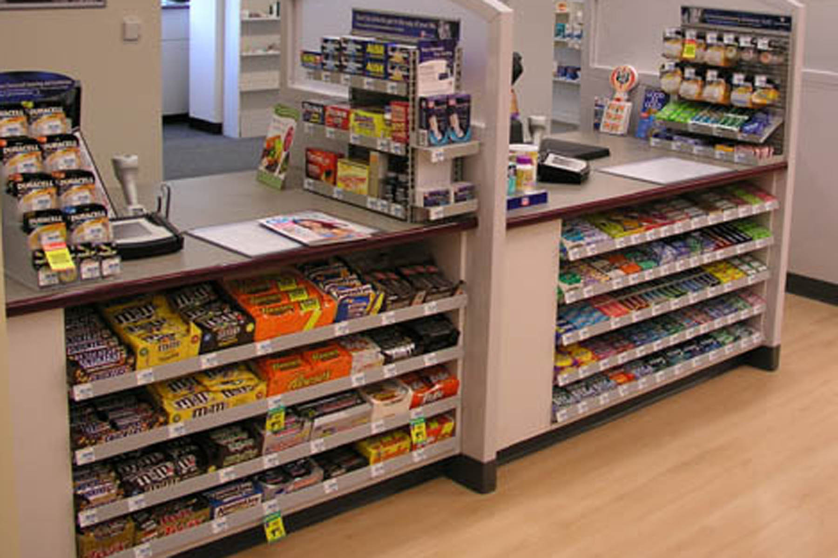
Shelf placement

Slide 38
Reflection
How many of you watch the commercials online?
How many of you see the whole commercial?
How many of you see & click the Ad on your Social Networks?

Slide 39
Selective exposure
Skipping
Zipping: Fast-forwarding through commercials on a program recorded earlier
Zapping: Switching channels during commercial breaks
Cord-cutting - Choosing streaming services over cable television

Slide 40

Subliminal Perception – BMW ad

Slide 41
Case BMW
Is this Ethical? Is this Legal?
How many of you would use Subliminal?
How would use it appropriate?

Slide 42
Stage 2: Attention
Attention is the extent to which processing activity is devoted to a particular stimulus
Consumers experience sensory overload
Marketers need to break through the clutter
Notes:
Attention refers to the extent to which processing activity is devoted to a particular stimulus. The allocation of processing activity can vary depending on the characteristics of the stimulus and the recipient. Although we live in an information society, consumers are often in a state of sensory overload. Sensory overload means consumers are exposed to far more information than they can process. Much of this comes from commercial sources. We are exposed to thousands of advertising messages each day in addition to the other types of stimuli we sense.

Slide 43
Under what conditions do you give full attention to advertising and marketing communication?

Slide 44
Focal and Nonfocal Attention
Focal attention - Consumers focus on a stimulus
Nonfocal attention - Consumers are simultaneously exposed to other stimuli
Pre-attentive processing: Non-conscious processing of stimuli
  Leads to liking a brand name

Slide 45
Characteristics of Stimulus That Attract Consumer Attention (continues..)
Personal relevance
  Appealing to one’s needs, values, emotions, or goals
Pleasantness
  Using attractive models, music, and humor – Doritos TVc
What are some other ways to make ads more pleasant to consumers?

Slide 46

Doritos TVc

Slide 47
Characteristics of Stimulus That Attract Consumer Attention (continued)
Element of surprise
  Using novelty, unexpectedness, and puzzles
Easy to process
  Prominence and concreteness of stimuli
  Limited number of competing stimuli
  Contrast with competing stimuli
What are ways to enhance suspense or surprise in advertising or marketing communications?
Is surprise a good thing in marketing communications?

Slide 48
How Do Marketers Get Attention?
Personal Selection Factors
Experience
Perceptual filters
Perceptual vigilance
Perceptual defense
Notes:
Experience is the result of acquiring and processing stimulation over time. It helps to determine how much exposure to a particular stimulus a person accepts. Perceptual filters based on our past experiences influence what we decide to process. Perceptual filters include vigilance, defense, and adaptation.
Vigilance means consumers are more likely to be aware of stimuli that relate to their current needs. A consumer who rarely notices car ads will become very much aware of them when she or he is in the market for a new car.
The flip side of perceptual vigilance is perceptual defense. This means that people see what they want to see—and don’t see what they don’t want to see. If a stimulus is threatening to us in some way, we may not process it, or we may distort its meaning so that it’s more acceptable.
Adaptation can also affect attention; adaptation is discussed further on the next slide.
In addition to the receiver’s mindset, characteristics of the stimulus itself play an important role in determining what we notice and what we ignore. Marketers need to understand these factors so they can create messages and packages that will have a better chance of cutting through the clutter. Several characteristics can aid in enhancing the chances of a stimulus for being noticed including size, color, position, and novelty.

Slide 49
Factors Leading to Adaptation
Intensity
Discrimination
Exposure
Relevance
Notes:
Adaptation is the degree to which consumers continue to notice a stimulus over time. The process of adaptation occurs when consumers no longer pay
attention to a stimulus because it is so familiar. A consumer can “habituate” and require increasingly stronger “doses” of a stimulus to notice it. Several factors can lead to adaptation. Less intense stimuli have less sensory impact. Stimuli that require relatively lengthy exposure in order to be processed habituate because they require a long attention span. Simple stimuli habituate because they do not require attention to detail. Frequently encountered stimuli habituate as the rate of exposure increases. Stimuli that are irrelevant or unimportant habituate because they fail to attract attention.

Slide 50
Stimulus Selection Factors
Contrast
Size
Color
Position
Novelty
Notes:
In addition to the receiver’s mindset, characteristics of the stimulus itself play an important role in determining what we notice and what we ignore. Marketers need to understand these factors so they can create messages and packages that will have a better chance of cutting through the clutter. Several characteristics can aid in enhancing the chances of a stimulus for being noticed including size, color, position, and novelty.

Slide 51
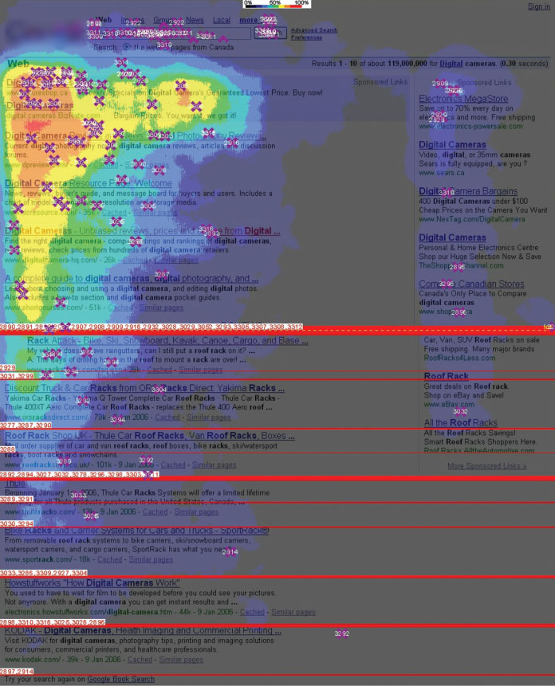

Figure 3.3 The Golden Triangle
Eye-tracking studies reveal that people typically spend most of their time on a website looking at the “golden triangle” outlined by yellow, orange and red.
Source: Enquiro Search Solutions, Inc. (Now Mediative Performance L P).
Notes:
The Golden Triangle illustrates how our eyes view web sites.

Slide 52
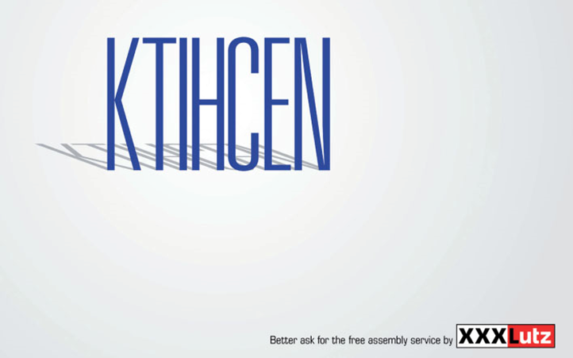
Interpretation
Interpretation refers to the meaning we assign to sensory stimuli, which is based on a schema
When you first look at this ad what is the word in blue?
Source: Client: X X XLutz; Head of Marketing: Mag. Thomas Saliger; Agency: Demner, Merlicek & Bergmann; Account Supervisor: Andrea Kliment; Account Manager: Albin Lenzer; Creative Directors: Rosa Haider, Tolga Buyukdoganay; Art Directors: Tolga Buyukdoganay, Rene Pichler; Copywriter: Alistair Thompson.
Notes:
The meaning we assign to a stimulus depends on the schema, or set of beliefs, to which we assign it. In a process called priming, certain properties of a stimulus evoke a schema. This leads us to compare the stimulus to other similar ones. When you first look at this ad what is the word in blue? Now look at the spelling.

Slide 53

Semiotics
The field of semiotics helps us to understand how marketers use symbols to create meaning.
Notes:
Semiotics, or semiology, is the study of signs, symbols, and signification. It is the study of how meaning is created, not what it is.

Slide 54
Stimulus Organization
Gestalt: The whole is greater than the sum of its parts
  Closure: people perceive an incomplete picture as complete
  Similarity: consumers group together objects that share similar physical characteristics
  Figure-ground: one part of the stimulus will dominate (the figure) while the other parts recede into the background (ground)
  https://www.usertesting.com/resources/topics/gestalt-principles
Notes:
One factor that determines how we will interpret a stimulus is the relationship we assume it has with other events, sensations, or images in memory. Our brains tend to relate incoming sensations to others already in memory based on some fundamental organizational principles. These principles derive from Gestalt psychology, a school of thought that maintains that people interpret meaning from the totality of a set of stimuli rather than from an individual stimulus. The German word Gestalt roughly means whole, pattern, or configuration, and we summarize this term as the whole is greater than the sum of its parts. The Gestalt perspective provides several principles that relate to the way our brains organize stimuli including the closure principle, the principle of similarity, and the figure-ground principle.

Slide 55
Perceptual Organization
Process by which stimuli are organized into meaningful units
Figure and ground: People interpret stimuli in the context of a background
Closure: Individuals’ need to organize perceptions so that they form a meaningful whole

Slide 56
Perceptual Organization (continued)
Grouping: Tendency to group stimuli to form a unified picture or impression
Preference for the whole: Perceiving more value in a whole than in combined parts that make a whole
  Even if the parts have the same objective value as the whole
  WORK in groups – find examples

Slide 57
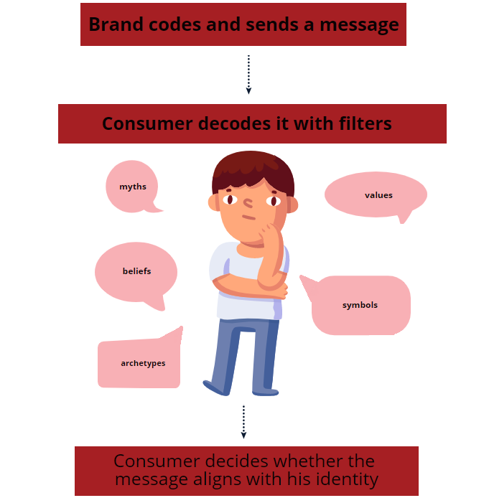
Semiotic Relationships
Correspondence between signs and symbols and how we assign meanings
i.e. Environment safe products..
MORE from you?
Notes:
Semiotics, a discipline that studies the correspondence between signs and symbols and their roles in how we assign meanings.
The object is the product that is the focus of the message (e.g., Marlboro cigarettes). The sign is the sensory image that represents the intended meanings of the object (e.g., the Marlboro cowboy). The interpretant is the meaning we derive from the sign (e.g., rugged, individualistic, American). Figure 3.4 diagrams this relationship.
An icon is a sign that resembles the product in some way (e.g., the Ford Mustang has a galloping horse on the hood). An index is a sign that connects to a product because they share some property (e.g., the pine tree on some of Procter & Gamble’s Spic and Span cleanser products conveys the shared property of fresh scent). A symbol is a sign that relates to a product by either conventional or agreed-on associations (e.g., the lion in Dreyfus Fund ads provides the conventional association with fearlessness and strength that it carries [or hopes to carry] over to the company’s approach to investments).

Slide 58
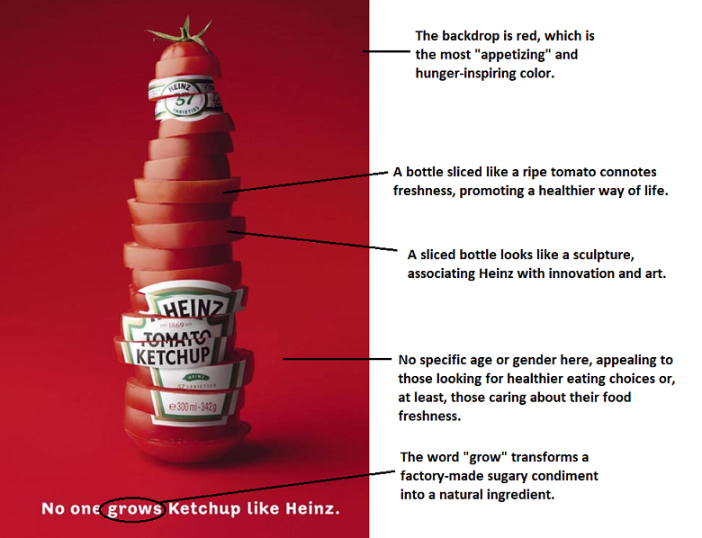
Marketing semiotics
Object
Sign
Interpretant
Icon
Index
Symbol

Slide 59
Algorithmic Choice & Consumer Agency
How recommendation systems shape:
Attention
Preferences
Decision shortcuts
Filter bubbles, echo chambers, and “algorithmic bias”
Consumers vs platforms: who is really choosing?

Slide 60
Activity
Compare Spotify / TikTok recommendations across users
Short reflection: “Is this personalization or manipulation?”

Slide 61
Reflection
How do your favorite brands position themselves in the marketplace?
Which possible positioning strategies seem to be most effective?

Slide 62
Chapter Summary
NEW Market Reality and TRENDS
Products and commercial messages often appeal to our senses, but because of the profusion of these messages we don’t notice most of them
Perception is a three-stage process that translates raw stimuli into meaning
The field of semiotics helps us to understand how marketers use symbols to create meaning.
Notes:
We’ve covered several key concepts in this chapter including perception, our perception is affected by our senses, subliminal advertising, and the factors which affect how we process symbols.

Slide 63
Read caseS For tomorrow
Nike Trends analyzing
- Netflix,
- spotify or
- Amazon personalization
Nike – Trend-Driven Innovation
Notes:
Nike - https://www.promptcloud.com/blog/nike-trend-analysis-strategy/
How Netflix, Amazon personalize
Spotify - https://nogood.io/2023/04/24/spotify-case-study/
3. Netflix - https://www.socialsamosa.com/2021/08/case-study-netflix-brand-affinity-audio-marketing-campaigns-on-spotify/

Slide 64

Thank you!
Any Questions?
ilijanata@gmail.com

