Slide 1
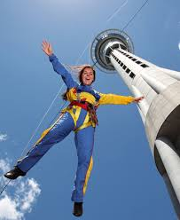

Consumer Choices
Personality & Emotions
Lifestyle and Values
Professor Ilijana Petrovska
Visiting professor @ Tor Vergata

Slide 2
PERSONALITY AND EMOTIONS

Slide 3
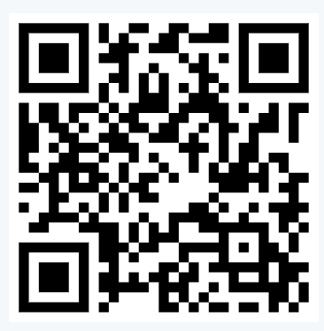
Not to forget
Reflection Log for the 1st week
Peer evaluation on the QR code
Take the quiz on MS Teams assignments
Personality review
Students’ presentations Emotions, Lifestyle, Values

Slide 4
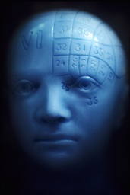
Personality
Personality is an individual’s characteristic response tendencies across similar situations.
While motivations are the energizing and directing force that makes consumer behavior purposeful and goal directed, the personality of the consumer guides and directs the behavior chosen to accomplish goals in different situations.
Royalty-Free/CORBIS
10-4

Slide 5
Personality Type test
Myers Briggs type
https://www.16personalities.com/free-personality-test

Slide 6
Trait Theory
Personality traits: identifiable characteristics that define a person
Traits relevant to consumer behavior:
  Innovativeness
  Materialism
  Self-consciousness
  Need for cognition
  Frugality
Notes:
Trait theory focuses on the quantitative measurement of personality traits. Personality traits are the identifiable characteristics that define a person. For instance, we might say that someone is an introvert or an extrovert. Some of the most relevant traits for consumer behavior are listed in the slide. Innovativeness is the degree to which a person likes to try new things. Materialism is the amount of emphasis a person places on acquiring and owning products. Self-consciousness is the degree to which a person deliberately monitors and controls the image of the self that he or she projects to others. The need for cognition is the degree to which a person likes to think about things and by extension, expends the necessary effort to process brand information. Frugality is the tendency to deny short-term purchases and to make due with what they already own. The use of standard personality trait measurements to predict product choices has met with mixed success. It is simply hard to predict consumer behavior based on personality! There are several explanations.

Slide 7
Personality
Multitrait Approach
  The Five-Factor Model is the most commonly used by marketers and identifies five basic traits that are formed by genetics and early learning.
Single Trait Approach
  Consumer Ethnocentrism
  Need for Cognition
  Consumers’ Need for Uniqueness
10-7

Slide 8
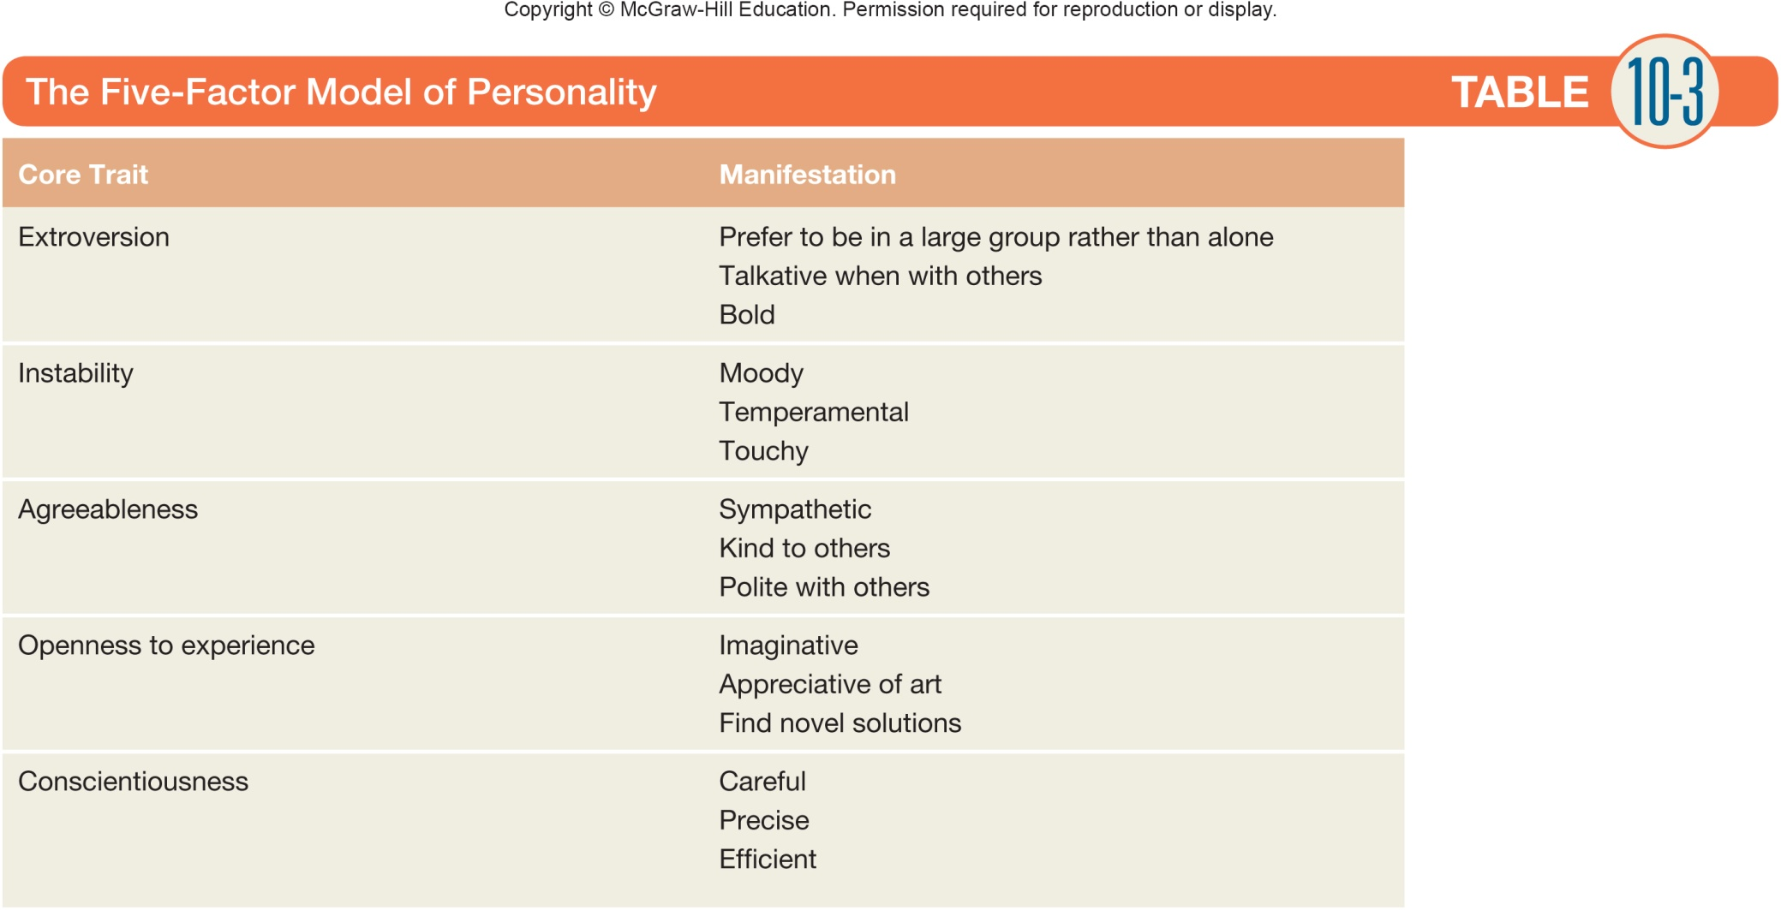
Personality
10-8

Slide 9
Personality
Single-Trait Approach:
Consumer Ethnocentrism
  Reflects an individual difference in consumers’ propensity to be biased against the purchase of foreign products.
Need for Cognition (NFC)
  Reflects an individual difference in consumers’ propensity to engage in and enjoy thinking.
Consumers’ Need for Uniqueness
  Reflects an individual difference in consumers’ propensity to pursue differentness relative to others through the acquisition, utilization, and disposition of consumer goods.
10-9

Slide 10
The Big Five
Table 7.3 Description of Big Five Personality Dimensions
Blank | Description | Example of Measurement Items (agree/disagree)
Openness to experience | The degree to which a person is open to new ways of doing things | Love to think up new ways of doing things
Conscientiousness | The level of organization and structure a person needs | Am always prepared
Extroversion | How well a person tolerates stimulation from people | Talk to a lot of different people at parties
Agreeableness | The degree to which we defer to other people | Take time out for others
Neuroticism (emotional instability) | How well a person copes with stress | Get upset easily
Source: Michael R. Solomon, Rebekah Russell-Bennett, and Josephine Previte, Consumer Behaviour: Buying, Having, Being, 3rd ed., Frenchs Forest, N S W: Pearson Australia, 2012.
Notes:
The most widely recognized approach to measuring personality traits is the Big Five (also known as the Neo-Personality Inventory). This is a set of five dimensions that form the basis of personality: openness to experience, conscientiousness, extroversion, agreeableness, and neuroticism. Table 7.4 describes these dimensions.

Slide 11
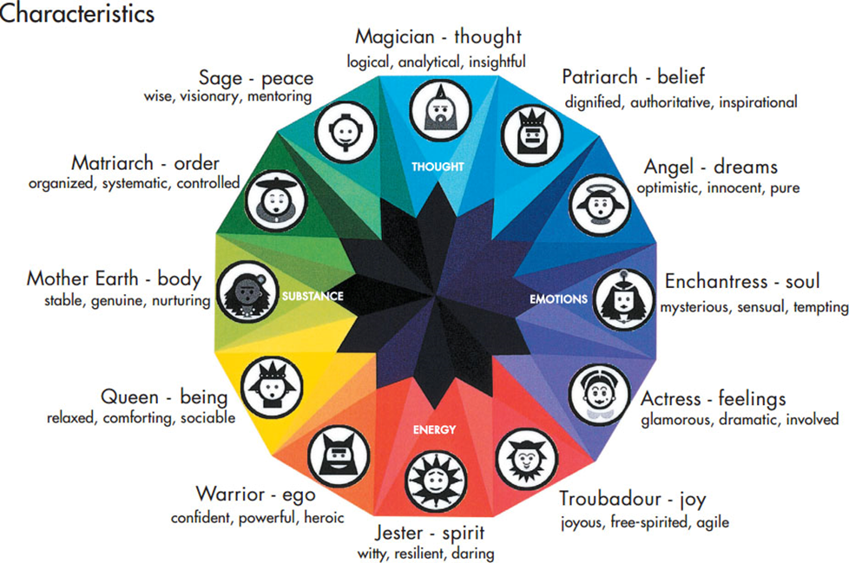
Brand Asset Valuator Archetypes (1 of 2)
Notes:
The model shows the relationships among the Archetypes. For each healthy personality, there is a corresponding Shadow. The Shadows are shown on the next slide. A healthy personality is one in which the Archetypes overwhelm their corresponding Shadows. A sick personality results when one or more Shadows prevail. When a brand’s Shadows dominate, this cues the agency to take action to guide the brand to a healthier personality.

Slide 12
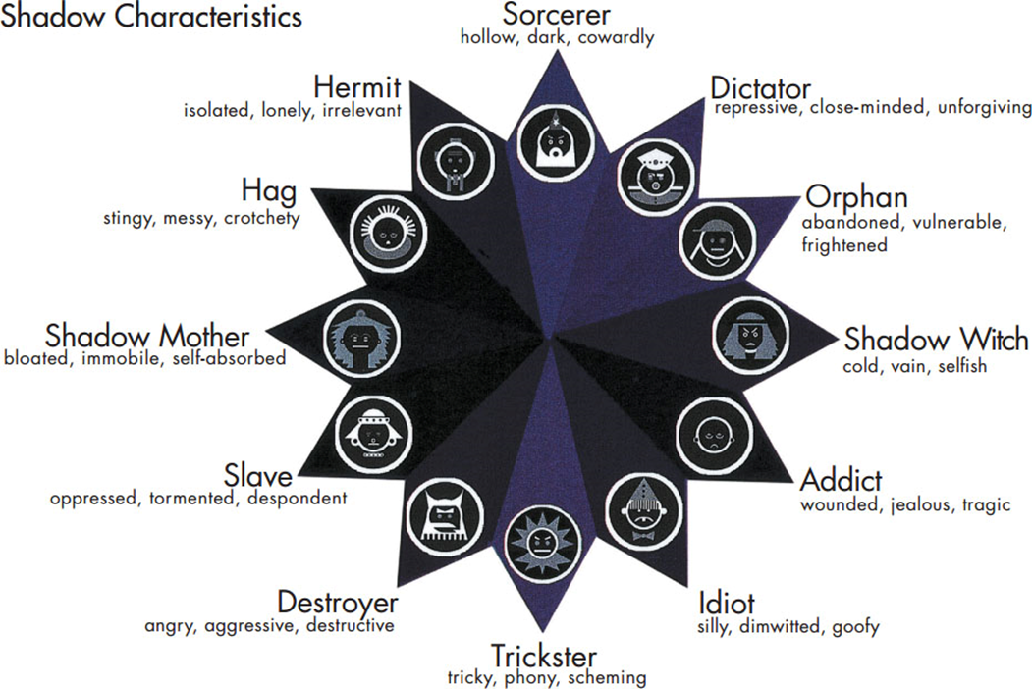
Brand Asset Valuator Archetypes (2 of 2)
Notes:
This slide illustrates the Shadows that correspond to the Archetypes.

Slide 13
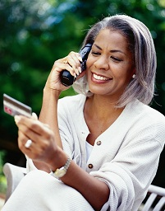
Use of Personality in Marketing Practice
Other times, consumers use products to bolster an area of their personality where they feel weak.
Sometimes consumers choose products that fit their personality.
Hoby Finn/Getty Images
10-13

Slide 14
Use of Personality in Marketing Practice
Brand image is what people think of and feel when they hear or see a brand name.
Brand personality is a set of human characteristics that become associated with a brand and are a particular type of image that some brands acquire.
10-14

Slide 15
Use of Personality in Marketing Practice
Communicating Brand Personality
Three important advertising tactics:
Celebrity Endorsers vs. Influencers
User Imagery (who I want to appear to be because I use your product)
Executional Factors (lifestyle, scientific, testimonial, demonstration, and slice-of-life)
10-15

Slide 16
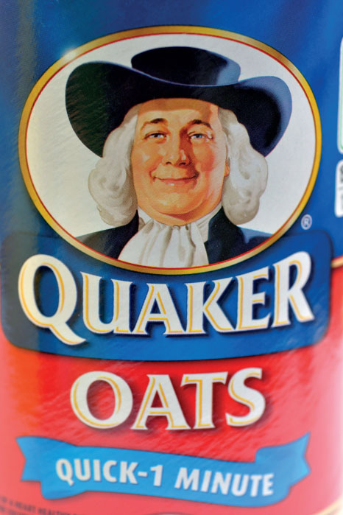
Brand personality
Brand have personalities.

Slide 17
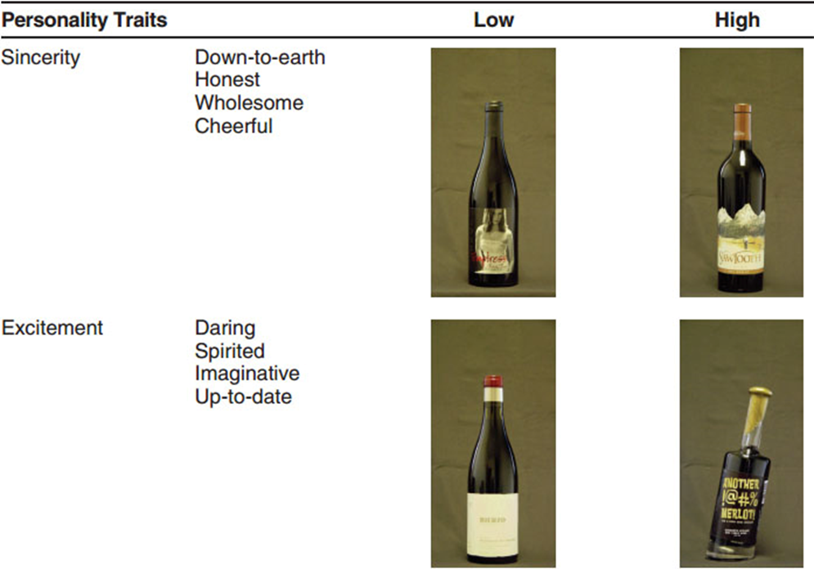
An Example of Brand Personality
Source: Reprinted with permission from Journal of Marketing, published by the American Marketing Association, Ulrich R. Orth & Keven Malkewitz, May 2008, Vol. 72, page 73.
Notes:
A study found that consumers infer strong differences in a wine’s “personality” based on the bottle’s label design. The text shows more examples of wine personality based on label design.

Slide 18
Brand Personality
Brand personality: set of traits people attribute to a product as if it were a person
Reader response theory
Underdog brand biography
Anthromorphism
Doppleganger brand image
Notes:
A product that creates and communicates a distinctive brand personality stands out from its competition, earns brand equity, and inspires years of loyalty.
Reader response theory, which is a widely accepted perspective in literature that focuses on the role of the reader in interpreting a story rather than just relying upon the author’s version.
Underdog brand biography. This includes details about a brand’s humble origins and how it defied the odds to succeed.
Anthropomorphism refers to the tendency to attribute human characteristics to objects or animals.
Doppelgänger brand image (one that looks like the original but is in fact a critique of it).

Slide 19
Brand Behaviors and Possible Personality Trait Inferences
Brand Action | Trait Inference
Brand is repositioned several times or changes slogan repeatedly | Flighty, schizophrenic
Brand uses continuing character in advertising | Familiar, comfortable
Brand charges high prices and uses exclusive distribution | Snobbish, sophisticated
Brand frequently available on deal | Cheap, uncultured
Brand offers many line extensions | Versatile, adaptable
Notes:
There are many things a marketer can do to influence consumers’ perceptions of a brand’s personality. Consumers will infer things about a brand’s personality from the brand’s positioning in the marketplace.

Slide 20
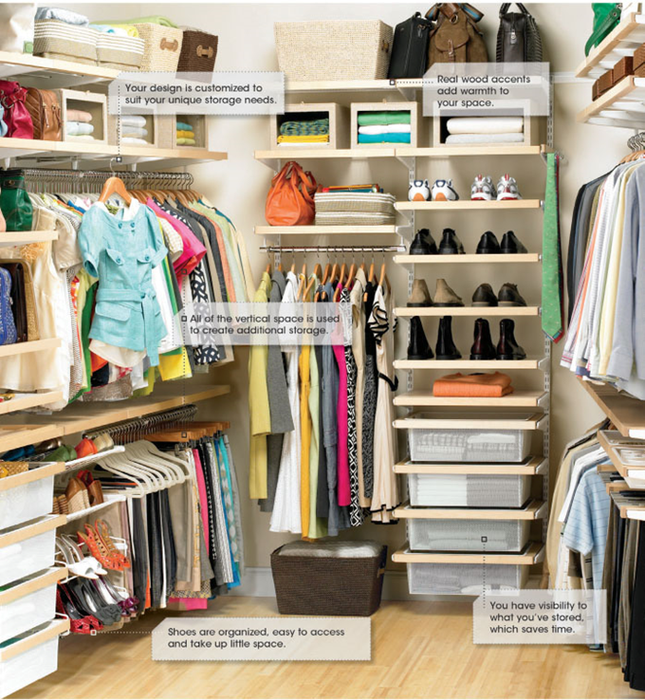
Closet Products and Personality
Notes:
This ad relates closet products and personality.

Slide 21
Emotion
Emotion is the identifiable specific feeling and affect to refer to the liking/disliking aspect of the specific feeling.
Emotions are strong, relatively uncontrolled feelings that affect behavior.
  They are strongly linked to needs, motivation, and personality.
  Unmet needs create motivation which is related to the arousal component of emotion.
  Personality also plays a role, e.g., some people are more emotional than others, a consumer trait referred to as affect intensity.
10-21

Slide 22
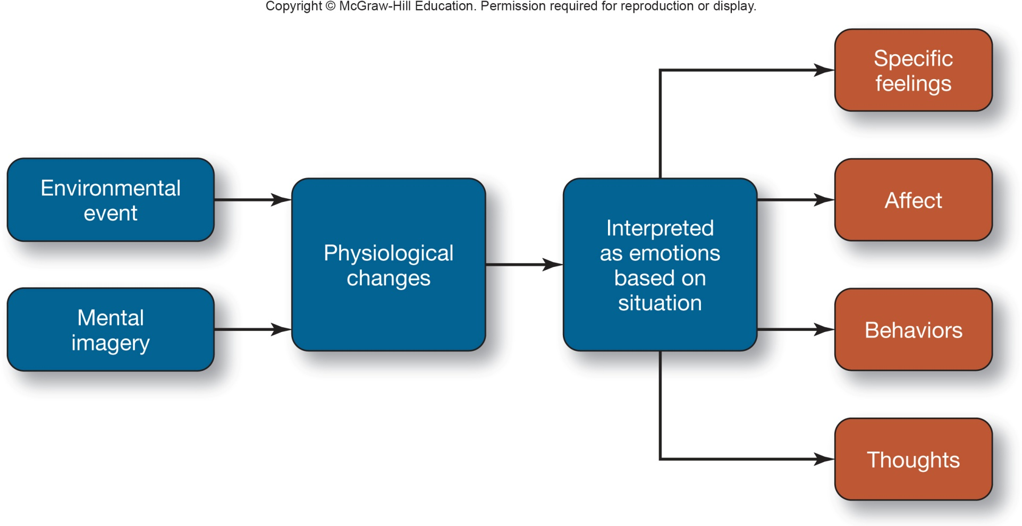
Emotion
Nature of Emotions
Source: Adapted with permission from M. B. Holbrook and R. Batra, “Assessing the Role of Emotions on Consumer Response to Advertising,” Journal of Consumer Research,
December 1987, pp. 404-20. Copyright © 1987 by the University of Chicago.
10-22

Slide 23
Emotion
Dimensions of Emotion
Pleasure
Arousal
Dominance
10-23

Slide 24
Emotions and Marketing Strategy
Emotion Arousal as a Product Benefit
  Consumers actively seek products whose primary or secondary benefit is emotion arousal.
  Gratitude or the emotional appreciation for benefits received is a desirable consumer outcome that can lead to increased consumer trust and purchases.
Emotion Reduction as a Product Benefit
  Marketers design or position many products to prevent or reduce the arousal of unpleasant emotions.
10-24

Slide 25
Emotions and Marketing Strategy
Emotion in Advertising
  Emotional content in ads can enhance attention, attraction, and maintenance capabilities.
  Emotional messages may be processed more thoroughly due to their enhanced level of arousal.
  Emotional ads may enhance liking of the ad itself.
  Repeated exposure to positive-emotion-eliciting ads may increase brand preference through classical conditioning.
  Emotion may operate via high-involvement processes especially if emotion is decision relevant.
10-25

Slide 26
Question
How would you use personality & emotion to develop a marketing strategy for each of the following?
  a. Visa card use
  b. Sky diving
  c. Tesla car
  d. Anti dandruff shampoo
  e. Newest smart watch

Slide 27
Student’s presentation lifestyle & Values

Slide 28

Lifestyle & Values
A consumer’s personality influences the way he or she responds to marketing stimuli, but efforts to use this information in marketing contexts meet with mixed results.
Notes:
This chapter begins by considering how people appear based on the products we surround ourselves with.

Slide 29
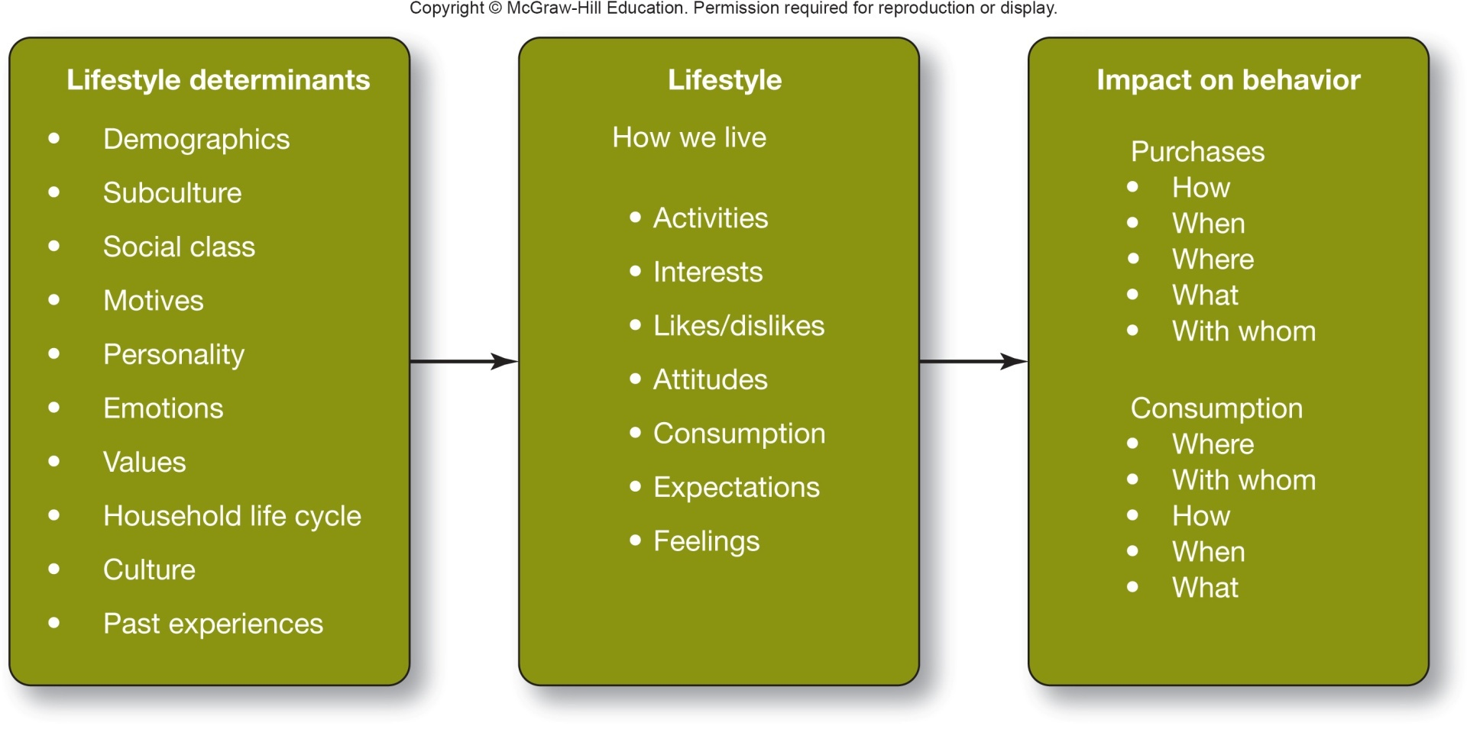
The Nature of Lifestyle
Lifestyle and the Consumer Process
12-29

Slide 30
The Nature of Lifestyle
Measurement of Lifestyle
Attempts to develop quantitative measures of lifestyle were initially referred to as psychographics. Measures include:
Attitudes | Evaluative statements about other people, places, ideas, products, etc.
Values | Widely held beliefs about what is acceptable or desirable
Activities and Interests | Nonoccupational behaviors to which consumers devote time and effort, such as hobbies, sports, public service, and church
Demographics | Age, education, income, occupation, family structure, ethnic background
Media patterns | The specific media the consumer utilize
Usage rates | Measurements of consumption within a specified product category; often consumers are categorized as heavy, medium, light, or nonusers
12-30

Slide 31
The Nature of Lifestyle
Three general lifestyle schemes:
The VALSTM System
The PRIZM® System
Roper Starch Global Lifestyles
12-31

Slide 32
For Reflection
How can marketers link a brand’s personality with the lifestyle of a consumer segment?

Slide 33
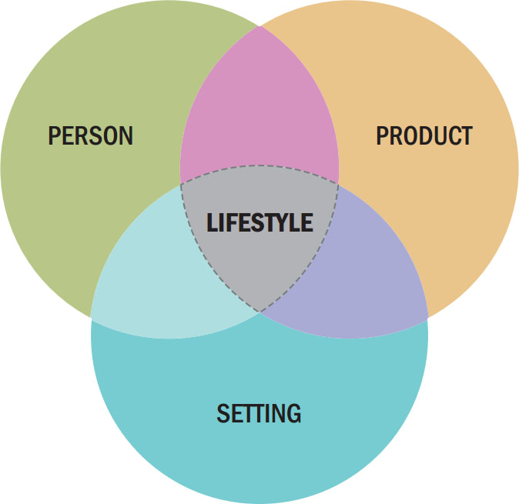
Product Complementarity and Co-Branding Strategies (2 of 2)
Figure 7.3 Consumption Style
Notes:
The desire to associate a product with a social situation is a long-standing one for advertisers whether they include a product in a round of golf, a family barbecue, or a night out. People, products, and settings result in an expressed consumption style which can be used as a cue.

Slide 34
For Reflection (3 of 8)
Identify products and settings that would be at home in your consumption styles.
Have marketers identified these consumption styles and used them in advertising?

Slide 35
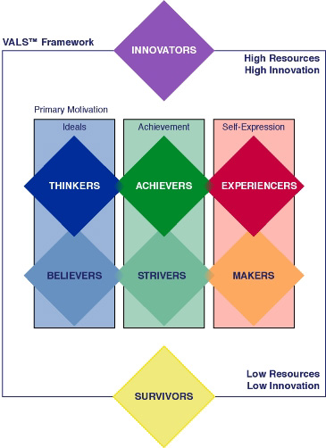
The VALSTM System
VALS provides a systematic classification of U.S. adults into eight distinct consumer segments.
VALS is based on enduring psychological characteristics that correlate with purchase patterns.
12-35

Slide 36
The VALSTM System
Three Primary Consumer Motivations:
Ideals Motivation
Achievement Motivation
Self-Expression Motivation
12-36

Slide 37
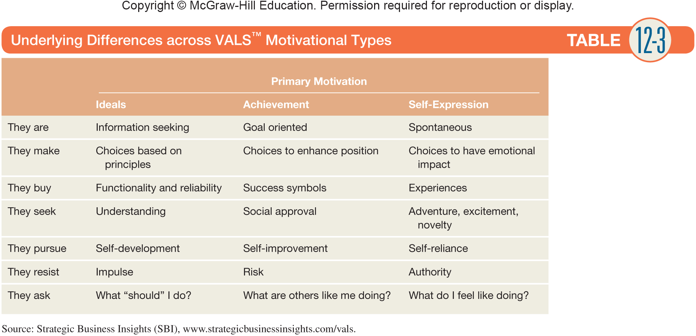
The VALSTM System
12-37

Slide 38
Geo-Lifestyle Analysis (PRIZM®)
The underlying logic:¹
People with similar cultural backgrounds, means and perspectives naturally gravitate toward one another.
They choose to live amongst their peers in neighborhoods offering …compatible lifestyles.
They exhibit shared patterns of consumer behavior toward products, services, media and promotions.
¹Nielsen Claritas.
12-38

Slide 39
Geo-Lifestyle Analysis (PRIZM)
PRIZM Social and Lifestage Groups
PRIZM organizes its 66 individual segments into social and lifestage groups.
Four social groupings are based on “urbaniticity.”
Urban | Major cities with high population density
Suburban | Moderately dens “suburban” areas surrounding metropolitan area
Second City | Smaller, less densely populated cities or satellites to major cities
Town & Rural | Low-density towns and rural communities
12-39

Slide 40
Geo-Lifestyle Analysis (PRIZM)
PRIZM Social and Lifestage Groups
The lifestage groups are based on age and the presence of children.
The three major lifestage groups are:
Younger Years | Singles and couples under 35 years of age with no children, or middle aged without children at home
Family Life | Households with children living at home
Mature Years | Singles and couples; age 55 yrs and older, or 45-64 without children at home
12-40

Slide 41
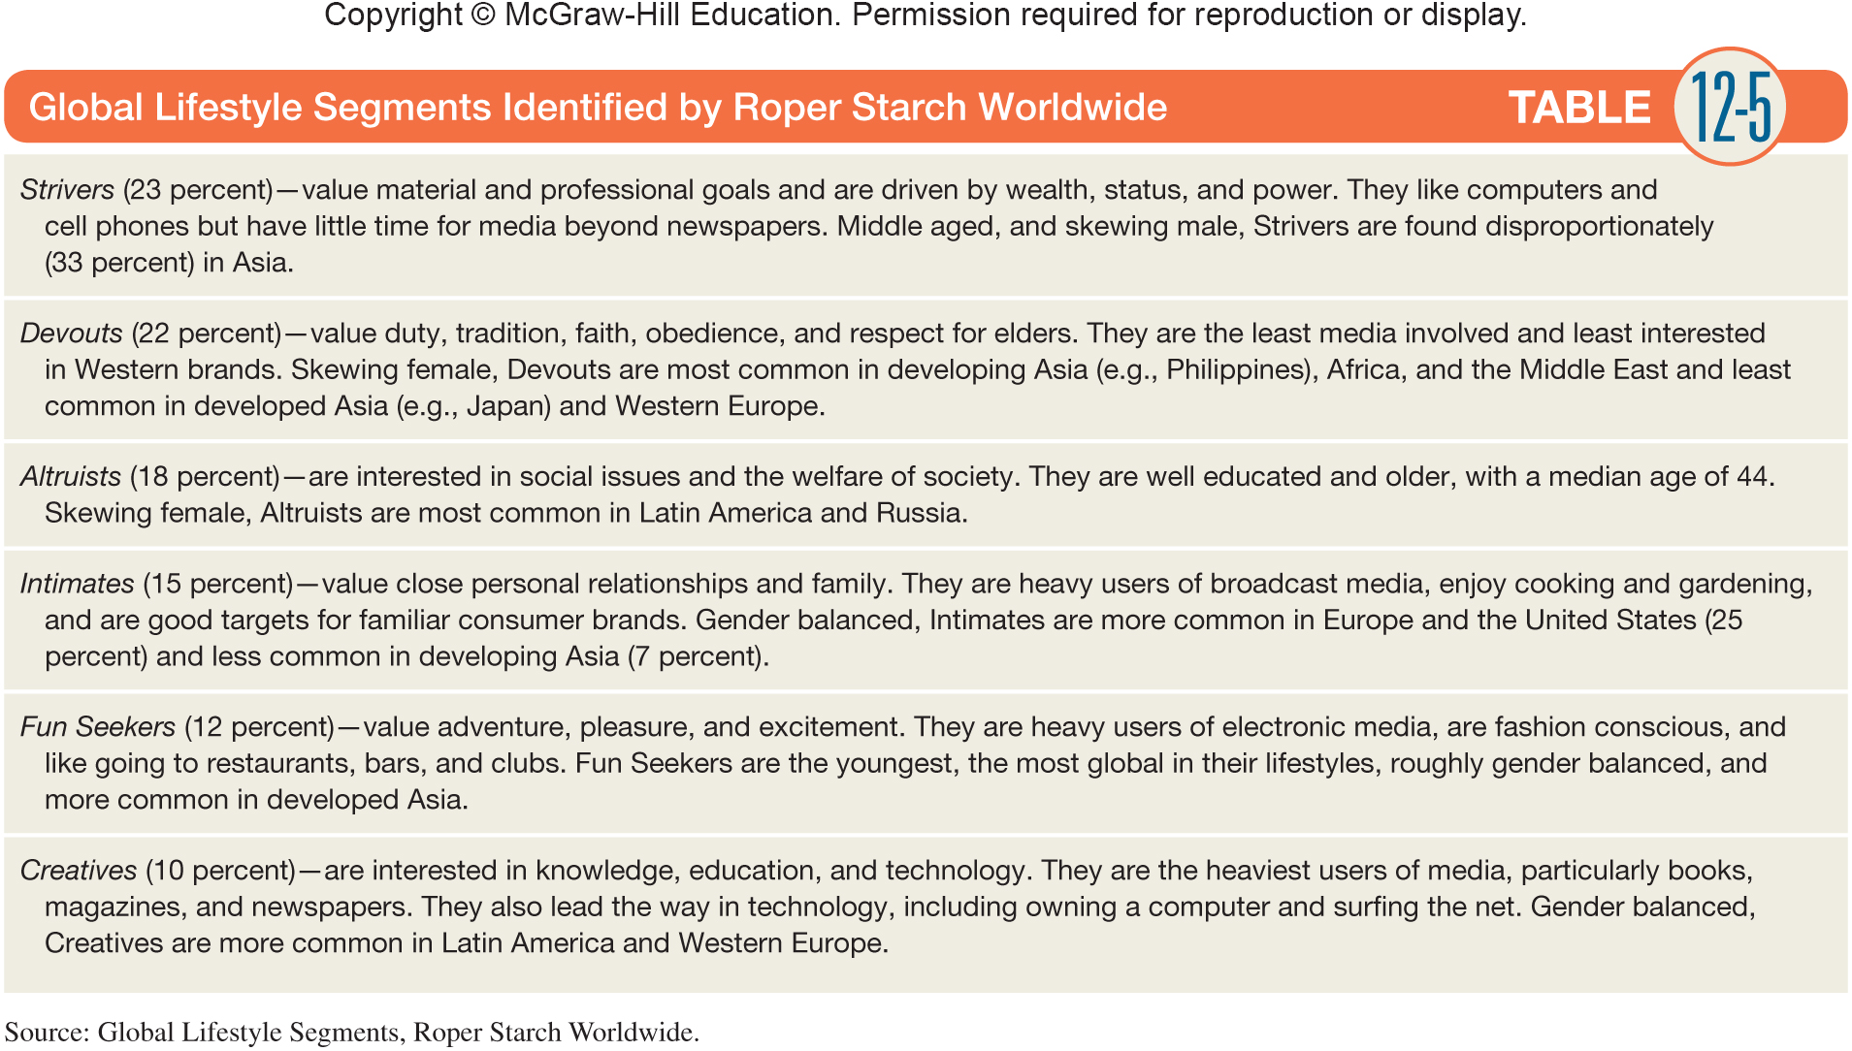
International Lifestyles
12-41

Slide 42
For Reflection (7 of 8)
Which VALS category would you guess you are in? Why?
Do you see possible linkages between brand images and the segments in the VALS system?
Notes:
Brands can reveal self-orientations too. Some brands will seem more focused on ideals; others on achievement. Do you see examples in which those brands are clearly targeting specific VALS segments?

Slide 43
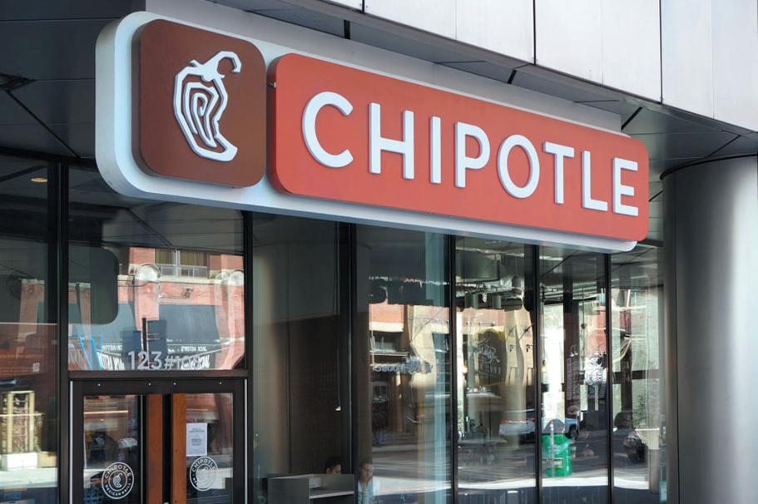
VALUES
Underlying values often drive consumer motivations
Notes:
A value is a belief that some condition is preferable to its opposite. A person’s set of values plays a very important role in consumption activities. Consumers purchase many products and services because they believe these products will help to attain a value-related goal.

Slide 44
Value Concepts
Core values
Value systems
Enculturation
Acculturation
Crescive norms
Custom
More
Conventions
A value is a belief that some condition is preferable to its opposite.
In some cases, values are universal.
We all value health, wisdom, and peace. What sets cultures apart is the relative importance of these universal values.
Notes:
A value is a belief that some condition is preferable to its opposite. In some cases, values are universal. We all value health, wisdom, and peace. What sets cultures apart is the relative importance of these universal values. This set of rankings constitutes a culture’s value system. It is usually possible to identify a general set of core values that uniquely define a culture.
Core values such as freedom, youthfulness, achievement, materialism, and activity characterize American culture.
The process of learning the beliefs and behaviors endorsed by one’s own culture enculturation.
We call the process of learning the value system and behaviors of another culture acculturation.
Crescive norms we discover as we interact with others and these include customs, mores, and conventions.
A custom is a norm that controls basic behaviors such as division of labor in a household.
A more is a custom with a strong moral overtone. It may involve something that is taboo or forbidden like cannibalism.
Conventions are norms that regulate how we conduct our everyday lives. They may be subtle like how we furnish a room or what we wear to a dinner party.

Slide 45
How Values Link to Consumer Behavior (1 of 2)
Table 7.7 Terminal and Instrumental Values
Instrumental values | Terminal values
Ambitious | A comfortable life
Broad-minded | An exciting life
Capable | A sense of accomplishment
Cheerful | A world of peace
Clean | A world of beauty
Courageous | Equality
Forgiving | Family security
Helpful | Freedom

Slide 46
How Values Link to Consumer Behavior (2 of 2)
Table 7.7 [continued]
Instrumental values | Terminal values
Honest | Happiness
Imaginative | Inner harmony
Independent | Mature love
Intellectual | National security
Logical | Pleasure
Loving | Salvation
Obedient | Self-respect
Polite | Social recognition
Responsible | True friendship
Self-controlled | Wisdom
Source: Copyright 1983 From Measuring the Cultural Values Manifest in Advertising,” Current Issues and Research in Advertising (1983): 71–92 by Richard Pollay. Reproduced by permission of the American Academy of Advertising (aaoa.wildapricot.org)
Notes:
The psychologist Milton Rokeach identified terminal values which are desired end states. The Rokeach Value Survey also identifies instrumental values which are those actions we need to take to achieve these terminal values. Table 3.1 lists several instrumental values and their corresponding terminal values.

Slide 47
Summary
Personality influence the lifestyle
Consumption style depends on Person, products and settings
Lifestyle models VALS, PRIZM, International - brands are clearly targeting specific VALS segments
Value concepts influence on Consumer Choices

Slide 48
NEXT STEPS
Read and Analyze the Case PAPER BOAT FOR TOMORROW’S CLASS

Slide 49
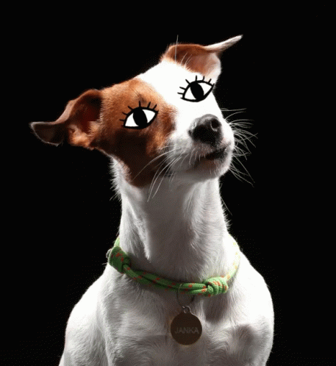
Thank you!
Any questions?

