Slide 1
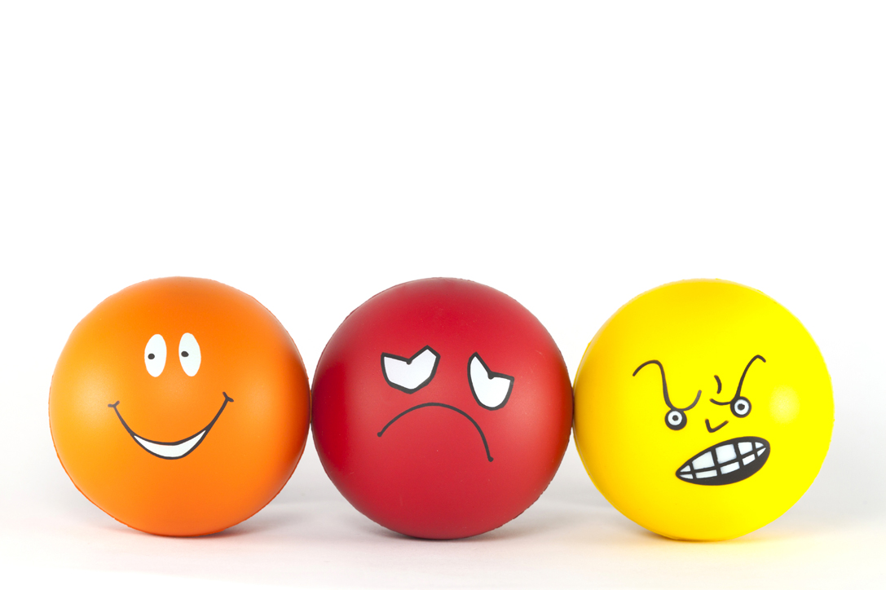
Consumer Choices
Attitudes
Professor Ilijana Petrovska
Visiting professor
@ Tor Vergata

Slide 2
The Power of Attitudes
Attitude: a lasting, general evaluation of people, objects, advertisements, or issues
Attitude object (A O): anything toward which one has an attitude
We use the term attitude in many contexts. Attitudes are general evaluations of people, objects, or issues that tend to last. They also tend to be predictive of behavior and to endure over time. Anything toward which one has an attitude is known as an attitude object.

Slide 3
Functional Theory of Attitudes
Utilitarian Function:
Relates to rewards and punishments
Value-Expressive Function:
Expresses consumer’s values or self-concept
E G O-Defensive Function:
Protect ourselves from external threats or internal feelings
Knowledge Function:
Need for order, structure, or meaning

Slide 4
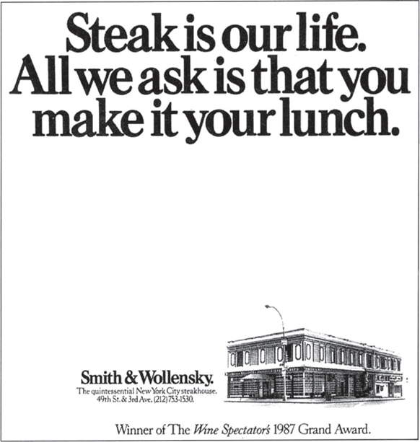
The A B C Model of Attitudes
Attitudes are more complex than they first appear.
An attitude has three components:
  Affect: the way a consumer feels about an attitude object
  Behavior: person’s intentions to do something with regard to an attitude object
  Cognition: beliefs a consumer has about an attitude object
Notes:
An attitude has three components:
Affect: the way a consumer feels about an attitude object
Behavior: person’s intentions to do something with regard to an attitude object
Cognition: beliefs a consumer has about an attitude object
Which comes first: knowing, feeling, or doing? It turns out that each element may lead things off depending on the situation. The hierarchies of effects show the relative impact of the three components. Each hierarchy shows a fixed sequence of steps which can occur in route to an attitude.
The standard learning hierarchy shown first assumes that a person approaches a product decision as a problem-solving process. She first forms beliefs based on knowledge, then evaluates the beliefs and forms feelings about the product. She then engages in relevant behavior.
The low-involvement hierarchy assumes the consumer initially does not have strong preferences for one brand over another and instead forms an evaluation only after she has bought the product.
The experiential hierarchy of effects says we act on our emotional reactions.

Slide 5
Hierarchies of Effects
High-involvement hierarchy
Low-involvement hierarchy
Experiential hierarchy of effects
Cognitive-affective model
Independence hypothesis
Notes:
The high-involvement hierarchy assumes that a person approaches a product decision as a problem-solving process.
The low-involvement hierarchy of effects assumes that the consumer initially doesn’t have a strong preference for one brand over another; instead, he or she acts on the basis of limited knowledge and forms an evaluation only after he or she has bought the product.
According to the experiential hierarchy of effects, we act on the basis of our emotional reactions.
The cognitive-affective model proposes that an emotional reaction is just the last step in a series of cognitive processes that follows sensory recognition of a stimulus and retrieval of information from memory that helps to categorize it.
In contrast the independence hypothesis argues that affect and cognition are separate systems so that it’s not always necessary to have a cognition to elicit an emotional response.

Slide 6
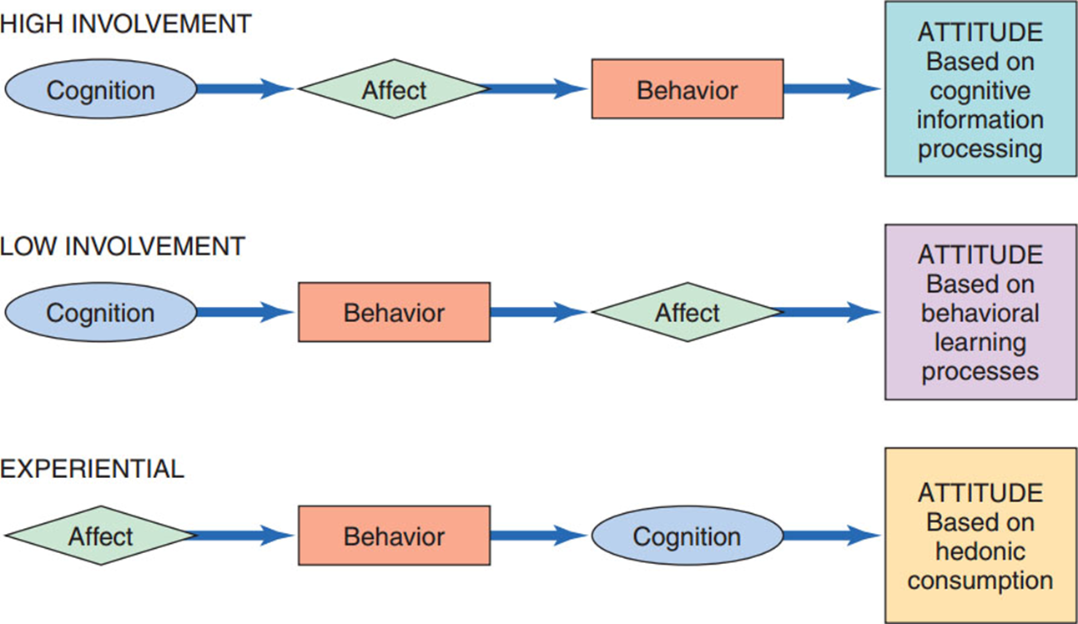
Figure 8.1: Three Hierarchies of Effects

Slide 7
Group Work
Group of 4 -5 students select a BRAND / type of product that best represents certain attitude hierarchy!
Share a decision you made following the three learning hierarchies:
  Think Feel Do
  Do Feel Think
  Feel Do Think

Slide 8
Attitude Commitment
Internalization
Highest level: deep-seeded attitudes become part of consumer’s value system
Identification
Mid-level: attitudes formed in order to conform to another person or group
Compliance
Lowest level: consumer forms attitude because it gains rewards or avoids punishments
Notes:
Consumers vary in their commitment to an attitude. Their degree of commitment relates to their level of involvement with the attitude object. The lowest level is compliance. At the compliance level, we form an attitude because it helps us gain rewards or avoid punishment. At the identification level, we form an attitude to conform to another person’s or group’s expectations. At the highest level of involvement, called internalization, our attitudes become a deep part of our value system. At this level, attitudes are difficult to change because they are important to us.

Slide 9
Personal Reflection – Write and discuss it with your group
Share a commitment you’ve made at each of the three levels of commitment:
Internalization
Identification
Compliance
Can you feel the variations in commitment for the three types? Explain.

Slide 10
Consistency Principle
We value/seek harmony among thoughts, feelings, and behaviors
We will change components to make them consistent
Cognitive dissonance – we take action to resolve dissonance when our attitudes and behaviors are inconsistent
Notes:
Our nature is to keep our attitudes and behaviors consistent. This is the basis for the principle of cognitive consistency. Further, the theory of cognitive dissonance explains that when we do have inconsistent attitudes and behaviors, we will find some way to rectify the dissonance and bring our attitudes and behaviors back into consistency.

Slide 11
Social Judgment Theory
We assimilate new information about attitude objects in light of what we already know/feel
Initial attitude = frame of reference
Latitudes of acceptance and rejection
  Assimilation effects
  Contrast effects
  Example: Product Perception: Suppose a consumer is very health-conscious – new product labeled “mostly organic” - latitude of acceptance.
Notes:
Social judgment theory also assumes that people assimilate new information about attitude objects in light of what they already know or feel. The initial attitude acts like a frame of reference, and we categorize new information in light of this standard. People do differ in terms of what information they find acceptable. They form what is known as latitudes of acceptance and rejection around the attitude standard. Ideas that fall within the latitude are deemed favorable but others are not. Messages that fall within the latitudes are deemed consistent even if they are not. This is known as an assimilation effect. However, those that fall outside our latitude of acceptance are rejected even if they are not that different. This is known as a contrast effect.

Slide 12
Balance Theory
Considers how a person might perceive relations among different attitude objects and how he might alter attitudes to maintain consistency.
Triad attitude structures:
Person perceptions
Perception of attitude object
Perception of other person/object
Notes:
Balance theory considers how a person perceives relations among different attitude objects, and how he alters his attitudes so that these remain consistent (or “balanced”). This perspective involves relations among three elements, so we call the resulting attitude structures triads. Each triad contains (1) a person and his perceptions of (2) an attitude object, and (3) some other person or object. The theory specifies that we want relations among elements in a triad to be harmonious. If they are unbalanced, this creates tension that we are motivated to reduce by changing our perceptions in order to restore balance.

Slide 13
Work in Two - Discussion
Interview a student next to you about a behavior that he or she has that is inconsistent with his or her attitudes (e.g., attitudes toward healthy eating or active lifestyle, attitudes toward materialism, etc.)
Ask the student to elaborate on why he or she has the behavior, then try to identify the way the person has resolved dissonant elements.

Slide 14
Attitude Models
Attitude models identify specific components and combine them to predict a consumer’s overall attitude toward a product or brand.
This type of model assumes that a consumer’s attitude toward an attitude object depends on the beliefs that she has about several of its attributes.
The three elements that make up multi-attribute models are:
attributes, beliefs, and important weights.

Slide 15
A Multiattribute Attitude Model:
The Fishbein Model
Salient Beliefs
Object-Attribute Linkages
Evaluation
Notes:
Multiattribute attitude models assume that consumers’ attitude toward an attitude object (Ao) depends on the beliefs they have about several of its attributes
The Fishbein model, developed by Martin Fishbein, is the most influential of multiattribute models. The model measures three components of attitudes: 1) salient beliefs, 2) object-attribute linkages, and 3) evaluation of each of the important attributes. Using these components, we can compute a consumer’s overall attitude toward an object.
Salient Beliefs – beliefs about the object a person considers during evaluation.
Object- Attribute- probability that a particular object has an important attribute
Evaluation- evaluate each important attribute.

Slide 16
The Extended Fishbein Model: The Theory of Reasoned Action
Intentions versus behavior: measure behavioral intentions, not just intentions
Social pressure: acknowledge the power of other people in purchasing decision
Attitude toward buying: measure attitude toward the act of buying, not just the product
Notes:
To improve Fishbein’s model a new version called the theory of reasoned action was developed. It contains several additions to the original to improve its ability to predict behavior. First, the theory of reasoned action aims to measure behavioral intentions. Second, it recognizes the power of other people to influence what we do. Third, it measures attitude toward the act of buying rather than just attitude toward the product. This means that it considers the consequences of purchase.
Even with these improvements, there are still obstacles to predicting behavior using the model.

Slide 17
Marketing Applications of the Multiattribute Model (1 of 2)
Table 8.1 The Basic Multiattribute Model: Saundra’s College Decision
Beliefs (B)
Attribute (i) | Importance (I) | Smith | Princeton | Rutgers | Northland
Academic reputation | 6 | 8 | 9 | 6 | 3
All women | 7 | 9 | 3 | 3 | 3
Cost | 4 | 2 | 2 | 6 | 9
Proximity to home | 3 | 2 | 2 | 6 | 9
Athletics | 1 | 1 | 2 | 5 | 1
Party atmosphere | 2 | 1 | 3 | 7 | 9
library facilities | 5 | 7 | 9 | 7 | 2
Attitude score | Blank | 163 | 142 | 153 | 131
Notes:
Table 8.1 illustrates a multiattribute model of the hypothetical ratings that we can develop by summing scores on each attribute after weighting each by its relative importance. Based on this example, we can see that Saundra has the best view of Smith as a college choice.

Slide 18
Marketing Applications of the Multiattribute Model
Capitalize on Relative Advantage
Strengthen Perceived Linkages
Add a New Attribute
Influence Competitor’s Ratings
Notes:
If prospective customers viewed one brand as superior, a marketer could try to convince the consumer that a particular attribute is important. A marketer might discover that consumers do not equate his brand with a certain attribute; a communications campaign can be used to strengthen the linkage. Marketers can encourage consumers to add a new attribute when new features are developed for products. Finally, one can decrease the competitors’ higher ratings with comparative advertising.

Slide 19
Group Work
In group of 4-5 students develop multiattribute table for buying one of the following products:
  New LapTop
  New Mobile Phone
  New Car
  New Bike

Slide 20
persuasion

Slide 21
How Do Marketers Change Attitudes?
Reciprocity
Scarcity
Authority
Consistency
Liking
Consensus
Notes:
Marketers try to persuade consumers and these persuasion attempts are based on basic psychological principles. There are six approaches to persuasion, as shown in the slide.
Reciprocity means that we are more likely to give if we first receive.
Scarcity means that people tend to find things that are not readily available more desirable.
Authority means that we tend to believe authoritative sources.
Consistency means that we try not to contradict what we’ve said before.
Liking means that we will agree with those we like or admire.
Consensus means that we will consider what others do before we decide what to do.

Slide 22
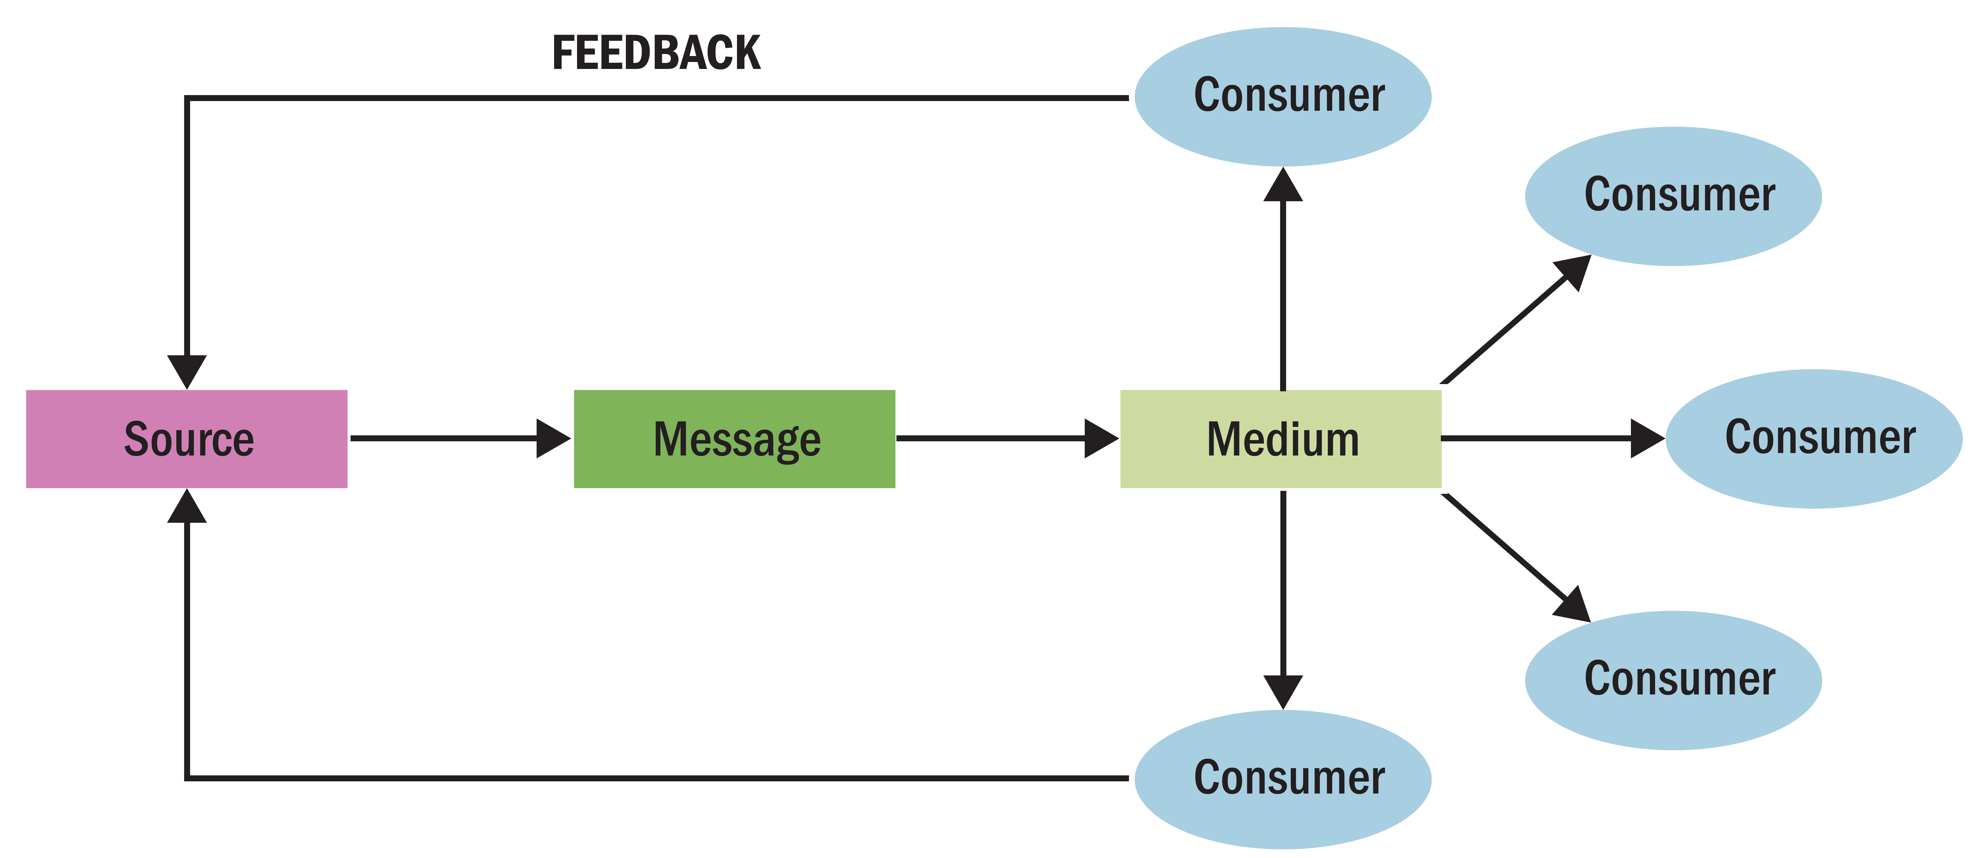
Elements of Communication
Figure 8.3 The Traditional Communications Model
Notes:
The figure illustrates the communications model. The elements of the model include the source, the message, and the method of transmitting the message. Social scientists developed this model to understand mass communications in which a source transmits information to many receivers at one time. This model doesn’t work as well in some situations like those encompassing social media.

Slide 23
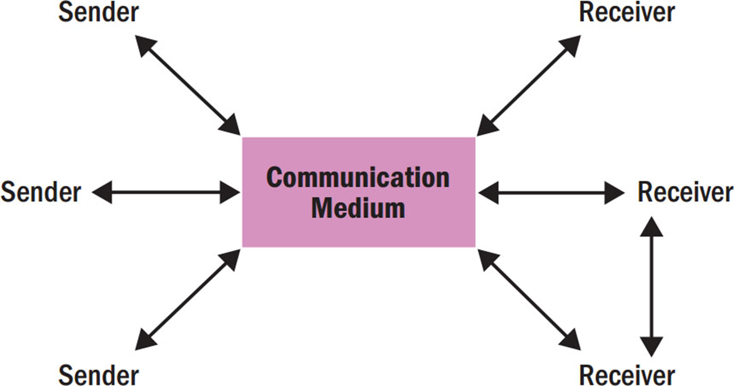
Figure 8.4 Updated Communications Model
Notes:
Figure 8.4 shows an updated model which accounts for the new developments like social media that now affect the communications process.

Slide 24
The Source
Source credibility
Disclaimers
Sleeper effect
Native advertising
Knowledge bias
Reporting bias
Source attractiveness
Shared endorsements
Halo effect
Spokecharacters
Notes:
Source credibility refers to a communicator’s expertise, objectivity, or trustworthiness.
Disclaimers typically happen at the end of a commercial message that supply additional information the advertiser is required to provide.
The Sleeper effect is when after a while, people appear to “forget” about the negative source and change their attitudes anyway.
Native advertising refers to digital messages designed to blend into the editorial content of the publications in which they appear.
Knowledge bias implies that a source’s knowledge about a topic is not accurate.
Reporting bias occurs when a source has the required knowledge but we question his or her willingness to convey it accurately—as when a racket manufacturer
pays a star tennis player to use its products exclusively.
Source attractiveness refers to the social value recipients attribute to a communicator.
Shared endorsements; users who follow or rate a product or service may find that their endorsements show up on the advertiser’s page.
Halo effect occurs when we assume that persons who rank high on one dimension excel on others as well.

Slide 25
New Message Formats
M-commerce - marketers promote goods and services via wireless devices.
New social media platforms:
Blogs and video blogs
Podcasts
Twitter
Virtual worlds
Widgets
Notes:
The revised communications model accounts for many new forms of messages that have arisen as social media has developed.

Slide 26

The Message (1 of 2)
The way a marketer structures his or her message determines how persuasive it will be.

Slide 27
Decisions to Make About the Message
Should we use pictures or words?
How often should message be repeated?
Should it draw an explicit conclusion?
Should it show both sides of argument?
Should it explicitly compare product to competitors?
Should it arouse emotions?
Should it be concrete or based on imagery?
Notes:
There are so many decisions to make about how we say what it is that we want to say. The questions listed are some of the decisions marketers must make about messages.

Slide 28
The Message
Characteristics of Good and Bad Messages
Positive effects | Negative effects
Showing convenience of use | Extensive information on components, ingredients, or nutrition
Showing new product or improved features | Outdoor setting (message gets lost)
Casting background (i.e., people are incidental to message) | Large number of on-screen characters
Indirect comparison to other products | Graphic displays
Source: Adapted from David W. Stewart and David H. Furse, “The Effects of Television Advertising Execution on Recall, Comprehension, and Persuasion,” Psychology & Marketing 2 (Fall 1985): 135–60. Copyright © 1985 by John Wiley & Sons, Inc. Reprinted by permission.
Notes:
Messages may have good and/or bad characteristics. To be effective, messages shouldn’t cover too much information or distract the receiver.

Slide 29
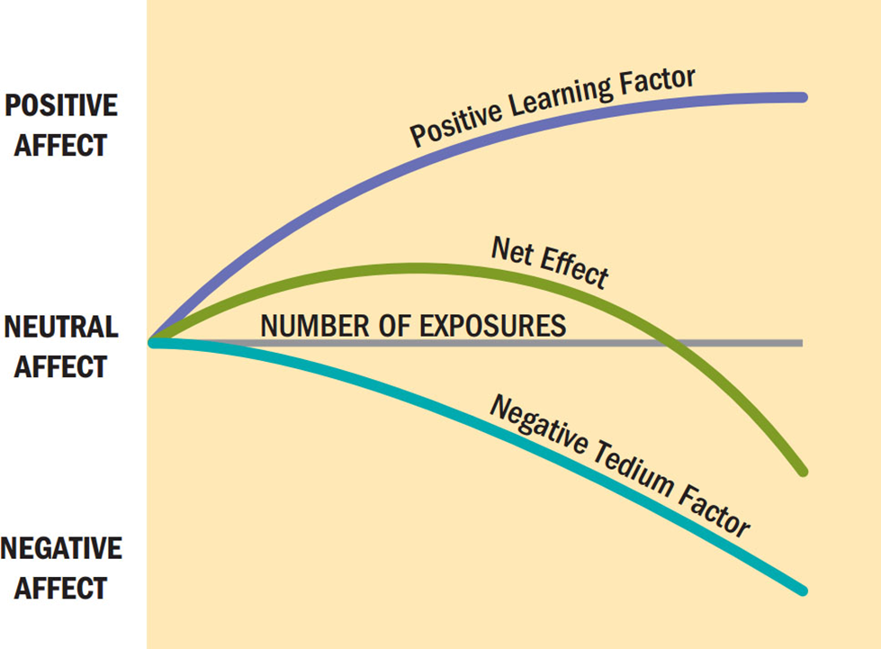
Repeating the Message
Figure 8.5 Two -Factor Theory of Message Repetition
Notes:
The two-factor theory explains the fine line between familiarity and boredom. It proposes that separate psychological processes operate when we repeatedly show an ad to a viewer. The positive side of repetition is that it increases familiarity and reduces uncertainty about the product. The negative side is that boredom increases with each exposure. At some point, the boredom is greater than the amount of reduced uncertainty and then wear-out begins. The figure depicts this relationship.

Slide 30
How Do We Structure Arguments?
One-sided: supportive arguments
Two-sided: both positive and negative information
  Refutational argument: negative issue is raised, then dismissed
  Positive attributes should refute presented negative attributes
  Effective with well-educated and not-yet-loyal audiences

Slide 31

One-sided: supportive arguments

Slide 32
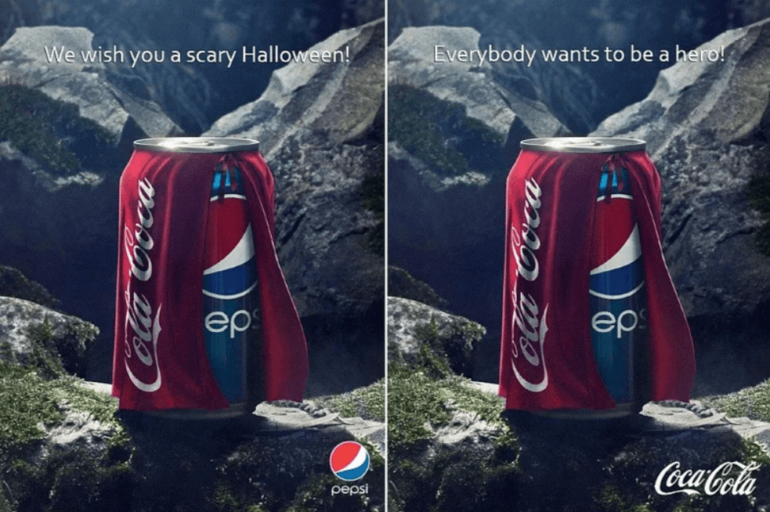
Comparative Advertising
Comparative advertising: message compares two recognizable brands on specific attributes.
Negative outcomes include source derogation
Notes:
Comparative advertising enables a brand to compare itself to another on specific attributes. However, it can result in a negative outcome. Consumers may doubt credibility.

Slide 33
New Message Formats (2 of 2)
M-commerce
Transmedia storytelling
Reality engineering
Guerrilla marketing

Slide 34
Product Placement and Branded Entertainment
Insertion of specific products and use of brand names in movie/T V scripts
Directors incorporate branded props for realism
Is product placement a positive or negative when it comes to consumer decision-making?
Notes:
The use of branded products in film is an old practice but it has renewed attention as brands pay large sums to be included in popular programming. Sometimes the product placement is free because the director wants to use the branded prop for realism. Other times, the placement comes with a fee. The practice is called branded entertainment sometimes because the brands may sponsor the program (like American Idol). Some researchers claim that product placement helps consumers to make decisions because consumers are then familiar with the brands when they shop. However, others say that placements can be a negative influence on consumer decisions if they are not congruent with the plot. In other words, the placement has to make sense in the minds of consumers in order to be effective.

Slide 35

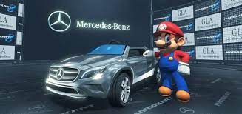
Advergaming
Advergaming refers to online games merged with interactive advertisements
Advertisers gain many benefits with advergames
Plinking is the act of embedding a product in a video
Notes:
Many brands have used advergaming including Axe, Burger King, and Mini Cooper. The games keep the attention of players longer than typical advertising. They let marketers target specific types of consumers. Marketers can tailor the nature of the game and the products in it to the profiles of different users. The format gives advertisers a great deal of flexibility. Lastly, the games enable marketers to track exposure to advertising in the games.

Slide 36
Types of Message Appeals
Emotional versus Rational Appeals
Sex Appeals
Humorous Appeals
Fear Appeals
Notes:
The types of message appeals that we may use to communicate are listed in the slide. Whether to use emotion or rational argument depends on the situation. It may depend on the nature of the product and the relationship consumers have with the product. Sex appeals can be good for getting attention but also come with risks. Humor is also a good choice for gaining attention but one has to be careful that the humor does not overwhelm the primary message. Fear appears emphasize the negative consequences that can occur unless the consumer changes a behavior or an attitude.
Advertisers use literary elements to communicate benefits and meaning
Allegory: story about an abstract concept personified in a fictional character
Metaphor: two dissimilar objects in a close relationship (“A is B”)
Simile: compares two objects (“A is like B”)
Resonance: play on words with pictures

Slide 37
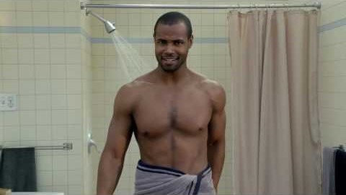
For Reflection (9 of 10)
Old Spice used a sex/humor appeal in its campaign, The Man Your Man Could Smell Like.
What benefits were communicated in the ad?
Is the message implicit or explicit? Explain.

Slide 38
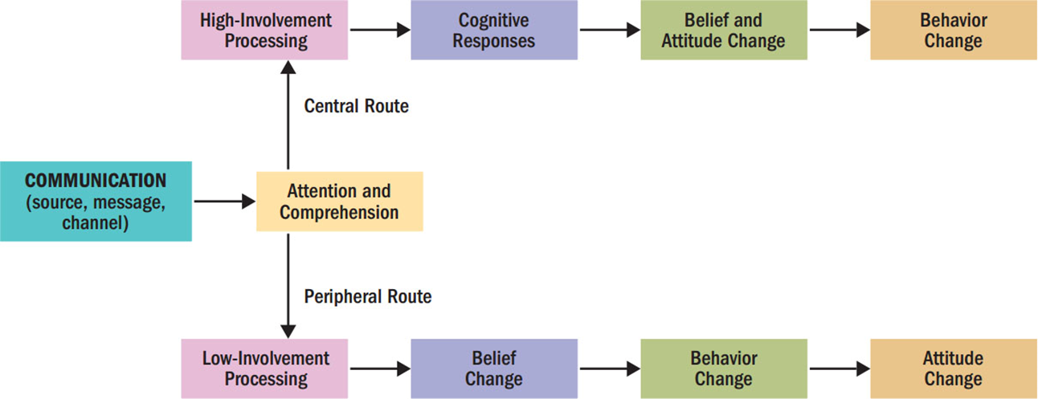
E L M
Figure 8.6 The Elaboration Likelihood Model (E L M) of Persuasion
Notes:
The elaboration likelihood model, known as the ELM, assumes that under conditions of high involvement, we will take the central route to persuasion, but under conditions of low involvement, we will take a peripheral route. The central route is focused on the consumer’s cognitive response to the message. The peripheral route focuses on other cues to decide how to react to the message.

Slide 39
Chapter Summary
It is important for consumer researchers to understand the nature and power of attitudes.
We form attitudes in several ways.
Persuasion involves an active attempt to change attitudes.

Slide 40
Paper Boat Group activity
This is an example of type of questions you will have at the Final Exam

Slide 41
Paper Boat Activity
Case analysis
Perception
Learning
Memory
Motivation
Personality
Emotions
7. Lifestyle
8. Values
9. Attitudes
10. Decision making
11. Culture
12. Group influence

Slide 42
If Paper boat increases its price by 20% tomorrow, which consumer psychology barrier (personality, emotion, or attitude) will break first, and how should the brand defend itself using the theories we studied?

Slide 43
Recommendations
Transitioning the learning
Addressing personality gaps
Reducing conflict

